Slide 1
IE 324 SIMULATION
INTRODUCTION

Slide 2
IE 324 SIMULATION
Instructor:
Teaching Assistants:
Utku Kuzey Ergül
Dr. Emre Uzun Email: emreu@bilkent.edu.tr Office: EA 328 Tel: 3484 Office Hours: By appointment

Slide 3
COURSE DESCRIPTION
Use of simulation as a decision tool.
The design and analysis of simulation models.
The use of simulation for estimation, comparison of policies, and optimization.
Topics include principle of simulation modeling, software, general-purpose computer simulation languages, and statistical analysis of simulation input and output data.

Slide 4
COURSE OUTLINE
Introduction to Simulation
Event Scheduling/Time Advance Algorithm
Simulation by Hand
Input Modeling
Random Number Generation
Random Variate Generation
Arena Modeling Basic Operations
Arena Modeling Detailed Operations
Output Analysis of Terminating Simulations
Output Analysis of Output from Steady-State Simulations
Validation and Verification
Comparing Alternative Scenarios
Optimization via Simulation
Variance Reduction Techniques (if time permits)

Slide 5
TEXTBOOKS
Required Text Books:
Banks, J., Carson, J. S., Nelson, B. L., and Nicol, D. M., Discrete-Event System Simulation, 2013, Pearson
Kelton, W. D., Sadowski, R. P., and Zupick, N. B., Simulation with Arena, 6th Ed., McGraw Hill, 2015
Recommended Text Books:
Seila, A., Ceric, V., Tadikamalla, P., Applied Simulation Modeling, Duxbury, 2003
Law, A. M., Simulation Modeling and Analysis, 4th Ed., McGraw Hill, 2006
Fishman, G. S., Discrete-Event Simulation: Modeling, Programming, and Analysis, Springer, 2001
Rosetti, M. D., Simulation Modeling and Arena, Wiley, 2009

Slide 6
LAB HOURS
Labs will complement the topics/discussions in classroom.
Until we begin modeling:
Simulation by Hand
Monte Carlo Simulation
Input Modeling
Random Number and Variate Generation
After we begin modeling:
Modeling Exercises
Output Analysis Exercises

Slide 7
GRADING
Midterm: 35%
Final Exam: 35%
Arena Quiz: 13%
Course Project: 12%
Homework Assignments: 5%

Slide 8
POLICIES
Open-Book Policy:
The midterm and final exam will be CLOSED BOOKS and CLOSED NOTES. A necessary formulas and statistical tables will be provided.
Arena Quiz will be OPEN BOOK (Kelton et. al. only) and OPEN NOTES.
Group Policy: Your project will be done in groups of maximum 3 students.
Homework Assignments: Individual homework assignments will be given and graded based on effort.

Slide 9
POLICIES
Moodle/Email:
Moodle course will be opened after the add/drops.
Students are responsible for all the announcements made in class or via e-mail.
It is the students’ responsibility to be aware of what has been covered in lectures, and to check their e-mail accounts regularly and not miss any activity or information.
Slides/Lecture Notes:
Lecture notes will NOT be shared
Slides will be available on Moodle
YouTube playlist for lecture videos will be on Moodle (Videos date back to 2021 – some content may not be on videos)

Slide 10
POLICIES
Makeup Policy: A make-up examination for the midterm or final will only be given under highly unusual circumstances (such as serious health or family problems). The student should contact the instructor as early as possible and provide the instructor with proper documentation (such as a medical note certified by Bilkent University’s Health Center). There is no make-up for quizzes.
Software Policy: The simulation software ARENA can only be installed to Windows computers. This means Mac users should either have their computers a Dual-Boot, or they will need an emulator software (like parallels). You are welcome to use the BCC Computer Labs but this might change during the semester.
You must install ARENA version 14.5. No other version should be used! We will supply the installation files.

Slide 11
QUESTIONS?

Slide 12
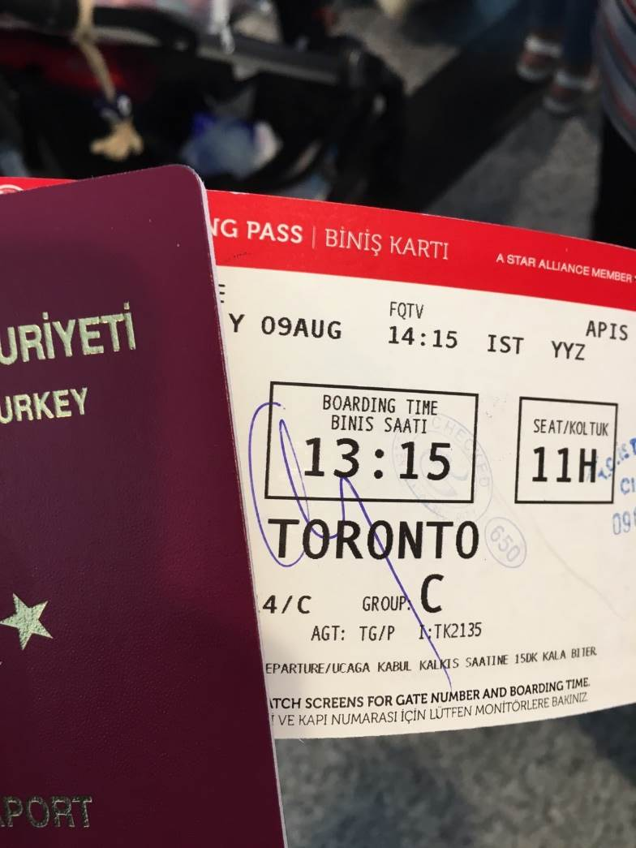
AIRPLANE BOARDING
How to board an airplane?
The order of boarding is
usually determined by the
carrier and denoted with
your boarding group.

Slide 13
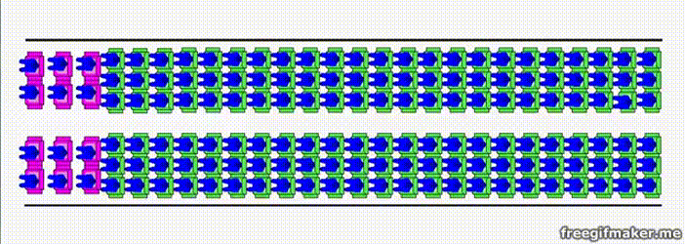
AIRPLANE BOARDING (BACK TO FRONT)
Source: Menkes van den Briel http://www.menkes76.com/projects/boarding/boarding.htm

Slide 14
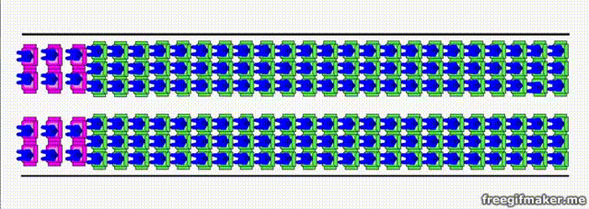
AIRPLANE BOARDING (RANDOM)
Source: Menkes van den Briel http://www.menkes76.com/projects/boarding/boarding.htm

Slide 15
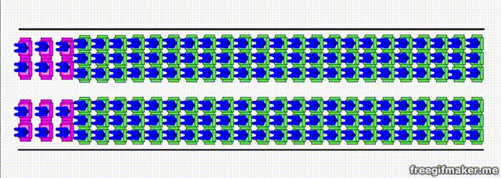
AIRPLANE BOARDING (OUTSIDE IN)
Source: Menkes van den Briel http://www.menkes76.com/projects/boarding/boarding.htm

Slide 16
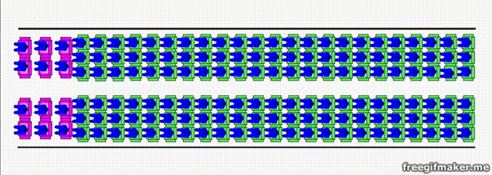
AIRPLANE BOARDING (BY SEAT)
Source: Menkes van den Briel http://www.menkes76.com/projects/boarding/boarding.htm

Slide 17
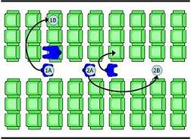
AIRPLANE BOARDING
How to determine the best method?
What performance metrics to decide?
Things to think about:
Passenger movements / lineup order
Single, double door usage?
Different type of passengers (young, old, with babies/kids, disabled…)
Passengers with/without carry-on
How to make the analysis?

Slide 18
SYSTEM
A set of interacting components or entities operating together to achieve a common goal or objective.
Examples
Manufacturing facility
Bank operation
Airport operations (passengers, security, planes, crews, baggage)
Transportation/logistics/distribution operation
Hospital facilities (emergency room, operating room, admissions)
Computer network
Freeway system
Business process (insurance office)
Fast-food restaurant
Supermarket
Theme park
Emergency-response system
REAL WORLD SYSTEMS OF INTEREST ARE HIGHLY COMPLEX!!!

Slide 19
WHY AND HOW TO STUDY A SYSTEM?
Measure/estimate performance
Improve operation
Prepare for failures
System
Experiment
with the
actual system
Experiment with
a physical model
of the system
Experiment with a
mathematical model
of the system
IE 325
IE 202
IE 303
…
Mathematical
Analysis
IE 324
Simulation

Slide 20
MODEL
An abstract and simplified representation of a system
Not an exact re-creation of the original system!
Specifies assumptions/approximations about how the system works
Translates them into a set of logical and mathematical relations
If model is simple, you may use:
Queueing Theory
Linear Programming
Differential Equations
If model is complex, simulation is usually the only way!

Slide 21
WHAT IS SIMULATION?
The imitation of the operation of a real-world process or system over time.
Most widely used tool (along with LP) for decision making
Applied to complex systems that are impossible to solve mathematically
This course focuses on one form of simulation modeling
Discrete-event simulation modeling

Slide 22
WHAT IS SIMULATION?
Simulation models seek to:
Describe the behaviour of the system
Construct theories or hypotheses based on the observed behaviour
Use these theories to predict the future behaviour, that is, the effects that will be produced by changes in the system or its method of operation

Slide 23
ORIGIN OF SIMULATION
Lie in statistical sampling theory, e.g., random numbers, random sampling (Before the 2nd world war)
Monte Carlo simulation (During the 2nd world war)
Modern Applications (After the 2nd world war)

Slide 24
SIMULATION AS A TOOL
1945-70 A technique of last resort
Rasmussen & George (1978) - Ranked 5th
Thomas & Decosta (1979) - Ranked 2nd
Shannon et al. (1980) - Ranked 2nd
Harpel et al. (1989) -Ranked 2nd
(Getting more popular…)

Slide 25
CLASSIFICATION OF SIMULATION MODELS
Static (Monte Carlo)
Dynamic Systems
Represents the system at a particular point in time
Represents the system behaviour over time
Continuous Simulation:
(Stochastic) Differential Equations
Discrete Event Simulation:
System quantities (state variables) change with events
Estimation of π
Risk Analysis in Business
Water Level in a Dam
Queueing Systems
Inventory Systems

Slide 26
CAPABILITIES / ADVANTAGES
Display dynamic behaviour
Handles randomness and uncertainty
Diagnose problems (Understand “why?”)
Explore possibilities (“What if?”)
Time compression and expansion (controlling time)
Requires fewer assumptions (than analytical models)
Flexible and easy to change
Credible* and results are easier to explain

Slide 27
LIMITATIONS
“Run” rather than “solved”.
Cannot generate optimal solution on their own
Requires specialized training (probability, statistics, computer programming, modelling, system analysis, simulation methodology)
Costly (software and hardware)

Slide 28
INPUT/OUTPUT PROCESS
REAL-LIFE
Operating Policies
Single queue, parallel servers, FIFO, …
Input Parameters
- Number of servers, distributions, …
System response
- Waiting times, system size, utilizations…
SIMULATION MODEL
(LOGIC)
(X)
Y=f(X)
(Y)

Slide 29
EXAMPLE: Health Center
Number of Doctors
Capacity of equipment
Arrival rate
Queue Discipline
SIMULATION
MODEL OF A
HEALTH CENTER
Time in system
Utilization of doctors
Number served

Slide 30
EXAMPLE: Serial production line
…….
1
2
3
N
Size of the line
Size of buffer
Buffer allocation
Location of bottleneck
Processing times
SIMULATION
MODEL OF A
PRODUCTION LINE
Throughput
Interdeparture time variability
Utilization

Slide 31
ANALYTICAL VS SIMULATION
Use analytical models whenever possible
Use simulation models when:
Complete mathematical formulation does not exist or an analytical solution cannot be developed
Analytical methods are available, but the mathematical procedures are so complex that simulation provides a simpler solution
It is desired to observe a simulated history of the process over a period of time in addition to estimating certain system performances

Slide 32
STEPS IN A SIMULATION STUDY
Conceptual
Model
No
Experimental
Design
Yes
Setting of
Objectives
and Overall
Project Plan
Problem
Formulation
Model
Translation
Verified?
Yes
Validated?
Simulation
Runs and
Analysis
No
Yes
Data Collection
No
More
Runs?
Yes
No
Implementation
Documentation
and Reporting

Slide 33
PROBLEM FORMULATION (NOT MODEL)
A statement of the problem
the problem is clearly understood by the simulation modeler
the formulation is clearly understood by the client
Criteria for selecting a problem
Technical and economical feasibility
Perceived urgency for a solution

Slide 34
SETTING OBJECTIVES AND PROJECT PLAN
Determine the questions that are to be answered
Objective to be achieved
Identify scenarios to be investigated
Level of details (assumptions)
Determine the end-user, data, hardware, software, personnel, and time requirements
Is simulation appropriate?

Slide 35
STEPS IN A SIMULATION STUDY
Conceptual
Model
No
Experimental
Design
Yes
Setting of
Objectives
and Overall
Project Plan
Problem
Formulation
Model
Translation
Verified?
Yes
Validated?
Simulation
Runs and
Analysis
No
Yes
Data Collection
No
More
Runs?
Yes
No
Implementation
Documentation
and Reporting

Slide 36
MODEL DEVELOPMENT
Real World
System
Conceptual model
Logical model
Simulation model

Slide 37
CONCEPTUAL MODEL
Real World System
Assumed system
Conceptual model

Slide 38
CONCEPTUAL MODEL
Level of details - assumptions
Model components
Events, entities, attribute, exogenous variables, endogenous variables, and their relationships
Data requirements

Slide 39
LEVEL OF DETAIL
Too little detail result in lost of information and goals cannot be accomplished
Too much detail requires:
more time and effort
longer simulation runs
more likely to contain errors

Slide 40
Accuracy of
the model
Scope and level of details
Cost of
the model
Scope and level of details

Slide 41
LEVEL OF DETAIL
Modeler
Novice
Experienced
Tends toward too much detail
Tends toward greater detail
KISS

Slide 42
LEVEL OF DETAIL
Evaluate candidate
systems if they work
Compare two or more systems to determine better ones
Accurately predict the performance of the selected system

Slide 43
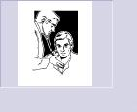
COMPONENTS OF A SYSTEM
Entity: is an object of interest in the system
Dynamic objects — get created, move around, change status, affect and are affected by other entities, leave (maybe)
Usually have multiple realizations floating around
Can have different types of entities concurrently
Example: Health Center
Patients
Visitors

Slide 44
COMPONENTS OF A SYSTEM
Attribute: is a characteristic of all entities, but with a specific value “local” to the entity that can differ from one entity to another.
Example: Patient
Type of illness,
Age,
Sex,
Temperature,
Blood Pressure

Slide 45
COMPONENTS OF A SYSTEM
Resources: what entities compete for
Entity seizes a resource, uses it, releases it
Think of a resource being assigned to an entity, rather than an entity “belonging to” a resource
“A” resource can have several units of capacity which can be changed during the simulation
Example: Health Center
Doctors, Nurses
X-Ray Equipment

Slide 46
COMPONENTS OF A SYSTEM
Variable: A piece of information that reflects some characteristic of the whole system, not of specific entities
Entities can access, change some variables
Example: Health Center
Number of patients in the system,
Number of idle doctors,
Current time

Slide 47
COMPONENTS OF A SYSTEM
State: A collection of variables that contains all the information necessary to describe the system at any time
Example: Health Center
{Number of patients in the system,
Status of doctors (busy or idle),
Number of idle doctors,
Status of Lab equipment, etc.}

Slide 48
COMPONENTS OF A SYSTEM
Event: An instantaneous occurrence that changes the state of the system
Example: Health Center
Arrival of a new patient,
Completion of service (i.e., examination)
Failure of medical equipment, etc.

Slide 49
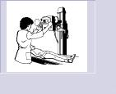
COMPONENTS OF A SYSTEM
Activity: represents a time period of specified length.
Example: Health Center
Surgery,
Checking temperature,
X-Ray.

Slide 50
DATA COLLECTION AND ANALYIS
Data collection is an expensive process!
The client often collects the data & submit it in electronic format
Simulation analyst analyse the data
Determine the random variables
Determine the data requirements
Analyse the data
Fit distribution functions

Slide 51
LOGICAL (or Flowchart model)
Shows the logical relationships among the elements of the model
Start
Read data
Generate
data
Check
Set new
event
Calculate
Stats
Print
Check
Stop

Slide 52
MODEL TRANSLATION
Simulation model executes the logic contained in the flow-chart model
Coding
General Purpose
Language
Special Purpose Simulation
Language/Software
JAVA, C++, Visual BASIC
SIMAN, ARENA, EXTEND

Slide 53
ARENA EXAMPLE

Slide 54
SIMAN EXAMPLE
--- MODEL FILE ---
BEGIN;
CREATE,1:,EXPO(40):EX(40):MARK(1);
QUEUE,1;
SEIZE:DOCTOR;
DELAY:EXPO(30);
TALLY:1,INT(1);
RELEASE:DOCTOR;
COUNT:1:DISPOSE;
END:
----EXPERIMENTAL FILE -----
BEGIN;
PROJECT,HEALTH_CENTRE, IHSA SABUNCUOGLU,24/1/2000;
DISCRETE,100,1,1;
RESOURCES:1,
DOCTORS;
DSTATS:1,NQ(!),NUMBER_IN_QUEUE:
2,NR(1),DOCTOR UTILIZATION;
TALLIES:1, TIME IN HEALTH_CENTRE;
COUNTERS:1,No. OF PATIENTS SERVED;
END:

Slide 55
JAVA EXAMPLE
public static void main(String argv[])
{
Initialization();
//Loop until first "TotalCustomers" have departed
while (NumberofDepartures < TotalCustomers)
{
Event evt = FutureEventList[0]; //get imminent event
removefromFEL(); //be rid of it
Clock = evt.get_time(); //advance in time
if (evt.get_type() == arrival) ProcessArrival();
else ProcessDeparture();
}
ReportGeneration();
}

Slide 56
STEPS IN A SIMULATION STUDY
Conceptual
Model
No
Experimental
Design
Yes
Setting of
Objectives
and Overall
Project Plan
Problem
Formulation
Model
Translation
Verified?
Yes
Validated?
Simulation
Runs and
Analysis
No
Yes
Data Collection
No
More
Runs?
Yes
No
Implementation
Documentation
and Reporting

Slide 57
VERIFICATION AND VALIDATION
Verification: the process of determining if the operational logic is correct.
Debugging the simulation software
Validation: the process of determining if the model accurately represents the system.
Comparison of model results with collected data from the real system

Slide 58
VERIFICATION AND VALIDATION
Real World
System
VALIDATION
Conceptual model
Operational Logic
VERIFICATION
Logical model
Simulation model

Slide 59
STEPS IN A SIMULATION STUDY
Conceptual
Model
No
Experimental
Design
Yes
Setting of
Objectives
and Overall
Project Plan
Problem
Formulation
Model
Translation
Verified?
Yes
Validated?
Simulation
Runs and
Analysis
No
Yes
Data Collection
No
More
Runs?
Yes
No
Implementation
Documentation
and Reporting

Slide 60
ANALYSIS OF RESULTS
Statistical tests for significance
Point Estimation
Confidence-Interval Estimation
Interpretation of results
More runs?

Slide 61
EXPERIMENTAL DESIGN
Alternative scenarios to be simulated
Type of output data analysis (steady state vs transient state analysis)
Number of simulation runs
Length of each run
The manner of initialization
Variance reduction

Slide 62
DOCUMENTATION & REPORTING
Program Documentation
Allows future modifications
Creates confidence
Progress Reports
Frequent reports (e.g. monthly) are suggested
Alternative scenarios
Performance measures or criteria used
Results of experiments
Recommendations

Slide 63
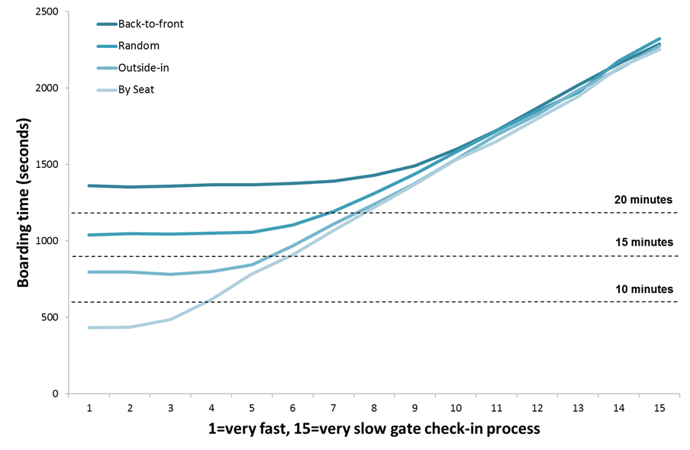
AIRPLANE BOARDING (COMPARISON)
Source: Menkes van den Briel http://www.menkes76.com/projects/boarding/boarding.htm

Slide 64
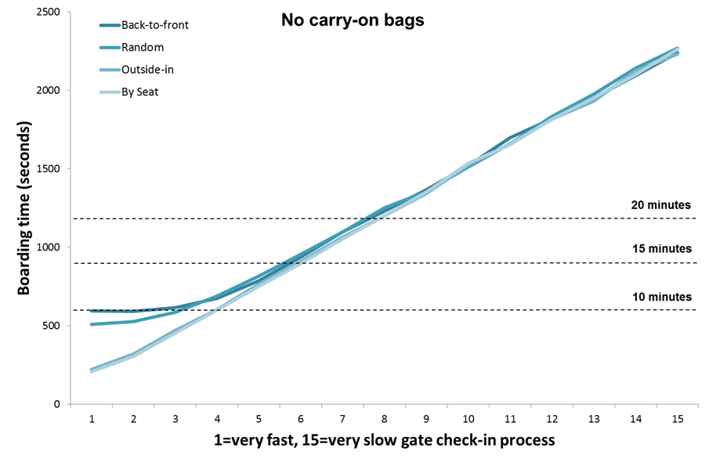
AIRPLANE BOARDING (COMPARISON)
Source: Menkes van den Briel http://www.menkes76.com/projects/boarding/boarding.htm

