Slide 1
IE469 Industrial Applications of Operations Research
Spring 2018

Slide 2
Charts

Slide 3
Using Charts to Create Effective Reports
Communicating your study’s results to your co-workers, managers, and clients in a way that is both professional and easy to understand is a crucial skill for any researcher.
Many studies with amazing results are not acted on or fall to the wayside because of its confusing report.
In a report, charts go a long way in illustrating findings that are clear and concise. They simplify data in a presentable and visually pleasing way.

Slide 4
Using Charts to Create Effective Reports
The main challenge with using charts is selecting the correct type from the wide variety available.
Many people do not understand the strengths and weaknesses that come with each chart type, either selects the nicest-looking or staying in their comfort zone by overloading their report with pie or vertical bar charts.

Slide 5
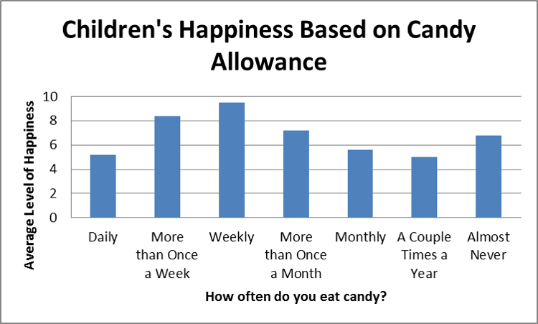
Bar Charts
Bar charts are best for comparing means or percentages (vertical: 2 to 7 groups, horizontal: more).
Each bar is separated by blank space. For this reason, the x-axis should be based on a scale that has mutually exclusive categories, but not on a continuous scale.

Slide 6
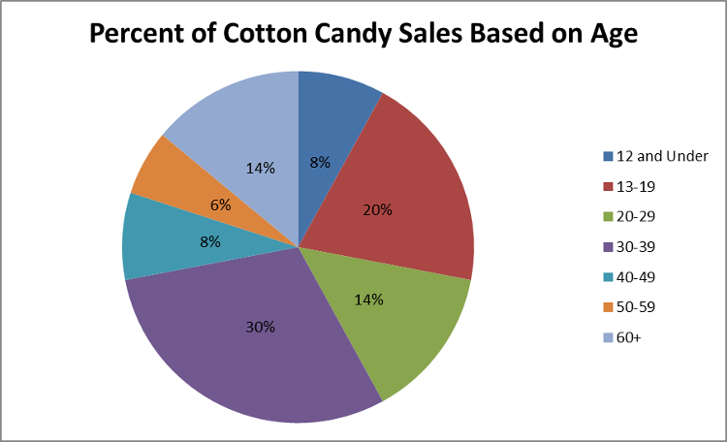
Pie Charts
Illustrate a sample break down in a single dimension.
When you want to show differences within groups based on one variable.
Pie charts should only be used with a group of categories that combine to make up a whole.

Slide 7
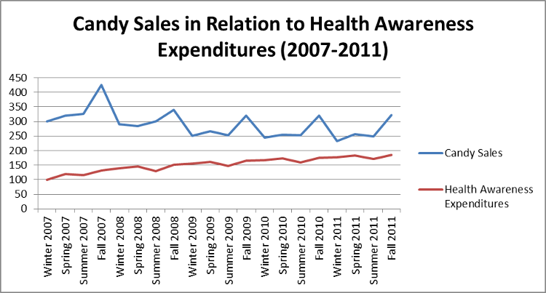
Line Charts
Illustrate trends over time (e.g. measure the long term progression of sales).
Also compare two or more different variables over time.

Slide 8
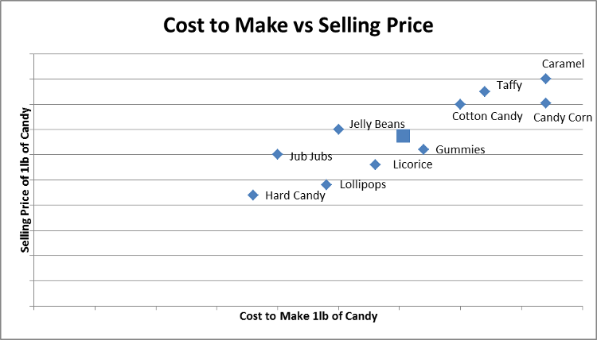
Scatter Plot
Scatter plots are used to depict how different objects settle around a mean based on 2 to 3 different dimensions.
This allows for quick and easy comparisons between competing variables.
(e.g. compare candies to one another based on its cost and selling price.
A viewer can quickly reference the difference between two objects or its relation to the average.

Slide 9
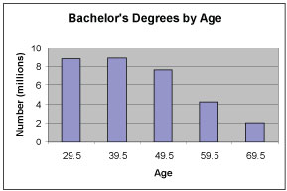
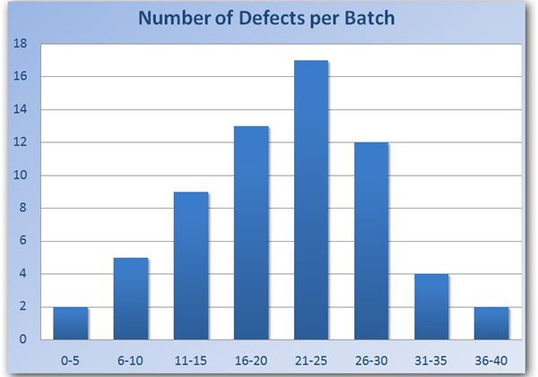
Histogram
Like pie charts, histograms break down the sample distribution in one dimension.
The difference is that they are ideal for illustrating sample distributions on dimensions measured with discrete intervals.
Unlike bar charts, the x-axis is not divided into mutually exclusive categories, it is a continuous scale.

Slide 10
Bad Charts

Slide 11
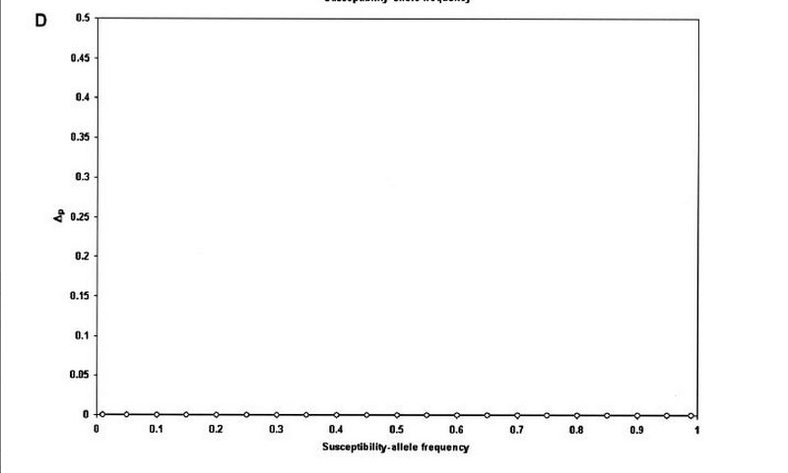
Bad Charts

Slide 12
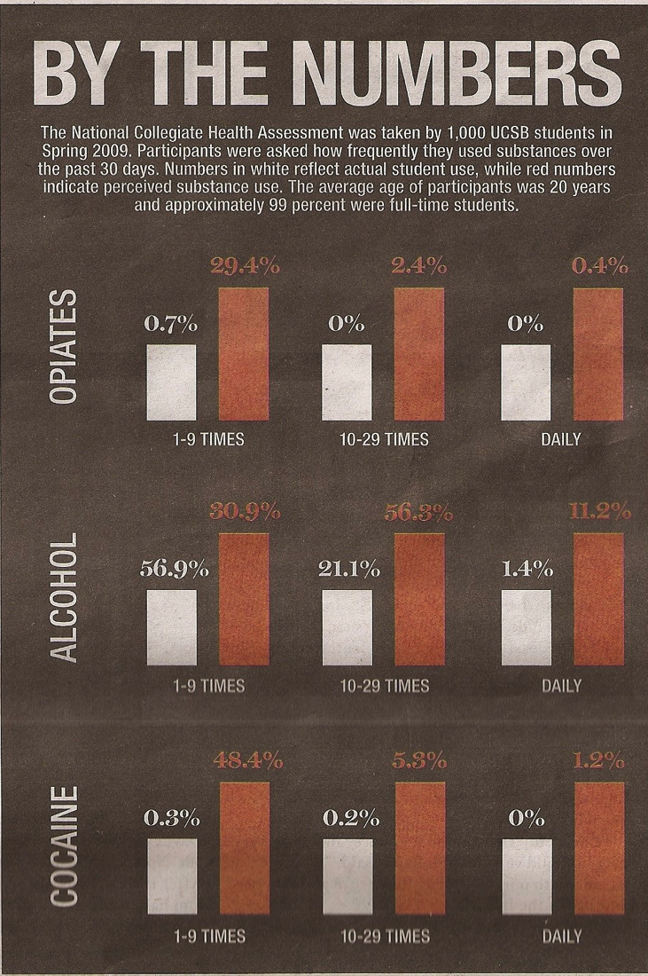
Bad Charts

Slide 13
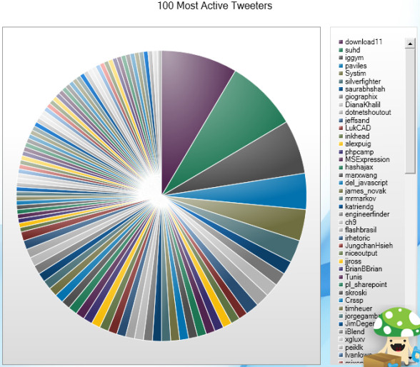
Bad Charts

Slide 14
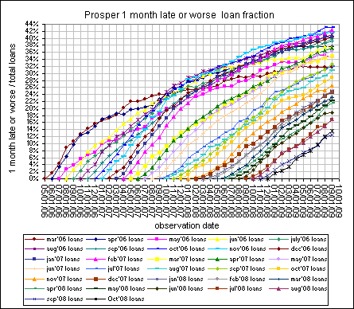
Bad Charts

Slide 15
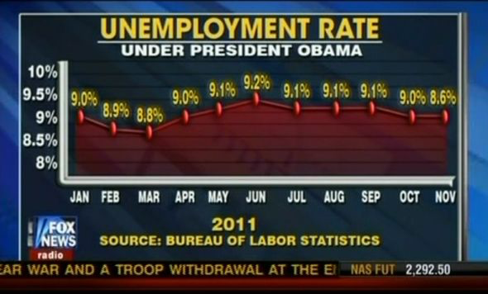
Bad Charts

Slide 16
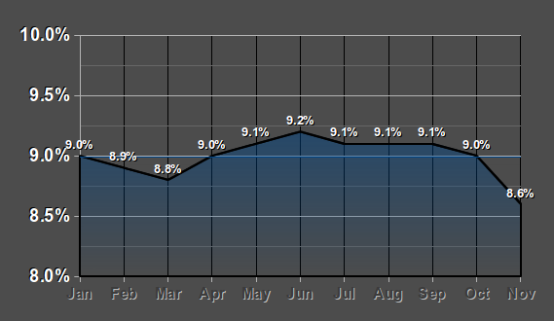
Bad Charts

Slide 17
Bad Charts

Slide 18
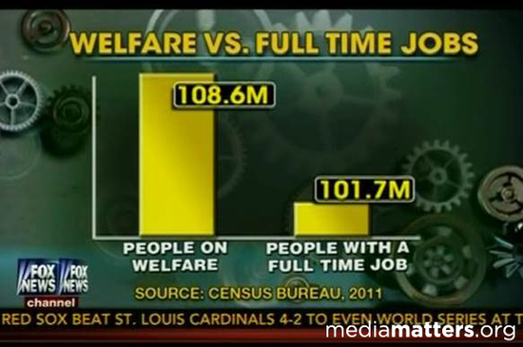
Bad Charts

Slide 19
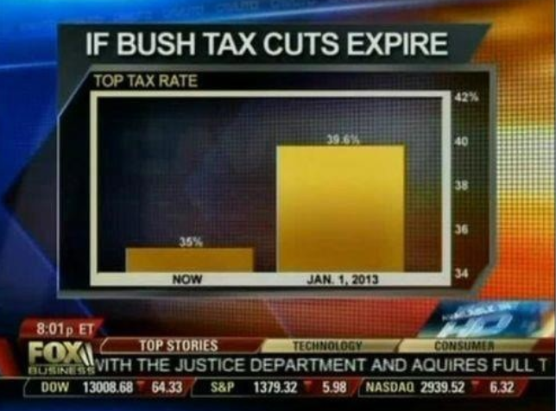
Bad Charts

Slide 20
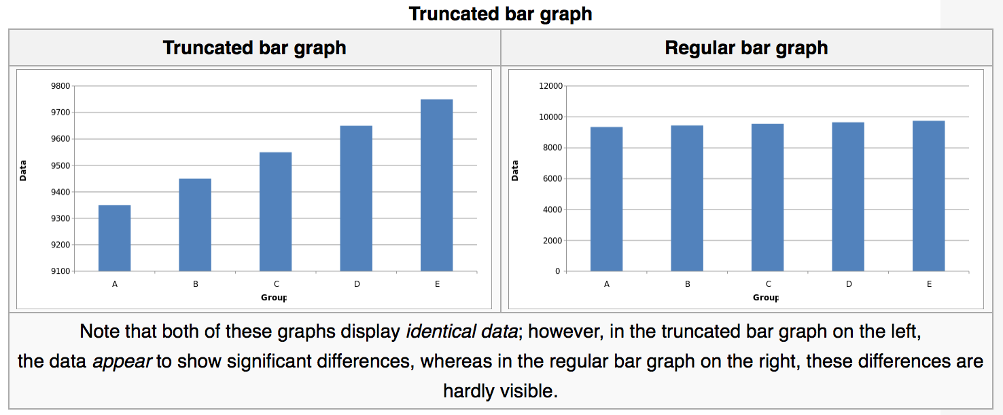
Bad Charts

Slide 21
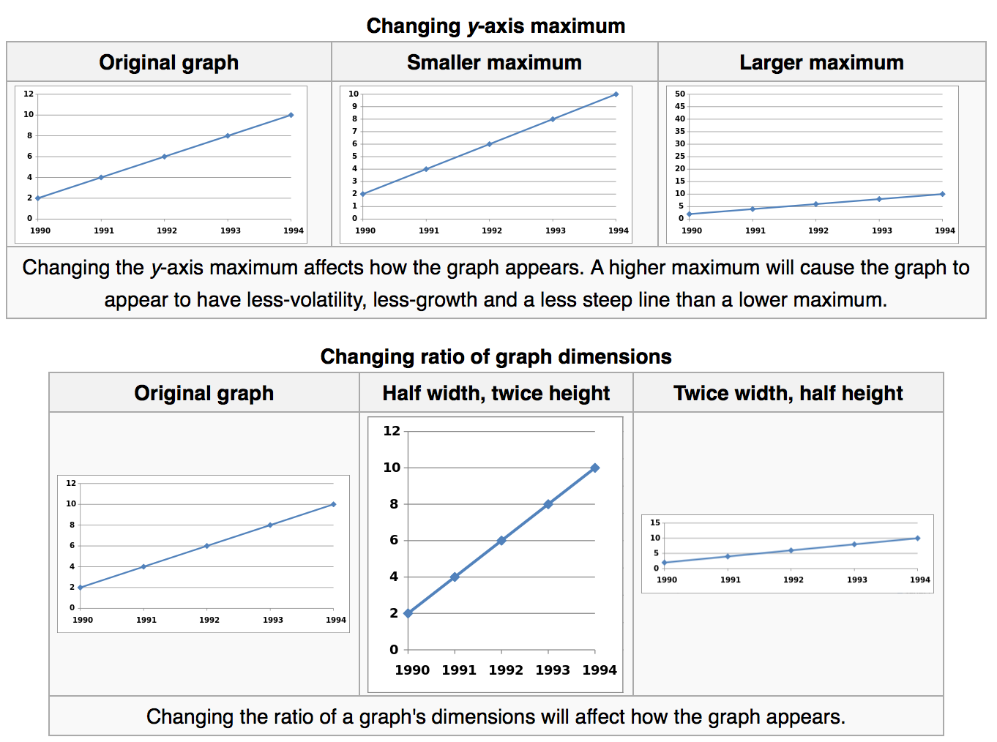
Bad Charts

Slide 22
Bad Charts

Slide 23
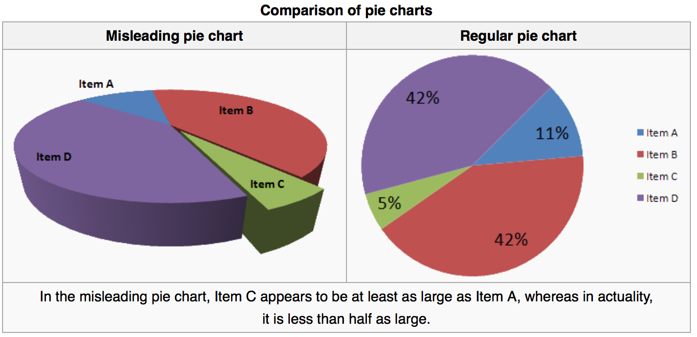
Bad Charts

Slide 24
Bad Charts

Slide 25
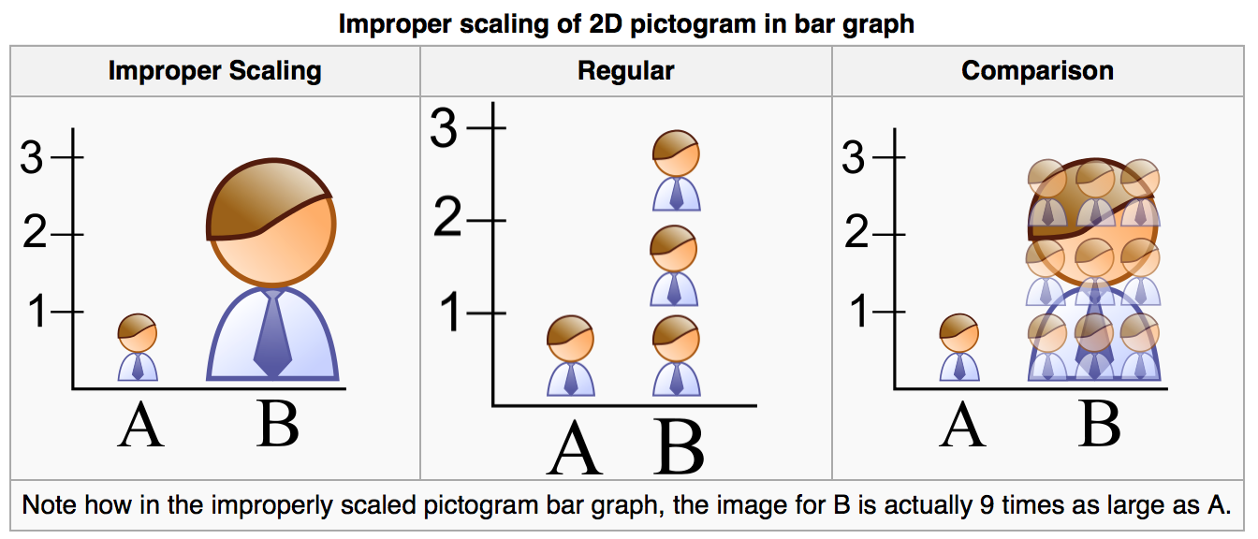
Bad Charts

Slide 26
Bad Charts

