Slide 1
Introduction to VBA
IE 469 Spring 2019

Slide 2
VBA
Visual Basic for Applications (VBA) brings a dynamic element to spreadsheet-based decision support systems (DSS) applications
VBA can be used to perform the same spreadsheet functions that are done in Excel along with some other advanced Excel object manipulation
For example, VBA can be used to:
  Modify a spreadsheet
  Create a user interface
  Perform simulation models
  Solve optimization problems

Slide 3
VBA
The VBA programming language is common across all Microsoft (MS) Office applications
  In addition to Excel, you can use VBA in Word, PowerPoint, Access and Outlook
When you work with a particular application, you need to learn about the objects it contains
  E.g., Word → Documents, paragraphs, words, etc.
Each MS Office application has a clearly defined set of objects according to the relationships among them
  This structure is referred to as the application’s object model

Slide 4
VBA
Objects in Excel include (but are not limited to)
  Workbooks and worksheets
  Cells and ranges of cells
  Charts and shapes
There is an object hierarchy which orders these objects
  Workbooks contain worksheets
  Worksheets contain ranges
  Ranges contain cells

Slide 5
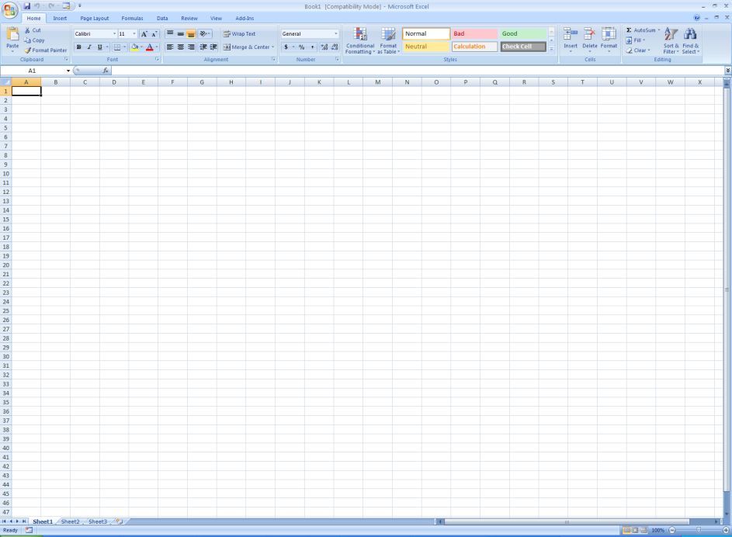
VBA
Workbook
Cell Range
Cell
Worksheets

Slide 6
VBA
Macros are technically defined as units of VBA code
  VBA code that is recorded in Excel is referred to as a macro
  VBA code that is written by a programmer is referred to as a procedure
Macros will be used to illustrate basic Excel VBA coding
Recording macros creates VBA code automatically!
  This code can be studied
  Disadvantage: It’s limited.
To tackle this limitation, we use a mixed approach:
  First, record a simple macro.
  Then, tweak it to achieve more complex tasks.
Macros are useful in developing the fundamental skills for reading, understanding, and writing VBA code

Slide 7
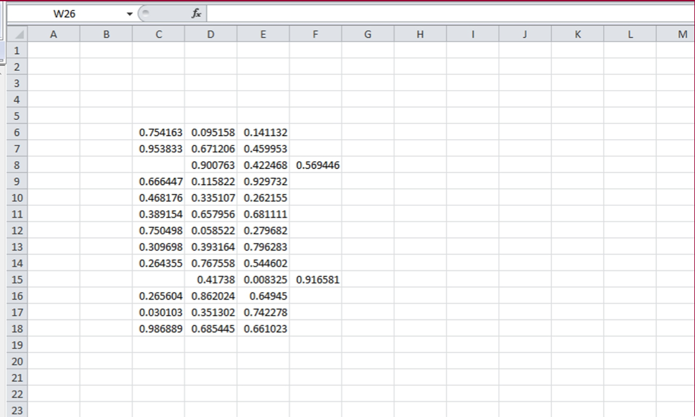
Problem

Slide 8
Problem
We have data spanning 3 columns and 13 rows (C6:F18).
  Data should be stored in the given range in order to use it for other application.
  Unfortunately, there are some errors in the data entry process, so some of the rows are shifted to the right by one column.
Our job is to correct all these mistakes:
  First, record a simple macro that correct a speciﬁc row (say Row 8).
  Then, tweak it to make correction in any given row.
  Finally, we let the code check any mistake and correct it.
While doing this, we learn how to
  Declare and name variables.
  Create Subroutines and Functions (We’ll learn what they are shortly).
  Use conditional statements.
  Create repetitions.

Slide 9
Our First Macro
Find the Macros option under the Excel 2010 View tab to record a VBA macro.
Let’s call our Macro “Shifter.” We want our macro to do the following:
  Select the range D8:F8.
  Cut the selected cells.
  Select cell C8.
  Paste the cut cells.

Slide 10
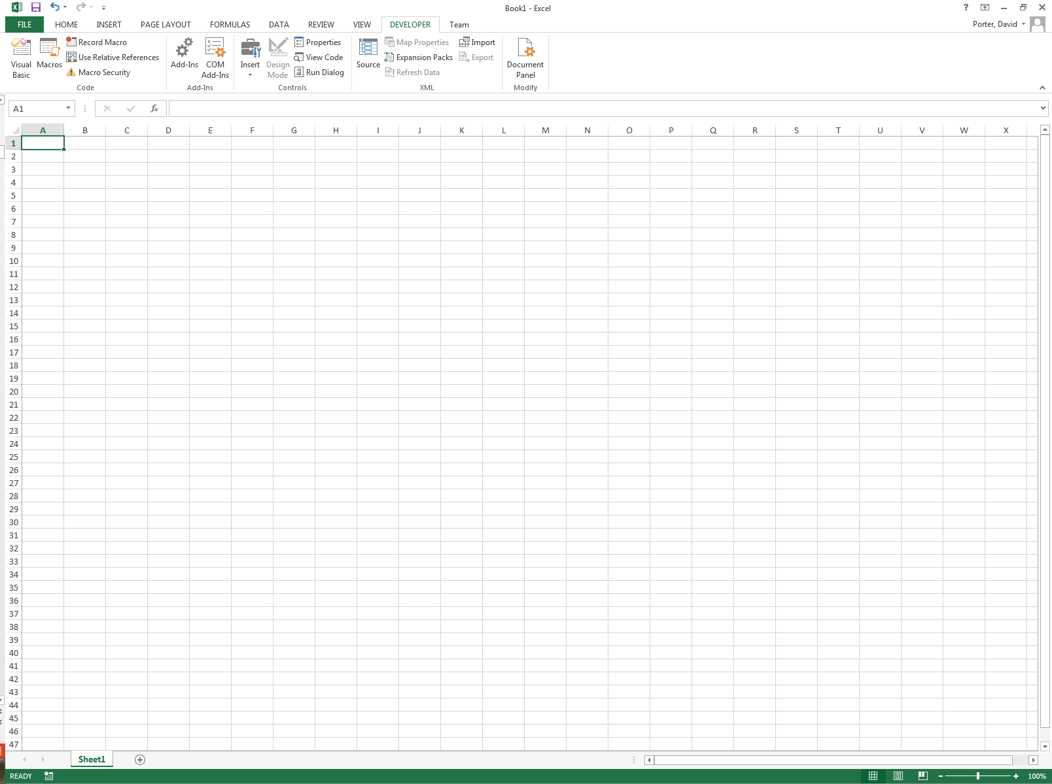
Our First Macro
Now we are ready to record the macro
You can do this in several different ways
  Select View > Macros > Record Macro…
  Record Macro button from the Developer Toolbar
  Click on the Record Macro icon located next to the legend “Ready” on the lower left corner of the workbook

Slide 11
Our First Macro
When the Record Macro dialog box appears, we enter a name for the macro
  The macro name should begin with a letter and may contain only letters, numbers and the underscore (i.e., _) character
  Maximum length is 255 characters
  Do not use special characters (e.g., !, ?, &) or blank spaces
Use a short and descriptive name
  Use _ to separate words
    First_Macro
  Capitalization works well too
    FirstMacro
Enter Shifter as the macro name for this example

Slide 12
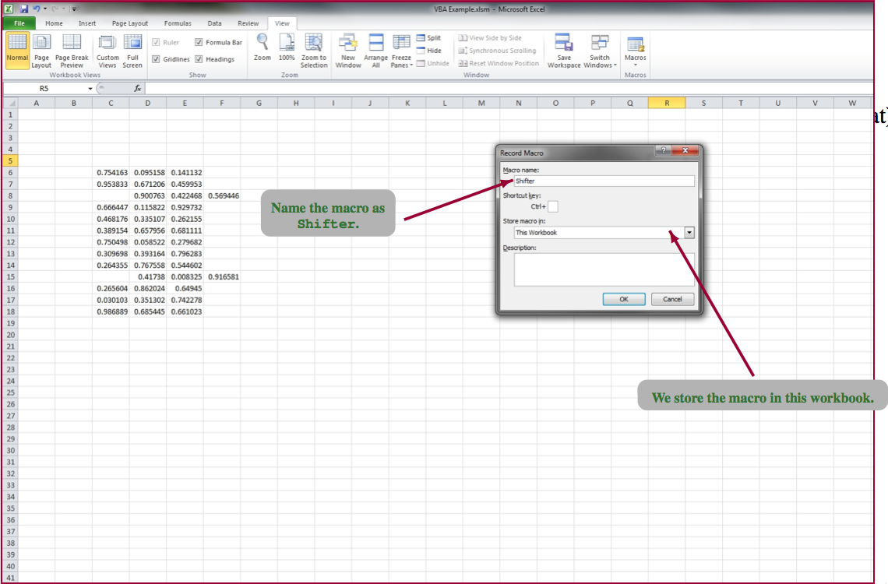
Our First Macro

Slide 13
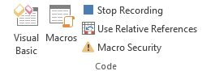

Our First Macro
Once you begin recording, notice that the Record Macro button is now the Stop Recording button
After finishing the steps needed to copy and paste the information, you can stop recording
  Select View > Macros > Stop Recording
  Click on the Stop Recording button from the Developer Toolbar
    There is also a Stop button on the lower left corner of the workbook
  Click on the square button next to the legend “Ready”

Slide 14
Our First Macro
As we learned earlier, each time a macro is recorded in Excel, VBA code is generated automatically
Let us review the code that was generated for this macro
  Go the VBE window (Alt-F11)
  A Modules folder has been added to the Project Explorer
  Expand the folder and double-click on “Module1” to see the code in the Code Window

Slide 15
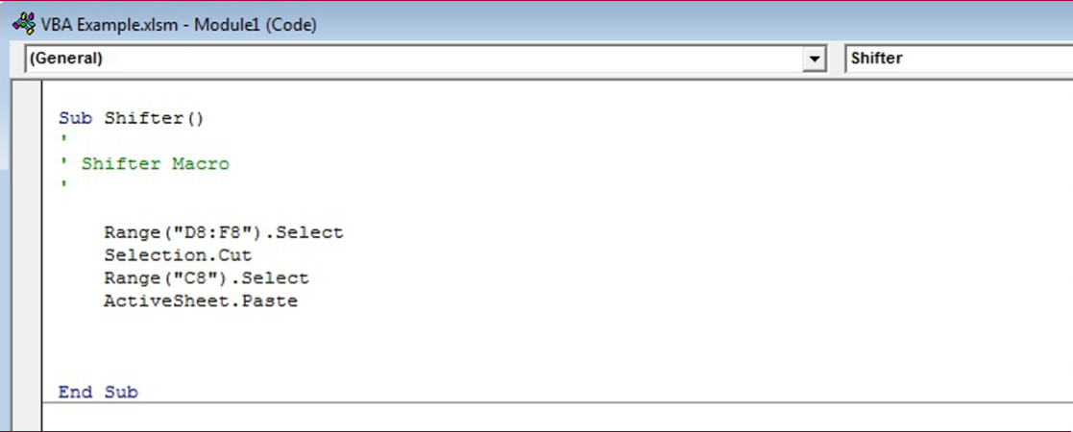
Our First Macro

Slide 16
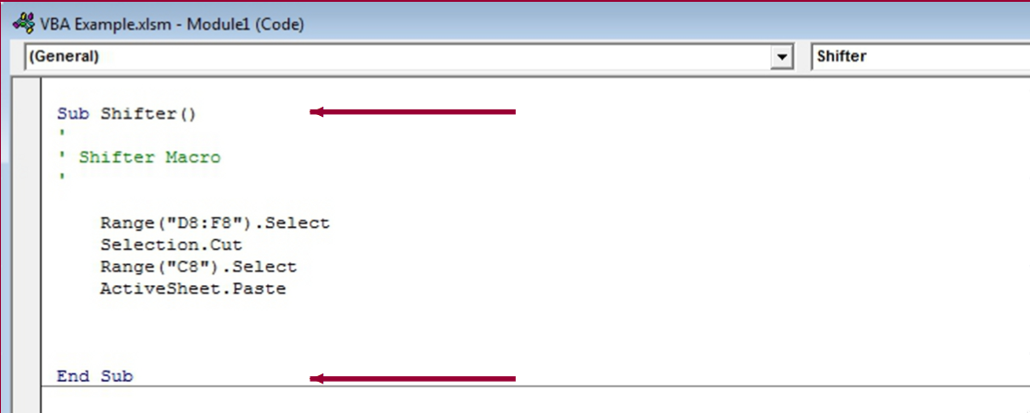
Our First Macro
Notice that the code starts with Sub command and ends with End Sub command.
Sub refers to the Subroutines.
  Subroutine: A portion of code within a larger program that performs a speciﬁc task and is relatively independent of the remaining code.
  We can use a subroutine in a different subroutine by “calling” it.
  e.g., Call Shifter().

Slide 17
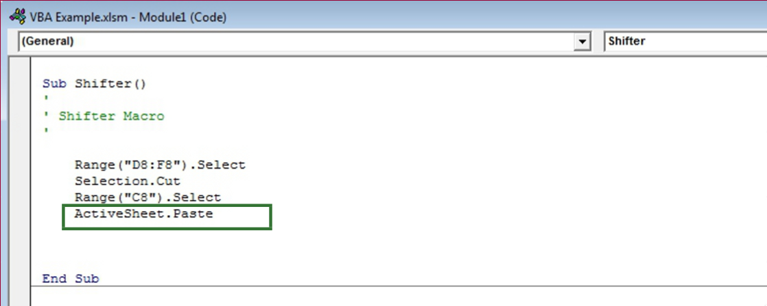
Our First Macro
Each line of a subroutine is executed sequentially.
  The first three green lines following each ‘ are simply comments/documentation.)
  The real ﬁrst line is Range("D8:F8").Select, and it selects the cells we want to select.
  The second line, Selection.Cut, cuts the selected cells.
  The third line, Range("C8").Select, selects the cell C8.
  Finally, the last line, ActiveSheet.Paste, pastes the cut values to the selected cell of the worksheet.

Slide 18
Our First Macro
We will generalize this example later as we learn more complex VBA coding.

Slide 19
Saving Excel Files Containing Macros
When a normal workbook (i.e., one without macros) is saved, MS Excel appends the standard .xlsx extension
For workbooks containing macros, the file must be saved as a Macro-Enabled file
  In this case, Excel appends the special extension .xlsm to these files
If you fail to save a file containing macros with the .xlsm extension, ALL YOUR WORK WILL BE LOST!

Slide 20
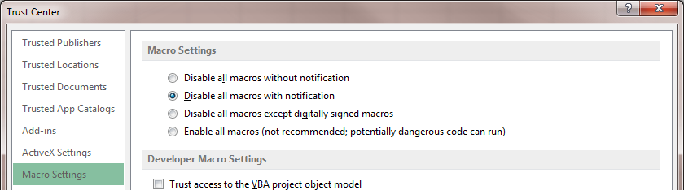
Macro Security
Macro security is an important feature since MS Excel 2007
  Because macros may be used to harm your computer
The level of protection can be set directly from the Developer ribbon by selecting Macro Security

Slide 21
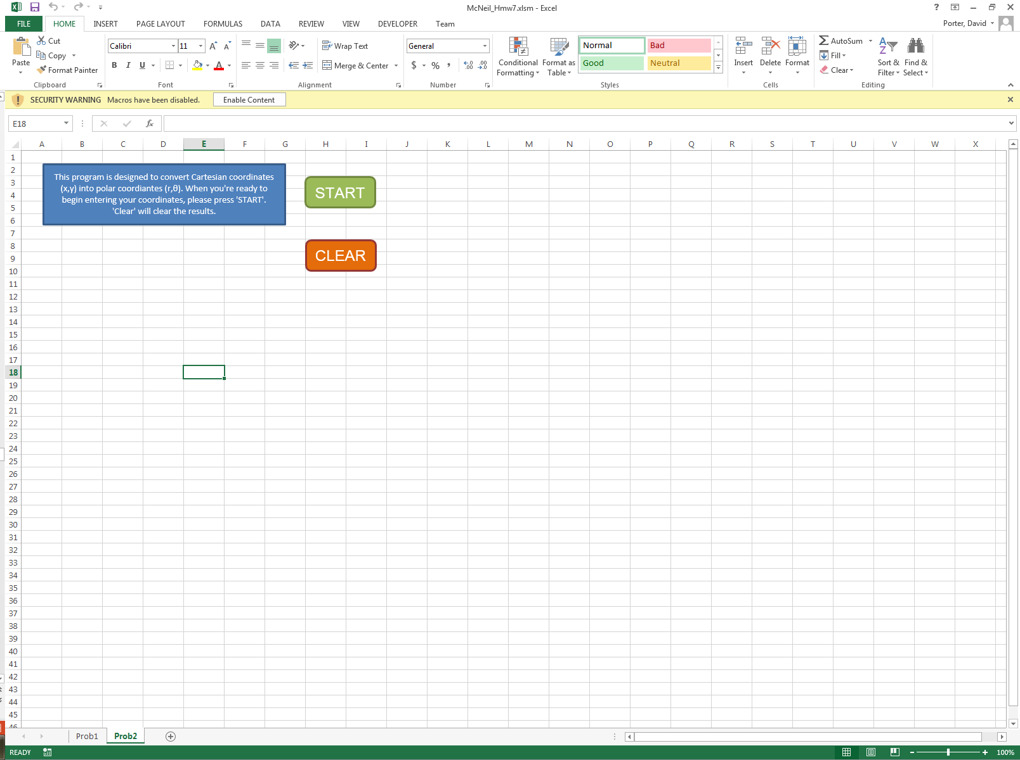
Macro Security (cont.)
When you open a spreadsheet that contains macros, Excel displays a warning on the ribbon alerting you that macros have been disabled
Select Enable Content only if you are sure the file is safe

Slide 22
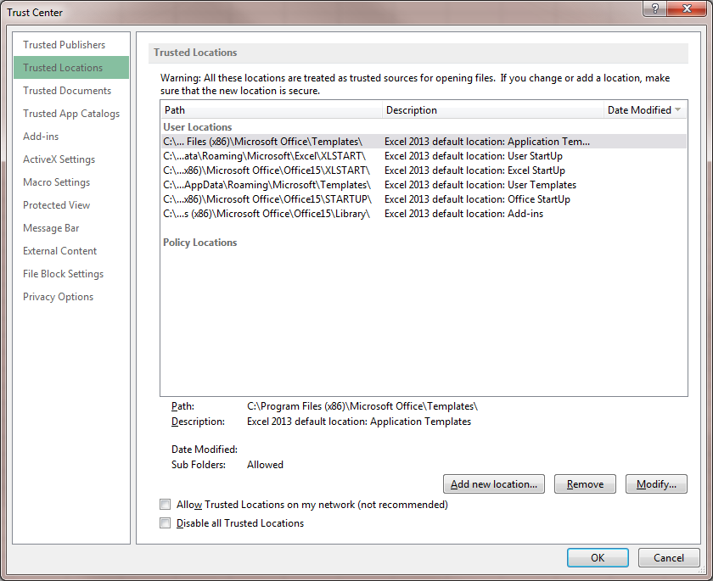
Macro Security (cont.)
To avoid having to authorize every spreadsheet with macros that is opened, define your working directory as a trusted location

Slide 23
Macro Security (cont.)
Save your file in the trusted location that you just defined
  Make sure to save it as fileName.xlsm
Remember
  If you save your file with the extension .xlsx, all you macros will be lost!

Slide 24
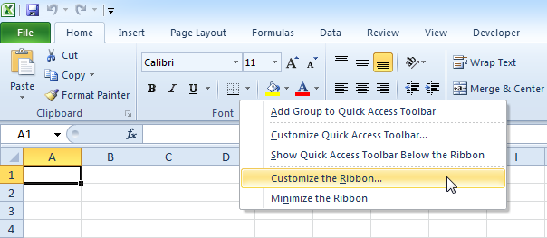
Create a Macro (From Scratch)
Turn on the Developer tab
  Right click anywhere on the ribbon, and then click Customize the Ribbon.

Slide 25
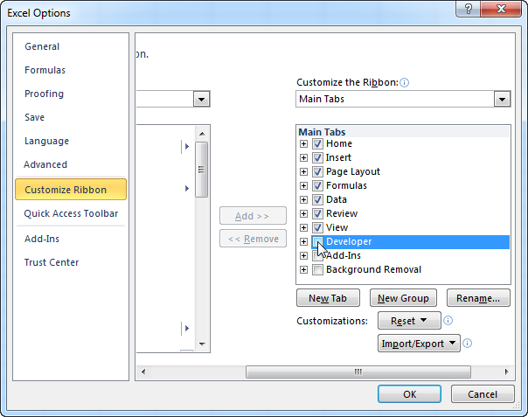
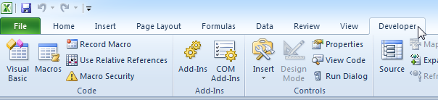
Create a Macro (From Scratch)
  Under Customize the Ribbon, on the right side of the dialog box, select Main tabs (if necessary).
  Check the Developer check box.

Slide 26
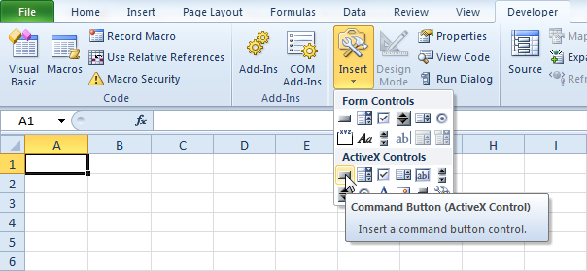
Create a Macro (From Scratch)
To place a command button on your worksheet, execute the following steps.
  On the Developer tab, click Insert.
  In the ActiveX Controls group, click Command Button.
  Drag a command button on your worksheet.

Slide 27
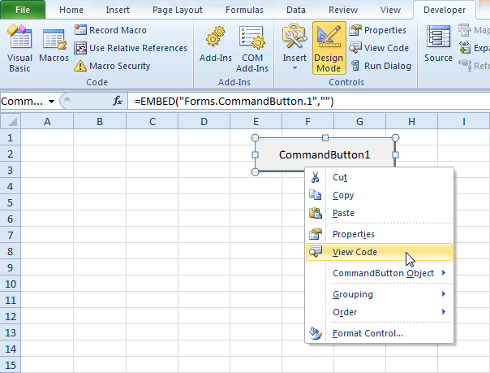
Create a Macro (From Scratch)
To assign a macro (one or more code lines) to the command button, execute the following steps.
  Right click CommandButton1 (make sure Design Mode is selected).
  Click View Code.

Slide 28
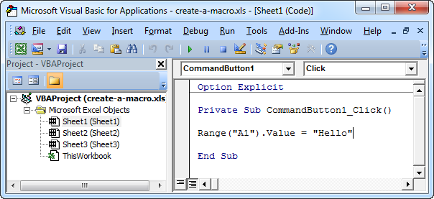
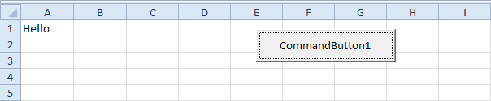
Create a Macro (From Scratch)
Write the following code:
When you click the button:

Slide 29
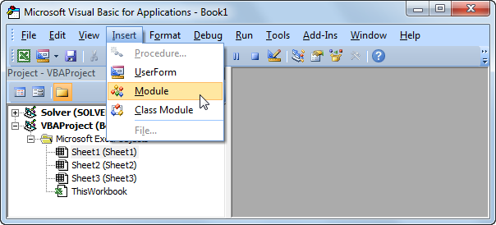
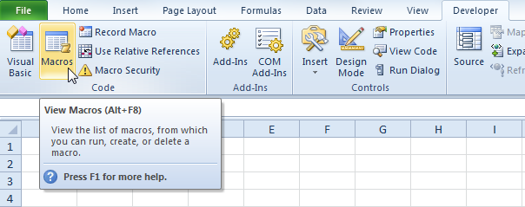
Run Code from a Module
You can also run a Macro directly from the Module.
  Open the Visual Basic Editor.
  Click Insert, Module.
  Create a procedure (macro)
  called Cyan.
Sub Cyan()
Cells.Interior.ColorIndex = 28
End Sub
To run the procedure, execute the following steps.
  Click Macros
  Select Cyan and click Run.

Slide 30
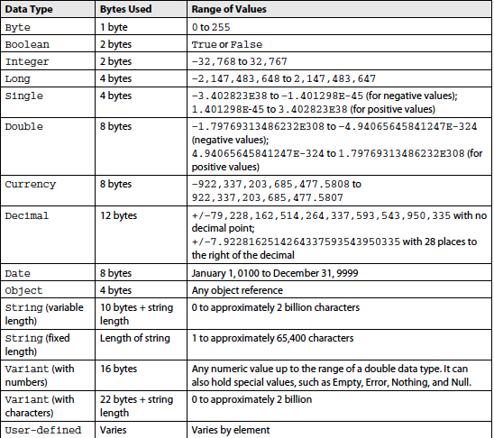
Variables

Slide 31
Variables
The variant data type is special – a variant can hold any type of data
A variable declared as variant (the default) can hold anything
The actual type of the data is kept in the data
It adds flexibility but at a cost – it requires more processing at compute time to determine what it is and how to handle it

Slide 32
Variables
Variables
  Must start with a letter
  Can contain _ and numbers
  Cannot exceed 255 characters in length
Within a procedure declare a variable using
  Dim variable
  Dim variable As type
If a variable is not declared it will be created when used, the type will be Variant
Use Option Explicit in the declarations section to require declaration of variables
VBA variables have scope restrictions
  Variables declared in a procedure are local to that procedure
  Variables declared in a module can be public or private

Slide 33
Variables
String variables
  Dim variable As String
  Dim variable As String * 50
The first form is variable length
The second form is limited to 50 characters
  The variable will be space filled if string is < 50 characters
  The string will be truncated if the contents are > 50 characters
Boolean variables contain either True or False

Slide 34
Variables
Watch out for
  Dim a, b, c As Integer
  it is equivalent to
  Dim a As Variant
  Dim b As Variant
  Dim c As Integer

Slide 35
Variables
The Object type is used to store the address (a reference) of an object
  Dim variable As Object
  This form can be used for any object
  This is referred to as late-binding, the object types are checked at runtime (slower)
The declaration of a specific object is
  Dim variable As Worksheet
  This form will only store Excel Worksheet objects, an attempt to put anything else into it will result in an error
  This is referred to as early-binding, the object types are checked at compile time (faster)

Slide 36
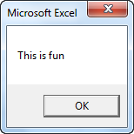
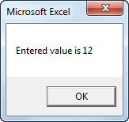
Message Box
The MsgBox is a dialog box in Excel VBA you can use to inform the users of your program.
A simple message:
  MsgBox "This is fun"
A little more advanced message. First, enter a number into cell A1.
  MsgBox "Entered value is " & Range("A1").Value

Slide 37
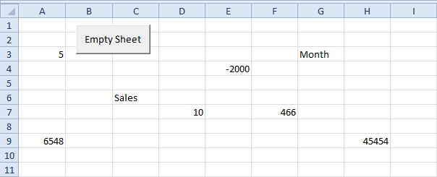
MsgBox Function
The MsgBox function in Excel VBA can return a result while a simple MsgBox cannot.

Slide 38
MsgBox Function
First, we declare a variable called answer of type Integer.
  Dim answer As Integer
We use the MsgBox function to initialize the variable answer with the input from the user.
  The MsgBox function, when using parentheses, has three arguments. The first part is used for the message in the message box. Use the second part to specify which buttons and icons you want to appear in the message box. The third part is displayed in the title bar of the message box.
  answer = MsgBox("Are you sure you want to empty the sheet?", vbYesNo + vbQuestion, "Empty Sheet")
  Place your cursor on vbYesNo in the Visual Basic Editor and click F1 to see which other buttons and icons you can use. Instead of the constants vbYesNo and vbQuestion, you can also use the corresponding values 4 and 32.

Slide 39
MsgBox Function

Slide 40
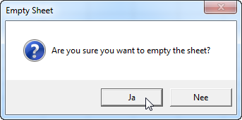
MsgBox Function
If the user clicks the Yes button, Excel VBA empties the sheet. If the user clicks the No button, nothing happens. Add the following code lines to achieve this.
  If answer = vbYes Then
  Cells.ClearContents
  Else
  'do nothing
  End If
Yes
No

Slide 41
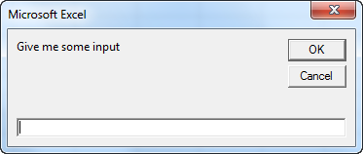
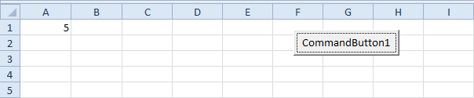
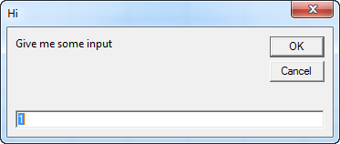
InputBox Function
You can use the InputBox function in Excel VBA to prompt the user to enter a value.
    Dim myValue As Variant
    myValue = InputBox("Give me some input")
    Range("A1").Value = myValue
    myValue = InputBox("Give me some input", "Hi", 1)

Slide 42
Objects
Excel VBA programming involves working with an object hierarchy.
The mother of all objects is Excel itself. We call it the Application object.
The application object contains other objects.
  For example, the Workbook object (Excel file). This can be any workbook you have created.
The Workbook object contains other objects, such as the Worksheet object. The Worksheet object contains other objects, such as the Range object.

Slide 43
Objects
When you type:
Range("A1").Value = "Hello"
You really mean:
Application.Workbooks("create-a-macro").Worksheets(1).Range("A1").Value = "Hello"

Slide 44
Collections
There is a special form of objects known as Collections
They contain references to other objects and collections
It is the mechanism by which the object hierarchy is defined
By convention, collection names are usually plural
  Workbooks – list of Workbook objects
  Worksheets – list of Worksheet objects
  Range – list of objects that represent cells, columns, rows

Slide 45

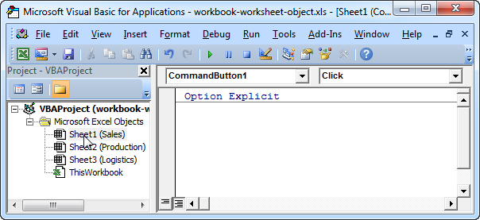
Collections
You can refer to a member of the collection, for example, a single Worksheet object, in three ways:
  Using worksheet name:
  Worksheets("Sales").Range("A1").Value = "Hello"
  Using index number:
  Worksheets(1).Range("A1").Value = "Hello"
  Using code name:
  Sheet1.Range("A1").Value = "Hello"

Slide 46
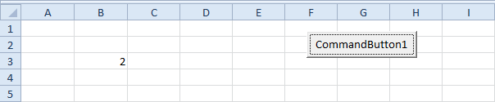

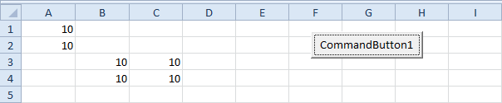
Range Object
The Range object is the representation of a cell (or cells) on your worksheet.
  Range("B3").Value = 2
  Range("A1:A4").Value = 5
  Range("A1:A2,B3:C4").Value = 10
Instead of Range, you can also use Cells. Using Cells is particularly useful when you want to loop through ranges.
  Cells(3, 2).Value = 2

Slide 47
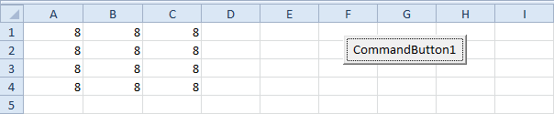
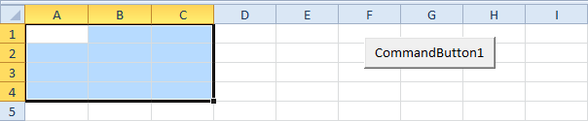
Range Object
You can declare a Range object by using the keywords Dim and Set.
  Dim example As Range
  Set example = Range("A1:C4")
  example.Value = 8
An important method of the Range object is the Select method. The Select method simply selects a range.
  Dim example As Range
  Set example = Range("A1:C4")
  example.Select
The following code line selects entire rows/columns.
  Cells.Select
  Columns(2).Select
  Rows(7).Select
  Rows("5:7").Select
  Columns("B:E").Select

Slide 48
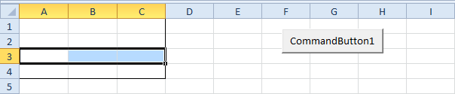
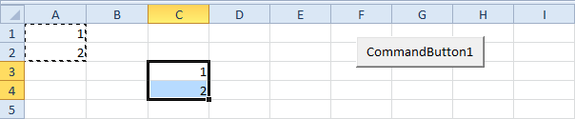
Range Object
The Rows property gives access to a specific row of a range.
  Dim example As Range
  Set example = Range("A1:C4")
  example.Rows(3).Select
The Columns property gives access to a specific column of a range.
The Copy and Paste method are used to copy a range and to paste it somewhere else on the worksheet.
  Range("A1:A2").Select
  Selection.Copy
  Range("C3").Select
  ActiveSheet.Paste

Slide 49
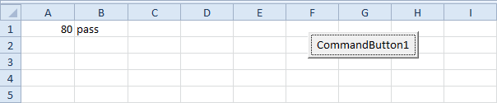
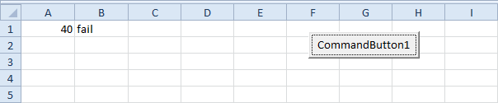
Logical Statements
Use the If Then statement in Excel VBA to execute code lines if a specific condition is met.
  Dim score As Integer, result As String
  score = Range("A1").Value
  If score >= 60 Then
  result = "pass"
  Else
  result = "fail"
  End If
  Range("B1").Value = result

Slide 50
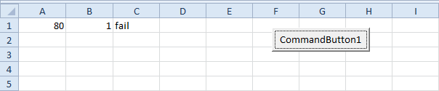
Logical Statements
The three most used logical operators in Excel VBA are: And, Or and Not.
Dim score1 As Integer, score2 As Integer, result As String
score1 = Range("A1").Value
score2 = Range("B1").Value
If score1 >= 60 And score2 > 1 Then
result = "pass"
Else
result = "fail"
End If
Range("C1").Value = result

Slide 51
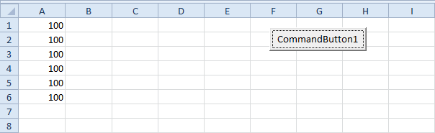
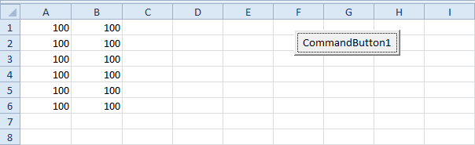
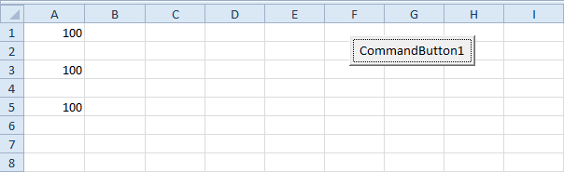
Loops
Single for loop
  Dim i As Integer
  For i = 1 To 6
  Cells(i, 1).Value = 100
  Next i
Nested for loop
  Dim i As Integer, j As Integer
  For i = 1 To 6
  For j = 1 To 2
  Cells(i, j).Value = 100
  Next j
  Next i
for loop with step
  Dim i As Integer
  For i = 1 To 6 Step 2
  Cells(i, 1).Value = 100
  Next i

Slide 52
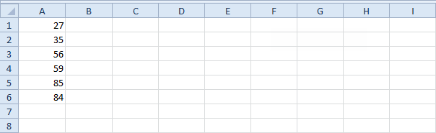
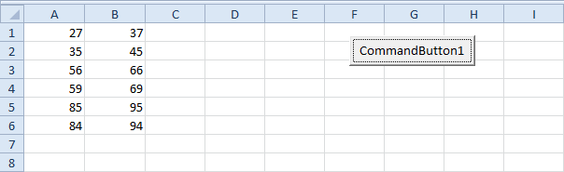
Loops
Do While Loop
  Dim i As Integer
  i = 1
  Do While Cells(i, 1).Value <> ""
  Cells(i, 2).Value = Cells(i, 1).Value + 10
  i = i + 1
  Loop

