Slide 1
Even More VBA
IE 469 Spring 2019

Slide 2
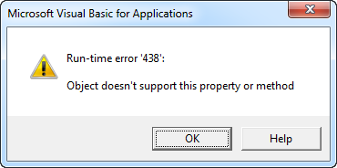
Error Handling
First of all as a VBA coder, you have to adhere to the VBA Syntax!
Or else...
x = 2 Range("A1").Valu = x

Slide 3
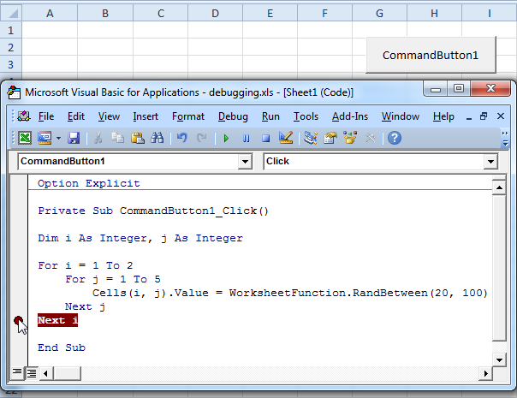
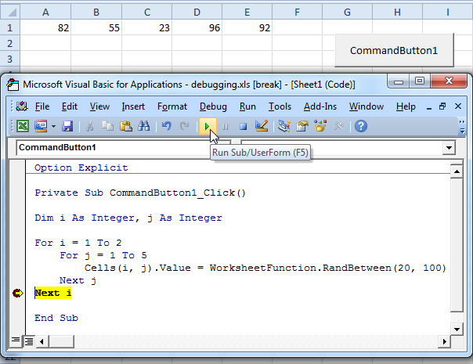
Error Handling
Single Step Debugging vs Debugging with Breakpoints
By pressing F8, you can single step through your code. The is very useful because it allows you to see the effect of each code line on your worksheet.
OR, you set a breakpoint to halt execution at a specific code line.

Slide 4
Error Handling
Your code may be just OK. But...
If you do not handle any possible error, then a user input given above will crash the code!

Slide 5
Error Handling
Solution 1: Ignoring the erroneous cells:
Dim rng As Range, cell As Range
Set rng = Selection
For Each cell In rng
On Error Resume Next
cell.Value = Sqr(cell.Value)
Next cell

Slide 6
Error Handling
Solution 2: Warning user
Dim rng As Range, cell As Range
Set rng = Selection
For Each cell In rng
On Error GoTo InvalidValue:
cell.Value = Sqr(cell.Value)
Next cell
Exit Sub
InvalidValue:
MsgBox "can't calculate square root at cell " & cell.Address
Resume Next

Slide 7
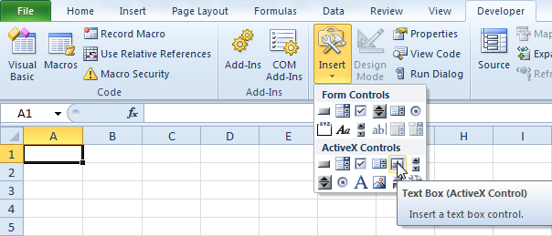
ActiveX Controls

Slide 8
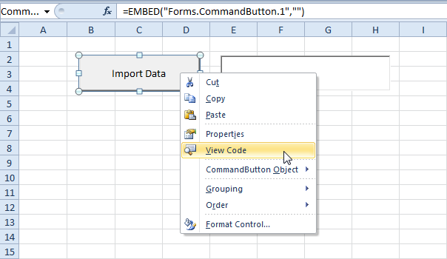
Text Box
Add the following code line to the command button:
TextBox1.Text = "Data imported successfully"

Slide 9
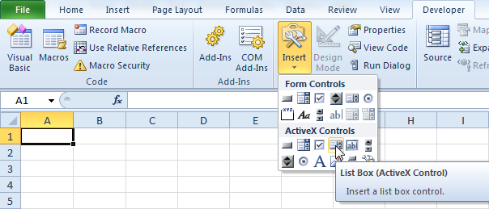
List Box

Slide 10
List Box
To add items to a list, use the following command:
With Sheet1.ListBox1 .AddItem "Paris" .AddItem "New York" .AddItem "London" End With
Note: use Sheet2 if your list box is located on the second worksheet, Sheet3 if your list box is located on the third worksheet, etc. If you use these code lines outside the Workbook Open event, you might want to add the following code line before these code lines. This code line clears the list box. This way your items won't be added multiple times if you execute your code more than once.
ListBox1.Clear

Slide 11
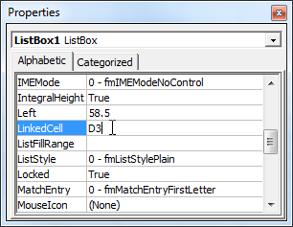
List Box
To link this list box to a cell, right click on the list box (make sure design mode is selected) and click on Properties. Fill in D3 for LinkedCell.

Slide 12
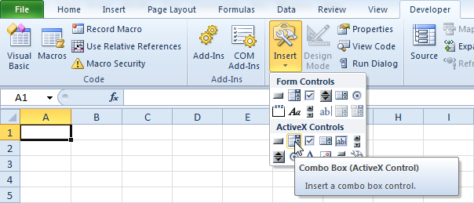
Combo Box
A combo box is a drop-down list from where a user can select an item or fill in his/her own choice.

Slide 13
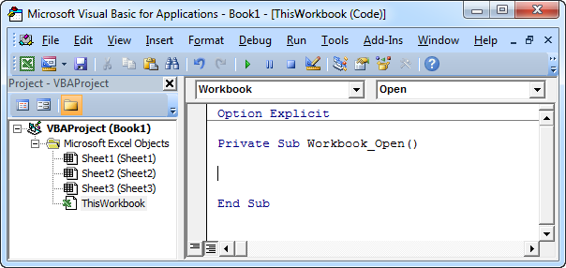
Combo Box
Create a Workbook Open Event. Code added to the Workbook Open Event will be executed by Excel VBA when you open the workbook.

Slide 14
Combo Box
To add items to the combo box, add the following code lines to the Workbook Open Event
With Sheet1.ComboBox1 .AddItem "Paris" .AddItem "New York" .AddItem "London" End With
Note: use Sheet2 if your combo box is located on the second worksheet, Sheet3 if your combo box is located on the third worksheet, etc. If you use these code lines outside the Workbook Open event, you might want to add the code lines below before these code lines. The first code line clears the combo box. This way your items won't be added multiple times if you execute your code more than once. The second code line clears your own choice.
ComboBox1.Clear ComboBox1.Value = ""

Slide 15
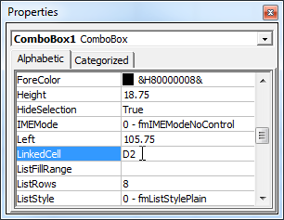
Combo Box
To link this combo box to a cell, right click on the combo box (make sure design mode is selected) and click on Properties. Fill in D2 for LinkedCell.

Slide 16
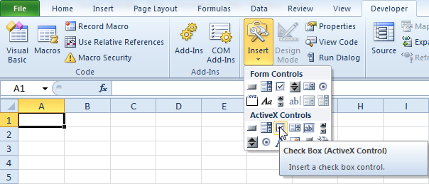
Check Box
A check box is a field which can be checked to store information.

Slide 17
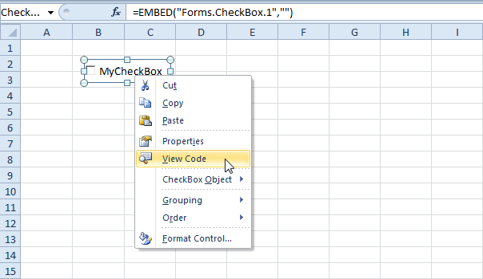
Check Box
Add the following code lines:
If CheckBox1.Value = True Then Range("D2").Value = 1 If CheckBox1.Value = False Then Range("D2").Value = 0

Slide 18
Check Box
Click the check box on the sheet (make sure Design Mode is deselected).

Slide 19
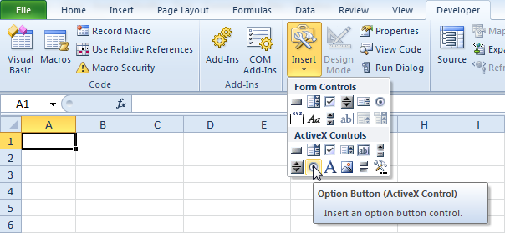
Option Buttons (Radio Buttons)
Option Buttons (a.k.a. Radio Buttons) are used to select an option among many. (Only one can be selected!)

Slide 20
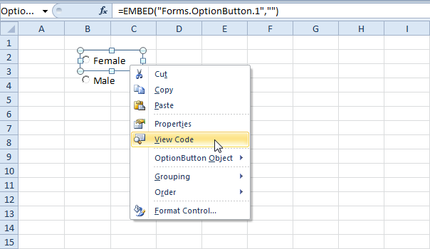
Option Buttons (Radio Buttons)
Drag two option buttons on your worksheet.

Slide 21
Option Buttons (Radio Buttons)
Right click the first option button (make sure Design Mode is selected).
If OptionButton1.Value = True Then Range("D3").Value = 10
Right click the second option button (make sure Design Mode is selected).
If OptionButton2.Value = True Then Range("D3").Value = 20

Slide 22
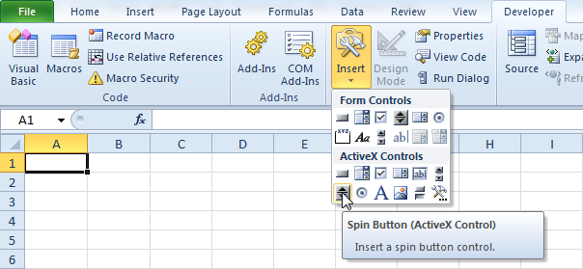
Spin Button
A spin button can be used to increment a number in a cell.

Slide 23
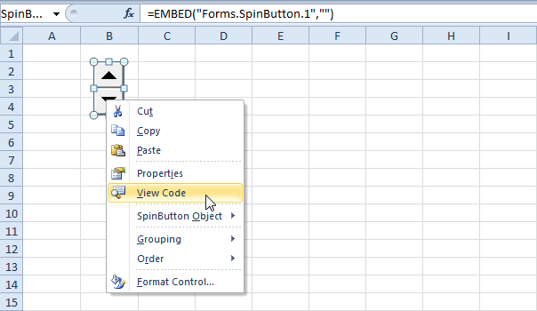
Spin Button
To link this spin button to a cell, add the following code line.
Range("C3").Value = SpinButton1.Value

Slide 24
Spin Button
You can set a maximum and minimum by adding the following code lines.
SpinButton1.Max = 100 SpinButton1.Min = 0
To change the incremental value, use the SmallChange property.
SpinButton1.SmallChange = 2

Slide 25
ActiveX Controls
All of these objects are useful on Worksheets.
But they are more useful on UserForms!

Slide 26
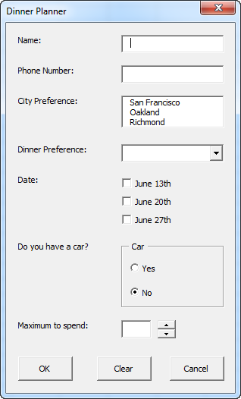
User Forms
We will create a user form to collect participant info for our Dinner Organization.

Slide 27
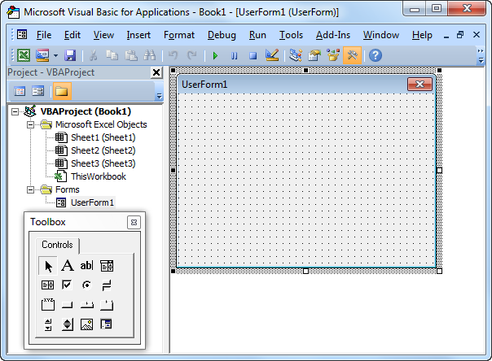
User Forms
Open the Visual Basic Editor. If the Project Explorer is not visible, click View, Project Explorer.
Click Insert, Userform. If the Toolbox does not appear automatically, click View, Toolbox. Your screen should be set up as below.

Slide 28
User Forms
Add the controls:
Caption will be displayed on the form.
Name is the VBA object name.
Control | Name | Caption
Userform | DinnerPlannerUserForm | Dinner Planner
Text Box | NameTextBox
Text Box | PhoneTextBox
List Box | CityListBox
Combo Box | DinnerComboBox
Check Box | DateCheckBox1 | June 13th
Check Box | DateCheckBox2 | June 20th
Check Box | DateCheckBox3 | June 27th
Frame | CarFrame | Car
Option Button | CarOptionButton1 | Yes
Option Button | CarOptionButton2 | No
Text Box | MoneyTextBox
Spin Button | MoneySpinButton
Command Button | OKButton | OK
Command Button | ClearButton | Clear
Command Button | CancelButton | Cancel
7 Labels | No need to change | Name:, Phone Number:, etc.

Slide 29
User Forms
To show the Userform, place a command button on your worksheet and add the following code line:
Private Sub CommandButton1_Click()
DinnerPlannerUserForm.Show
End Sub

Slide 30
User Forms
We are now going to create the Sub UserForm_Initialize. When you use the Show method for the Userform, this sub will automatically be executed.
Open the Visual Basic Editor.
In the Project Explorer, right click on DinnerPlannerUserForm and then click View Code.
Choose Userform from the left drop-down list. Choose Initialize from the right drop-down list.

Slide 31
User Forms
Private Sub UserForm_Initialize() 'Empty NameTextBox NameTextBox.Value = "" 'Empty PhoneTextBox PhoneTextBox.Value = "" 'Empty CityListBox CityListBox.Clear 'Fill CityListBox With CityListBox .AddItem "San Francisco" .AddItem "Oakland" .AddItem "Richmond" End With

Slide 32
User Forms
'Empty DinnerComboBox DinnerComboBox.Clear 'Fill DinnerComboBox With DinnerComboBox .AddItem "Italian" .AddItem "Chinese" .AddItem "Frites and Meat" End With 'Uncheck DataCheckBoxes DateCheckBox1.Value = False DateCheckBox2.Value = False DateCheckBox3.Value = False 'Set no car as default CarOptionButton2.Value = True 'Empty MoneyTextBox MoneyTextBox.Value = "" 'Set Focus on NameTextBox NameTextBox.SetFocus End Sub
With this code, text boxes are emptied, list boxes and combo boxes are filled, check boxes are unchecked, etc.

Slide 33
User Forms
We have now created the first part of the Userform. Although it looks neat already, nothing will happen yet when we click the command buttons on the Userform.
Open the Visual Basic Editor.
In the Project Explorer, double click on DinnerPlannerUserForm.
Double click on the Money spin button.
Add the following code line:
Private Sub MoneySpinButton_Change() MoneyTextBox.Text = MoneySpinButton.Value End Sub
This code line updates the text box when you use the spin button.

Slide 34
User Forms
Double click on the OK button.
Add the following code lines:
Private Sub OKButton_Click() Dim emptyRow As Long 'Make Sheet1 active Sheet1.Activate 'Determine emptyRow emptyRow = WorksheetFunction.CountA(Range("A:A")) + 1 'Transfer information Cells(emptyRow, 1).Value = NameTextBox.Value Cells(emptyRow, 2).Value = PhoneTextBox.Value Cells(emptyRow, 3).Value = CityListBox.Value Cells(emptyRow, 4).Value = DinnerComboBox.Value

Slide 35
User Forms
If DateCheckBox1.Value = True Then Cells(emptyRow, 5).Value = DateCheckBox1.Caption If DateCheckBox2.Value = True Then Cells(emptyRow, 5).Value = Cells(emptyRow, 5).Value & " " & DateCheckBox2.Caption If DateCheckBox3.Value = True Then Cells(emptyRow, 5).Value = Cells(emptyRow, 5).Value & " " & DateCheckBox3.Caption If CarOptionButton1.Value = True Then Cells(emptyRow, 6).Value = "Yes" Else Cells(emptyRow, 6).Value = "No" End If Cells(emptyRow, 7).Value = MoneyTextBox.Value End Sub
First, we activate Sheet1. Next, we determine emptyRow. The variable emptyRow is the first empty row and increases every time a record is added. Finally, we transfer the information from the Userform to the specific columns of emptyRow.

Slide 36
User Forms
Double click on the Clear button.
Add the following code line:
Private Sub ClearButton_Click() Call UserForm_Initialize End Sub
This code line calls the Sub UserForm_Initialize when you click on the Clear button.

Slide 37
User Forms
Double click on the Cancel Button.
Add the following code line:
Private Sub CancelButton_Click() Unload Me End Sub

Slide 38
User Forms

Slide 39
Next time...
Using Solver via VBA

