Slide 1
2011
TŌHOKU
EARTHQUAKE
AND
TSUNAMI
Tolga Tubay
Dilara Korkmaz
Kadir Kaan Kılıçarslan

Slide 2
1
Overview
2
Precautions
TABLE OF
CONTENTS
3
Disaster Management
4
What was right/wrong?
5
Lessons Learned
6
References

Slide 3
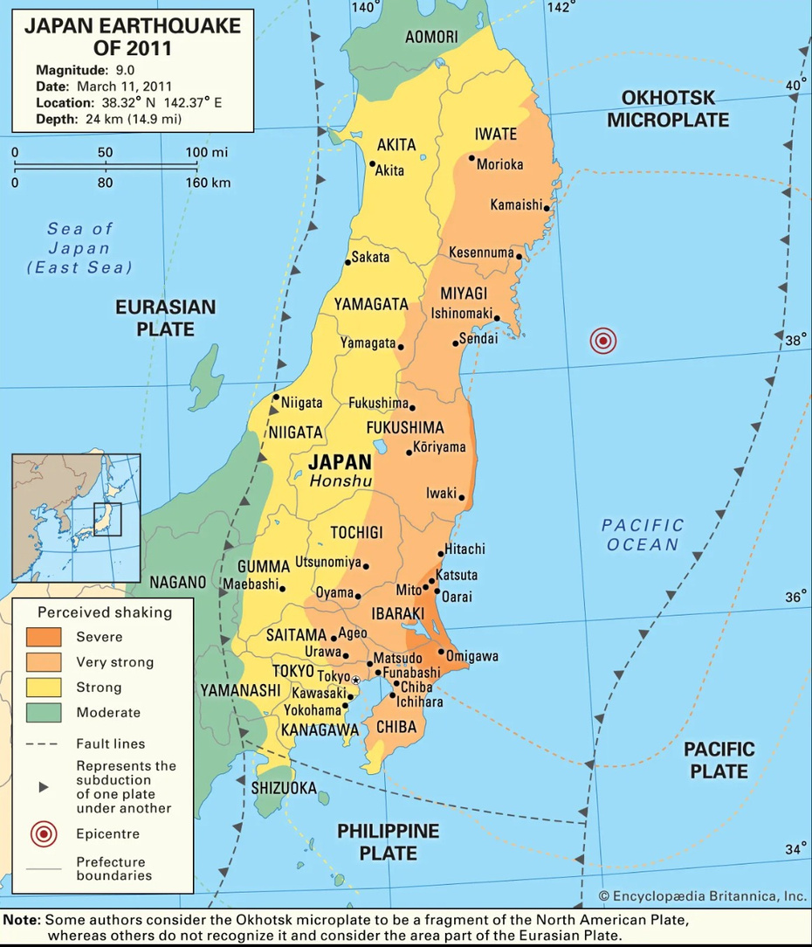
1:OVERVIEW
Magnitude : 9.0 (largest earthquake recorded in the country)
Date and Time : 11 March 2011 , 14:46 JST
Epicenter : Pacific Coast of Northeastern Japan (Tohoku region)
Duration : 6 minutes
Casualties [1]:
Deaths: 15.899
Injured: 6.157
Missing: 2.527
More than 1200 aftershocks
4th largest earthquake in the history of world

Slide 4
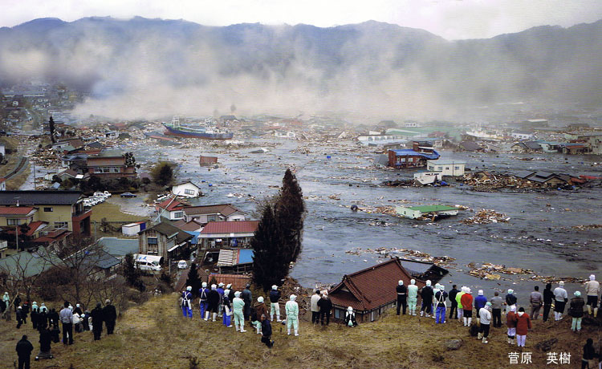
1:OVERVIEW
Tsunami waves reached 40 meters.
2000 km of the coast was impacted
Nearly 120.000 houses were destroyed
Nearly 900.000 houses were damaged
Economic loss : Roughly $300 Billion
5.5 Million households’ electricity were disconnected [2]
600.000 people cut off from water supply
Fukushima Daiichi Nuclear disaster
100.000 people evacuated from their homes

Slide 5
2: PRECAUTIONS
Early warning system:
The Japan Meteorological Agency (JMA) estimated the earthquake and tsunami.
JMA issued major tsunami warning to residents nearby by categorizing expected tsunami heights area by area [3].

Slide 6
3:DISASTER MANAGEMENT
Immediate Response to the Disaster
100,000 members of the Japanese Self-defense force (army) were mobilized to deal with the crisis and build shelters [8]
People in the region whose houses were damaged and at nuclear risk were taken to shelters [4]
The communication between the government - fire brigade - military - municipalities and their communication with the public were kept dynamic [4]
An emergency command centre in Tokyo [4]

Slide 7
3:DISASTER MANAGEMENT
Coordination System between National and Local Governments during the Great East Japan Earthquake[4]

Slide 8
3:DISASTER
MANAGEMENT
Disaster recovery and reconstruction policy and planning stages in Japan [5]

Slide 9
4:WHAT WAS
RIGHT?
Early Warning System[3]
Infrastructure[6]
Effective Communication
Preparedness and Drills
Rapid Response and Mobilization

Slide 10
4:WHAT WAS WRONG?
Nuclear Disaster
Evacuation Process
Continuity in education stopped for 5-6 [7]

Slide 11
5:LESSONS LEARNED
Importance of the Infrastructure,
Height of seawalls has been increased [8],
Communication and Transparency,
Preparedness,
Seismic/tsunami monitoring network
Improvemetn in nuclear safety standards and emergency preparedness [9].

Slide 12
REFERENCES
[1] “On This Day: 2011 Tohoku Earthquake and Tsunami.” National Centers for Environmental Information (NCEI), 27 July 2023, www.ncei.noaa.gov/news/day-2011-japan-earthquake-and-tsunami#:~:text=All%20three%20nuclear%20cores%20largely,the%20Great%20East%20Japan%20event.
[2] M. Capdevila, S. Maas S. Zimmermann, Evaluation of Civil Protection Mechanism Case study report- Earthquake Japan 2011, November 2014.
[3] Koshimura, Shunichi, and Nobuo Shuto. “Response to the 2011 Great East japan earthquake and tsunami disaster.” Philosophical Transactions of the Royal Society A: Mathematical, Physical and Engineering Sciences, vol. 373, no. 2053, 28 Oct. 2015, p. 20140373, https://doi.org/10.1098/rsta.2014.0373.
[4] Rethinking Future, “Learning disaster management from Japan”. [Online]. Available: https://www.re-thinkingthefuture.com/designing-for-typologies/a9523-learning-disaster-management-from-japan/
[5]N. Leelawat, A. Suppasri and F. Imamura, “Disaster Recovery and Reconstruction Following the 2011 Great East Japan N.Leelawat, A. Suppasri and F. Imamura Earthquake and Tsunami: A Business Process Management Perspective” International Journal of Disaster Risk Science, vol 6, page 310-314, September 2015. Available: https://link.springer.com/article/10.1007/s13753-015-0066-1. [Accessed: February 18,2024]
[6]Sanzone, Matt, and Matt Sanzone. “Why Japan’s Earthquake Resistant Buildings Are the Future of Real Estate.” Housing Japan | Why Japan’s Earthquake-Resistant Buildings Are the Future of Real Estate, 11 Jan. 2024, housingjapan.com/blog/why-japans-earthquake-resistant-buildings-are-the-future-of-real-estate/#:~:text=Japan%20is%20renowned%20for%20its,even%20the%20most%20powerful%20earthquakes.

Slide 13
REFERENCES
[7]M. Capdevila, S. Maas S. Zimmermann, Evaluation of Civil Protection Mechanism Case study report- Earthquake Japan 2011, November 2014.
[8] S.Koshimura and N. Shuto, “Response to the 2011 Great East Japan Earthquake and Tsunami disaster”, Philosophical Transactions: Mathematical, Physical and Engineering Sciences: Tsunamis: Bridging Science, Engineering and Society, pp. 1-15, October 2015
[9]Prevention Web, “Learning from megadisasters: A decade of lessons from the Great East Japan Earthquak”. [Online]. Available: https://www.preventionweb.net/news/learning-megadisasters-decade-lessons-great-east-japan-earthquake.

Slide 14
Thank You For Listening
Do you have any questions?

