Slide 1
GEA Search and Rescue
Batuhan Bahriş
Elif Baykan
Egehan Uğraş
Eda Tatar

Slide 2
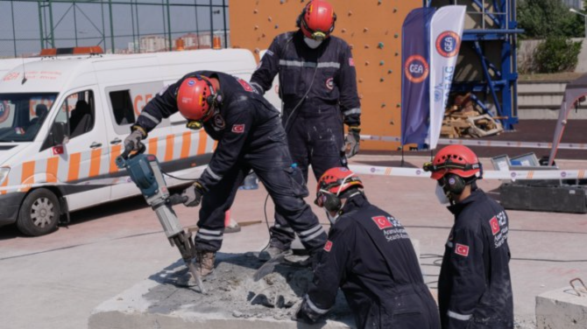
TABLE OF CONTENTS
1
What is GEA?
2
Who, When, Why?
3
Main Projects / Operations
4
Current Situation
5
Similar NGO’s

Slide 3
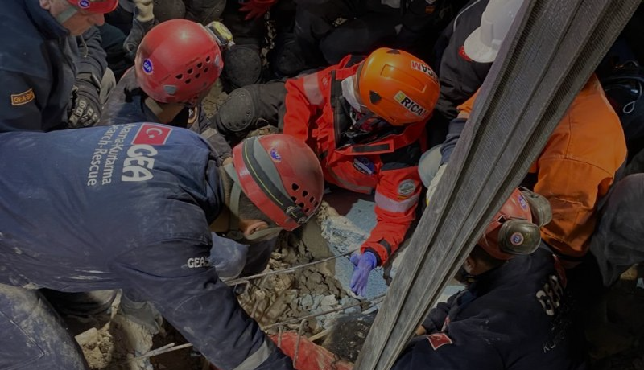
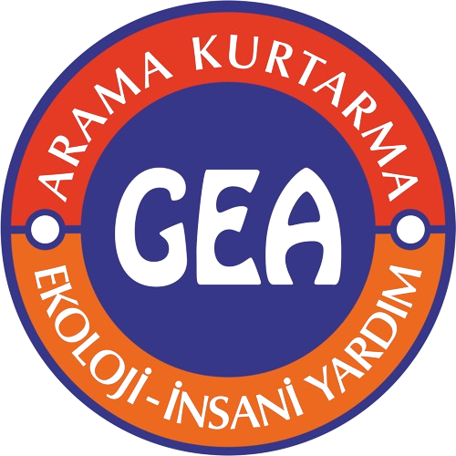
01
History of GEA

Slide 4
What is GEA?
Mother Earth
Search and Rescue
Aid Group

Slide 5
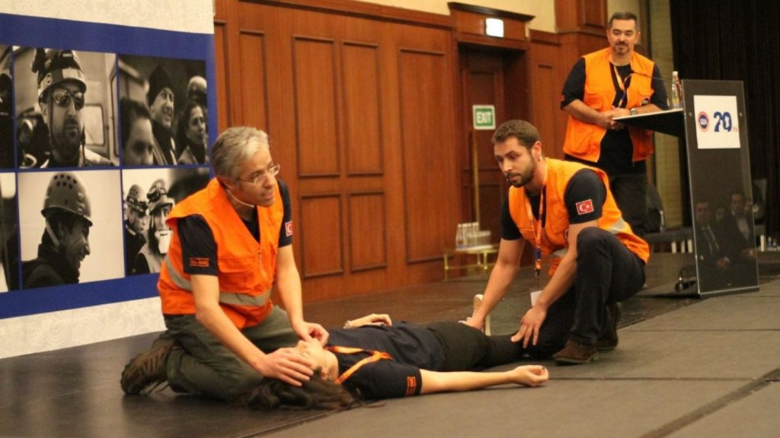
Who, When, Why?
1994
Umut Dinçşahin
To access the disaster area within the earliest time possible

Slide 6
02
Main Projects / Operations

Slide 7
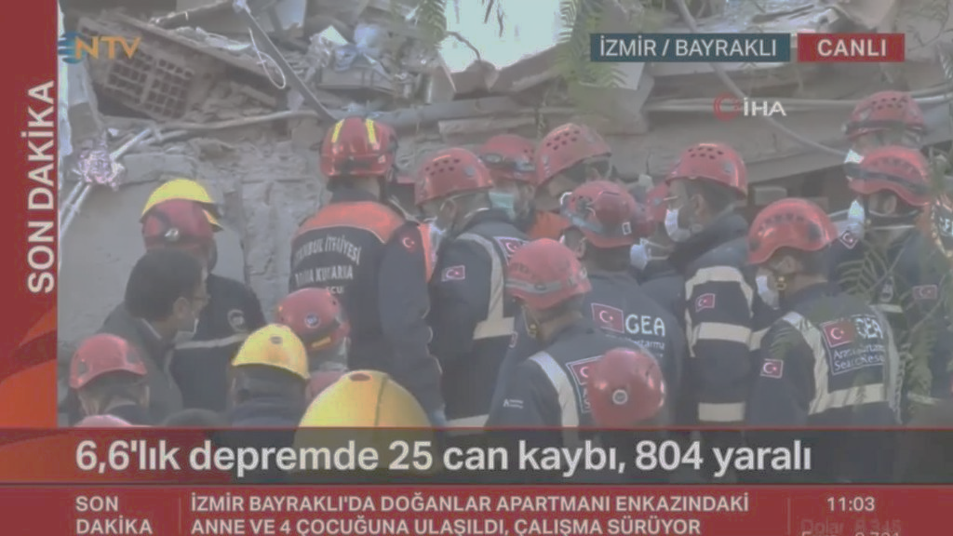
Main Projects of GEA
Search and Rescue
Social Campaigns
Ecology
GEA Webinars

Slide 8
Search and Rescue
GEA Team, in line with the Urban Search and Rescue team criteria in the United Nations INSARAG guide (USAR), can occur anywhere in the world;
Search and rescue and humanitarian aid operations in earthquakes.
Building collapses.
Search and rescue operations in explosion and bomb attacks.
Rescue in urban flood disasters.
It has the capacity to intervene in forest fires.

Slide 9
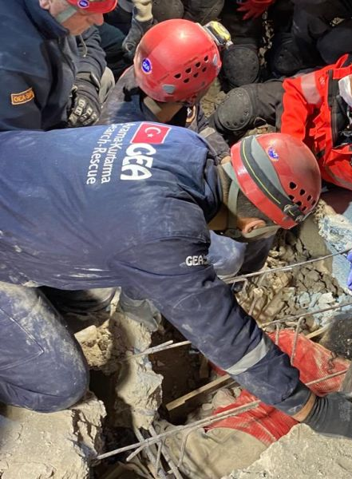
Social Campaigns
Post-disaster Humanitarian Aid Efforts
Nursing Home Visits
GEA Life Internship
Oncology Service Visits
New Friends for Lonely Toys
Dream, Sacrifice, Realize
Be Prepared! Stay Healthy!

Slide 10
ECOLOGY
Environmental Cleaning Campaigns
Tree Planting Campaigns
Protect Animals and Improve Habitats
Ecology Seminars

Slide 11
GEA WEBINARS
Human Psychology
Raising Awareness About Animals
Awareness About Environmental Protection
Search and Rescue Workshop

Slide 12
03
Current Situation

Slide 13
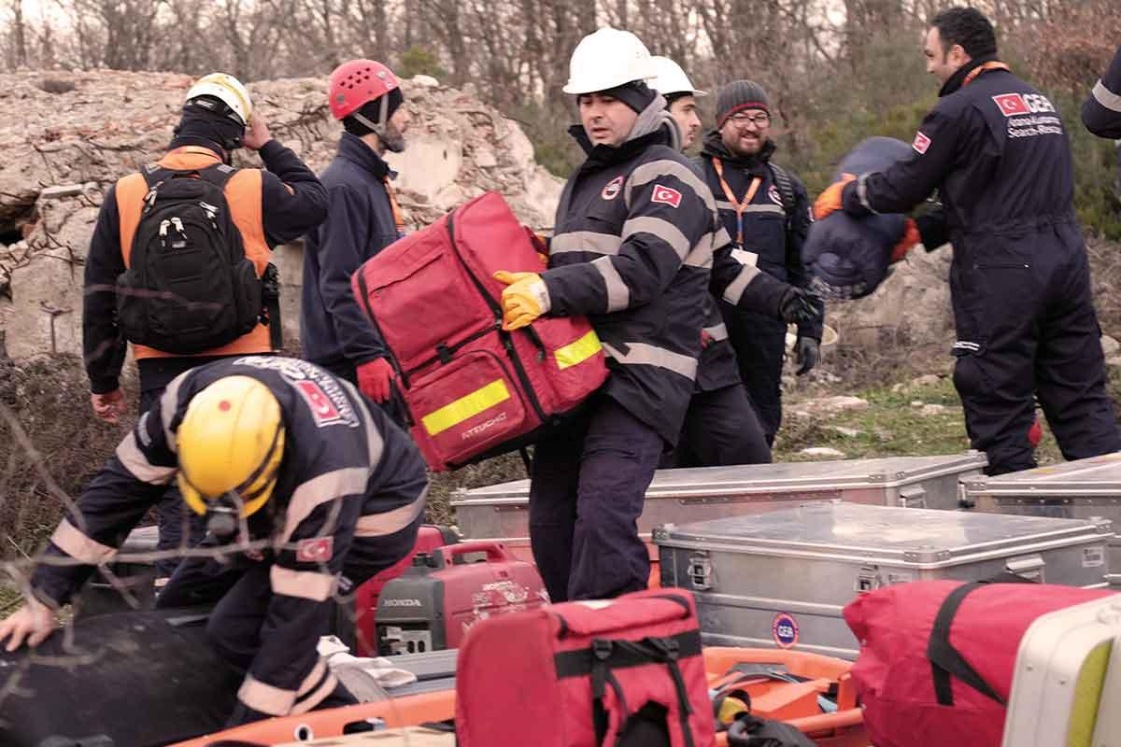
GEA-Sar has
+7350 Volunteers
13 Branches
786 Operation and Support Team Members

Slide 14
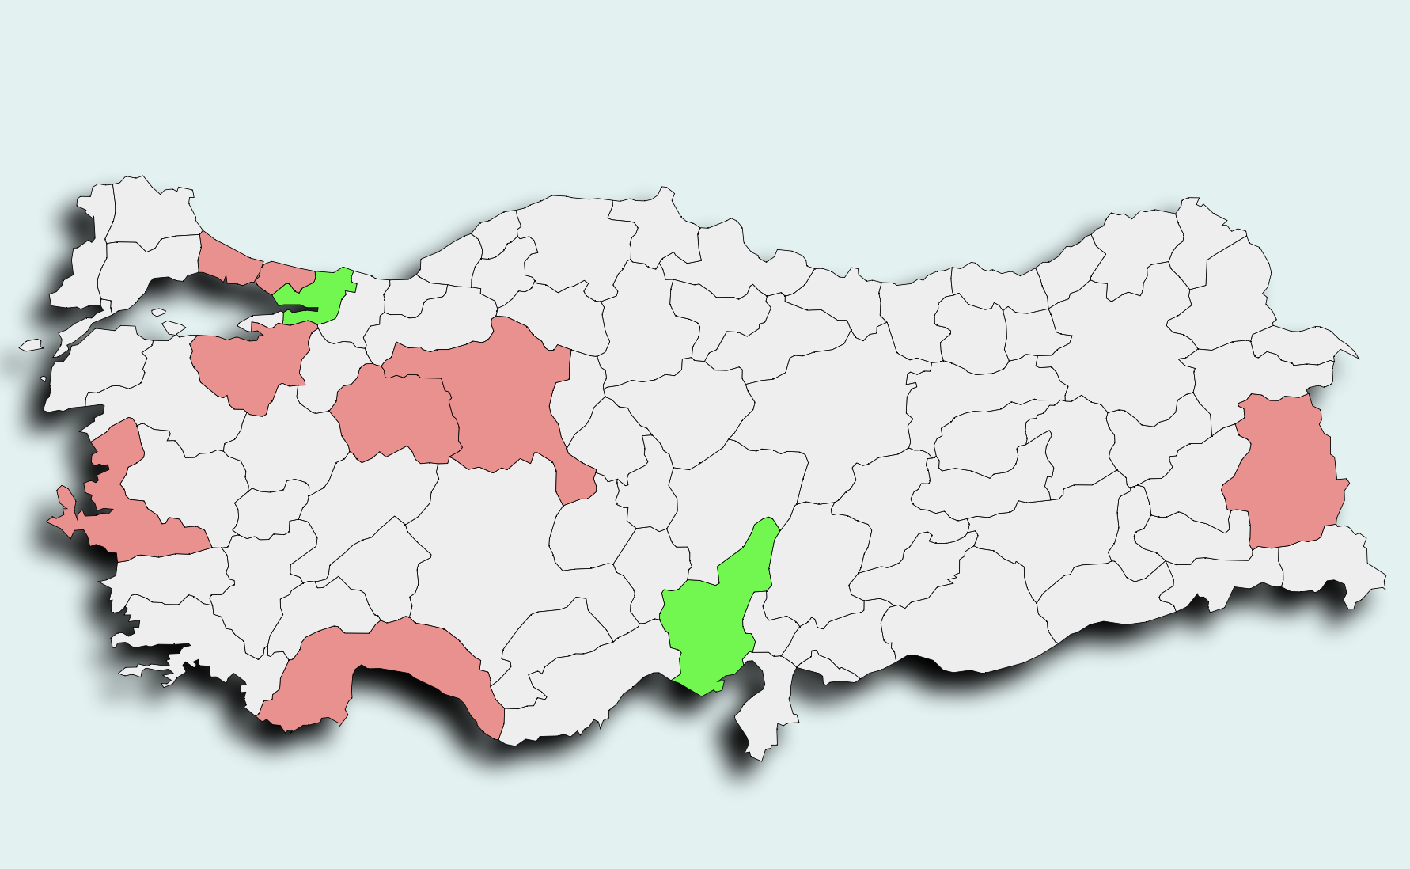
Branches of GEA-Sar
İzmit
Bursa
İstanbul
Eskişehir
Ankara
Van
İzmir
Adana
Antalya

Slide 15
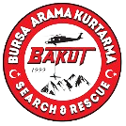
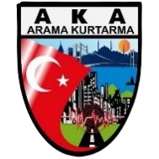
Classification of SAR by AFAD
Light SAR
Medium SAR
Heavy SAR

Slide 16
Classification of SAR by INSARAG
Light SAR
Medium SAR
Heavy SAR

Slide 17
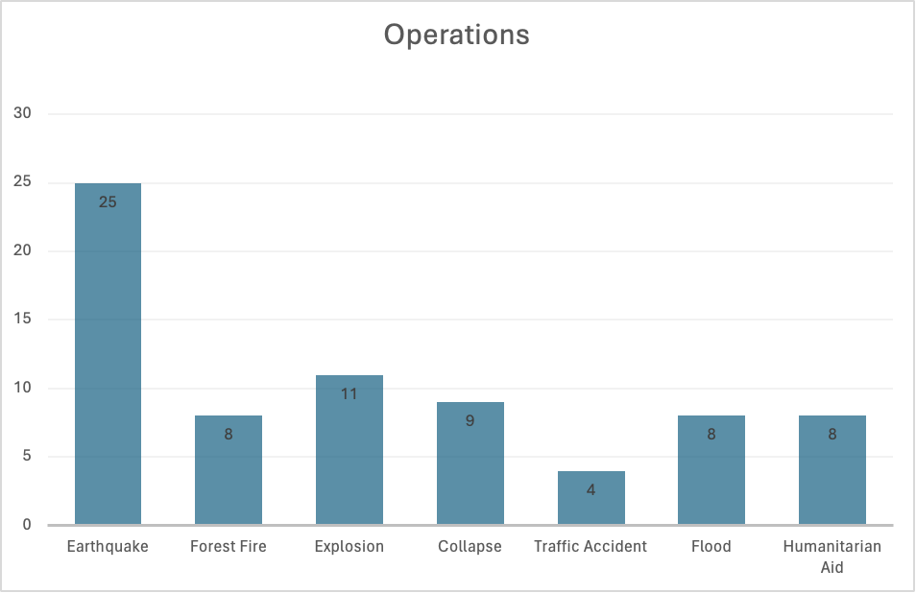
Recent Operations
Arakan Medical Support, 2017
Indonesian Earhtquake, 2018
Albania Earhtquake, 2019
Elazığ Earhtquake, 2020
İzmir Earhtquake, 2020
Ukraine Humanitarian Aid, 2022
Kahramanmaraş Earhtquakes, 2023

Slide 18
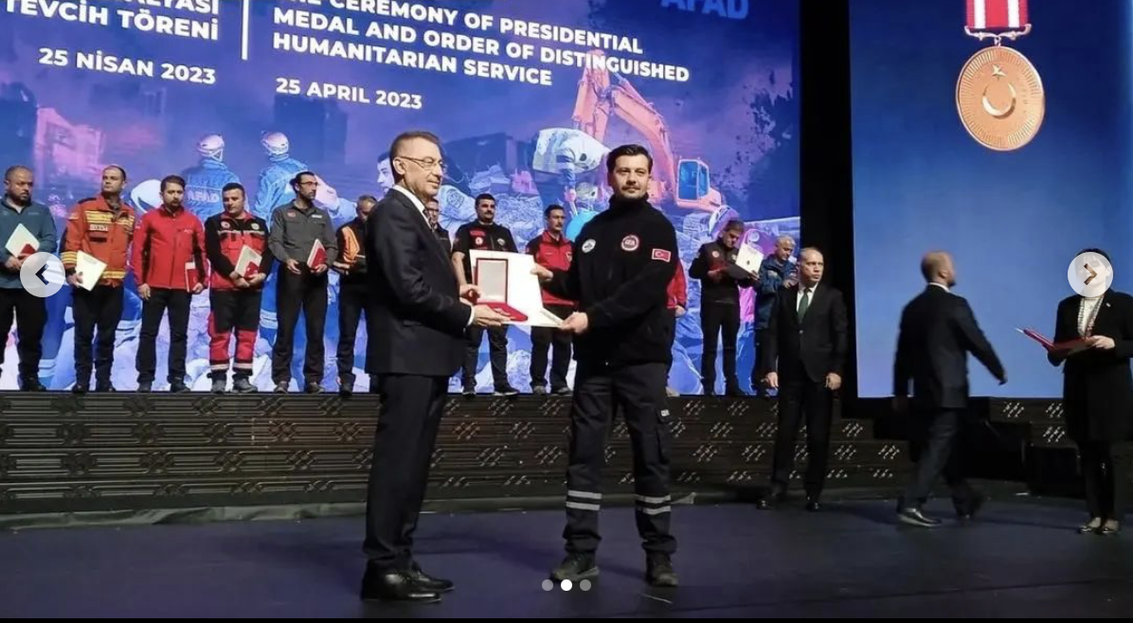
State Medal
Presidential Medal and Order of Distinguished Humanitarian Service

Slide 19
04
Similar NGO’s

Slide 20
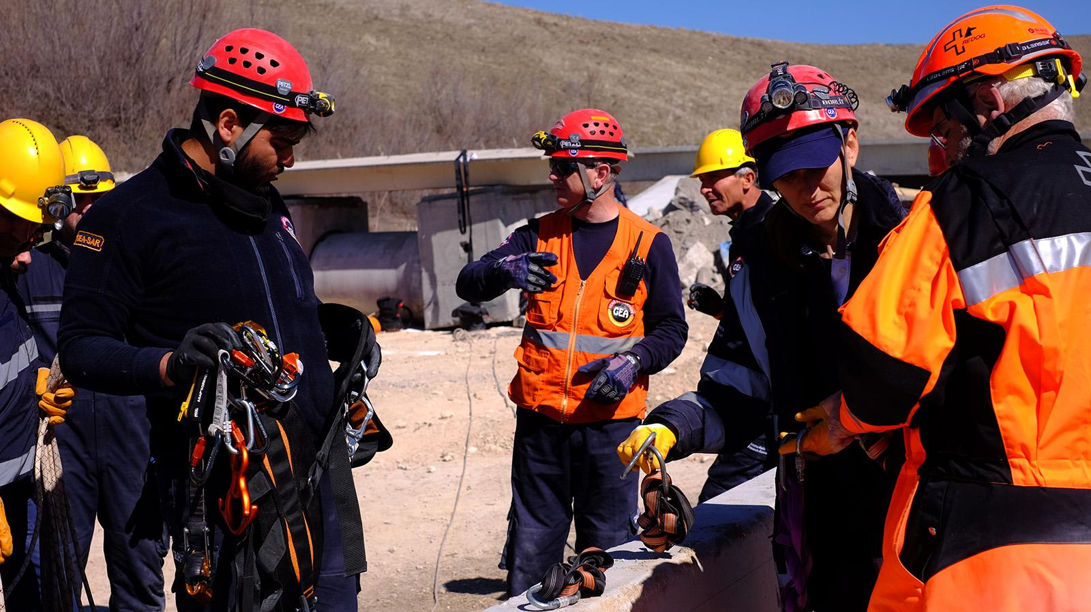
Similar National NGO’s
Disaster and Emergency Management Presidency - AFAD
The Turkish Red Crescent
AKUT- Search and Rescue Association

Slide 21
Some supporting organizations
Abbott İlaç Sanayi
Mc Donald’s
Alman Başkonsolosluğu
Japon Büyükelçiliği
IBM
P&G
Bosch
Oracle
Vodafone
Garanti Bankası
Duracell
Nike
Mercedes Benz Turk
Nestle
Unilever
Zorlu Holding etc.

Slide 22
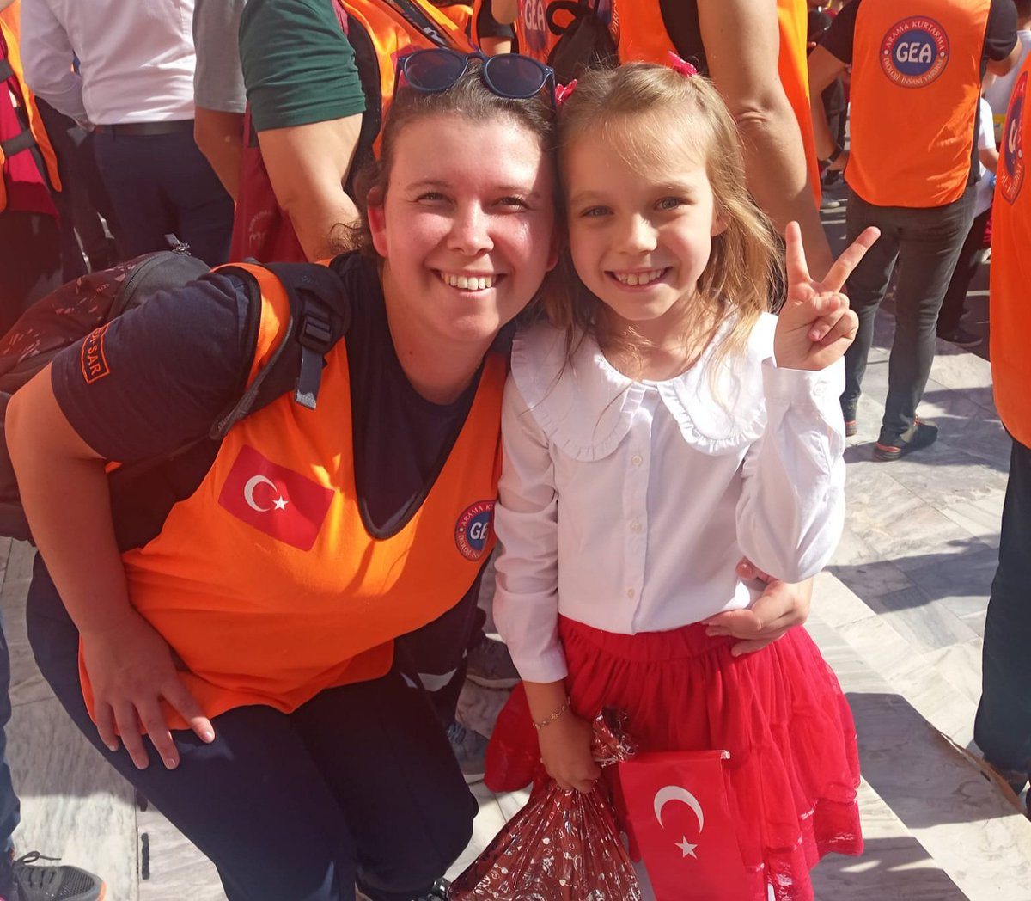
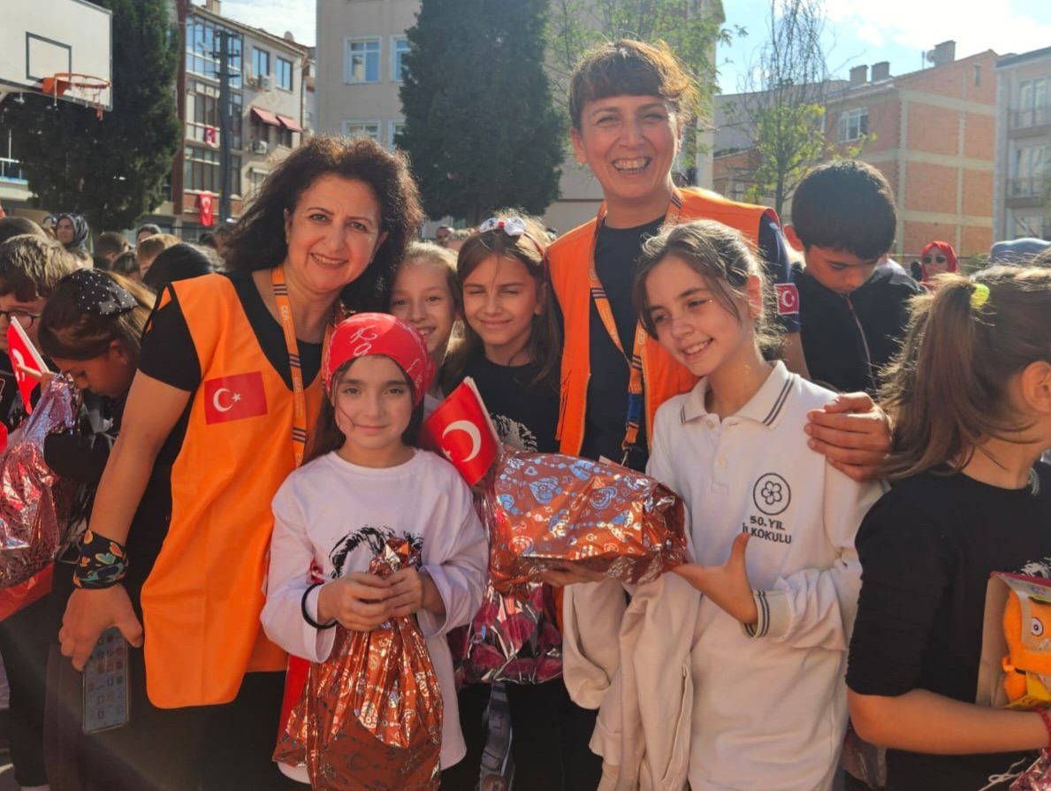
Similar International NGO’s
International Federation of Red Cross and Red Crescent Societies - IFRC
United Nations Office for Disaster Risk Reduction - UNDRR
International Rescue Committee - IRC
Shelter Box

Slide 23
Thanks for Listening
Q&A

Slide 24
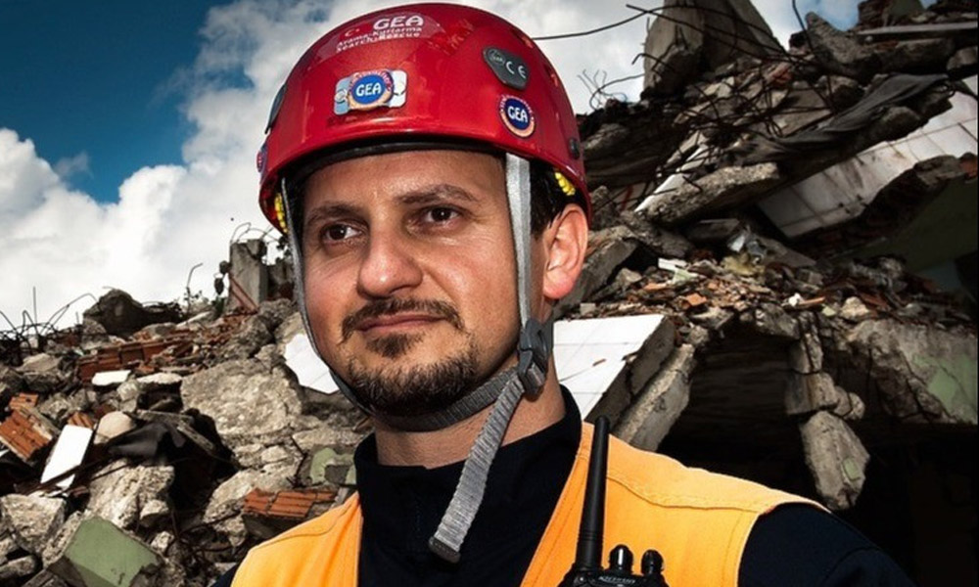
References
https://gea.org.tr/en/about-gea/
https://www.insarag.org/iec/insarag-guidelines-volume-ii-manual-c-iec-r/
https://www.akut.org.tr/en
https://www.aktiffelsefe.org/gea-arama-kurtarma-ekoloji-grubu/
https://www.ifrc.org/
https://www.aa.com.tr/en/turkiye/turkiye-presents-medals-to-rescue-teams-for-efforts-after-feb-6-earthquakes/2881278

