Slide 1
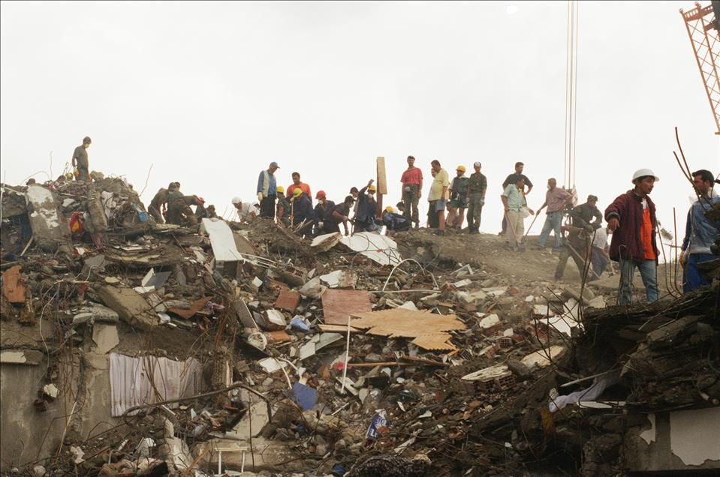
1999 Gölcük Earthquake
Toygar Şentürk
Umut Zümrütdal
Janset Ekin Ak
Bilgehan Öztürk

Slide 2
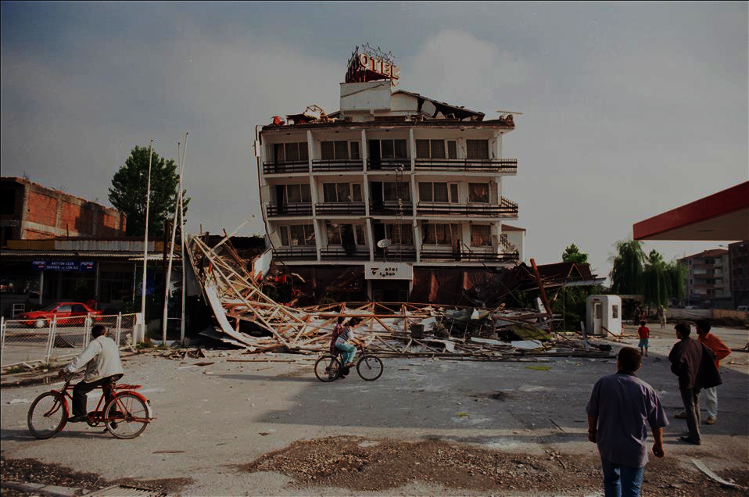
Contents
Overview Of Disaster
Precautions
Disaster Management
What Was Right or Wrong
Lessons Learned
References

Slide 3
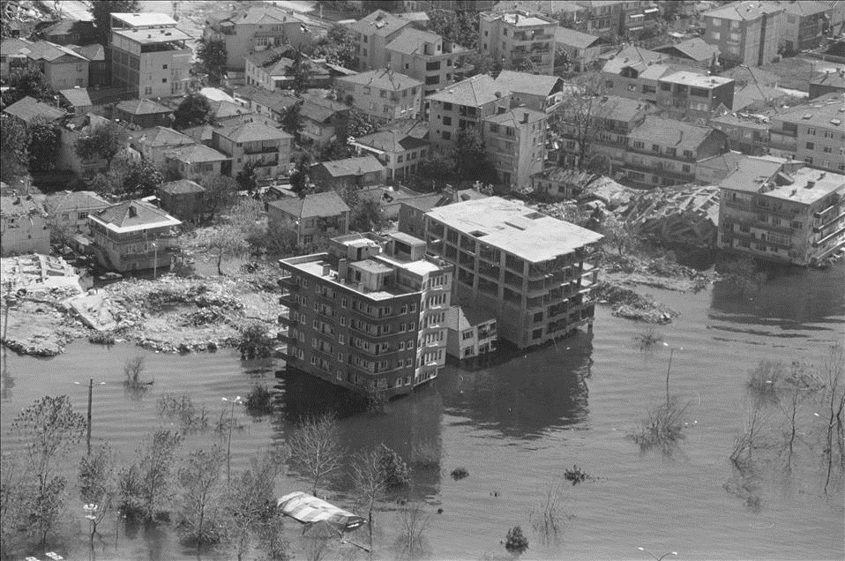
Overview of the Disaster
01
02
03
04
Date and Time
Magnitude and Epicenter
Casualties
Duration
The earthquake struck in the early hours of August 17, 1999, at around 3:02 AM local time.
It had a magnitude of 7.6 and the epicenter was near the town of Gölcük, about 70 miles east of Istanbul.
17,000 people lost their lives and more than 200.000 people were left homeless.
The quake lasted for only 37 seconds but caused widespread destruction.

Slide 4
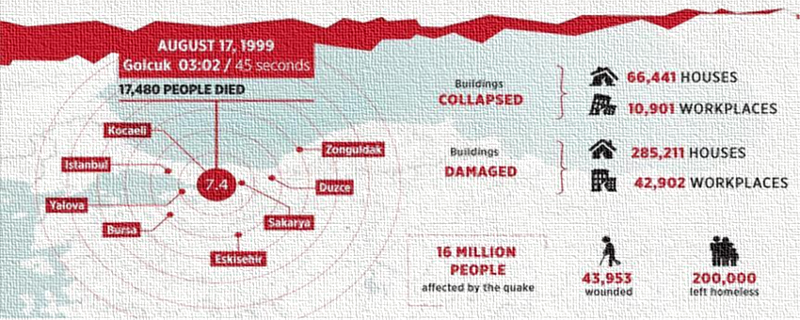
Affected Regions and Critical Datas

Slide 5
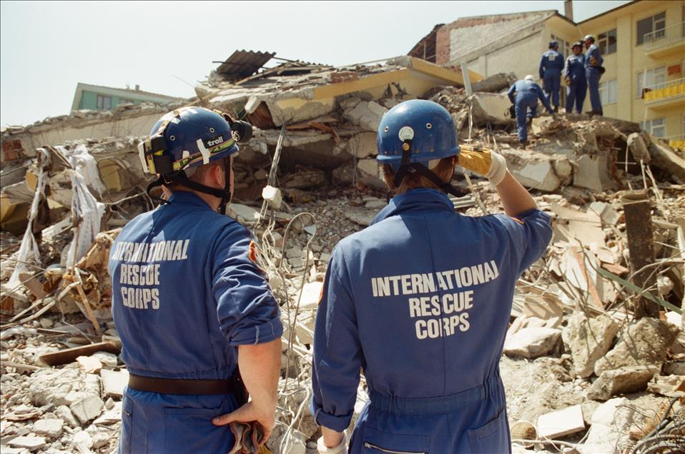
Precautions
The aftermath of the 1999 Gölcük (İzmit) earthquake prompted a comprehensive reevaluation of earthquake preparedness and response strategies in Turkey. Here are five key precautions.

Slide 6
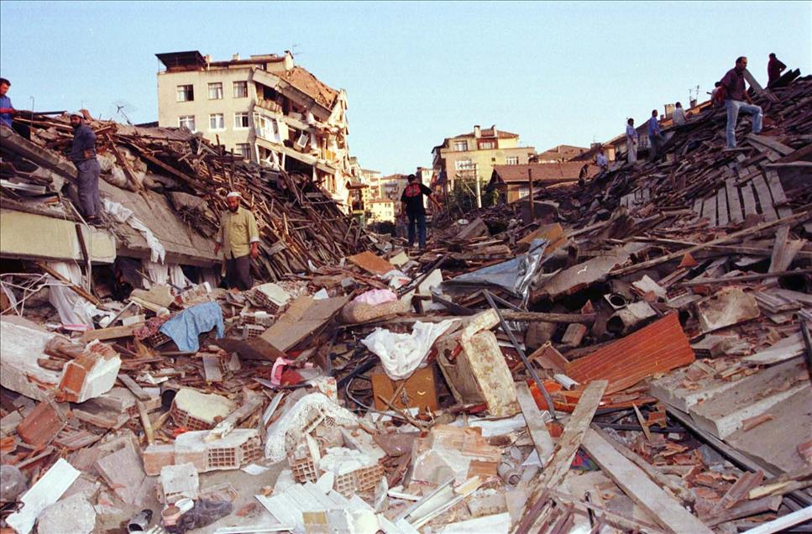
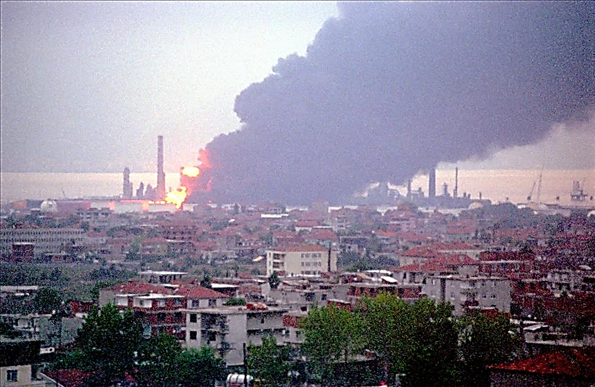
Precautions
01
05
Strengthening and Reinforcing Buildings
Public Awareness and Education
02
04
Implementation of Stricter Building Codes
Emergency Response and Disaster Preparedness Training
03
Development of Early Warning Systems and Seismic Monitoring

Slide 7
Disaster Management
Recovery and Reconstruction
Relocation
Review and Improvement of Disaster Preparedness Plans
Strengthening Legal and Institutional Frameworks
After the disaster
Natural disaster
Immediate Response and Rescue Operations
Medical Assistance
Emergency Shelter and Basic Needs
Assessment of Damage
Communication
During the disaster

Slide 8
What Was Right/Wrong ?
Global Help
Lack of Building Resilliance
Local Community Response
Lack of Public Awareness
Coordination Between International Help and Local Government
No Emergency Plan

Slide 9
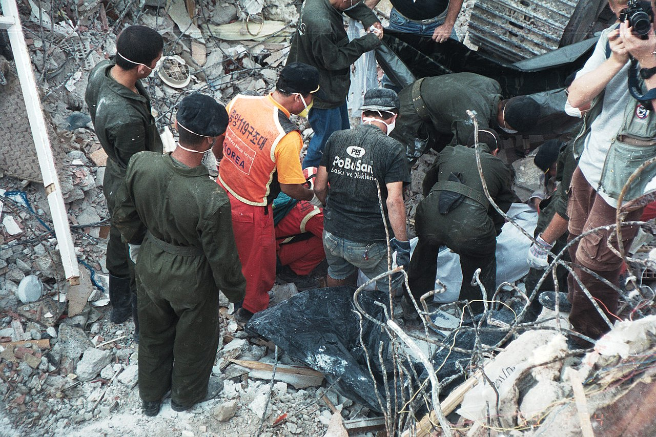
Metin eklemek için tıklayın
Figure: South Korean search and rescue team in Gölcük

Slide 10
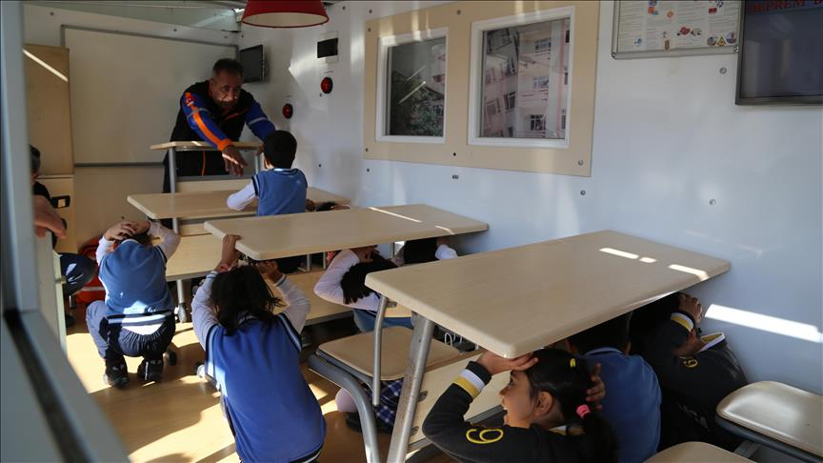
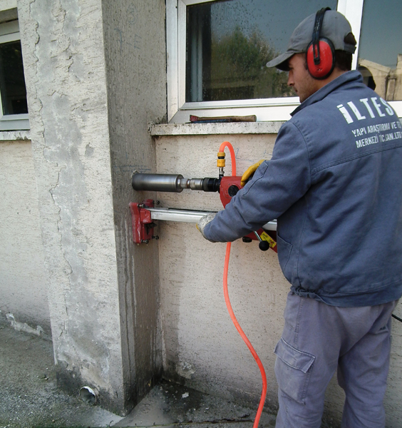
Lessons Learned
1. Enforcing building codes
2. Emergency planning
3. Public education
4. Investing in infrastructure resillience
5. Coordinated response
Figure: Earthquake education given to students
Figure: Core sampling

Slide 11
References https://commons.wikimedia.org/wiki/File:990817중앙119구조본부_터키_이즈미트_지진_출동9.jpg https://www.aa.com.tr/tr/egitim/ogrencilere-simulasyon-tirinda-deprem-egitimi-/1297744 https://www.iltest.com/essential_grid/karot-testi https://www.indyturk.com/node/608066/haber/depremde-430-bin-personele-sahip-tskdan-yeterince-faydalanılmıyor-mu https://www.dailysabah.com/gallery/1999-izmit-earthquake-looking-back-on-the-45-seconds-that-devastated-turkey/images Tang, Alex K., ed. (2000). Izmit (Kocaeli), Turkey, earthquake of August 17, 1999 including Duzce Earthquake of November 12, 1999 Lifeline Performance https://www.britannica.com/event/Izmit-earthquake-of-1999 https://www.aljazeera.com/news/2023/3/6/how-golcuk-town-epicentre-turkey-1999-earthquake-was-rebuilt https://www.researchgate.net/figure/Map-of-the-1999-Golcuk-Earthquake-Zone-Source-Anadolu-Agency-2018-Accessed-from_fig1_352825253/download?_tp=eyJjb250ZXh0Ijp7ImZpcnN0UGFnZSI6Il9kaXJlY3QiLCJwYWdlIjoiX2RpcmVjdCJ9fQ https://www.aa.com.tr/tr/pg/foto-galeri/marmara-depreminin-16-yili https://www.aa.com.tr/tr/asrin-felaketi/golcuk-depreminin-ardindan-kurulan-arama-kurtarma-dernegi-afetzedelerin-yardimina-kostu/2820801

Slide 12
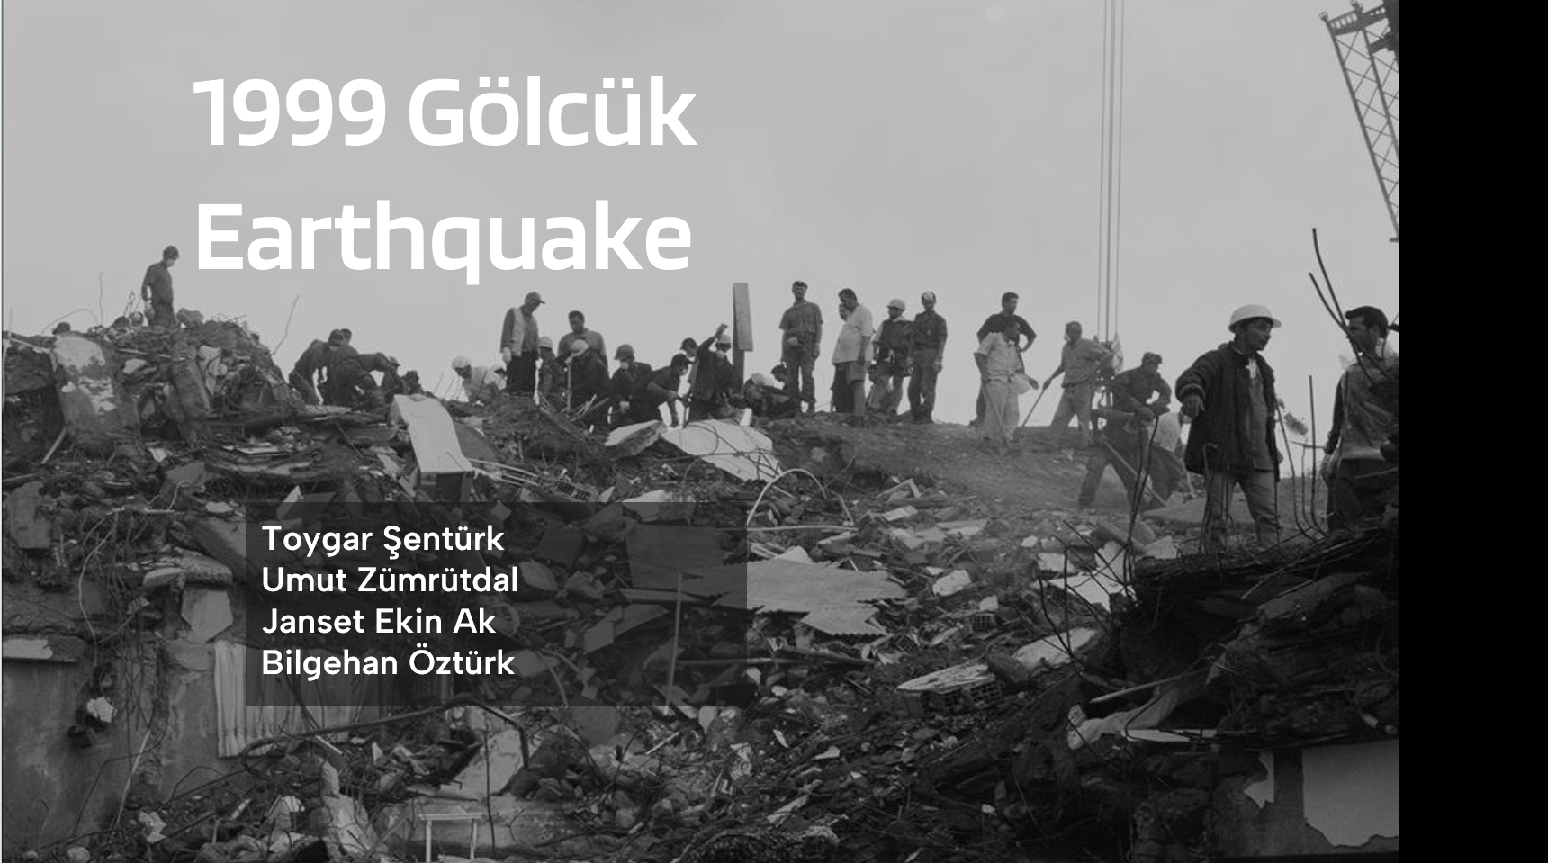
Thanks for Listening!

