Slide 1
Diyar Kağanarslan
Ayşe Selin Türker
Çağdaş Yenilmez

Slide 2
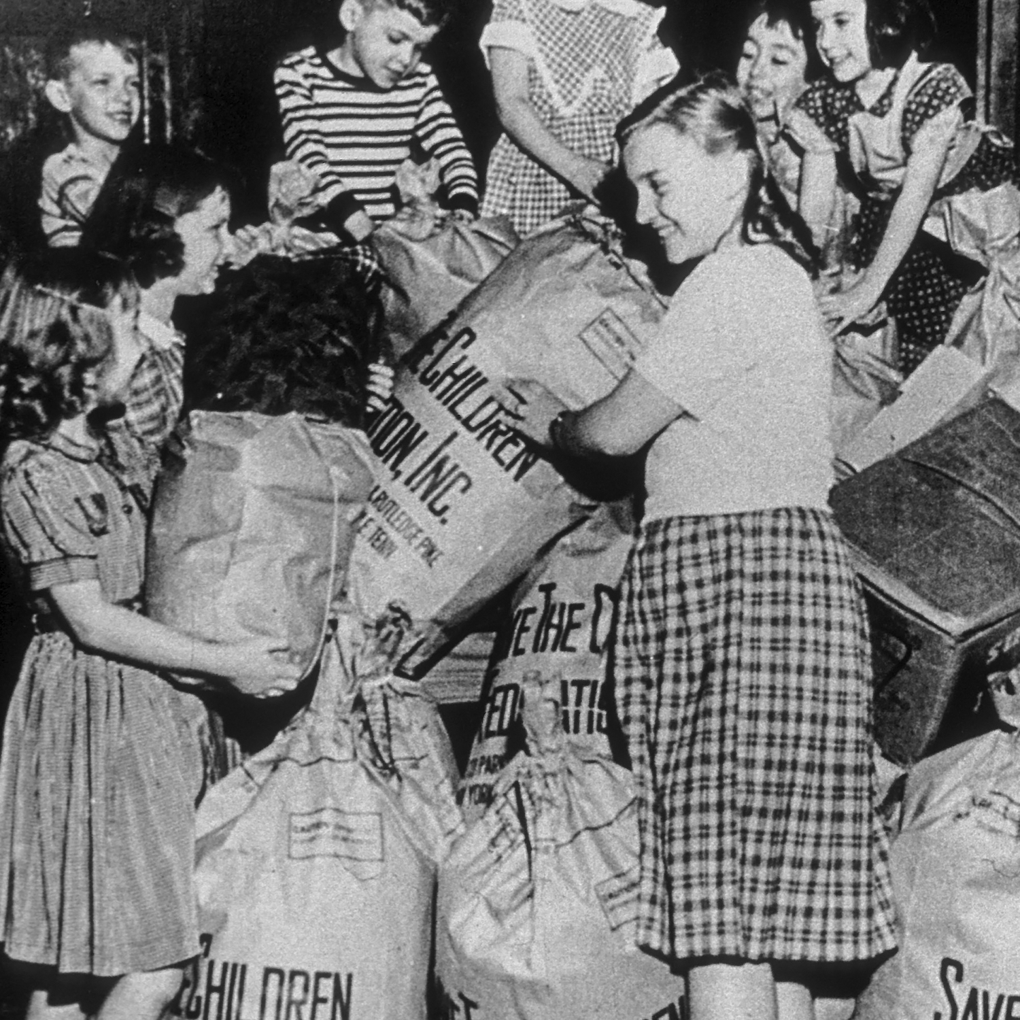
About Save the Children
They formed in 1919 after World War I as Save the Children Fund in London by Eglantyne Jebb and her sister Dorothy Buxton [1].
At first their aim was to fight with the famine after the WWI [1].
After a few years they started to work on education, farming, and scholarship programs all around the world.
Now, they are working in more than 100 countries in the world [2].
[1]

Slide 3
Aim & Values
Their aim is help children to reach their full potential by ensuring they grow up healthy, receive a good education, and stay safe [2].
Their values are:
Accountability
Integrity
Ambition
Collaboration
Creativity [3]

Slide 4
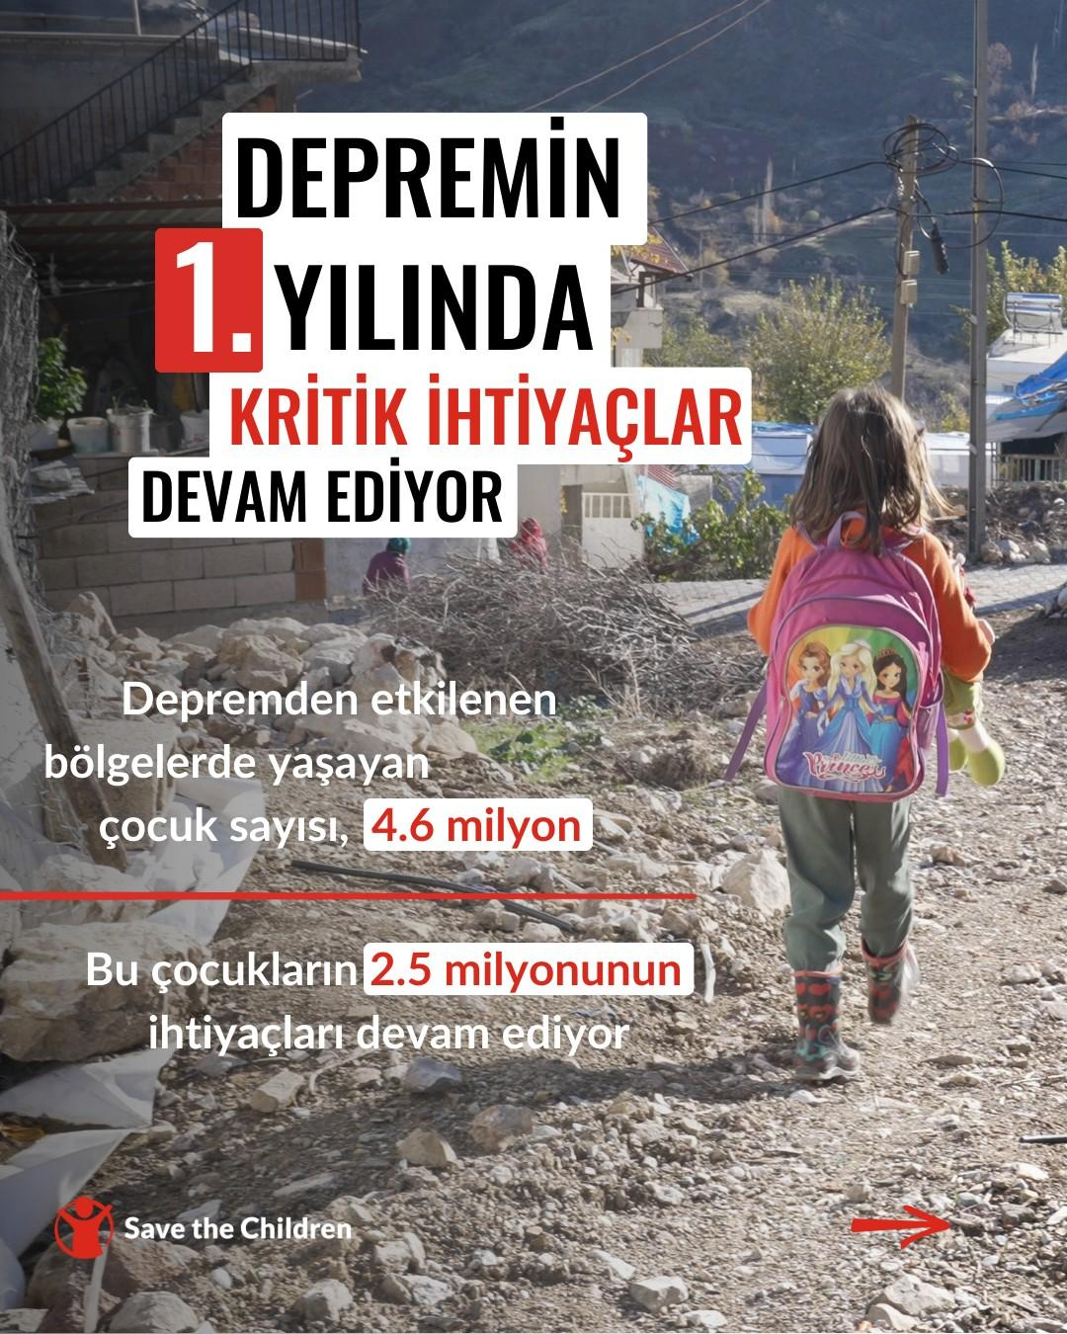
Save the Children - Türkiye
Save the Children have been working in Türkiye, in the cities of Istanbul and Hatay to help children affected by the Syrian civil war since 2013 [4].
Providing child protection
Early childhood education
Livelihood aid
After the earthquakes in 2023, they increased their aid areas [4].

Slide 5
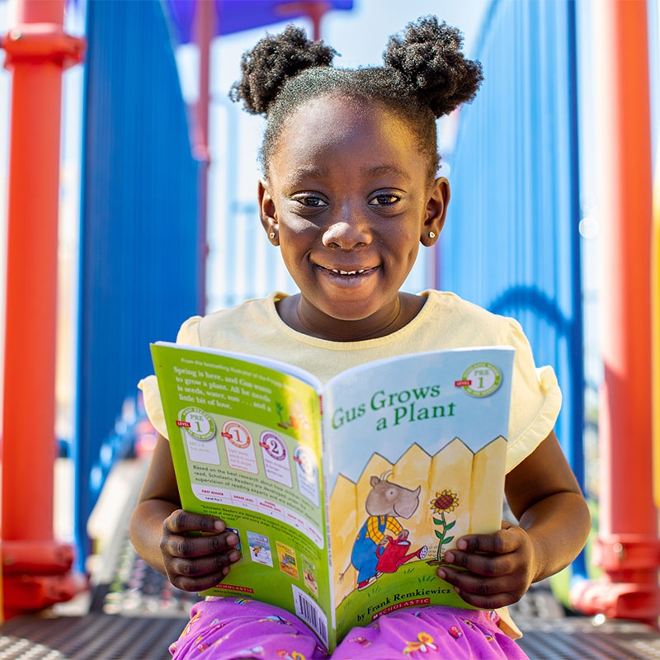
How Does Save the Children Foundation Work ?
Various Programs Every Last Child Newborn and Child Survival
Emergency Response Syria Crisis Response Turkey Earthquake Response
Advocacy and Campaigning Girls’ Education
Partnership and Collaboration Scholastic - Unlocking Books For Rural Families [5]
[5]

Slide 6
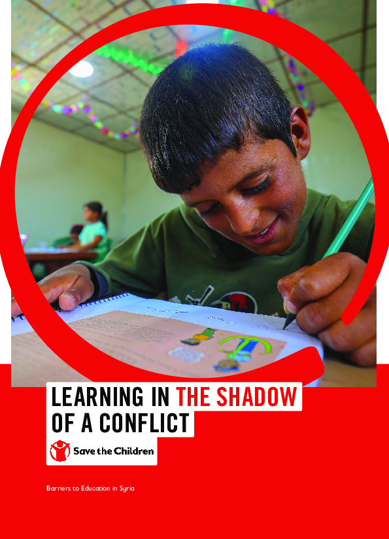
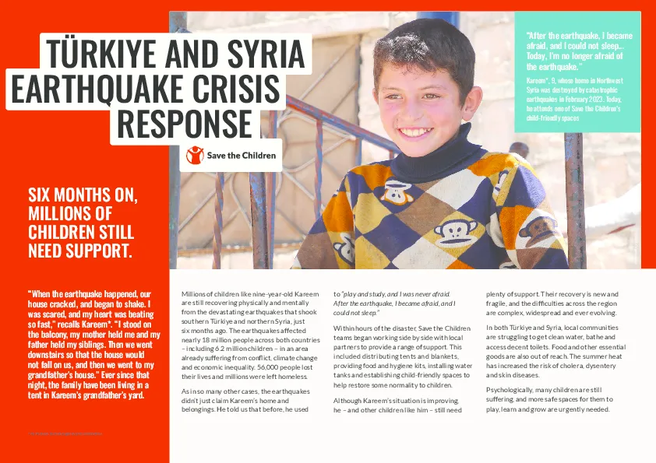
Syria Crisis Response
Turkey/ Syria Earthquake Crisis Response
[5]
[5]

Slide 7
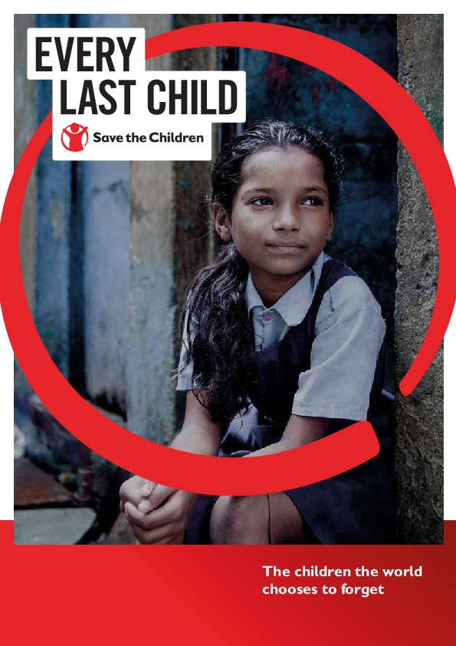
Newborn and Child Survival
[5]
[5]

Slide 8
Projects
Fighting For Breath Childhood Pneumonia Children under 5 800,000 lives every year Health Services Training Health Workers[6]
Save Our Education After Covid-19 1.6 Billion Children Affected Education in Emergencies Increasing the Fund[6]

Slide 9
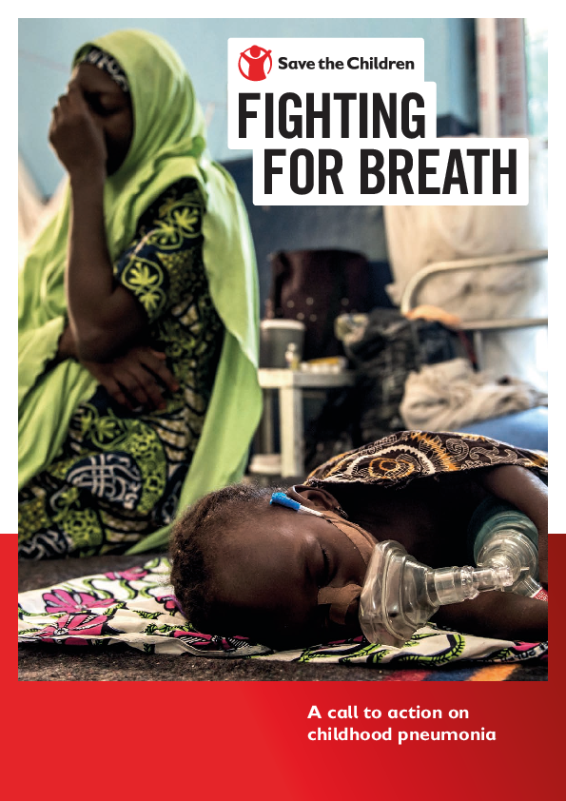
[6]
[6]

Slide 10
Projects
Stop the War on Children Global Campaign Children’s Rights in Armed Conflict Killing of Children Sexual Violence Attacks on School and Hospitals International Humanitarian Laws [5]
Unlocking Books for Rural Families Inceasing Literacy Access to Books 1,000,000 Books 100,000 $ Fund per Year [6]

Slide 11
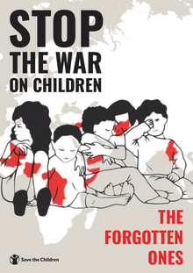
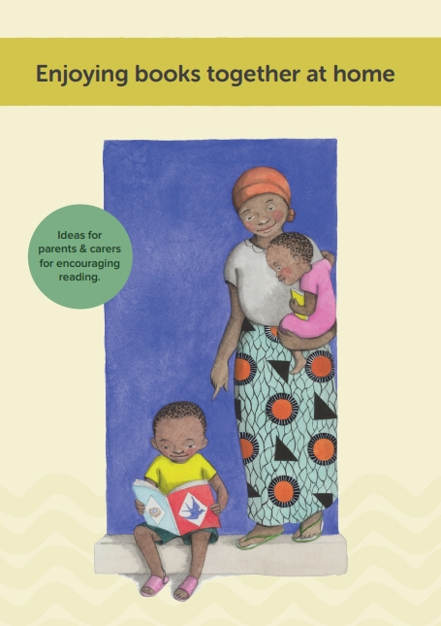
[6]
[6]

Slide 12
Their Impact on Society
33 Policy or Legislation Changes
1989 Declaration of the Rights of the Child
2015 Sustainable Development Goals and Paris Agreement
2016 World Humanitarian Summit [2]

Slide 13
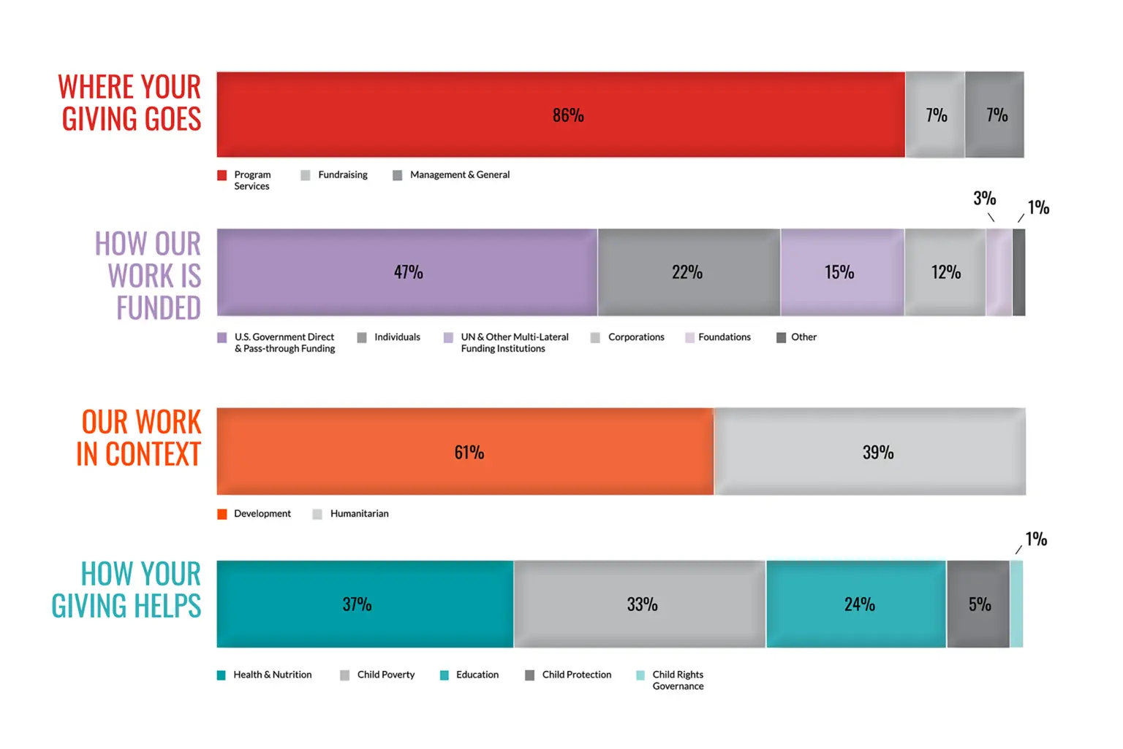
[2]

Slide 14
Successes
5 million Meals to 250,000 Children during Covid-19
Reduce the under 5 year Mortality by 40% in Tanzania since 2000
3.5 million Children get the Aid in Syrian by Syria Crisis Response
118 Countries 116,000,000 Children got help
Influence on Governments - UK 66,000,000 £ for 1,300,000 Children [7]

Slide 15
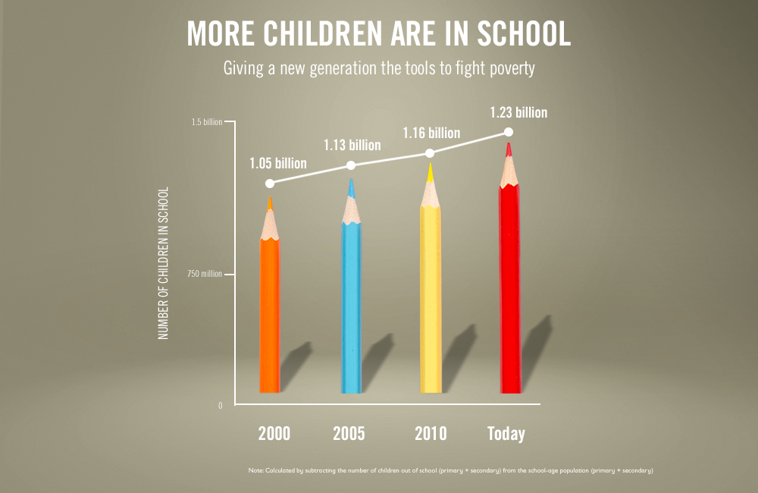
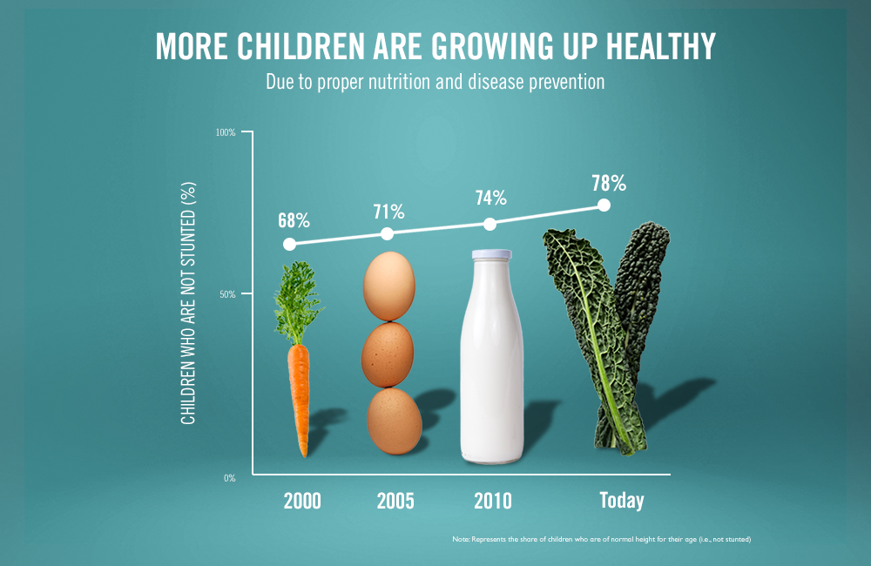
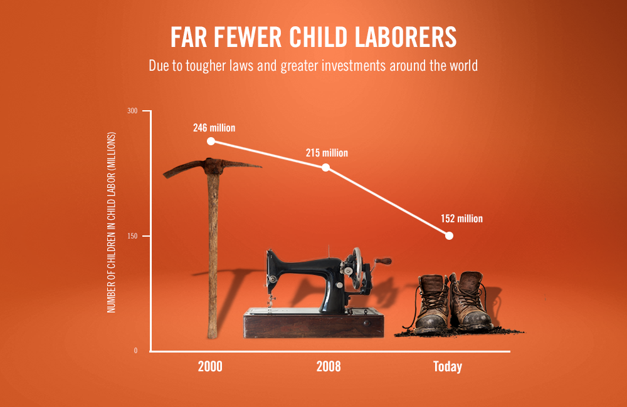
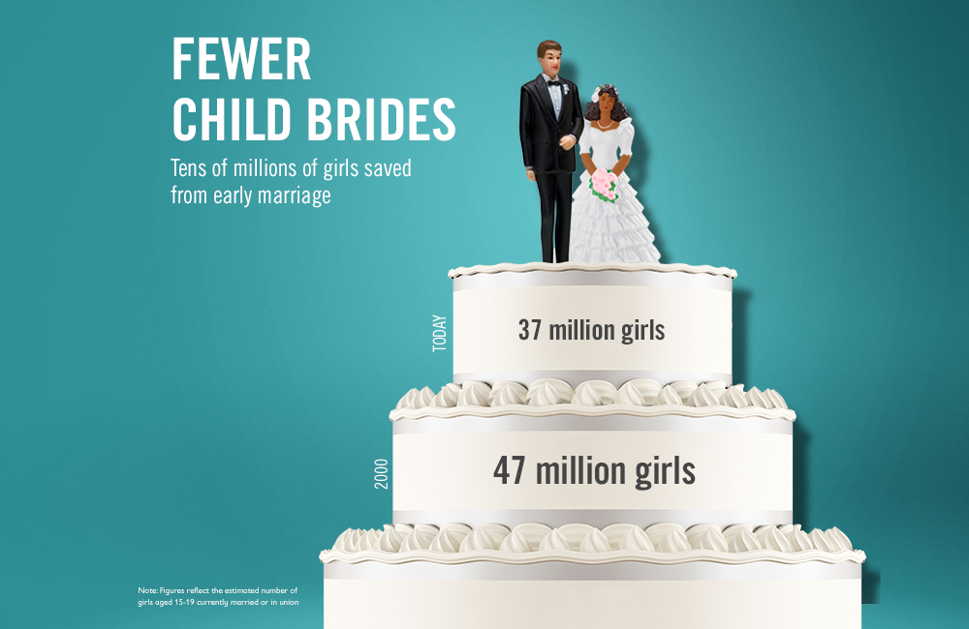
[6]

Slide 16
Failures
Child protection crisis in Spain - Eyes that failed to see [8]
Expulsion from Pakistan [9]
Sexual harassment in work environment by two senior officers in Save the Children UK [10], [11]
Cybersecurity incident [12], [13]

Slide 17
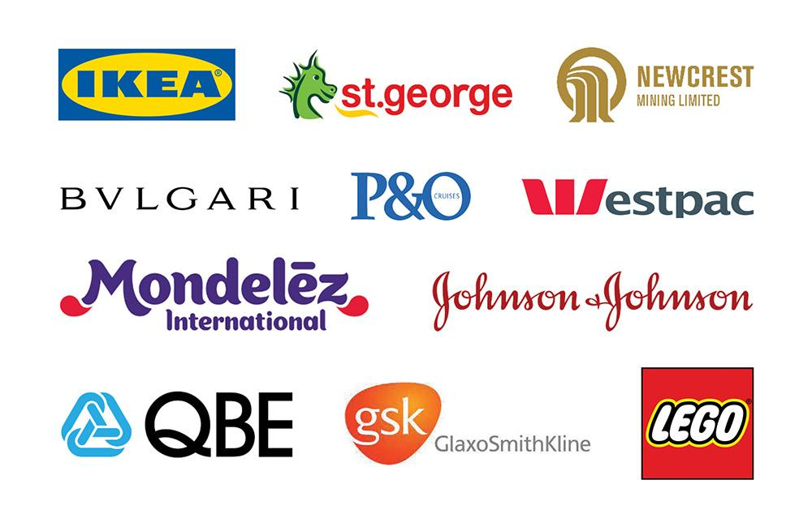
Current Supporters
Major Donors: Big families around the western world. [14]
Corporate Partnerships: Boston Consulting, Ikea, Johnson & Johnson, C&A, Bulgari, WWF, Amazon,
Disney, Google, Meta, Pfizer, P&G, etc. [15]

Slide 18
Similar NGOs
UNICEF(United Nations Children's Fund)
Similarities:
Global child rights advocacy
Emergency response
Diversity of programmes
Differences:
NGO vs UN system
Scale
Operational freedom

Slide 19
Similar NGOs
World Vision
Similarities:
Global presence
Sustainable development goals
Diversity of programmes
Differences:
Scope of influence
Funding sources
Religious aspects

Slide 20
Similar NGOs
Global Fund for Children
Similarities:
Global child rights advocacy
Mission
Child-focused programmes
Differences:
Operational model
Reach
Funding model

Slide 21
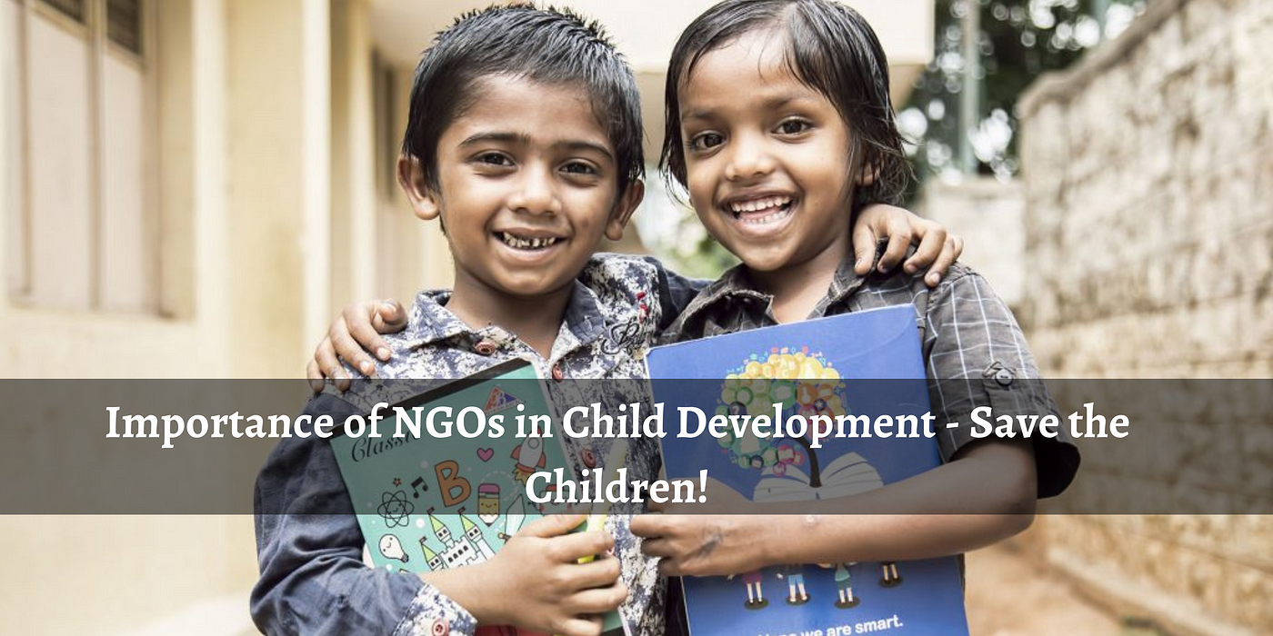
Thank you all for your time!

Slide 22
References
[1] “The History of Save the Children,” Save the Children. https://www.savethechildren.org/us/about-us/why-save
-the-children/history#:~:text=Our%20story%20begins%20in%201919
[2] “What We Stand For | Save the Children UK,” Savethechildren.org.uk, 2019.
https://www.savethechildren.org.uk/about-us/who-we-are/values
[3]“About Us,” Save the Children, 2017. https://www.savethechildren.org/us/about-us
[4]“What we do: Türkiye,” Save the Children | Türkiye, https://turkiye.savethechildren.net/what-we-do
[5] Save the Children, “What We Do,” Save the Children, 2023. https://www.savethechildren.org.uk/what-we-do
[6]“Global Programs,” Save the Children, 2023. https://www.savethechildren.org/us/what-we-do/global-programs
[7] “Measuring Our Impact,” Save the Children, 2023.
https://www.savethechildren.net/what-we-do/campaigns/measuring-our-impact

Slide 23
References
[8] "The Eyes That Do Not See: Sexual Abuse of Children in Spain and the Failures of the System," Save the Children.https://resourcecentre.savethechildren.net/document/eyes-fail-see-sexual-abuse-children-spain-and-failures-system/.
[9] "Pakistan expels aid agency Save the Children," The Washington Post, June 11, 2015. https://www.washingtonpost.com/world/asia_pacific/pakistan-expels-aid-agency-save-the-children/2015/06/11/5ff94be0-1079-11e5-a0dc-2b6f404ff5cf_story.html
[10] M. Townsend, "Save the Children bosses quit over claims of harassment and racism," The Independent, Feb. 23, 2020. https://www.independent.co.uk/news/uk/home-news/save-the-children-sex-sexual-harassment-justin-forsyth-brendan-cox-a9376336.html.
[11] "Save the Children response to Charity Commission report," Save the Children UK, June 5, 2019. https://www.savethechildren.org.uk/news/media-centre/press-releases/save-the-children-response-to-charity-commission-report.

Slide 24
References
[12] "Save the Children Statement on Blackbaud Security Breach," Save the Children, Aug. 20, 2020. https://www.savethechildren.org/us/about-us/media-and-news/2020-press-releases/save-the-children-statement-on-blackbaud-security-breach.
[13] N. McCarthy, "BianLian: The New Ransomware Group That's Targeting Save the Children," Tech Monitor, Dec. 1, 2021. https://techmonitor.ai/technology/cybersecurity/bianlian-save-the-children.
[14] "Meet Our Donors," Save the Children. https://www.savethechildren.org/us/ways-to-help/plan-your-legacy/meet-our-donors.
[15] "Corporations and Organizations," Save the Children. https://www.savethechildren.org/us/about-us/become-a-partner/corporations.

