Slide 1
NGO: AHBAP
Orhan Can Ardıç
Ege Hamdi Özcan
Ödül Velioğlu

Slide 2
Outline
Where and Whom?
When was AHBAP Founded?
What is AHBAP?
Why?
Main Projects and Achievements
Success Stories
Failure Stories
Current Situation
Similar NGOs Worldwide

Slide 3
About: AHBAP

Slide 4
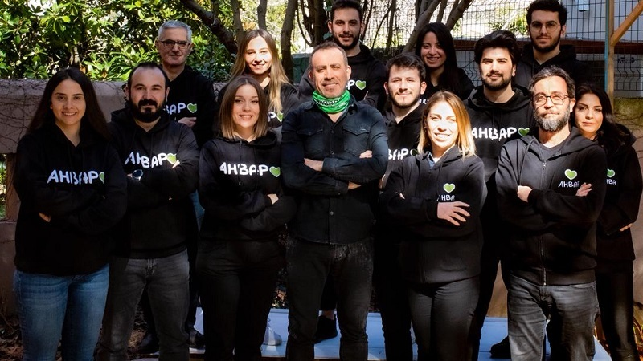
Where and Whom?
Haluk Levent's recognition, with the increasing the number of followers of his social media account, emerged as a result of the efforts he initiated with the intention of using it to bring together people and organizations that can help people in need in Turkey.

Slide 5
When was AHBAP Formed?
As a result of these studies, a mutual aid platform called "AHBAP Platform" was formed; "AHBAP Association" was established on July 31, 2017 to coordinate the work on the AHBAP Platform. The headquarters of the association is Istanbul.

Slide 6
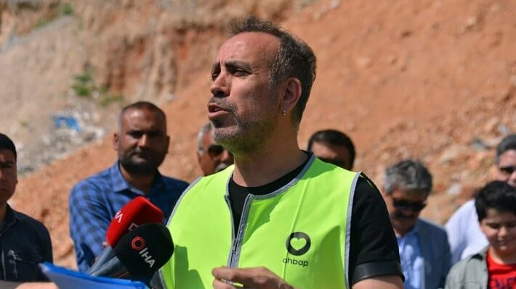
What is AHBAP?
AHBAP; It is a non-governmental organization based on solidarity and cooperation. As of 2023, there is a volunteer network in 68 cities of Turkey. It organizes activities in the fields of sustainable solidarity, cooperation, non-violent communication, scholarship, medical aid, humanitarian aid, special events, campaigns, education, art, science and technology.

Slide 7
Why?
Ahbap Association was founded to provide various forms of aid, including material and financial assistance, to promote cooperation, build a better society, and create sustainable networks. Our mission encompasses supporting those in need, preserving local culture, and embracing technological advancements, all with the goal of advancing opportunities and shaping a brighter future.

Slide 8
Content: AHBAP

Slide 10
Main Projects and Achievements
•Earthquake Housing Project
•Earthquake Solidarity Project
•Fire and Flood Support Project
•Education Support Project
•My Sister Project
•HPV vaccine project

Slide 11
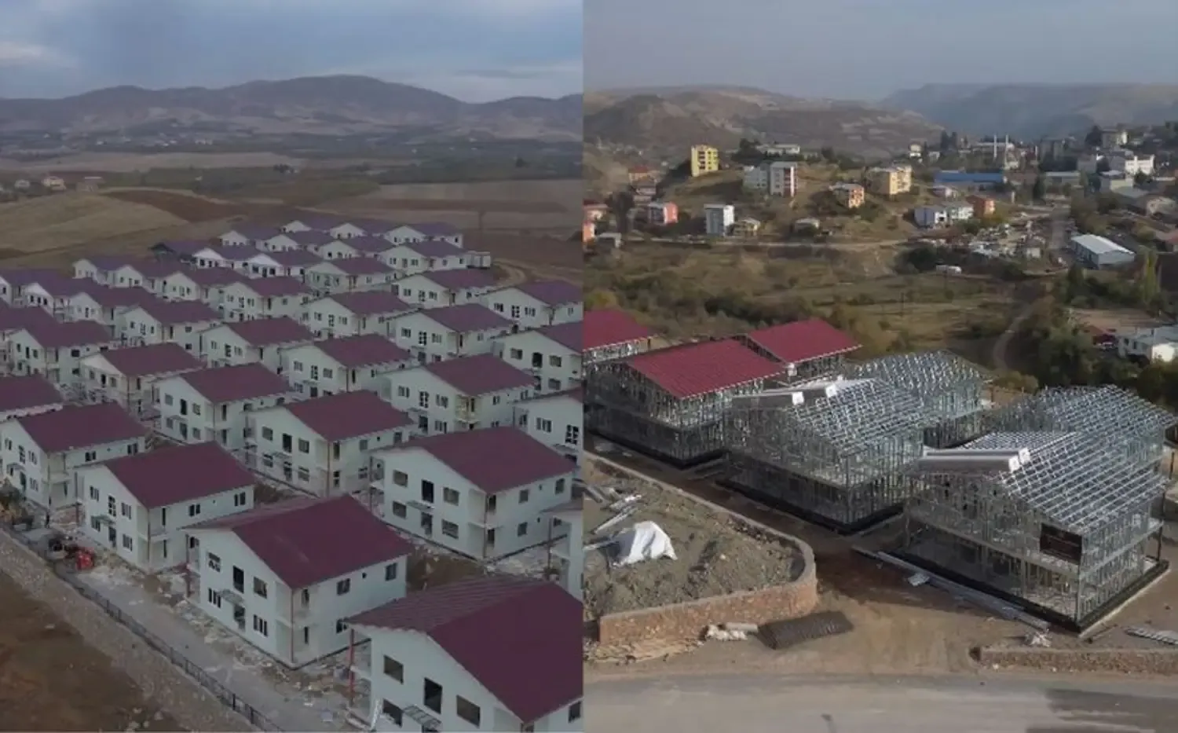
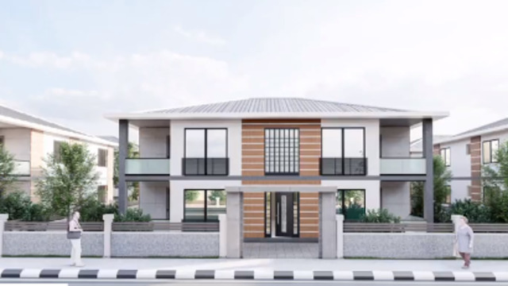
Earthquake Housing Project
•4 April 2023
•1150 steel construction house for Adıyaman,Hatay,K.Maraş,Malatya ve G.Antep
•448 Finished House (196 nurdağı and 252 malatya)

Slide 12
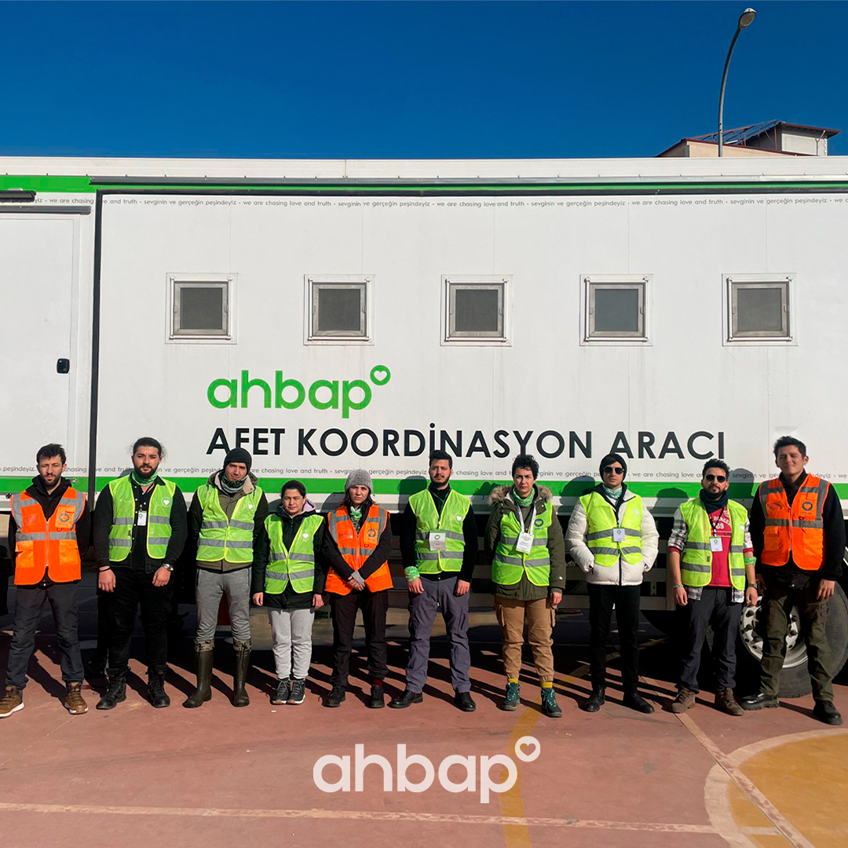
Earthquake Solidarity Project
•5000 life containers
•15,653 living tents
•15 prefabricated schools
•25,503 Hygiene parcels
•16,000 Stationery kits
•1144 tons of sheep and cattle feed
•1,550,080 boxes of drinking water
•692,030 food parcels (1,292,800 portions of food)
•Safe map in the ahbap application for those who had housing problems during the February 6 earthquake

Slide 13
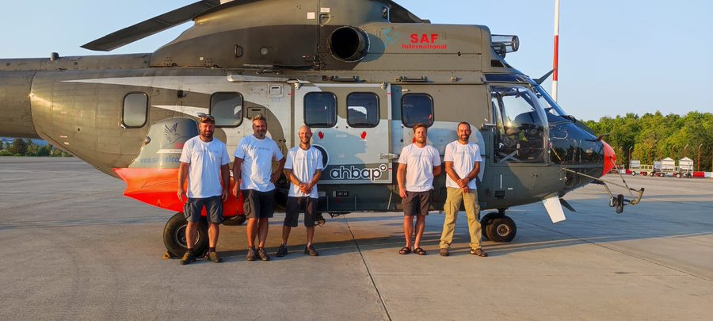
Fire and Flood Support Project
•7.5 million TL budget support for those damaged by fire and floods
•1 fire fighting helicopter was rented
•Fire safe accommodation map 28 July 2021

Slide 14
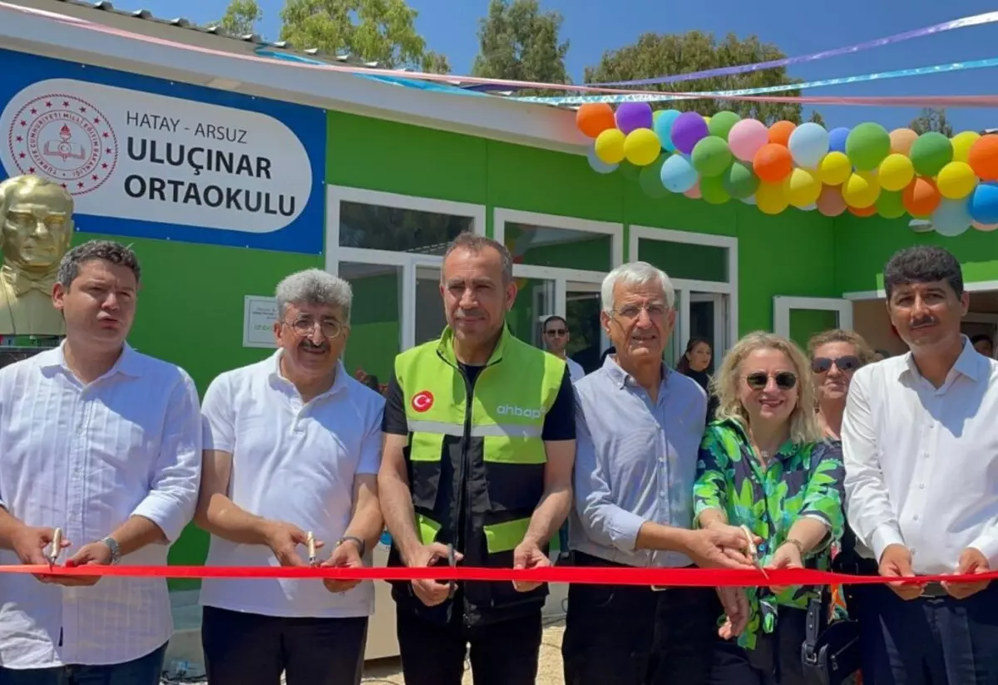
Education Support Project
•5000 TL university scholarship application for university students in earthquake zones
•6000 TL scholarship application for 500 university students

Slide 15
HPV vaccine project
•200 people, girls and boys over the age of 11, adolescents over the age of 15, men and women, will be able to benefit from the application.
•2 doses with an interval of 6 months for children,
•3 doses for adults, 2 months after the first dose and 4 months after the 2nd dose.

Slide 16
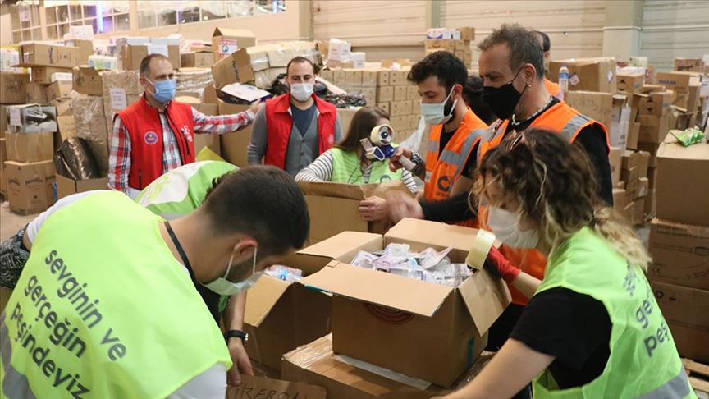
Success Stories
•It has nearly 300 thousand volunteer members, 24 thousand 530 of whom are in the field.
•1,550,080 boxes of drinking water
•692,030 food parcels (1,292,800 portions of food)
•25,503 Hygiene parcels
•16,000 Stationery kits
•1144 tons of sheep and cattle feed
•15 Prefabricated schools
•448 Steel construction house

Slide 17
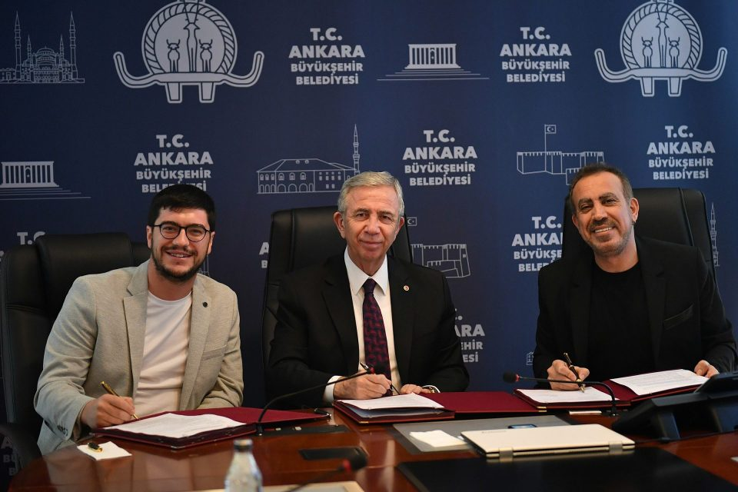
Failure Stories
Ahbap Science and Art Campus
•The project is targeted for April 23, 2023 with the support of Ankara metropolitan municipality, scientists and artists.
•Due to February 6 Earthquake, Ahbap Science and Art Campus Project was postponed

Slide 18
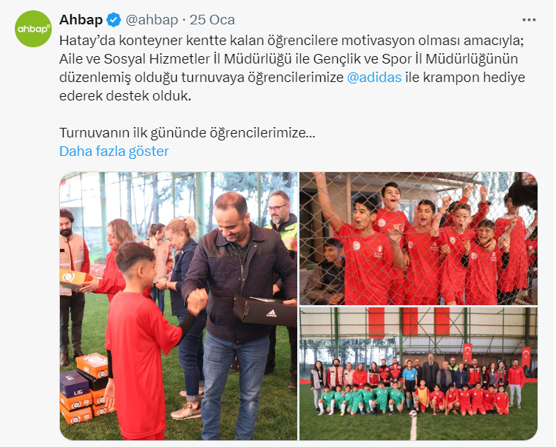
Current Situation
Has around 13000 volunteers that are helping people in need
Has a big following in social media
Working with Adidas to provide crampon shoes to motivate kids in Hatay

Slide 19
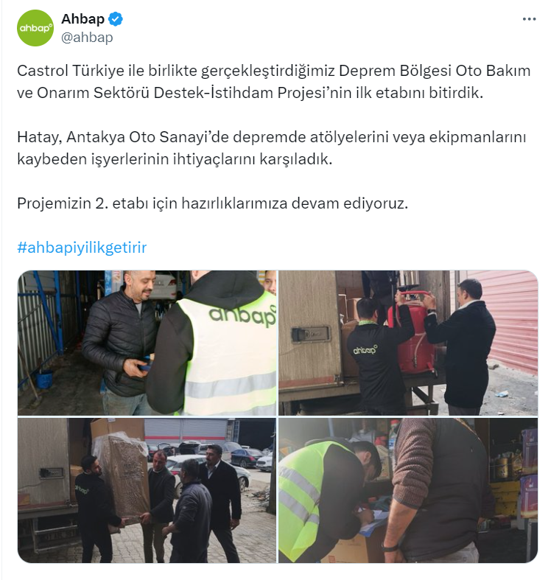
Current Situation
Working with Castrol to help workers who have lost their workshops and equipments in Antakya in automotive sector
Working with Coca-Cola and ÖSGD to provide in-kind and financial support to young women who are actively involved in art, sports and social welfare(Total Budget: 2 Million TL)

Slide 20
Similar NGOs Worldwide
World Food Programme(WFP)
Medecins Sans Frontieres(Doctors Without Borders)(MSF)

Slide 21
World Food Programme(WFP)
Provides food assistance to people who are recovering from conflict, disasters and impacts of climate change
Unlike AHBAP, WFP collaborates with governments
WFP was founded in 1961

Slide 22
Medecins Sans Frontieres(Doctors Without Borders)(MSF)
Cares for people affected by conflict, disease outbreaks, natural and human-made disasters, and exclusion from health care in more than 70 countries.
Focus of MSF is more limited, they operate only in healthcare and medical humanitarian sector
MSF was founded in 1971

Slide 23
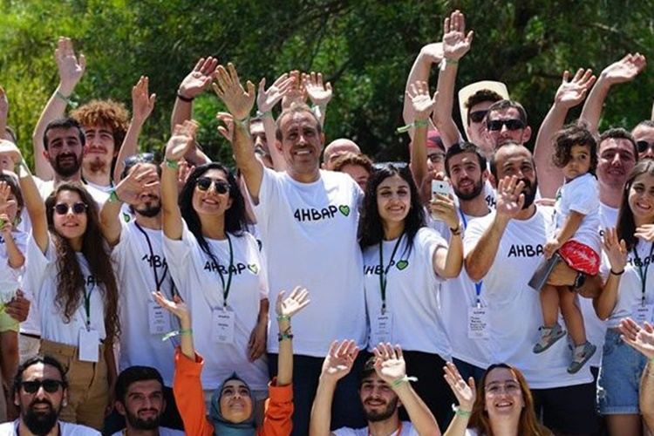

Slide 24
References
Derneğin Amacı . Ahbap.(n.d.). https://ahbap.org/dernegin-amaci .
500 Öğrenciye 6000 TL Konaklama Desteği Başvuruları Sonuçlandı!. Ahbap. (2021, September 28). https://ahbap.org/haber/500-ogrenciye-6000-tl-konaklama-destegi-basvurulari-sonuclandi
AHBAP Derneği’Nin Bağışlarla Kiraladığı fransız Helikopteri Türkiye’ye Geliyor. Sözcü. (2021, August 6). https://www.sozcu.com.tr/ahbap-derneginin-bagislarla-kiraladigi-fransiz-helikopteri-turkiyeye-geliyor-wp6579278
Bilim ve Sanat akademisi. Ankarakuzeyyildizi. (n.d.). https://www.ahbapbilimvesanatkampusu.com/
Deprem Bölgesi Burs Başvurusu Başladı. Ahbap. (2023, May 31). https://ahbap.org/haber/deprem-bolgesi-burs-basvurusu-basladi
Haluk Levent Açıkladı: AHBAP’Tan Yangın ve Sellerden Zarar Görenlere 7.5 milyon TL DESTEK. T24. (2022, July 14). https://t24.com.tr/haber/haluk-levent-acikladi-ahbap-tan-yangin-ve-sellerden-zarar-gorenlere-7-5-milyon-tl-destek,1046387
Haluk Levent, AHBAP Derneği’Nin Deprem Konutları Projesini Açıkladı. Gazete Duvar. (2023, April 5). https://www.gazeteduvar.com.tr/haluk-levent-ahbap-derneginin-deprem-konutu-projesini-acikladi-haber-1611786

Slide 25
References
.HPV Aşılarının Ilk Dozu Uygulandı!. Ahbap. (2022, April 27). https://ahbap.org/haber/hpv-asilarinin-ilk-dozu-uygulandi
AHBAP platformu Resmi Sitesi. (n.d.). Haberler. https://ahbap.org/haberler
AHBAP. (2023, March 2). [Twitter post]. Twitter. https://twitter.com/ahbap/status/1755635126854181039
AHBAP. (2023, February 20). [Twitter post]. Twitter. https://twitter.com/ahbap/status/1750505265575649435
World Food Programme. (n.d.). Support Us - Stories - Donate. https://www.wfp.org/support-us/stories/donate?utm_source=google&utm_medium=cpc&utm_campaign=16867703674&utm_content=138048455160&gad_source=1&gclid=CjwKCAiA_tuuBhAUEiwAvxkgTiapvBey9_WkQT8nx87RPus7Qocae7k4A2mZCWYAiUhbErdW9tvSYRoCGMwQAvD_BwE&gclsrc=aw.ds
Médecins Sans Frontières (MSF). (n.d.). Who We Are. https://www.msf.org/who-we-are?gad_source=1&gclid=CjwKCAiA_tuuBhAUEiwAvxkgTnS2v70cqnfv1MQRFSRv-xFgM3G7IwF8q9TLibnbvo1zc8AnaqyxHxoCriIQAvD_BwE

Slide 26
"We are in pursuit of love and truth."
- AHBAP

Slide 27
Thank You

