Slide 1
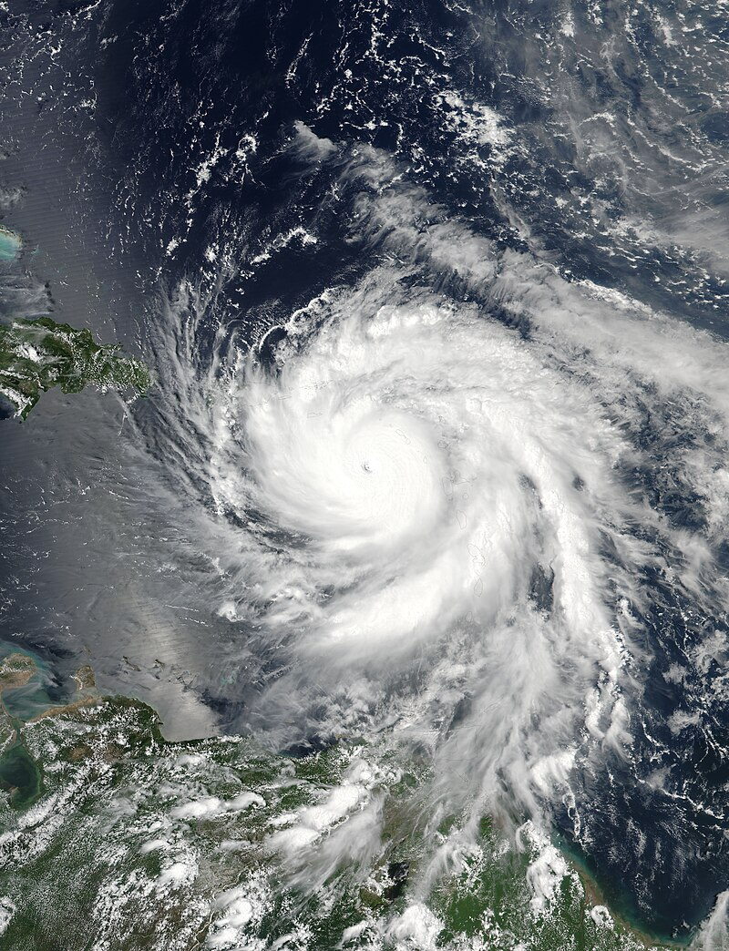
Hurricane Maria
IE482 Humanitarian Logistics
Disaster Presentation
Ece Battaloğlu
Deniz Ceylan
Derin Gözüyaşlı
Selin Palamut

Slide 2
AGENDA
01
02
03
04
05
06
Precautions
Overview of The Disaster
Disaster Management
Lessons Learned
Q&A
What Was Right/Wrong?

Slide 3
01
OVERVIEW OF THE DISASTER

Slide 4
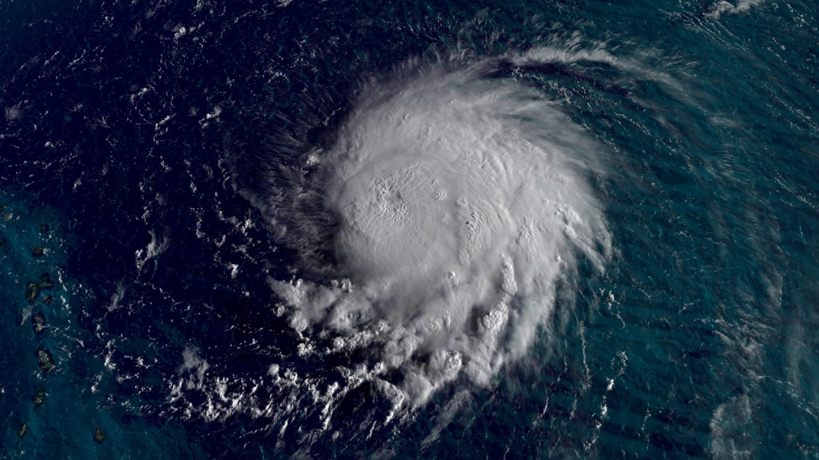
What is Hurricane?
Powerful, rotating storms
Low pressure and organized thunderstorms
Form over warm ocean waters
Saffir-Simpson Scale:
Hurricanes are categorized from 1 to 5 based on wind speed
The higher the category, the greater the potential for damage
Notes:
A tropical cyclone is a rotating low-pressure weather system that has organized thunderstorms but no fronts (a boundary separating two air masses of different densities). Tropical cyclones with maximum sustained surface winds of less than 39 miles per hour (mph) are called tropical depressions. Those with maximum sustained winds of 39 mph or higher are called tropical storms.
When a storm's maximum sustained winds reach 74 mph, it is called a hurricane. The Saffir-Simpson Hurricane Wind Scale is a 1 to 5 rating, or category, based on a hurricane's maximum sustained winds. The higher the category, the greater the hurricane's potential for property damage.
Hurricanes originate in the Atlantic basin, which includes the Atlantic Ocean, Caribbean Sea, and Gulf of Mexico, the eastern North Pacific Ocean, and, less frequently, the central North Pacific Ocean. A six-year rotating list of names, updated and maintained by the World Meteorological Organization, is used to identify these storms.
"Hurricane Season" begins on June 1 and ends on November 30, although hurricanes can, and have, occurred outside of this time frame. NOAA's National Hurricane Center predicts and tracks these massive storm systems, which occur, on average, 12 times a year in the Atlantic basin.
As a world leader in hurricane research, NOAA strives to understand the mechanics of these complex storms in order to protect people, property, commerce, and natural resources.
https://oceanservice.noaa.gov/facts/hurricane.html

Slide 5
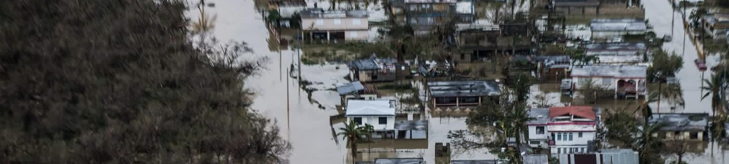
What happened?
Puerto Rico was still recovering from Hurricane Irma, which struck the island with high winds just two weeks prior to Hurricane Maria.
Made landfall on Dominica as a Category 5 storm on September 18, 2017, with winds exceeding 160 mph.
Devastated Puerto Rico, making it the first Category 5 hurricane to directly impact the island in 85 years.
Led to the departure of around 130,000 Puerto Ricans.
Wiped out about 80 percent of the island’s crop value, resulting in a $780 million loss in agricultural yields.
Three years after the storm, Puerto Ricans still required significant support with essentials and long-term recovery efforts.
Notes:
- **Hurricane Maria**:
- Made landfall on Dominica as a Category 5 storm on September 18, 2017, with winds exceeding 160 mph.
- It later devastated Puerto Rico, making it the first Category 4 hurricane to directly impact the island in 85 years.
- The storm left nearly the entire population of Puerto Rico, over 3 million American citizens, without electricity after landfall on September 20.
- Officials estimate it could take four to six months to restore power fully.
- **Context**:
- Puerto Rico was still recovering from Hurricane Irma, which struck the island with high winds just two weeks prior to Hurricane Maria.
These points highlight the severity and impact of Hurricane Maria on both Dominica and Puerto Rico, as well as the challenges faced by Puerto Rico due to its back-to-back hurricanes.
Certainly, here are the key points summarized for your disaster presentation:
- **Impact of Hurricane Maria**:
- Struck Puerto Rico as the worst storm in over 80 years.
- Caused approximately $94.4 billion in damages.
- Wiped out about 80 percent of the island’s crop value, resulting in a $780 million loss in agricultural yields.
- Led to the departure of around 130,000 Puerto Ricans, who are U.S. citizens, between July 2017 and July 2018.
- Many Puerto Ricans remain committed to staying and recovering, despite the challenges.
- **Current Status**:
- Three years after the storm, Puerto Ricans still require significant support with essentials and long-term recovery efforts.
These points underscore the extensive damage and ongoing challenges faced by Puerto Rico in the aftermath of Hurricane Maria.
https://edition.cnn.com/specials/weather/hurricane-maria#:~:text=Hurricane%20Maria%20made%20its%20first,U.S.%20territory%20of%20Puerto%20Rico.
https://www.mercycorps.org/blog/facts-hurricane-maria-puerto-rico

Slide 6
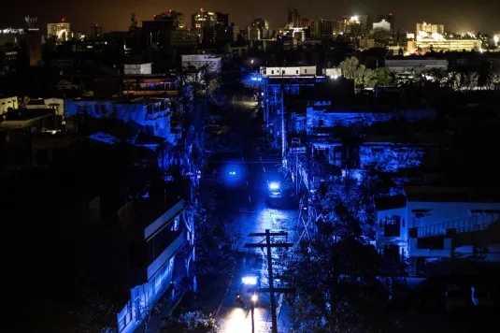
“Maria Strikes, and Puerto Rico Goes Dark” (New York Times)

Slide 7
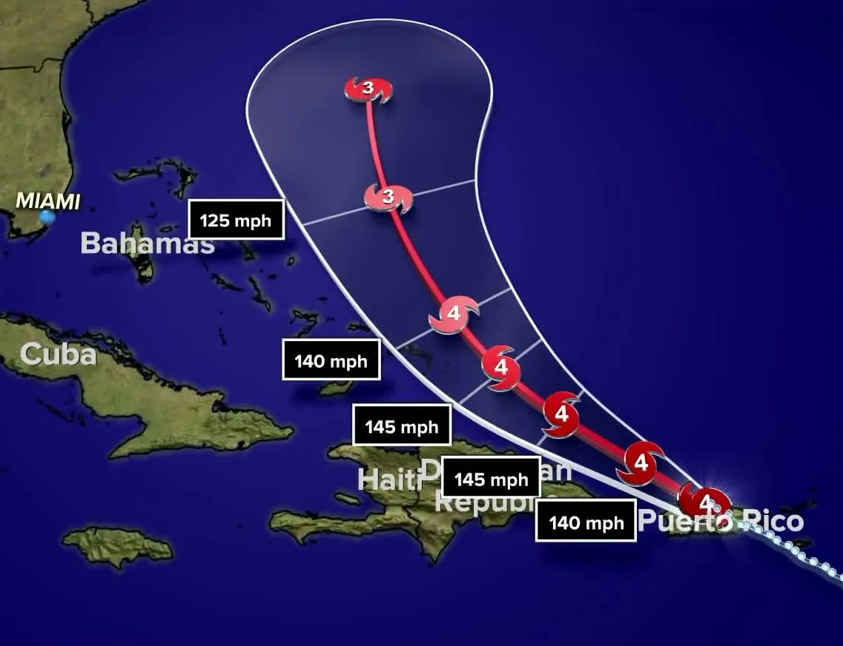
What Happened?
Dominica: At least $1.31 billion.
Guadeloupe: $120 million.
Puerto Rico: $90 billion (90% confidence interval of $65-$115 billion). Costliest hurricane in modern Puerto Rican history.
Notes:
https://www.nhc.noaa.gov/data/tcr/AL152017_Maria.pdf

Slide 8
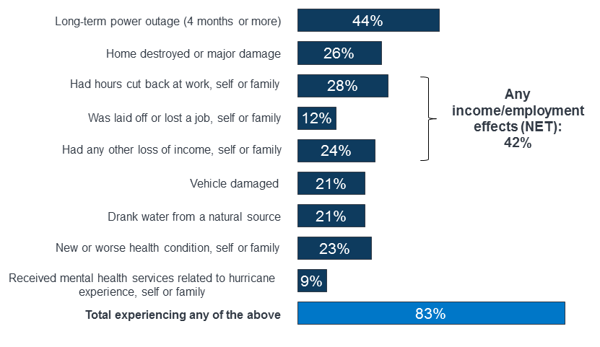
What Happened?
Views and Experiences of Puerto Ricans after Hurricane Maria

Slide 9
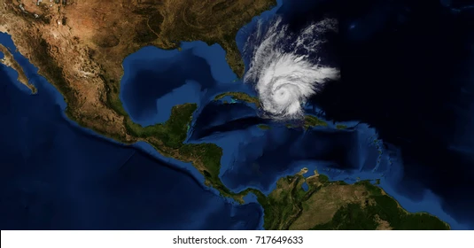
02
PRECAUTIONS

Slide 10
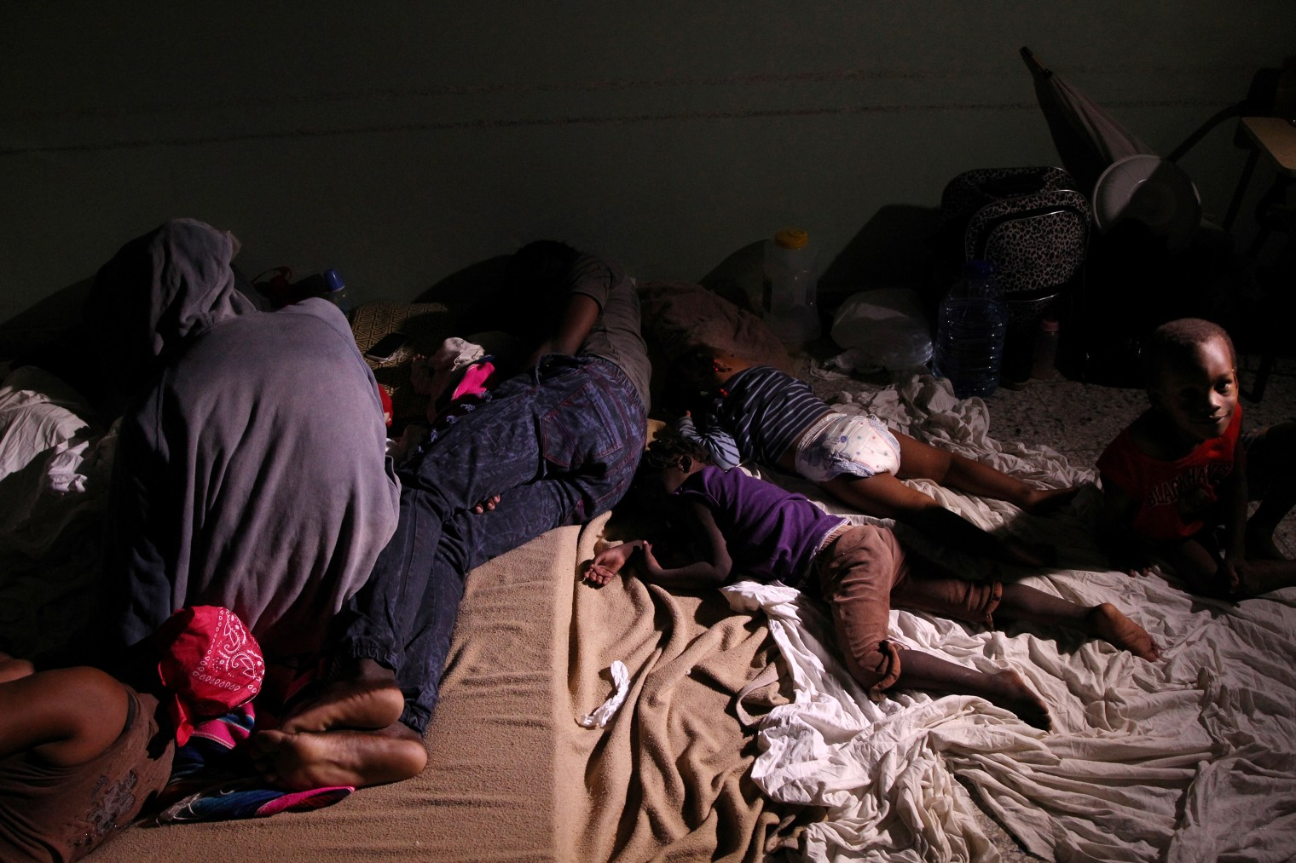
Precautions
On September 6th, Hurricane Irma
The island's infrastructure was already fragile which limited its ability to withstand a powerful storm.
Puerto Rico government underestimated the severity of the hurricane.
People in the Puerto Rico could not imagine that a hurricane like Maria could cause the amount of damage it did.
Locals rest inside a shelter before the arrival of the Hurricane Maria in Punta Cana, Dominican Republic.

Slide 11
03
DISASTER MANAGEMENT

Slide 12
Disaster Management
Residents focused on providing critical care, with surgery limited to emergencies.
Hospitals relied on satellite telephones for communication and implemented curfews to ensure safety.
Arrangements were made with gas stations to prioritize physicians and health care personnel.

Slide 13
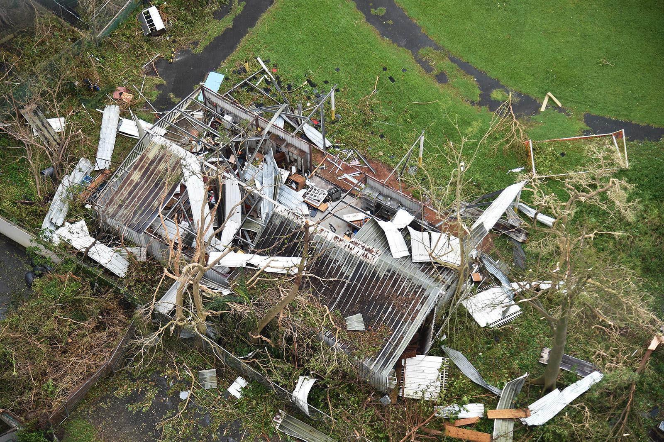
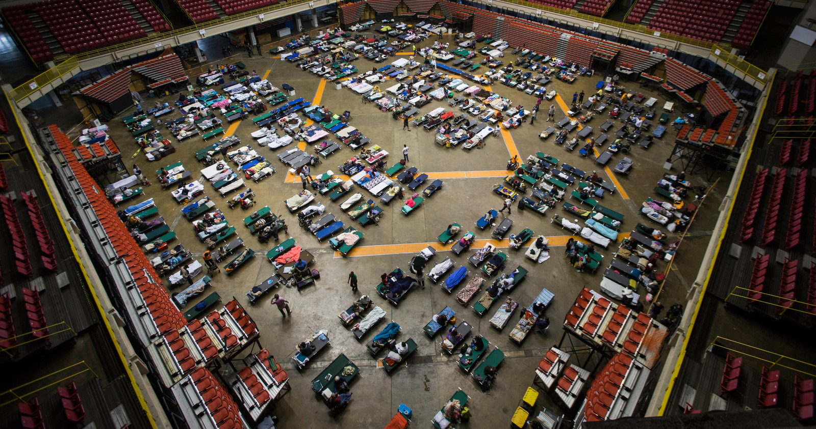
Disaster Management
Many NGOs organized to bring food, water, medications, and other supplies and offered health care to people in shelters, remote areas, and damaged homes.
Existing low food security got worse, even with consistent supply of food from government and organizations.

Slide 14
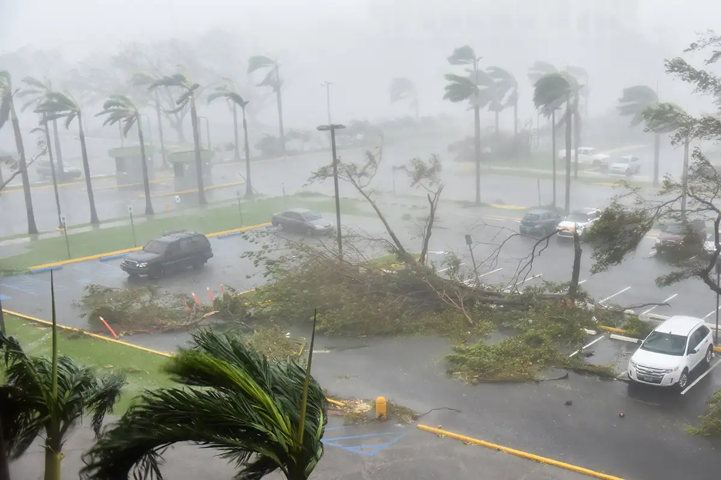
04
WHAT WAS
RIGHT/ WRONG?

Slide 15
WHAT COULD HAVE BEEN DONE BETTER?
#3 Lack of Capacity of FEMA
#2 Lack of Communication
#1 Postponing the Action
Preference for reacting after a disaster happens, rather than remedying vulnerabilities before the disaster.
Communication infrastructure has collapsed and it could not be repaired for long time.
The Federal Emergency Management Agency (FEMA) could not handle four catastrophic disasters simultaneously.

Slide 16
WHAT WAS WELL DONE?
#2 Humanitarian Assistance
#3 Restoration Support
#1 International Assistance and Solidarity
Vaccines were flown with support from the
WHO in response to
an urgent request made by Dominica and
the British Virgin Islands.
Dutch engineers coordinated with PAHO to repair the water plant at Dominica’s hospital.
International Medical Corps (IMC), Direct Relief, the Dutch Navy, and other partners provided medical supplies, equipment, and insecticides.

Slide 17
05
LESSONS LEARNED

Slide 18
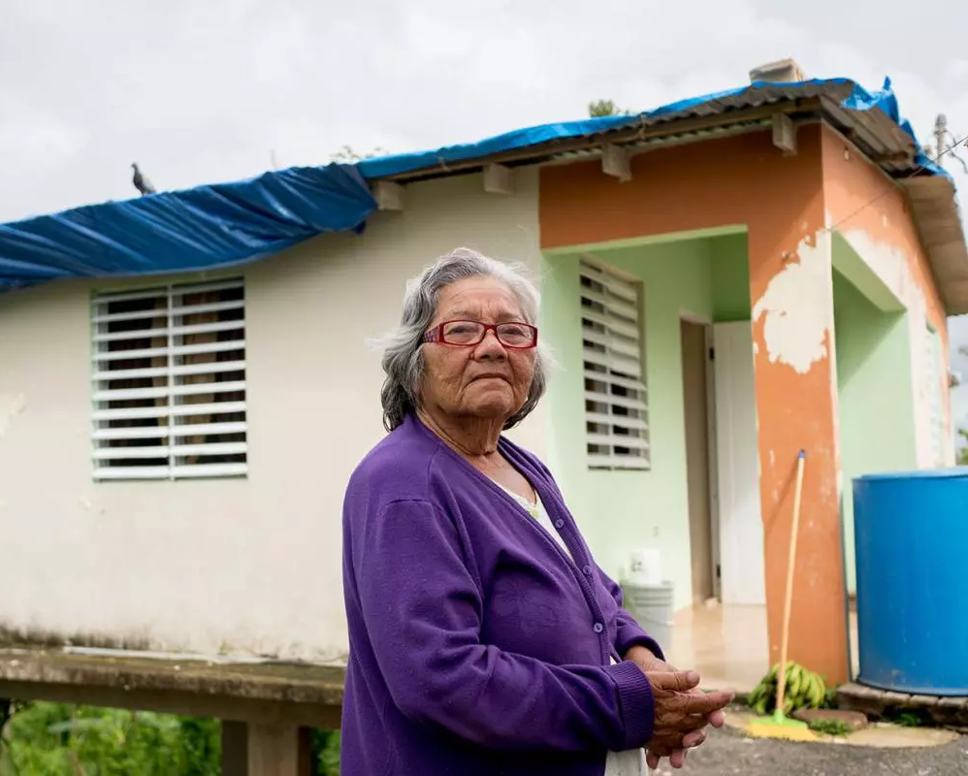
Lessons Learned
1. Communication infrastructure repairs should be made before the disaster occurs and planning should be made for the post disaster period.
2. Power lines and plumbing should have been strengthened before the disaster.
3. The capacity of organizations such as FEMA should be increased enough to respond to several disasters at the same time.
4. The local population should be warned of the upcoming disaster and directed to the shelters being built.

Slide 19
06
QUESTION &
ANSWERS

Slide 20
REFERENCES
[1] NOAA, “What is a hurricane?,” Noaa.gov, Jun. 14, 2021. https://oceanservice.noaa.gov/facts/hurricane.html
[2] “Hurricane Maria,” CNN. https://edition.cnn.com/specials/weather/hurricane-maria#:~:text=Hurricane%20Maria%20made%20its%20first
[3] Mercy Corps, “The facts: Hurricane Maria’s effect on Puerto Rico,” Mercy Corps, Jan. 19, 2018. https://www.mercycorps.org/blog/facts-hurricane-maria-puerto-rico
[4] R. Pasch, A. Penny, and R. Berg, “HURRICANE MARIA,” Jan. 2023. Available: https://www.nhc.noaa.gov/data/tcr/AL152017_Maria.pdf
[5] K. J.Martínez-Lozano, Joshipura, M.Ríos-Jim ́enez, and P. I.et al., “Preparedness, hurricanes irma and Maria, and impact on health in Puerto Rico,” PreventionWeb, https://www.preventionweb.net/publication/preparedness-hurricanes-irma-and-maria-and-impact-health-puerto-rico (accessed Feb. 20, 2024).
[6] “Hurricane Maria Preparedness and response,” PHMSA, https://www.phmsa.dot.gov/news/hurricane-maria-preparedness-and-response (accessed Feb. 20, 2024).

Slide 21
REFERENCES
[7] Fink, S., & Robles, F. (2017, September 20). Puerto Rico’s Power Outage Could Be America’s Longest. The New York Times. https://www.nytimes.com/2017/09/20/us/hurricane-maria-puerto-rico-power.html
[8] Pan American Health Organization. (2017). Emergency Report: Hurricane Maria. Washington, D.C.: PAHO. Retrieved from https://iris.paho.org/bitstream/handle/10665.2/49738/Newsletter-125-Eng.pdf?sequence=1&isAllowed=y
[9] Rob Moore, "Maria Exposed Problems in U.S. Disaster Policy," NRDC (Natural Resources Defense Council), . Available: https://www.nrdc.org/bio/rob-moore/maria-exposed-problems-us-disaster-policy

Slide 22
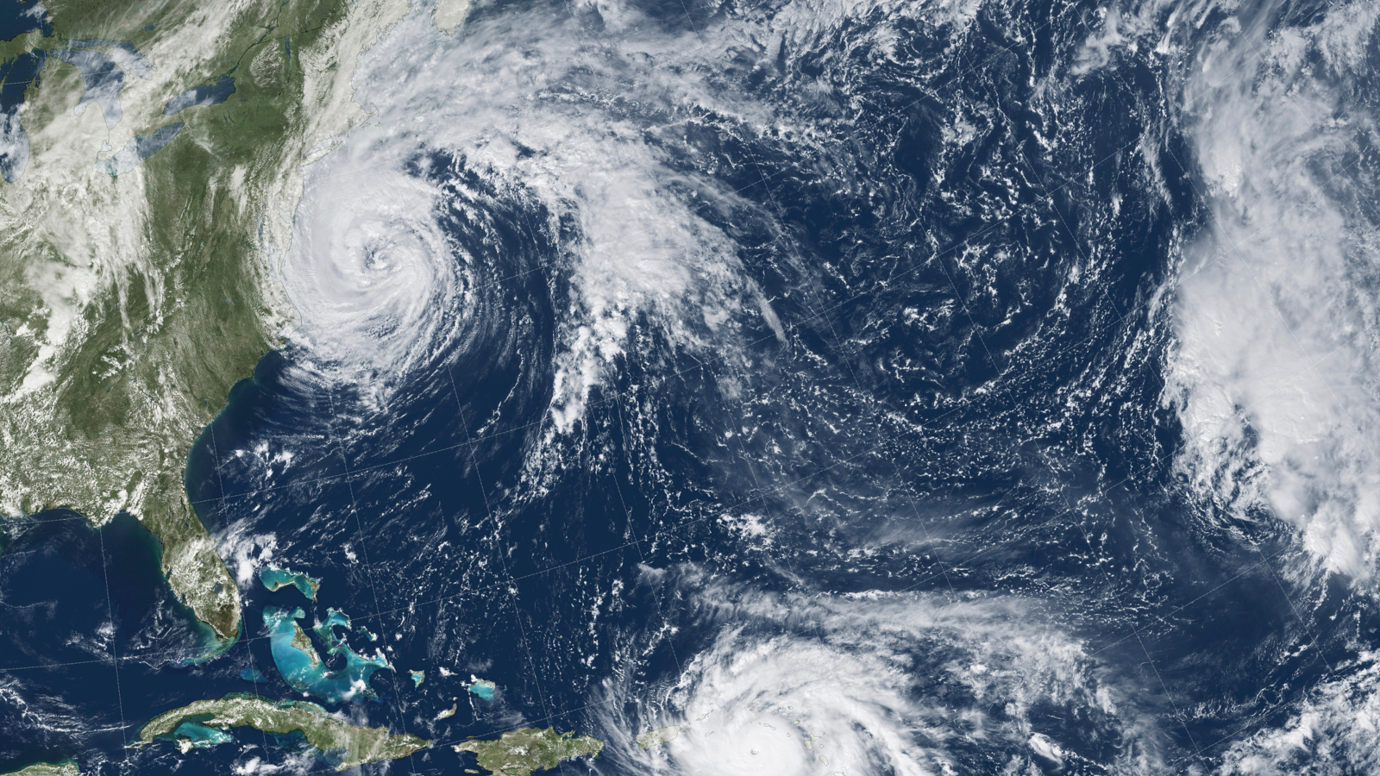
THANKS!

