Slide 1
IE 102
Spring 2016
Lecture 3
Charts and Diagrams:
Tools for Analysis

Slide 2
Objectives of Charts and Diagrams
Communication: permit work processes to be communicated and comprehended more readily
Use of algorithms specifically designed for the particular diagramming technique
Detailed analysis (Divide & Conquer): divide a given work process into its constituent elements for analysis purposes
Provide a structure in the search for improvements
Represent a proposed new work process or method

Slide 3
4 Types
GANTT Charts: Shows the anticipated completion times for various activities on a time axis
Operations Charts: Graphical and symbolic representation of the operations used to produce a product or service
Process Charts: Graphical and symbolic representation of the processing activities performed on something or by somebody
Flow Diagrams: To depict the movement (traffic)

Slide 4
Operations Charts
Graphical and symbolic representation of operations used to produce a product.
2 types of operations
  Processing and/or assembly
    changing the shape, properties
    Joining 2 or more parts to form an assembly
  Inspection operations
    Checking the material, work-part or assembly for quality or quantity

Slide 5
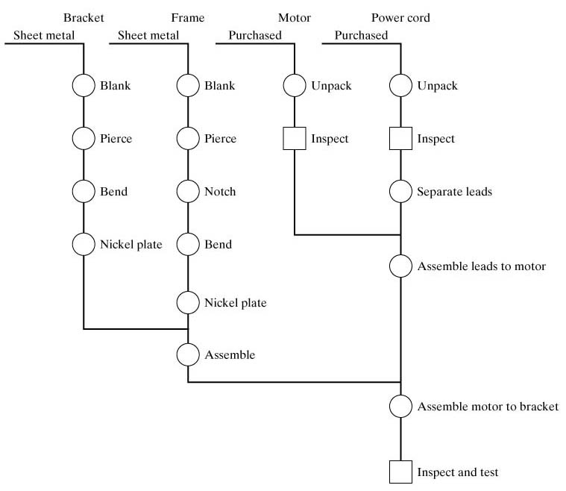
Example: Operation Chart for Subassembly

Slide 6
Operations Charts
Operations chart shows each manufacturing operation required to produce the final product

Slide 7
Operations Charts
The charts show:
  the introduction of raw materials at the top of the chart on a horizontal line
  Vertical stems-sequence of operations and inspections performed on a given component

Slide 8
Operations Charts
2 symbols
      Operation
      Inspection
At the top of each part: starting material, or purchased part
Then, steps performed on it.
Once each component is completed it is assembled to other components to the right.

Slide 9
Operation Charts
First step : Developing detailed listing of operations for the components and their assembly
Second step : Examination of the chart for possible improvements
  Focus of the operation chart is the materials and the operations performed on them
  Alternative materials, can operations be eliminated, combined, …
Last step: Develop proposals for improvement

Slide 10
Step by Step Procedures For Preparing an Operations Chart
Identify the parts to be manufactured and purchased
Determine the operations required to fabricate each part and sequence them
Determine the sequence or assembly for buyouts and fabricated parts
Draw the operations chart as explained
Put time standards, operation numbers and
descriptions
Other relevant information can be added

Slide 11
Recall
What does this symbol correspond to in operation charts?

Slide 12
Process Charts
Graphical and symbolic representation of the processing activities performed on something or by somebody
Principal types of process charts:
1.Flow process chart – analysis of a material or workpiece being processed
2.Worker process chart – analysis of a worker performing a task
3.Form process chart – analysis of the processing of paperwork forms

Slide 13
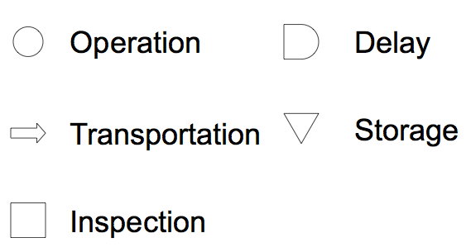
Process Chart Symbols

Slide 14
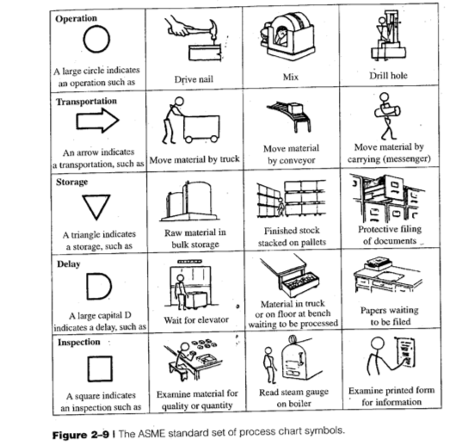

Slide 15
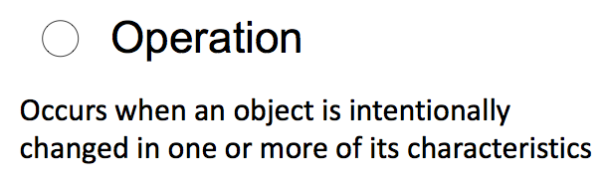
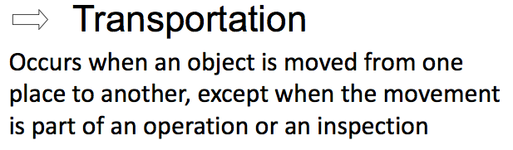

Slide 16
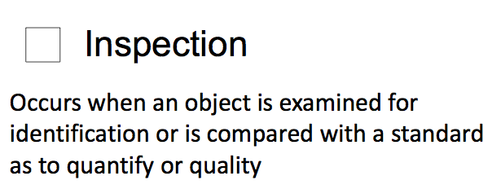
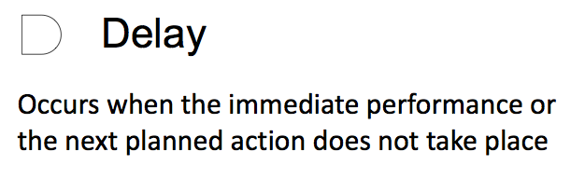

Slide 17
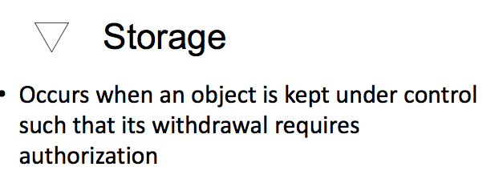
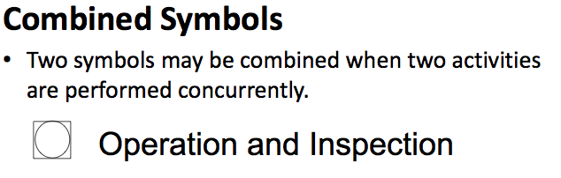

Slide 18
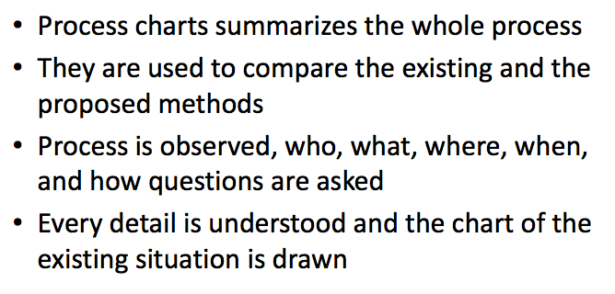
Process Charts

Slide 19
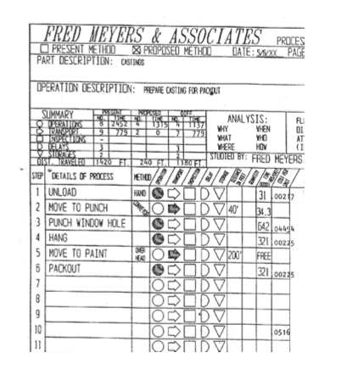

Slide 20
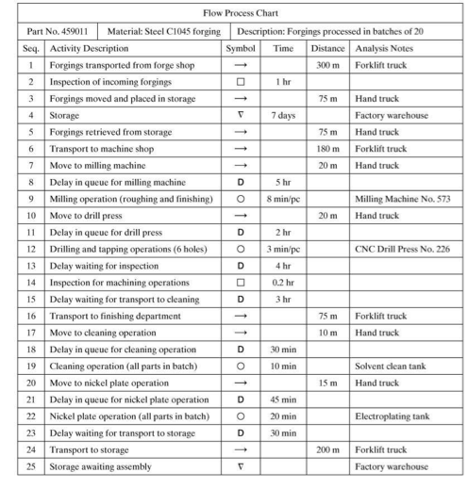

Slide 21
Exercise: cooking spagetti

Slide 22
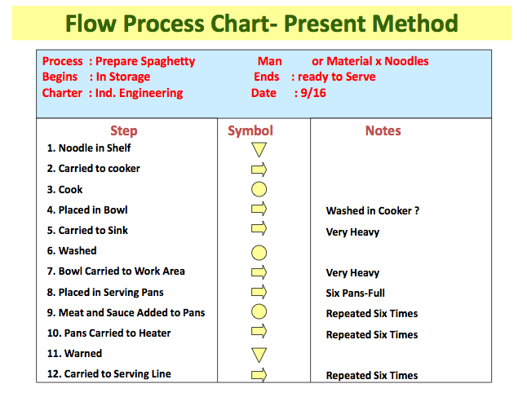

Slide 23
Exercise: cooking spagetti
Notes are about inefficiencies of the process
Notes are about suggestions for improving the inefficiencies
Notes 9 ,10, 12 denote repetitive tasks
Note 4 suggests a method for improving
Proposed method

Slide 24
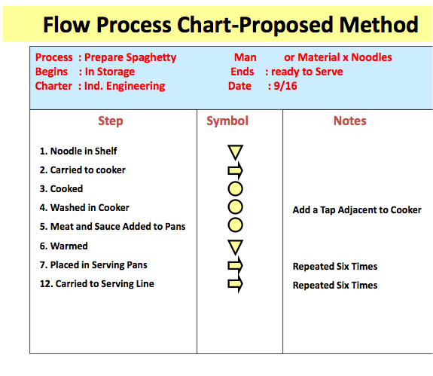

Slide 25
Exercise: cooking spagetti
Difference between the two charts:
  Number of steps
  Transportation time
  Number of repetitive tasks

Slide 26
Exercise: cooking spagetti
Improved in two ways:
  No investment required,
    adding meat and sauce in the cooker
    Matter of timing
    Trade-off is not monetary
  Investment required:
    Adding a tap adjacent to cooker
    Some infrastructural design in the kitchen
    Trade-off money invested vs money saved from operations

Slide 27
Process Charts
Process Charts require more detail about the steps of the process than the operation charts.
Flow Process charts : Follow the product
Worker Process charts: Follow the worker
  Example: Tost kaizen
    Flow Process chart : Follow the bread
    Worker Process chart: Follow the man

Slide 28
Worker Process Charts
Activities of the worker as s/he performs the task
Symbols: What the worker does rather than what is done to the material
Storage is omitted.
You may need some other symbols for sophisticated needs:
  For example: Operation & Inspection together

Slide 29
Recall
How many main shapes are there in process charts?

Slide 30
Exercise: Blood Donation
Consider one mobile unit. Our aim is to follow the typical set of activities carried out by a nurse for drawing blood from a donor.
The following paragraph describes these activities: “A donor is screened for two purposes: (1) Donor must be fit enough so to not to have any side effects during and at the end of the process of giving blood. The typical activities related are material read by the donor, reply of some health history questions, blood pressure measurement, body weight measurement, and finally if found fit a signature to ensure willingness of the donor. (2) Donor’s blood should be “clean” to ensure no possible disease transmission to the users of the blood (although formal tests are carried out at a lab). Some material should be read by the donor before a group of questions are asked about the related health history. Finally, they complete and sign a form. Any suspicious information may result Kızılay’s decline of the donor.
Once the donor is accepted to give blood the following set of activities take place: Donor is rested for a while. The nurse washes his/her hands with antiseptic and picks up gloves from a shelf; then picks up a needle guard and moves to the bed that the donor is resting. Nurse prepares the donor, and with the use of the needle starts to draw blood. The whole process continues for 20-30 minutes depending on the amount of blood. The nurse checks the donor at some intervals. Once it is over, the donor rests for another 10 minutes, is then given a glass of juice to balance the blood pressure, and finally discharged after a final check.”
a) Use a worker process chart to describe what a nurse is doing for donor
b) Use a flow process chart to describe the blood donation process.

Slide 31
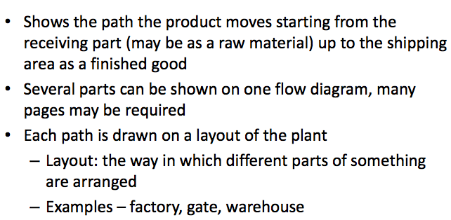
Flow Diagrams

Slide 32
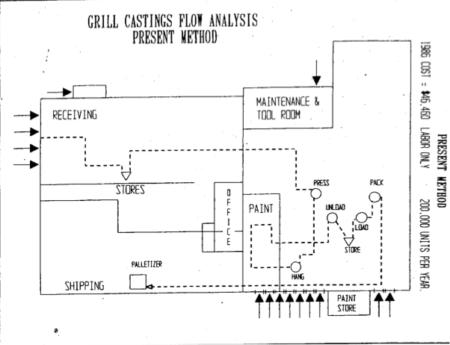

Slide 33
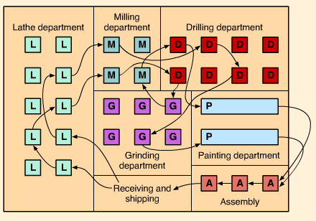
Example: Flow Diagram

Slide 34
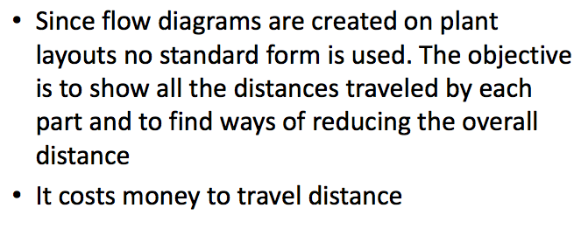
Flow Diagrams

Slide 35
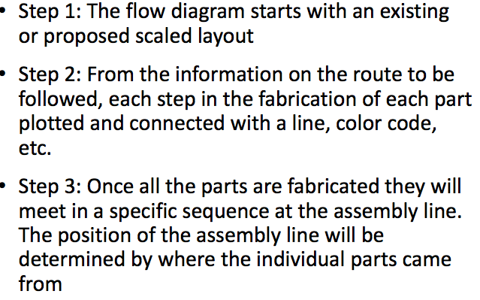
Step by Step Procedure for Developing a Flow Diagram

Slide 36
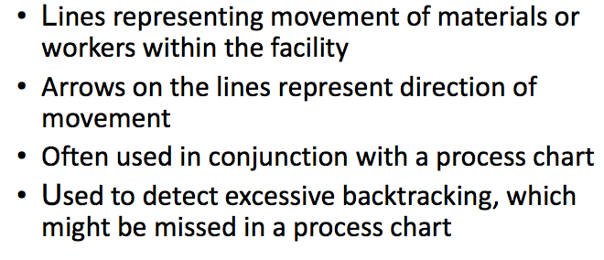
Flow Diagram

Slide 37
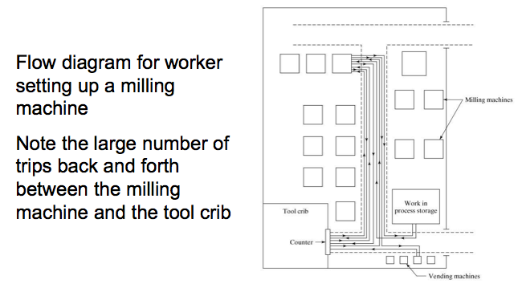
Flow Diagram

Slide 38
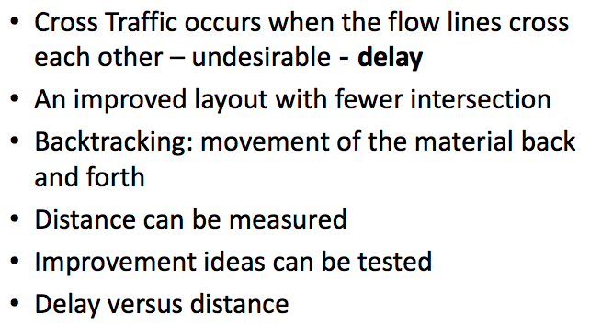
Flow Diagram

Slide 39
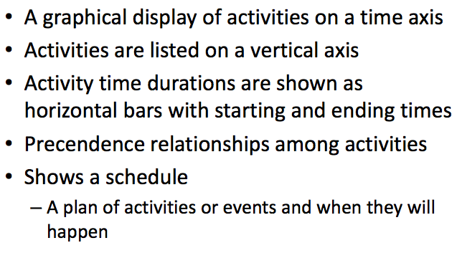
GANTT CHARTS

Slide 40
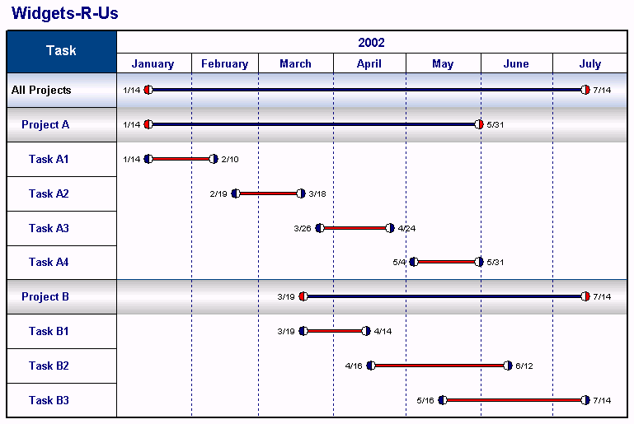
GANTT Charts
Shows the anticipated completion times for various activities on a time axis

Slide 41
QUIZ
Let’s recap the concepts covered in today’s lecture!
http://getkahoot.com/
You have 60 seconds to register to the quiz
Please remain silent through activity

