Slide 1
IE 102
Lecture 5
Performance Measures

Slide 2
Performance Measures: Definitions
Video Mini Cooper

Slide 3
Performance Measures: Definitions
QUIZ!
www.getkahoot.com
Don’t forget to enter nicknames as your ID’s.

Slide 4
Mini Cooper Video
Summary of observations:
Make-to-order – production planning
Quality Control – 100% Inspection versus sampling
Stages of Production
Integrated Logistics Center
Just-in-time ideas
Layout - The manner in which physical facilities are laid out
Final Assembly – moving floor
“Improvement” revisited: Team Work effort

Slide 5
Mini Cooper Video
Main Issue to ALWAYS remember
Although it is a manufacturing environment, almost half of the operations are for service (such as service operations in a super-market)
There is no possible generalization of a work-place for any sector: The type of duties you carry out determines your speciality, not the sector.

Slide 6
Performance Measures: Definitions
Neely et al (2005): Two fundemental dimensions of performance:
Effectiveness: the extent the requirements are met
Efficiency: how economically the resources are utilized
Example: airplane - time at the gate
Effectiveness – can we meet the requirements set by safety standards? Always?
Efficiency – are we using the “gate” resource economically?

Slide 7
Definitions (continued)
Performance Measurement: Process of quantifying the efficiency and/or effectiveness of an action
Performance Measure: A metric (measure) used to quantify the efficiency and/or effectiveness of an action
*USUALLY WE HAVE A COMBINATION*

Slide 8
Performance Measures
Consider the new cafeteria (FAMEO)
Potential performance measures:
Number of people getting coffee in an hour
Minutes a customer waiting in line to be served
Minutes the cashier is empty waiting for new customers
….

Slide 9
Performance Measures
Improvements?
Number of people getting coffee in an hour
Minutes a customer waiting in line to be served
More people working (one for prep one for cashier)
Different queues (one for coffee, one for food)
…
Minutes the cashier is empty waiting for new customers
Less people working !
Have the cashier prepare food?

Slide 10
Performance Measures
Efficiency: Are we using resources economically
  so that money we spent is min?
  other resources as well (like people)
Effectiveness: Related with more expectations

Slide 11
Performance Measures
Blood Donation
Efficiency of nurse: idle time of nurse,
Effectiveness: health standards

Slide 12
Performance Measuring
More abstract:
Why do we measure?
More familiar ones:
Evaluate – to find the value, to judge the worth
Control – to direct, to verify by comparison
Improve – to become better

Slide 13
Why do we measure?
Evaluate: (to find the value) Definitive value
  Is this operation efficient?
  Total time to complete a task.
Control: (verify bu comparison)
  Inflation to check stability (success) of the government
Improve: (to become better)
  Toast Kaizen
OTHER REASONS?

Slide 14
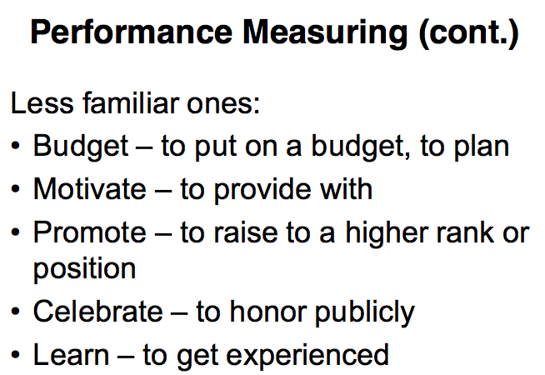

Slide 15
Performance Measuring (cont.)
Relate to our previous examples
Toast Kaizen? Control, improve?
Airport Operations? All?

Slide 16
Individual measures
  Example: Delay
  Individual Measure: Average Delay
  Individual Measure: Maximum Delay
Depends on the situation
We have a tendency of selecting it from a list – may not be always meaningful, but always helpful
To set what you want to measure is more important.
Example: Neely et al (2005), p. 1234

Slide 17
Interesting Note
Neely et al (2005) Manufacturing perspective
Behn (2003) Public Administration perspective (service)
BOTH ARE SIMILAR, THOUGH WITH SLIGHTLY DIFFERENT LANGUAGE

Slide 18
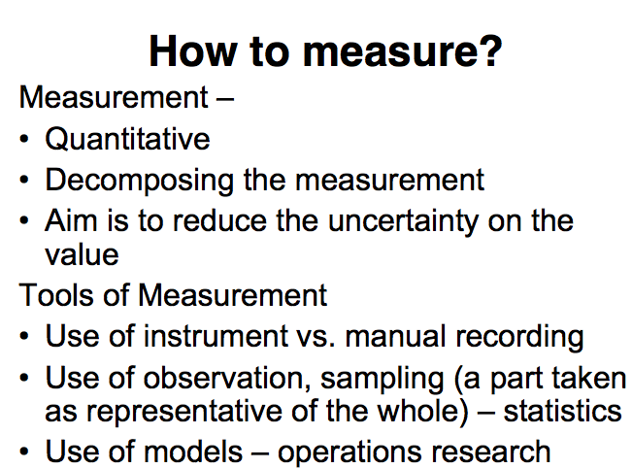

Slide 19
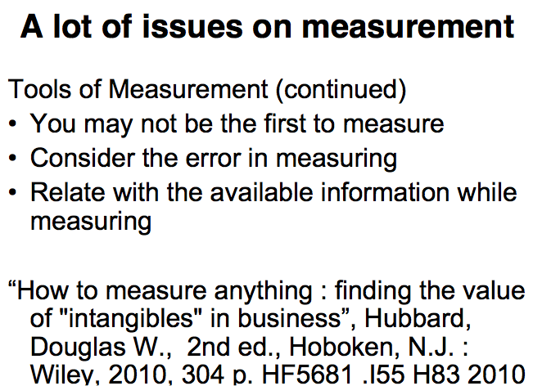

Slide 20
Decision
Daily word but more structured for IEs
Decision: an input over which the decision maker (the person who is going to make the decision) has control in the form of:
1) a single action (do A or B)
It might be a very simple action (going to a movie or not) or complicated one (but still simple idea). For example, a manufacturer can question to produce a part in the factory or buy from somewhere else. This is called a make or buy decision

Slide 21
Decision
Decision: an input over which the decision maker (the person who is going to make the decision) has control in the form of:
2) setting a group of values or assignments. For example you make a production plan for a facility. (product a produced in machine b at time t) Not as simple as a single action but still can be defined as a plan and implemented.
3) rules (or control mechanism), a set of rules that defines what you are going to do.
If X occurs, take action (or a group of actions)

Slide 22
Decision
Decision: an input over which the decision maker (the person who is going to make the decision) has control in the form of:
4) Policy, a set of standards.
For example, working for an air mail carries (UPS) you promise to deliver within 24 hrs. You obey regardless of what you observe.
While setting these standards, make sure that you are competitive in the market.

Slide 23
Decision
Decision: an input over which the decision maker (the person who is going to make the decision) has control in the form of:
5) Setting amount of resources to be used.
For example, number of waiters in a cafe,
you have an expensive machine and you decide you will use it 30% of the time for job A and 70% of the time for job B. (allocate the resources)

Slide 24
Decision
Decision: an input over which the decision maker (the person who is going to make the decision) has control in the form of:
6) Investment with a combination of the above. In an investment, we are deciding a number of things at the same time, like standards to obey, number of resources …
KEY is to have control over doing it.

Slide 25
Performance Measure
Performance measures is an output used to measure the system (environment you are in) performance as a function of the decision.
Toast Kaizen : He knows that certain decisions he is going to give will change the total time.

Slide 26
An Example
The largest soft drink manufacturer and distributor in Turkey (Coca Cola) holds a leading 66% market share in the Turkish carbonated soft drink market. The company makes sales under 12 brands and more than 150 stock keeping units (SKU’s) in Turkey, with five manufacturing plants and an annual production capacity of 400 million units. There are more than 500 distributors throughout Turkey.
The company has two different sales channels which are traditional and modern. Traditional sales channels include grocery stores, hotels and schools whereas modern sales channels include the national hypermarkets and the local hypermarkets.
There are several distributors in every city. Factories ship products to the nearest distributors, which supply these products to both traditional and modern channels. The company makes several campaigns for particular products being sold in modern sales channels for particular dates during the year. The campaign products in the hypermarkets should meet the demand during the campaign process. However, especially in Eastern Anatolia Region, the company faces a problem that there are not enough products in the shelves during the campaign.
This is a challenging problem that contains efficiency and effectiveness issues. What are the possible performance measures you would use for this situation? Give two examples, and describe how you are planning to measure each.

Slide 27
An Example
The largest soft drink manufacturer and distributor in Turkey (Coca Cola) holds a leading 66% market share in the Turkish carbonated soft drink market. The company makes sales under 12 brands and more than 150 stock keeping units (SKU’s) in Turkey, with five manufacturing plants and an annual production capacity of 400 million units. There are more than 500 distributors throughout Turkey.
Distribute to all over Turkey from 5 manufacturing plants
SKU: Different forms of the same product, can of coke, plastic 1 lt, plastic 2.5 lt are different SKUs. They need to be kept in stock separately. you cannot store as liquid coke.

Slide 28
An Example
The company has two different sales channels which are traditional and modern. Traditional sales channels include grocery stores, hotels and schools whereas modern sales channels include the national hypermarkets and the local hypermarkets.
Traditional: Distribution to each grocery stores, restaurants,
Modern: Distribution to central warehouse of Migros, then redistribute to other Migroses.

Slide 29
An Example
There are several distributors in every city. Factories ship products to the nearest distributors, which supply these products to both traditional and modern channels. The company makes several campaigns for particular products being sold in modern sales channels for particular dates during the year. The campaign products in the hypermarkets should meet the demand during the campaign process. However, especially in Eastern Anatolia Region, the company faces a problem that there are not enough products in the shelves during the campaign.
For hypermarkets like Migros, selling in larger quantities than traditional channel.
They are facing problems with shipping from factories to distributors in Eastern part of Turkey

Slide 30
An Example
This is a challenging problem that contains efficiency and effectiveness issues. What are the possible performance measures you would use for this situation? Give two examples, and describe how you are planning to measure each.

Slide 31
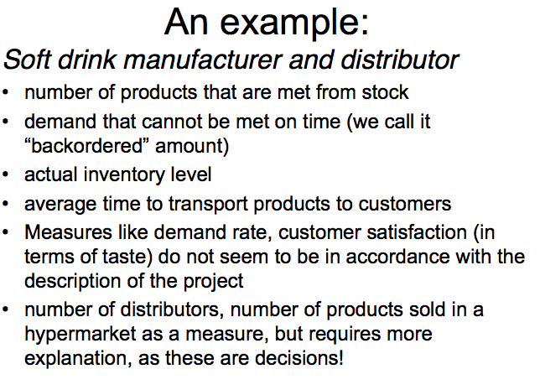

Slide 32
An Example
This is a challenging problem that contains efficiency and effectiveness issues. What are the possible performance measures you would use for this situation? Give two examples, and describe how you are planning to measure each.
Number of products met from stock (especially during the period when demand is high)
Demand that cannot be met on time
Actual inventory level
Average time to transport products to customers
Number of distributors, number of products sold in a hypermarket can also be measures but requires more explanation as they are also decisions!

Slide 33
An Example
Measures like demand rate, customer satisfaction (in terms of taste) do not seem to be appropriate
We need to differentiate decisions and performance measures.

Slide 34
Reading
Neely et al (2005) (read up-to “Performance measures relating to quality” p.1231)
Page 1231 – Table II
Behn (2003) Read pp. 586-588 upto Purpose 1. Then, read parts which are related to Purpose 1, 2, and 8 only (Purpose 1 - pp. 588-589 and 593-594; Purpose 2 - pp. 589-590 and 594; Purpose 8 - pp. 592-593 and 597-598).

Slide 35
Performance Measures
Let’s recap the lecture
QUIZ!
www.getkahoot.com
Don’t forget to enter nicknames as your ID’s.

