Slide 1
Logistics

Slide 2
Logistics
The process of planning, implementing, and controlling the efficient, cost effective flow and storage of raw materials, in-process inventory, finished goods and related information from point of origin to point of consumption for the purpose of meeting customer requirements.

Slide 3
Logistics
Get the:
                right amount of
                right material
                to the right place
                at the right time.

Slide 4
Why Logistics?

Slide 5
CASE study: Shoes From China
As a manufacturer, how should I ship my shoes from Shenzen (China) to Kansas City (USA)
  Shoes are manufactured, labeled, and packed at a plant
  ~4.5M shoes shipped per year from this plant
  6000-6500 shoes shipped per container
  Value of pair of shoes ~$35

Slide 6
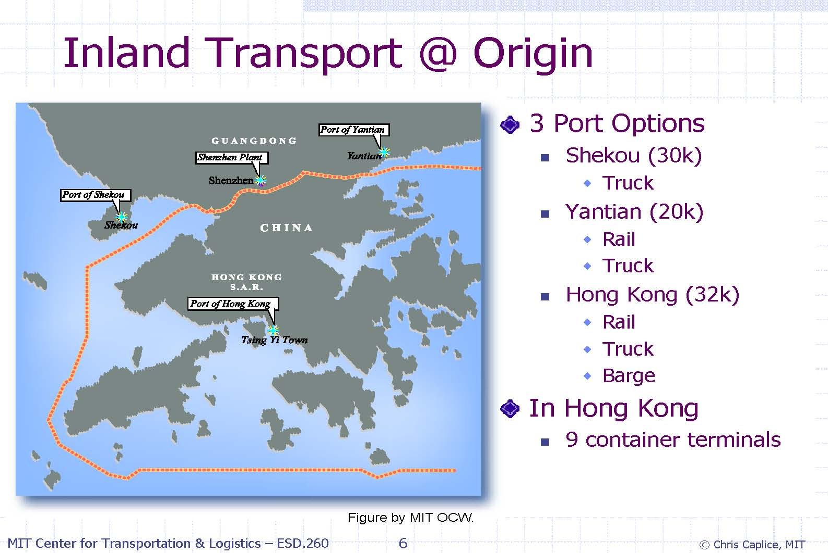
CASE study: Shoes From China

Slide 7
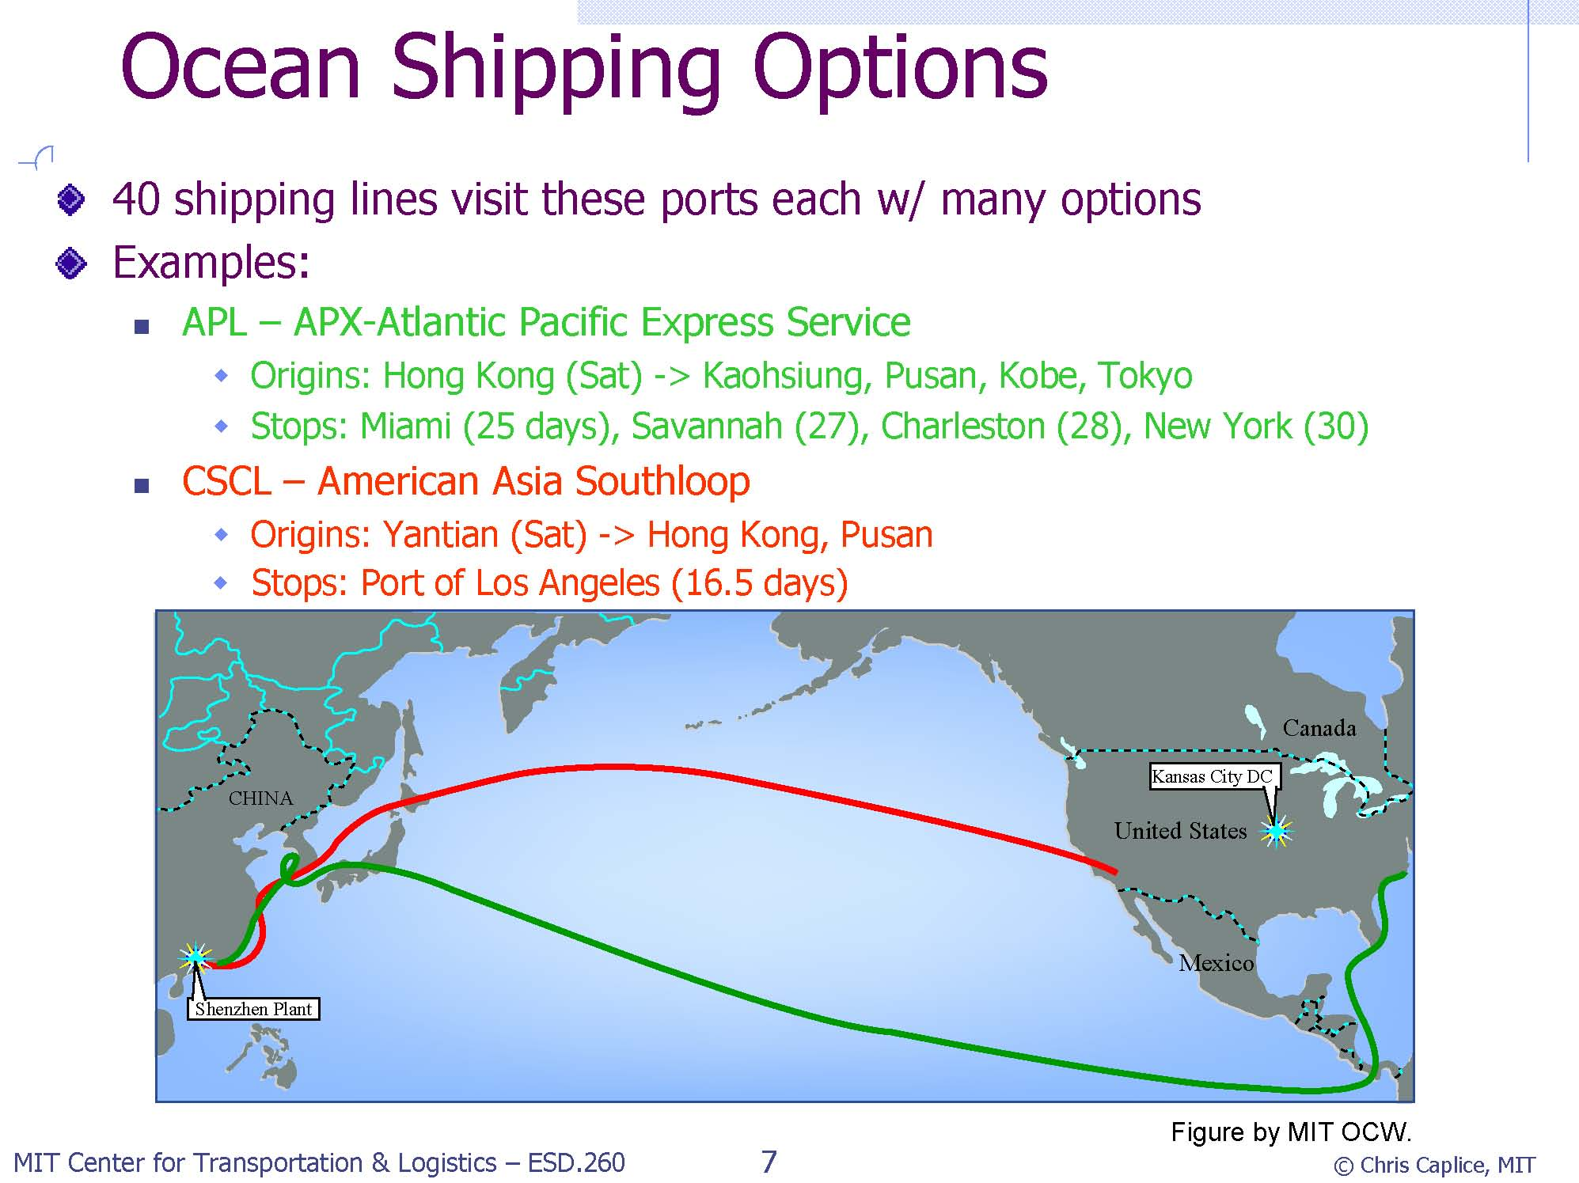
CASE study: Shoes From China

Slide 8
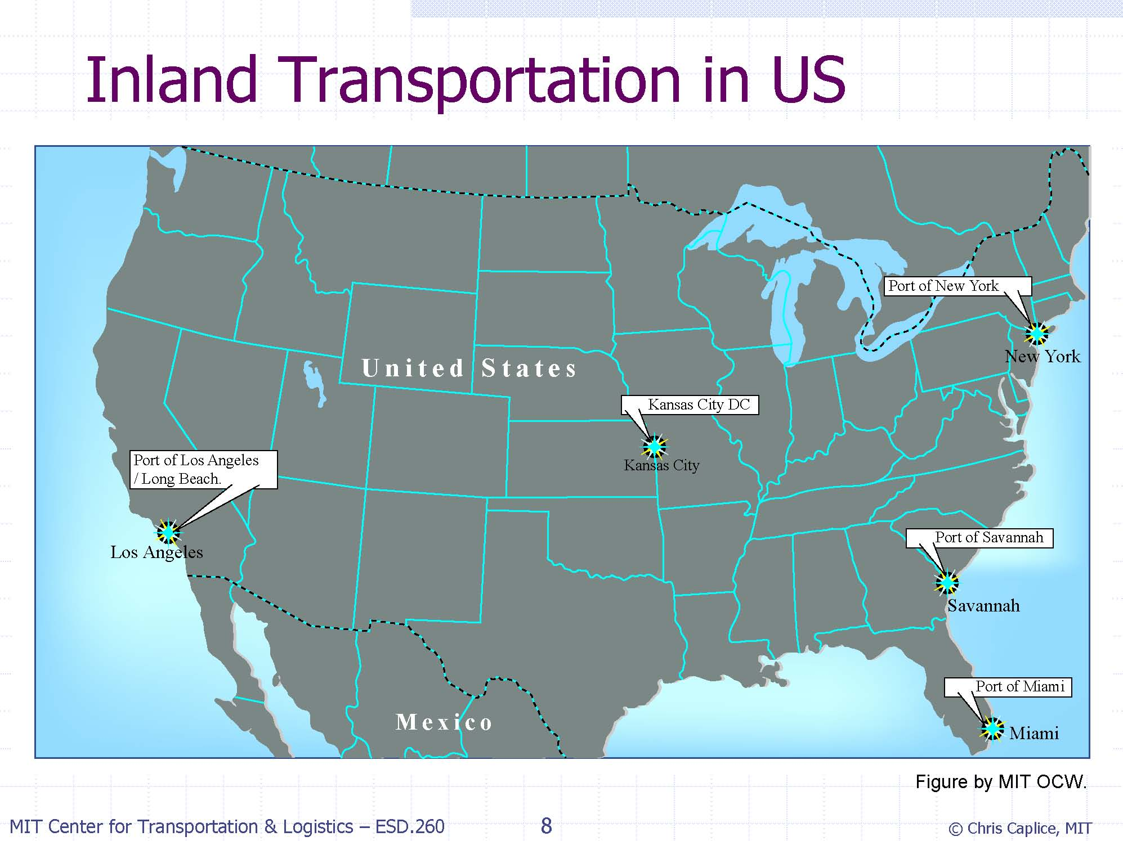

Slide 9
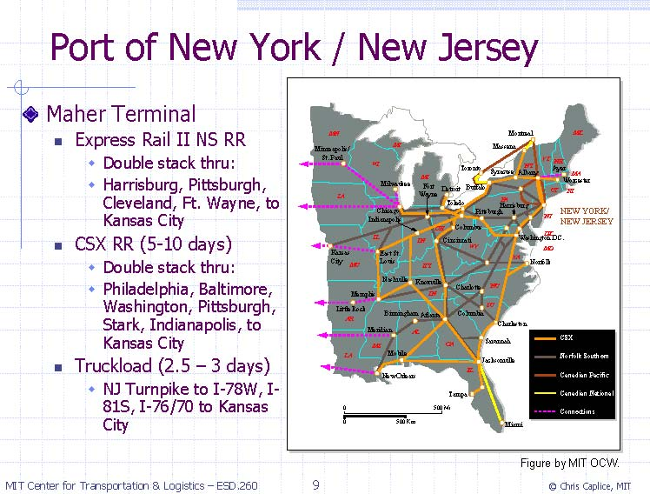

Slide 10
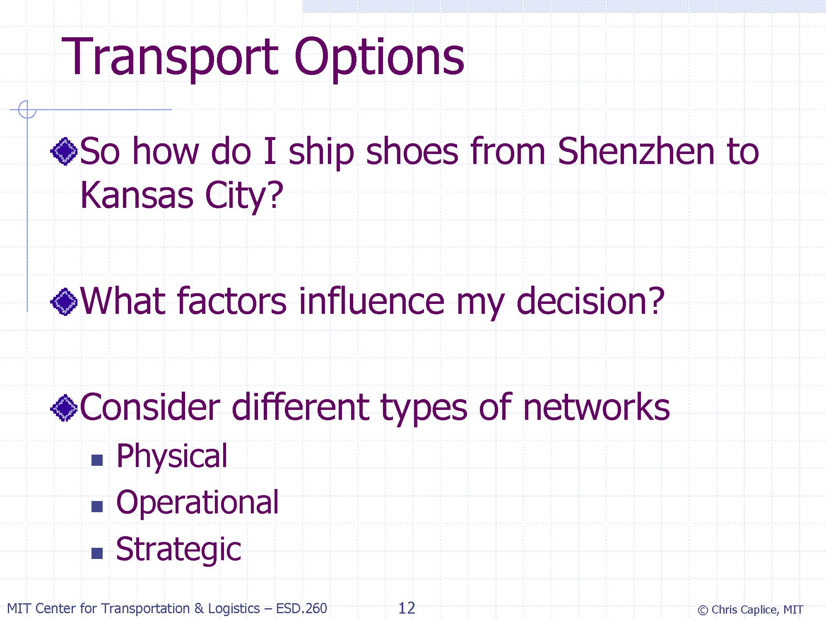

Slide 11
Logistics systems
Composed of facilities linked by transportation services
Facilities include
  Sites of manufacturing, storing, sorting, selling, consuming etc…
  Warehouses, distribution centers (DCs), transportation terminals, dump sites, etc…

Slide 12
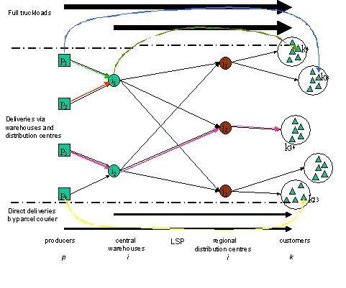
Logistics Systems (Supply Chains)

Slide 13
Logistic System Characteristics
Push versus Pull Systems
  make-to-order, make-to-stock, make-to-assembly
Vertical integration vs. third-party logistics (3PL)
  transaction based relationships, strategic alliances

Slide 14
Third Party Logistics(3PL)
Use of an outside company
  Perform all or part of a company’s product distribution
Three different levels:
  Basic service providers
    Physical distribution services (warehousing, transportation)
  Value added service providers
    Basic service + services such as specialized pick/pack, labeling
  Logistics integrators
    Full responsibility for managing key supply chain operations on a daily basis.

Slide 15
Outsourcing: Pros and Cons
Pros:
  Improve company focus
  Access to new technology
  Free-up resources
  Reduce operation costs
Cons:
  Coordination costs
  Loss of internal logistics management capability
  Reduced contact with final customer

Slide 16
Logistic System Characteristics
Push versus Pull Systems
  make-to-order, make-to-stock, make-to-assembly
Vertical integration vs. third-party logistics (3PL)
  transaction based relationships, strategic alliances

Slide 17
Logistic System Characteristics
Push versus Pull Systems
  make-to-order, make-to-stock, make-to-assembly
Vertical integration vs. third-party logistics (3PL)
  transaction based relationships, strategic alliances
Retailer managed vs. vendor managed inventory
Product and information flows

Slide 18
Logistics systems
Can categorize in three main activities:
  Order processing
    Links information flow with product flows
  Inventory management
    Controls inventories that are waiting to be manufactured, assembled, sold or salvaged
  Freight transportation
    Allows production and consumption to be far apart

Slide 19
Order processing
Links information flows with product flows
  Customers request products (EDI, fax, telephone,…)
  Availability of requested items is checked (PPS, SAP,…)
  Required items are produced (if necessary) or retrieved from the warehouse
  Items are shipped to customers
  Customers are kept informed about order status

Slide 20
Inventory management
Inventories are stocked
  Raw materials
  Semi-finished products and components
  finished products (in warehouse or en-route)
waiting to be manufactured, assembled, sold or salvaged

Slide 21
Inventory management
Reasons for holding inventories
  Demand seasonality
  Improving customer service level
  Price seasonality
  Exploit economies of scale in freight transportation
  Cope with demand and lead-time randomness
  Cover inefficiencies in managing the logistics system

Slide 22
Inventory management
A good inventory policy takes into account
  the economic significance of stored products
  transportation policies
  production process characteristics
  competitors’ policies

Slide 23
Freight transportation
allows production and consumption to be far apart
  global availability of certain products
  economic benefits from production at low wage countries
  improved availability of perishable goods

Slide 24
Freight Transportation
Types:
  Private transportation
    (owned or leased vehicles)
  Contract transportation
    (dedicated carrier)
  Common transportation
    (general carrier)

Slide 25
Freight Transportation
Main features:
  Distribution channels:
    warehouses, DCs, direct...
  Freight consolidation:
    Facility consolidation : (e.g. hubs) individual shipments are consolidated at hubs .
    multi-stop: serving some customers together
    Temporal: adjusting schedules to ship larger quantities
  Modes of transportation

Slide 26
Distribution channels

Slide 27
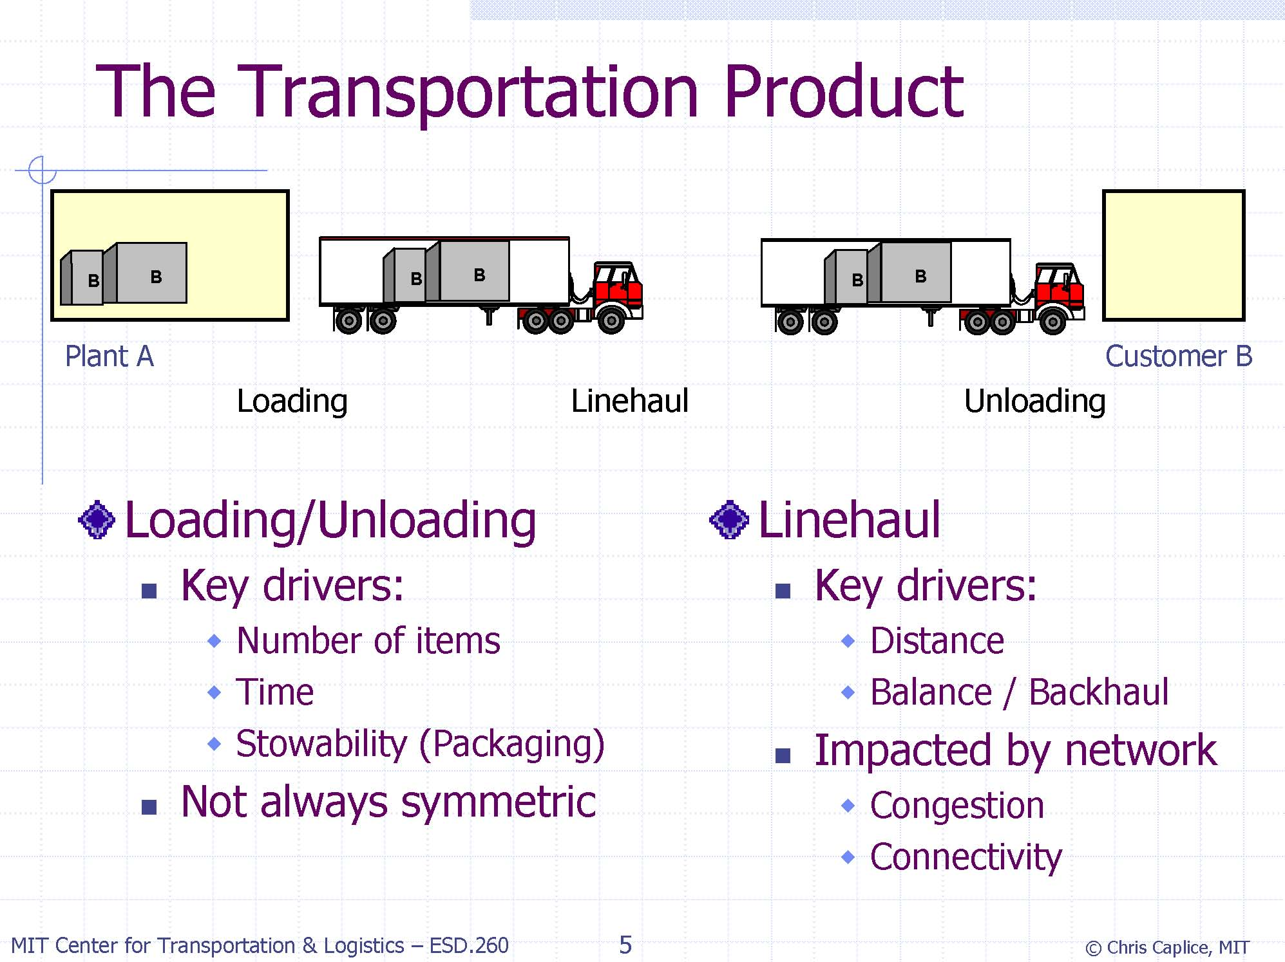

Slide 28
Freight consolidation
Facility consolidation
  e.g. UPS consolidates individual shipments at hubs for joint transportation between hubs
Multi-stop consolidation
  e.g. Fedex delivers individual shipments to their final destination on routes serving several customers
Temporal consolidation
  e.g. shipments schedules may be adjusted forward or backward to ship large quantities periodically

Slide 29
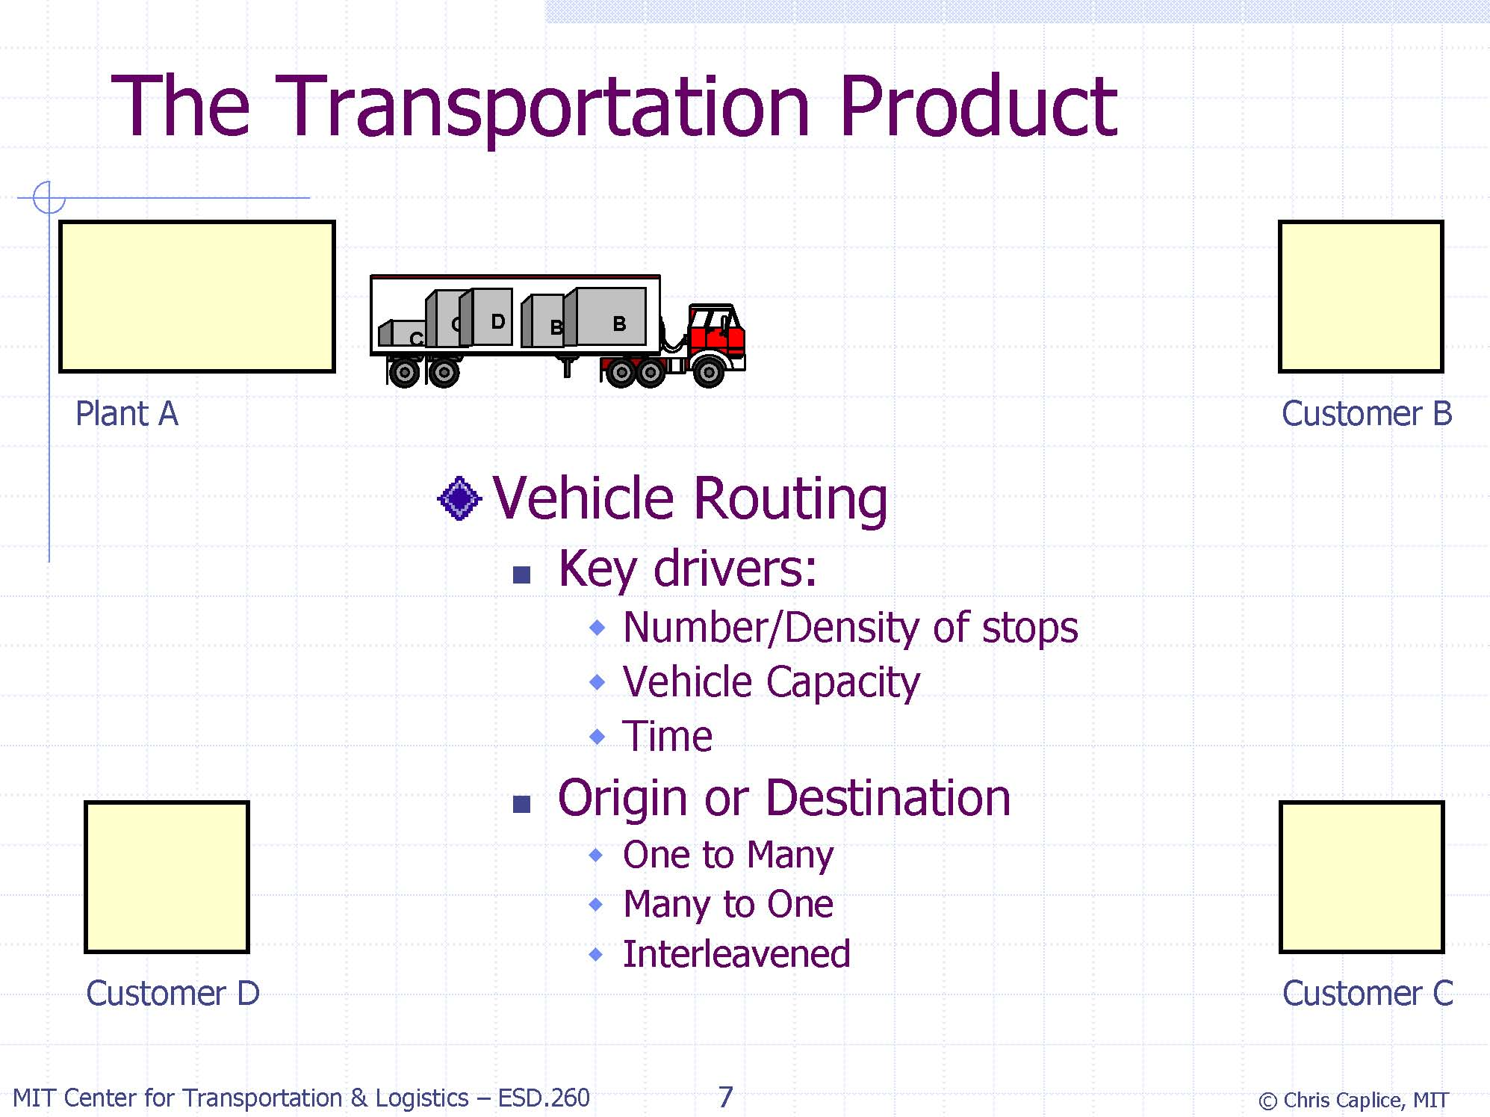
Multi-stop consolidation

Slide 30
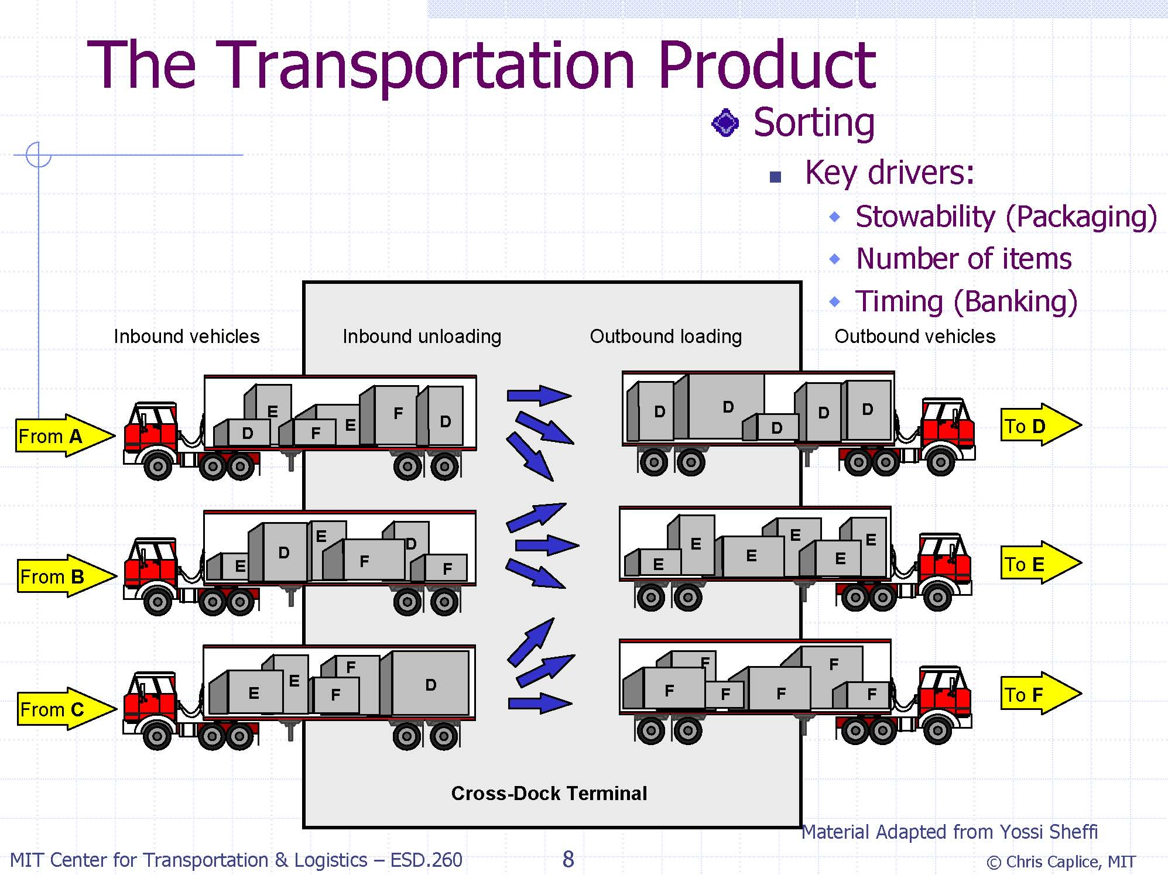
Facility consolidation

Slide 31
Freight Transportation
Modes of transportation:
  Air
  Truck
  Train
  Ship
  Pipeline
  intermodal

Slide 32
Freight Transportation
Mode Choice Decisions:
Air:
  Fastest, handling slows down the process
  Long distance high value goods
Truck
  Truck load vs Less-Than-Truck load
Rail
  Inexpensive, relatively slow

Slide 33
Freight Transportation
Mode Choice Decisions:
Intermodal
  Air-Truck
  Birdyback
  Train-Truck
  Piggyback
  Ship-Truck
    Fishyback

Slide 34
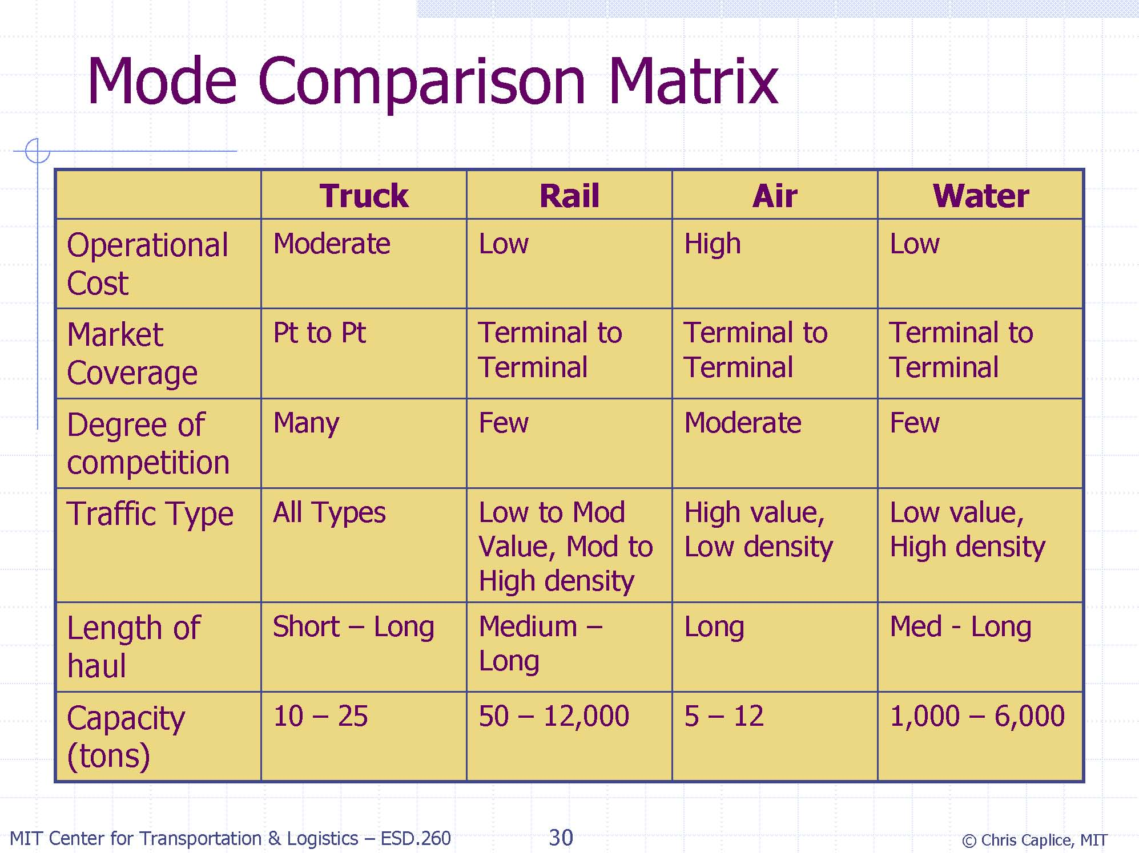

Slide 35
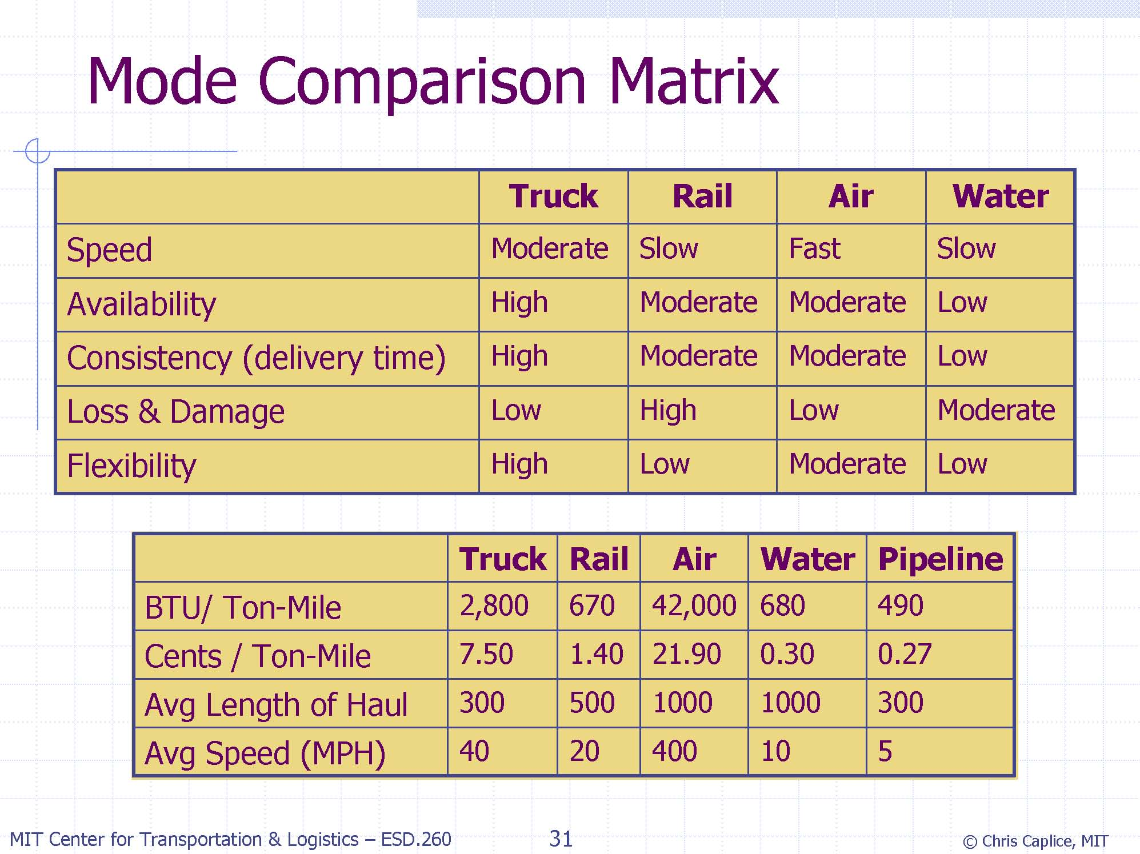

Slide 36
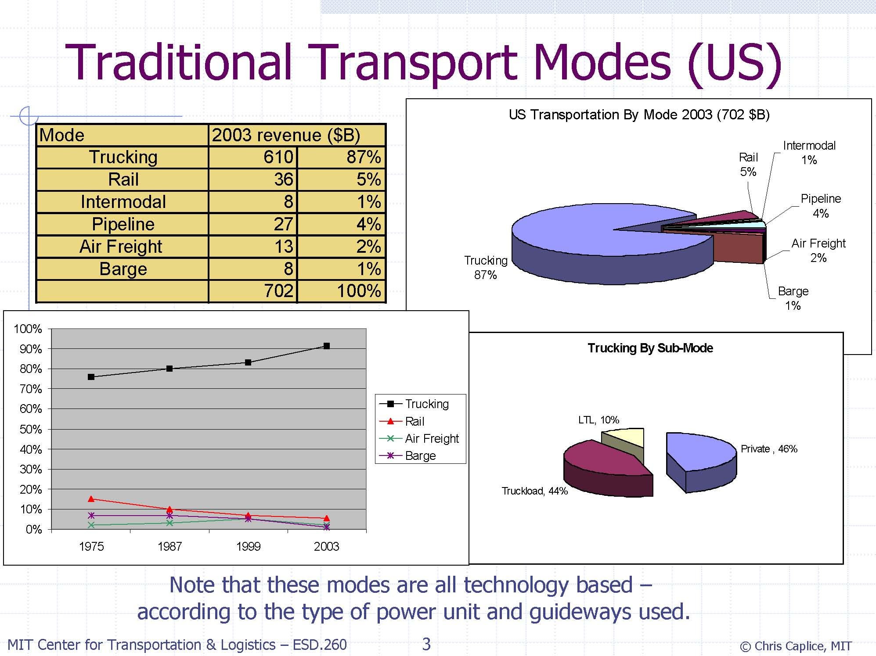

Slide 37
Logistics Managerial Issues
Capital reduction vs. Operating cost reduction
Service level improvement
Cost vs. Level of service trade-off
Sales vs. Level of service trade-off

Slide 38
Logistics Decisions
 | Planning Horizon | Data | Decision maker | E.g.
Strategic | Up to several years | Very imprecise and incomplete | Top management | Facility location, layout
Tactical | Up to a year | Disaggregated data available | Middle management | Resource allocation, production and distribution planning
Operational | Days | Precise data available | Lower management | Order picking, vehicle dispatching

Slide 39
Logistics Part: A
QUIZ!
www.getkahoot.com
Don’t forget to enter nicknames as your ID’s.

