Slide 1
Logistics - 2

Slide 2
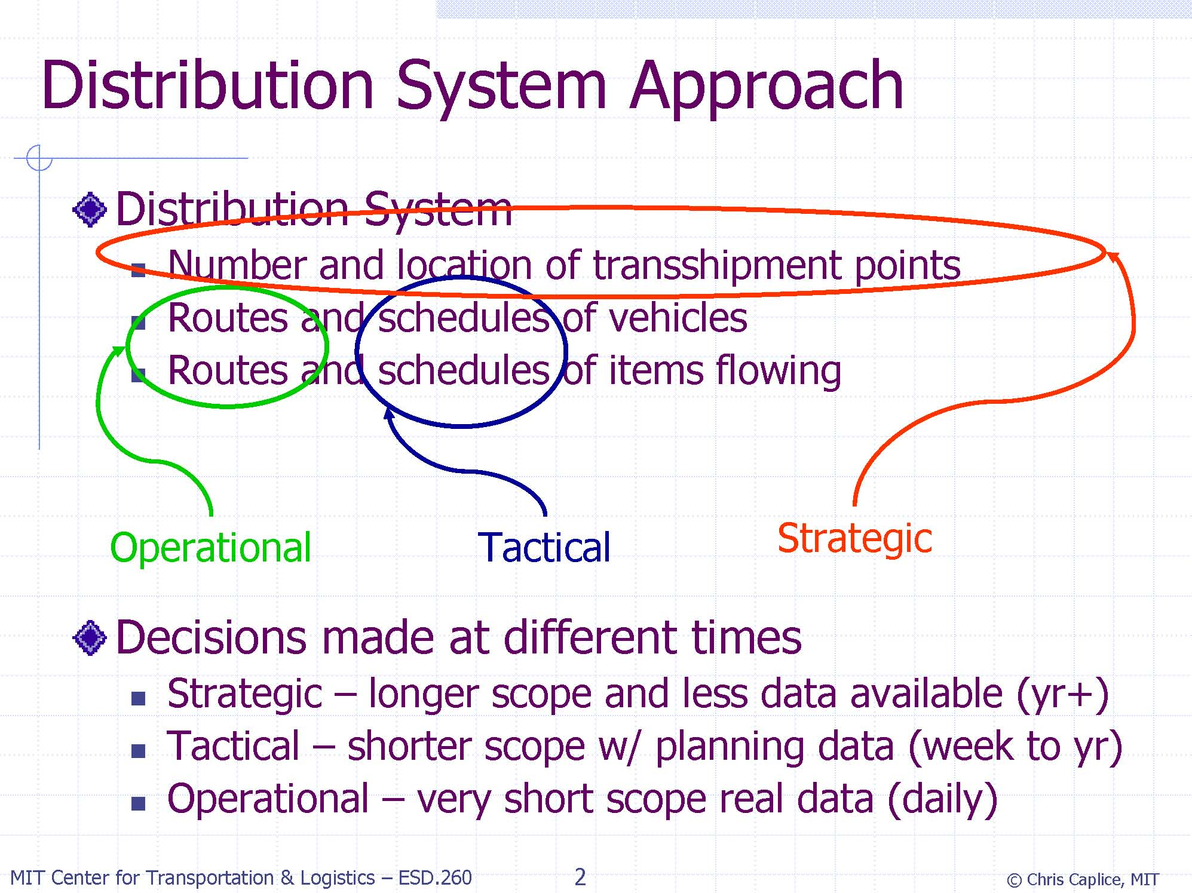

Slide 3
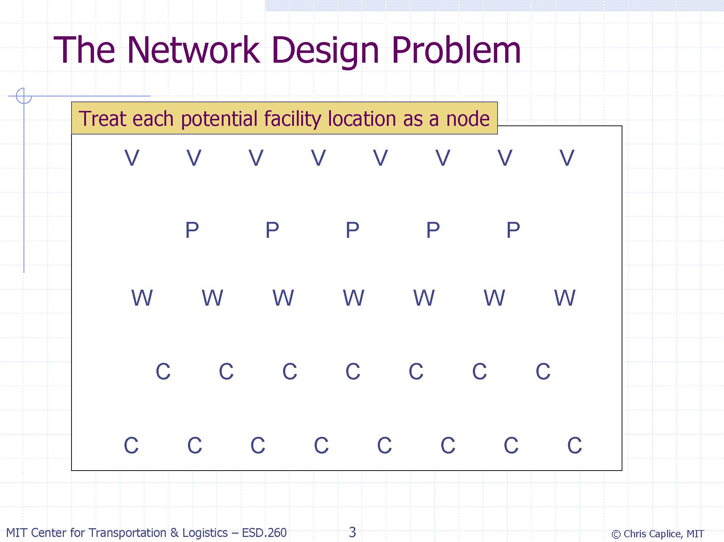

Slide 4
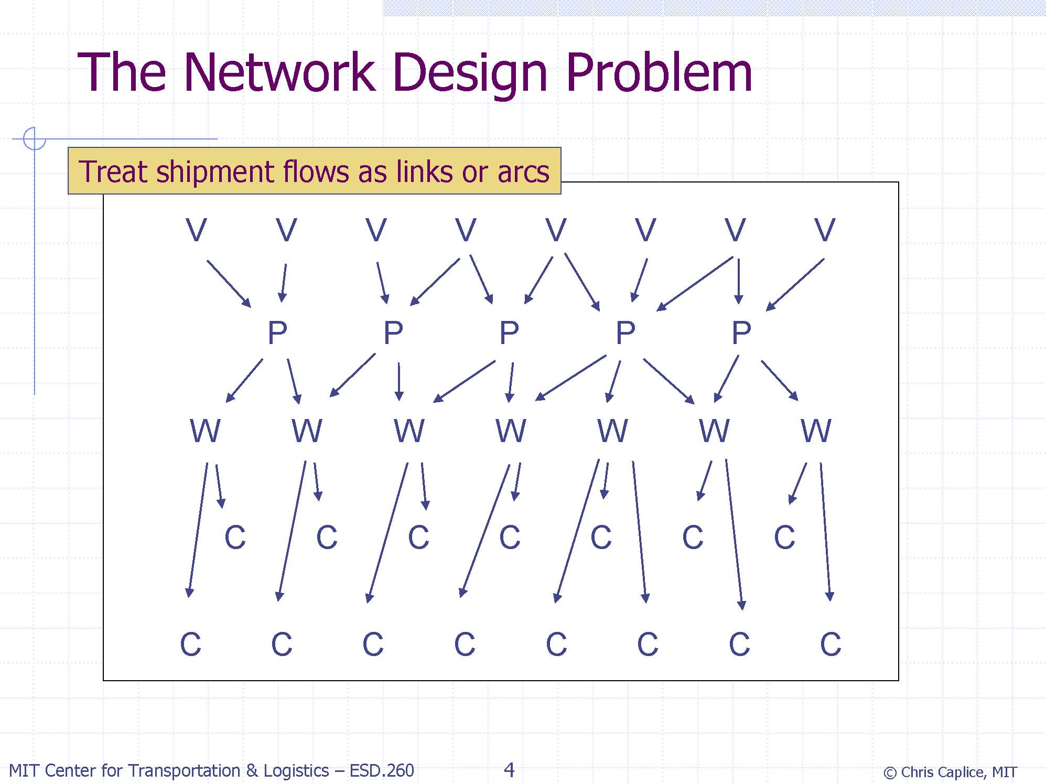

Slide 5
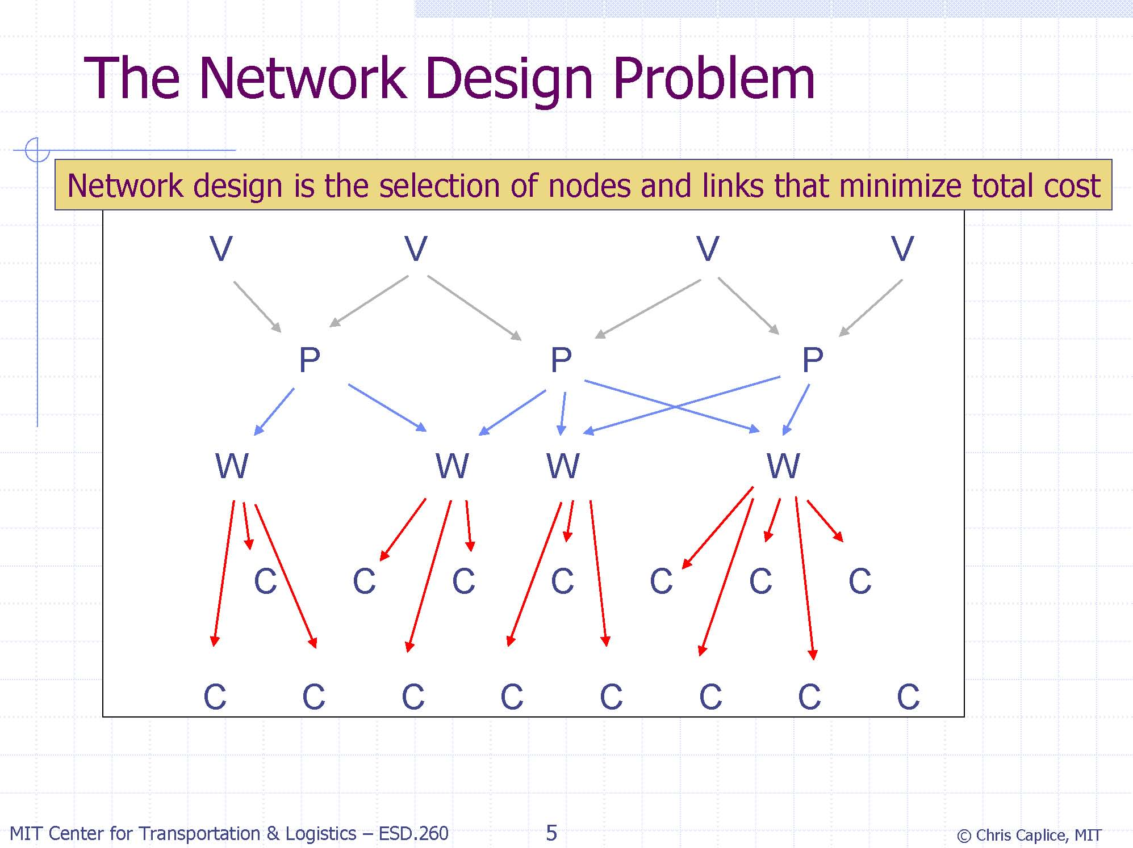

Slide 6
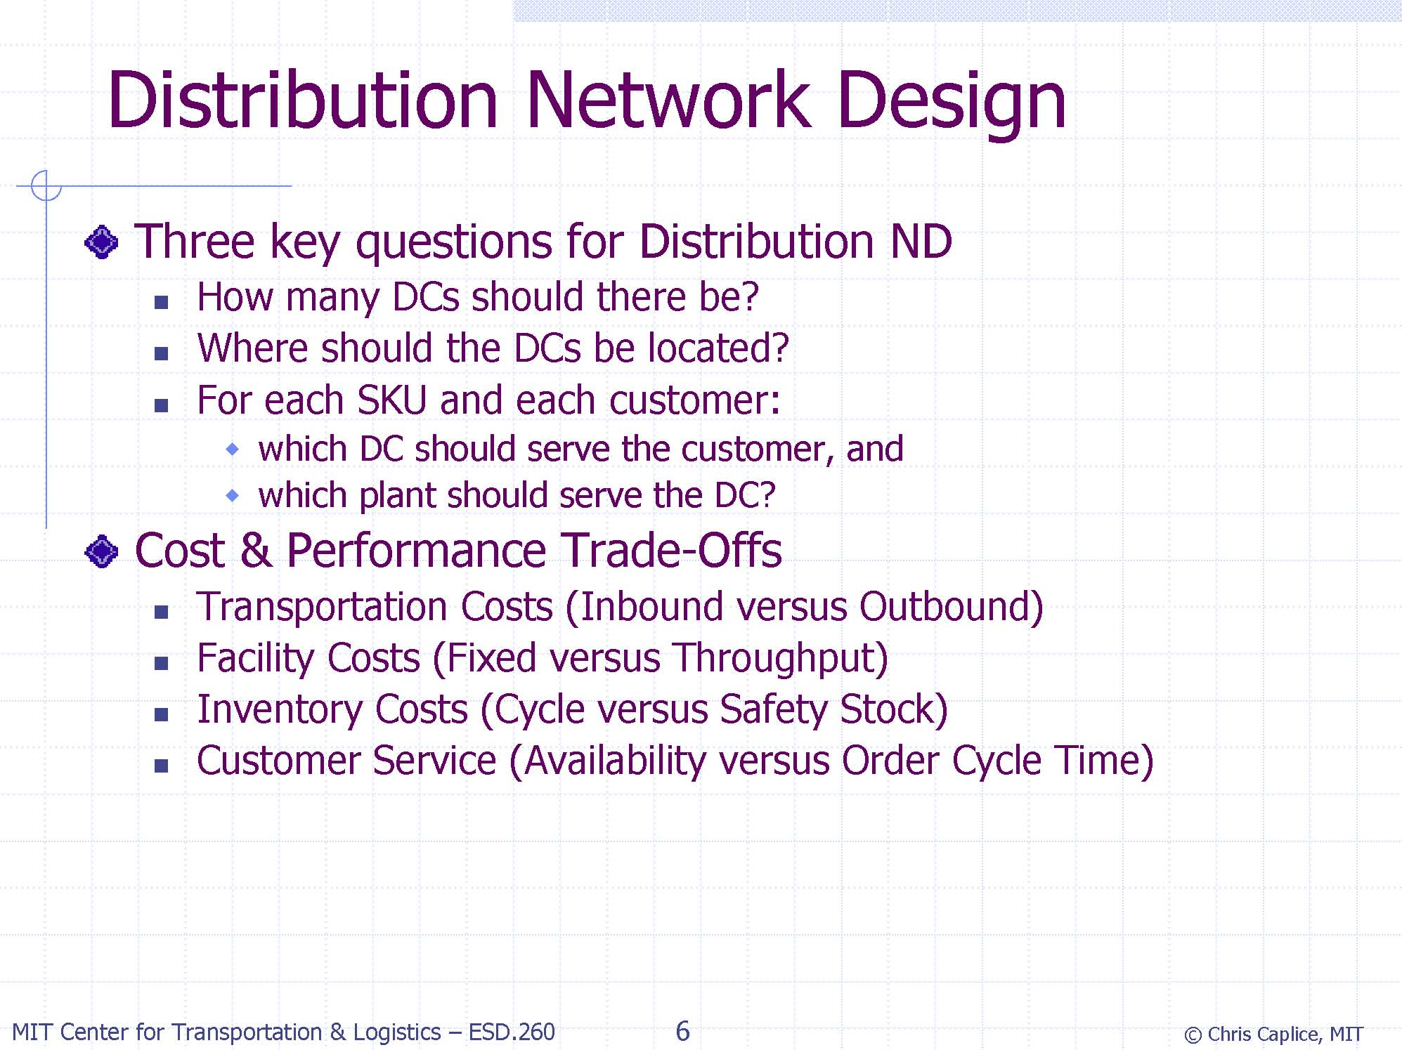

Slide 8
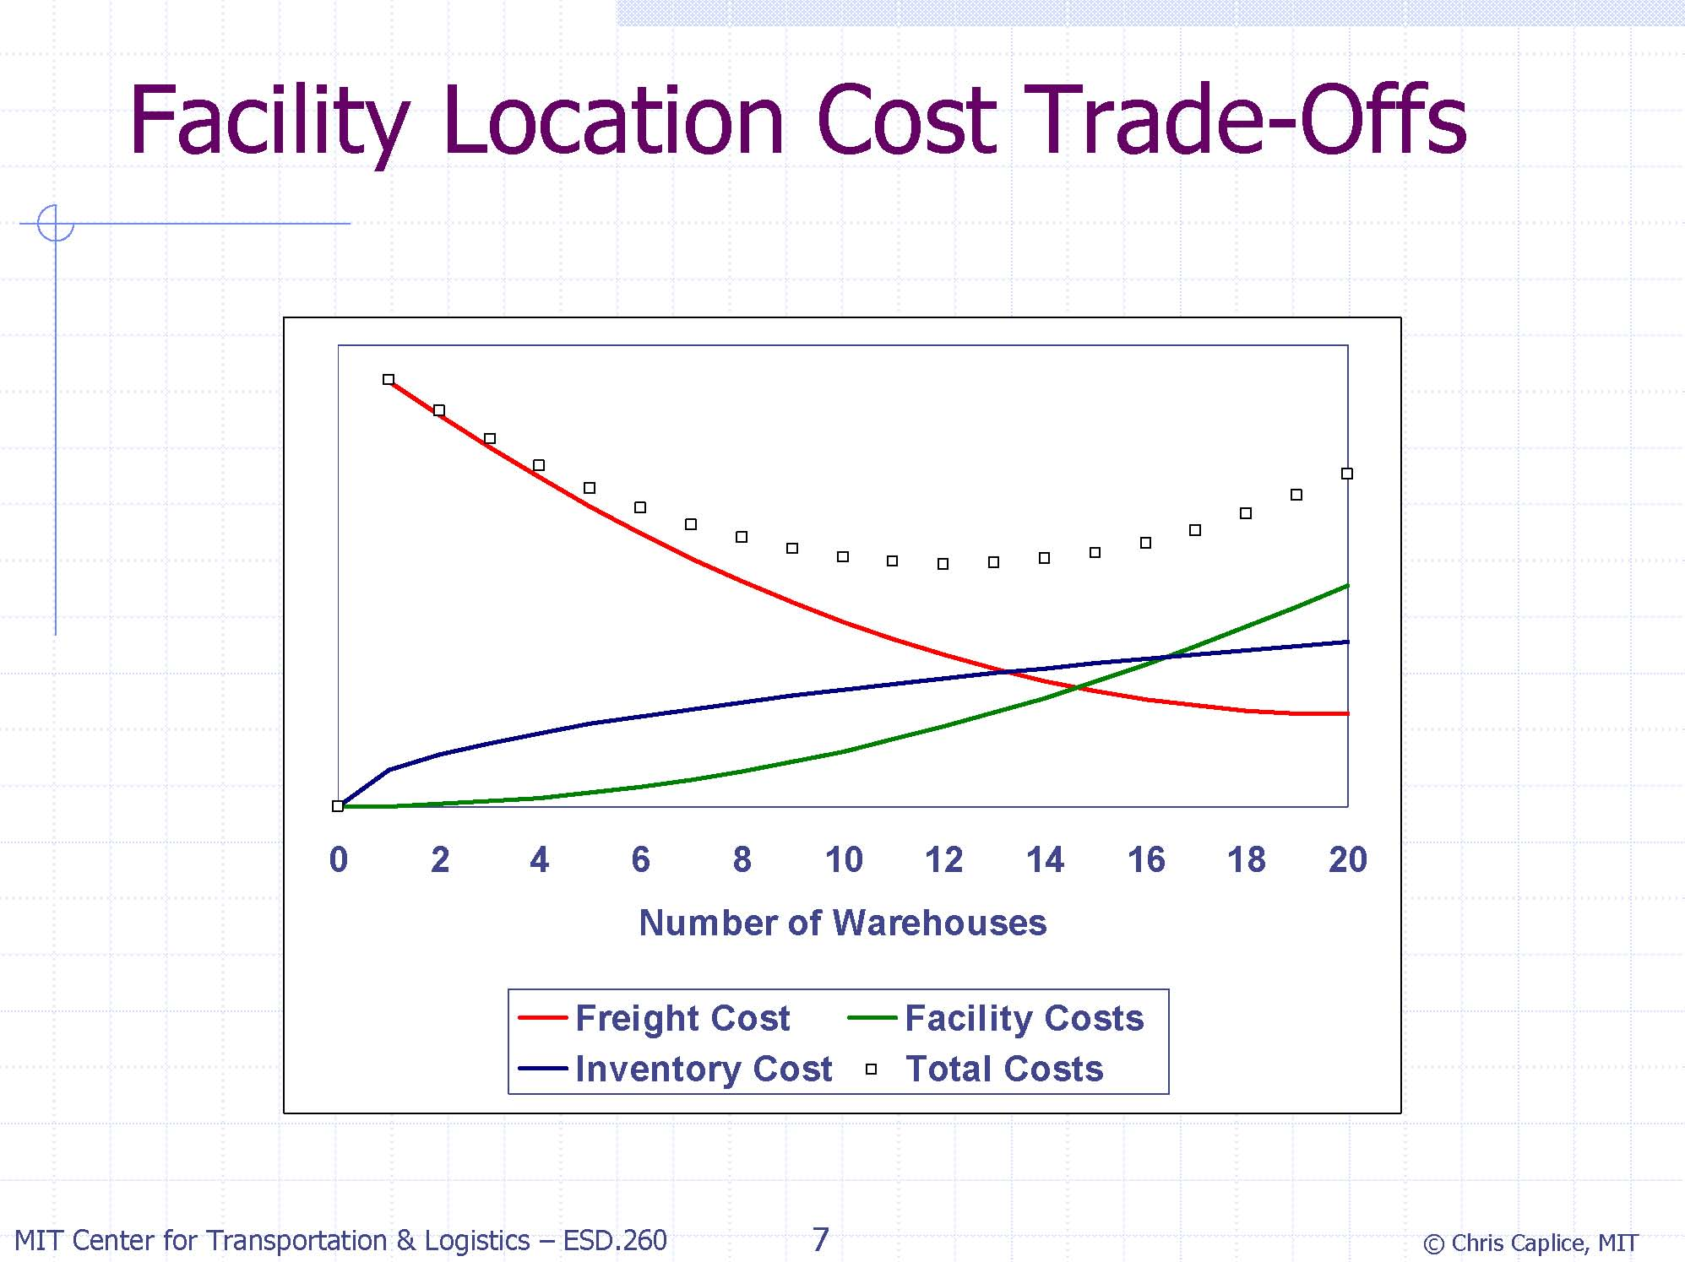

Slide 9
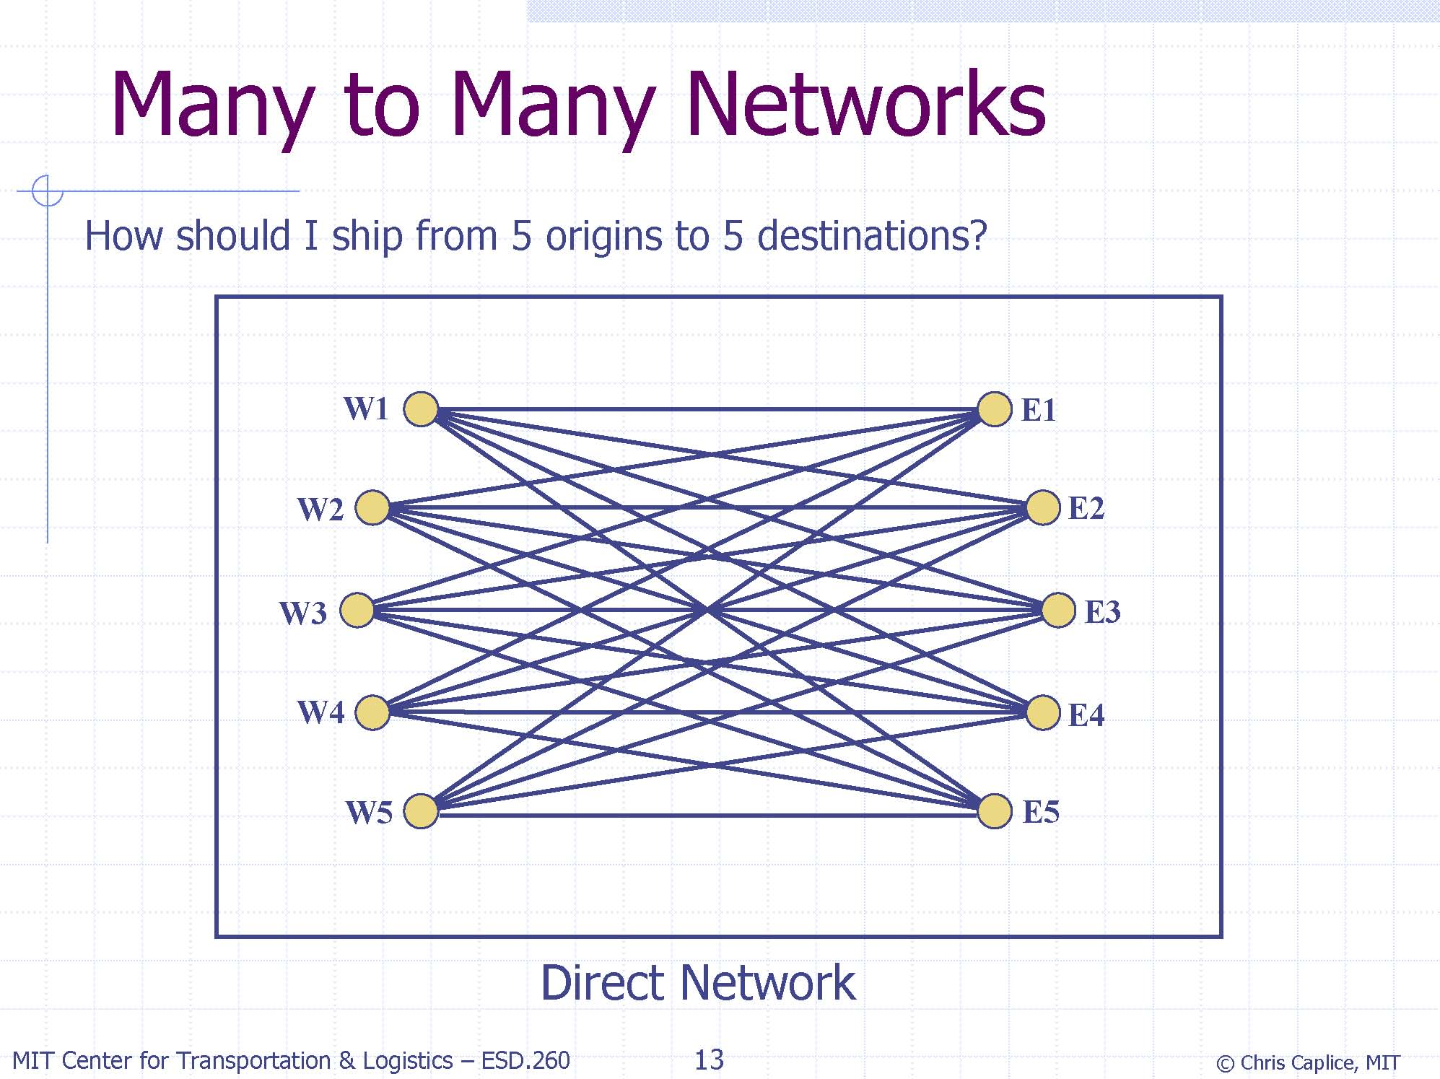

Slide 10
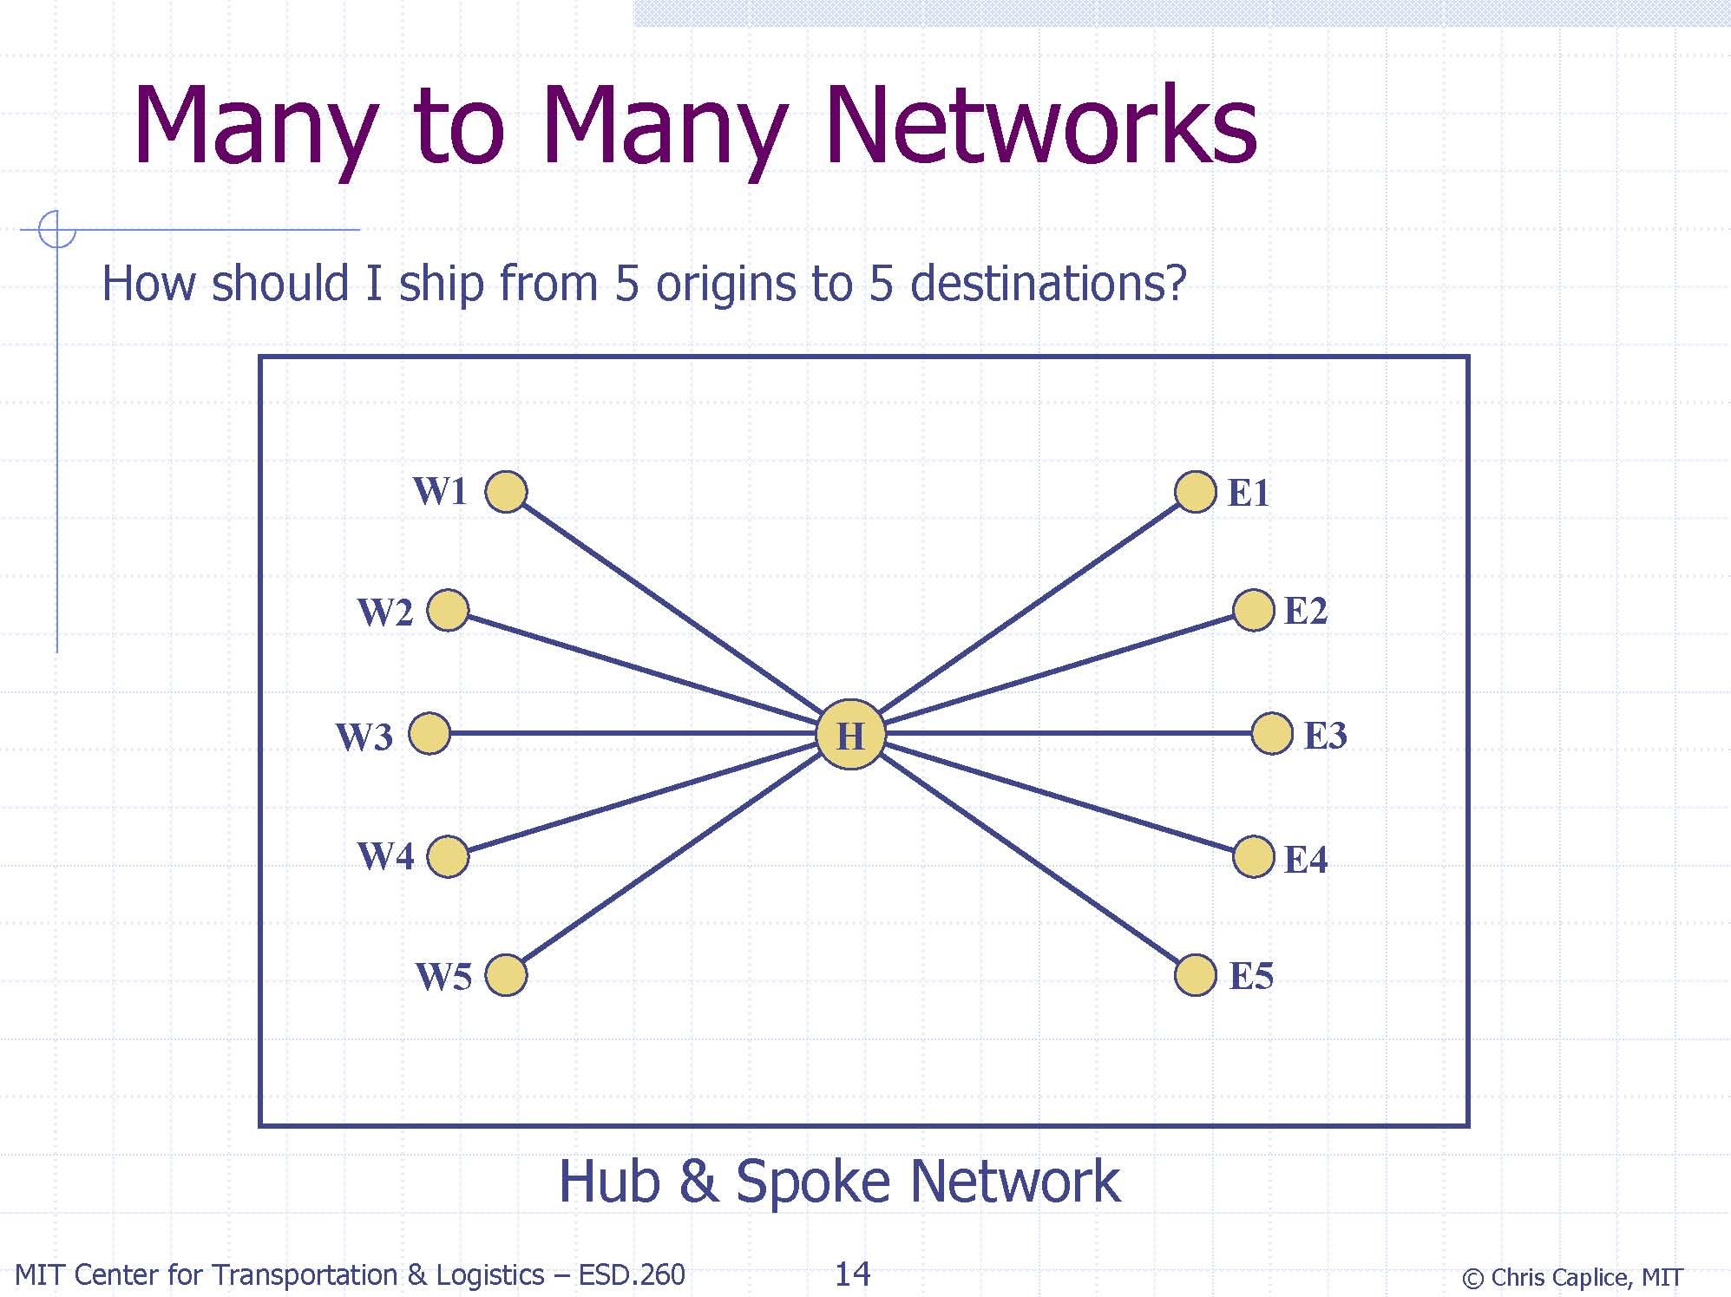

Slide 11
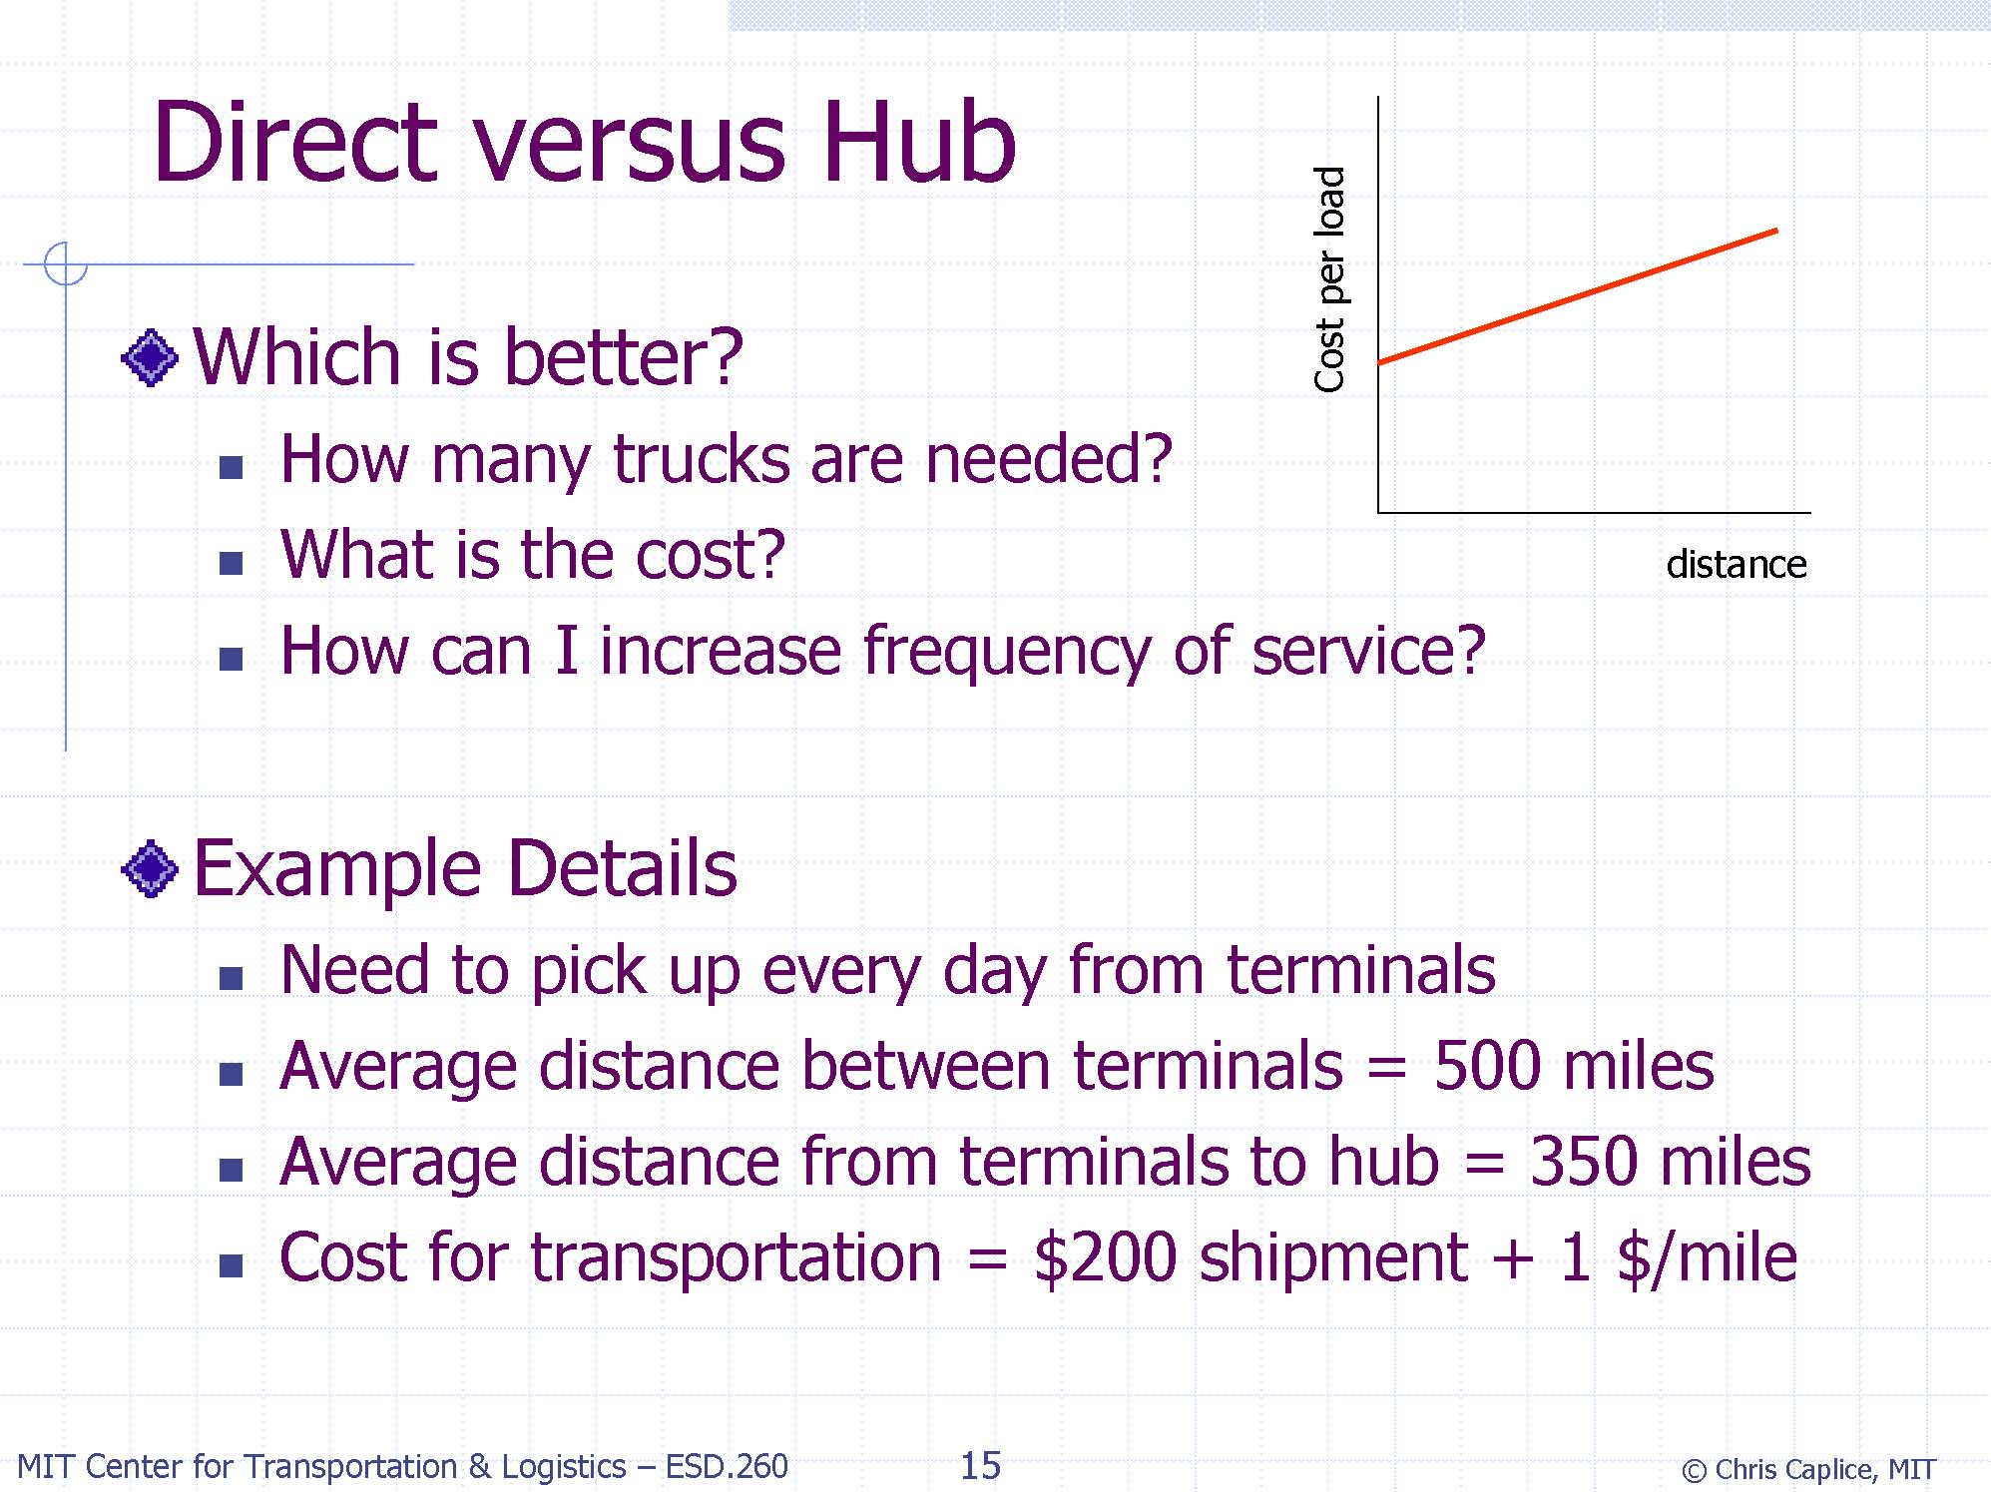

Slide 12
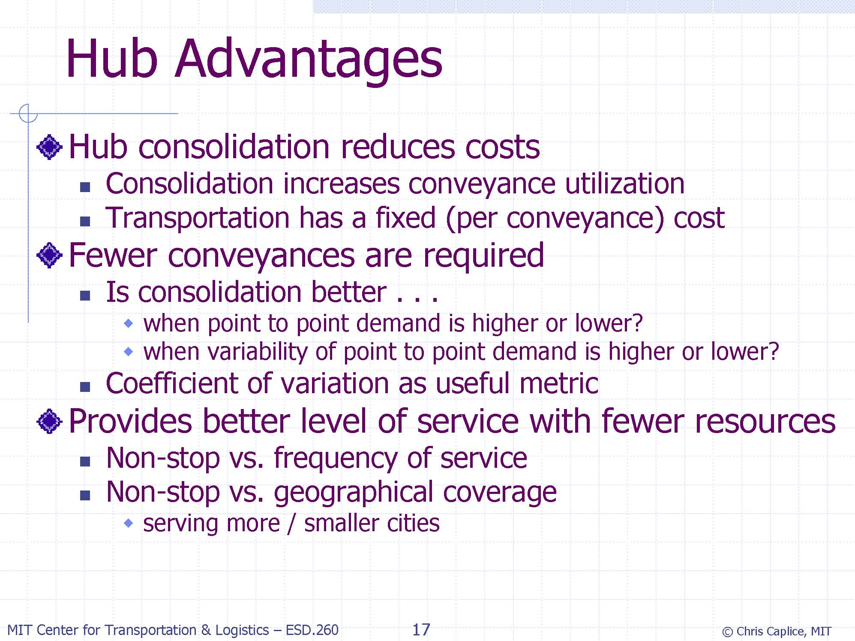

Slide 13
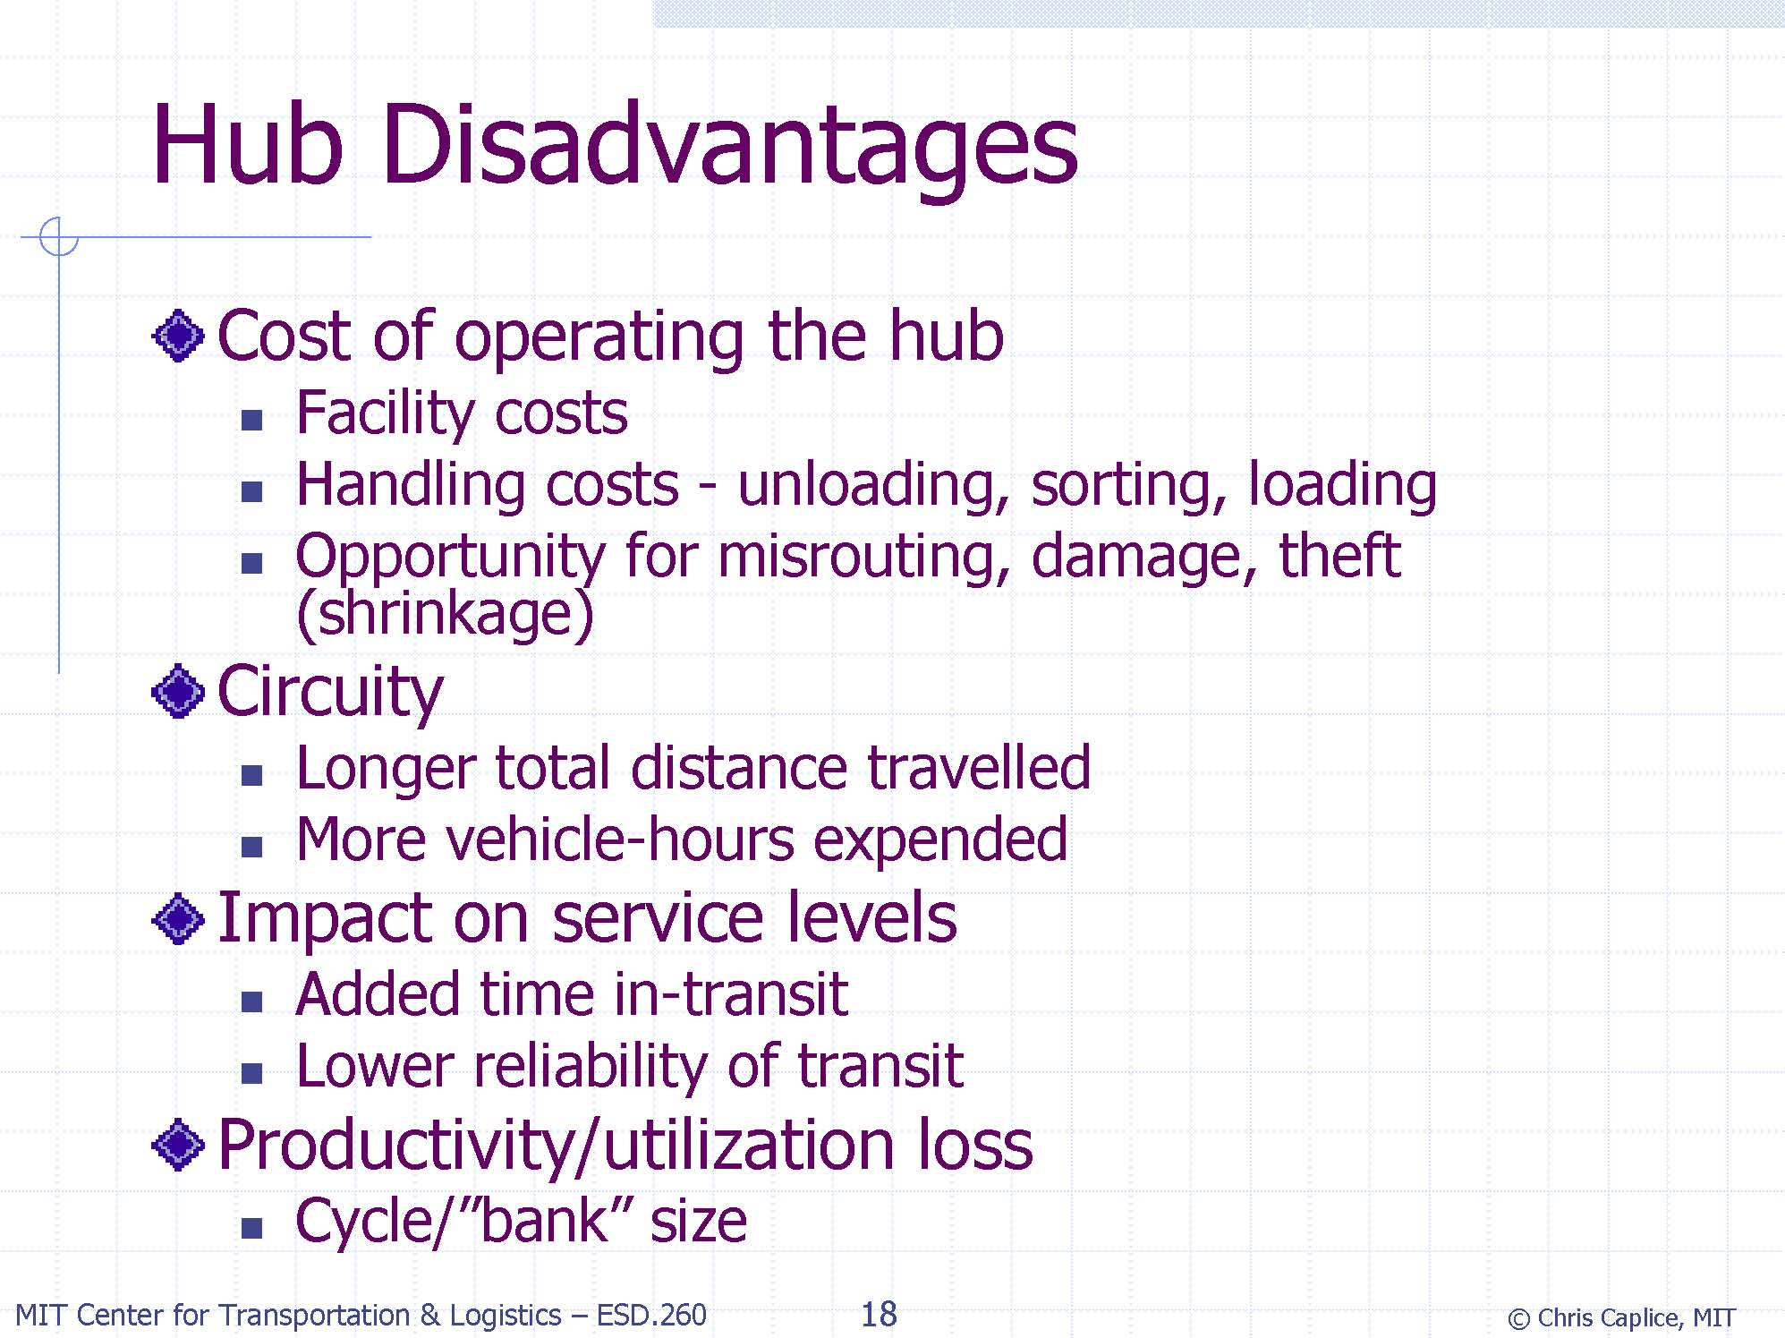

Slide 14
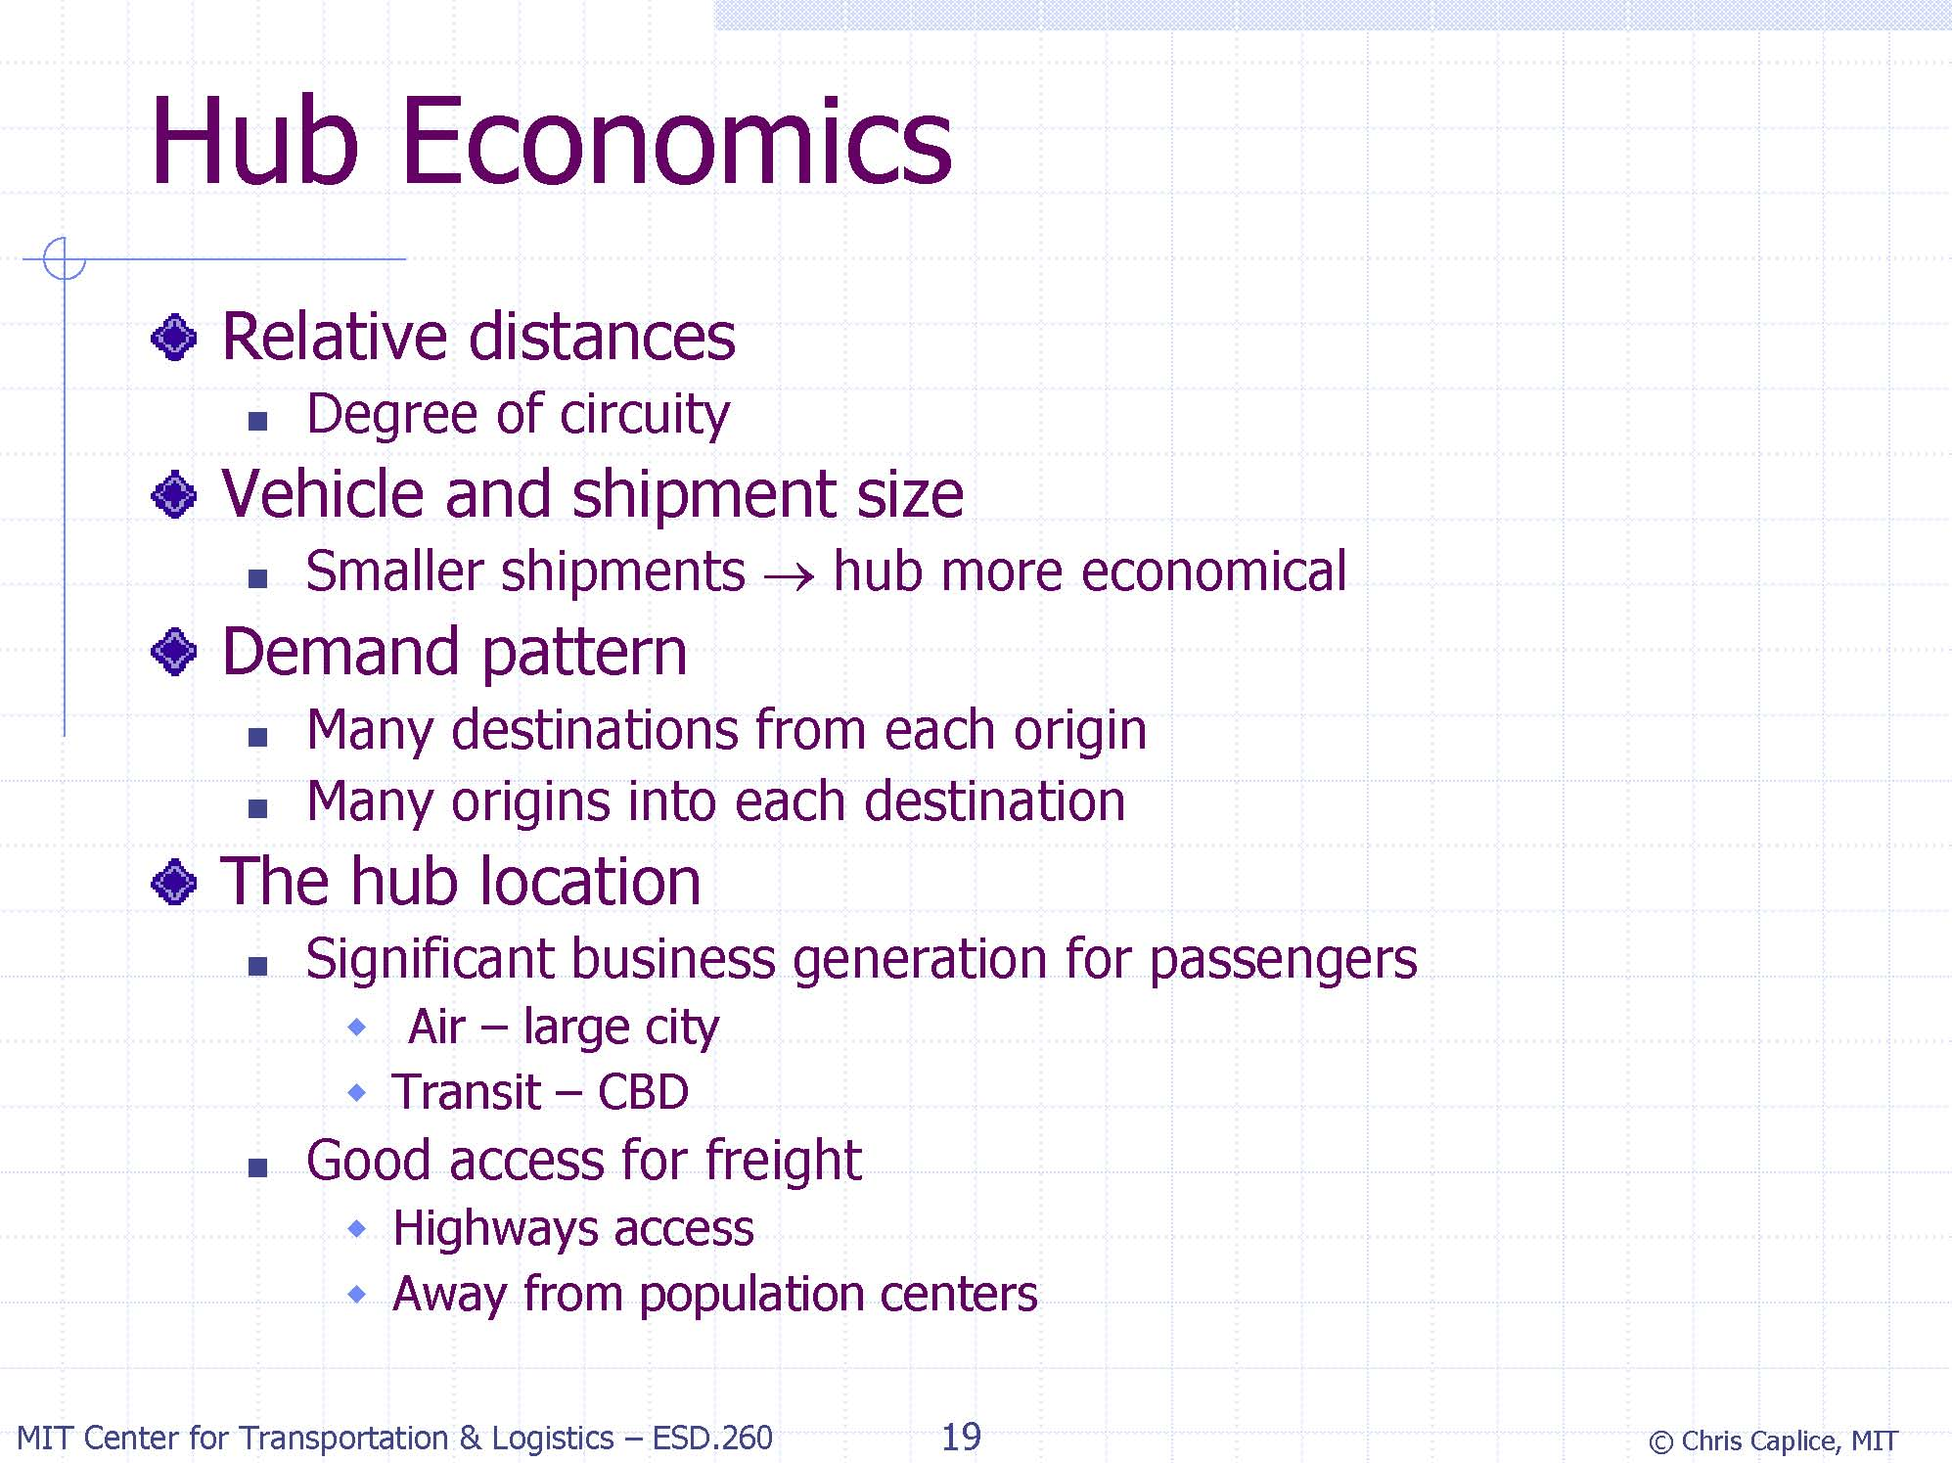

Slide 15
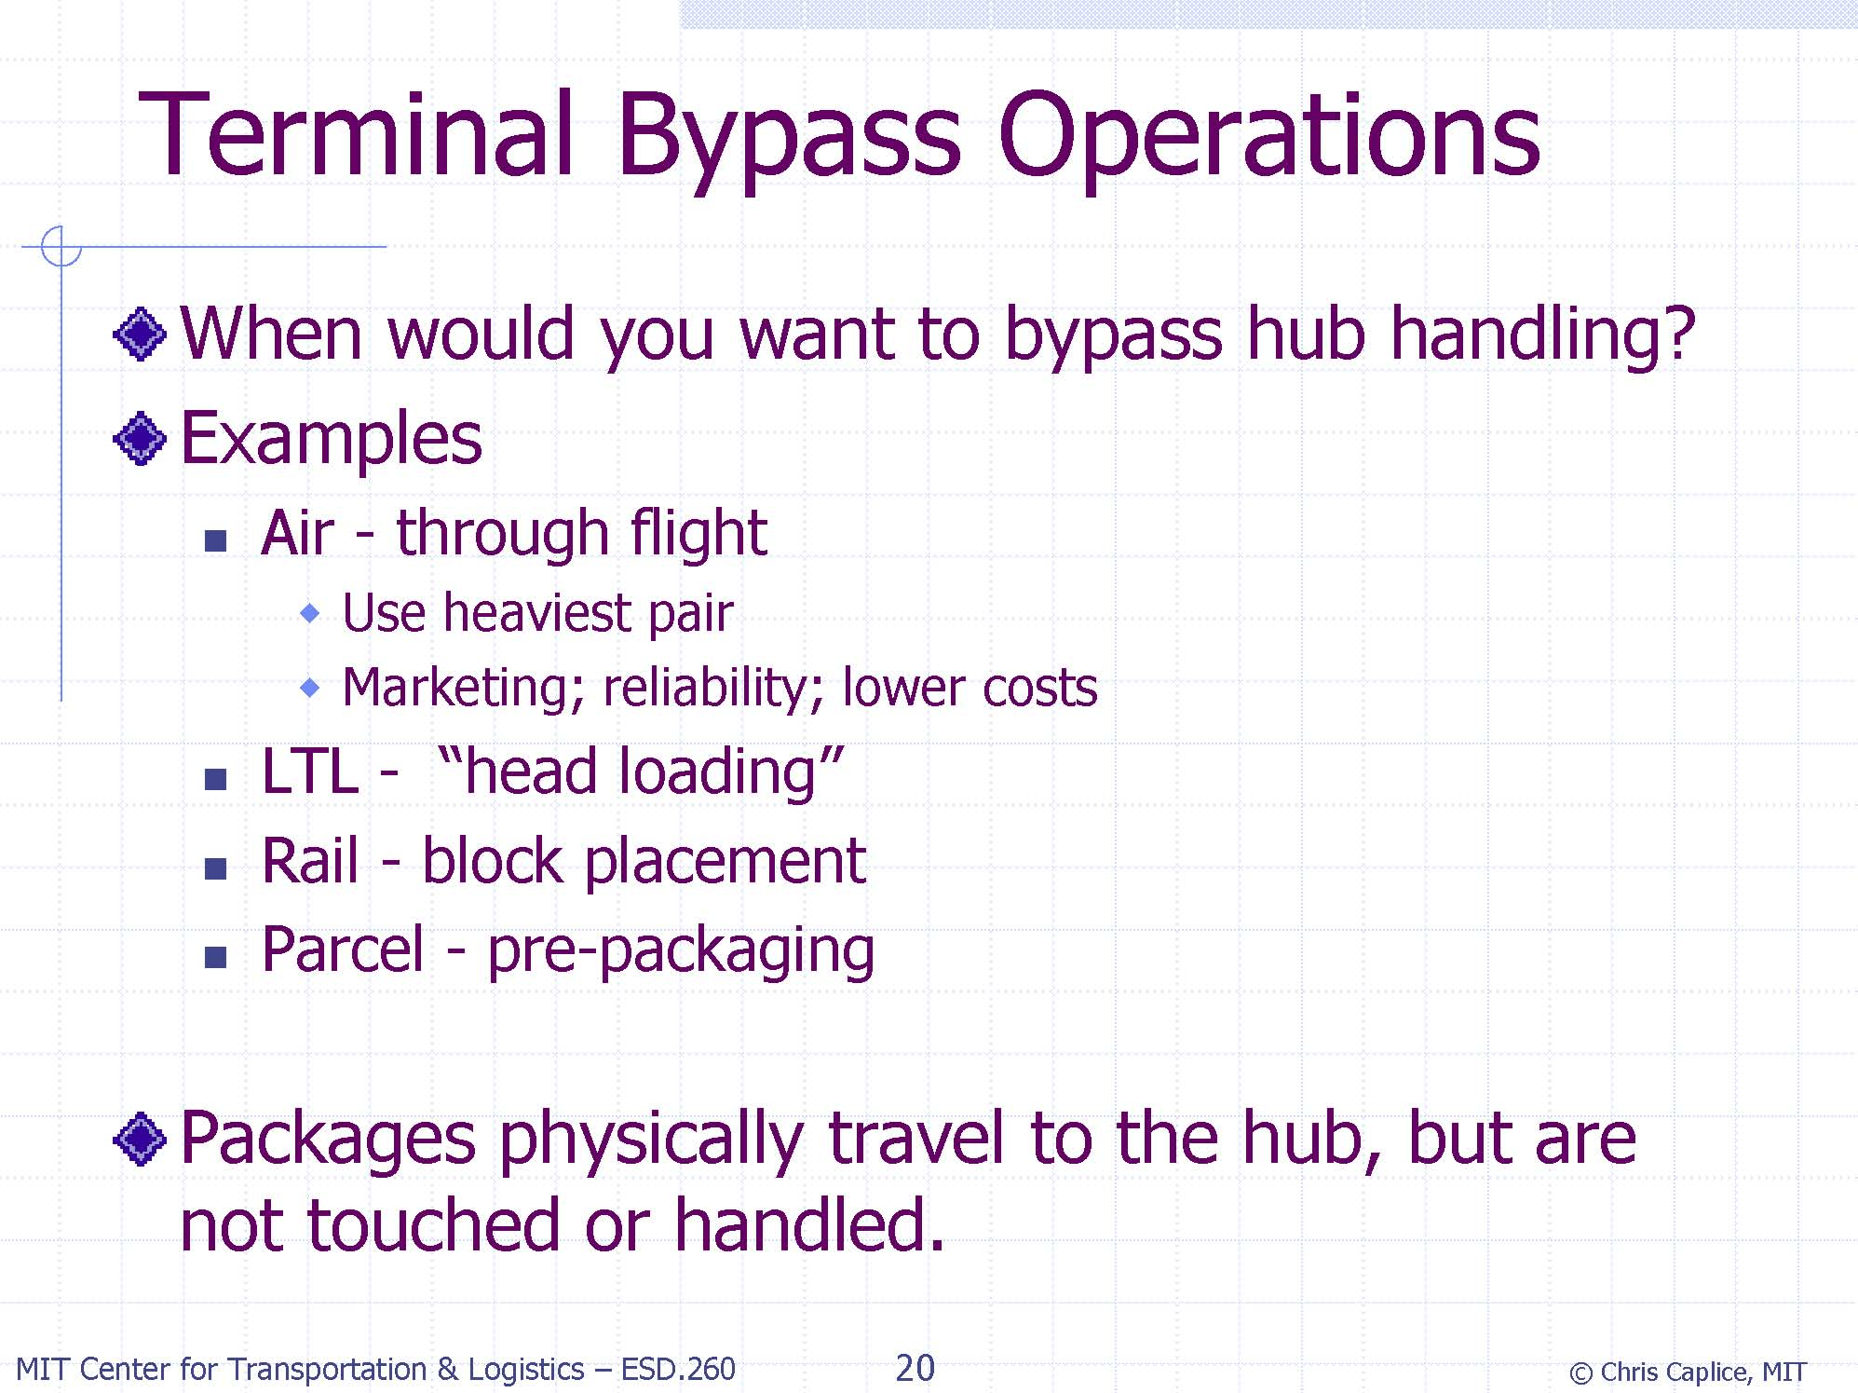

Slide 16
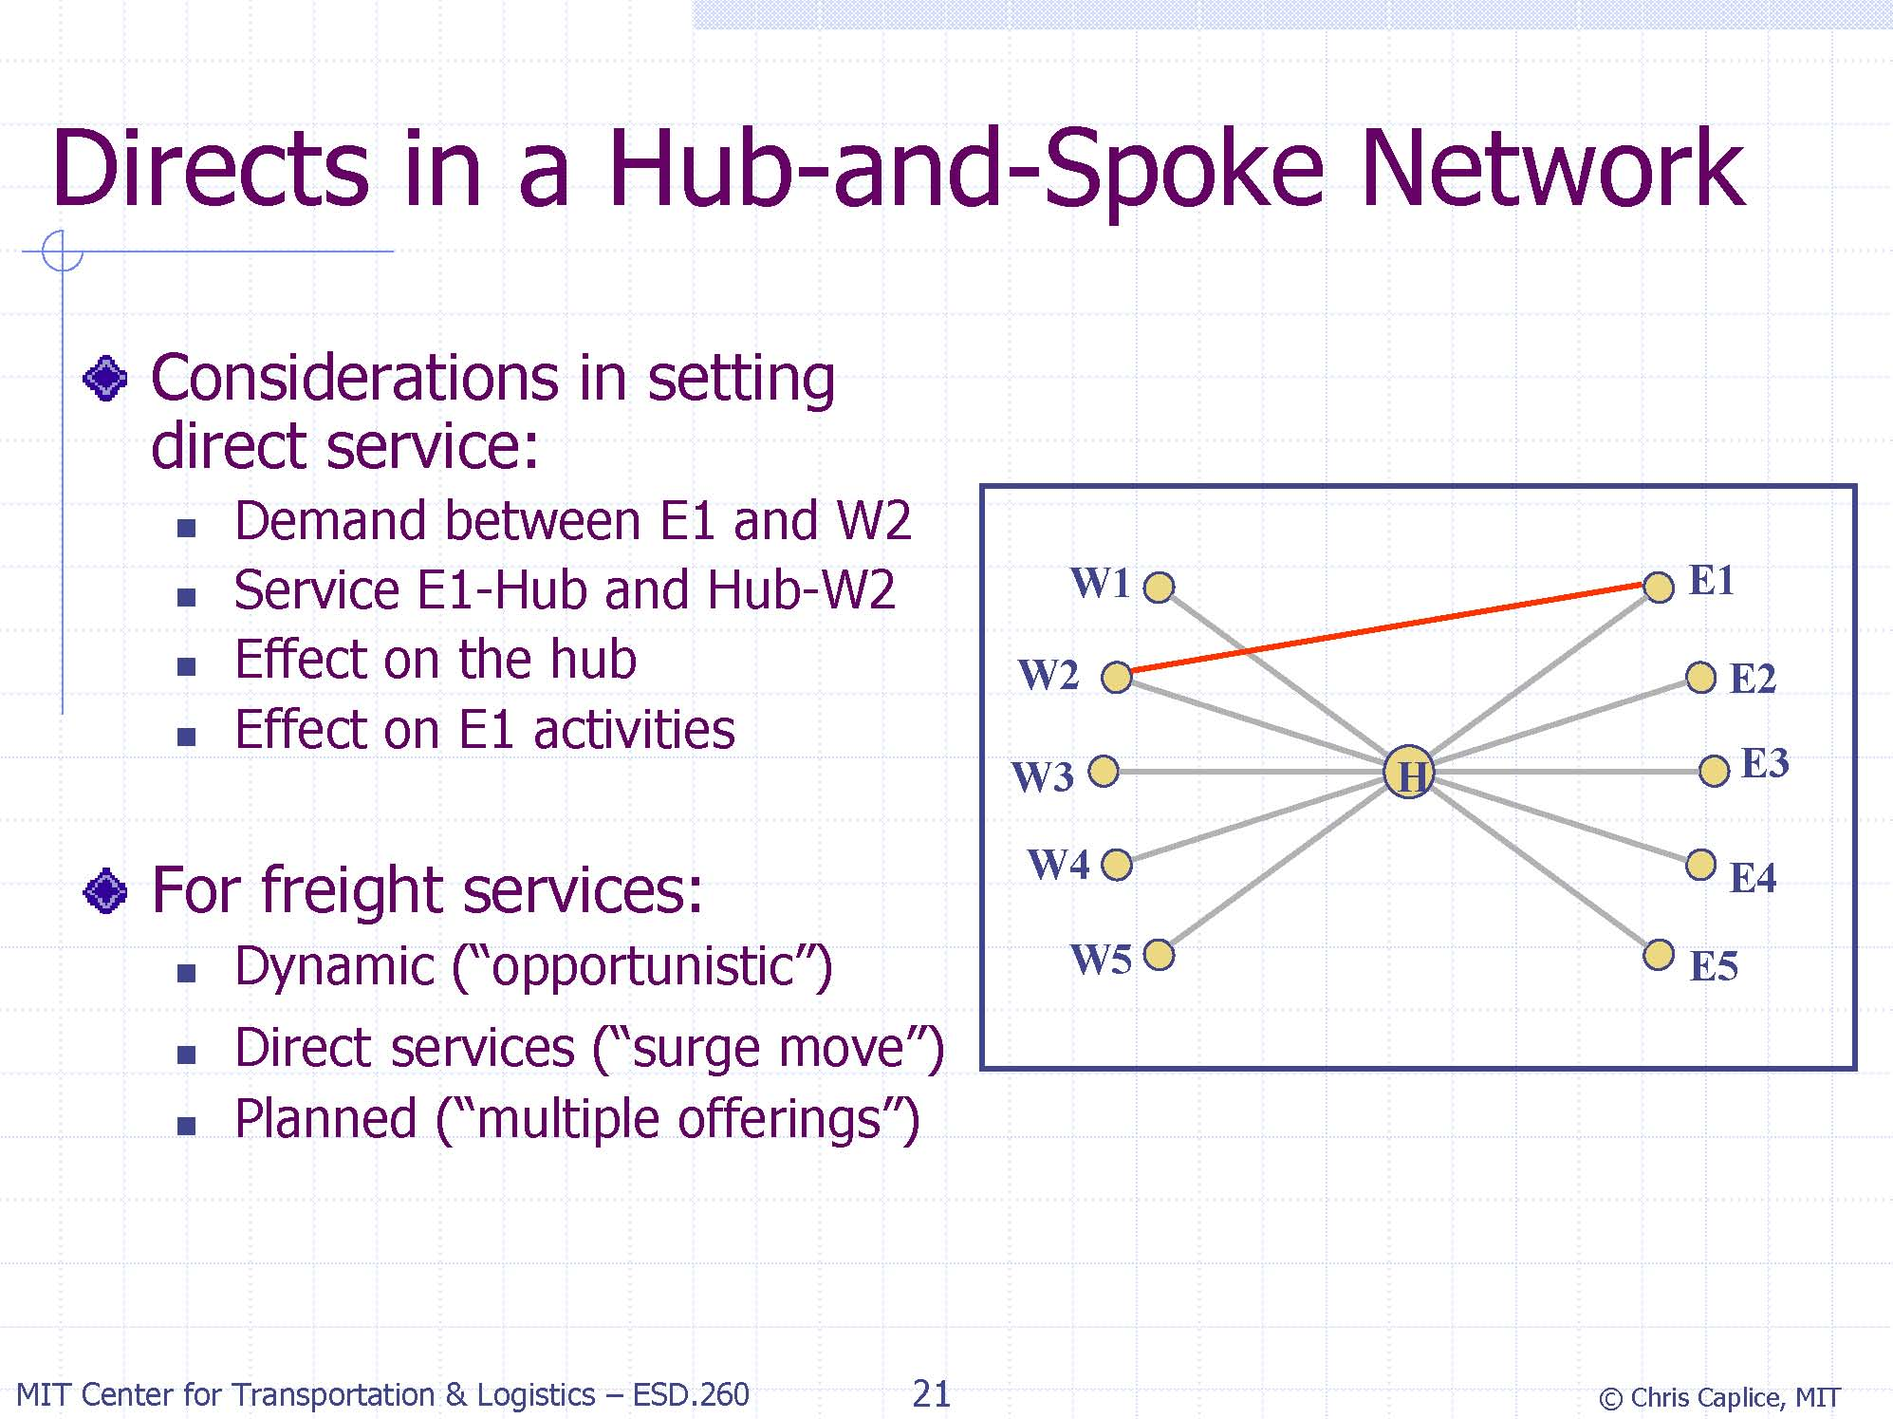

Slide 17
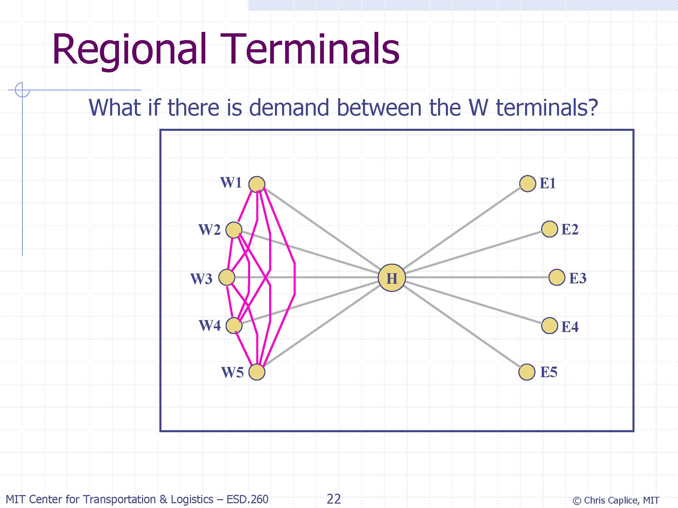

Slide 18
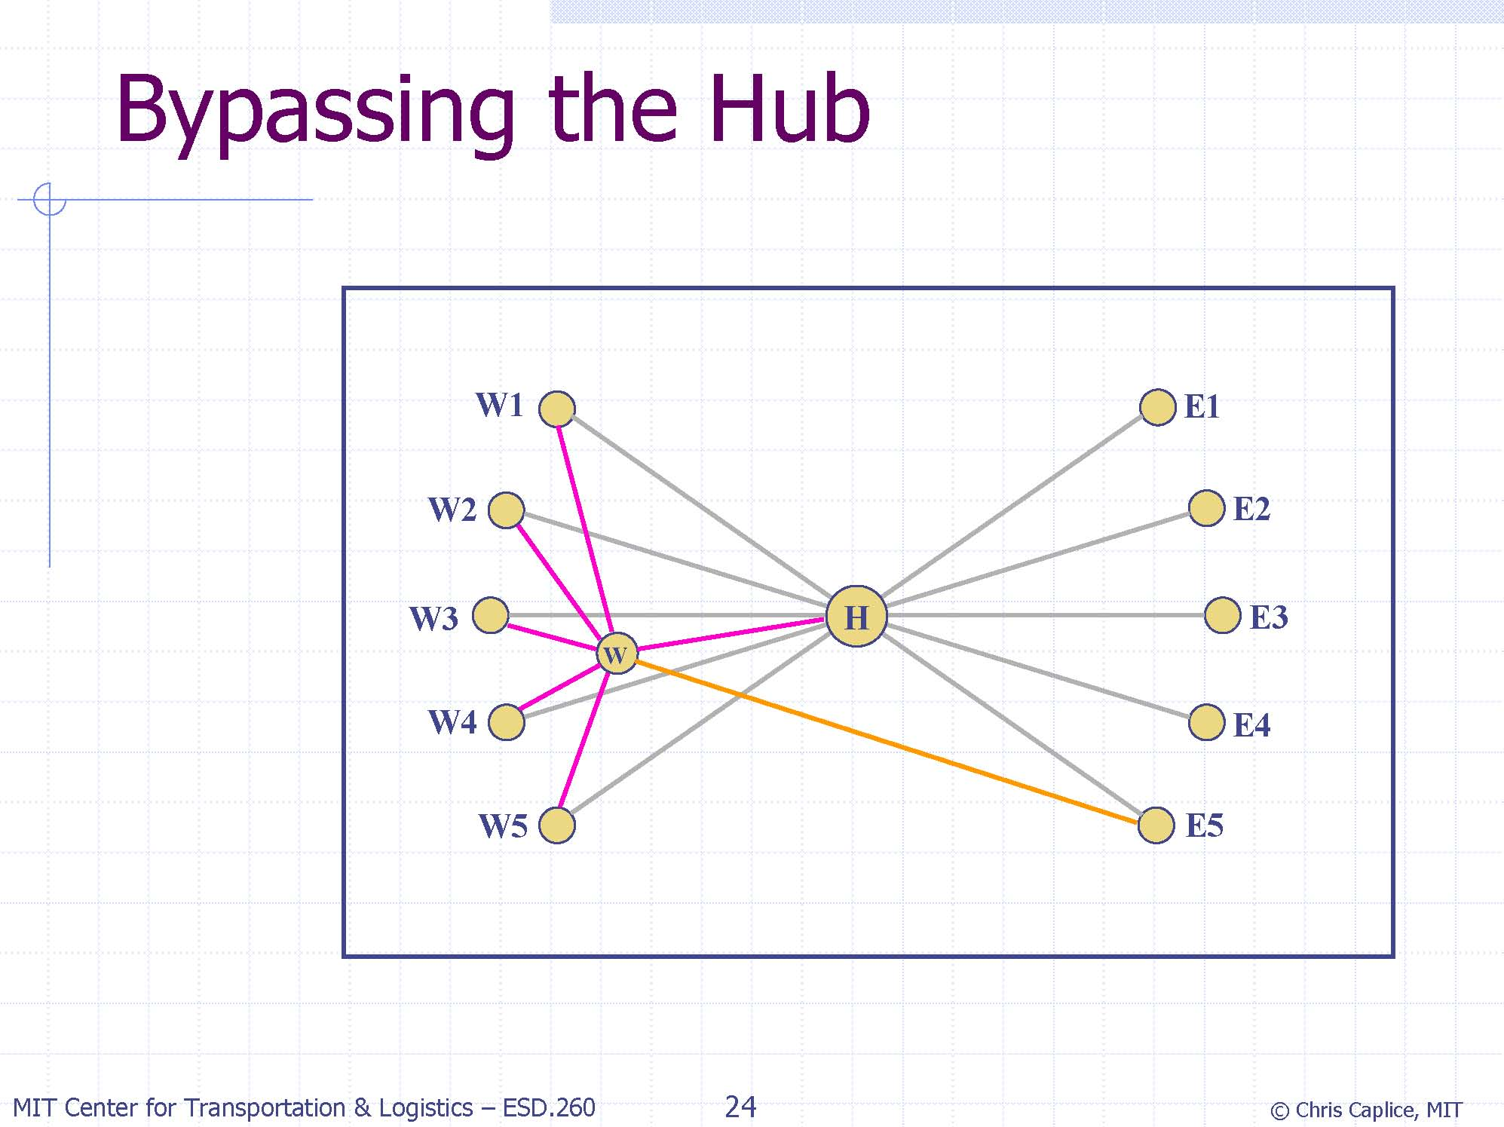

Slide 19
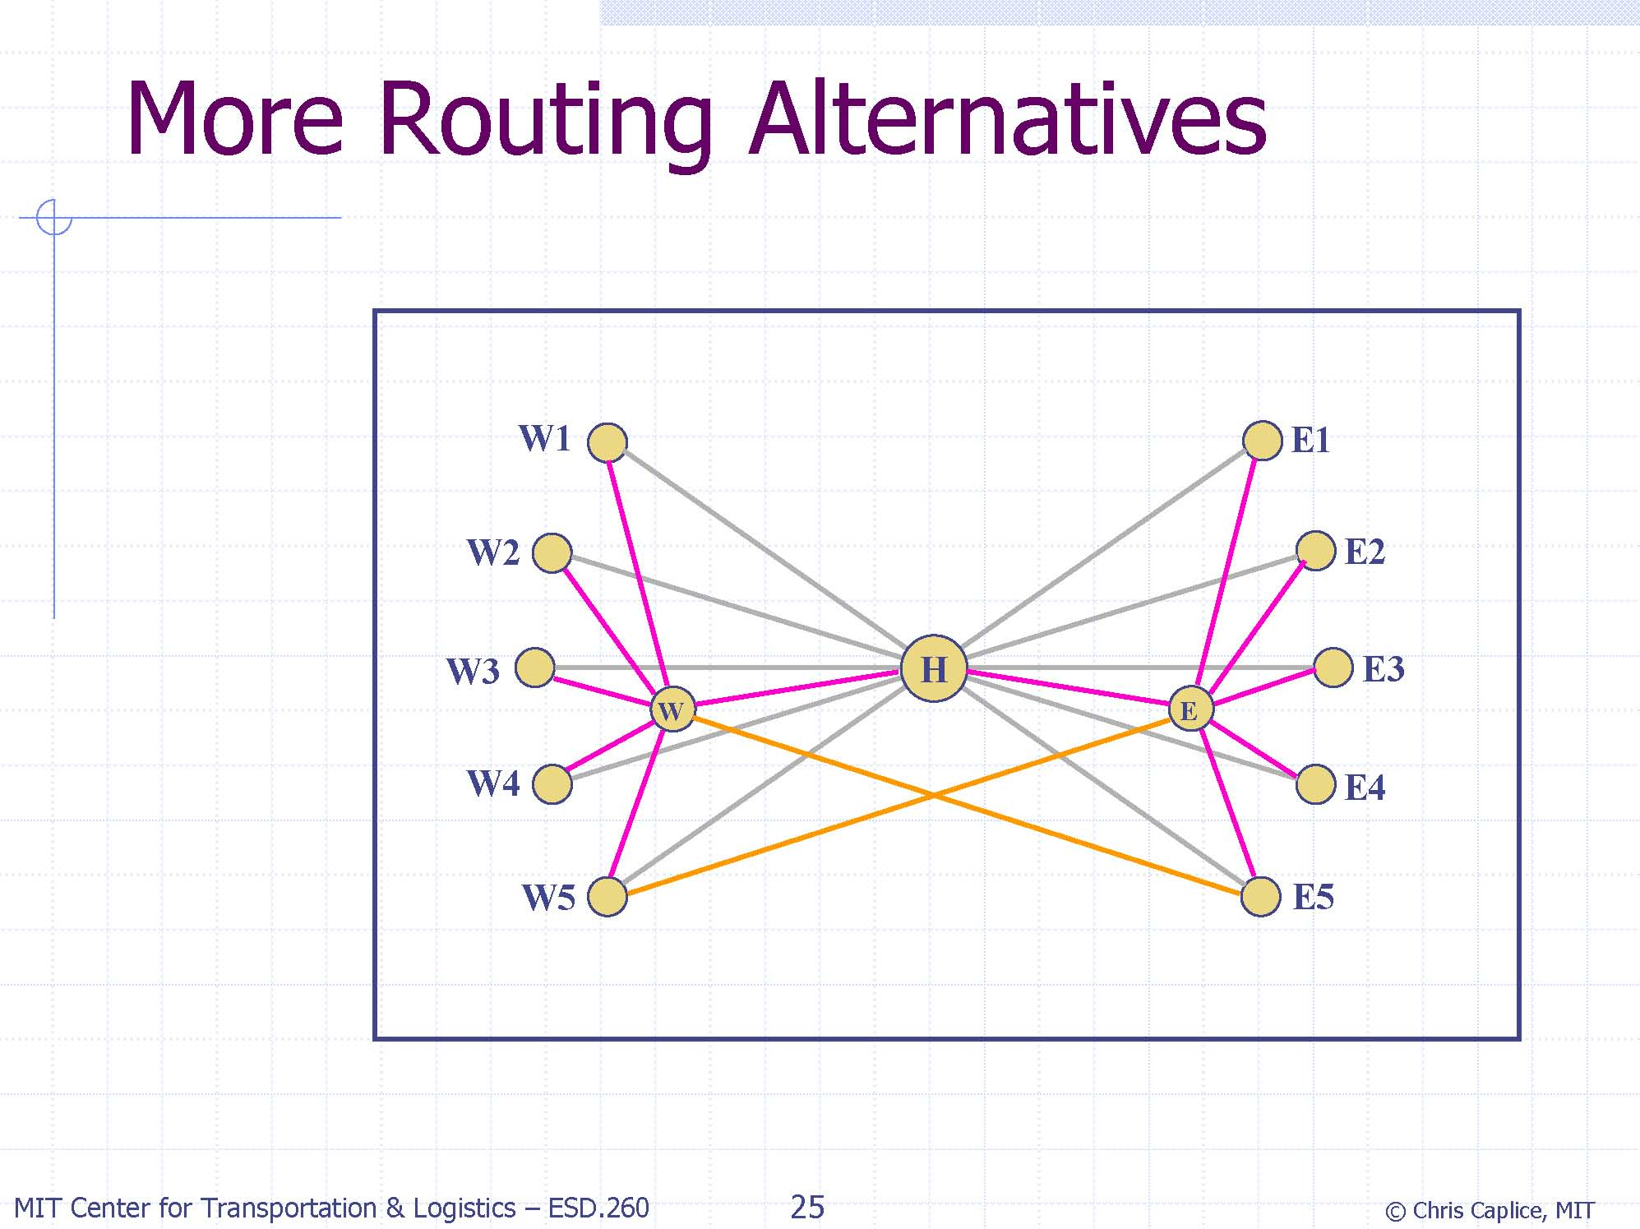

Slide 20
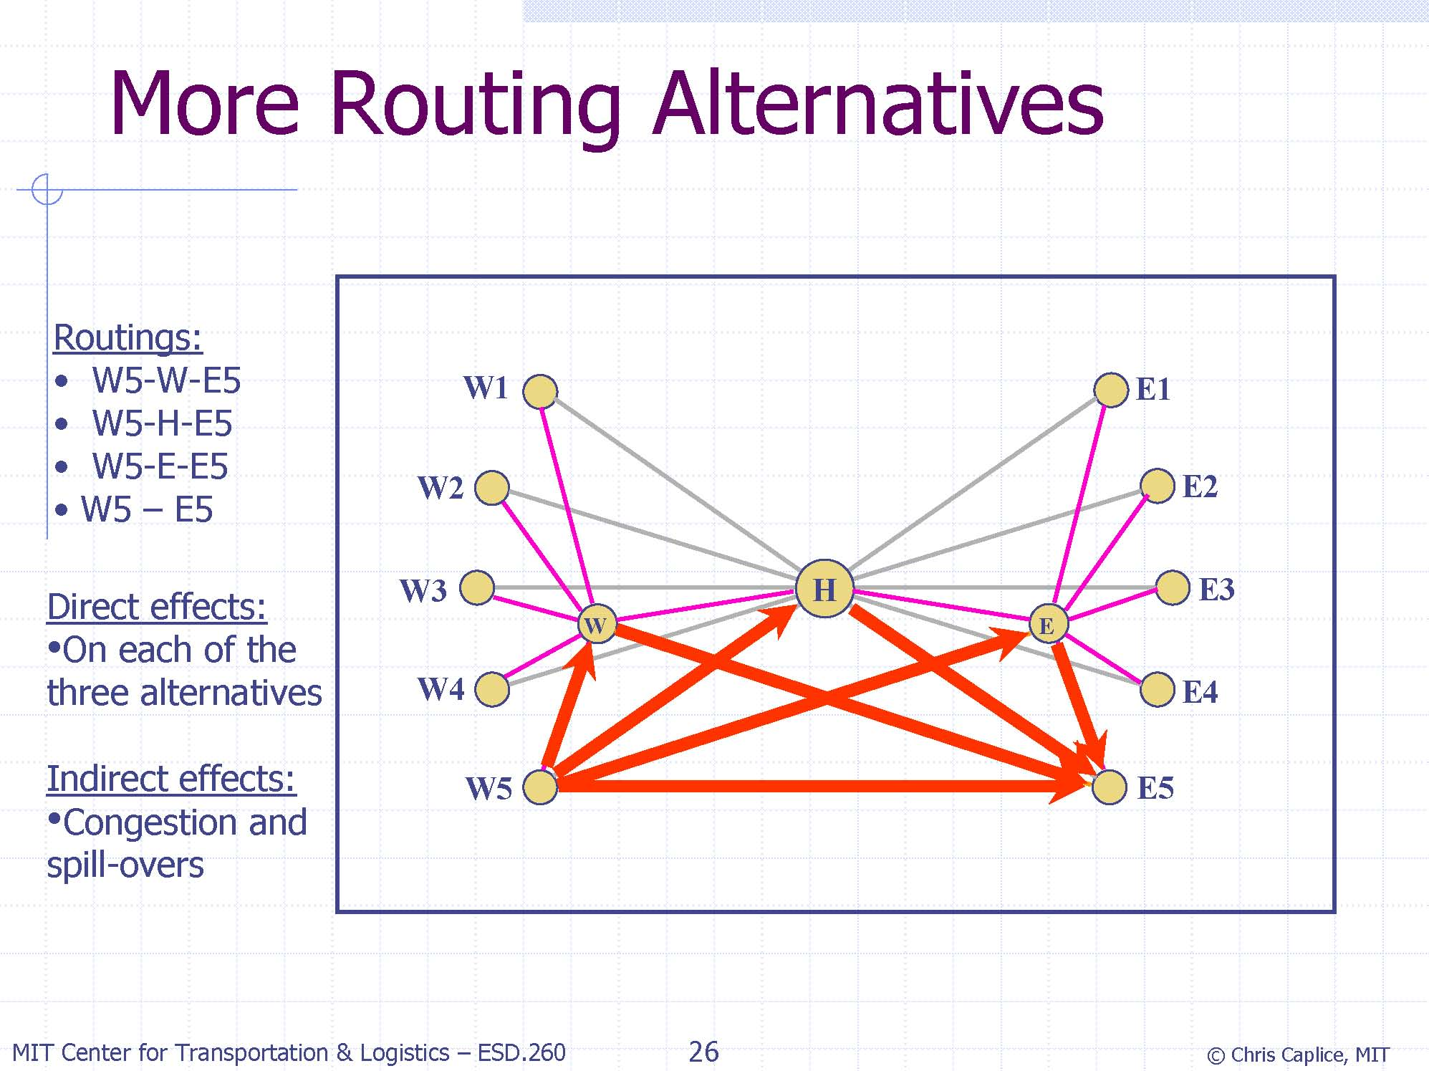

Slide 21
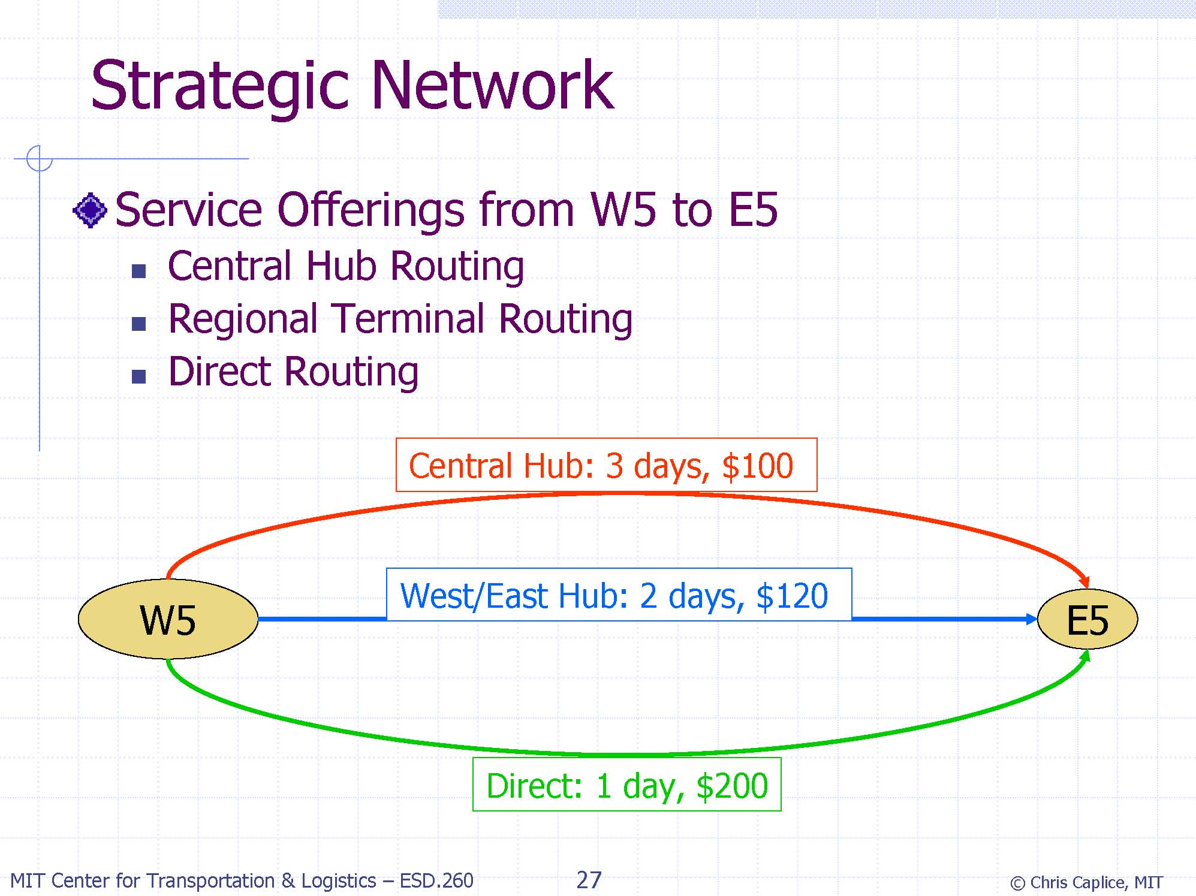

Slide 22
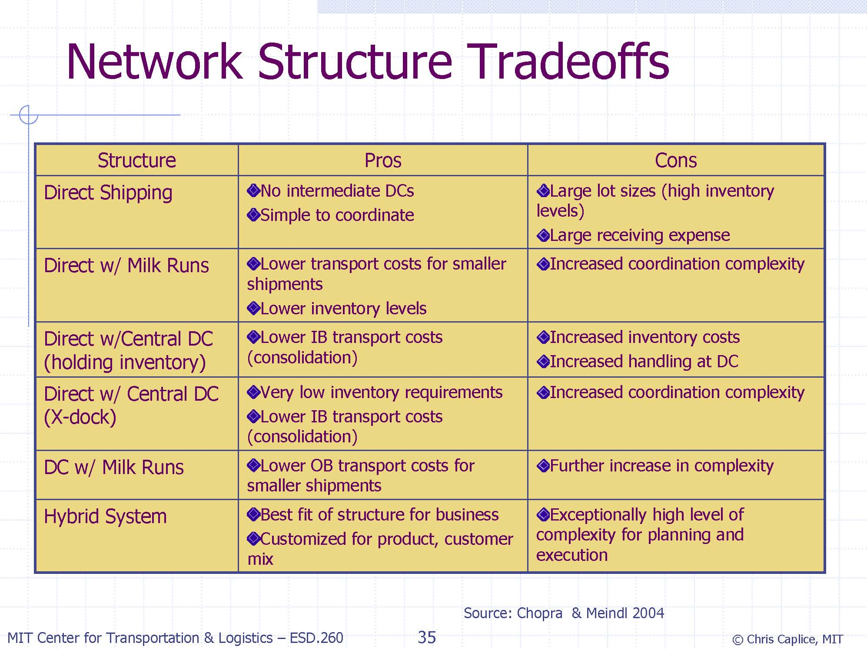

Slide 23
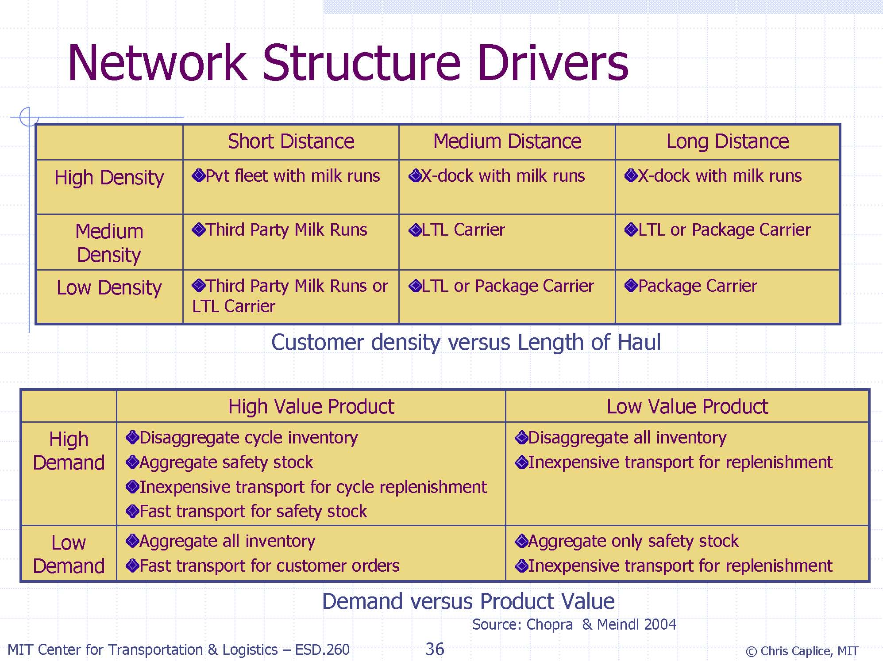

Slide 25
Designing the Logistics Network
May involve
  Determining the number of facilities (retailers, distirbution centers, warehouses etc)
  Determining the location of each facility
  Determining the size of each facility
  Allocations
  Transport modes
  Etc.

Slide 26
Different types of facilities
Manufacturing plants
Distribution centers (DCs)
  Reducing lead times
  Increasing product availability
  Economies pf scale through consolidation
  Level of support for emergency orders
  Consolidation point for reverse logistics
Retailers

Slide 27
Applications in 3 levels
Strategic level (Not easy to undone)
  Airport
  Metro system
  Major manufacturing facility
Tactical level (Should be good for 5 to 10 years)
  Warehose
  McDonalds
  Buslines
Operational level
  Post boxes
  Transfer points for trucks

Slide 28
Logistics Network Design
Objectives and criteria vary depending on the sector and on the type of facilities (DCs, plants, etc)
Criteria
  Location availability
  Cost
  Accessibility
  Coverage
  Market share
  Anti-accessibility (dump sites, bomb testing)

Slide 29
Location Problems
Suggest and identify options for
  Number
  Location
  Size of facilities
  Allocation of demands (supplies) to facilities

Slide 30
Logistics Part: A
QUIZ!
www.getkahoot.com
Don’t forget to enter nicknames as your ID’s.

