Slide 1
IE 102
Lecture 6
Critical Thinking

Slide 2
What is critical thinking?
Video – Leeds University
Critical thinking – “thinking based on logical reasoning and questioning, which enables you to reflect on the weaknesses and strengths of any evidence provided, draw conclusions and contribute new ideas to a topic.” – Open University (2008)
Even applies for daily routine (personal and worklife)

Slide 3
What is critical thinking? (cont.)
Videos: 2, 3.
Academic – Source: University of Toronto
A higher order of thinking
Focuses on thought : how not just what
Self-reflexive: involves reflecting on (questioning and testing) your own thinking process

Slide 4
What is critical thinking? (cont.)
Source: Univ. of Canberra-university disciplines
  Ask questions, relate theory to practice, find and use appropriate evidence, evaluate, find links, and categorize
  Science: Interpretation within a framework, describing, explaining, predicting, and identifying cause and effect
  Management: Identifying problems and solutions, relating theories to practice, and making comparisons and contrasts
+ IE (Eng) : use of mathematical reasoning, verbal/written communication skills

Slide 5
“Good” Critical Thinking
Source: University of Toronto
Following intellectual values:
Clarity, accuracy, precision, consistency, relevance, sound evidence, good reasons, depth, breadth, fairness.
Reading, writing (a lof of clues for your writing exercise)
Example activities (next slide)

Slide 6
Example activities
(Source: Univ of Canberra)
Interpreting according to a framework | Asking questions | Synthesizing
Relating theory to practice | Evaluating | Categorizing
Making claim and supporting it | Predicting | Establishing Cause and Effect
Using appropriate evidence | Describing | Comparing and Contrasting
Making links between ideas | Analyzing | Identifying problems and solutions

Slide 7
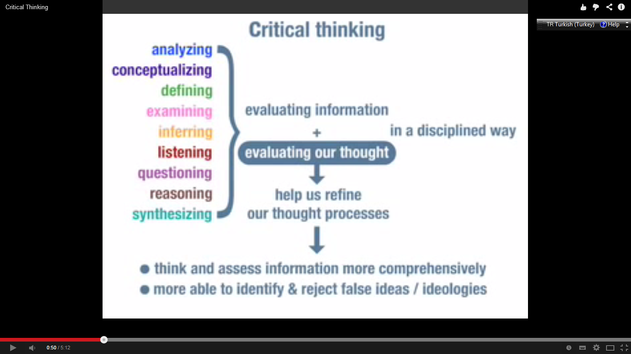
video – QualiaSoup - From the video

Slide 8
Core Critical Thinking Skills
Interpretation
Analysis
Inference
Evaluation
Explanation
Self-Regulation
Taken from: P.A. Faccione, Insight Assessment, 2011, Critical Thinking: What it is and why it counts http://www.student.uwa.edu.au/__data/assets/pdf_file/0003/1922502/Critical-Thinking-What-it-is-and-why-it-counts.pdf

Slide 9
Core Critical Thinking Skills
Skills | Experts’ Description | Subskill
Interpretation | To comprehend and express the meaning or significance of a wide variety of experiences, situations, data, events, judgments, conventions, beliefs, rules, procedures, or criteria | Categorize, Decode signifciance, clarify meaning
Analysis | To identify the intended and actual inferential relationship among statements, questions, concepts, descriptions, or other forms of representation intended to express belief judgment, experiences, reasons, information, or opinions | Examine ideas, Identify arguments, Identify reasons and claims

Slide 10
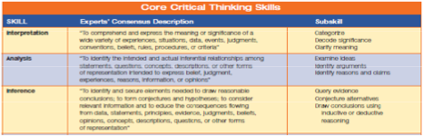
Core Critical Thinking Skills
Skills | Experts’ Description | Subskill
Inference | To identify and secure elements needed to draw reasonable conclusions; to form conjectures and hypothesis; to consider relevant information and to educe the consequences flowing from data, statements, principles, evidences, judgements, beliefs, opinions, concepts, descriptions, questions or other forms of representation | Query evidence, Conjecture alternatives, Draw conclusions using inductive or deductive reasoning
Evaluation | To assess the credibility of statements or other representations that are accounts or descriptions of a person’s perception, experience, situation, judgement, belief, or opinion and to assess the logical strength of the actual or intended inferential relationships among statements, descritptions, questions, or other forms of representation. | Access credibility of claims, Assess quality of arguments that were made using inductive or deductive reasoning

Slide 11
Core Critical Thinking Skills
Skills | Experts’ Descritption | Subskill
Explanation | To state and to justify that reasoning in terms of the evidential, conceptual, methodological, criteriological, and contextual considerations upon which one’s results were based: and to present one’s reasoning in the form of cogent arguments. | State results, Justify procedures, Present arguments
Self Regulation | Self-consciously monitor one’s cognitive activities, the elements used in those activities and the results educed, particularly by applying skills in analysis, and evaluation to one’s own inferential judgements with a view toward questioning, confirming, validating, or correcting either one’s reasoning or one’s results | Self-monitor Self-correct

Slide 12
Core Critical Thinking Skills
Questions to fire up critical thinking skills

Slide 13
Questions
Skills
Interpretation | What does this mean? What’s happening? How should we understand that? (or what s/he just said?) What is the best way to characterize/categorize/classify this? What was intended by saying / doing that? How can we make sense out of this (experience, feeling, statement?
Analysis | Please tell us again your reasons for making that claim What is your conclusion? What is that you are claiming?Why do you think that? What are the arguments pro and con? What assumptions must we make to accept that conclusion? What is your basis for saying that?

Slide 14
Questions
Skills
Inference | Given what we know so far, what conclusions can we draw? Given what we know so far, what can we rule out? What does this evidence imply? If we abandoned/accepted that assumption, how would things change? What additional information do we need to resolve this question? If we believed these things, what would they imply for us going forward? What are the consequences of doing things that way? What are some alternatives we haven’t yet explored? Let’s consider each option and see where it takes us Are there any undesirable consequences that we can and should foresee?
Evaluation | How credible is that claim? Why do we think we can trust what this person claims? How strong are those arguments? Do we have our facts right? How confident can we be in our conclusion, given what we know?

Slide 15
Questions
Skills
Explanation | What were the specific findings/results of the investigation? Please tell us how you conducted that analysis? How did you come to that interpretation? Please take us through your reasoning one more time Why do you think that (was the right answer/was the solution)? How would you explain why this particular decision was made?
Self Regulation | Our position on this issue is still too vague, can we be more precise? How good was our methodology and how well did we follow it? Is there a way we can reconcile these two apparently conflicting conclusions? How good is our evidence? OK, before we commit, what are we missing? I’m finding some of our definitions a little confusing, can we revisit what we mean by certain things before making any final decisions?

Slide 16
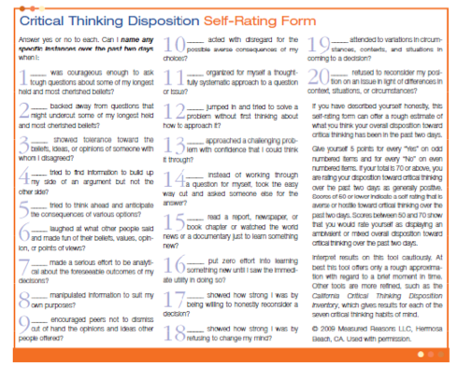

Slide 18
Summary
Critical thinking abilities are off utmost importance for IE’s
Modeling real life includes other’s opinion and their possible biases
Your own context (or role) is important
Example: Ranking for selecting universities/departments
IE’s role:
Support Decision Making Process

Slide 19
Critical Thinking
QUIZ!
www.getkahoot.com
Don’t forget to enter nicknames as your ID’s.

