Slide 1
IE 102 Spring 2017
Routing Through Networks - 1

Slide 2
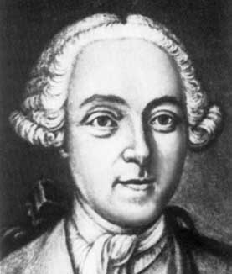
The Bridges of Koenigsberg: Euler 1735
“Graph Theory” began in 1735
Leonard Eüler
  Visited Koenigsberg
  People wondered whether it is possible to take a walk, end up where you started from, and cross each bridge in Koenigsberg exactly once
  Generally it was believed to be impossible

Slide 3
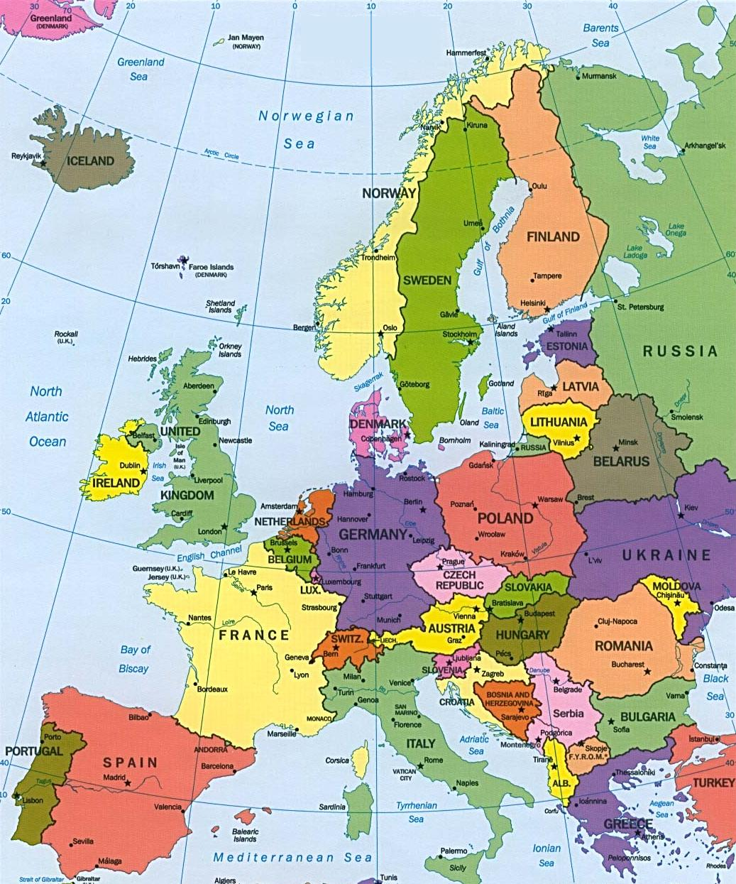

Slide 4
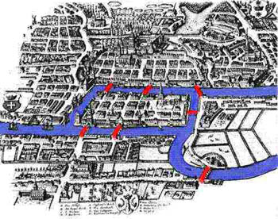

Slide 5
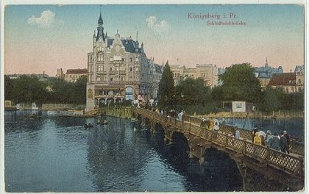

Slide 6
The Bridges of Koenigsberg: Euler 1736
A
1
2
3
B
4
C
5
6
7
D
Is it possible to start in A, cross over each bridge exactly once, and end up back in A?

Slide 7
The Bridges of Koenigsberg: Euler 1736
A
1
2
3
B
4
C
5
6
7
D
Conceptualization: Land masses are “nodes”.

Slide 8
The Bridges of Koenigsberg: Euler 1736
A
1
2
3
B
4
C
5
6
7
D
Conceptualization: Bridges are “arcs.”

Slide 9
The Bridges of Koenigsberg: Euler 1736
A
1
2
3
B
4
C
5
6
7
D
Is there a “walk” starting at A and ending at A and passing through each arc exactly once?

Slide 10
The Bridges of Koenigsberg: Euler 1736
A
1
2
3
B
4
C
5
6
7
D
Is there a closed tour starting at A and ending at A and passing through each arc exactly once?
Such a walk is called an eulerian cycle.

Slide 11
Adding two more bridges creates such a walk
A
8
1
2
3
4
B
C
5
6
9
7
D
Here is the tour
A, 1, B, 5, D, 6, B, 4, C, 3, A, 8, C, 7, D, 9, B, 2, A

Slide 12
On Eulerian Cycles
4
A
3
The degree of a node in an undirected graph is the number of incident arcs
8
1
2
6
B
4
4
C
5
6
9
7
D
4
Theorem. An undirected graph has an eulerian cycle if and only if
(1) every node degree is even and
(2) the graph is connected (that is, there is a path
from each node to each other node).

Slide 13
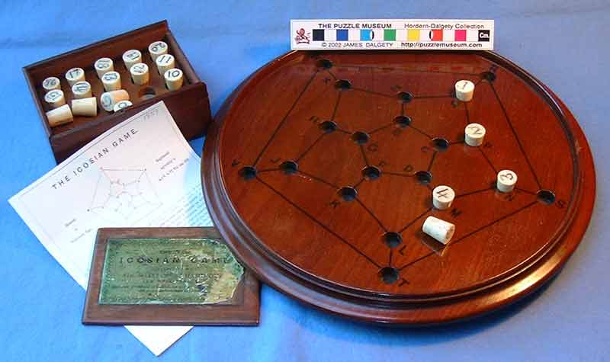
Hamilton’s Around the World Game
In 1857, the Irish mathematician, Sir William Rowan Hamilton invented a puzzle that he hoped would be very popular.

Slide 14
Hamilton’s Around the World Game
The objective was to make what we just called a hamiltonian cycle.
The game was not a commercial success, especially the 3D version.
But the mathematics of hamiltonian cycles is very popular today.

Slide 15
Hamilton’s Around the World Game
We will see this problem again when we generalize it to be the traveling salesman problem.

Slide 16
Where Network Flows Arise
Transportation
  Transportation of goods over transportation networks
  Scheduling of fleets of airplanes: time/space networks
Manufacturing
  Scheduling of goods for manufacturing
  Flow of manufactured items within inventory systems
Communications
  Design and expansion of communication systems
  Flow of information across networks
Personnel Assignment
  Assignment of crews to airline schedules
  Assignment of drivers to vehicles
Notes:
See if I can tie this back to the student’s comments about thesis work.

Slide 17
Travel and Delivery Problem
Aim: To go from one-location to another
Repetitive operations
Example 1 – Kebab Delivery
Example 2 – Mail Delivery
Example 3 – Goods Delivery for a Retailer
Example 4 – Electricity-Meter Reading

Slide 18

Representation by networks
Graphical representation
Nodes (vertices) + arcs (edges)

Slide 19
Representation by networks
Nodes – often represent geographic points
(cities, intersections, railroad stops, production points, ....)
Arcs – often represents links between nodes
(Roads, railroads, ....)
Arcs can be undirected (two-way) or directed (one-way)
Nodes, arcs can be uncapacitated, capacitated
Arcs are weighted with numerical values
(distance, time, cost, ....)

Slide 20
Hamiltonian Path Problem
Assume a network with all possible arcs – called complete graph
Hamiltonian Circuit (path, graph) – a path that visits each node exactly once
Find the path that minimizes total “distance” written on the arcs.
An approach: Brute-force approach (total enumeration) Try every unique circuit

Slide 21
Questions to answer:
How many possible circuits?
Take any circuit and travel in reverse
How many unique circuits remain?
Writing General formulas:
How many total circuits? Without duplicates?

Slide 22
More questions to answer:
Let n = 21. Then total number of unique circuits without repetition 20!/2 – 1.22x10¹⁸
What is an operation?
Let the fastest computer do approximately 1 trillion (1x10¹²) operations (computations) per second
Let us assume that we need more or less 100 operations to obtain a circuit
1400 days if the computer runs continuously

Slide 23
Traveling Salesman Problem - TSP
Definition: What is the shortest possible route that visits each city exactly once and returns to the origin city?
Find the Hamiltonian path that minimizes total “distance” written on the arcs.

Slide 24
More on solution
What if enumeration is not possible?
Will they give the optimal solution? Not always
A good solution? Not sure
But can be applied in reasonable time
We can try a bit more sophisticated techniques, as well.
These methods are called “heuristics”.

Slide 25
Ending Remarks
NP-Hard (non-polynomial) - # of operations required by the solution algorithm is not polynomial in # of nodes.
NP-Hard problems can not be solved to optimality unless # of nodes is “reasonable”.
We resort to use of heuristics – no quarantee of optimality; if lucky get bounds – benchmark.

Slide 26
Ending Remarks (continued)
Heuristics
Should be easier to apply
Should be based on some “logic”
Construction heuristic – construct a solution (Random, Greedy / Nearest Neighbour)
Improvement heuristic – improve an available solution (2-opt)
You need both aspects, in general.
Implications for IE curriculum

Slide 27
Heuristics
Random
  Connect the cities randomly
Nearest Neighbour
  Each time insert the closest unvisited node
Greedy
  Go along the cheapest arc between a visited and unvisited node, continue until none remains
Then apply 2-opt
  Choose two arcs and switch if the distance decreases. Continue until no such switch is possible

Slide 28
Heuristics
Videos:
1) TSP general: https://www.youtube.com/watch?v=pQCpdrAxWkg
2) Some Algorithms:
https://www.youtube.com/watch?v=q6fPk0--eHY
First, 1:37 min
3) Visualization https://flowingdata.com/2016/05/06/algorithms-for-the-traveling-salesman-problem-visualized/

Slide 29
Networks
QUIZ!
www.getkahoot.com
Don’t forget to enter nicknames as your ID’s.

