Slide 1
IE 102 Spring 2017
Routing Through Networks - 2

Slide 2
Hamiltonian Path Problem
Assume a network with all possible arcs – called complete graph
Hamiltonian Circuit (path, graph) – a path that visits each node exactly once
Find the path that minimizes total “distance” written on the arcs.
An approach: Brute-force approach (total enumeration) Try every unique circuit

Slide 3
Eulerian Cycle Problem
Eulerian Circuit (path, graph) – a path that visits each edge exactly once

Slide 4
On Eulerian Cycles
4
A
3
The degree of a node in an undirected graph is the number of incident arcs
8
1
2
6
B
4
4
C
5
6
9
7
D
4
Theorem. An undirected graph has an eulerian cycle if and only if
(1) every node degree is even and
(2) the graph is connected (that is, there is a path
from each node to each other node).

Slide 5
Eulerian Cycle Problem
Fleury’s algorithm
Video: 4,55 min https://www.youtube.com/watch?v=Lr6C8u-FDL8

Slide 6
Shortest Path Problem
Performance measure that can be used:
distance traveled
cost
time
....
Performance measure is whatever the number on the arc represents.
Minimize one of the above

Slide 7
Shortest Path Problem
We have a systematic method to solve the problem, an algorithm (a detailed procedure – Dijkstra’a Algorithm)
What is the meaning of optimal solution?
A solution that yields the minimum value of the performance measure considered
VERY LUCKY TO KNOW/PROVE IF THE ALGORITHM YIELDS AN OPTIMAL SOLUTION

Slide 8
Dijkstra’s Algorithm
Notes:
Obtain a network, and use the same network to illustrate the shortest path problem for communication networks, the max flow problem, the minimum cost flow problem, and the multicommodity flow problem. This will be a very efficient way of introducing the four problems. (Perhaps under 10 minutes of class time.)

Slide 9
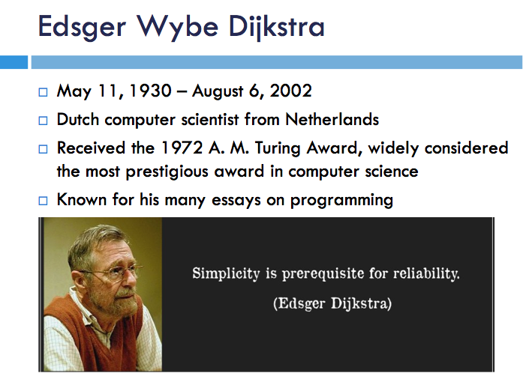

Slide 10
Dijsktra’s Algorithm
General Description
Suppose we want to find a shortest path from a given node s to other nodes in a network (one-to-all shortest path problem)
  • Node s is called a starting node or an initial node
• Dijkstra’s algorithm starts by assigning some initial values for the
distances from node s and to every other node in the network
• It operates in steps, where at each step the algorithm improves the
distance values.
• At each step, the shortest distance from node s to another node is determined

Slide 11
An Example
∞
∞
2
4
4
0
2
2
1
1
2
3
∞
1
6
4
2
3
3
5
∞
∞
Initialize
Select the node with the minimum temporary distance label.

Slide 12
Update Step
2
∞
∞
2
4
4
0
2
2
1
1
2
3
6
∞
4
2
3
3
5
∞
∞
4

Slide 13
Choose Minimum Temporary Label
2
∞
2
4
4
0
2
2
1
1
2
3
6
∞
4
2
3
3
5
4
∞

Slide 14
Update Step
6
2
∞
2
4
4
0
2
2
1
1
2
3
6
∞
4
2
3
3
5
4
∞
3
4
The predecessor of node 3 is now node 2

Slide 15
Choose Minimum Temporary Label
2
6
2
4
4
0
2
2
1
1
2
3
6
∞
4
2
3
3
5
3
4

Slide 16
Update
2
6
2
4
4
0
2
2
1
1
2
3
6
∞
4
2
3
3
5
3
4
d(5) is not changed.

Slide 17
Choose Minimum Temporary Label
2
6
2
4
4
0
2
2
1
1
2
3
6
∞
4
2
3
3
5
3
4

Slide 18
Update
2
6
2
4
4
0
2
2
6
1
1
2
3
6
∞
4
2
3
3
5
3
4
d(4) is not changed

Slide 19
Choose Minimum Temporary Label
2
6
2
4
4
0
2
2
1
1
2
3
6
6
4
2
3
3
5
3
4

Slide 20
Update
2
6
2
4
4
0
2
2
1
1
2
3
6
6
4
2
3
3
5
3
4
d(6) is not updated

Slide 21
Choose Minimum Temporary Label
2
6
2
4
4
0
2
2
1
1
2
3
6
6
4
2
3
3
5
3
4
There is nothing to update

Slide 22
End of Algorithm
2
6
2
4
4
0
2
2
1
1
2
3
6
6
4
2
3
3
5
3
4
All nodes are now permanent
The predecessors form a tree
The shortest path from node 1 to node 6 can be found by tracing back predecessors

Slide 23
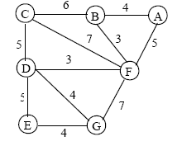
Exercise for Tomorrow and Friday

Slide 24
Assignment Problem
n tasks – n workers
A worker is assigned only one task
Each task is assigned to a single worker
“Cost” of performing a task is a function of the worker and task.
Examples:
  tasks / workers at Mini
  jobs/employees at airport
  lawyers/cases
  students/topics
  swimmers/strokes for medley

Slide 25
Assignment Problem – as a network
tasks worker cost
1
1
1
2
n
n

Slide 26
Solution
Matrix representation of costs
One of the lucky cases
Hungarian Algorithm
We’ll see tomorrow and Friday in class
Workers Tasks | 1 | 2 | ... | n
1 | c₁₁ | c₁₂ |  | c_{1n}
...
n | c_{n1} | c_{n2} |  | c_{nn}

Slide 27
A few ideas on the problem
Minimize total cost
Only one worker for a task, one task for a worker
  (1) Find the minimum for each row and add – Is it possible to have total cost less than that?
  (2) Find the minimum in each column and add - Is it possible to have total cost less than that?
Both are lower bounds on the optimal cost

Slide 28
Networks II
QUIZ!
www.getkahoot.com
Don’t forget to enter nicknames as your ID’s.

