Slide 1
Spring 2017 IE 102
Part 1
Mathematical Programming

Slide 2
High Step Sports Shoe
Maximize profits
Two styles of sports shoe: Airheads and Groundeds
Production Plan – How much to produce?
Facts:
  $10 profit on each pair of Airheads
  $8 profit on each pair of Groundeds
  Limited source: # of workers
  Limited source: Raw material availability
  Maximum demand for a product ......

Slide 3
General Definitions:
Decision variable: Represents a quantity that a decision-maker can change.
Objective Function: The equation that represents a performance measure; is either maximizing or minimizing type
Constraints: Are limitations created by scarce resources

Slide 4
High Step Sports Shoe
Plan? Decision variables: Quantities that can change and decision maker(s) is able to control
In this case: # of pairs to produce
Performance measure: Profit (revenue – cost)
Objective function: Maximize profit - optimization
Constraints: Resources limit # of pairs to produce
In this case: Machine time, worker time

Slide 5
“The assembly plant works a 40 hour week.
There are 6 machines that cut the materials. Each pair of Airheads requires 3 minutes of cutting time while Groundeds require 2 minutes. Each hour, each cutting machine can do 50 minutes of work.
There are 850 workers who assemble the shoes. It takes a single worker 7 hours to assemble a pair of Airheads and 8 hours to assemble a pair of Groundeds.”

Slide 6
High Step Sports Shoe
40-hour week – How many minutes of work can a machine do?
50 mins/hr*40 hrs/week = 2 000 mins/week
6 machines – 12 000 mins/week
40-hour week – How many hours of work can one worker do?
40 hrs/week
850 workers – 850*40 = 34 000 hrs/week

Slide 7
High Step Sports Shoe – Formulating, Modeling
Representing with symbols and expressions:
Decision variables:
A: # of pairs of Airheads to produce per week
G: # of pairs of Groundeds to produce per week
Objective function: 10A + 8.5G
M/C Constraint: 3A + 2G ≤ 12 000
Worker constraint: 7A + 8G ≤ 34 000
Non-negativity constraints: A,G ≥ 0
  A, G need to be integer – never mind

Slide 8
Linear Programming
Mathematical Programming
Maximize (or minimize) a linear objective function, subject to linear constraints
In general: Mathematical programming: Objective function can be a non-linear or linear function, with non-linear and/or linear constraints.

Slide 9
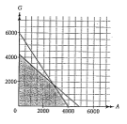
High Step Sports Shoe - Solution
Geometry:
Draw the feasible region – the region identified by the inequalities

Slide 10
High Step Sports Shoe - Solution
Any point in the feasible region is a solution
One can compute the profit of each solution
Optimization: We want the solution that will yield the maximum profit

Slide 11
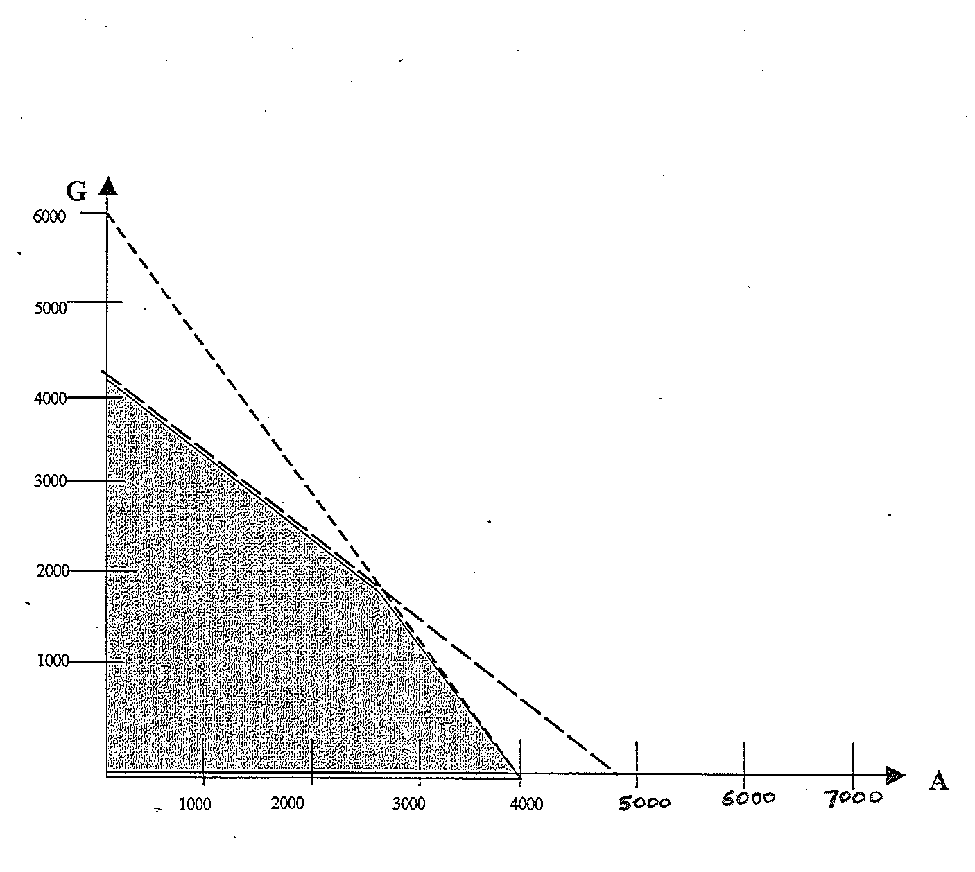
High Step Sports Shoe - Solution

Slide 12
High Step Sports Shoe - Solution
profit = 10A + 8.5G
Let profit = 42500
Can you draw the line?

Slide 13
High Step Sports Shoe - Solution
Line contains all solutions with the
same objective value (iso-profit line)
Move the added line away from (0.0)
objective will increase

Slide 14
Two-dimensional Problem
Geometric Intuition:
Observe the specific objective function
Place it over the feasible region, and move the function so to increase the profit (north east direction)
Eventually, will be out of the feasible region – just stop in the last possible point

Slide 15
High Step Sports Shoe - Solution
One property – Corner principle – Extreme point: One optimal solution of an LP always occurs at a corner point (extreme point) of the feasible region

Slide 16
General Problem
For the time being search for all extreme points
Our example:
Extreme Point (A,G), O= Objective Value
Move in a clock-wise direction
(0,0) –– O = $0
(0,34000/8) –– O = $36125
(14000/5,9000/5) –– O = $43300
( 4000, 0) –– O = $40000

Slide 17
Graphical Solution of 2-variable LP Problems
Another example
max x₁ + 3 x₂
s.t.
x₁ + x₂ ≤ 6 (1)
- x₁ + 2x₂ ≤ 8 (2)
x₁, x₂ ≥ 0 (3), (4)

Slide 18
x₂
-x₁ + 2x₂ = 8
(3)
(1)
(2)
(0,6)
(4/3,14/3)
(0,4)
(4)
(4)
x₁
(-8,0)
(0,0)
(6,0)
(2)
(3)
(1)
x₁ + x₂ = 6

Slide 19
x₂
-x₁ + 2x₂ = 8
(3)
(1)
(2)
(0,6)
(4/3,14/3)
(0,4)
Feasible Region
(4)
(4)
x₁
(-8,0)
(0,0)
(6,0)
(2)
(3)
(1)
x₁ + x₂ = 6

Slide 20
x₂
-x₁ + 2x₂ = 8
(3)
(1)
(2)
(0,6)
(4/3,14/3)
(0,4)
(4)
(4)
x₁
(-8,0)
(0,0)
(6,0)
(2)
(3)
(1)
x₁ + x₂ = 6

Slide 21
x₂
-x₁ + 2x₂ = 8
Recall the objective function:
max x₁ + 3x₂
(0,6)
(4/3,14/3)
(0,4)
x₁
(-8,0)
(0,0)
(6,0)
x₁ + 3x₂ = 6
x₁ + 3x₂ = 3
x₁ + x₂ = 6
x₁ + 3x₂ = 0

Slide 22
Graphical Solution of 2-variable LP Problems
A line on which all points have the same z-value
(z = x₁ + 3x₂) is called :
  Isoprofit line for maximization problems,
  Isocost line for minimization problems.

Slide 23
Graphical Solution of 2-variable LP Problems
Consider the coefficients of x₁ and x₂ in the
objective function and let c=[1 3].

Slide 24
x₂
-x₁ + 2x₂ = 8
objective function:
max x₁ + 3x₂
(0,6)
(4/3,14/3)
(0,4)
c=[1 3]
x₁
(-8,0)
(0,0)
(6,0)
x₁ + 3x₂ = 6
x₁ + 3x₂ = 3
x₁ + x₂ = 6
x₁ + 3x₂ = 0

Slide 25
Graphical Solution of 2-variable LP Problems
Note that as move the isoprofit lines in the
direction of c, the total profit increases for this
max problem!

Slide 26
Graphical Solution of 2-variable LP Problems
For a maximization problem, the vector c, given
by the coefficients of x₁ and x₂ in the objective
function, is called the improving direction.
On the other hand, -c is the improving direction
for minimization problems!

Slide 27
Graphical Solution of 2-variable LP Problems
To solve an LP problem in the two variables, we
should try to push isoprofit (isocost) lines in the
improving direction as much as possible while
still staying in the feasible region.

Slide 28
x₂
-x₁ + 2x₂ = 8
Objective :
max x₁ + 3x₂
(0,6)
(4/3,14/3)
(0,4)
(0,3)
(0,2)
c=[1 3]
(1,0)
x₁
(-8,0)
(0,0)
(3,0)
(6,0)
(9,0)
x₁ + 3x₂ = 9
x₁ + 3x₂ = 6
x₁ + 3x₂ = 3
x₁ + x₂ = 6
x₁ + 3x₂ = 0

Slide 29
x₂
-x₁ + 2x₂ = 8
Objective :
max x₁ + 3x₂
(0,6)
(4/3,14/3)
(0,4)
c=[1 3]
(0,3)
c=[1 3]
x₁
(-8,0)
(0,0)
(6,0)
(9,0)
x₁ + 3x₂ = 9
x₁ + x₂ = 6

Slide 30
x₂
-x₁ + 2x₂ = 8
Objective :
max x₁ + 3x₂
(0,6)
(4/3,14/3)
(0,4)
c=[1 3]
(0,3)
c=[1 3]
x₁
(-8,0)
(0,0)
(6,0)
(9,0)
(12,0)
x₁ + 3x₂ = 12
x₁ + 3x₂ = 9
x₁ + x₂ = 6

Slide 31
x₂
-x₁ + 2x₂ = 8
Objective :
max x₁ + 3x₂
c=[1,3]
(0,6)
(4/3,14/3)
(0,4)
x₁+3x₂= 46/3
x₁
(-8,0)
(0,0)
(6,0)
x₁ + x₂ = 6

Slide 32
x₂
-x₁ + 2x₂ = 8
Objective :
max x₁ + 3x₂
(0,6)
(4/3,14/3)
(0,4)
c=[1,3]
Can we improve (6,0)?
x₁
(-8,0)
(0,0)
(6,0)
x₁ + x₂ = 6

Slide 33
x₂
-x₁ + 2x₂ = 8
Objective :
max x₁ + 3x₂
(0,6)
Can we improve (0,4) ?
(4/3,14/3)
(0,4)
c=[1 3]
x₁
(-8,0)
(0,0)
(6,0)
x₁ + x₂ = 6

Slide 34
x₂
-x₁ + 2x₂ = 8
Objective :
max x₁ + 3x₂
(0,6)
c=[1 3]
Can we improve (4/3,16/3)?
(4/3,14/3)
(0,4)
No! We stop here
No!
x₁
(-8,0)
(0,0)
(6,0)
x₁ + x₂ = 6

Slide 35
x₂
-x₁ + 2x₂ = 8
Objective :
max x₁ + 3x₂
(0,6)
c=[1 3]
(4/3,14/3)
(4/3,14/3) is the OPTIMAL solution
(0,4)
x₁
(-8,0)
(0,0)
(6,0)
x₁ + x₂ = 6

Slide 36
Graphical Solution of 2-variable LP Problems
Point (4/3, 14/3) is the last point in the feasible
region when we move in the improving
direction. So, if we move in the same direction
any further, there is no feasible point.
Therefore, point z*= (4/3, 14/3) is the
maximizing point. The optimal value of the LP
problem is 46/3.

Slide 37
Graphical Solution of 2-variable LP Problems
Let us modify the objective function while keeping the constraints unchanged:
Ex 1.a)
max x₁ + 3 x₂
s.t.
x₁ + x₂ ≤ 6 (1)
- x₁ + 2x₂ ≤ 8 (2)
x₁, x₂ ≥ 0 (3), (4)
Ex 1.b)
max x₁ - 2 x₂
s.t.
x₁ + x₂ ≤ 6 (1)
- x₁ + 2x₂ ≤ 8 (2)
x₁, x₂ ≥ 0 (3), (4)

Slide 38
Graphical Solution of 2-variable LP Problems
Does feasible region change?

Slide 39
x₂
-x₁ + 2x₂ = 8
(3)
(1)
(2)
(0,6)
(4/3,14/3)
(0,4)
Feasible Region
(4)
(4)
x₁
(-8,0)
(0,0)
(6,0)
(2)
(3)
(1)
x₁ + x₂ = 6

Slide 40
Graphical Solution of 2-variable LP Problems
What about the improving direction?

Slide 41
x₂
-x₁ + 2x₂ = 8
(3)
(1)
(2)
(0,6)
(4/3,14/3)
x₁ - 2x₂ = 0
(0,4)
Feasible Region
(4)
(4)
x₁
(-8,0)
(0,0)
(6,0)
(2)
c=[1 -2]
(3)
(1)
x₁ + x₂ = 6

Slide 42
x₂
-x₁ + 2x₂ = 8
(3)
(1)
(2)
(0,6)
(4/3,14/3)
(0,4)
Feasible Region
(6,0) is the optimal solution!
(4)
(4)
x₁
(-8,0)
(0,0)
(6,0)
(2)
c=[1 -2]
(3)
(1)
x₁ + x₂ = 6

Slide 43
Graphical Solution of 2-variable LP Problems
Now let us consider:
Ex 1.c)
max -x₁ + x₂
s.t.
x₁ + x₂ ≤ 6 (1)
- x₁ + 2x₂ ≤ 8 (2)
x₁, x₂ ≥ 0 (3), (4)

Slide 44
x₂
-x₁ + 2x₂ = 8
(3)
(1)
(2)
(0,6)
(4/3,14/3)
(0,4)
c=[-1 1]
(4)
(4)
x₁
(-8,0)
(0,0)
(6,0)
(2)
(3)
(1)
x₁ + x₂ = 6

Slide 45
Graphical Solution of 2-variable LP Problems
Now, let us consider:
Ex 1.c)
max -x₁ + x₂
s.t.
x₁ + x₂ ≤ 6 (1)
- x₁ + 2x₂ ≤ 8 (2)
x₁, x₂ ≥ 0 (3), (4)
Question:
Is it possible for (5,1) be
the optimal?

Slide 46
x₂
-x₁ + 2x₂ = 8
(3)
(1)
(2)
(0,6)
(4/3,14/3)
-x₁ + x₂ = -4
(0,4)
c=[-1 1]
improving direction!
(5,1)
(4)
(4)
x₁
(-8,0)
(0,0)
(6,0)
(2)
(3)
(1)
x₁ + x₂ = 6

Slide 47
x₂
-x₁ + 2x₂ = 8
(3)
(1)
(2)
(0,6)
-x₁ + x₂ = 0
(4/3,14/3)
-x₁ + x₂ = -4
(0,4)
(3,3)
c=[-1 1]
improving direction!
(5,1)
(4)
(4)
x₁
(-8,0)
(0,0)
(6,0)
(2)
(3)
(1)
x₁ + x₂ = 6

Slide 48
x₂
-x₁ + x₂ = 10/3
-x₁ + 2x₂ = 8
(3)
-x₁+ x₂= 4
(1)
(2)
(0,6)
-x₁ + x₂ = 0
Point (0,4) is the
optimal solution!
(4/3,14/3)
(0,4)
-x₁ + x₂ = -4
(3,3)
c=[-1 1]
(5,1)
(4)
(4)
x₁
(-8,0)
(0,0)
(6,0)
(2)
(3)
(1)
x₁ + x₂ = 6

Slide 49
Graphical Solution of 2-variable LP Problems
Now, let us consider:
Ex 1.d)
max -x₁ - x₂
s.t.
x₁ + x₂ ≤ 6 (1)
- x₁ + 2x₂ ≤ 8 (2)
x₁, x₂ ≥ 0 (3), (4)
Question:
Is it possible for (0,4) be
the optimal?

Slide 50
x₂
-x₁ + 2x₂ = 8
(3)
(1)
(2)
-x₁ - x₂ = -4
(0,6)
-x₁ - x₂ = 0
(4/3,14/3)
(0,4)
Point (0,0) is the
optimal solution!
(4)
(4)
x₁
(-8,0)
(0,0)
(6,0)
c=[-1 -1]
(2)
(3)
(1)
x₁ + x₂ = 6

Slide 51
Another Example

Slide 52
Graphical Solution of 2-variable LP Problems
Ex 2)
A company wishes to increase the demand for its
product through advertising. Each minute of radio ad
costs $1 and each minute of TV ad costs $2.
Each minute of radio ad increases the daily demand by
2 units and each minute of TV ad by 7 units.
The company would wish to place at least 9 minutes of
daily ad in total. It wishes to increase daily demand by
at least 28 units.
How can the company meet its advertising requirementsat
minimum total cost?

Slide 53
Graphical Solution of 2-variable LP Problems
x₁: # of minutes of radio ads purchased
x₂: # of minutes of TV ads purchased

Slide 54
Graphical Solution of 2-variable LP Problems
x₁: # of minutes of radio ads purchased
x₂: # of minutes of TV ads purchased
min x₁ + 2 x₂
s.t.
2x₁ + 7x₂ ≥ 28 (1)
x₁ + x₂ ≥ 9 (2)
x₁, x₂ ≥ 0 (3), (4)

Slide 55
x₂
(3)
(2)
(1)
(0,9)
(0,4)
(4)
(4)
x₁
(0,0)
(9,0)
(14,0)
(1)
2x₁+7x₂=28
(2)
(3)
x₁ + x₂ = 9

Slide 56
x₂
Objective :
min x₁ + 2x₂
(3)
(2)
c=[1 2]
total cost x₁ + 2x₂ INCREASES in this direction!
(1)
(0,9)
-c=[-1 -2]
-c=[-1 -2] is the improving direction
(0,4)
(7,2)
x₁+2x₂=24
(4)
(4)
x₁
(0,0)
(9,0)
(14,0)
(1)
2x₁+7x₂=28
(2)
(3)
x₁ + x₂ = 9

Slide 57
x₂
Objective :
min x₁ + 2x₂
(3)
(2)
(1)
(0,9)
-c=[-1 -2]
(0,4)
(7,2)
x₁+2x₂=24
x₁+2x₂=18
(4)
(4)
x₁
(0,0)
(9,0)
(14,0)
(1)
2x₁+7x₂=28
(2)
(3)
x₁ + x₂ = 9

Slide 58
x₂
Objective :
min x₁ + 2x₂
(3)
(2)
(1)
(0,9)
(0,4)
(7,2)
x₁+2x₂=18
(4)
(4)
x₁
(0,0)
(9,0)
(14,0)
(1)
2x₁+7x₂=28
(2)
(7,2) is the optimal solution and optimal value is 11
(3)
x₁+2x₂=14
x₁ + x₂ = 9
x₁+2x₂=11

Slide 59
Graphical Solution of 2-variable LP Problems:
We may graphically solve an LP with two
decision variables as follows:
Step 1: Graph the feasible region.
Step 2: Draw an isoprofit line (for max problem) or an
isocost line (for min problem).
Step 3: Move parallel to the isoprofit/isocost line in the
improving direction. The last point in the feasible
region that contacts an isoprofit/isocost line is an
optimal solution to the LP.

Slide 60
Mathematical Programming
QUIZ!
www.getkahoot.com
Don’t forget to enter nicknames as your ID’s.

