Slide 1
HUMANITARIAN LOGISTICS
Bahar Yetiş Kara

Slide 2
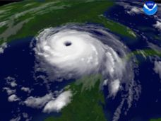
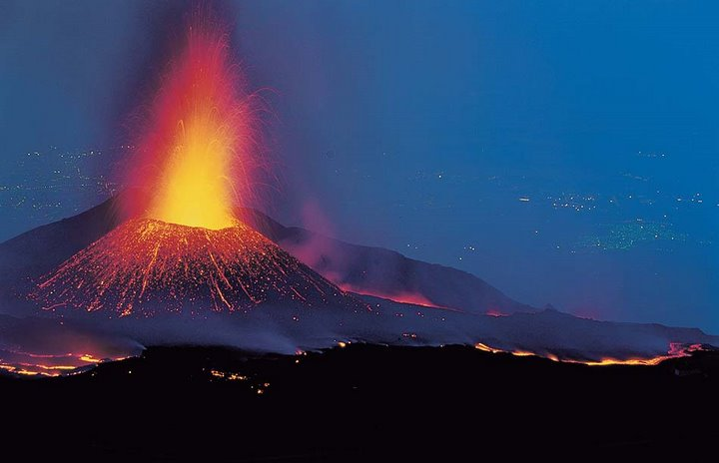
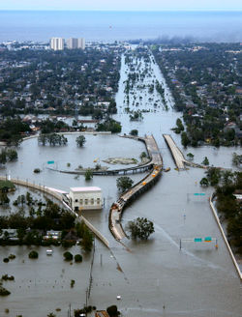
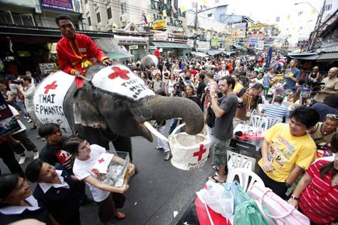
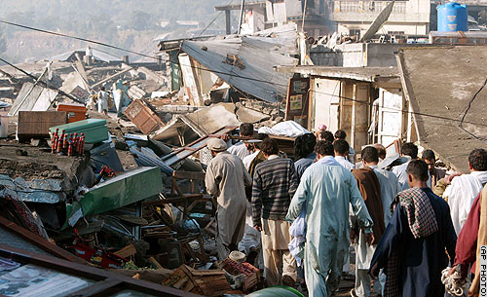
Context
Natural and Man-Made Disaster
Ongoing Problems:
  Food, water, shelter....essential components of life

Slide 3
Humanitarian Logistics
Relief logistics
Development logistics
Type
Health
Education
Food
Sustainability
...
Complex emergencies
(Man-made disaster)
Natural disaster
Slow onset
-Famine
-Drought
Sudden onset
Timeline
Unpredictable Location
-Tsunami
Predictable Location
Pre-disaster
(mitigation & preparedness)
Disaster
(response)
Post-disaster
(recovery)
Predictable Timing
-Hurricane
-Flood
Unpredictable Timing
-Earthquake
-Volcanic eruption
* assessment
* planning
* training/education
* relief operations
* second phase
* logistics stages
* debris cleaning
* measure the effect of
-infrastructure
-planning
-response
* short & long term
* lessons learned
Notes:
Humanitarian organizations logos (WFP, WHO, IFRC, …)

Slide 4
Disasters
Natural
Man-Made
Slow Onset
Famine
Drought
Sudden Onset
Slow Onset
- Political Crisis
- Refugee Crisis
Sudden Onset
- Terrorist Attack
- Chemical attack
Unpredictable Location
- Tsunamis
Predictable Location
Predictable Timing
- Hurricanes
- Floods
Unpredictable Timing
- Earthquakes
- Volcanic Eruption

Slide 5
Context
Natural and Man-Made Disaster
Ongoing Problems:
  Food, water, shelter....essential components of life

Slide 6
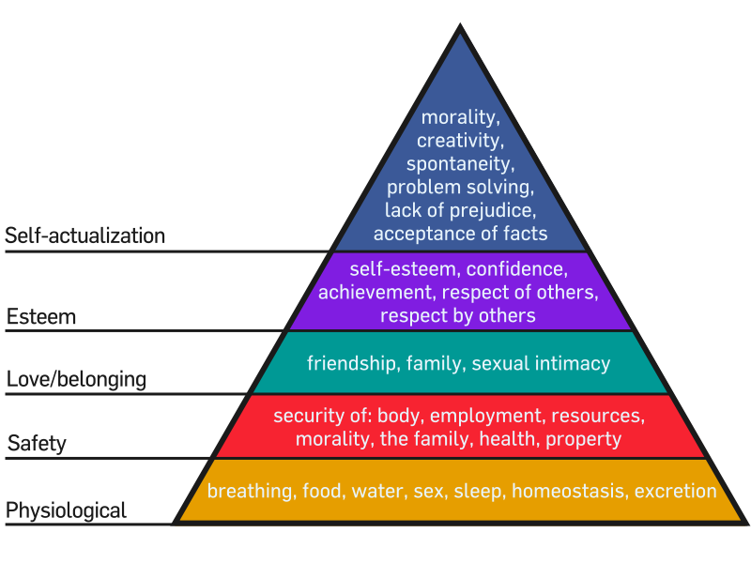
Humanitarian Crises
Top Ten Problems Facing Humanity Over the Next 50 Years (Richard Smalley, Nobel Prize Winner)
Energy
Water
Food
Environment
Poverty
Terrorism and War
Disease/Health
Education
Democracy
Population
An interpretation of Maslow's hierarchy of needs, represented as a pyramid with the more basic needs at the bottom. Wikipedia

Slide 7
World Overview: Hunger
Hunger and malnutrition are the #1 risks to health worldwide
  Greater than AIDS, malaria, tuberculosis combined
1 in 8 people goes to bed hungry every night.
148 million children are underweight in the developing world
Source: WFP, http://www.wfp.org/hunger

Slide 8
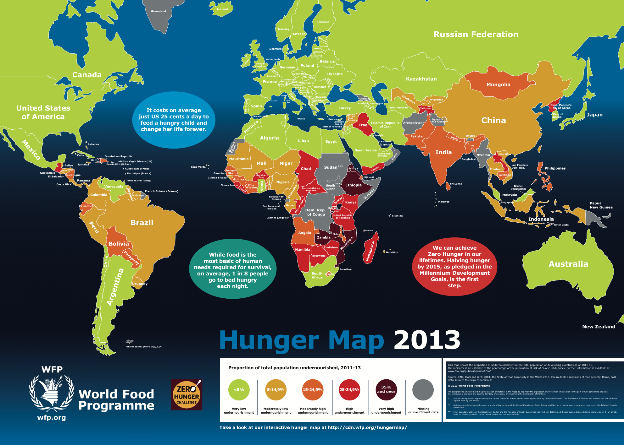
Every 3.6 seconds one person dies of starvation. Usually it is a child under the age of 5.
www.unicef.org

Slide 9
World Overview: Health
 | African Region | Americas Region
Life expectancy | 52 | 76
Mortality (per1000 live births) | 145 | 19
In 2007,9.2 million children died before age five. 92 % of these deaths in Africa and Asia.
A child born in a least developed country is almost 14 times more likely to die during the first 28 days of life than one born in an industrialized country.

Slide 10
UN Millenium Development Goals 2015
“This is the historic promise 189 world leaders made at the United Nations Millennium Summit in 2000 when they agreed to meet the Millennium Development Goals (MDGs). The United Nations Millennium Campaign supports and inspires people from around the world to take action in support of the MDGs.”

Slide 11
UN Millenium Development Goals 2015
Goal 1: Eradicate extreme poverty and hunger
  Number of people living under international poverty line of $1.25 / day declined to 1.4 billion by 2005
Goal 2: Achieve universal primary education
  Enrollment in developing regions reached 89% in 2008
Goal 3: Promote gender equality and empower women
Goal 4: Reduce child mortality
  In some regions 1 of 7 die before age 5, many of preventable causes
Goal 5: Improve maternal health
  Insub-Saharan Africa, maternal mortality risk is 1 in 30
Goal 6: Combat HIV/AIDS, malaria, other diseases
  In Africa, malaria accounts for one-fifth of childhood mortality
Goal 7: Ensure environmental sustainability
Goal 8: Develop a global partnership for development

Slide 12
Context
Natural and Man-Made Disaster
Ongoing Problems:
      Food, water, shelter....essential components of life
Environments with disruptions
Many decision makers but often limited resources

Slide 13
Humanitarian supply Chains : Challenges
Challenges with demand | Uncertain and dynamic demand Specific to disaster or humanitarian issue
Challenges with supply | Uncertainties in supply quantities Timing of supplies Perishability Unnecessary, unusable and/or unwanted donations

Slide 14
Humanitarian Supply Chains – Examples of Supply-Demand Mismatch
In the months following the January12 earthquake, donated medical equipment and supplies were shipped into Haiti by the container-full, overwhelming hospitals across this disaster-ravaged nation. Much of it will never get used, and even worse, the unopened boxes sometimes obstruct doctors from locating supplies they actually need to treat patients. (Huffington Post, May 2013)
In Japan in 2011,...about 60% of the supplies that arrive at a disaster site are not beneficial to the survivors and should not have been sent. ... relief workers reported "too many blankets," "too much clothing" and "a lot of broken bikes.“ (Los Angeles Times, November 2012)

Slide 15
Examples of Supply-Demand Mismatch
Stockpiling antiviral drugs in preparation for a flu pandemic (Wall Street Journal, May 2009)
Despite months of dire warnings ..., less than half of the 229 million doses of H1N1 vaccine the government bought to fight the pandemic have been administered -- leaving an estimated 71.5 million doses that must be discarded if they are not used before they expire. (Washington Post, April 2012)
When Supply > Demand
  Inefficient use of limited funds and resources
  Bottlenecks in the network
  Extra cost of managing and storing
  Extra cost and environmental impact of disposal

Slide 16
Summary of Problem Characteristics
High complexity
High uncertainty, dynamically changing environments, information may not be available or reliable
Timing is key for decisions and actions
Multiple players, multiple perspectives, multiple/conflicting objectives
Difficult (but very important!) to assess the potential impact and consequences of actions (short term and long term)
Important to consider the human/social/behavioral component
Interdisciplinary nature

Slide 17
WFP: Humanitarian Game
Video 1: Setting
Video 2: Hunger assessment
Video 3: Food Drop
Video 4: Buying the food

Slide 18
QUIZ!
www.getkahoot.com
Don’t forget to enter nicknames as your ID’s.
PLEASE ENTER & symbol between your ID’s while eliminating the first digit!

