Slide 1
Resource Allocation for Malaria Prevention
Bahar Yetis Kara

Slide 2
Malaria
Video 1: JumboJets

Slide 3
10 Facts about Malaria (WHO)
Fact 1:
  can be transmitted to people of all ages.
  bites of infected mosquitoes.
  If not treated promptly with effective medicines, malaria can often be fatal.
Fact 2:
  About 3.3 billion people - half of the world's population - are at risk of malaria.
  Every year, this leads to about 250 million malaria cases and nearly one million deaths.
  People living in the poorest countries are the most vulnerable.

Slide 4
10 Facts about Malaria (WHO)
Fact 3:
  One in five of all childhood deaths in Africa are due to malaria.
  Every 30 seconds a child dies from malaria in Africa.
Fact 4:
  Early diagnosis and prompt treatment are two basic elements of malaria control.
  Early and effective treatment of malaria can shorten the duration of the infection and prevent further complications including the great majority of deaths.

Slide 5
10 Facts about Malaria (WHO)
Fact 5:
  Inappropriate use of antimalarial drugs in the past century contributed to widespread resistance in the malaria parasite to drugs such as chloroquine, leading to rising rates of sickness and death.
  Over the past decade, a new group of antimalarials – known as artemisinin-based combination therapies – has brought new hope in the fight against malaria

Slide 6
10 Facts about Malaria (WHO)
Fact 6:
  The main objective is to significantly reduce the rate and number of cases of both parasite infection and clinical malaria. This is achieved by controlling the malaria-bearing mosquito and thereby reducing or interrupting transmission.

Slide 7
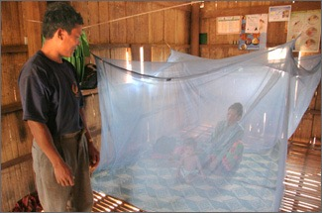
10 Facts about Malaria (WHO)
Fact 7:
  Long-lasting insecticidal nets can be used to provide protection to risk groups, especially young children and pregnant women in high transmission areas.
  This provides personal protection. The nets can also protect communities when coverage is high enough (more than 80% of people in a target community sleeping inside them).
  The nets are effective for a number of years (3 to 5 years, depending on models and conditions of use).

Slide 8
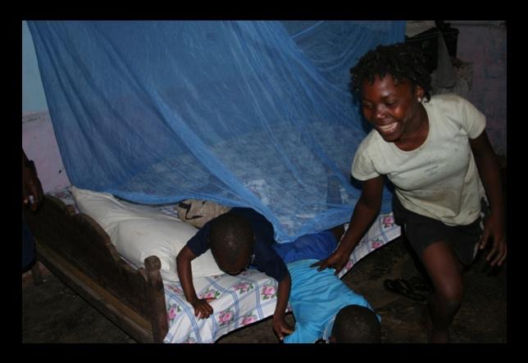

Slide 9
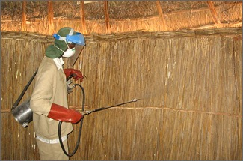
10 Facts about Malaria (WHO)
Fact 8:
  Indoor residual spraying is the most effective means of rapidly reducing mosquito density.
  Its full potential is obtained when at least 80 % of premises with malaria vectors are sprayed.
  Indoor spraying is effective for 3 to 6 months, depending on the insecticide used and the type of surface on which it is sprayed. (DDT is effective for longer periods, up to 12 months in some cases).

Slide 10
10 Facts about Malaria (WHO)
Fact 9:
  Pregnant women are at high risk not only of dying from the complications of severe malaria, but also spontaneous abortion, premature delivery or stillbirth.
  Malaria is also a cause of severe maternal anaemia and is responsible for about one third of preventable low birth weight babies.
  It contributes to the deaths of an estimated 10 000 pregnant women and up to
  200 000 infants each year in Africa alone.

Slide 11
10 Facts about Malaria (WHO)
Fact 10:
  Malaria causes an average loss of 1.3% of annual economic growth in countries with intense transmission.
  It traps families and communities in a downward spiral of poverty, disproportionately affecting marginalized and poor people who cannot afford treatment or who have limited access to health care.
  Malaria cuts attendance at schools and workplaces.
  However, it is preventable and curable.

Slide 12





Some of the NGOs about Malaria

Slide 13
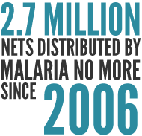
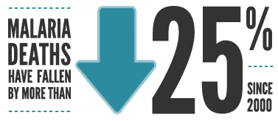
Video 2: What we do:

Slide 14
TAMTAM was founded in 2004 by a couple of economists.
Through their work in the rural district of Busia, Kenya, they realized that distributing bed nets is one of the most efficient means to save lives and improve the health of mothers and their children.
TAMTAM was born out of their desire to put this finding into action
.TAMTAM stands for "Together Against Malaria, Tunapenda Afya na Maisha".
The Swahili translates to "We love health and living" in the native language of Busia.

Slide 15
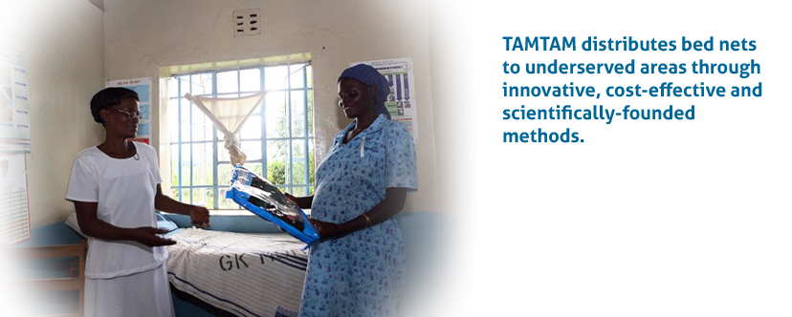

Slide 16
More Facts on Malaria

Slide 17
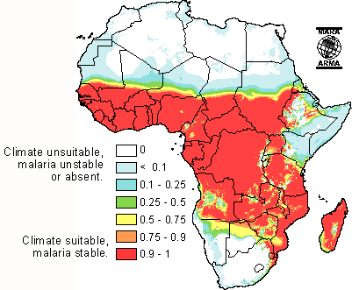
Malaria and Climate
Suitability of local climate
Potential distribution of malaria transmission

Slide 18
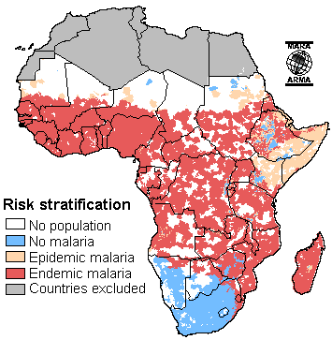
Malaria distribution model
Endemic: Regions
  Significant transmission
Epidemic Regions
  Prone to distinct variation (in some years no transmission)

Slide 19
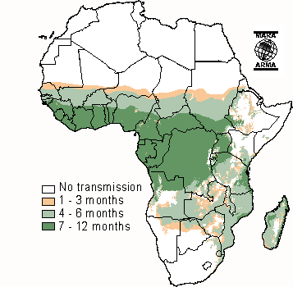
Duration of Malaria Transmission Session
Yellow: Strongly seasonal and epidemic
Light green: Seasonal and endemic
Dark green: Perennial and endemic

Slide 20
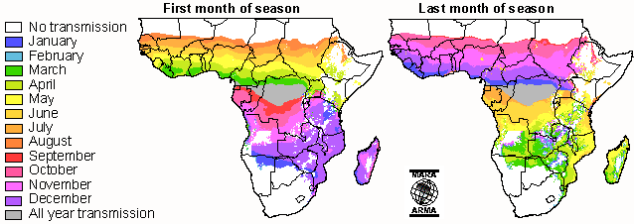
Malaria Season

Slide 21
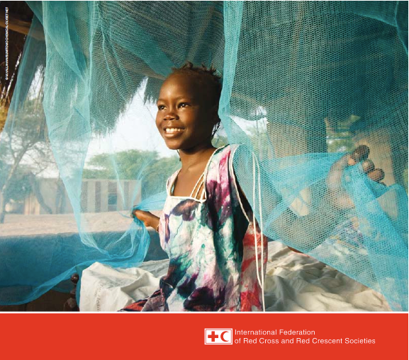
April 2010 Health Report

Slide 22
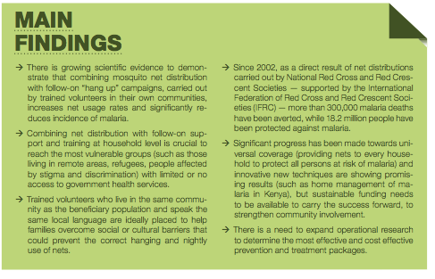

Slide 23
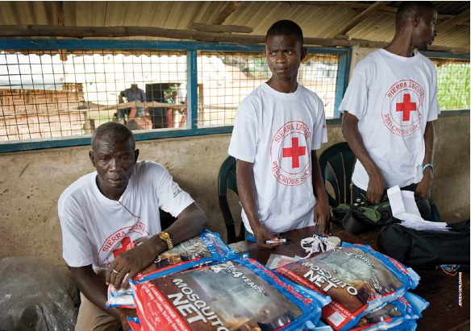
IFRC in action

Slide 24
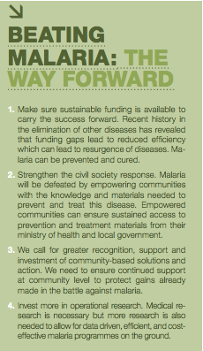
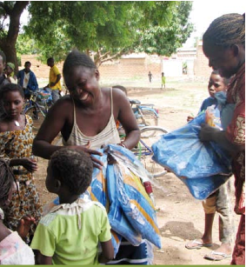

Slide 25

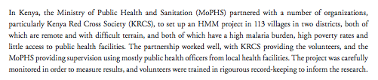
Kenya

Slide 26
HMM basics
Based on volunteers (from IFRC)
Each volunteer is responsible from some villages
  Distribute nets
  Distribute ACTs for sick people
  Checks for correct dosage usage

Slide 27
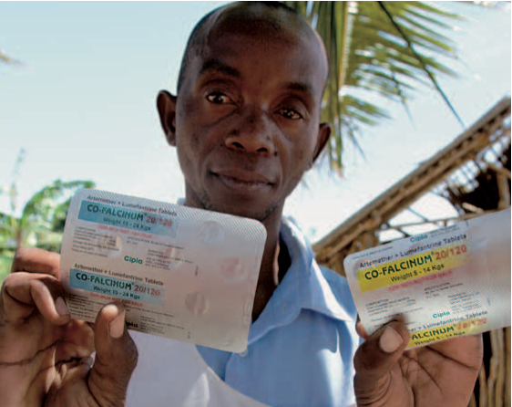
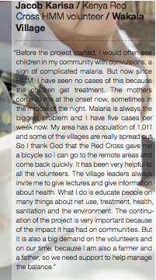

Slide 28
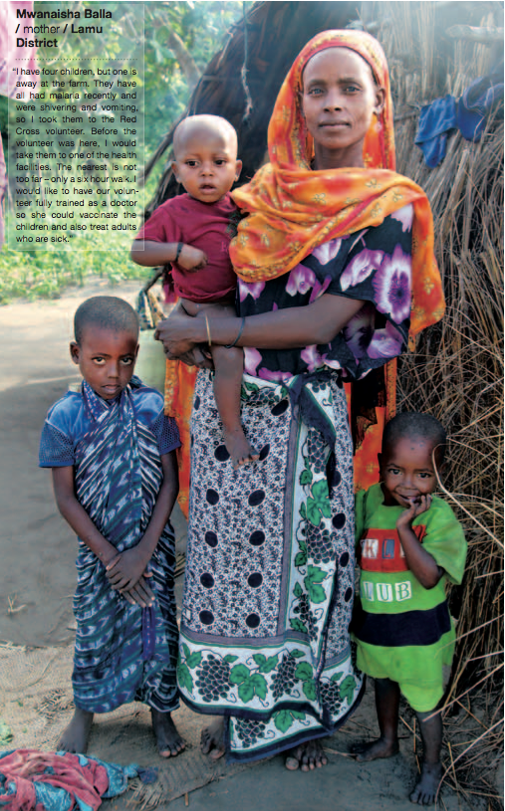

Slide 29
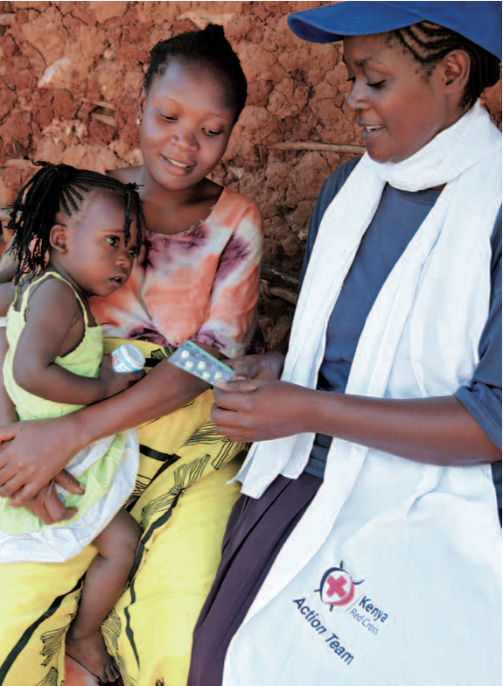
HMM (Home Management of Malaria) project is successful in Kenya

Slide 30
A Case study for OR usage in Malaria Prevention
IFRC reports keep saying more OR tools
???

Slide 31
Case study

Slide 32
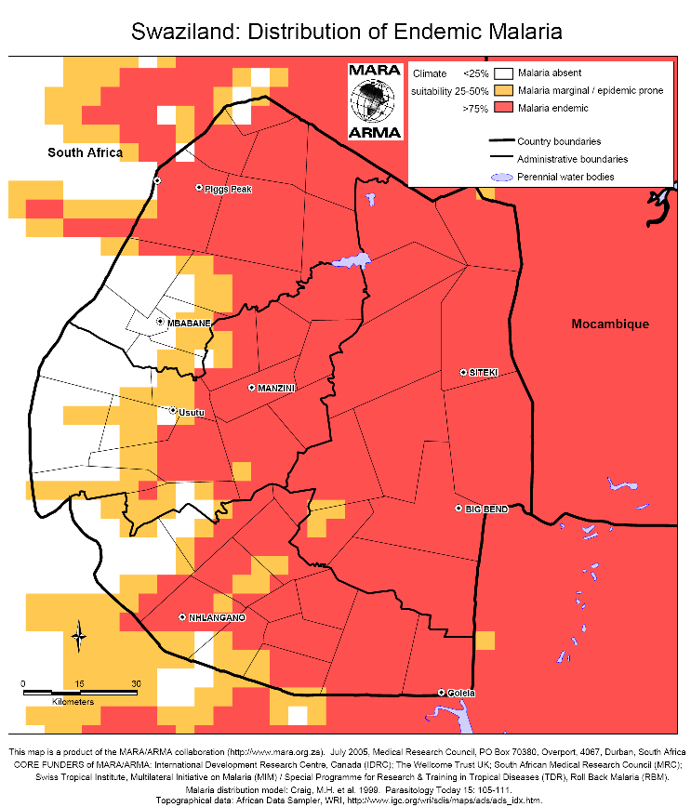
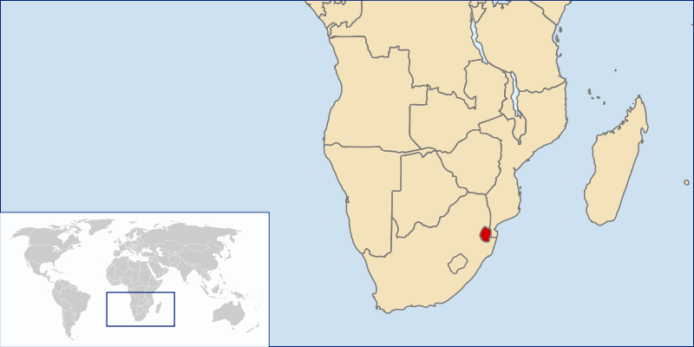
A Case Study
Create a systems-based approach to minimize the incidence of malaria with limited resources.
Swaziland as pilot country
  Historical data availability
  Wide range of conditions
http://en.wikipedia.org/wiki/Swaziland
http://www.mara.org.za/

Slide 33
A Case Study
Design a system for malaria prevention in Swaziland
Locate distribution centers
Assign enough crew and equipment including nets and indoor sprays, to each DC
Design the distribution structure

Slide 34
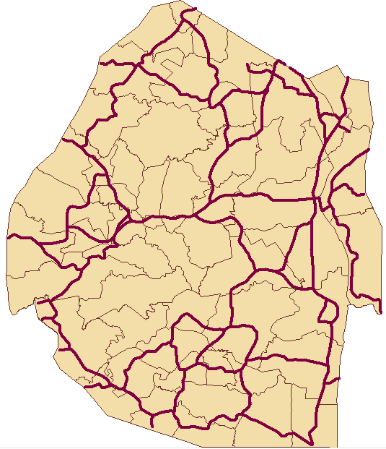
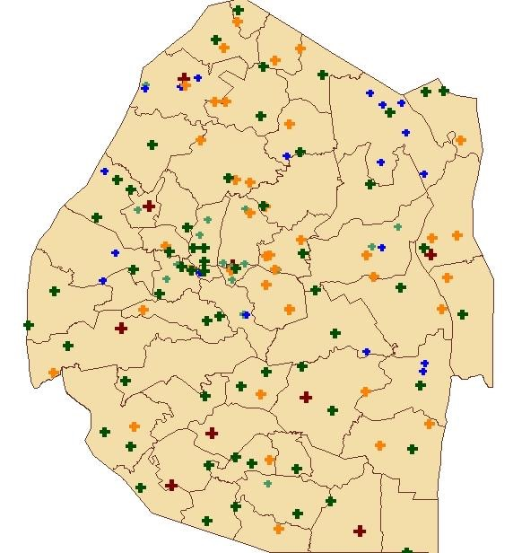
Data Sources
Road Infrastructure
Facility Infrastructure

Slide 35
Model Objective
An optimization model will allow for a systems-based approach to resource allocation and deployment.
Decisions may include:
  Where to locate Distribution Centers (DCs)
  How many DCs to open
  What regions DCs should serve
  When DCs should be open
  When to cover each zone
  Number of people to protect in each zone
  Labor, trucks, equipment, insecticide/nets to base at DCs
  Labor, trucks, equipment to allocate to each zone

Slide 36
DC Placement Heuristic
Potential locations for DCs
  Factors considered:
    Population
    Malaria risk
    Infrastructure

Slide 37
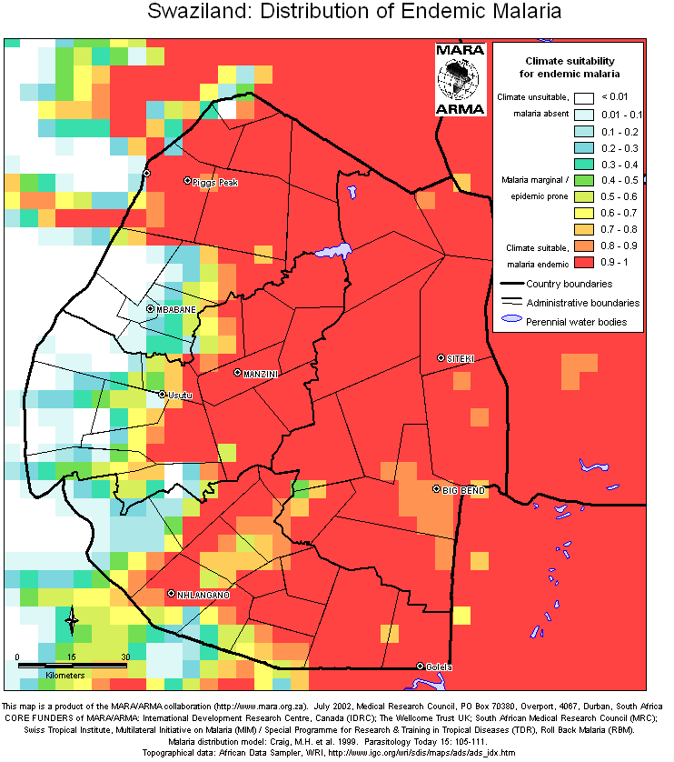
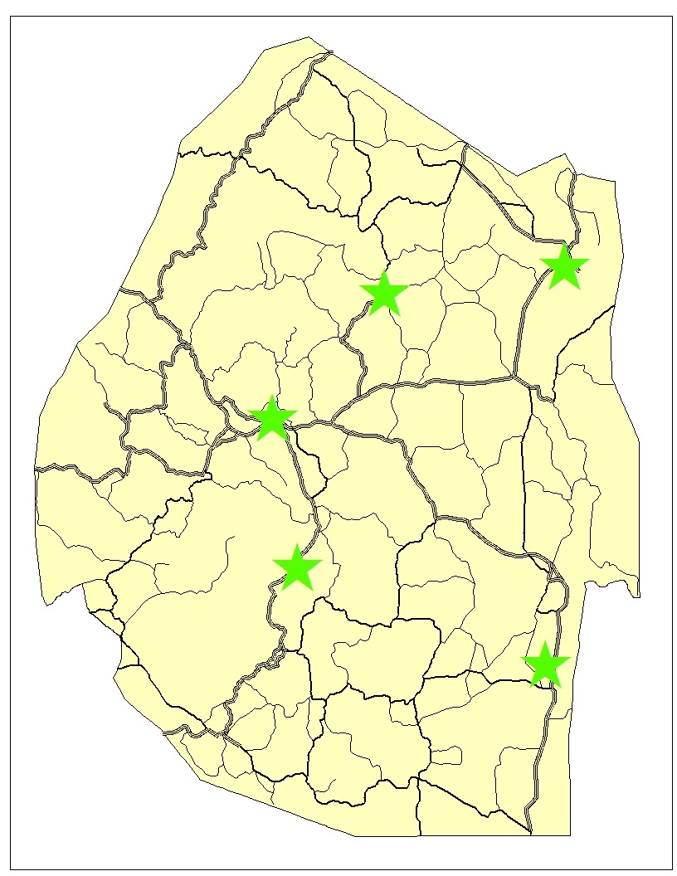
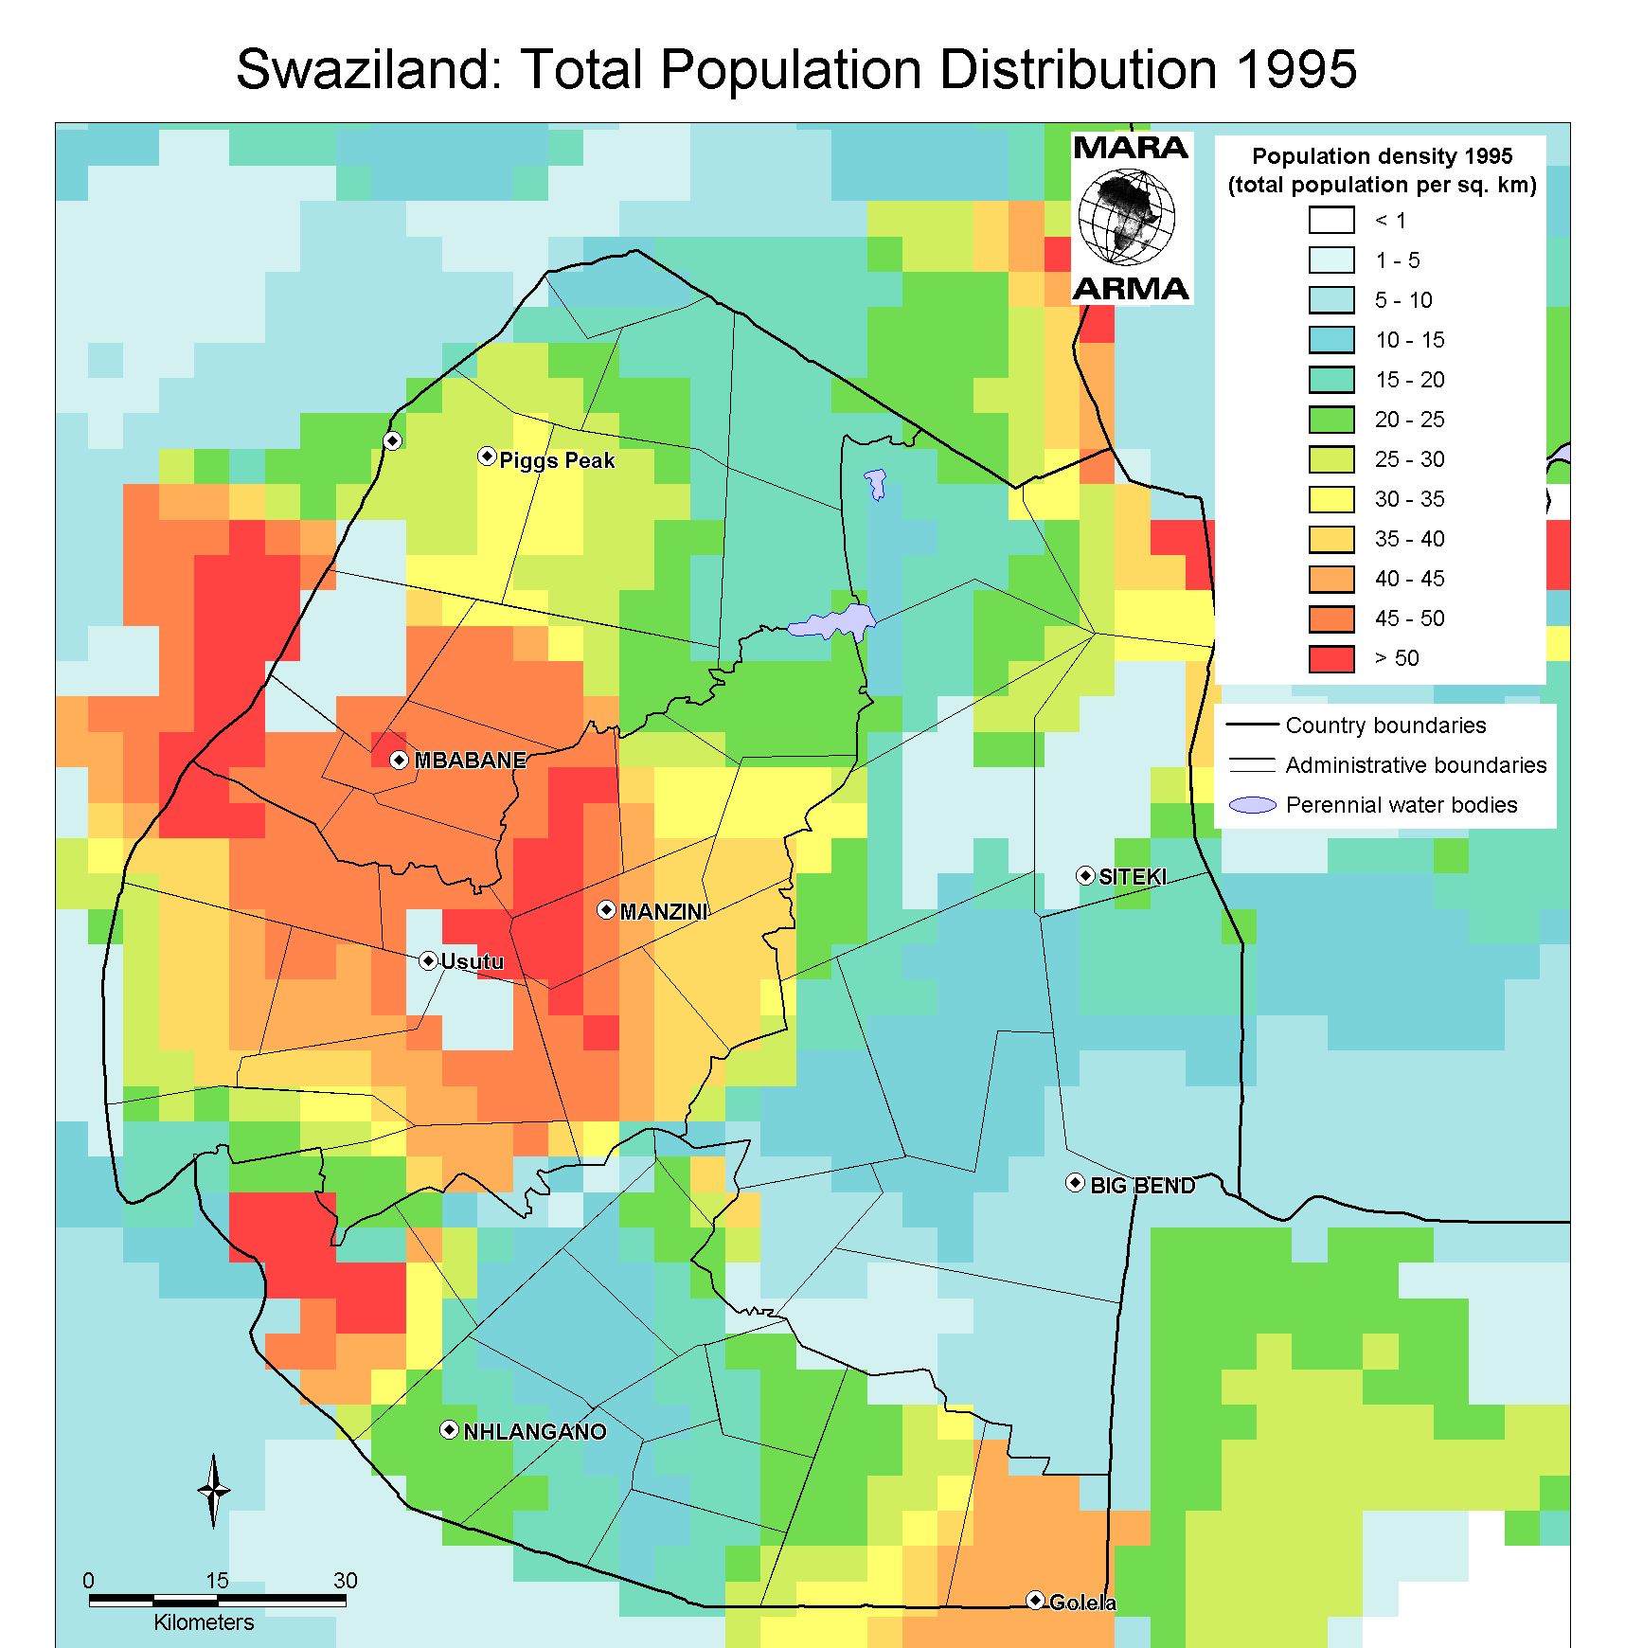
DC Placement Heuristic
Swaziland: 5 Potential Locations
Malaria Risk
Population

Slide 38
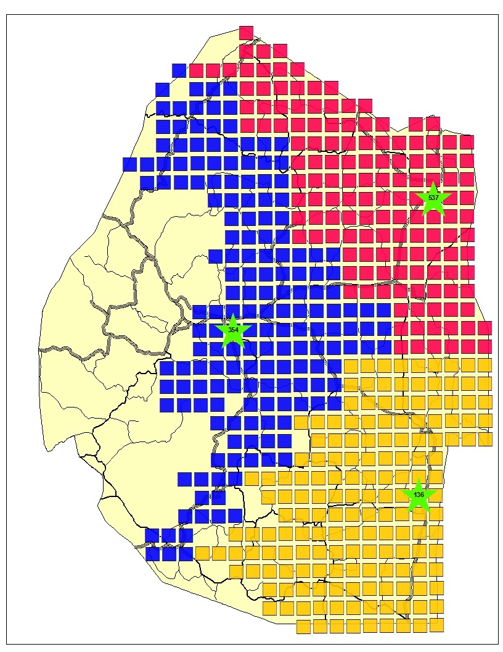
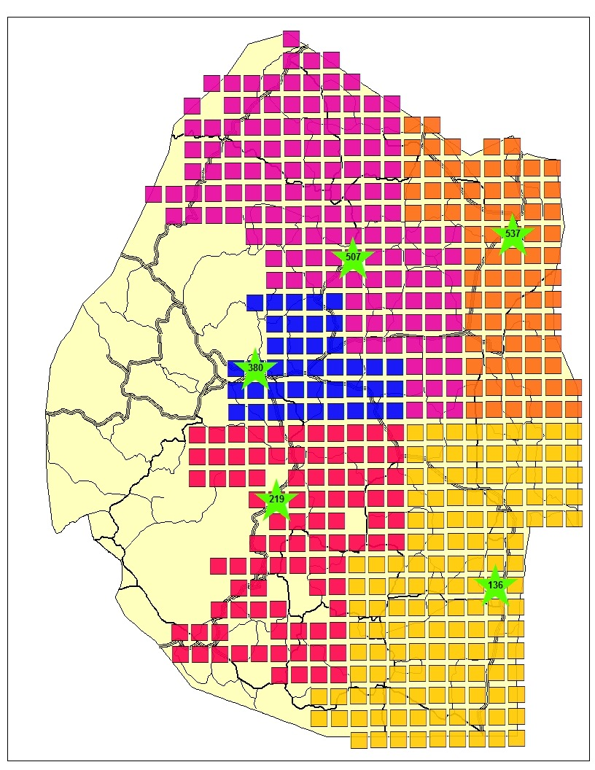
Zone Assignment Heuristic
Customer zones are serviced by a single DC
  Straight-line distance: DC to customer zone
Zone Assignment with 3 DCs
Zone Assignment with 5 DCs

Slide 39
IRS (Indoor Residual Spraying)Resource Deployment Model
Given the DCs and the assigned zones:
Schedule a deployment plan
  What zones to target for spraying
  When to deploy in each zone
  How many people in each zone to protect
  Resources to base at DCs

Slide 40
Typical Constraints
Deployment restricted by:
Capacity | Relative Effectiveness | Costs/Budget
Truck capacity DC capacity Amount of resources based at DCs Zone population | Duration of DDT effectiveness Concentration of DDT per m² Coverage rate of spray personnel | Labor wages Vehicle rental and travel costs Equipment purchase and repair Cost of DDT

Slide 41
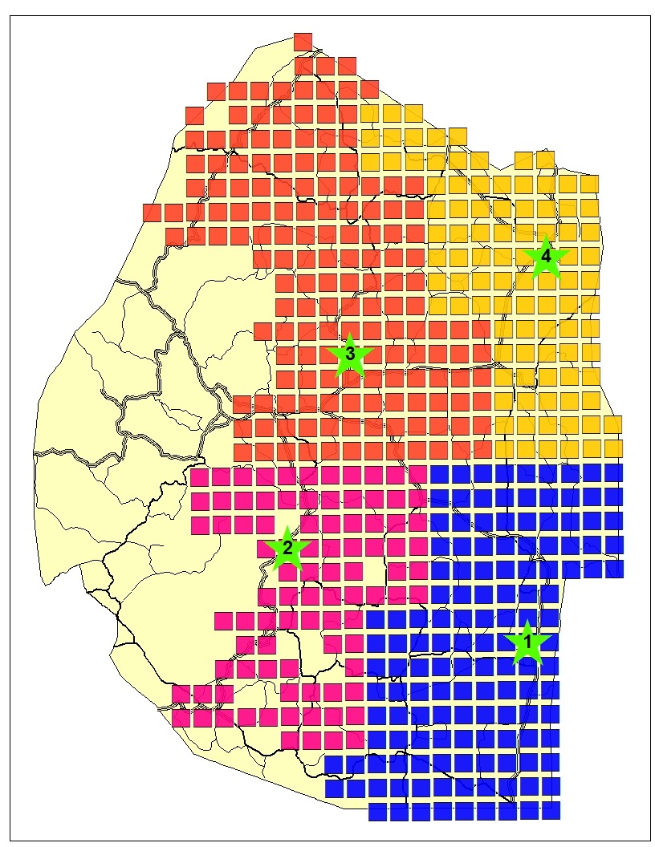
Recommendation

Slide 42
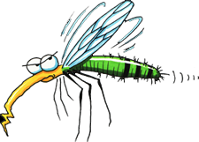
Questions?

Slide 43
QUIZ!
www.getkahoot.com
Don’t forget to enter nicknames as your ID’s.
PLEASE ENTER & symbol between your ID’s while eliminating the first digit!

