Slide 1
IE 485
«Decision Making in
Health Care»

Slide 2
Course Objectives
The purpose of this course is to provide an introduction to the use of decision sciences in health-care industry.
As the pressures of managed care and increasing health care costs push providers, payers and purchasers of health care to become more efficient, methods for understanding the appropriate basis for how to allocate shrinking health care resources must be understood.

Slide 3
Course Objectives
In addition to developing a conceptual understanding of medical decision making, you will develop technical skills in decision analysis including:
The creation and evaluation of decision trees
The use of sensitivity analysis,
Using Markov processes
Incorporation of specific patient preferences through the use of utility analysis
The use of multi-criteria decision making tools in health care resource allocation.
Examples from the current medical literature will be discussed.

Slide 4
Decision Making Process
Decision Making:
The study of identifying and choosing alternatives based on the values and preferences of the decision maker.
Harris, R. (1998) Introduction to Decision Making, VirtualSalt. http://www.virtualsalt.com/crebook5.htm

Slide 5
Decision Making in Health Care
The decision makers in health care services: those who plan, provide, receive, or pay for it
Health care policy making: MoH, SSI
Medical decision making:
Physicians must frequently choose treatment long before they know which disease is present
Even when the illness is known one must usually select from among several treatment options the consequences of each cannot be foretold with certainty.

Slide 6
Decision Making in Health Care
Some example decision settings:
Should clinicians check the blood pressure of each adult who walks into their offices?
Should health care planners start a breast cancer screening programme?
Should local health departments free scarce resources used for cancer treatments to increase the care for new-borns?

Slide 7
The Creation and Evaluation of
Decision Trees

Slide 8
This lecture focuses on determining the appropriate clinical strategy for patients
The analysis method involves building a decision tree, evaluating the tree and performing sensitivity analysis

Slide 9
Medical Decision Analysis
Decision Analysts
Deliberatively seek out new creative alternatives
Identify possible outcomes
Identify relevant uncertain factors
Encode probabilities for the uncertain factors
Specify the value placed on each outcome (cost, QALYs, LE)
Formally analyze the decision

Slide 10
Decision Analysis Using a Decision Tree

Slide 11
A construction worker with a badly infected compound fracture of the left ankle presents to your consulting room.
The infection is not only threatening to destroy the ankle itself, but is spreading proximally and the septic complications are potentially life threatening.

Slide 12
You are now faced with the difficult decision:
Should you perform a below knee amputation immediately?
Should you perform a surgical debridement followed by antibiotic treatment to save the ankle?

Slide 13
You are now faced with the difficult decision:
Should you perform a below knee amputation immediately?
Should you perform a surgical debridement followed by antibiotic treatment to save the ankle?
Although the second option offers a chance of complete recovery , it is associated with a substantial risk of infection that spreads, possibly leading to an above or below the knee amputation, or even death. Even this second option is successful, there is still a chance of minor long term disability of the limb.

Slide 14
Question:
What is the main clinical problem here?
a) Headache
b) Fractured ankle
c) Broken arm

Slide 15
What is the choice that has to be made?

Slide 16
You are now faced with the difficult decision:
Should you perform a below knee amputation immediately?
Should you perform a surgical debridement followed by antibiotic treatment to save the ankle?
- Although the second option offers a chance of complete recovery , it is associated with a substantial risk of infection that spreads, possibly leading to an above or below the knee amputation, or even death. Even this second option is successful, there is still a chance of minor long term disability of the limb.

Slide 17
What is the choice that has to be made?
Below knee amputation
Debridement and antibiotics

Slide 18
What are the possible outcomes?

Slide 19
You are now faced with the difficult decision:
Should you perform a below knee amputation immediately?
Should you perform a surgical debridement followed by antibiotic treatment to save the ankle?
Although the second option offers a chance of complete recovery , it is associated with a substantial risk of infection that spreads, possibly leading to an above or below the knee amputation, or even death. Even this second option is successful, there is still a chance of minor long term disability of the limb.

Slide 20
What are the possible outcomes?
    If the first option is chosen: BKA
    If the second option is chosen: (We do not know whether infection will be controlled)
      If not controlled: BKA, AKA or death
      If controlled: Full recovery or recovery with limp

Slide 21
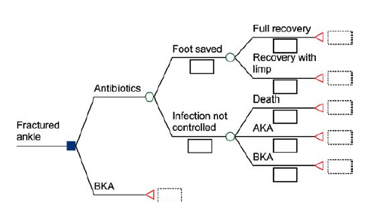

Slide 22
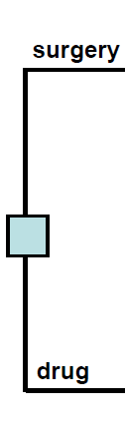
Elements of a Decision Tree
Decision Node: A point in a decision tree at which several choices are possible. The DM controls what is chosen
The choices should be mutually exclusive
Mutually exclusive:
The intersection of the events is empty
One and (only one) of the events must occur

Slide 23
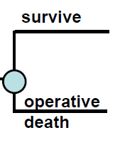
Elements of a Decision Tree
Chance Node: A point in decision tree at which chance determines which outcome will occur
The outcomes should be mutually exclusive and collectively exhaustive
Collectively exhaustive
The set of events take up the entire outcome space
At least one of the events must occur

Slide 24
Terminal Node: Final outcome state associated with each possible path way

Slide 25
Elements of Decision Analysis
Structure the Problem
  Identify decision alternatives
  List possible clinical outcomes
  Represent sequence of events
Assign probabilities to all chance events
Assign utility or value, to all outcomes
Evaluate the expected utility of each strategy
Perform sensitivity analysis

Slide 26
Structure the problem:

Slide 27
Elements of Decision Analysis
Structure the Problem
  Identify decision alternatives
  List possible clinical outcomes
  Represent sequence of events
Assign probabilities to all chance events

Slide 28
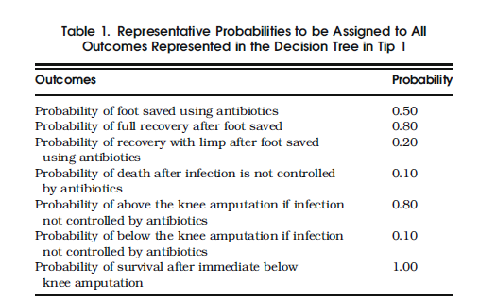

Slide 29
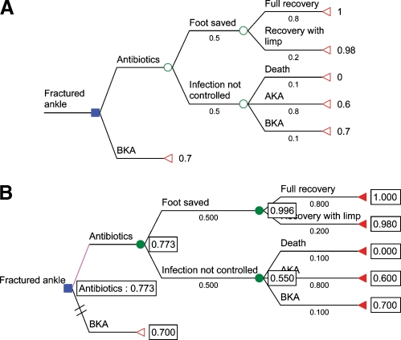

Slide 30
Elements of Decision Analysis
Structure the Problem
  Identify decision alternatives
  List possible clinical outcomes
  Represent sequence of events
Assign probabilities to all chance events
Assign utility or value, to all outcomes

Slide 31
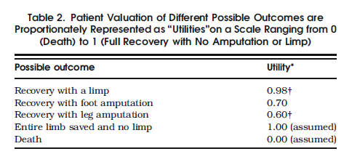

Slide 33
Elements of Decision Analysis
Structure the Problem
  Identify decision alternatives
  List possible clinical outcomes
  Represent sequence of events
Assign probabilities to all chance events
Assign utility or value, to all outcomes
Evaluate the expected utility of each strategy

Slide 34
0.8*1+0.2*0.98=0.996
0.1*0+0.8*0.6+0.1*0.7=0.55

Slide 35
Elements of Decision Analysis
Structure the Problem
  Identify decision alternatives
  List possible clinical outcomes
  Represent sequence of events
Assign probabilities to all chance events
Assign utility or value, to all outcomes
Evaluate the expected utility of each strategy
Perform sensitivity analysis

Slide 36
What happens if this probability changes?

Slide 37
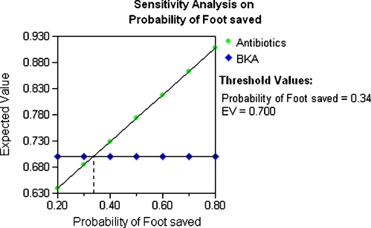

Slide 38
Another Example
A symptomatic patient
Operate (risky)
Medical management (drug therapy)
If disease present at surgery, must decide whether try for cure or palliate (to ease symptoms without curing the underlying disease)
We want to evaluate surgery versus medical management

Slide 39
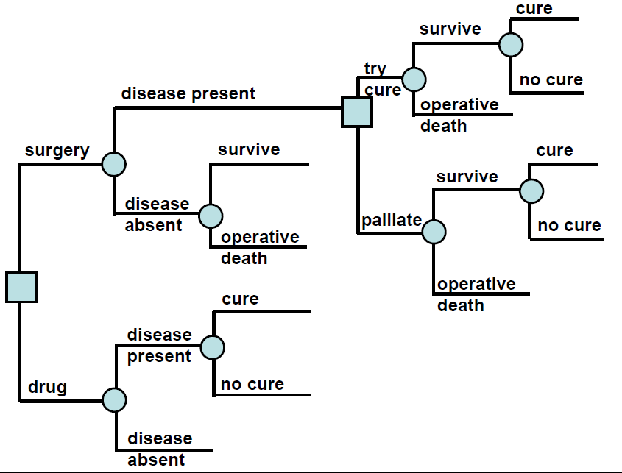

Slide 40
Sensitivity Analysis
Systematically asking what of question to see how the decision result changes
Determines how robust the decision is
  One parameter varied (Threshold analysis)
  Multiple parameters systematically varied (Multi-way analysis)

Slide 41
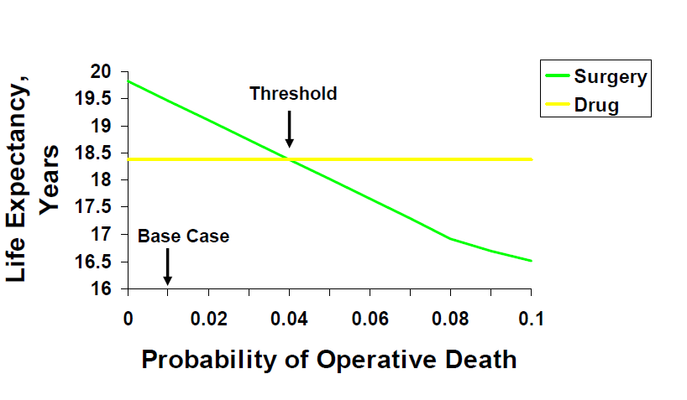
One-way Sensitivity Analysis

Slide 42
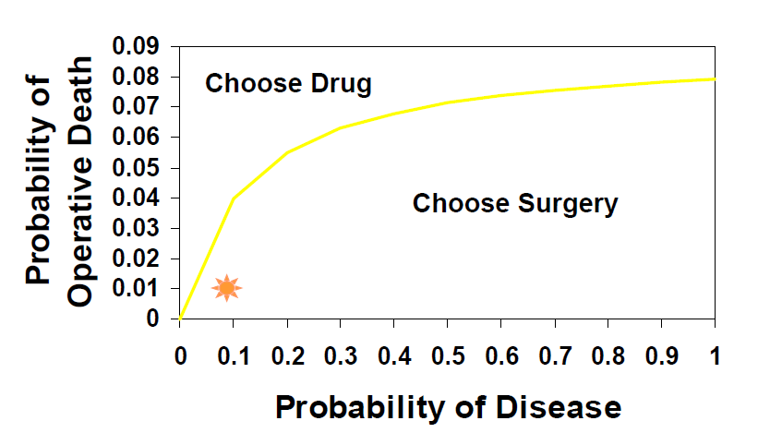
Two-way Sensitivity Analysis

Slide 43
IE 485 - Intro
QUIZ!
www.getkahoot.com
Don’t forget to enter nicknames as your ID’s.

