Slide 1
Operations Research (OR) in HEALTH CARE

Slide 2
In both rich and poor countries public resources for health care are inadequate to meet the demand
The policy makers must determine how to provide the most effective health care to citizens using the limited resources that are available
OR models can play a significant role in solving health care delivery related problems

Slide 3
  Health care planning
  Health care planning
  Demand forecasting
  Location selection
  Capacity planning

Slide 4
Facility Location Problems in Health Care
Locate hospitals:
Minimization of the maximum distance between a demand node and its closest facility
Minimization of the location cost of the facilities needed to cover the total demand
Maximization of the total covered demand

Slide 5
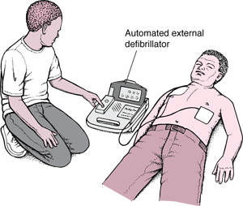
Locating AEDs
Source: http://nursingcrib.com/demo-checklist/automated-external-defibrillation/

Slide 6
Automated External Defibrillators (AEDs)
Can be used by bystanders to diagnose and treat a cardiac arrest victim
Place AEDs in public locations so that they can be used in case of emergency
Identify a set of locations where placing AEDs would maximize the number of cardiac arrests that could be covered within a 100-m radius
Decision: Locations of the AEDs to be deployed

Slide 7
Capacity Planning Example:
Bed Management
How much bed capacity to allocate to different hospital units?

Slide 8
Capacity Planning Example:
Bed Management
Problem: Overflow (i.e. Patients lodging at another specialty) of wards
The demand of inpatient beds by medical specialties changes over time
A periodic review of bed allocation by specialties is needed
Assign the beds such that the specialties will end up with equitable bed occupancy rates subject to number of beds available

Slide 9
Health Care Management and Logistics
Patient Scheduling
Resource scheduling
  Nurse
  Operating room and physician
Logistics
Others

Slide 10
Outpatient Appointment Scheduling
Problem: Long waiting time at outpatient clinics before consultation
Possible methods:
Queuing theory
Discrete Event Simulation

Slide 11
The Science of Scheduling:
https://www.youtube.com/watch?v=9MrL2BxKh1E

Slide 12
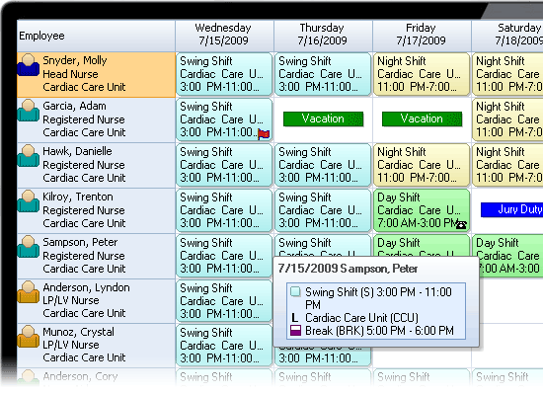
Nurse scheduling
http://www.bmscentral.com/products/schedule/industries/nurse-scheduling-software.aspx

Slide 13
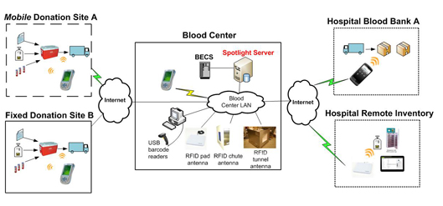
Logistics: Blood Supply Chain

Slide 14
Healthcare Practice
Disease diagnosis
Treatment planning

Slide 15
Intensity-modulated radiation therapy (IMRT)
https://www.youtube.com/watch?v=_moypMx05Fw
You want to target the tumor
You want to minimize the harm to healthy tissue

Slide 16
IMRT
Challenge: As a patient breathes during treatment, a tumor in the lung will be moving (possibly irregularly)
Build a model of motion uncertainty using probability density functions that describe breathing motion
Optimizing intensity modulated radiation therapy
Find a method that reliably delivers a sufficient amount of dose to the tumor, while sparing the healthy tissue as much as possible.

Slide 17
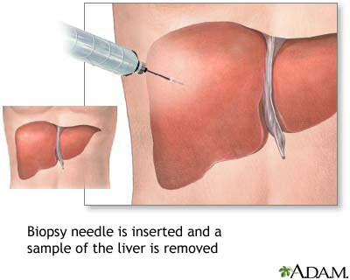
Biopsy
Determine the zones to be biopsied in order to maximize the probability of cancer detection
http://www.okclipart.com/Biopsy-Clip-Art30rofhkibn/

Slide 18
Specialised and Preventive Healthcare
Organ donation and transplant
Prevention of diseases

Slide 19
Organ Transplant
There are patients waiting
A kidney becomes available
Decision: Whom to offer the kidney?
-Challenges: Patients’ conditions are different
The system should be efficient
The system should be fair
The system should be transparent

Slide 20
Prevention of Diseases: Determining Screening Policy
Mammography:
Too frequent : early detection but high cost
Not frequent: less cost, late detection
TRADEOFF
Find the optimal policy that balances cost and detection

Slide 21
OR in Health Care
QUIZ!
www.getkahoot.com
Don’t forget to enter nicknames as your ID’s.

