Slide 1
IE Curricullum

Slide 2
IE Curriculum
Freshman
Sophomore
Junior
Senior
Phys101
Phys102
Math250
Math260
IE375
IE376
Project-1
Project-2
Math101
Math102
Math225
IE202
IE325
IE324
IE
Elective
IE
Elective
IE102
Math 132
IE303
IE380
IE272
IE342
IE
Elective
IE
Elective
IE
Elective
Eng101
Eng102
Econ 207
CS 115
Hist200
Turk101
Turk102
Hum111
Hum112
CS281
BrEL
BrEL
BrEL
GE100
GE 250
GE 251
IE299
IE496
HSS
HSS
GE 301
Eng401
IE399
17
16
18
17
17
18
15
15

Slide 3
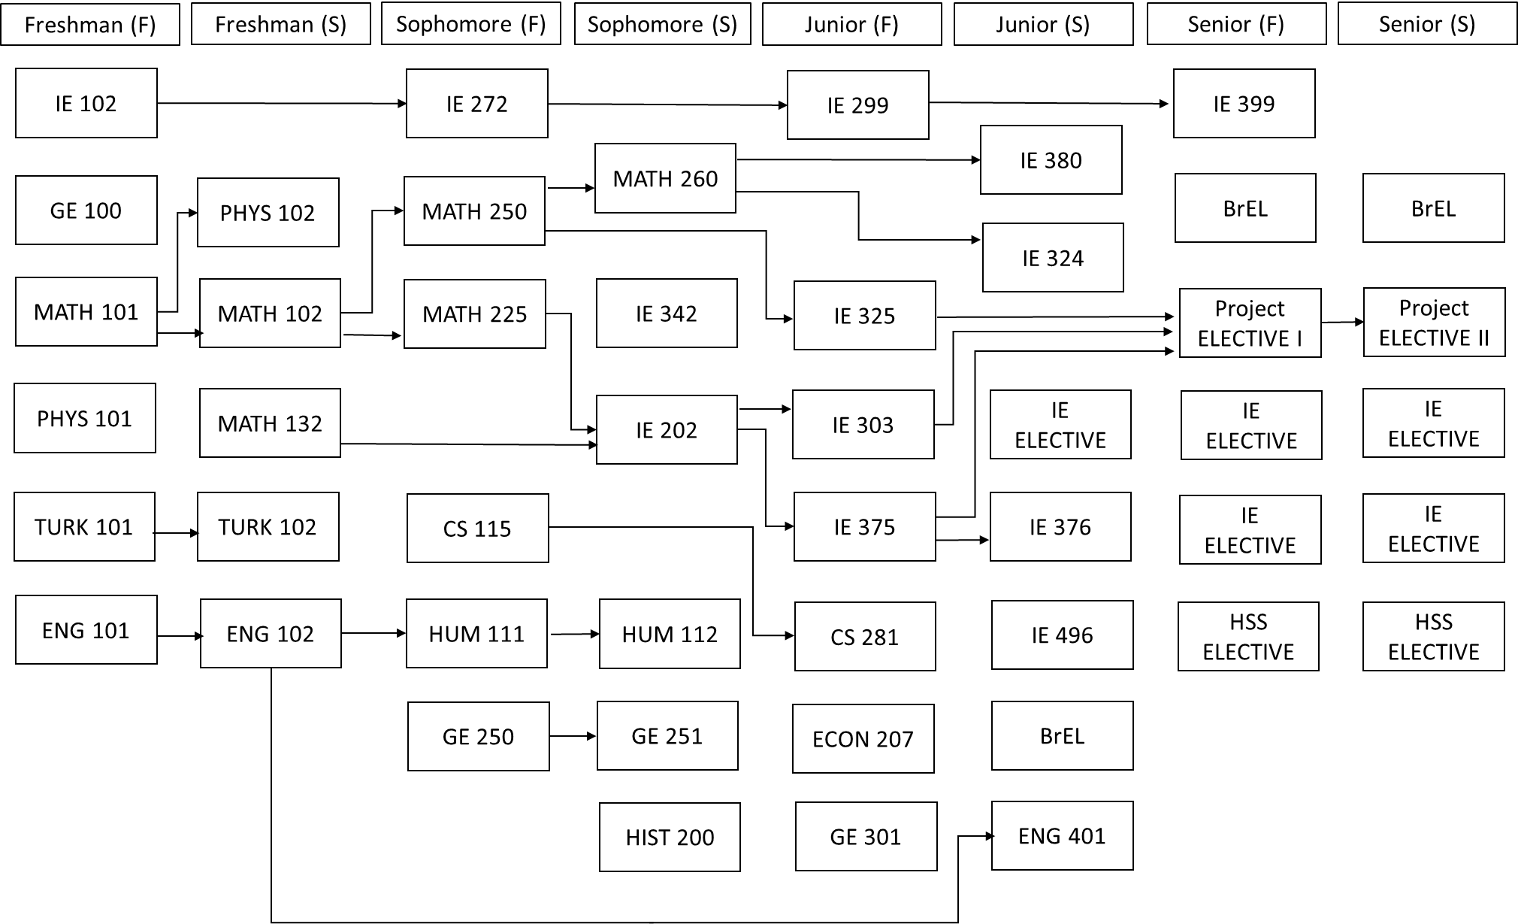

Slide 6
IE Curriculum
Freshman
Sophomore
Junior
Senior
Phys101
Phys102
Math250
Math260
IE375
IE376
Project-1
Project-2
Math101
Math102
Math225
IE202
IE325
IE324
IE
Elective
IE
Elective
IE102
Math 132
IE303
IE380
IE272
IE342
IE
Elective
IE
Elective
IE
Elective
Eng101
Eng102
Econ 207
CS 115
Hist200
Turk101
Turk102
Hum111
Hum112
CS281
BrEL
BrEL
BrEL
GE100
GE 250
GE 251
IE299
IE496
HSS
HSS
GE 301
Eng401
IE399
17
16
18
17
17
18
15
15

Slide 7
IE Must Courses
IE 102
IE 272
IE 303
IE 375
IE 324
IE 376
IE 380
IE 202
IE 325
IE 324
IE 299
IE 399
IE 496

Slide 8
IE 262 Manufacturing Processes and Operations Analysis
  The course is designed to give the student an holistic view of manufacturing world.
  The course starts from traditional industrial engineering concepts and functions
    in the design,
    improvement, and
    analysis of
  man – machine systems
  mainly in the context of a manufacturing environment and
  extends to novel concepts like factories of the future.

Slide 9
IE 325 Stochastic Models
  Basic queuing models and applications.
  Stochastic inventory models: periodic and continuous review.
  Introduction to stochastic maintenance models.
IE 202 Introduction to Modeling and Optimization
  Introduction to mathematical modelling.
  Linear and integer models.
  Linear programming.
IE 324 Simulation
  Use and misuse of simulation as a decision tool.
  The use of simulation for estimation, and comparison of policies.
  Emphasis is primarily on applications in the areas of production management.

Slide 10
IE 303 Modeling and Methods in Optimization
  Extension of linear programming to different methodologies including network models, integer programming and dynamic programming.
  Discrete optimization: local search heuristics.
IE 375 Production Planning
  Design of production planning systems
  Forecasting;
  integrated production-inventory systems;
  multi-echelon supply networks;
  machine scheduling and capacity planning.
IE 376 Production Information Systems
  The role of computers and data bases in production systems.
  Fundamental concepts like:
    ERP, lean production and JIT

Slide 11
IE 342 Engineering Economic Analysis
  Concepts of time value of money. Effects of depreciation, inflation, and taxation on economic decisions.
  Analysis of engineering decisions; principles and methodology of comparing decision alternatives.
  Cost-benefit analysis of public projects.
  Replacement analysis. Introduction to financial engineering.
IE 380 Quality Assurance and Reliability
  Various philosophies and definitions of quality.
  Statistical process control.
  Process capability.
  Experimental design and the Taguchi methods for quality improvement.
  Acceptance sampling.

Slide 12
IE Curriculum
Freshman
Sophomore
Junior
Senior
Phys101
Phys102
Math250
Math260
IE375
IE376
Project-1
Project-2
Math101
Math102
Math225
IE202
IE325
IE324
IE
Elective
IE
Elective
IE102
Math 132
IE303
IE380
IE272
IE342
IE
Elective
IE
Elective
IE
Elective
Eng101
Eng102
Econ 207
CS 115
Hist200
Turk101
Turk102
Hum111
Hum112
CS281
BrEL
BrEL
BrEL
GE100
GE 250
GE 251
IE299
IE496
HSS
HSS
GE 301
Eng401
IE399
17
16
18
17
17
18
15
15

Slide 13
IE Restricted Electives
IE 411 Mathematical Programming
IE 412 Large Scale Optimization and Apps
IE 420 Heuristics in Optimization
IE 421 Introduction to Stochastic Processes
IE 422 Dynamic Programming
IE 423 Forecasting Methods and Applications
IE 427 Introduction to Defense Analysis
IE 428 Project Scheduling
IE 432 Quantitative Risk Management
IE 436 Simulation Exp. Design and Analysis
IE 440 Introduction to Financial Engineering
IE 441 Cost Analysis and Control
IE 443 Multi-Objective Decision Analysis
IE 444 Operations Research in Finance
IE 448 Financial Issues in Engineering Projects
IE 451 Applied Data Analysis
IE 453 Energy Systems Planning
IE 455 Service Systems
IE 457 Sustainable Operations
IE 460 Quantitative Models in Supply Chain Mgmt
IE 461 Supply Chain Management
IE 462 Int. to Advanced Manufac. Technologies
IE 463 Operations Scheduling
IE 464 Inventory Planning Models
IE 467 Emerging Trends in Manufacturing
IE 468 Pricing and Revenue Optimization
IE 469 Industrial Applications of OR
IE 474 Facility Layout and Location
IE 479 Distribution Logistics
IE 482 Humanitarian Logistics
IE 485 Decision Making in Health Care
IE 490 Introduction to Research in IE and OR

Slide 14
IE Restricted Electives
IE 411 Mathematical Programming
IE 412 Large Scale Optimization and Apps
IE 420 Heuristics in Optimization
IE 421 Introduction to Stochastic Processes
IE 422 Dynamic Programming
IE 423 Forecasting Methods and Applications
IE 427 Introduction to Defense Analysis
IE 428 Project Scheduling
IE 432 Quantitative Risk Management
IE 436 Simulation Exp. Design and Analysis
IE 440 Introduction to Financial Engineering
IE 441 Cost Analysis and Control
IE 443 Multi-Objective Decision Analysis
IE 444 Operations Research in Finance
IE 448 Financial Issues in Engineering Projects
IE 451 Applied Data Analysis
IE 453 Energy Systems Planning
IE 455 Service Systems
IE 457 Sustainable Operations
IE 460 Quantitative Models in Supply Chain Mgmt
IE 461 Supply Chain Management
IE 462 Int. to Advanced Manufac. Technologies
IE 463 Operations Scheduling
IE 464 Inventory Planning Models
IE 467 Emerging Trends in Manufacturing
IE 468 Pricing and Revenue Optimization
IE 469 Industrial Applications of OR
IE 474 Facility Layout and Location
IE 479 Distribution Logistics
IE 482 Humanitarian Logistics
IE 485 Decision Making in Health Care
IE 490 Introduction to Research in IE and OR

Slide 15
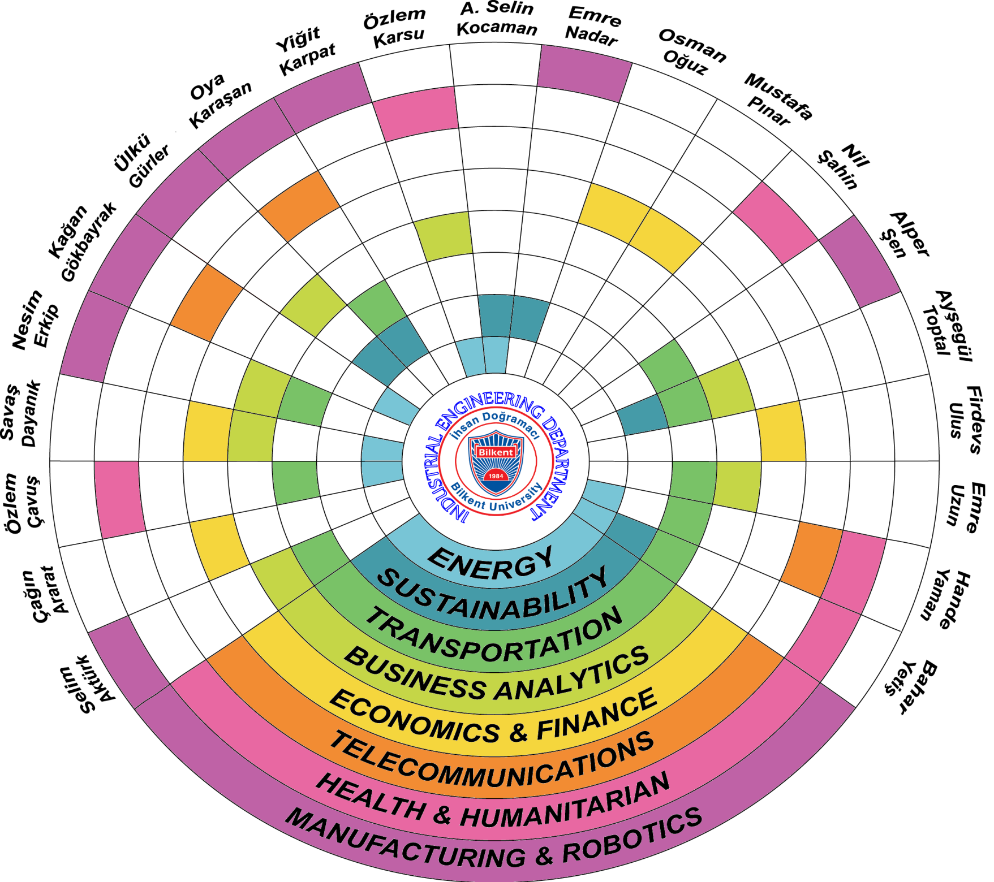

Slide 16
KAHOOT!
Go to kahoot.it
Have your KAHOOT partner.
Enter nicknames as ID1, ID2

