Slide 1
IE 479
Distribution Logistics

Slide 2
Personal Information
Instructor: Bahar Yetiş Kara
  Office: EA-314
  Tel: 3156
  Email: bkara@bilkent.edu.tr
Assistant: Gizem İkizler
  Email:gizem.ikizler@bilkent.edu.tr
Office hour: by appointment

Slide 3
Text Book
Introduction to Logistics Systems Planning and Control, G. Ghiani, G. Laporte, R. Musmanno, Wiley, 2003, ISBN : 0-470-84917-7
Lecture notes are very crucial

Slide 4
Course Grading Policy- Tentative
Midterm 25 %
Final 30 %
Article presentation 10 %
Projects 25 % (10 + 10+5)
Class-participation 10 %
No FZ policy

Slide 5
Teams of 2-3
Article Presentation
  Interfaces articles
Project 1 & 2 (20%, 10% each)
  Realistic problems
  Will sort the reports based on the objective function values
  Report format is very important (Latex is highly suggested)
Project3 (5%)
  A Class project!

Slide 6
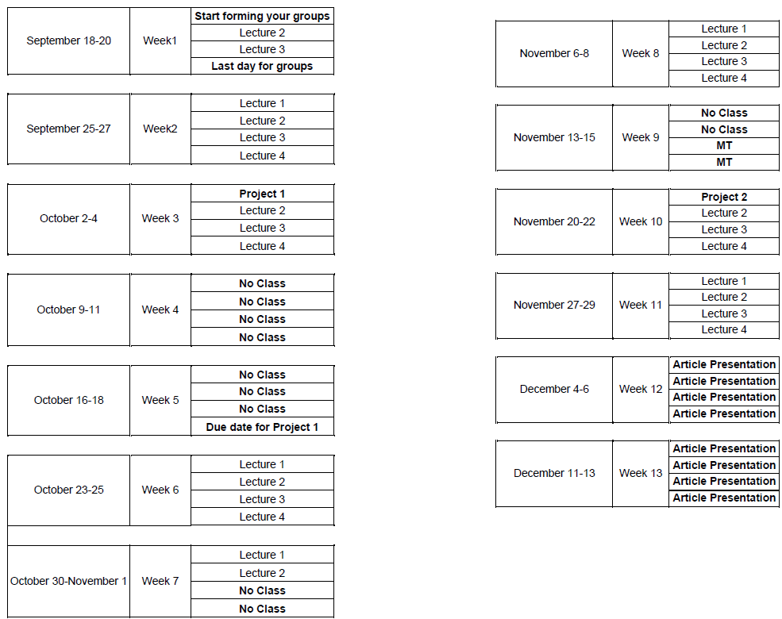
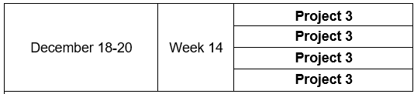
2023 Fall Calender

Slide 7

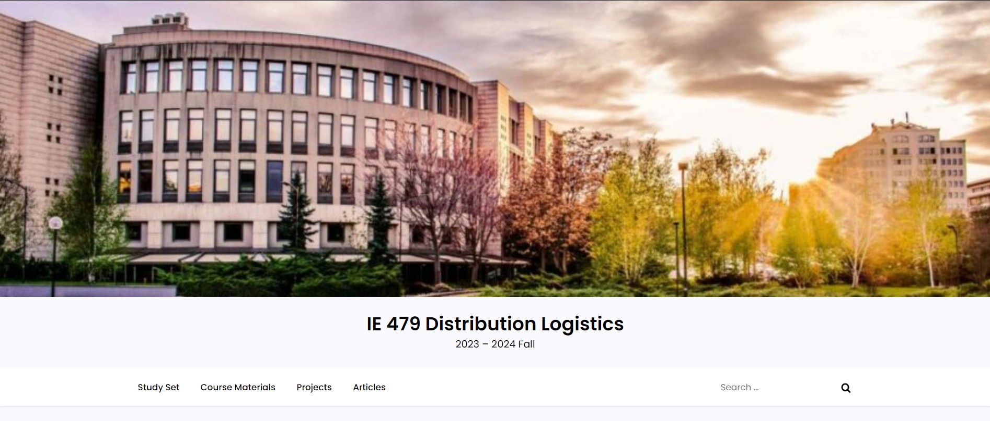
Course Webpage
https://courses.ie.bilkent.edu.tr/ie479/

Slide 8
Questions on
Rules of the Game

Slide 9
Why Logistics?

Slide 10
CASE study: Shoes From China
As a manufacturer, how should I ship my shoes from Shenzen (China) to Kansas City (USA)
  Shoes are manufactured, labeled, and packed at a plant
  ~4.5M shoes shipped per year from this plant
  6000-6500 shoes shipped per container
  Value of pair of shoes ~$35

Slide 11
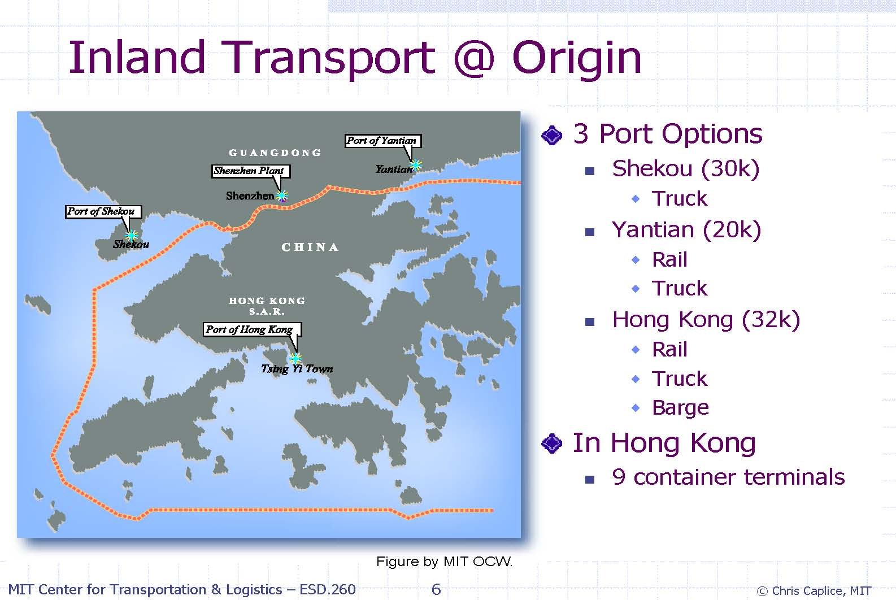
CASE study: Shoes From China

Slide 12
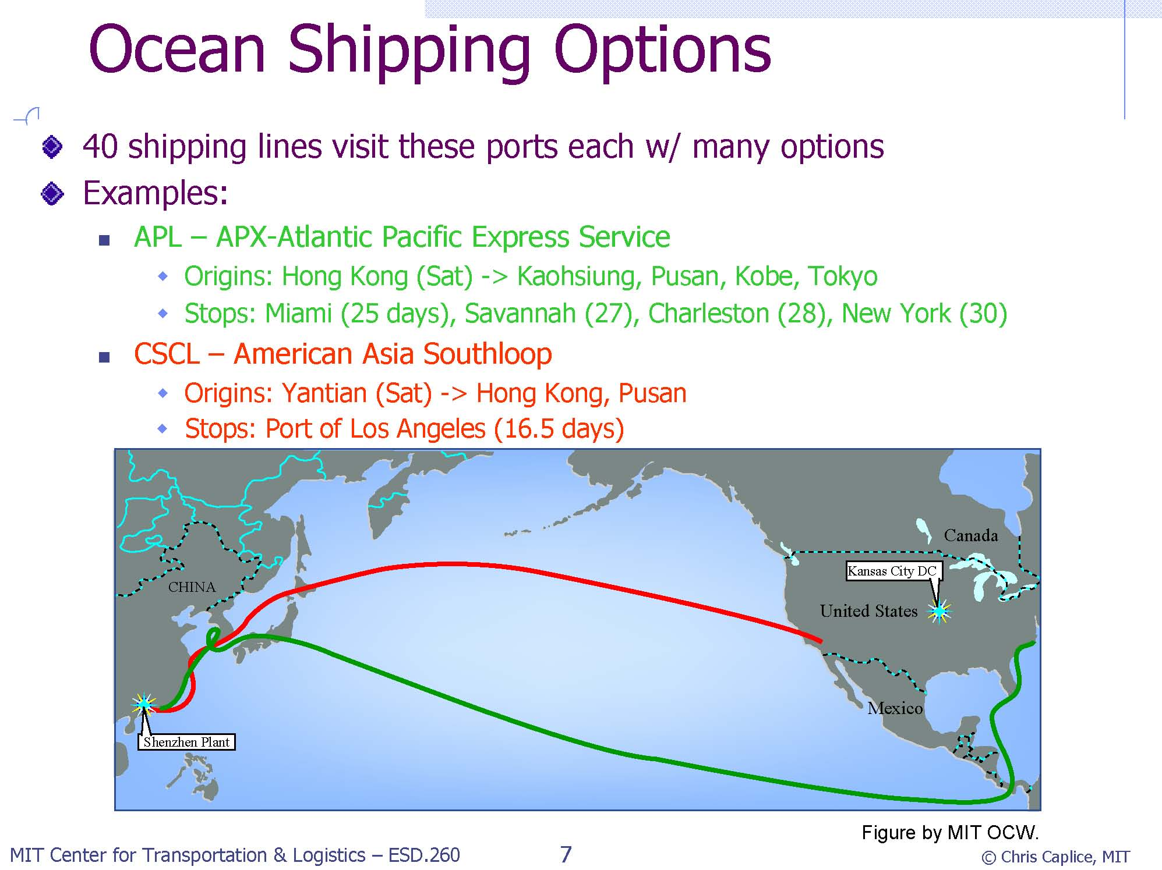
CASE study: Shoes From China

Slide 13
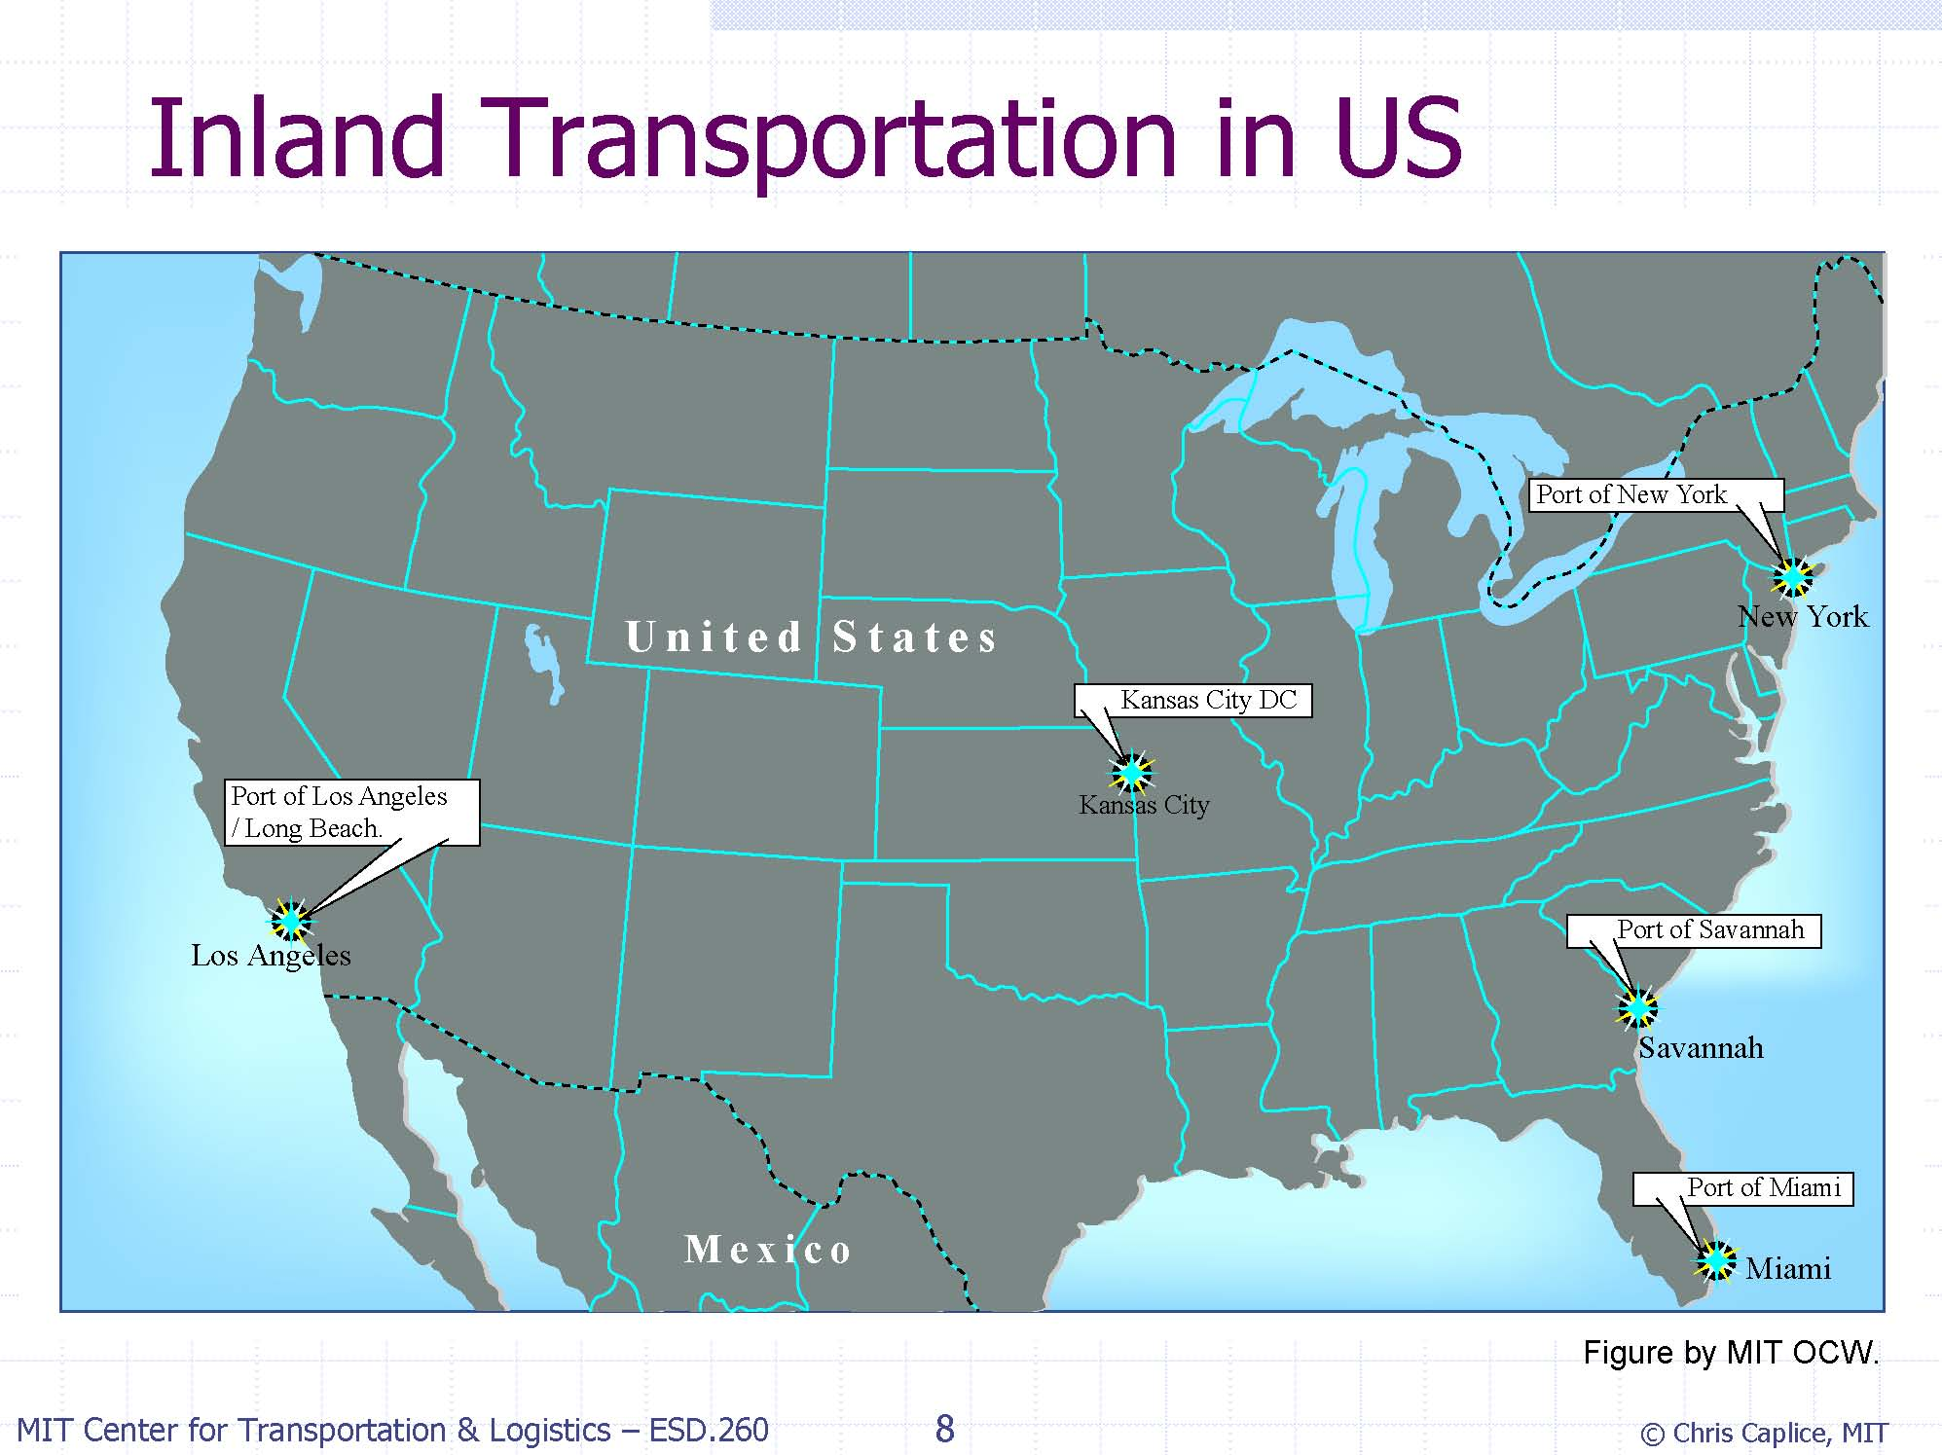

Slide 14
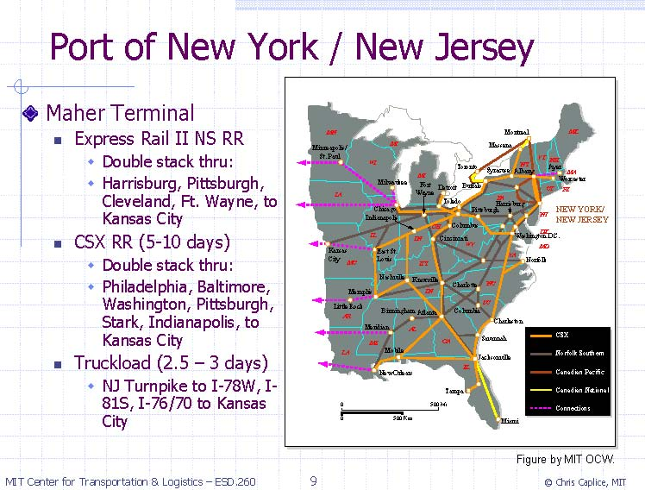

Slide 15
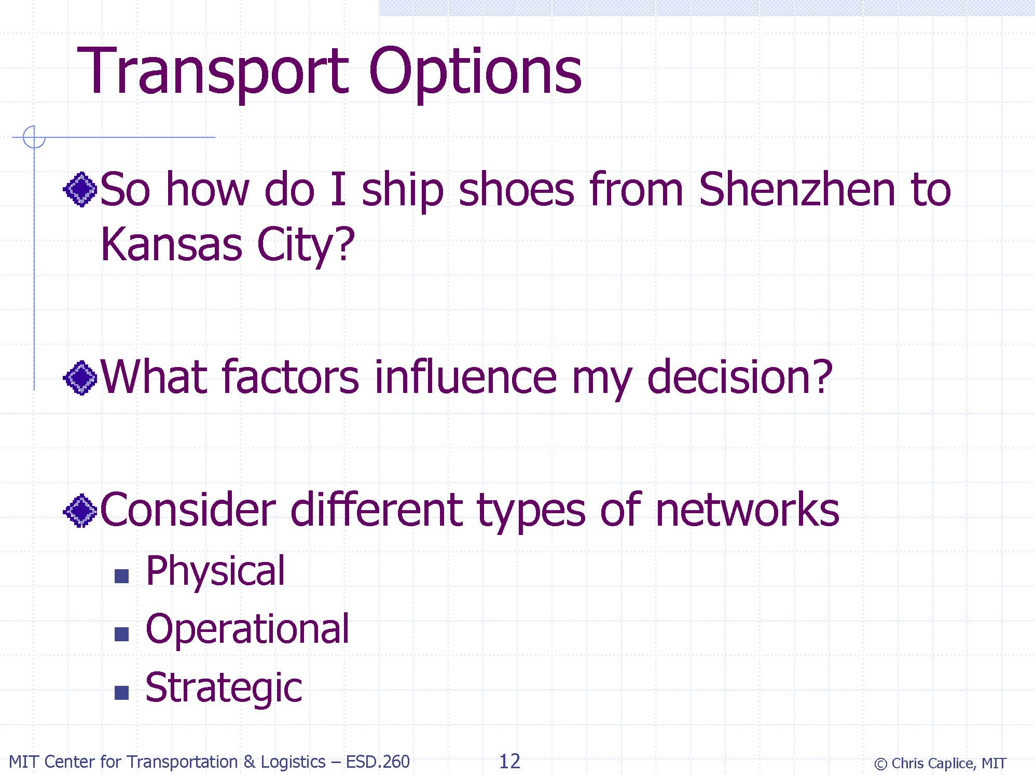

Slide 16
Why Logistics?

Slide 17
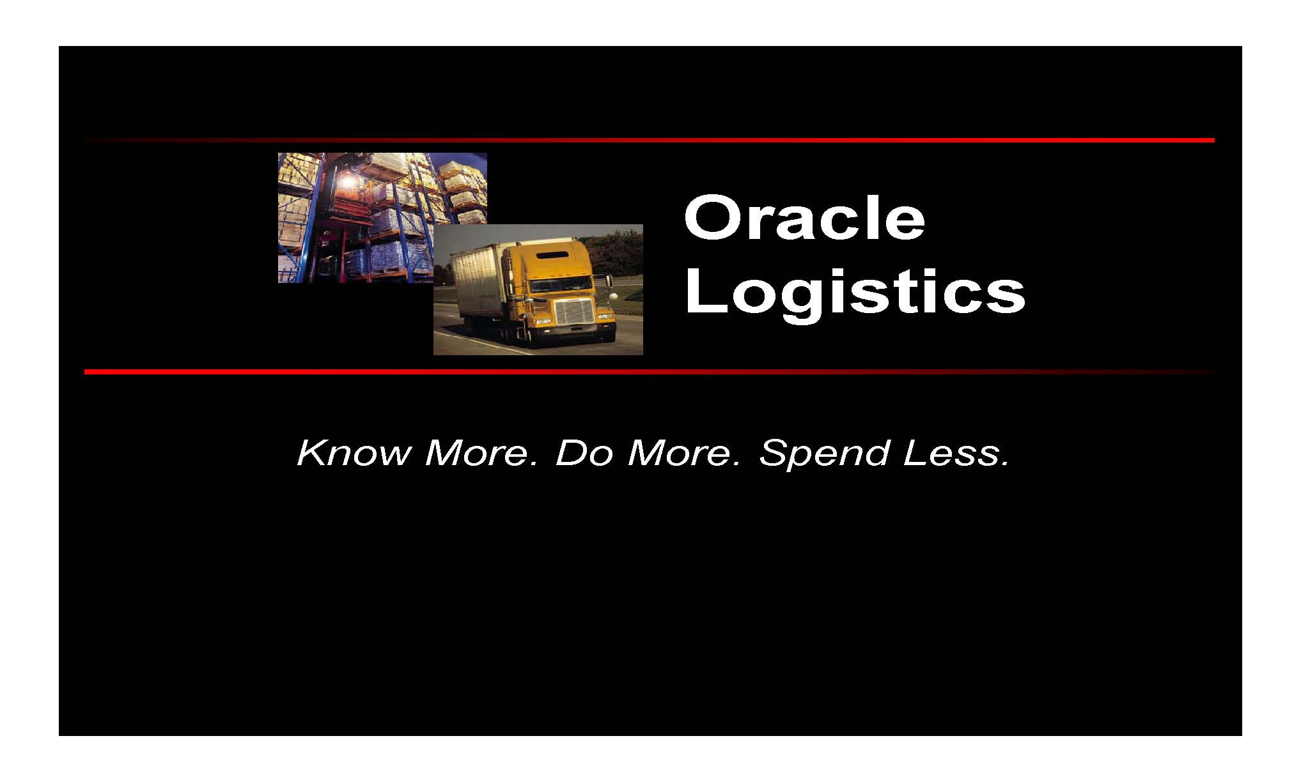

Slide 18
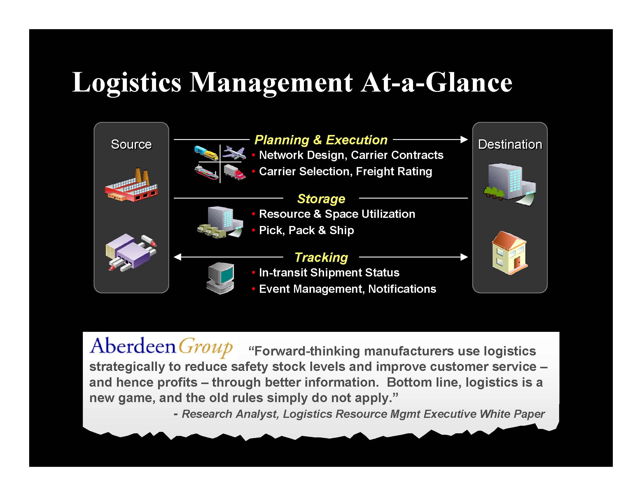

Slide 19
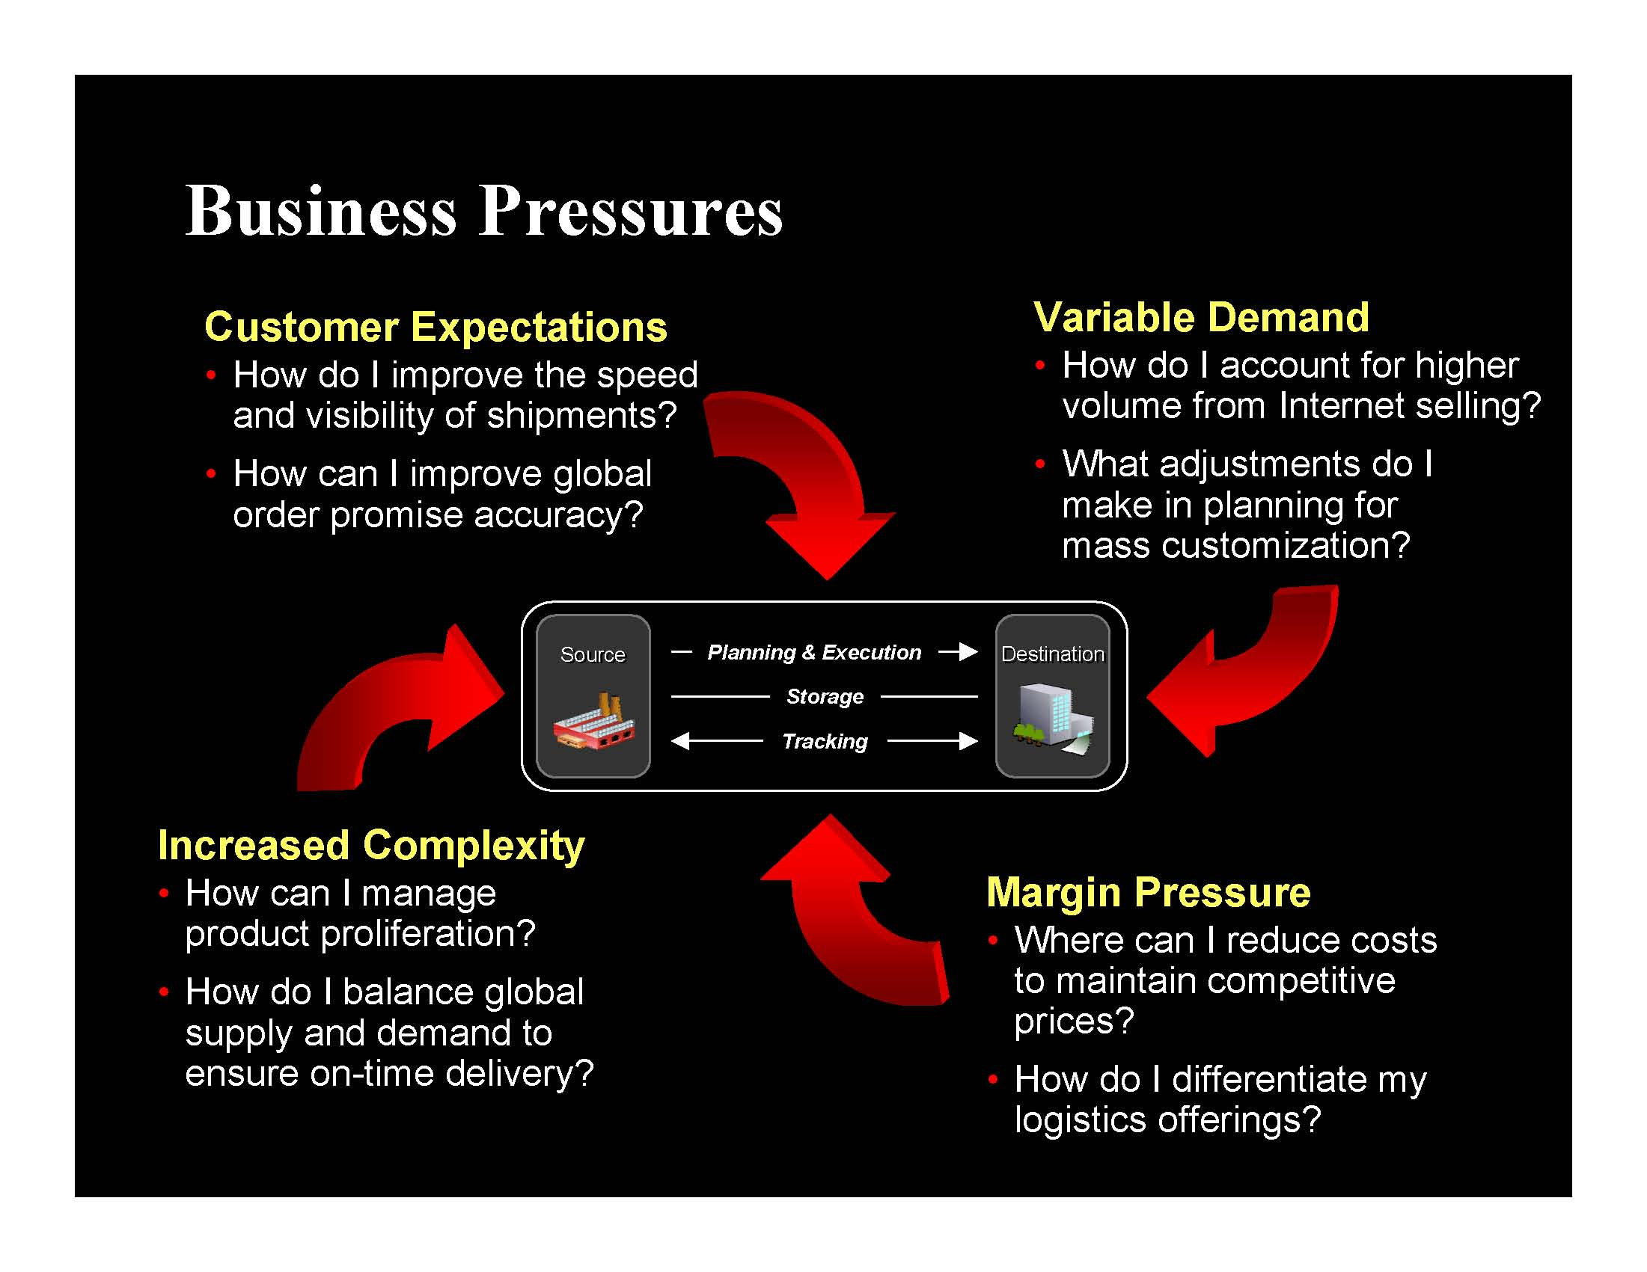

Slide 20
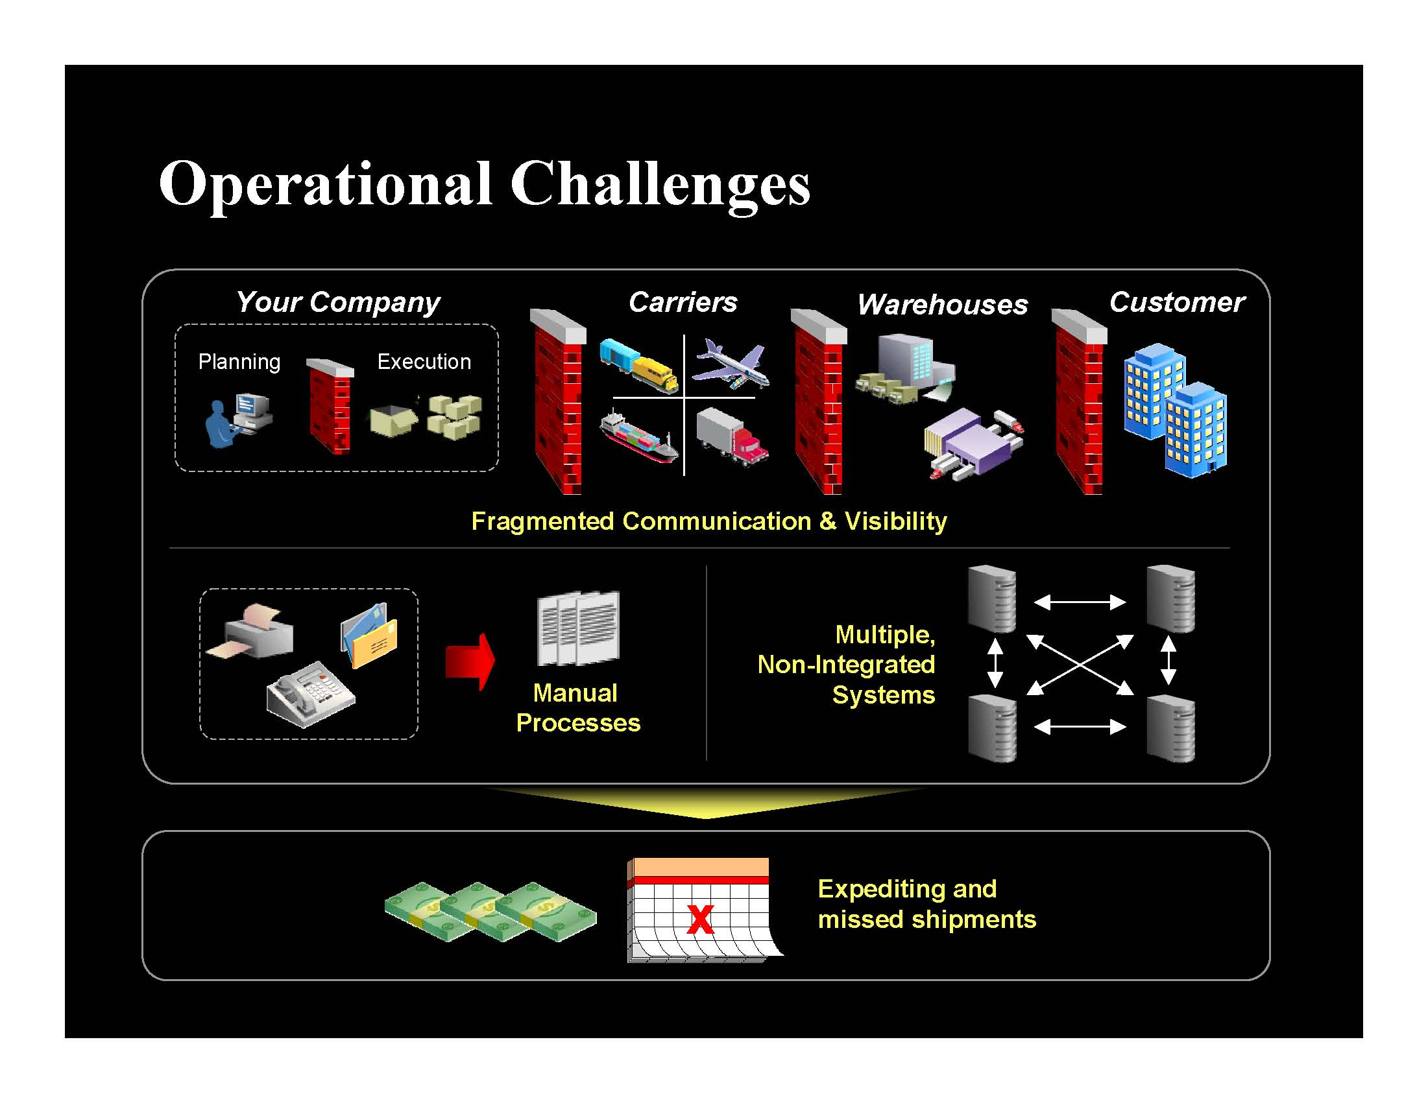

Slide 21
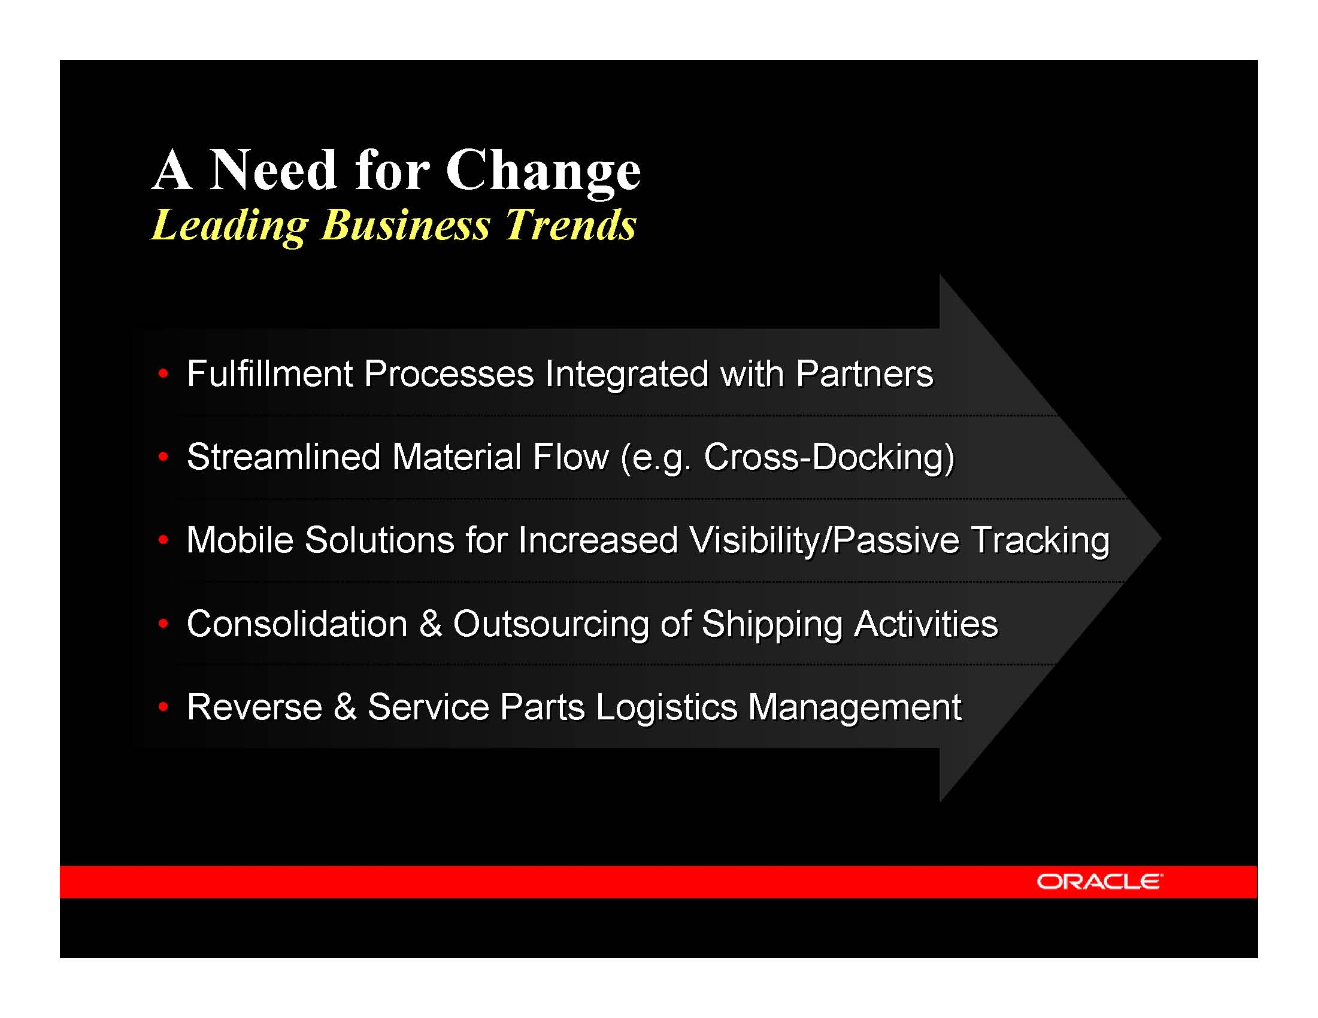

Slide 22
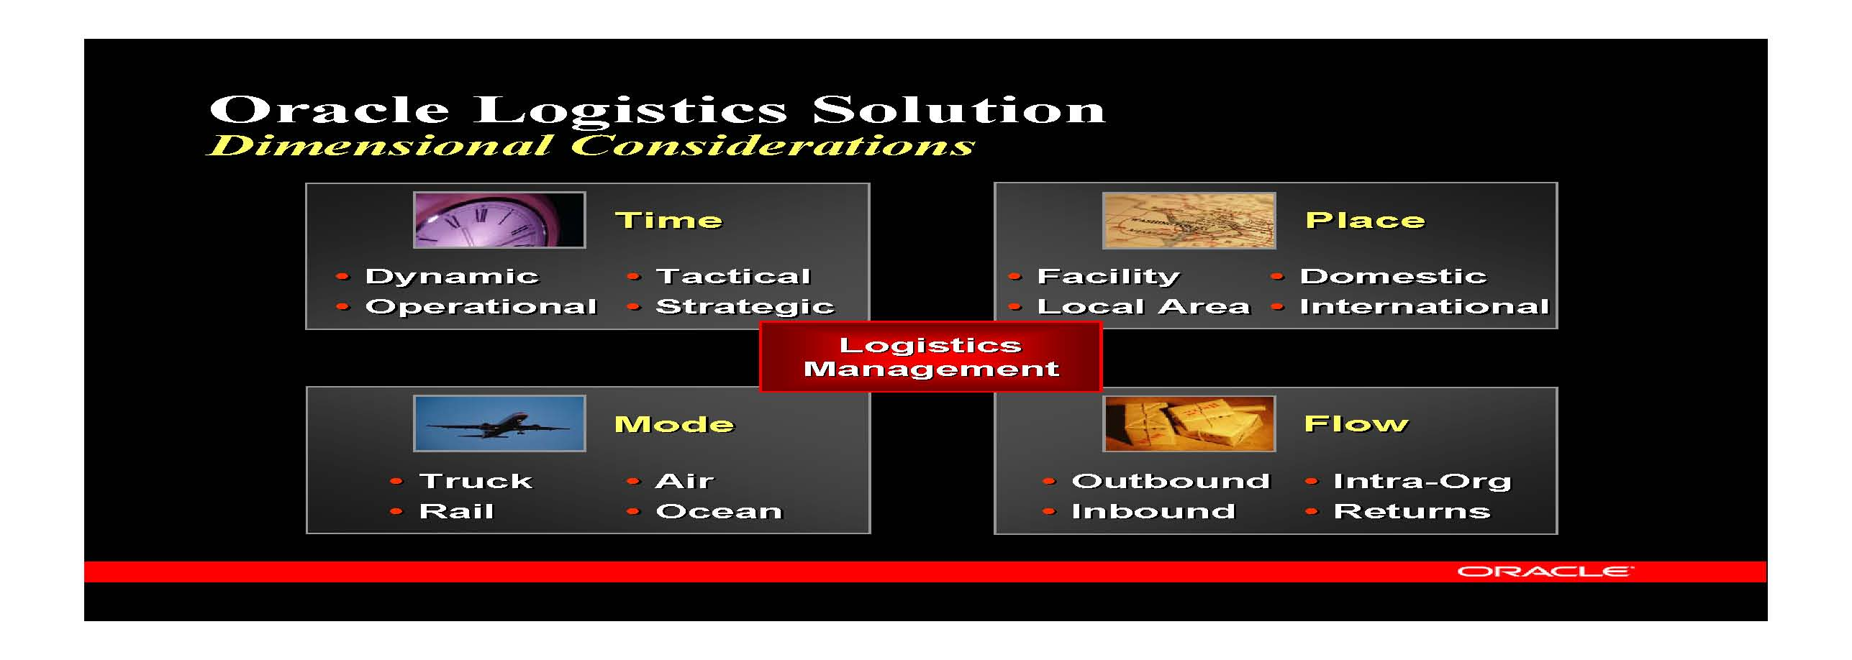

Slide 23
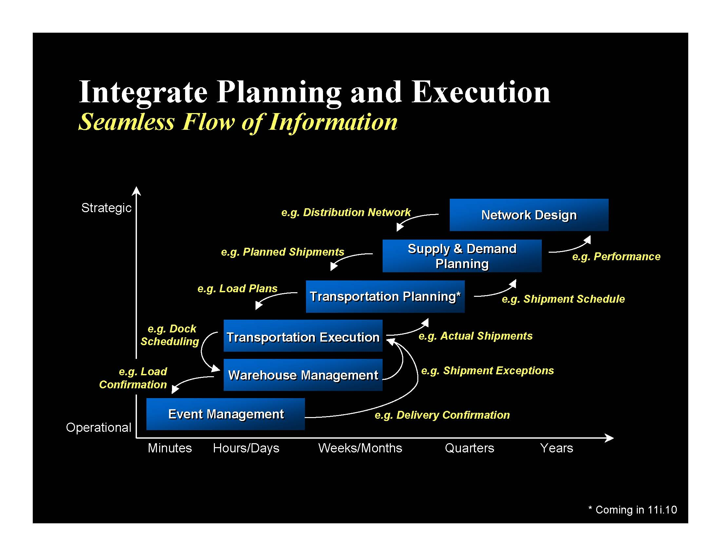

Slide 24
IE 479 Distribution Logistics

Slide 25
Aim of the Course
Provide an understanding for logistics problems
Using OR point of view
Introduce models to analyze logistics problems
Introduce quantitative models to analyze logistics problems
Present solution techniques for selected models

Slide 26
Logistics
Deals with the planning and control of :
  Material flows
  Related information
Mission is to get
  The right materials
  To the right place
  At the right time
while optimizing a performance measure and satisfying constraints

Slide 27
Logistics Decisions
This course is focused on quantitative methods used for planning, organizing, and controlling of logistics systems.

Slide 28
Logistics systems
Composed of facilities linked by transportation services
Facilities include
  Sites of manufacturing, storing, sorting, selling, consuming etc…
  Warehouses, distribution centers (DCs), transportation terminals, dump sites, etc…

Slide 29
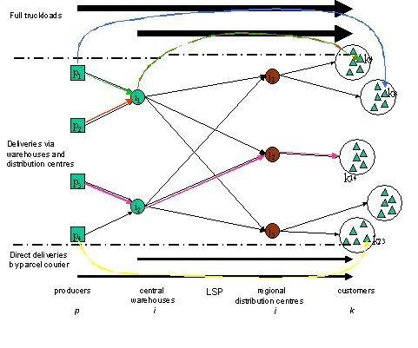
Logistics Systems (Supply Chains)

Slide 30
Logistic System Characteristics
Push versus Pull Systems
  make-to-order, make-to-stock, make-to-assembly
Vertical integration vs. third-party logistics (3PL)
  transaction based relationships, strategic alliances

Slide 31
Third Party Logistics(3PL)
Use of an outside company
  Perform all or part of a company’s product distribution
Three different levels:
  Basic service providers
    Physical distribution services (warehousing, transportation)
  Value added service providers
    Basic service + services such as specialized pick/pack, labeling
  Logistics integrators
    Full responsibility for managing key supply chain operations on a daily basis.

Slide 32
Outsourcing: Pros and Cons
Pros:
  Improve company focus
  Access to new technology
  Free-up resources
  Reduce operation costs
Cons:
  Coordination costs
  Loss of internal logistics management capability
  Reduced contact with final customer

Slide 33
Logistic System Characteristics
Push versus Pull Systems
  make-to-order, make-to-stock, make-to-assembly
Vertical integration vs. third-party logistics (3PL)
  transaction based relationships, strategic alliances

Slide 34
Logistic System Characteristics
Push versus Pull Systems
  make-to-order, make-to-stock, make-to-assembly
Vertical integration vs. third-party logistics (3PL)
  transaction based relationships, strategic alliances
Retailer managed vs. vendor managed inventory
Product and information flows

Slide 35
Logistics systems
Can categorize in three main activities:
  Order processing
    Links information flow with product flows
  Inventory management
    Controls inventories that are waiting to be manufactured, assembled, sold or salvaged
  Freight transportation
    Allows production and consumption to be far apart

Slide 36
Order processing
Links information flows with product flows
  Customers request products (EDI, fax, telephone,…)
  Availability of requested items is checked (PPS, SAP,…)
  Required items are produced (if necessary) or retrieved from the warehouse
  Items are shipped to customers
  Customers are kept informed about order status

Slide 37
Inventory management
Inventories are stocked
  Raw materials
  Semi-finished products and components
  finished products (in warehouse or en-route)
waiting to be manufactured, assembled, sold or salvaged

Slide 38
Inventory management
Reasons for holding inventories
  Demand seasonality
  Improving customer service level
  Price seasonality
  Exploit economies of scale in freight transportation
  Cope with demand and lead-time randomness
  Cover inefficiencies in managing the logistics system

Slide 39
Inventory management
A good inventory policy takes into account:
  the economic significance of stored products
  transportation policies
  production process characteristics
  competitors’ policies

Slide 40
Freight transportation
allows production and consumption to be far apart
  global availability of certain products
  economic benefits from production at low wage countries
  improved availability of perishable goods

Slide 41
Freight Transportation
Types:
  Private transportation
    (owned or leased vehicles)
  Contract transportation
    (dedicated carrier)
  Common transportation
    (general carrier)

Slide 42
Freight Transportation
Main features:
  Distribution channels:
    warehouses, DCs, direct...
  Freight consolidation:
    Facility consolidation : (e.g. hubs) individual shipments are consolidated at hubs .
    multi-stop: serving some customers together
    Temporal: adjusting schedules to ship larger quantities
  Modes of transportation

Slide 43
Distribution channels

Slide 44
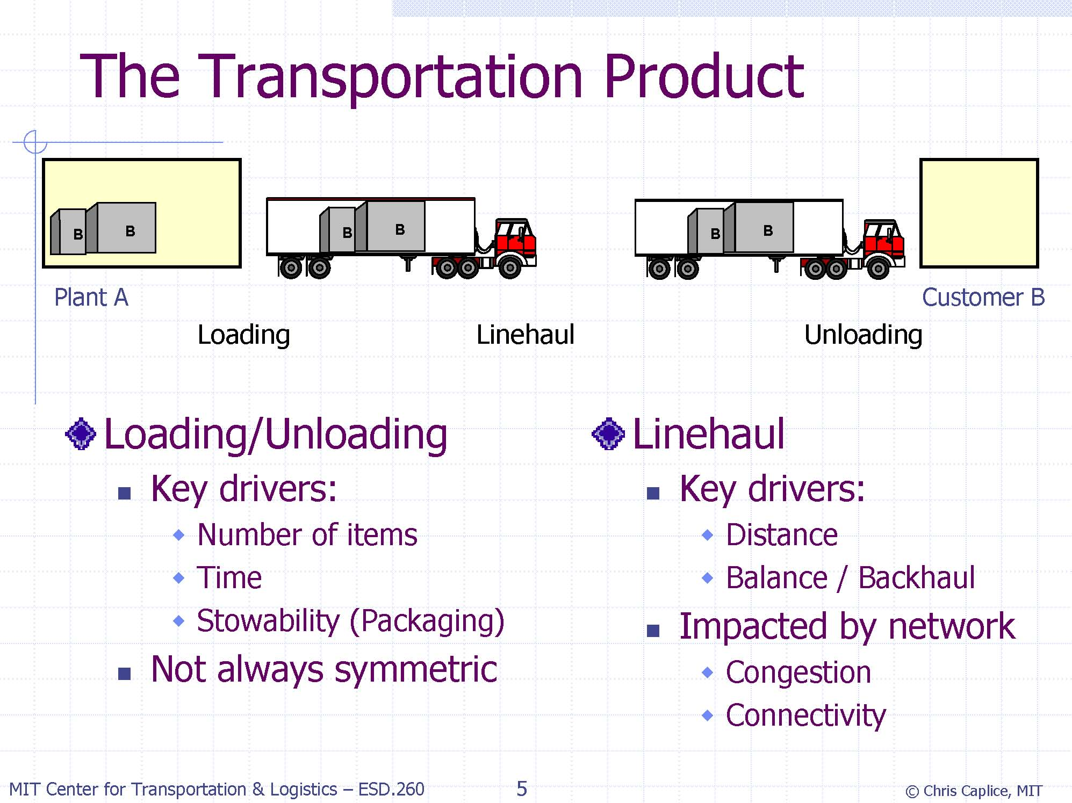

Slide 45
Freight consolidation
Facility consolidation
  e.g. UPS consolidates individual shipments at hubs for joint transportation between hubs
Multi-stop consolidation
  e.g. Fedex delivers individual shipments to their final destination on routes serving several customers
Temporal consolidation
  e.g. shipments schedules may be adjusted forward or backward to ship large quantities periodically

Slide 46
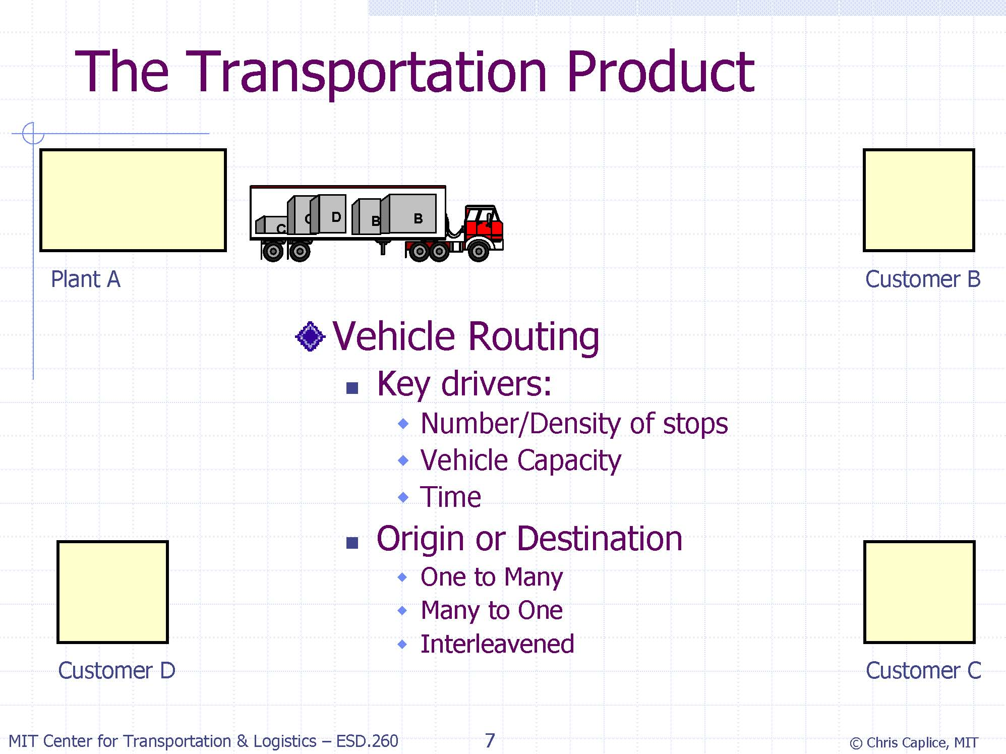
Multi-stop consolidation

Slide 47
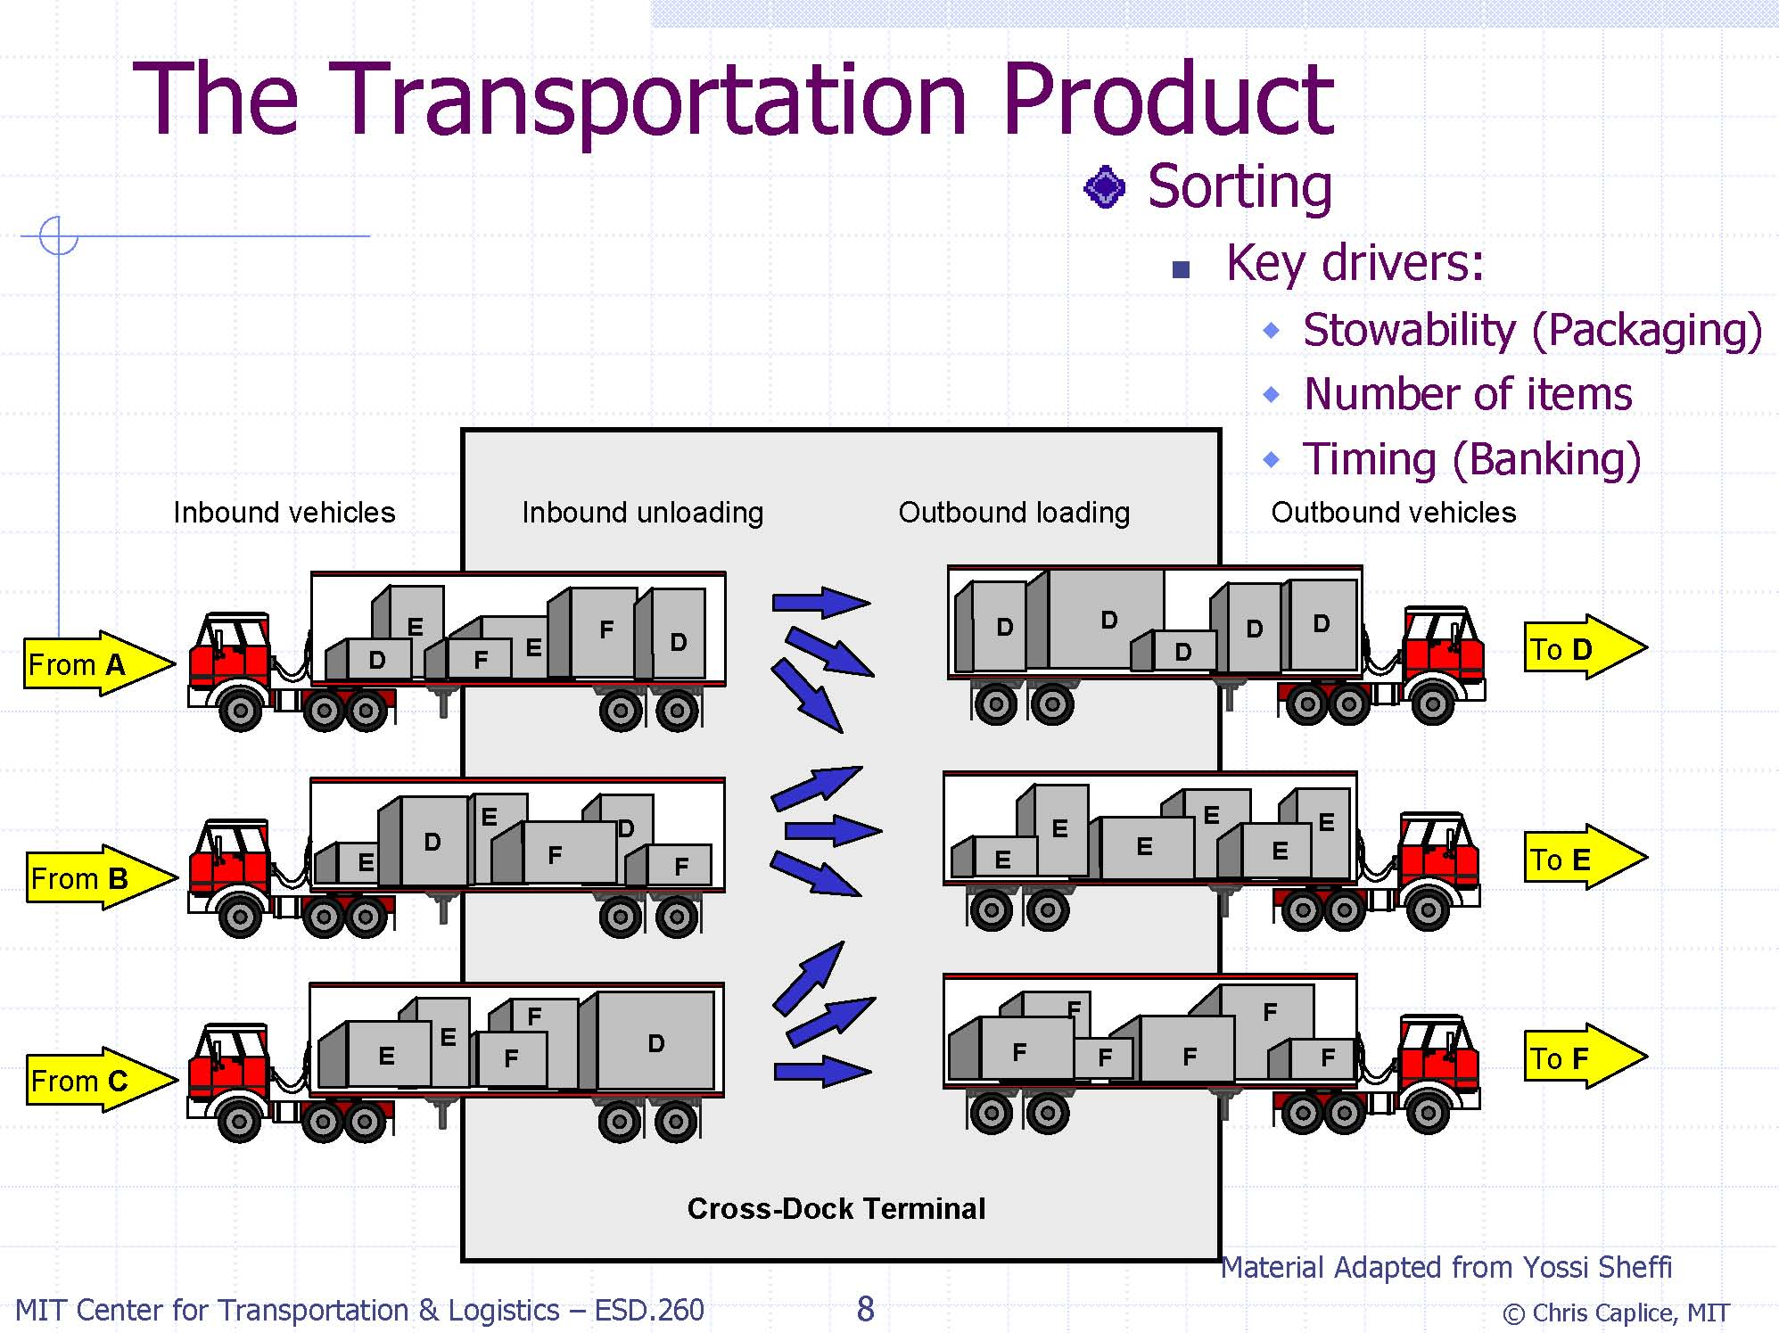
Facility consolidation

Slide 48
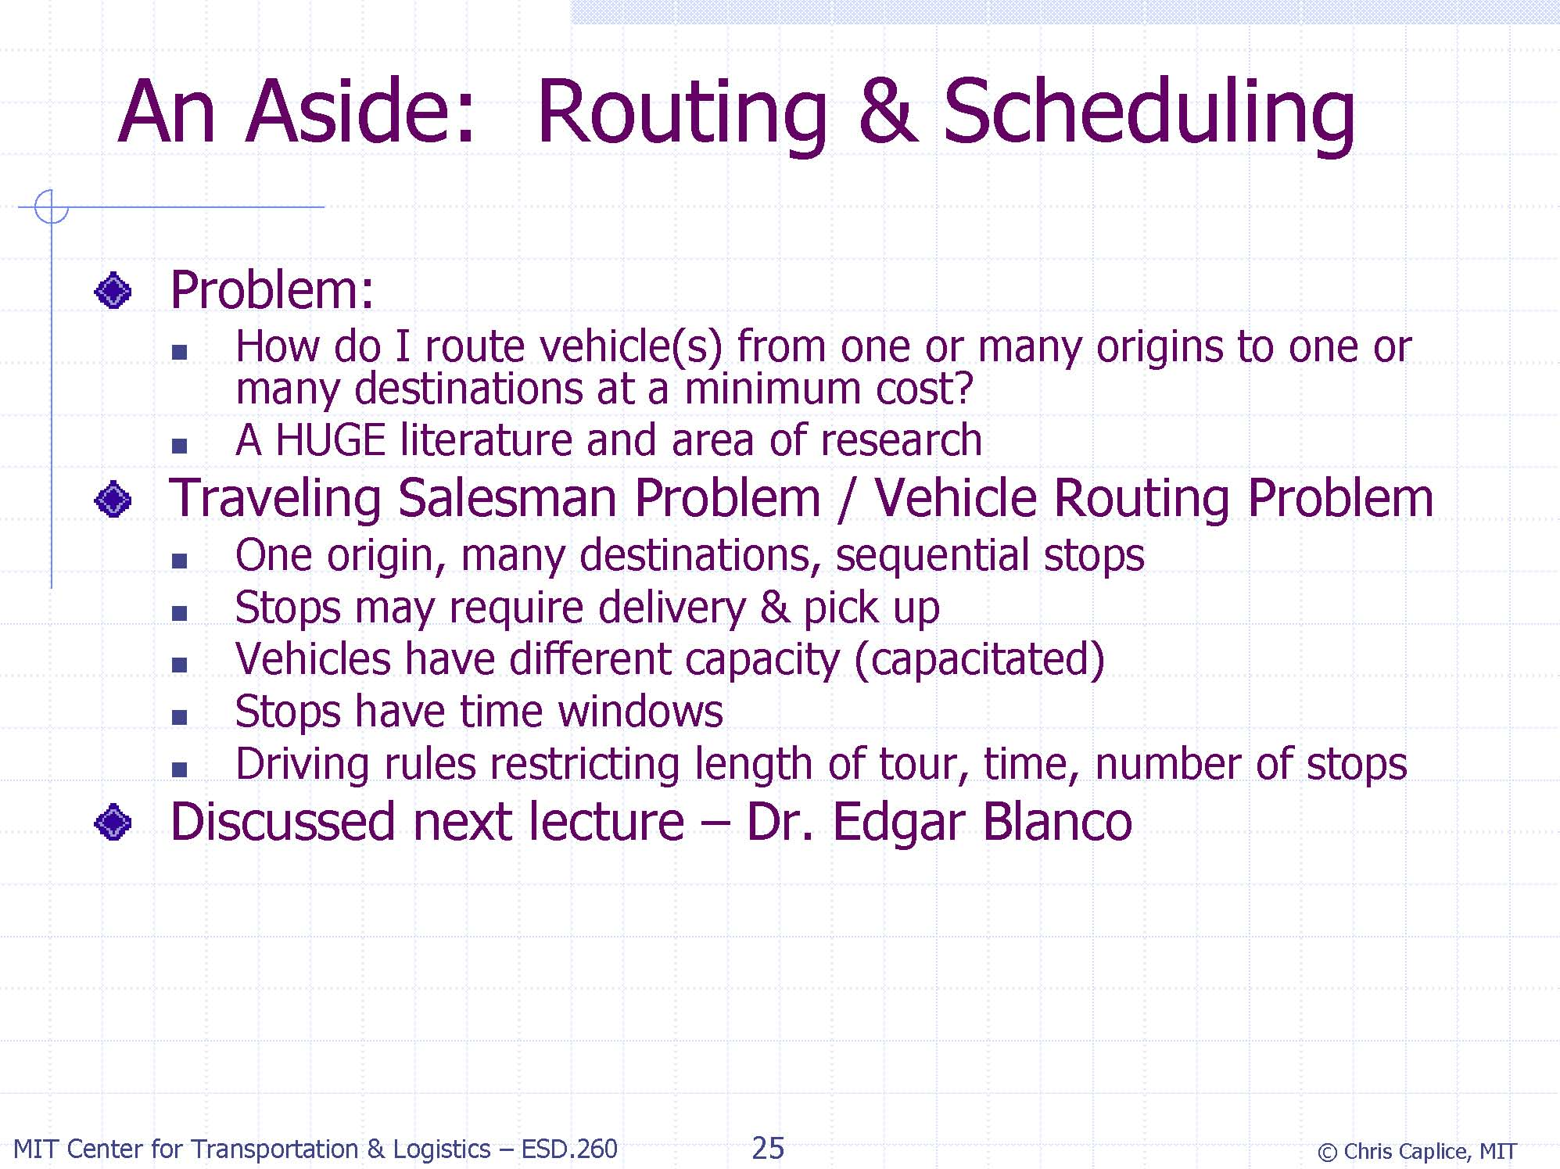

Slide 49
Freight Transportation
Modes of transportation:
  Air
  Truck
  Train
  Ship
  Pipeline
  intermodal

Slide 50
Freight Transportation
Mode Choice Decisions:
Air:
  Fastest, handling slows down the process
  Long distance high value goods
Truck
  Truck load vs Less-Than-Truck load
Rail
  Inexpensive, relatively slow

Slide 51
Freight Transportation
Mode Choice Decisions:
Intermodal
  Air-Truck
  Birdyback
  Train-Truck
  Piggyback
  Ship-Truck
  Fishyback

Slide 52
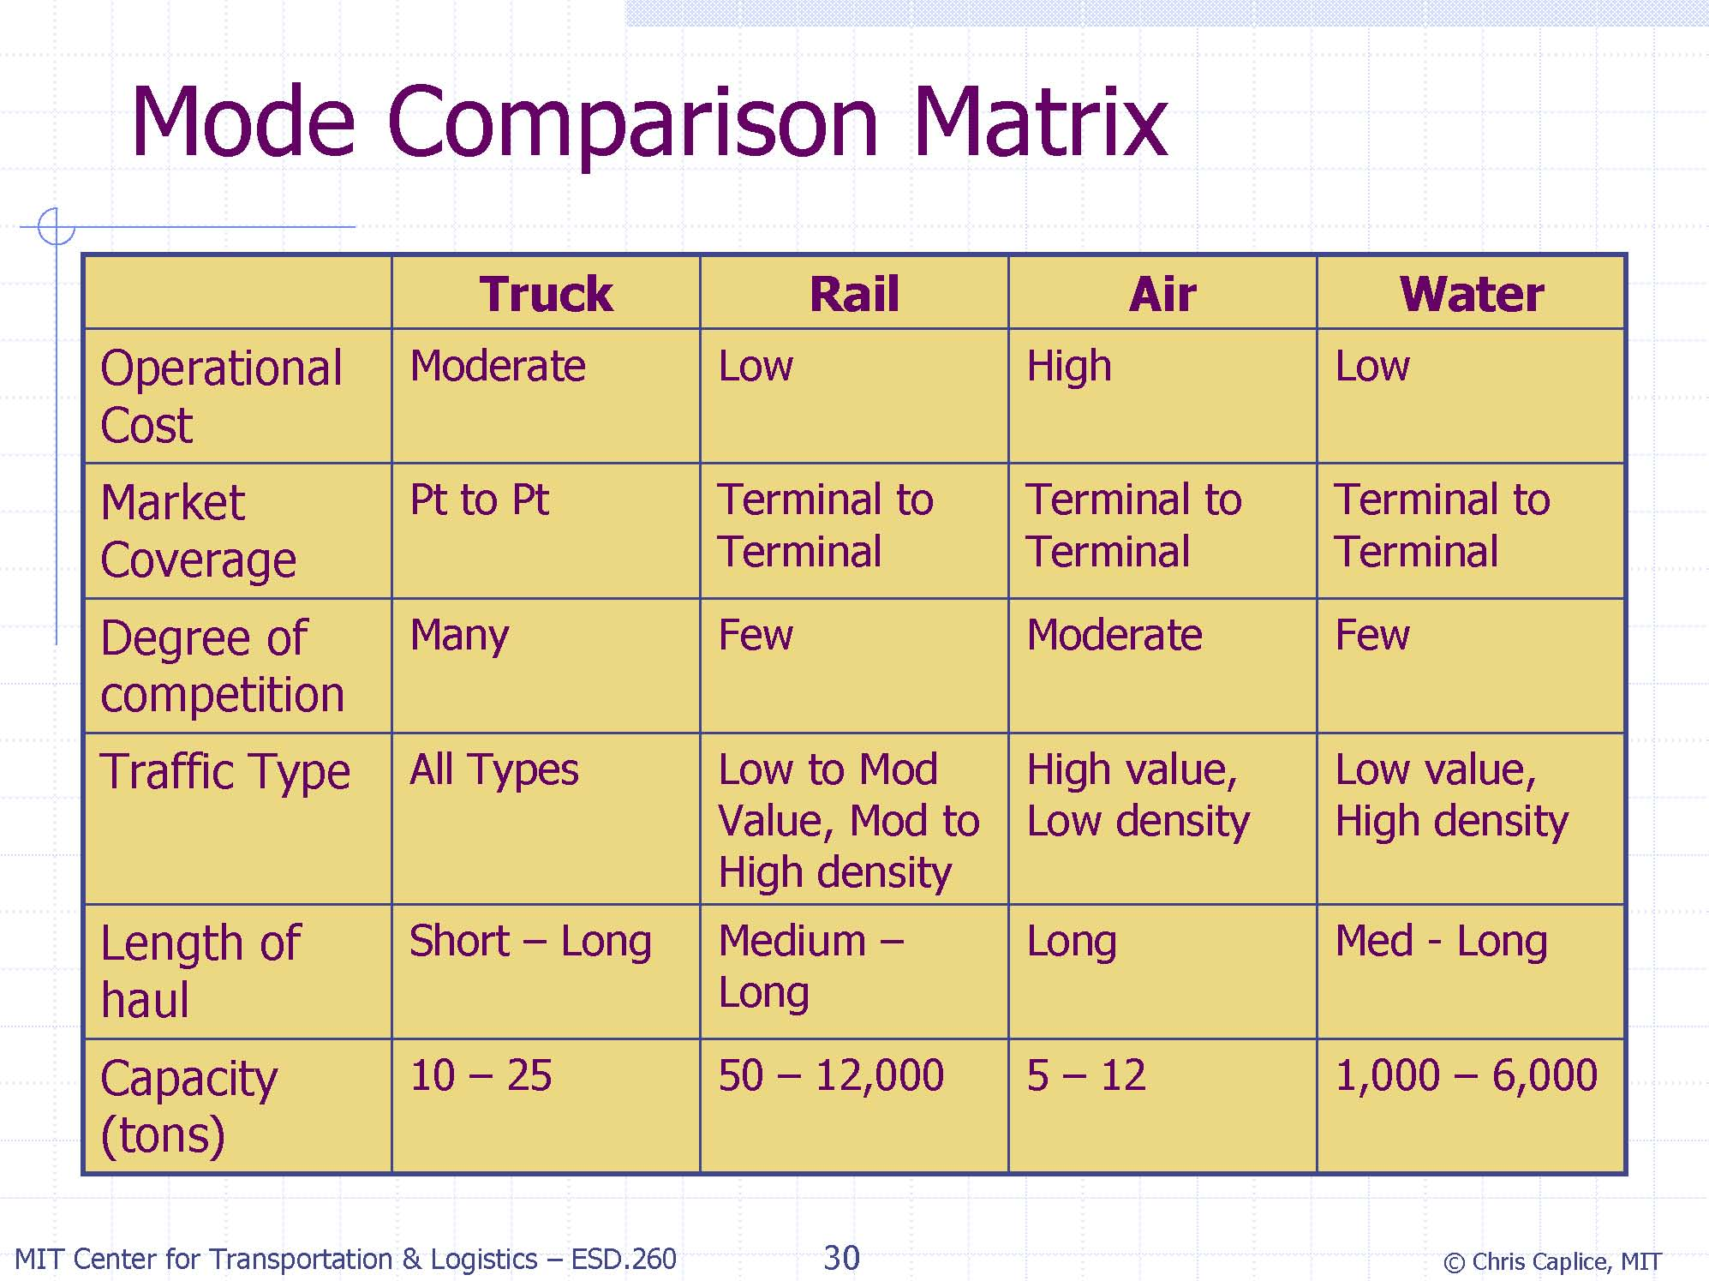

Slide 53
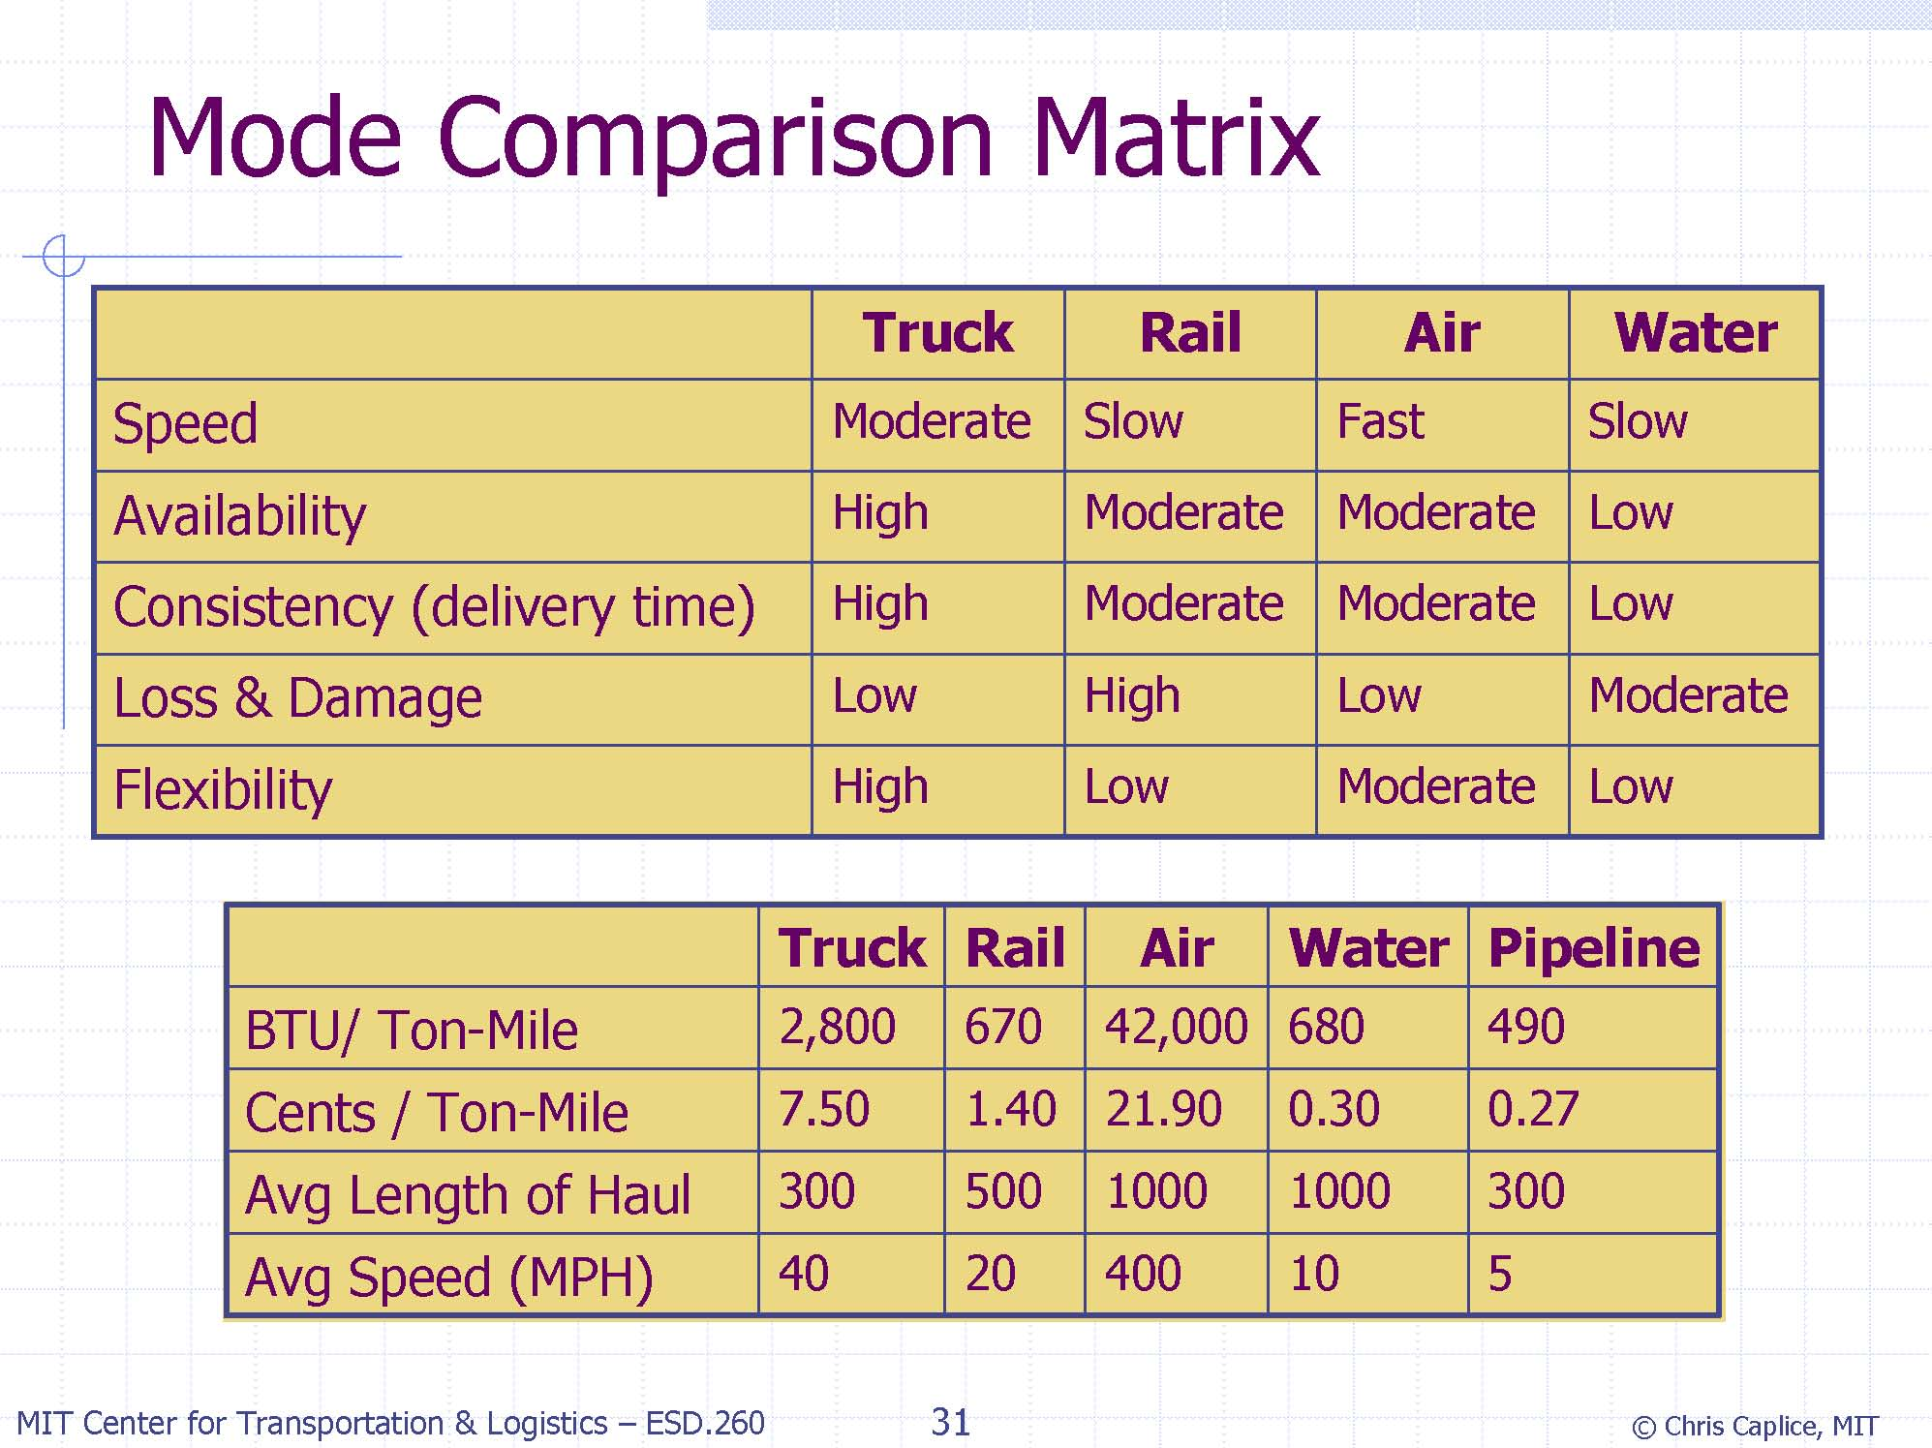

Slide 54
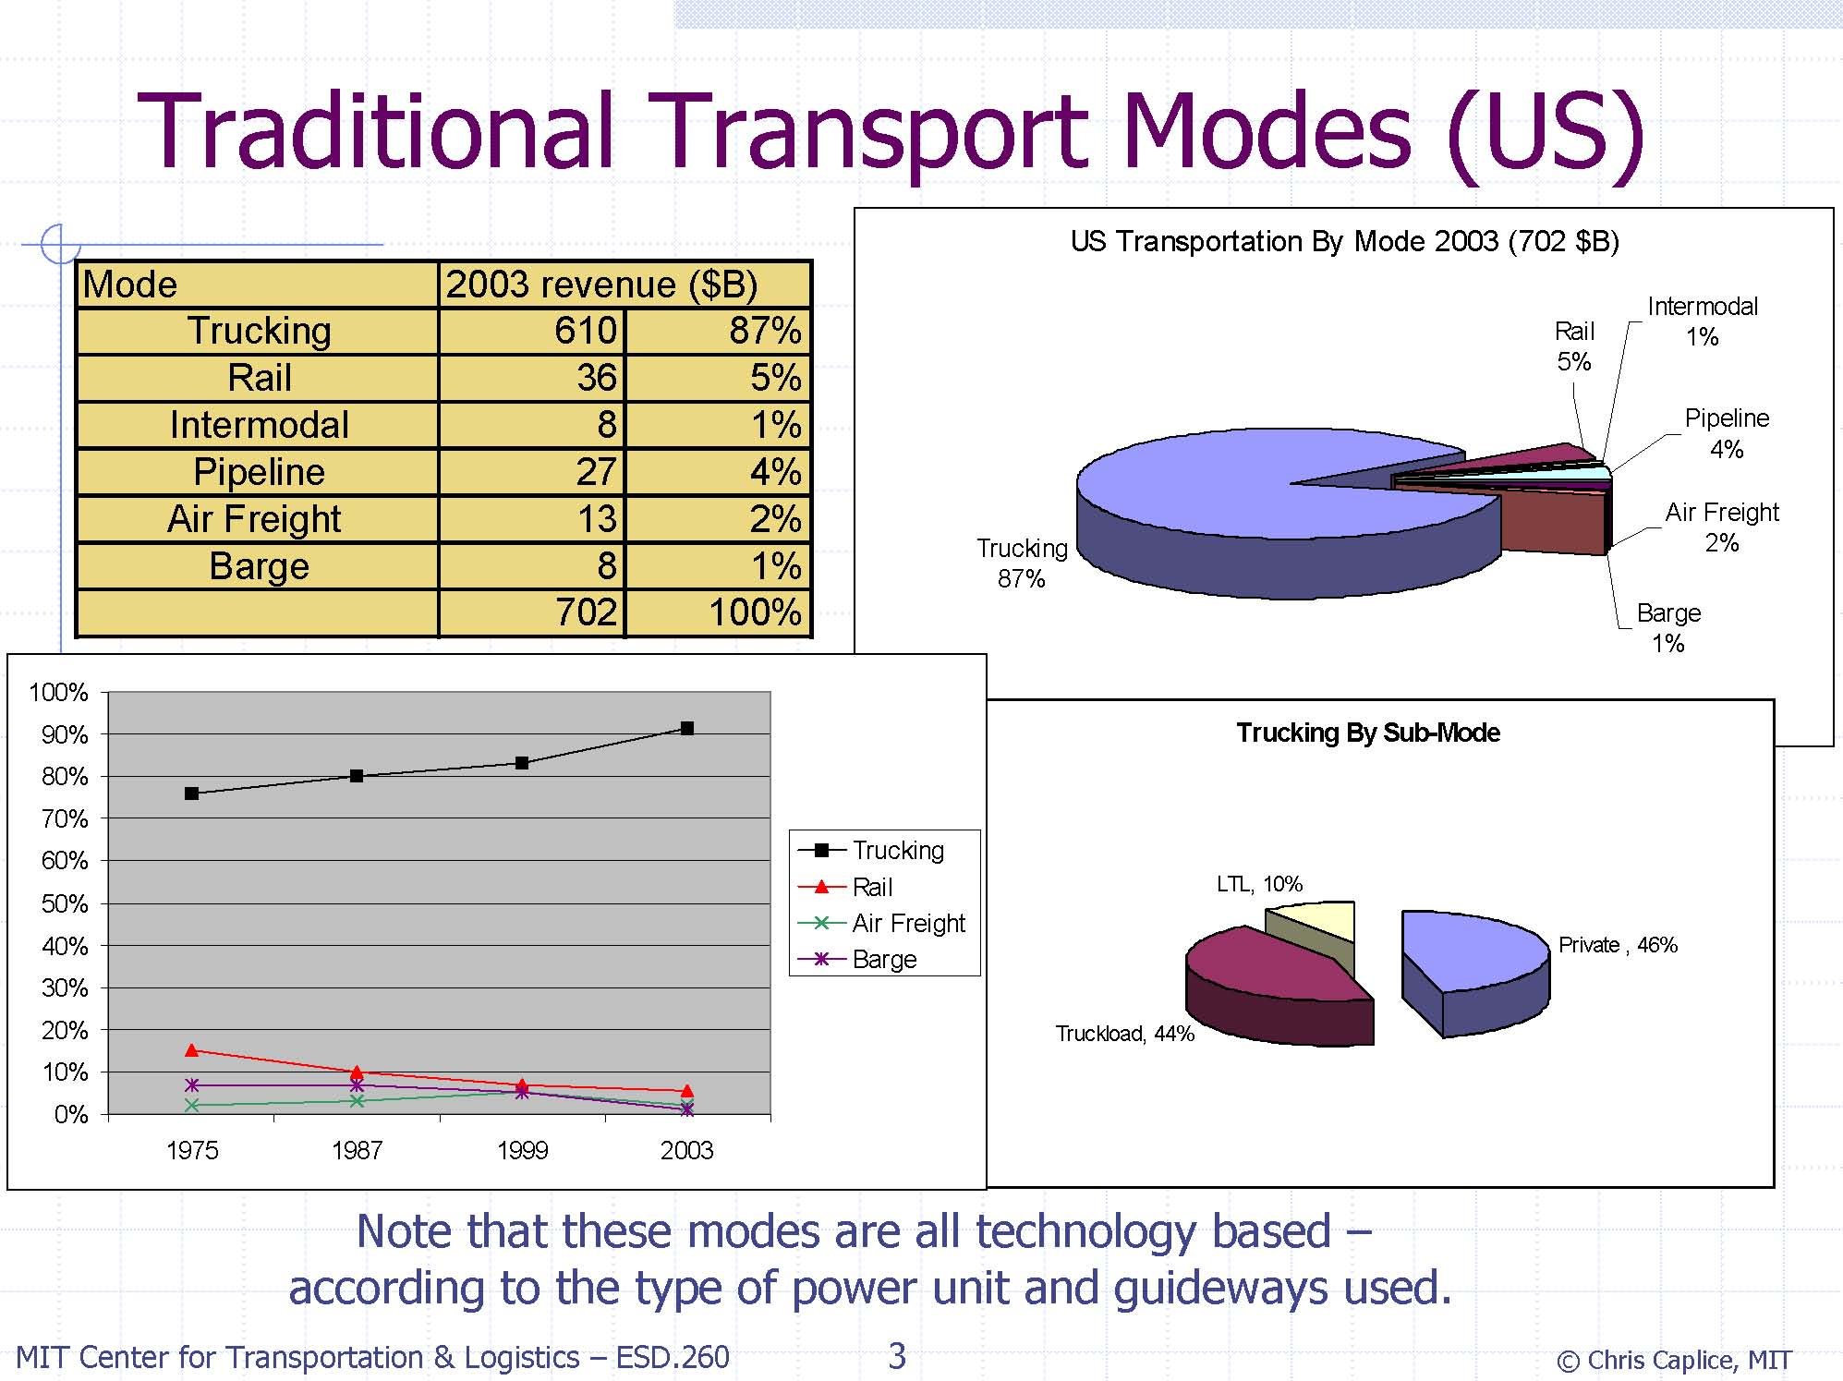

Slide 55
Logistics Managerial Issues
Capital reduction vs. Operating cost reduction
Service level improvement
Cost vs. Level of service trade-off
Sales vs. Level of service trade-off

Slide 56
Logistics Decisions
 | Planning Horizon | Data | Decision maker | E.g.
Strategic | Up to several years | Very imprecise and incomplete | Top management | Facility location, layout
Tactical | Up to a year | Disaggregated data available | Middle management | Resource allocation, production and distribution planning
Operational | Days | Precise data available | Lower management | Order picking, vehicle dispatching

Slide 57
Back to book and Course Outline
Book categorizes the logistics decisions in five main streams :
  Forecasting
  Designing logistics networks ch.3
  Managing inventories
  Warehouse management
  Planning and controlling
  long-haul ch.6
  short-haul transportation ch.7

Slide 58
Tentative Course Outline
Topic Duration
Introducing Logistics Systems 2 weeks
Introduction
Logistics Managerial Issues
Logistics Decisions
3PL
Reverse Logistics
Designing the Logistics Network 3 weeks
Introduction
Classification of Location Problems
Single-Echelon Single Commodity Location Models
Two-Echelon Multicommodity Location Models

Slide 59
Tentative Course Outline
Topic Duration
Planning and Managing Long-Haul
Freight Transportation 3 weeks
Introduction
Classification of Transportation Problems
Freight Traffic Assignment Problems
Fixed Charge Network Design Models
Planning and Managing Short-Haul
Freight Transportation 2 weeks
Introduction
Vehicle Routing Problems
The Travelling Salesman Problems
Integrated Location and Routing
Cases 2 weeks

