Slide 1
IE477 - IE 478 Systems Design
GENERAL INFORMATION AND SCHEDULE
Course Coordinators:
Dr. Savaş Dayanık
Dr. Selin Kocaman
Dr. Emre Uzun
Administrative Coordinator:
Yeşim Gülseren
Teaching Assistants:
Atahan Bayır
Yunus Emre Çakır
Aslı Eroğlu

Slide 2
Characteristics
This is the capstone project course series
  Different than other courses in the curriculum
  Design a system to solve a real-life problem
  Analysis – Synthesis
Communication
Team work
  Group Members
  Industrial Advisor
  Academic Advisor
  Course Coordinator

Slide 3
Industrial Project
Solve a real-life problem and implement the proposed solutions
  Supply chain management
  Inventory management
  Distribution logistics
  Production planning, scheduling and control
  Forecasting
  Energy or health applications
  Financial engineering, cost control, etc.

Slide 4
Explanations – CAPSTONE
Currently, your strength is “engineering education”
  Engineer – numbers, facts, abstraction, measurement
Your current background – All required courses are finished + electives + current courses
  Any diversion from above requires more effort
Capstone – Bring together all your previous knowledge + methods of inquiries + critical thinking + ability to learn and apply + ......

Slide 5
Explanations – CAPSTONE
IE Capstone Project – more specifically
  Prerequisites: IE 303, IE 325, IE 375 and others
  Text Books for all courses – First thing to read
  ~ 60% of the your work can be handled
  References in the text book – a good start to go further
Get support + advice from current TA’s of other courses – Source: Course web pages
Designing a system means a preparation to repeatedly implement the proposed approach over time, under almost all conditions

Slide 6
Industrial Project
The following steps will be taken:
  Analyze/collect system data to understand the system and the problem
  Define the scope of the project and the solution approach
  Access information and do literature survey
  Formulate the problem - a model or models
  Verify the models using appropriate software
  Validate the models and do benchmarking
  Implement the proposed system via a pilot study

Slide 7
Industrial Project
You will also learn:
  Effectively use group work
  Prepare reports and presentations to explain ideas
  Practice professional and ethical responsibilities

Slide 8
Ethical and Professional Responsibility
Projects are important for the reputation of Bilkent IE Department
  Companies are your potential employers or partners in the future
Ethical and Professional Responsibility:
  Your commitment to signed agreements – non-disclosure of data, information + any additional requirements by the company
  Your responsibility to carry-out oral and written promises made
  Your manner and behavior while communicating within the group, with advisors and coordinators, etc – be formal
  Any information source or material from literature should be cited
  Technical results should be clear and reproducible
      Any violation by any group will affect all of us, our reputation and value of your Bilkent University diploma

Slide 9
Roadmap
First
Meeting
with Course
Coordinators
Second
Meeting
with Course
Coordinators
Project
Progress
Meeting
Final
Report
Project
Proposal
Report
Third
Meeting
with Course
Coordinators
Fourth
Meeting
with Course
Coordinators
Kick-off
Meeting
Project
Proposal
Meeting
First
Progress
Report
Second
Progress
Report
October
November
December
January
February
March
April
May
Preliminary Analysis
Literature/Industrial Review
Problem Definition
Project Plan
Model Formulation
Model Coding
Verification
Validation
Benchmarking
User Interface Coding
Pilot Implementation
Revisions
Delivery of the Project

Slide 10
Requirements
Kick-off Meeting Early to Mid October
Project Proposal Report Late October to Early November
Project Proposal Meeting and Presentation Early to Mid November
First Meeting with Course Coordinators Nov 23 – Nov 28
First Progress Report Report Due December 23
Second Meeting with Course Coordinators January 10, January 11
Second Progress Report Report Due March 3
Project Progress Meeting and Presentation Mid to Late March
Third Meeting with Course Coordinators April 12 – April 17
Final Report Report Due May 15
Fourth Meeting with Course Coordinators Late May

Slide 11
Project Proposal Report
(Late Oct to Early Nov)
Complaints and symptoms from the company
Required outcomes,expectations: Deliverables
Project constraints and limitations
Definition and Scope of the Problem - CONSENSUS
Go beyond the initial description!!
Main project activites: Workpackages, Timetable

Slide 12
First Meeting with Course Coordinators
(Nov 23 - 28)
You will prepare a presentation video and upload it by Nov 21
  A short version of the proposal presentation to course coordinators
In the meeting you will be asked questions about the project and your proposal
  To enable coordination between projects

Slide 13
First Progress Report and
Second Meeting with Course Coordinators
Brief definition of the Problem
Literature Review
  Previous studies in the scientific literature
  Similar Studies in the industry
Proposed Methodolgy
Model Development and Verification
Timetable
You will upload a video by Jan 5. However you will also present LIVE during the meeting.

Slide 14
Important
All documents related to reports, meetings and presentations are available on the course web page.
  You are advised to take a look at these documents well in advance to plan ahead.
Check our web-site frequently for announcements/updates. courses.ie.bilkent.edu.tr/ie477

Slide 15

Important
You will find a report template on course web site.
  We will use the template for all reports

Slide 16
Important
Attendance to all of the workshops and seminars is mandatory from the beginning of the semester!
Punctuality is very important!
  “If you're early, you're on time. If you're on time, you're late.” ― Lik Hock Yap Ivan
  “Better three hours too soon than a minute too late” ― W. Sheakespeare
  “Never leave to be on time to be on time.” ― Brian Spellman
  Hence;
  Submit all of your requirements on time.
  Be ready for any meeting at least 10 minutes before the scheduled time.

Slide 17
Important
Time to devote to the project is significantly more than a regular course
  Too much course load is not desired
Part-time Jobs, Internships
  No excuse for any part time job you may have.
    You have to perform all of your duties that are assigned to you in your group.
    You have to attend all meetings with your advisors and coordinators!
  You cannot be assigned to an IE 477 - IE 478 project received from a company where you work part-time or do internship.

Slide 18
Upload / Naming Principles
You will upload a lot of documents to the links provided.
Your file names must contain your 4-5 character project short-code along with its purpose:
  Example from previous years:
    Arçelik Bolu Pişirici Cihazlar Fab: ARBOL
    BSH Ev Aletleri: BSHE
    ETİ Talep Tahmin: ETIT
    DHL Depo İyileştirme: DHLD
  File name could be: ARBOL-ProposalReport

Slide 19
Writing Principles
Please state your
  Project Short Code
  Team number
  Project title
  Names of the team members (always in alphabetical order of the last names)
  Academic and industrial advisors
in all of the written documents that you submit.

Slide 20
Project Management
Project Plan
  Tasks, phases, milestones, etc.
Time plan
  Deadlines, due dates, deliverables
Resource Allocation
  Team work
Coordination

Slide 21
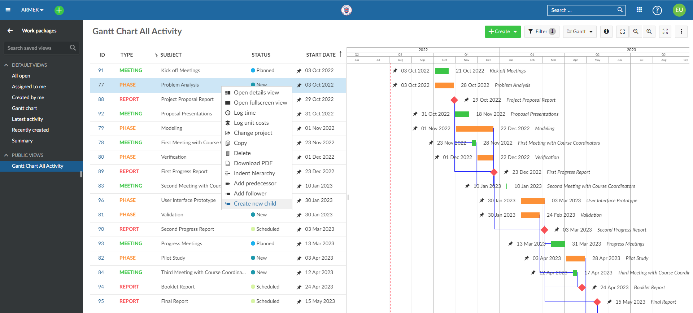
Project Management
Starting this year we will use an online Project Management Software

Slide 22
Project Management
Project Management System
  All project related tasks, task assignments, outcomes will be posted
  Each student must have a task in each phase of the project
  All meetings with your IA and AA (meeting agenda and minutes)
  Your CC, AA and IA will have access to this system to monitor your progress
More details available on the course web page

Slide 23
General Meetings
This semester there are 4 general meetings scheduled*:
  Sep 16 (Today): Introduction and General Schedule, Team Formation
  Sep 23: “Capstone Project – How to approach?”, Details on Industrial Projects
  Sep 30: Details on Administrative Processes
  Dec 2: General Feedback on Progress
* Subject to change

Slide 24
Capstone Projects Assessment Criteria
System design:
  Model development and validation: The proposed model can be an optimization, statistical, database, marketing or simulation model.
  Consideration of alternatives: Extent to which the team demonstrated critical thinking in the design process.
  Scenario / what if analysis: Model usage for changing environments.
  Creativity: Extent to which the team developed a novel solution to the design problem while still achieving a functional design.
  Technical competencies: Extent to which and validity of the technical aspects have been used properly, including methods, tools and techniques.

Slide 25
Capstone Projects Assessment Criteria
Success of the design:
  Attainment of project deliverables: Extent to which the goals of the project and end-user specifications have been met.
  Benchmarking: A comparison of the current and proposed systems should be provided along with a cost/benefit analysis.
  Implementation and system integration: Extent to which the proposed system is successfully implemented and integrated into the existing system. (If not applicable a detailed implementation plan and a pilot study should be provided.)
  End-user evaluation and assessment: A written statement from the industrial advisor(s) evaluating the project.
  Impact on the organization: Effect of the proposed system on the organization in large (financial impact, affect on company’s operational policies, etc.).
  Global and societal impact: Consideration

Slide 26
Grading
Grading is based on evaluations on:
  Reports
    Project Proposal Report
    First Progress Report
  Meetings and Presentations
    Proposal Presentation
    First Meeting with Course Coordinators
    Second Meeting with Course Coordinators
  Group dynamics
    Academic/Industrial Advisor Individual Evaluation
    Peer Evaluation

Slide 27
Grading
You will not see individual grades for these evaluations
  Feedback during the semesters
  Letter grades at the end of each semester
What might land you on a lower letter grade?
  Not participating to key parts of the project
  Not providing a satisfactory answer to questions about your project
  Not attending to meetings
  Not submitting required documents on time

Slide 28

Effect of Peer Evaluation
Grup AA | Student A | Student B | Student C | Student D | Student E | Student F | Student G | AVG.
Student A |  | 5 | 5 | 5 | 5 | 5 | 5 | 5.00
Student B | 5 |  | 5 | 5 | 5 | 5 | 5 | 5.00
Student C | 5 | 5 |  | 5 | 5 | 5 | 5 | 5.00
Student D | 5 | 5 | 5 |  | 5 | 5 | 5 | 5.00
Student E | 5 | 5 | 5 | 5 |  | 5 | 5 | 5.00
Student F | 5 | 5 | 5 | 5 | 5 |  | 5 | 5.00
Student G | 5 | 5 | 5 | 5 | 5 | 5 |  | 5.00

Slide 29
Effect of Peer Evaluation
Grup BB | Student A | Student B | Student C | Student D | Student E | Student F | Student G | AVG.
Student A |  | 1 | 5 | 2 | 5 | 5 | 3 | 3.50
Student B | 1 |  | 1 | 4 | 1 | 1 | 3 | 1.83
Student C | 5 | 2 |  | 2 | 5 | 5 | 3 | 3.67
Student D | 1 | 5 | 1 |  | 3 | 2 | 5 | 2.83
Student E | 1 | 3 | 3 | 3 |  | 5 | 3 | 3.00
Student F | 2 | 3 | 3 | 4 | 5 |  | 3 | 3.33
Student G | 1 | 5 | 1 | 4 | 1 | 1 |  | 2.17

Slide 30
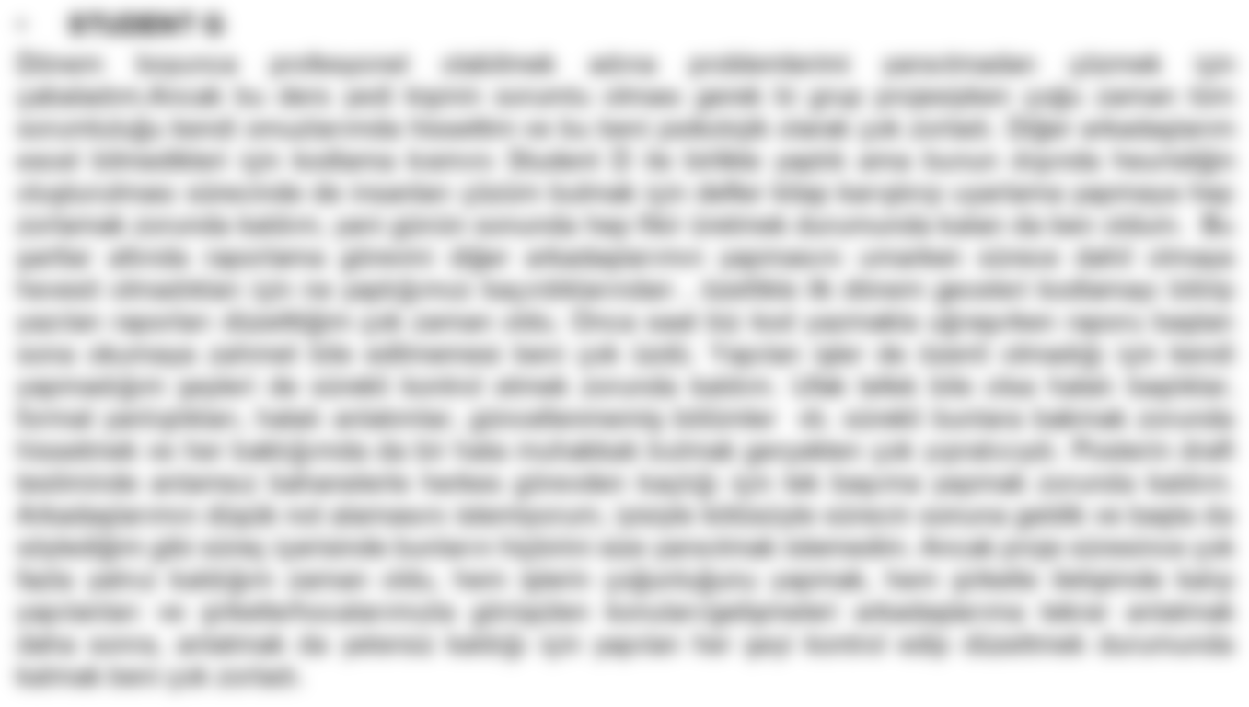
Effect of Peer Evaluation

Slide 31
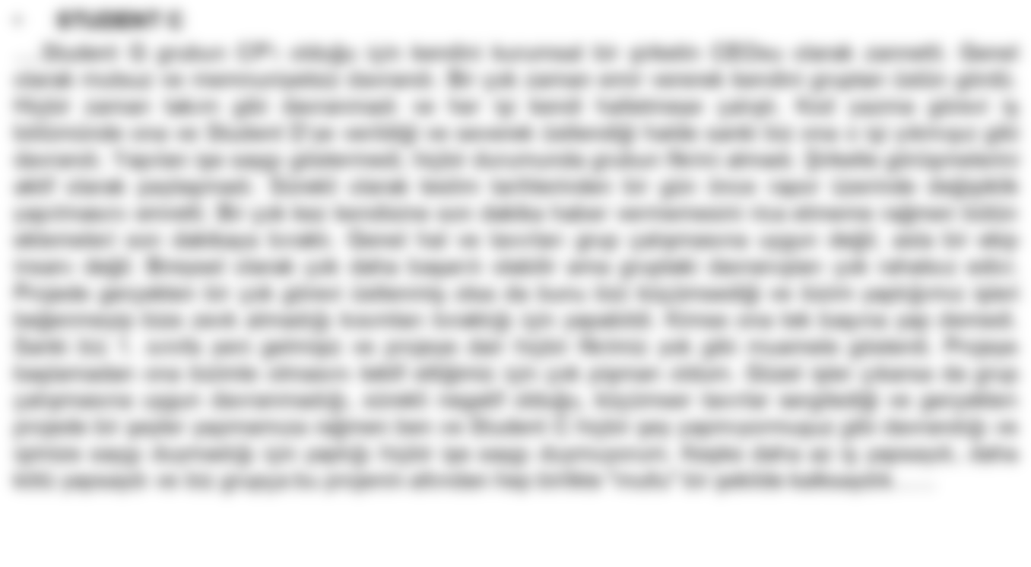
Effect of Peer Evaluation

Slide 32
Grading
Last year there are:
  5 groups (Fall Semester)
  7 groups (Spring Semester)
received different grades among the group members
Example: Six members B-, one member D

Slide 33
Grading
If we observe that you have not accomplished the goals to be reached by the end of this semester, you may receive an I (Incomplete) as a group!
  If you do not complete the missing work within the time limit, this grade will be replaced with an F

Slide 34
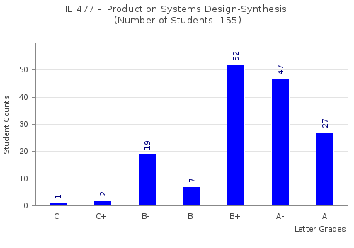
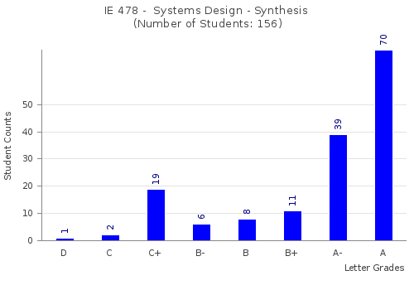
Grading
Benefit of the doubt The “Real” Grade

Slide 35
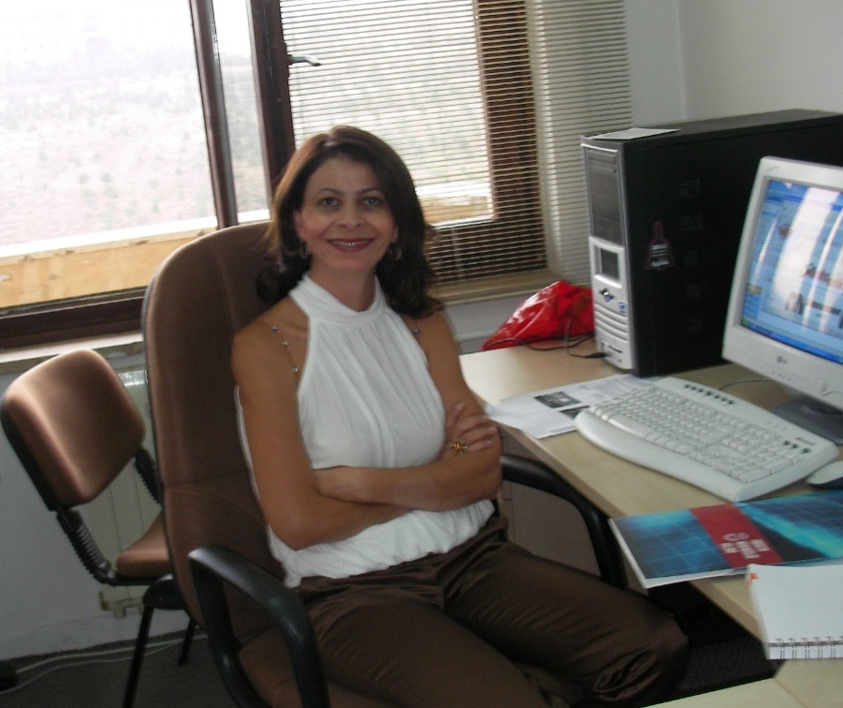
Administrative Coordinator: Yeşim Gülseren
Üniversite-Sanayi İşbirliği Mezuniyet Projeleri Koordinatörü
Destek Verilen Çalışmalar
İş dünyası ile iletişim
Projelere hazırlık ve bilgilendirme
Proje yönetimi, koordinasyon
Projelerin mali, idari ve yasal süreçleri
İç iletişim ve motivasyon
Seyahat organizasyonu
Fuar, kitap ve etkinlik organizasyonu
Kariyer planlama
Girişimcilik
Sektör tanıtım etkinlikleri
Rektörlük Binası 3. Kat
No : 308
yesime@bilkent.edu.tr

Slide 36
Grants and Competitions
INFORMS Undergraduate Operations Research Prize (June 30, 2022, USA)
YA/EM Student Competition
TÜBİTAK 2241-A Sanayi Odaklı Lisans Bitirme Tezi Destekleme Programı

Slide 37

Projects Booklet

Slide 38
Project Fair and Competition 2023
We are planning to organize
  21st Industrial Engineering Project Fair and Competition
  Industrial Projects 2023 Book

Slide 39
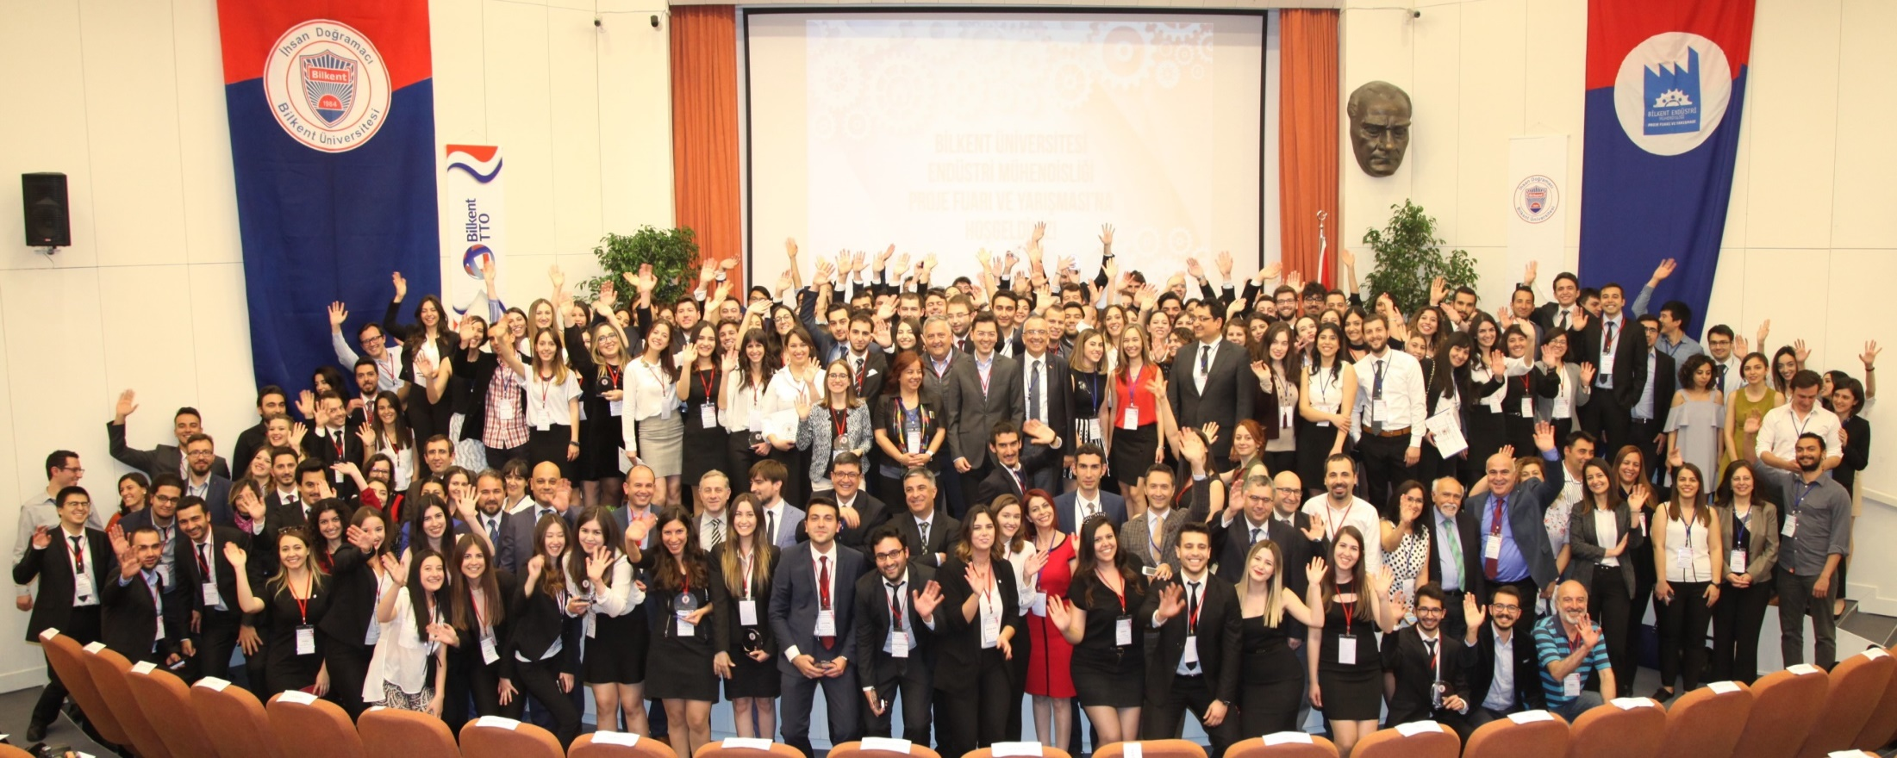
Project Fair and Competition 2017

Slide 40
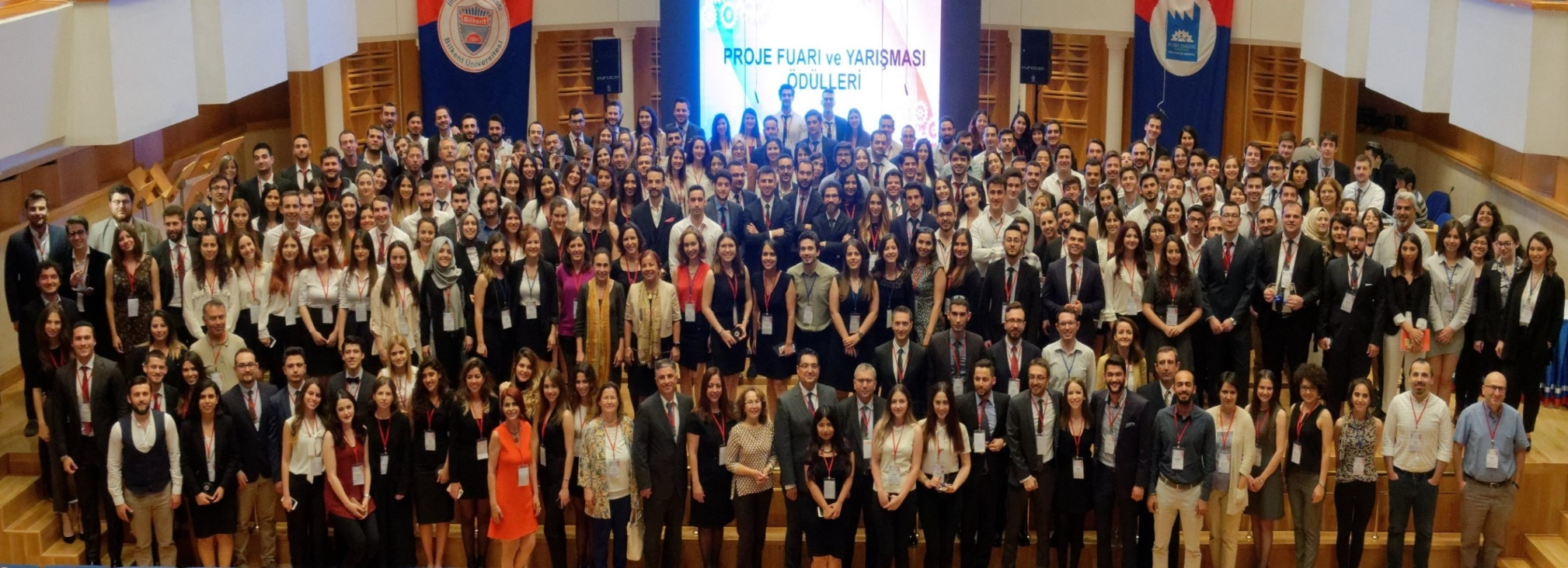
Project Fair and Competition 2018

Slide 41
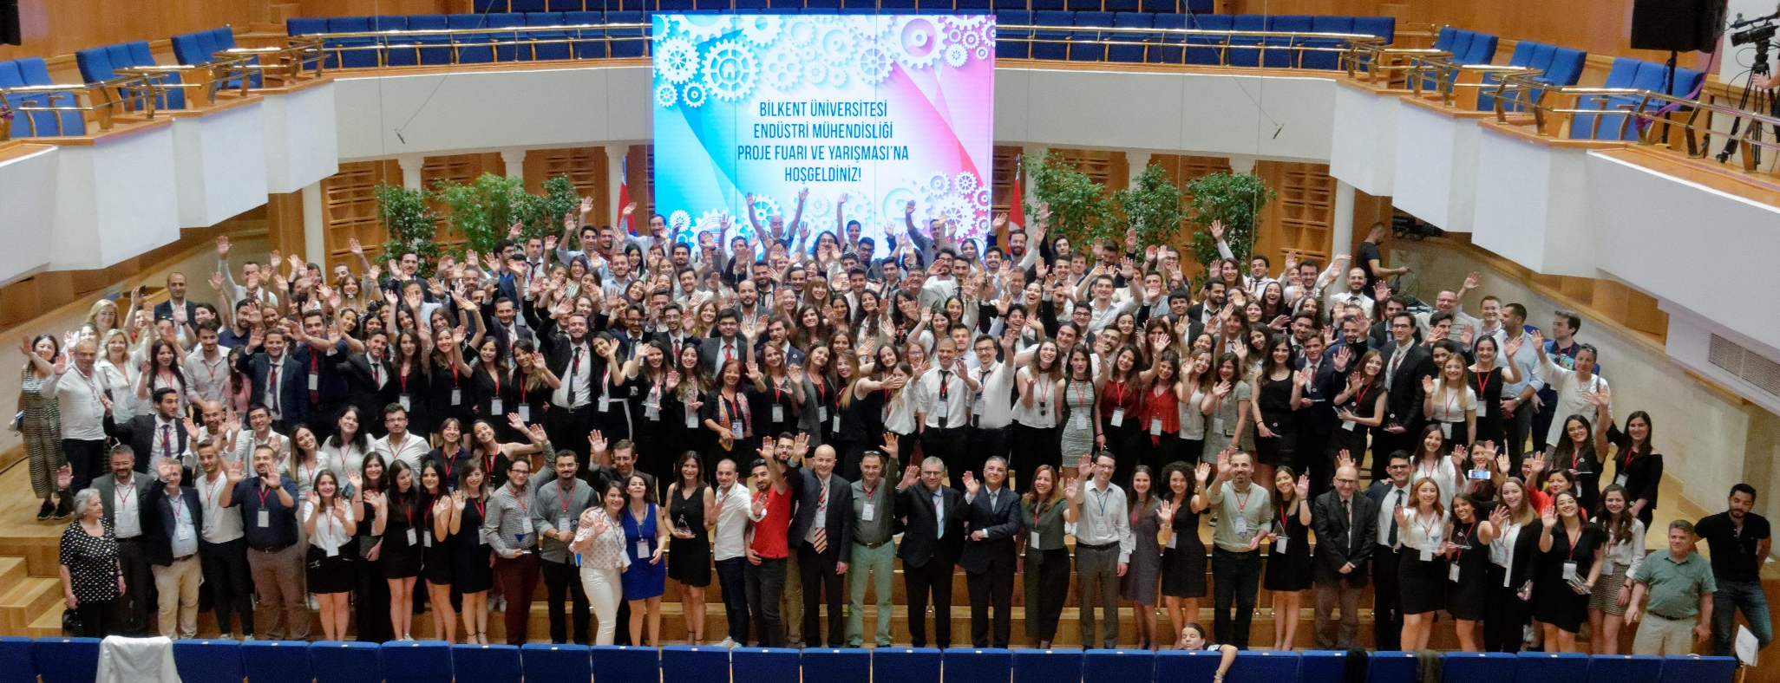
Project Fair and Competition 2019

Slide 42
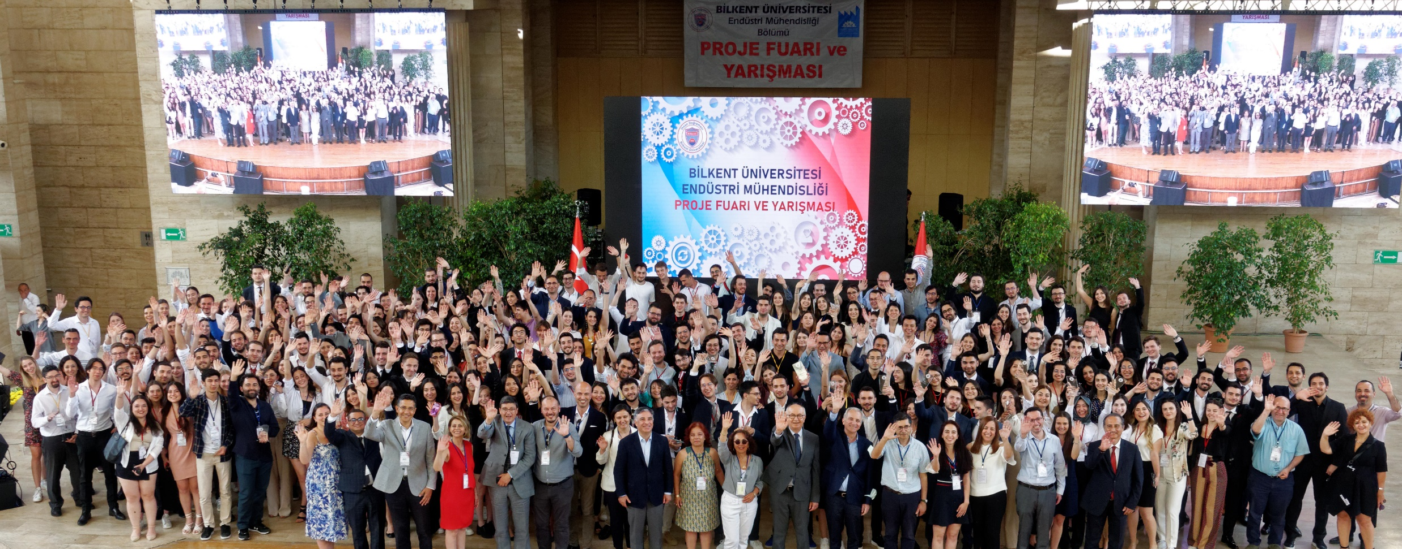
Project Fair and Competition 2022

Slide 43
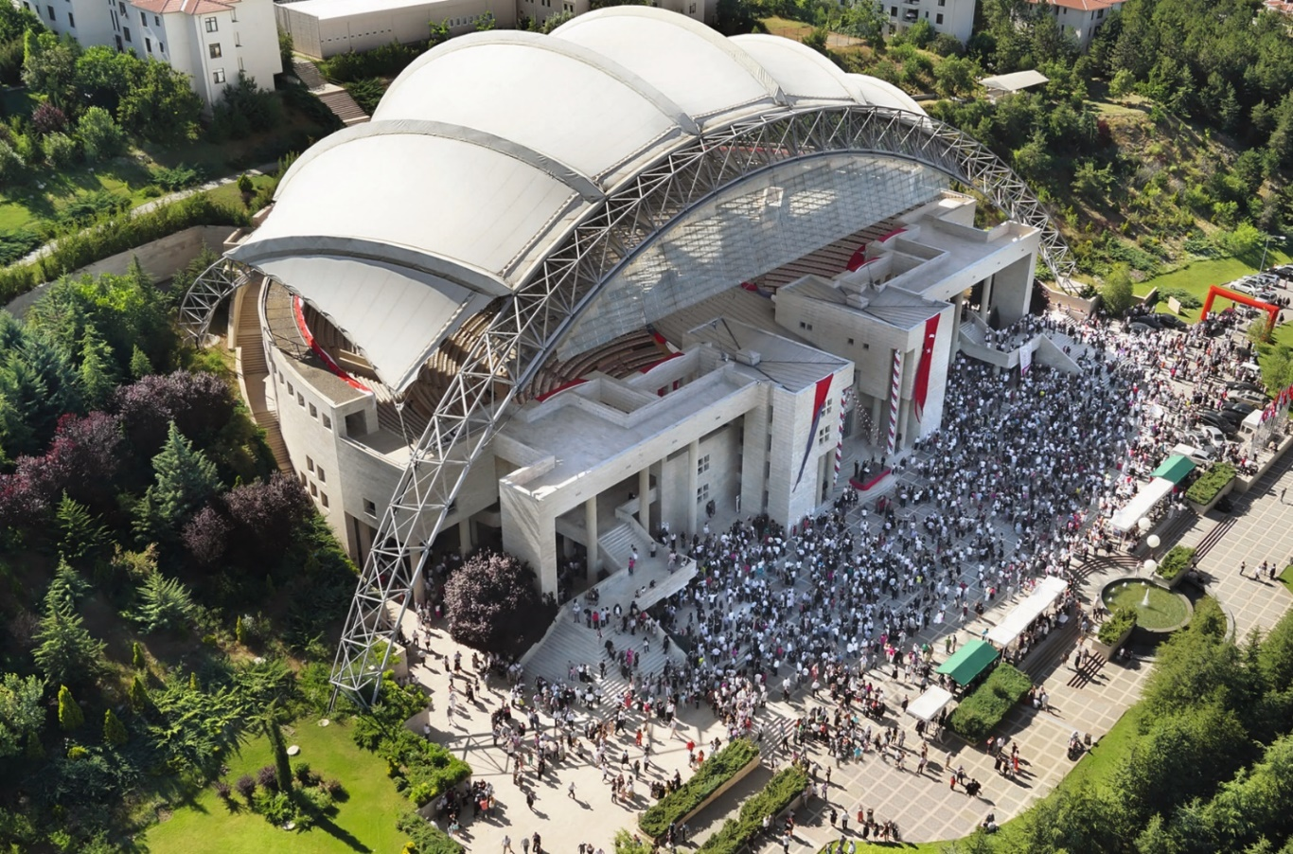
Project Fair and Competition 2023
Thursday, June 1st, 2023 at Bilkent ODEON

Slide 44
Next Steps…
Project
Preferences
Submitted
Advisors and
Coordinators
Assigned
Groups
Formed
Projects
Announced
Projects
Assigned

Slide 45
Group Formation
All groups will have 7 students*
Different skills
  Leader, consensus builder, problem solver, contributor, assisting
  Report writing (Turkish/English)
  Presentation (Turkish/English)
  At least 2 members good in coding
Projects may require company visits (Leave two half-days off as a group)

Slide 46
Group Formation
Each group will have a contact person
  Not necessarily the group leader
  Reserve time slots for coordinator meetings
  Receive links to upload documents
  Make travel arrangements with Yeşim Gülseren
  Must be available to respond to calls, emails, texts promptly

Slide 47
Group Formation
For information on team dynamics follow announcements on https://courses.ie.bilkent.edu.tr/ie477
For each team, fill out the “Team Information Form” via the link sent to you online until 17:00 TODAY!
  Names, e-mail addresses, elective courses, summer trainings, strongest and weakest skills.
  ONE SUBMISSION PER GROUP.
Each team should have a project contact person
Students with no groups:
  Inform TAs via ie477@ie.bilkent.edu.tr

Slide 48
Project Assignments
  Project List will be announced by early next week.
Each team is going to send their rankings of the projects and a single page cover letter until September 23 Friday by 17:00
  Wait for the meeting next week to finalize your list.
Fill the required online form (to be provided on the course web page.)

Slide 49

Project Assignments
We will use a version of Nobel Prize Winning Algorithm by Shapley and Roth
See course web page for a detailed explanation on the algorithm
GROUPS’
PROJECT
PREFERENCES
PROJECTS’
GROUP
PREFERENCES

Slide 50
Project Assignments
Groups:
  Rank all projects based on how much you wish to get assigned.
Projects:
  Rank all groups (information form)
Basis is the same as the original algorithm. However, we may consider additional constraints imposed by the companies (such as at most one project), as well as others.
Applied to assign projects to groups in the last six years.

Slide 51
Example
Group A
Project Y
Project X
Project Z
Group B
Project Z
Project X
Project Y
Group C
Project Z
Project X
Project Y
Project Z
Group A
Group C
Group B

Slide 52
People
All groups will be assigned:
  Academic advisor
  Industrial advisor
  Course coordinator
  Other interested faculty members
  Teaching assistant
Administrative coordinator

