Slide 1
CPLEX
Recitation
23.10.2017

Slide 2
How to download?
https://ibm.onthehub.com/WebStore/OfferingDetails.aspx?o=9b4eadea-9776-e611-9421-b8ca3a5db7a1

Slide 3
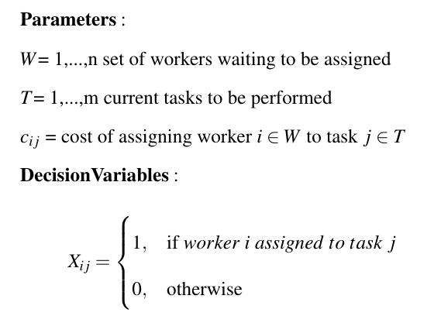
Assignment Problem

Slide 4
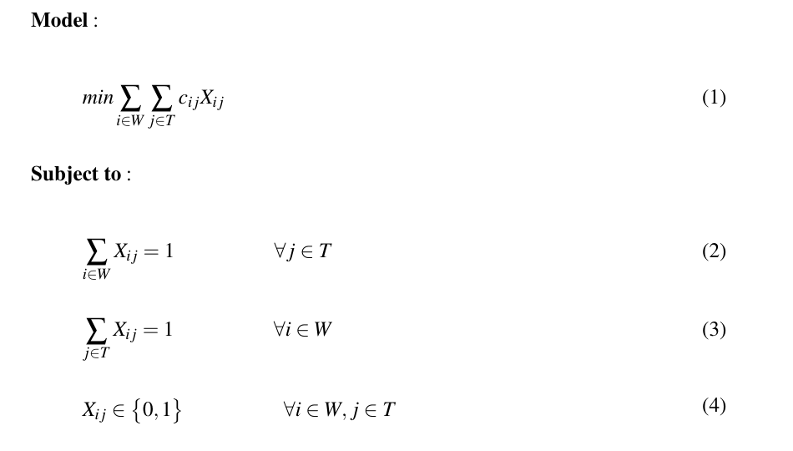
Assignment Problem

Slide 5
Assignment Problem
4 workers, 4 tasks
 | Task 1 | Task 2 | Task 3 | Task 4
Worker 1 | 14 | 5 | 8 | 7
Worker 2 | 2 | 12 | 6 | 5
Worker 3 | 7 | 8 | 3 | 9
Worker 4 | 2 | 4 | 6 | 10

Slide 6
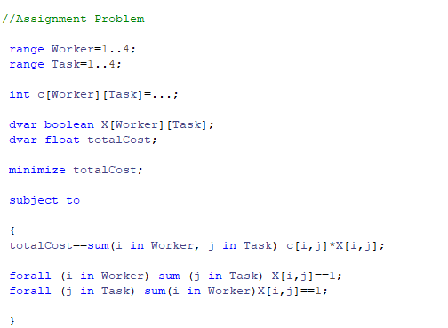
Cplex Code

