Slide 1
IE 324 SIMULATION
2019 – 2020 SPRING
DISCRETE EVENT SYSTEM SIMULATION BASICS

Slide 2
SIMULATION
REAL-LIFE
Operating Policies
Single queue, parallel servers, FIFO, …
Input Parameters
- Number of servers, distributions, …
System response
- Waiting times, system size, utilizations…
SIMULATION MODEL
(LOGIC)
(X)
(Y)
Y=f(X)

Slide 3
SIMULATION
In this course we will focus on Discrete-event stochastic dynamic systems.
  The system is stochastic because at least one of the system state variables is random (o.w. deterministic simulation)
  The system is dynamic because system behavior over time is examined. (o.w. static systems – Monte Carlo simulation)
  The system is discrete-event because the changes in the system state variables are associated with events that occur at discrete time instances only.

Slide 4
COMPONENTS OF A SIMULATION MODEL
STATE: A collection of variables that contain all information necessary to describe the status of a system at any given point in time.
ACTIVITY: A duration of time of specified length that is known as it begins.
  Called “Unconditional Wait”
  It can be:
    Deterministic
    Statistical
    A function of system variables
  Ex: Inter-arrival times, service times…etc.
DELAY: An indefinite duration of time that depends on activities or system conditions.
  Called “Conditional Wait”
  Ex: Waiting time in queue

Slide 5
COMPONENTS OF A SIMULATION MODEL
All ACTIVITIES culminate with an EVENT.
  Since the duration of the activities are known in advance, an event notice is placed for an upcoming event is placed in a future event list (FEL) as the activity begins.
  Delays are not placed in the FEL.
  Every feasible event has one entry in the FEL.
  If an event becomes infeasible, it should be removed from the FEL.
    Ex: Machine breaks down (service completion is not going to happen at the scheduled time)

Slide 6
EXAMPLE: Queueing Systems
Entities
Population
……
Server
Waiting Line (Queue)
Finite vs.
Infinite
One line vs.
Multiple lines
One server vs.
multiple server

Slide 7
CHARACTERISTICS
Interarrival and Service Times
  Exponential (M)
  Deterministic (D)
  Erlang (E)
  General (G)
Queue discipline
  First Come/In First Served/Out (FCFS/FIFO)
  Last Come/In First Served/Out (LCFS/LIFO)
  Earliest Due Date (EDD)
System Capacity
Number of Servers

Slide 8
EXAMPLE
Consider a bank teller queue with one teller (G/G/1) and FIFO queue discipline
  State Variables: Number of customers in queue
  Busy/Idle Status of Teller (0,1)
  Activities: Customer Inter Arrival Customer Service
  Events: Customer Arrival Event Customer Departure Event
  Delay: Waiting time in queue
Triggers
Triggers

Slide 9
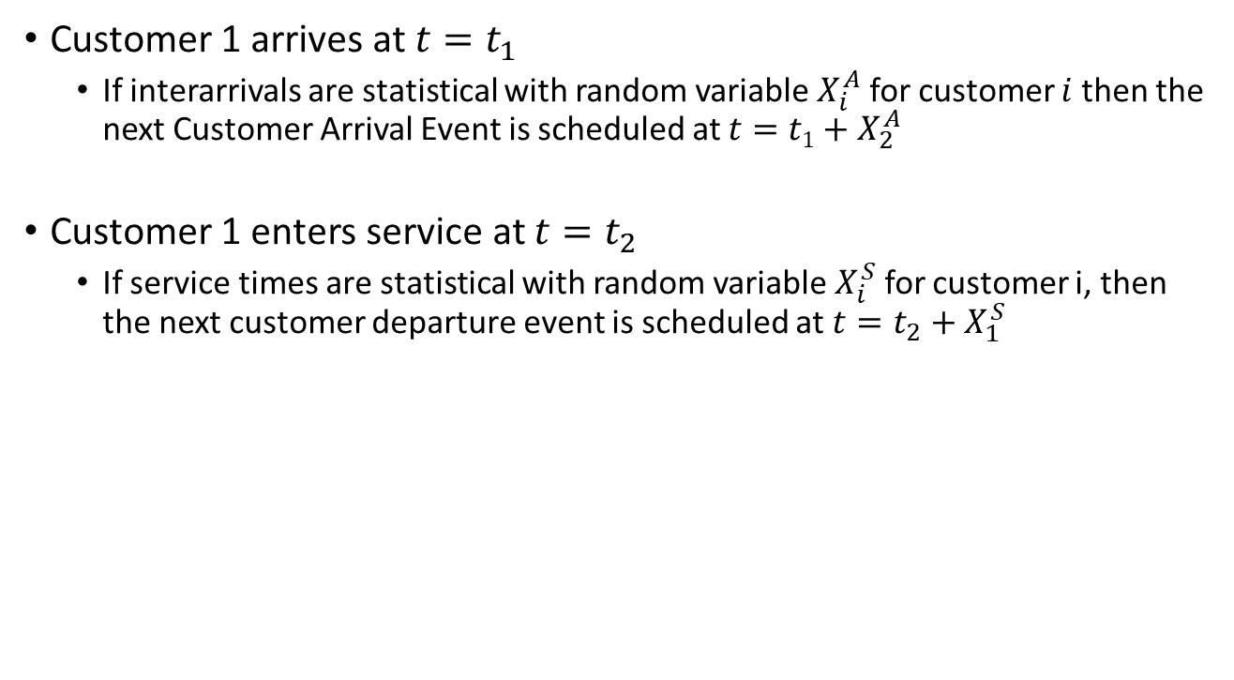
EXAMPLE
Customer 1 arrives at $t=t_{1}$
  If interarrivals are statistical with random variable $X_{i}^{A}$ for customer $i$ then the next Customer Arrival Event is scheduled at $t=t1+X_{2}^{A}$
Customer 1 enters service at $t=t_{2}$
  If service times are statistical with random variable $X_{i}^{S}$ for customer i, then the next customer departure event is scheduled at $t=t_{2}+X_{1}^{S}$

Slide 10
COMPONENTS OF A SIMULATION MODEL
We advance the system time t (called “Clock”) one by one to each event in a chronological order as we make a simulation run.
  This is called “Event Driven Simulation”
WHY?
  System state remains unchanged between events. (Nothing happens until the next event!)
There is also an additional type of event called the “Ending Event” that represents the time to stop the simulation run. We add this event to the FEL when simulation run starts (E, T_{E}).
Note that, for now interarrival and service times are generated randomly for us.

Slide 11
EXAMPLE (Cont’d)
What if there were two servers? (G/G/2)
  We will have two “Customer Service” activities each triggering a separate “Customer Departure Event” in the FEL.

Slide 12
COMPUTATION OF STATISTICS
As a result of a simulation run, we need to obtain statistical information about a performance measure of interest.
  Average Waiting Time
  Maximum Waiting Time
  Average Number of Entities in the System
  Maximum Number of Entities in the System
  Server Utilization
  Average System Time
  Maximum System Time
We need to keep track of some more variables to capture the performance measure we wish to investigate.

Slide 13
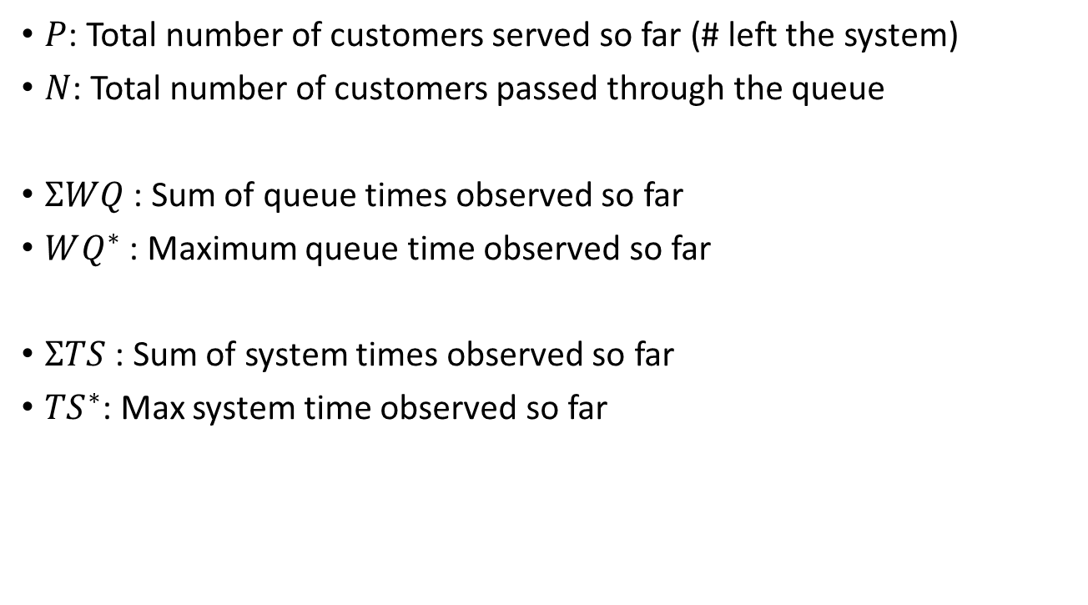
COMPUTATION OF STATISTICS
$P$: Total number of customers served so far (# left the system)
$N$: Total number of customers passed through the queue
$ΣWQ$: Sum of queue times observed so far
$WQ^{∗}$: Maximum queue time observed so far
$ΣTS$: Sum of system times observed so far
${TS}^{∗}$: Max system time observed so far
Updated whenever a customer finishes waiting in queue
Updated whenever a customer leaves the system

Slide 14

COMPUTATION OF STATISTICS
$Q(t)$: Function of number of customers waiting in queue (state var.)
$Q\left(t\right)∈\{0,1,2,…\}$
$B(t)$: Server busy function (state var.)
$B(t)∈\{0,1\}$
$L\left(t\right)=Q\left(t\right)+B(t)$

Slide 15
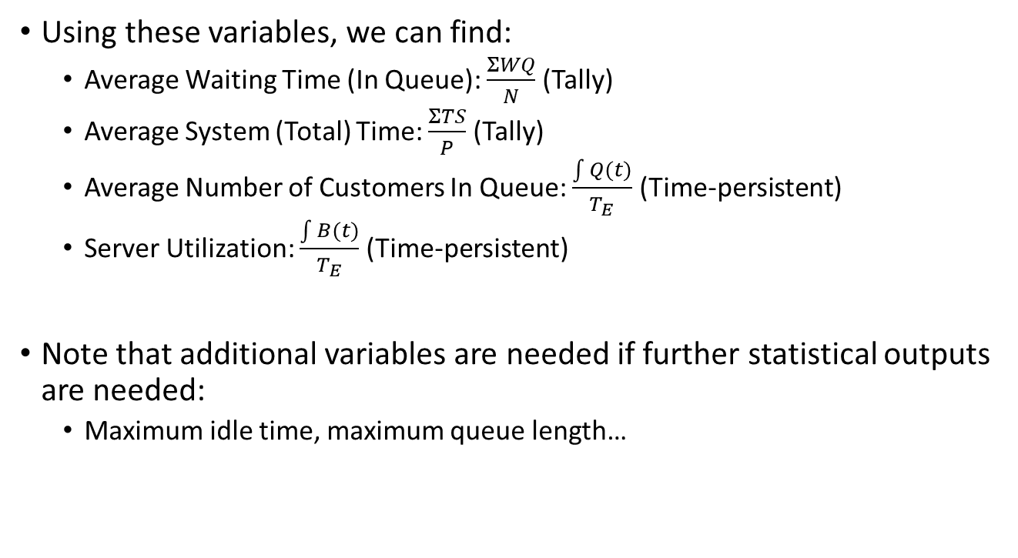
COMPUTATION OF STATISTICS
Using these variables, we can find:
  Average Waiting Time (In Queue): $\frac{ΣWQ}{N}$ (Tally)
  Average System (Total) Time: $\frac{ΣTS}{P}$ (Tally)
  Average Number of Customers In Queue: $\frac{\int{Q(t)}}{T_{E}}$ (Time-persistent)
  Server Utilization: $\frac{\int{B(t)}}{T_{E}}$ (Time-persistent)
Note that additional variables are needed if further statistical outputs are needed:
  Maximum idle time, maximum queue length…

Slide 16
TOWARDS MAKING A SIMUATION RUN
Now that we know how to advance simulation time, keep track of events and collect statistics, we will now see how to analyze a G/G/1 queue system.

Slide 17
Arrival Event Flowchart (Logical Model)
Arrival event
Schedule next arrival
Increase number in the system
L(t)=L(t)+1
NO
Is
server
busy?
YES
Make server busy
Increase entity number
in queue
B(t)=1
Q(t)=Q(t)+1
Set service time &
schedule departure

Slide 18
Departure Event Flowchart (Logical Model)
Departure event
Decrease number in system
L(t)=L(t)-1
NO
Is
queue
empty?
YES
Decrease number in
queue
Make server idle
Q(t)=Q(t)-1
B(t)=0
Set service time &
scheduled departure for
entity in service

Slide 19
Simulation by Hand
Run simulation for 20 minutes to find
Average / Max Waiting Time
Average / Max System Time
Average Queue Length
Average Utilization
Assume the first arrival occurs at zero

Slide 20
t = 0.00, Initialize

Slide 21
t = 0.00, Arrival of Part 1
1

Slide 22
t = 1.73, Arrival of Part 2
2
1

Slide 23
t = 2.90, Departure of Part 1
2

Slide 24
t = 3.08, Arrival of Part 3
3
2

Slide 25
t = 3.79, Arrival of Part 4
4
3
2

Slide 26
t = 4.41, Arrival of Part 5
5
4
3
2

Slide 27
t = 4.66, Departure of Part 2
5
4
3

Slide 28
t = 8.05, Departure of Part 3
5
4

Slide 29
t = 12.57, Departure of Part 4
5

Slide 30
t = 17.03, Departure of Part 5

Slide 31
t = 18.69, Arrival of Part 6
6

Slide 32
t = 19.39, Arrival of Part 7
7
6

Slide 33
t = 20.00, The End
7
6

Slide 34
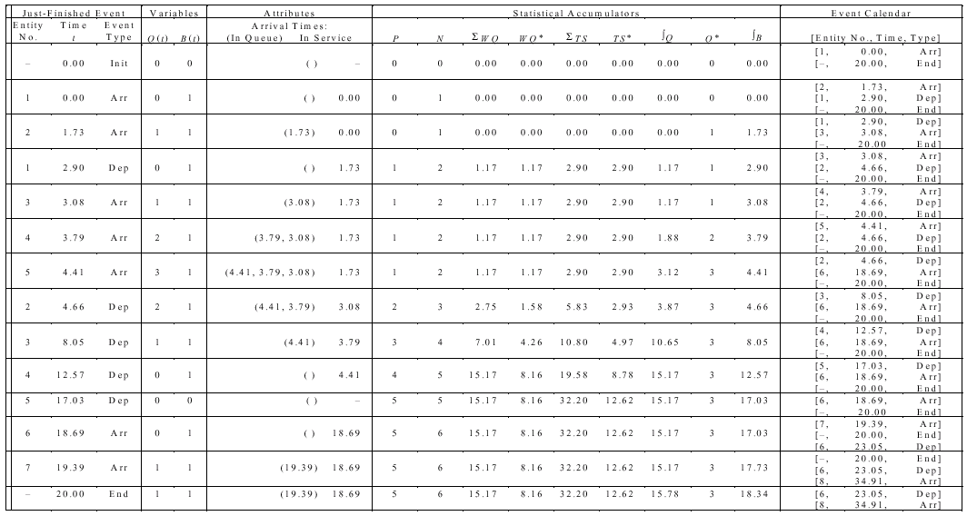
Complete Record of Hand Simulation

