Slide 1
IE 324 SIMULATION
SIMULATION EXERCISE:
“PICKING THE RIGHT
HIGHWAY INTERCHANGE”

Slide 2
HIGHWAY INTERCHANGES
Consider yourself being a highway engineer being consulted to design a new interchange.
  How would you address the problem?
  Considerations?
    Traffic volume (now/future)
    Land space available
    Material use / budget
    Environmental impact

Slide 3
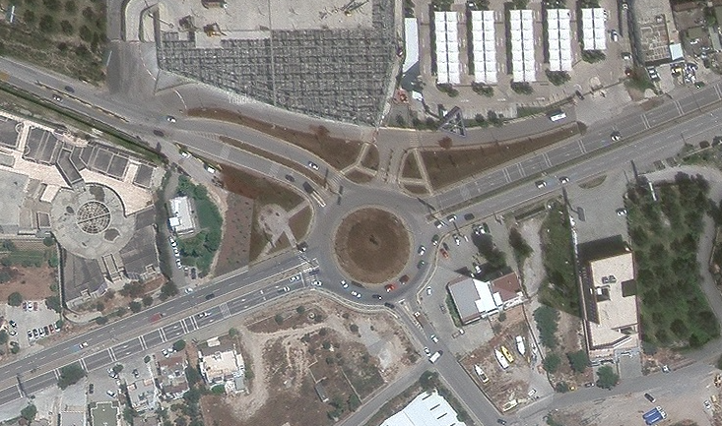
D-330 in Ortakent, Bodrum
Roundabout

Slide 4
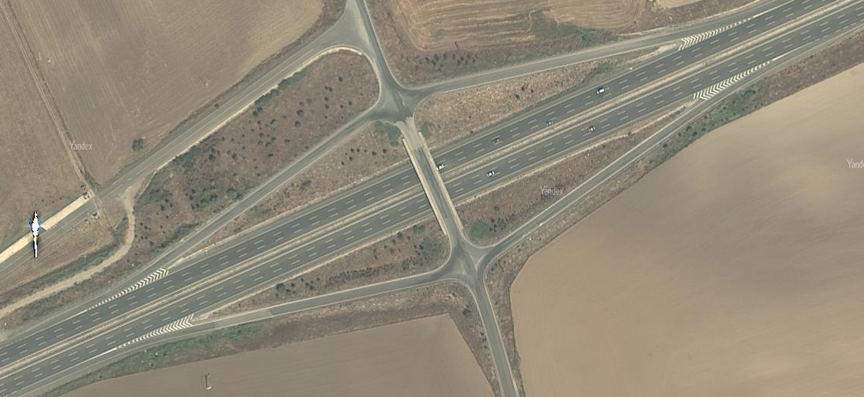

D-200 in Ankara
Diamond Interchange

Slide 5
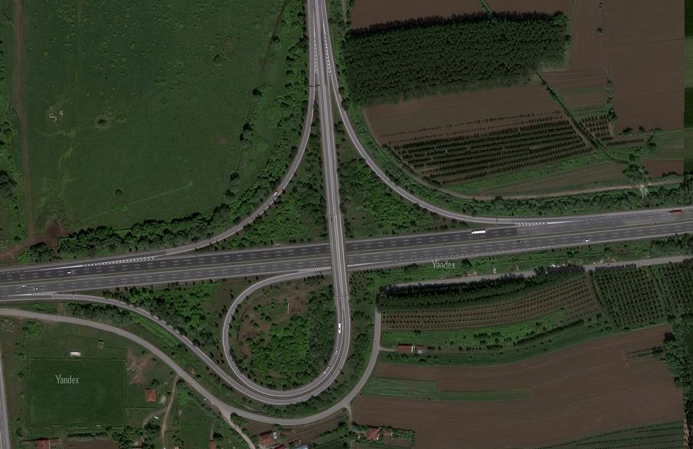
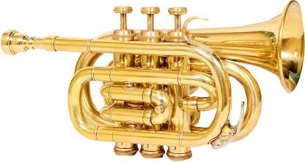
O-4 in Sakarya
Trumpet Interchange

Slide 6
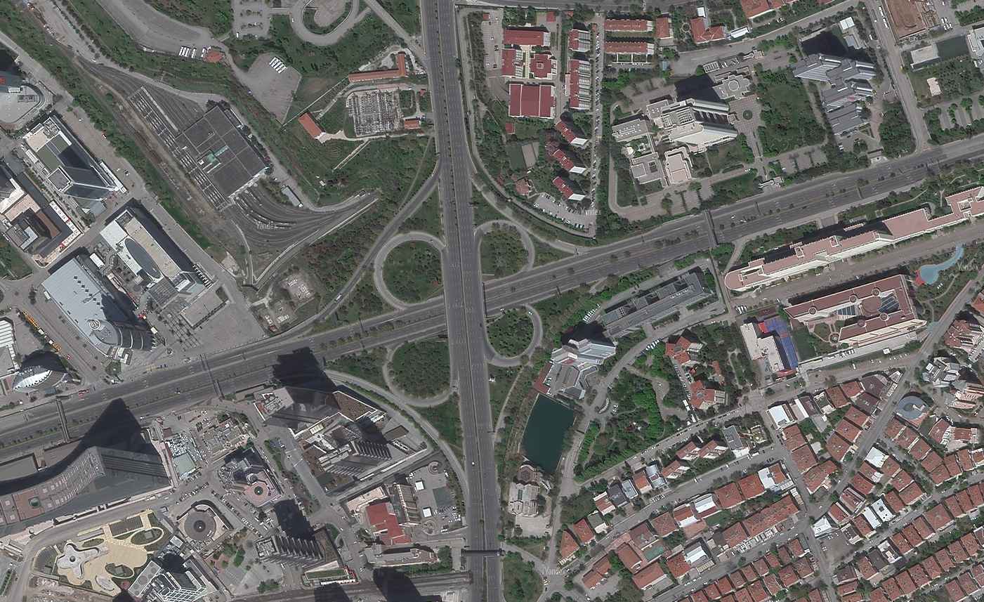

D-200 and D-750 junction in Ankara
Cloverleaf

Slide 7
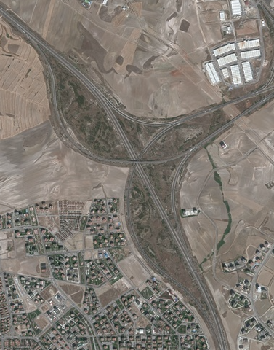
O-20 and O-4 junction in Ankara
Three-leg all-directional
(or wye interchange)

Slide 8
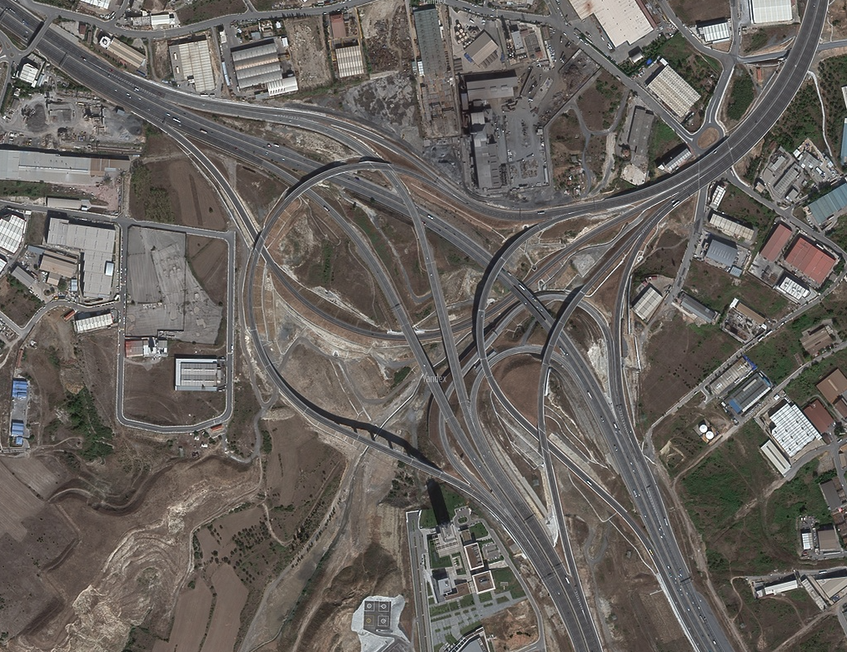
O-4, O-5 and O-7 junction in Kocaeli
All-directional four-leg
(or stacked interchange)
(or spaghetti junction)

Slide 9
HIGHWAY INTERCHANGES
Let us design a highway interchange

