Slide 1
IE 324 SIMULATION
HISTOGRAMS

Slide 2
Histograms
A histogram is a frequency distribution that is useful in identifying the shape of a distribution.
If data is continuous, histogram will represent the pdf
If data is discrete, histogram will represent the pmf.

Slide 3
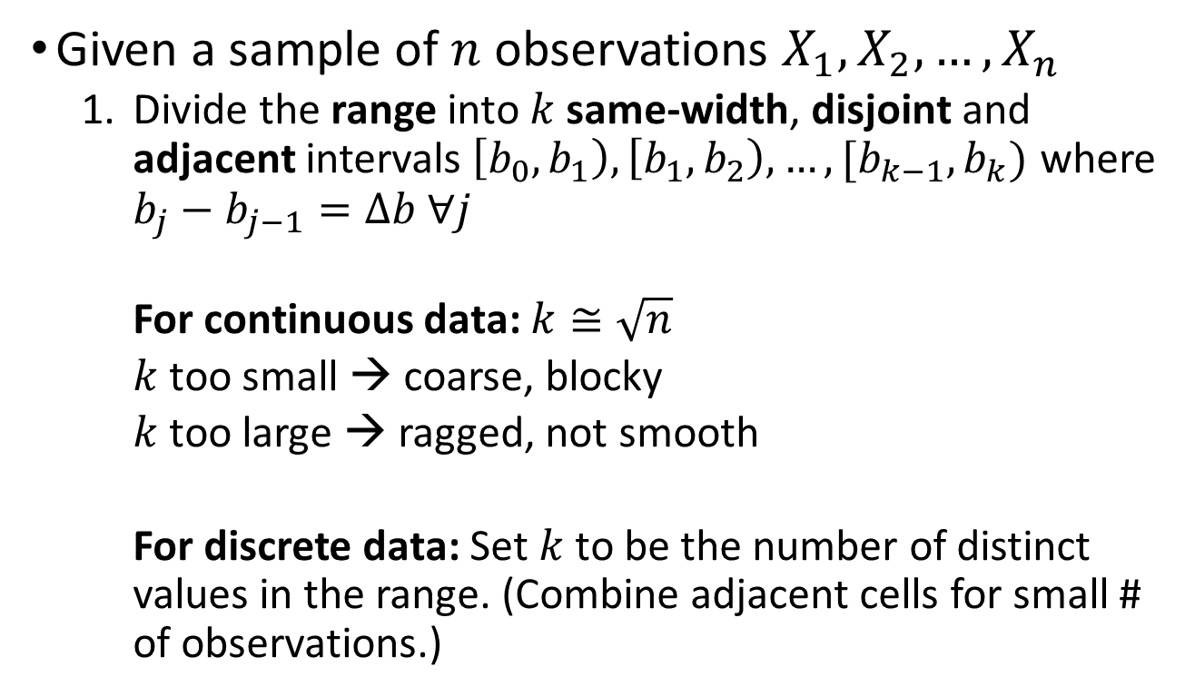
Histograms
Given a sample of $n$ observations $X_{1},X_{2},…,X_{n}$
  Divide the range into $k$same-width, disjoint and adjacent intervals$\left[b_{0},b_{1}\right),\left[b_{1},b_{2}\right),…,[b_{k−1},b_{k})$ where $b_{j}−b_{j−1}=Δb ∀j$
    For continuous data: $k≅\sqrt{n}$
    $k$ too small → coarse, blocky
    $k$ too large → ragged, not smooth
    For discrete data: Set $k$ to be the number of distinct values in the range. (Combine adjacent cells for small # of observations.)

Slide 4

Example
150 data points, $k≅12$

Slide 5
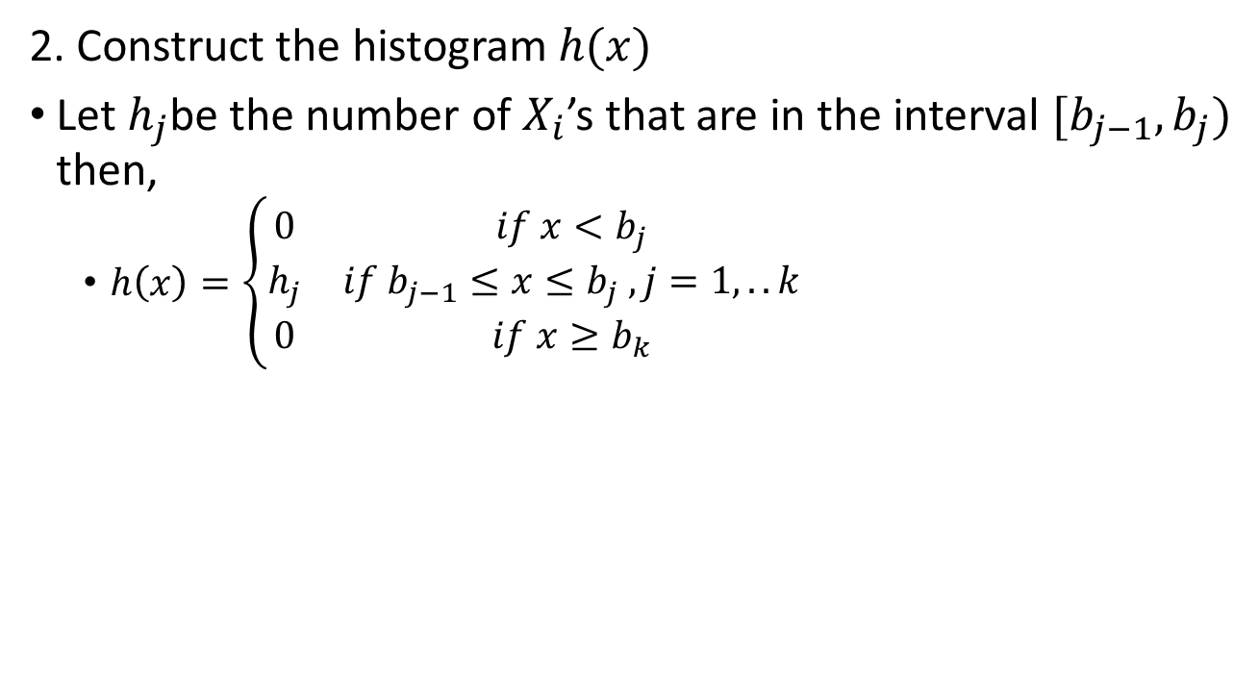
Histograms
2. Construct the histogram $h(x)$
Let $h_{j}$be the number of $X_{i}$’s that are in the interval $[b_{j−1},b_{j})$ then,
  $h\left(x\right)=\left\{\begin{matrix}0 & if x<b_{j} \\ h_{j} & if b_{j−1}≤x≤b_{j} , j=1,..k \\ 0 & if x≥b_{k}\end{matrix}\right.$

Slide 6
Example 1
Number of customers arrived at a bank during lunch hour
is recorded for 50 workdays and given in Dataset #1 below.
Draw the histogram.
Obs. No. | Value | Obs. No. | Value | Obs. No. | Value | Obs. No. | Value | Obs. No. | Value
1 | 6 | 11 | 4 | 21 | 2 | 31 | 2 | 41 | 5
2 | 5 | 12 | 3 | 22 | 5 | 32 | 3 | 42 | 2
3 | 4 | 13 | 0 | 23 | 4 | 33 | 3 | 43 | 2
4 | 5 | 14 | 4 | 24 | 5 | 34 | 5 | 44 | 4
5 | 11 | 15 | 10 | 25 | 5 | 35 | 4 | 45 | 5
6 | 2 | 16 | 10 | 26 | 11 | 36 | 8 | 46 | 4
7 | 6 | 17 | 4 | 27 | 1 | 37 | 7 | 47 | 1
8 | 7 | 18 | 9 | 28 | 11 | 38 | 2 | 48 | 2
9 | 8 | 19 | 7 | 29 | 6 | 39 | 4 | 49 | 1
10 | 4 | 20 | 4 | 30 | 4 | 40 | 2 | 50 | 2

Slide 7
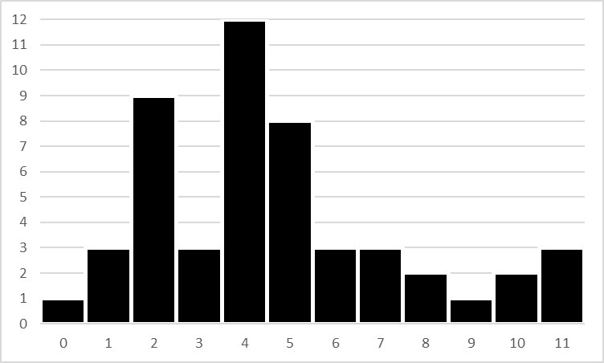
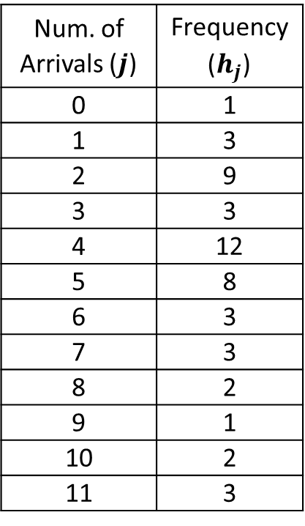
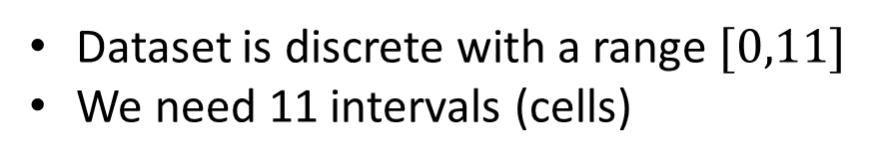
Example 1
Dataset is discrete with a range $[0,11]$
We need 11 intervals (cells)
Num. of Arrivals ($j$) | Frequency ($h_{j}$)
0 | 1
1 | 3
2 | 9
3 | 3
4 | 12
5 | 8
6 | 3
7 | 3
8 | 2
9 | 1
10 | 2
11 | 3

Slide 8
Example 2
Service time distribution of a bank teller is measured for 50 customers and given in Dataset #2 below. Draw the histogram.
Obs. No. | Value | Obs. No. | Value | Obs. No. | Value | Obs. No. | Value | Obs. No. | Value
1 | 8.616 | 11 | 7.386 | 21 | 18.204 | 31 | 10.144 | 41 | 0.886
2 | 12.474 | 12 | 3.212 | 22 | 29.524 | 32 | 19.620 | 42 | 2.017
3 | 7.845 | 13 | 9.702 | 23 | 8.795 | 33 | 5.022 | 43 | 17.912
4 | 6.208 | 14 | 16.589 | 24 | 12.640 | 34 | 0.050 | 44 | 6.927
5 | 14.872 | 15 | 6.174 | 25 | 15.359 | 35 | 4.219 | 45 | 3.727
6 | 3.429 | 16 | 13.147 | 26 | 13.490 | 36 | 3.192 | 46 | 14.886
7 | 3.652 | 17 | 18.537 | 27 | 5.731 | 37 | 28.195 | 47 | 7.816
8 | 5.895 | 18 | 5.895 | 28 | 1.254 | 38 | 11.711 | 48 | 3.328
9 | 10.247 | 19 | 17.044 | 29 | 0.060 | 39 | 5.908 | 49 | 21.482
10 | 6.059 | 20 | 10.087 | 30 | 67.254 | 40 | 81.117 | 50 | 2.415

Slide 9
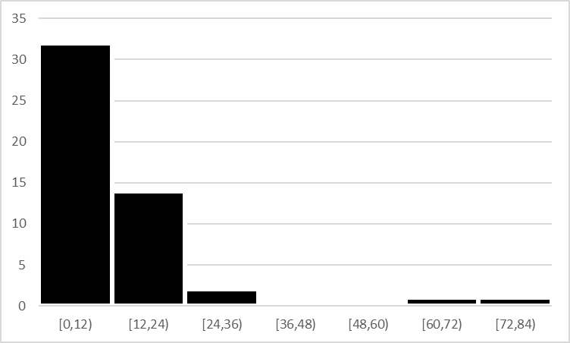
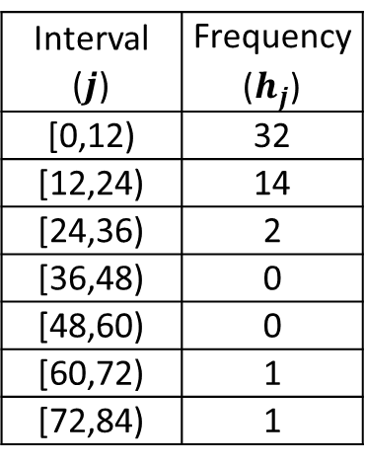
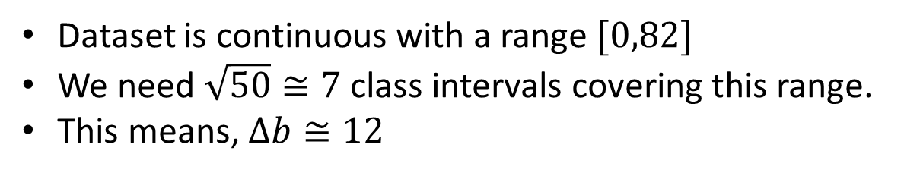
Example 2
Dataset is continuous with a range $[0,82]$
We need $\sqrt{50}≅7$ class intervals covering this range.
This means, $Δb≅12$
Interval ($j$) | Frequency ($h_{j}$)
[0,12) | 32
[12,24) | 14
[24,36) | 2
[36,48) | 0
[48,60) | 0
[60,72) | 1
[72,84) | 1

