Slide 1
IE 324 SIMULATION
INTRODUCTION

Slide 2
IE 324 SIMULATION
Instructor:
Teaching Assistants:
  Emre Can Yayla
  Aziza Rafiq
Dr. Emre Uzun Email: emreu@bilkent.edu.tr Office: EA 328 Tel: 3484 Office Hours: By appointment

Slide 3
COURSE DESCRIPTION
Use of simulation as a decision tool.
The design and analysis of simulation models.
The use of simulation for estimation, comparison of policies, and optimization.
Topics include principle of simulation modeling, software, general-purpose computer simulation languages, and statistical analysis of simulation input and output data.

Slide 4
COURSE OUTLINE
Introduction to Simulation, Monte Carlo Simulation
Event Scheduling/Time Advance Algorithm, Simulation by Hand
Input Modeling
Random Number Generation
Random Variate Generation
Arena Modeling Basic Operations
Arena Modeling Detailed Operations
Output Analysis of Terminating Systems
Output Analysis of Non-Terminating Systems
Validation and Verification
Comparing Alternative Scenarios
Optimization via Simulation
Variance Reduction Techniques (if time permits)

Slide 5
TEXTBOOKS
Required Text Books:
  Banks, J., Carson, J. S., Nelson, B. L., and Nicol, D. M., Discrete-Event System Simulation, 2013, Pearson
  Kelton, W. D., Sadowski, R. P., and Zupick, N. B., Simulation with Arena, 6th Ed., McGraw Hill, 2015
Recommended Text Books:
  Seila, A., Ceric, V., Tadikamalla, P., Applied Simulation Modeling, Duxbury, 2003
  Law, A. M., Simulation Modeling and Analysis, 4th Ed., McGraw Hill, 2006
  Fishman, G. S., Discrete-Event Simulation: Modeling, Programming, and Analysis, Springer, 2001
  Rosetti, M. D., Simulation Modeling and Arena, Wiley, 2009

Slide 6
LAB HOURS
Labs will complement the topics/discussions in classroom.
Until we begin modeling:
  Simulation by Hand
  Monte Carlo Simulation
  Input Modeling
  Random Number and Variate Generation
After we begin modeling:
  Modeling Exercises
  Output Analysis Exercises

Slide 7
GRADING
Midterm: 35%
Final Exam: 35%
Arena Quiz: 13%
Course Project: 12%
Homework Assignments: 5%

Slide 8
POLICIES
Open-Book Policy:
  The midterm and final exam will be CLOSED BOOKS and CLOSED NOTES. A necessary formulas and statistical tables will be provided.
  Arena Quiz will be OPEN BOOK (Kelton et. al. only) and OPEN NOTES.
Group Policy: Your project will be done in groups of a maximum of 3 students.
Homework Assignments: Individual homework assignments will be given and graded based on effort.

Slide 9
POLICIES
Moodle/Email:
Moodle course will be opened after the add/drops.
Students are responsible for all the announcements made in class or via e-mail and what has been covered in lectures
Slides/Lecture Notes:
Lecture notes will NOT be shared
Slides will be available on Moodle
YouTube playlist for lecture videos will be on Moodle (Videos date back to 2021 – some content may not be on videos)

Slide 10
MAKEUP POLICY
A make-up examination for the midterm or final will only be given under highly unusual circumstances (such as serious health or family problems). The student should contact the instructor as early as possible and provide the instructor with proper documentation (such as a medical report certified by Bilkent University’s Health Center). There is no make-up for quizzes.

Slide 11
SOFTWARE POLICY
The simulation software ARENA can only be installed to Windows computers. This means Mac users should either have their computers a Dual-Boot, or they will need an emulator software (like parallels). You are welcome to use the BCC Computer Labs but this might change during the semester.
You must install ARENA version 14.5. No other version should be used! We will supply the installation files.

Slide 12
QUESTIONS?

Slide 13
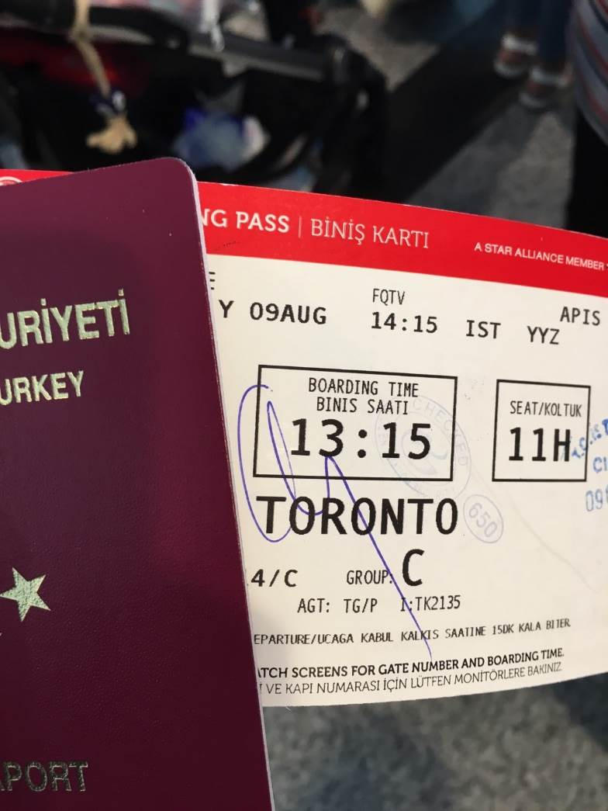
AIRPLANE BOARDING
How to board an airplane?
The order of boarding is
usually determined by the
carrier and denoted with
your boarding group.

Slide 14
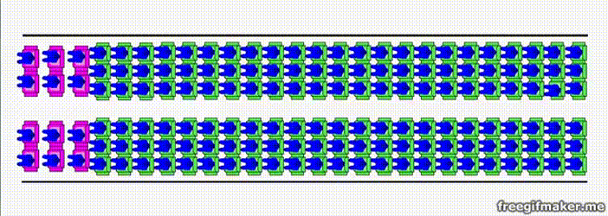
AIRPLANE BOARDING (BACK TO FRONT)
Source: Menkes van den Briel http://www.menkes76.com/projects/boarding/boarding.htm

Slide 15
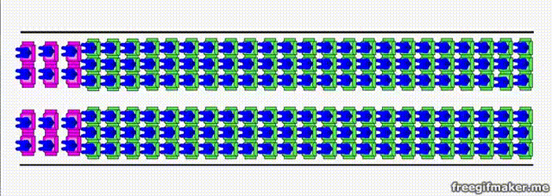
AIRPLANE BOARDING (RANDOM)
Source: Menkes van den Briel http://www.menkes76.com/projects/boarding/boarding.htm

Slide 16
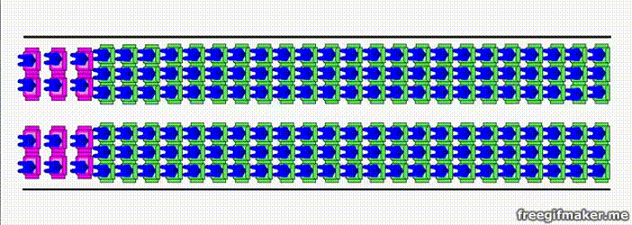
AIRPLANE BOARDING (OUTSIDE IN - WILMA)
Source: Menkes van den Briel http://www.menkes76.com/projects/boarding/boarding.htm

Slide 17
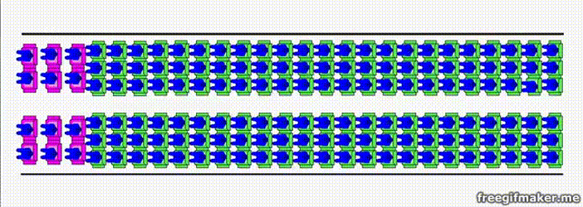
AIRPLANE BOARDING (BY SEAT)
Source: Menkes van den Briel http://www.menkes76.com/projects/boarding/boarding.htm

Slide 18
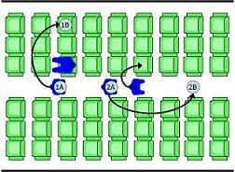
AIRPLANE BOARDING
How to determine the best method?
  What performance metrics to decide?
Things to think about:
  Passenger movements / lineup order
  Single, double door usage?
  Different type of passengers (young, old, with babies/kids, disabled…)
  Passengers with/without carry-on
How to make the analysis?

Slide 19
SYSTEM
A set of interacting components or entities operating together to achieve a common goal or objective.
Examples
  Manufacturing facility
  Bank operation
  Airport operations (passengers, security, planes, crews, baggage)
  Transportation/logistics/distribution operation
  Hospital facilities (emergency room, operating room, admissions)
  Computer network
  Freeway system
  Business process (insurance office)
  Fast-food restaurant
  Supermarket
  Theme park
  Emergency-response system
REAL WORLD SYSTEMS OF INTEREST ARE HIGHLY COMPLEX!!!

Slide 20
COMPONENTS OF A SYSTEM
Entity: is an object of interest in the system
  Dynamic objects — get created, move around, change status, affect and are affected by other entities, leave (maybe)
  Usually have multiple realizations floating around
  Can have different types of entities concurrently
Banking | Inventory | Health Center | Airplane Boarding
Customers | Items | Patients | ?

Slide 21
COMPONENTS OF A SYSTEM
Attribute: is a characteristic of all entities, but with a specific value “local” to the entity that can differ from one entity to another.
Banking | Inventory | Health Center | Airplane Boarding
Account Balance | Item properties (type, model no.) | Type of illness, Blood pressure | ?

Slide 22
COMPONENTS OF A SYSTEM
Resources: what entities compete for
  Entity seizes a resource, uses it, releases it
  Think of a resource being assigned to an entity, rather than an entity “belonging to” a resource
  A resource can have several units of capacity which can be changed during the simulation
Banking | Inventory | Health Center | Airplane Boarding
Tellers, ATMs | Available space, material handling equipment | Doctors, nurses, equipment | ?

Slide 23
COMPONENTS OF A SYSTEM
Variable: A piece of information that reflects some characteristic of the whole system, not of specific entities
  Entities can access, change some variables
Banking | Inventory | Health Center | Airplane Boarding
Number of customers waiting | Inventory Level | Number of doctors busy | ?

Slide 24
COMPONENTS OF A SYSTEM
State: A collection of variables that contains all the information necessary to describe the system at any time
Banking | Inventory | Health Center | Airplane Boarding
Number of Busy Tellers, Number of Customers Waiting | Inventory Level, Backlogged Demand | Number of Patients, State of the Doctors and Equipment | ?

Slide 25
COMPONENTS OF A SYSTEM
Event: An instantaneous occurrence that changes the state of the system
Banking | Inventory | Health Center | Airplane Boarding
Arrival, departure of customers | New demand, order arriving | New patient arrival, Completion of diagnosis, treatment | ?

Slide 26
COMPONENTS OF A SYSTEM
Activity: represents a time period of specified length.
Banking | Inventory | Health Center | Airplane Boarding
Depositing money | Lead time for replenishment | Surgery, diagnosis | ?

Slide 27
WHY AND HOW TO STUDY A SYSTEM?
Measure/estimate performance
Improve operation
Prepare for failures
System
Experiment
with the
actual system
Experiment with
a physical model
of the system
Experiment with a
mathematical model
of the system
IE 325
IE 202
IE 303
…
Mathematical
Analysis
IE 324
Simulation

Slide 28
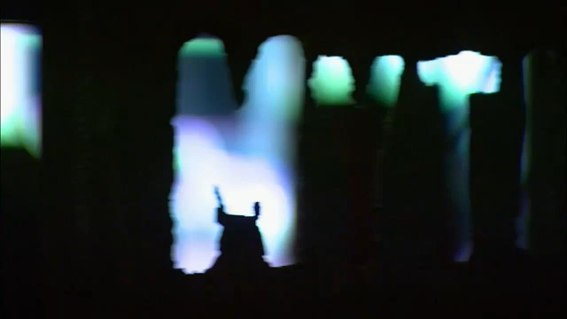

Slide 29
WHY AND HOW TO STUDY A SYSTEM?
Measure/estimate performance
Improve operation
Prepare for failures
System
Experiment
with the
actual system
Experiment with
a physical model
of the system
Experiment with a
mathematical model
of the system
IE 325
IE 202
IE 303
…
Mathematical
Analysis
IE 324
Simulation

Slide 30
ALL MODELS ARE WRONG!
George E. P. Box
Science and Statistics, George E. P. Box, Journal of the American Statistical Association, Vol. 71, No. 356. (Dec., 1976), pp. 791-799

Slide 31
MODEL
An abstract and simplified representation of a system
  Not an exact re-creation of the original system!
  Specifies assumptions/approximations about how the system works
  Translates them into a set of logical and mathematical relations
If model is simple, you may use:
  Queueing Theory
  Linear Programming
  Differential Equations
If model is complex, simulation is usually the only way!

Slide 32
WHAT IS SIMULATION?
The imitation of the operation of a real-world process or system over time.
  Most widely used tool (along with LP) for decision making
Applied to complex systems that are impossible to solve mathematically
This course focuses on one form of simulation modeling
  Discrete-event simulation modeling

Slide 33
WHAT IS SIMULATION?
Simulation models seek to:
Describe the behavior of the system
Construct theories or hypotheses based on the observed behavior
Use these theories to predict the future behavior, that is, the effects that will be produced by changes in the system or its method of operation

Slide 34
ORIGIN OF SIMULATION
Lie in statistical sampling theory, e.g., random numbers, random sampling (Before the 2nd world war)
Monte Carlo simulation (During the 2nd world war)
Modern Applications (After the 2nd world war)

Slide 35
SIMULATION AS A TOOL
1945-70 A technique of last resort
Rasmussen & George (1978) - Ranked 5th
Thomas & Decosta (1979) - Ranked 2nd
Shannon et al. (1980) - Ranked 2nd
Harpel et al. (1989) -Ranked 2nd
(Getting more popular…)

Slide 36
ADVANTAGES
Requires fewer assumptions (than analytical models)
Explore new policies, operating procedures…etc without disrupting the real system (“What if?”)
Diagnose problems such as bottlenecks (Understand “why?”)
Display dynamic behaviour
Handles randomness and uncertainty
Time compression and expansion (controlling time)
Flexible and easy to change
Credible* and results are easier to explain

Slide 37
DISADVANTAGES
“Run” rather than “solved”.
Cannot generate optimal solution on their own.
Requires specialized training (probability, statistics, computer programming, modelling, system analysis, simulation methodology).
Time consuming and costly (software and hardware)

Slide 38
ANALYTICAL VS SIMULATION
Use analytical models whenever possible
Use simulation models when:
Complete mathematical formulation does not exist, or an analytical solution cannot be developed
Analytical methods are available, but the mathematical procedures are so complex that simulation provides a simpler solution
It is desired to observe a simulated history of the process over a period of time in addition to estimating certain system performances

Slide 39
CLASSIFICATION OF SIMULATION MODELS
Static (Monte Carlo)
Dynamic Systems
Represents the system at a particular point in time
Represents the system behaviour over time
Continuous Simulation:
(Stochastic) Differential Equations
Discrete Event Simulation:
System quantities (state variables) change with events
Estimation of π
Risk Analysis in Business
Water Level in a Dam
Queueing Systems
Inventory Systems

Slide 40
INPUT/OUTPUT PROCESS
REAL-LIFE
Operating Policies
Single queue, parallel servers, FIFO, …
Input Parameters
- Number of servers, distributions, …
System response
- Waiting times, system size, utilizations…
SIMULATION MODEL
(LOGIC)
(X)
Y=f(X)
(Y)

Slide 41
EXAMPLE: Health Center
Number of Doctors
Capacity of equipment
Arrival rate
Queue Discipline
SIMULATION
MODEL OF A
HEALTH CENTER
Time in system
Utilization of doctors
Number served

Slide 42
STEPS IN A SIMULATION STUDY
Conceptual
Model
No
Experimental
Design
Yes
Setting of
Objectives
and Overall
Project Plan
Problem
Formulation
Model
Translation
Verified?
Yes
Validated?
Simulation
Runs and
Analysis
No
Yes
Data Collection
No
More
Runs?
Yes
No
Implementation
Documentation
and Reporting

Slide 43
PROBLEM FORMULATION
(NOT MODEL)
A statement of the problem
  The problem is clearly understood by the simulation modeler
  The formulation is clearly understood by the client
Criteria for selecting a problem
  Technical and economical feasibility
  Perceived urgency for a solution

Slide 44
SETTING OBJECTIVES AND
PROJECT PLAN
Determine the questions that are to be answered
  Objective to be achieved
  Identify scenarios to be investigated
  Determine the end-user, data, hardware, software, personnel, and time requirements
Is simulation appropriate?

Slide 45
STEPS IN A SIMULATION STUDY
Conceptual
Model
No
Experimental
Design
Yes
Setting of
Objectives
and Overall
Project Plan
Problem
Formulation
Model
Translation
Verified?
Yes
Validated?
Simulation
Runs and
Analysis
No
Yes
Data Collection
No
More
Runs?
Yes
No
Implementation
Documentation
and Reporting

Slide 46
MODEL DEVELOPMENT
Real World
System
Conceptual model
Logical model
Simulation model

Slide 47
CONCEPTUAL MODEL
Real World System
Assumed system
Conceptual model

Slide 48
CONCEPTUAL MODEL
Level of details - assumptions
Model components
  Events, entities, attributes, variables and their relationships
Data requirements

Slide 49
LEVEL OF DETAIL
Too little detail result in lost of information and goals cannot be accomplished
Too much detail requires:
  more time and effort
  longer simulation runs
  more likely to contain errors

Slide 50
Accuracy of
the model
Scope and level of details
Cost of
the model
Scope and level of details

Slide 51
LEVEL OF DETAIL
Modeler
Novice
Experienced
Tends toward too much detail
Tends toward greater detail
KISS

Slide 52
LEVEL OF DETAIL
Evaluate candidate
systems if they work
Compare two or more systems to determine better ones
Accurately predict the performance of the selected system

Slide 53
DATA COLLECTION AND ANALYIS
Data collection is an expensive process!
The data may or may not be in electronic format!
Simulation analyst analyse the data
  Determine the random variables
  Fit distribution functions

Slide 54
LOGICAL (or Flowchart model)
Shows the logical relationships among the elements of the model
Start
Read data
Generate
data
Check
Set new
event
Calculate
Stats
Print
Check
Stop

Slide 55
MODEL TRANSLATION
Simulation model executes the logic contained in the flow-chart model
Coding
General Purpose
Language
Special Purpose Simulation
Language/Software
JAVA, C++, Visual BASIC
SIMAN, ARENA, EXTEND

Slide 56
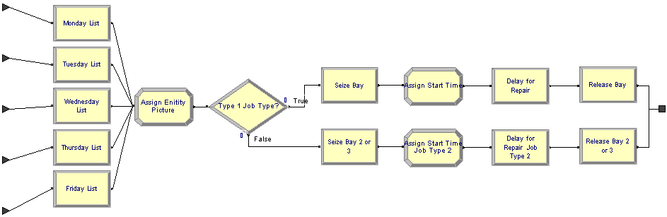
ARENA EXAMPLE

Slide 57
SIMAN EXAMPLE
--- MODEL FILE ---
BEGIN;
CREATE,1:,EXPO(40):EX(40):MARK(1);
QUEUE,1;
SEIZE:DOCTOR;
DELAY:EXPO(30);
TALLY:1,INT(1);
RELEASE:DOCTOR;
COUNT:1:DISPOSE;
END:
----EXPERIMENTAL FILE -----
BEGIN;
PROJECT,HEALTH_CENTRE, IHSA SABUNCUOGLU,24/1/2000;
DISCRETE,100,1,1;
RESOURCES:1,
DOCTORS;
DSTATS:1,NQ(!),NUMBER_IN_QUEUE:
2,NR(1),DOCTOR UTILIZATION;
TALLIES:1, TIME IN HEALTH_CENTRE;
COUNTERS:1,No. OF PATIENTS SERVED;
END:

Slide 58
JAVA EXAMPLE
public static void main(String argv[])
{
Initialization();
//Loop until first "TotalCustomers" have departed
while (NumberofDepartures < TotalCustomers)
{
Event evt = FutureEventList[0]; //get imminent event
removefromFEL(); //be rid of it
Clock = evt.get_time(); //advance in time
if (evt.get_type() == arrival) ProcessArrival();
else ProcessDeparture();
}
ReportGeneration();
}

Slide 59
STEPS IN A SIMULATION STUDY
Conceptual
Model
No
Experimental
Design
Yes
Setting of
Objectives
and Overall
Project Plan
Problem
Formulation
Model
Translation
Verified?
Yes
Validated?
Simulation
Runs and
Analysis
No
Yes
Data Collection
No
More
Runs?
Yes
No
Implementation
Documentation
and Reporting

Slide 60
VERIFICATION AND VALIDATION
Verification: the process of determining if the operational logic is correct.
  Debugging the simulation software
Validation: the process of determining if the model accurately represents the system.
  Comparison of model results with collected data from the real system

Slide 61
VERIFICATION AND VALIDATION
Real World
System
VALIDATION
Conceptual model
Operational Logic
VERIFICATION
Logical model
Simulation model

Slide 62
STEPS IN A SIMULATION STUDY
Conceptual
Model
No
Experimental
Design
Yes
Setting of
Objectives
and Overall
Project Plan
Problem
Formulation
Model
Translation
Verified?
Yes
Validated?
Simulation
Runs and
Analysis
No
Yes
Data Collection
No
More
Runs?
Yes
No
Implementation
Documentation
and Reporting

Slide 63
EXPERIMENTAL DESIGN AND ANALYSIS OF RESULTS
Alternative scenarios to be simulated
Type of output data analysis (terminating vs non-terminating systems)
Number of simulation runs and length of each run
Initialization bias?
Statistical analysis
  Point Estimation
  Confidence-Interval Estimation
Variance reduction necessary?

Slide 64
DOCUMENTATION AND REPORTING
Program Documentation
  Allows future modifications
  Creates confidence
Progress Reports
  Frequent reports (e.g. monthly) are suggested
  Alternative scenarios
  Performance measures or criteria used
  Results of experiments
  Recommendations

Slide 65
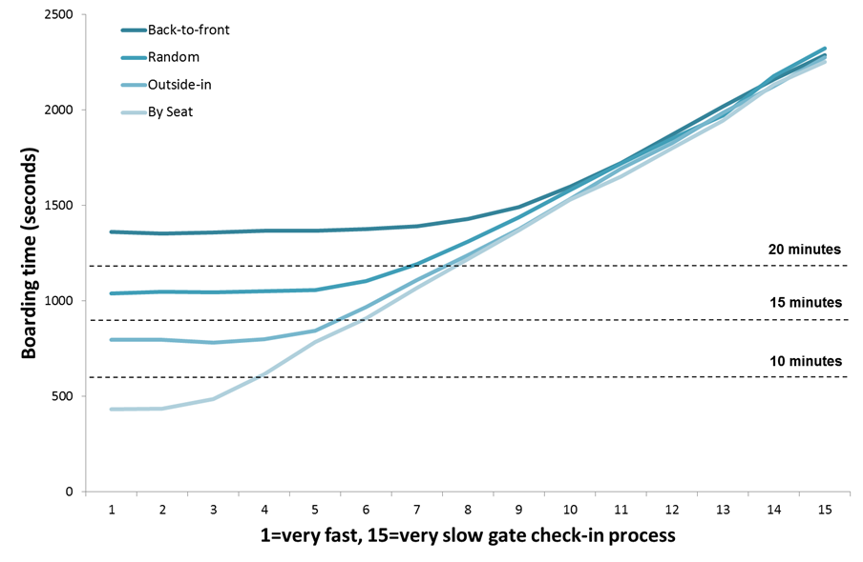
AIRPLANE BOARDING (COMPARISON)
Source: Menkes van den Briel http://www.menkes76.com/projects/boarding/boarding.htm

Slide 66
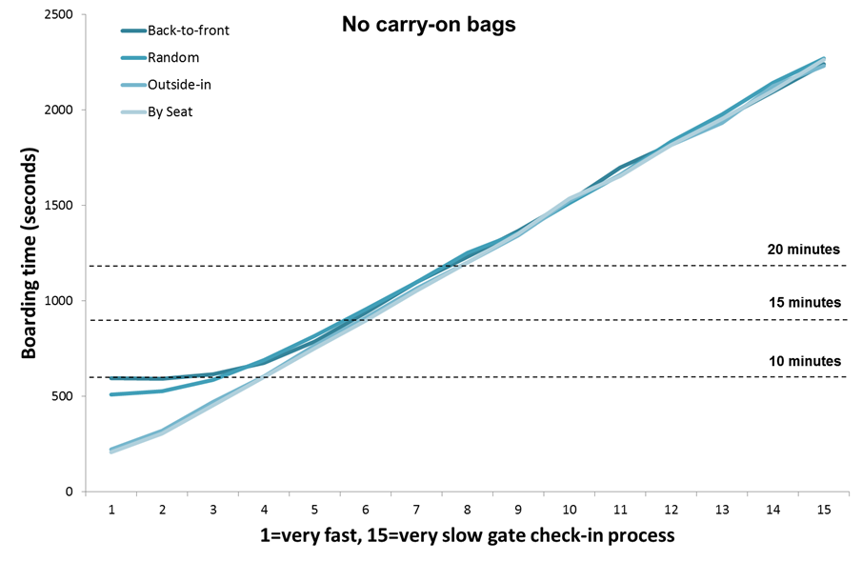
AIRPLANE BOARDING (COMPARISON)
Source: Menkes van den Briel http://www.menkes76.com/projects/boarding/boarding.htm

