Slide 1
IE 324 SIMULATION
MONTE CARLO SIMULATION

Slide 2
MONTE CARLO SIMULATION
Static simulations
  Simulation of a system at a particular point in time.
  Each iteration is independent of the other (No progression of time)
Monte Carlo methods are tools for solving problems using random numbers and sampling.
  Sometimes much easier than analytical solutions
  Sometimes the only way to solve a problem

Slide 3
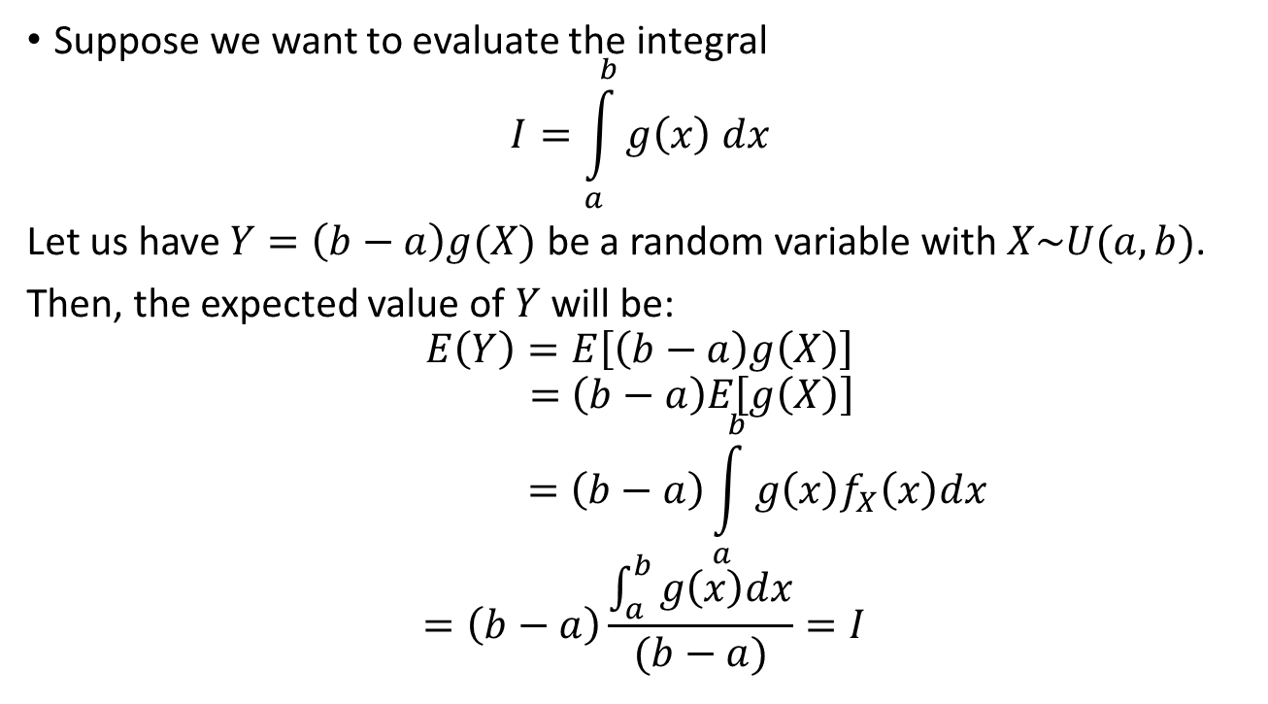
EVALUATING INTEGRALS
(Deterministic Problem)
Suppose we want to evaluate the integral
$$I=\int_{a}^{b}{g\left(x\right) dx}$$
Let us have $Y=\left(b−a\right)g(X)$ be a random variable with $X\sim U(a,b)$.
Then, the expected value of $Y$ will be:
$$E\left(Y\right)=E\left[\left(b−a\right)g\left(X\right)\right]$$
$$=\left(b−a\right)E\left[g\left(X\right)\right]$$
$$=\left(b−a\right)\int_{a}^{b}{g\left(x\right)f_{X}\left(x\right)dx}$$
$$=\left(b−a\right)\frac{\int_{a}^{b}{g\left(x\right)dx}}{(b−a)}=I$$

Slide 4
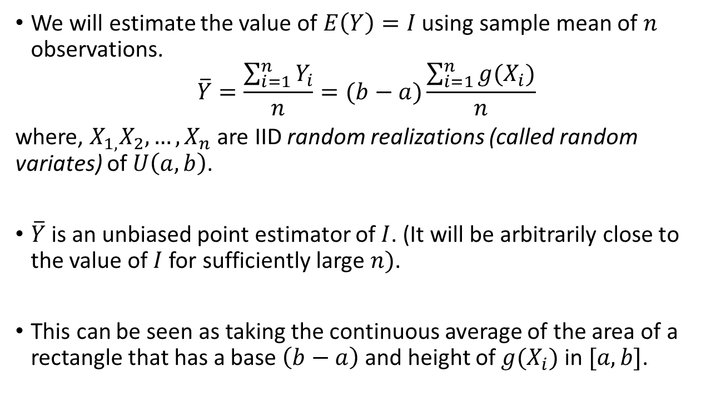
EVALUATING INTEGRALS
(Deterministic Problem)
We will estimate the value of $E\left(Y\right)=I$ using sample mean of $n$ observations.
$$\overline{Y}=\frac{\sum_{i=1}^{n}{Y_{i}}}{n}=(b−a)\frac{\sum_{i=1}^{n}{g(X_{i})}}{n}$$
where, $X_{1,}X_{2},…,X_{n}$ are IID random realizations (called random variates) of $U\left(a,b\right)$.
$\overline{Y}$ is an unbiased point estimator of $I$. (It will be arbitrarily close to the value of $I$ for sufficiently large $n)$.
This can be seen as taking the continuous average of the area of a rectangle that has a base $\left(b−a\right)$ and height of $g(X_{i})$ in $[a,b]$.

Slide 5
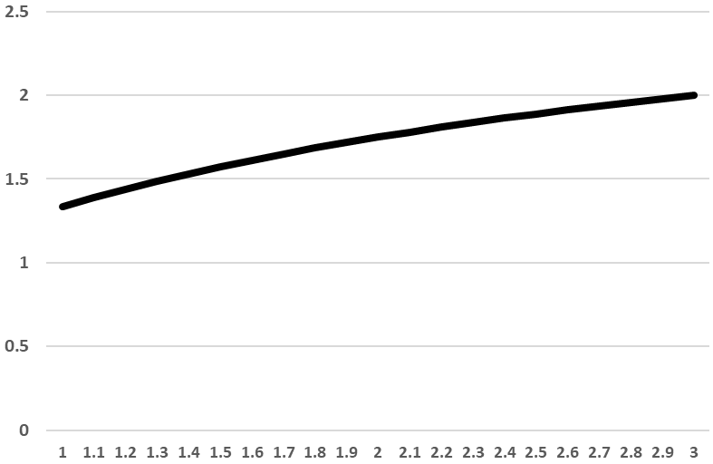

EVALUATING INTEGRALS
(Deterministic Problem)
Let us evaluate the following integral using Monte Carlo Simulation:
Analytical solution: 3.4459
$$I=\int_{1}^{3}{\frac{3x+1}{x+2}}dx$$

Slide 6
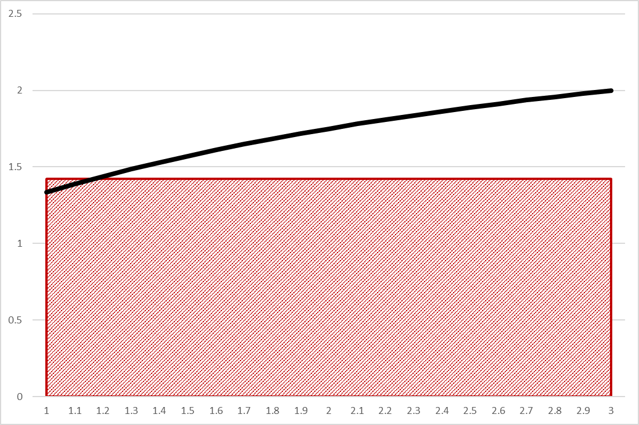
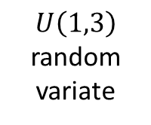
EVALUATING INTEGRALS
(Deterministic Problem)
2.8893
$U\left(1,3\right)$ random variate

Slide 7
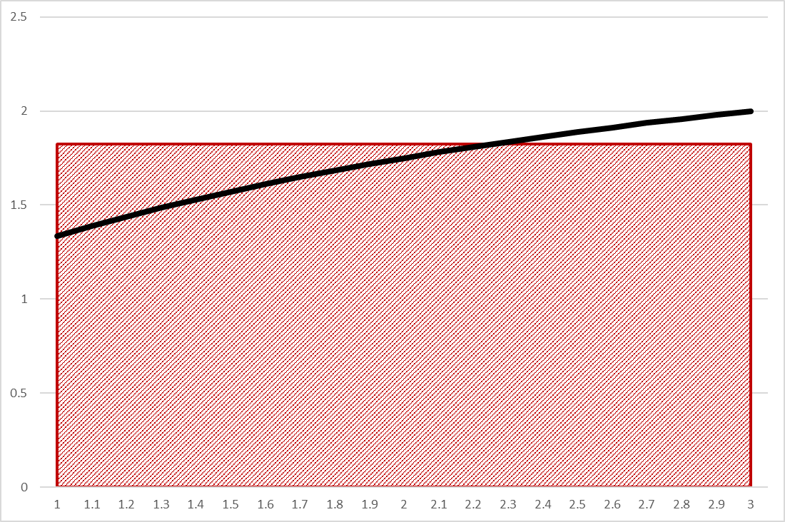
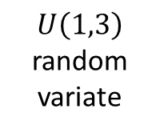
EVALUATING INTEGRALS
(Deterministic Problem)
3.6803
$U\left(1,3\right)$ random variate

Slide 8
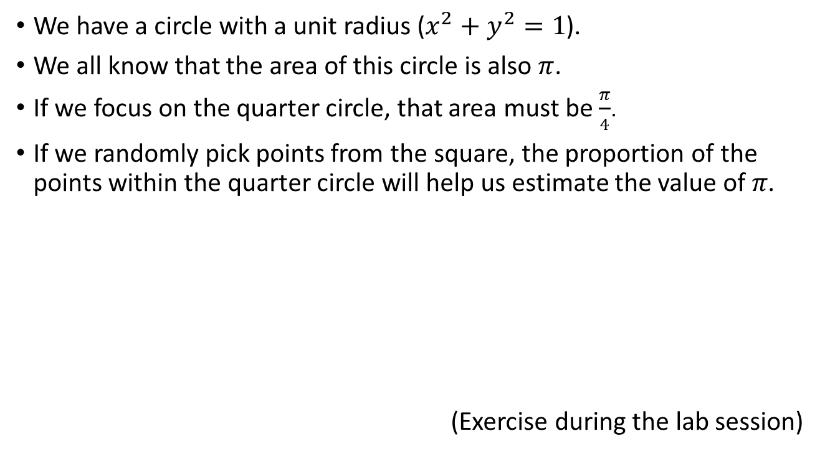
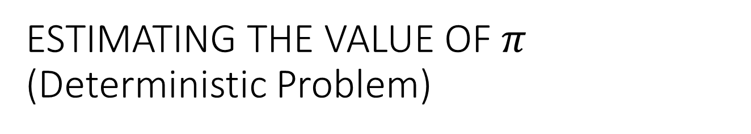

ESTIMATING THE VALUE OF $π$
(Deterministic Problem)
We have a circle with a unit radius ($x^{2}+y^{2}=1$).
We all know that the area of this circle is also $π$.
If we focus on the quarter circle, that area must be $\frac{π}{4}$.
If we randomly pick points from the square, the proportion of the points within the quarter circle will help us estimate the value of 𝜋.
(Exercise during the lab session)
1
$\frac{π}{4}$
1

Slide 9

ESTIMATING A PROBABILITY
(Stochastic Problem)
Monty Hall Problem
  There are three doors
  One has the grand prize
  Contestant picks one door
  Monty opens one other door with a “goat” and asks the contestant whether to switch the door.
Would you switch your door?

Slide 10



1
2
3

Slide 11
1
2
3

Slide 12
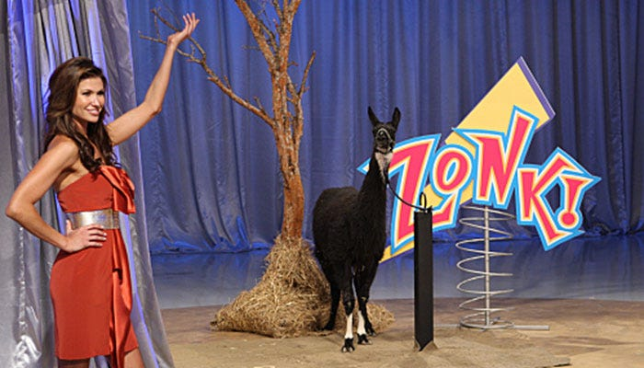
1
2
3

Slide 13
1
2
3

Slide 14
1
2
3

Slide 18


Slide 19
ESTIMATING A PROBABILITY
(Stochastic Problem)
Theoretical winning probability of:
  Not switching strategy is 1/3
  Switching strategy is 2/3
  (See your IE 325 notes for the calculations)
Let us find this probability using Monte Carlo Simulation.

Slide 20
ESTIMATING A PROBABILITY
(Stochastic Problem)
Birthday Problem
  In a group of 23 people, the probability of at least two people to share a common birthday is at least 50%. (50.729% to be exact)
  In this classroom this probability is about 99.76%.
  (To prove, think about the negation of the probability of not sharing a birthday)
  Let us estimate this using Monte Carlo Simulation.

Slide 21
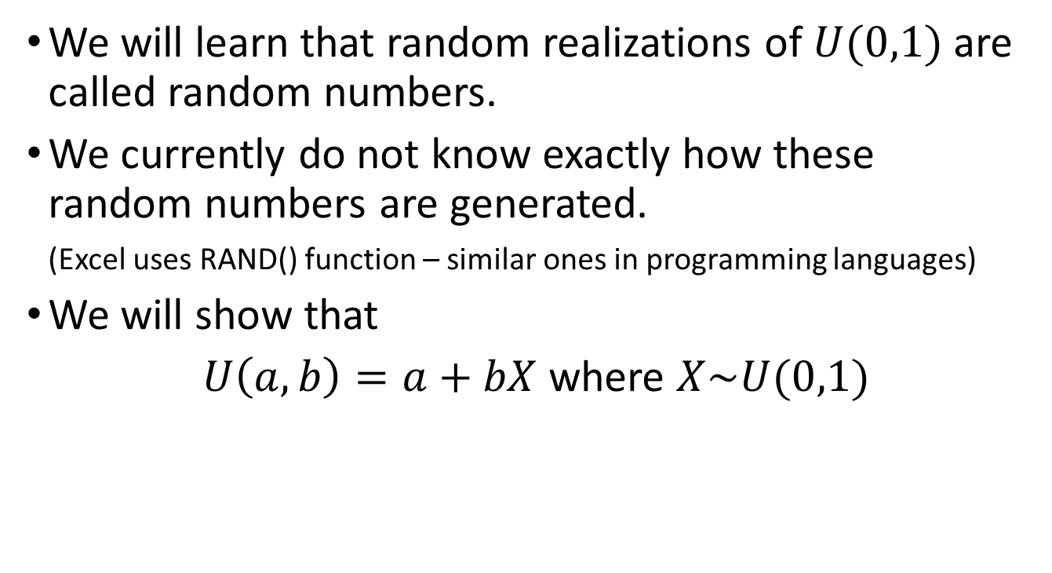
NOTES
We will learn that random realizations of $U(0,1)$ are called random numbers.
We currently do not know exactly how these random numbers are generated.
(Excel uses RAND() function – similar ones in programming languages)
We will show that
$U\left(a,b\right)=a+bX$ where $X\sim U(0,1)$

