Slide 1
IE 324 SIMULATION
Q-Q PLOT EXAMPLE

Slide 2
Example
Does the following sample of 50 observations follow an exponential distribution?
Obs. No. | Value | Obs. No. | Value | Obs. No. | Value | Obs. No. | Value | Obs. No. | Value
1 | 8.616 | 11 | 7.386 | 21 | 18.204 | 31 | 10.144 | 41 | 0.886
2 | 12.474 | 12 | 3.212 | 22 | 29.524 | 32 | 19.620 | 42 | 2.017
3 | 7.845 | 13 | 9.702 | 23 | 8.795 | 33 | 5.022 | 43 | 17.912
4 | 6.208 | 14 | 16.589 | 24 | 12.640 | 34 | 0.050 | 44 | 6.927
5 | 14.872 | 15 | 6.174 | 25 | 15.359 | 35 | 4.219 | 45 | 3.727
6 | 3.429 | 16 | 13.147 | 26 | 13.490 | 36 | 3.192 | 46 | 14.886
7 | 3.652 | 17 | 18.537 | 27 | 5.731 | 37 | 28.195 | 47 | 7.816
8 | 5.895 | 18 | 5.895 | 28 | 1.254 | 38 | 11.711 | 48 | 3.328
9 | 10.247 | 19 | 17.044 | 29 | 0.060 | 39 | 5.908 | 49 | 21.482
10 | 6.059 | 20 | 10.087 | 30 | 67.254 | 40 | 81.117 | 50 | 2.415

Slide 3
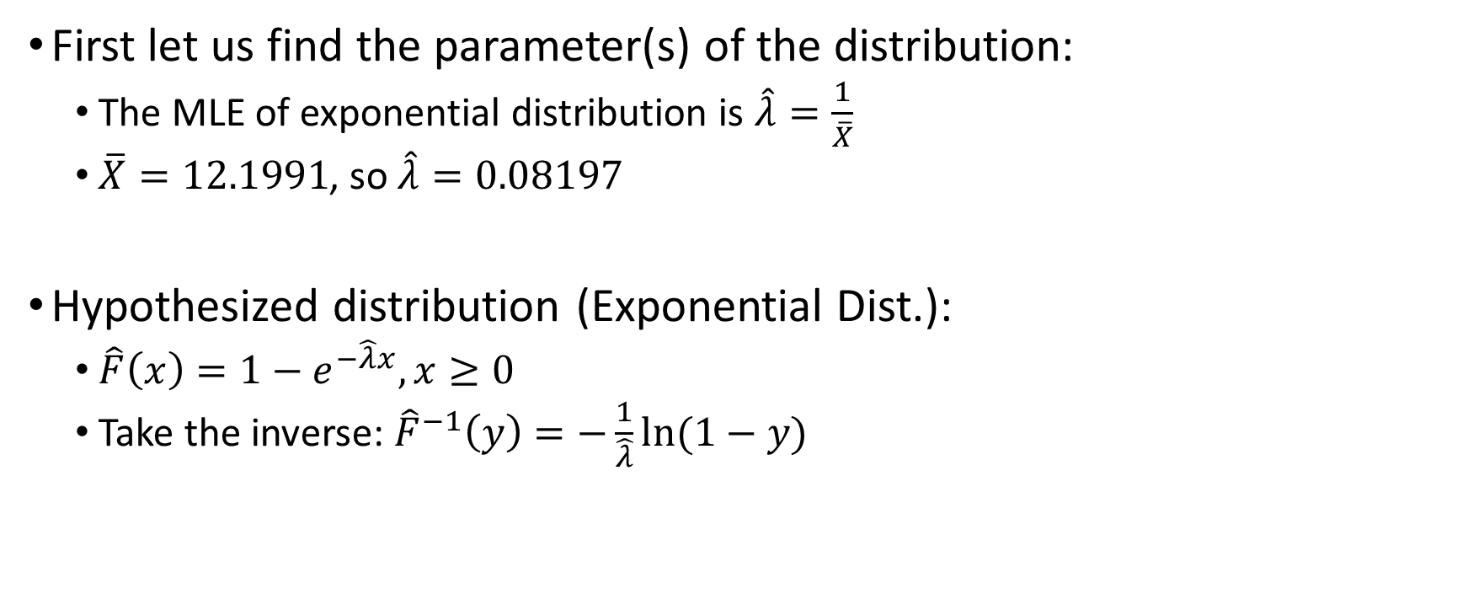
Example
First let us find the parameter(s) of the distribution:
  The MLE of exponential distribution is $\hat{λ}=\frac{1}{\overline{X}}$
  $\overline{X}=12.1991$, so $\hat{λ}=0.08197$
Hypothesized distribution (Exponential Dist.):
  $\hat{F}\left(x\right)=1−e^{−\hat{λ}x}, x≥0$
  Take the inverse: ${\hat{F}}^{−1}\left(y\right)=−\frac{1}{\hat{λ}}ln⁡(1−y)$

Slide 4

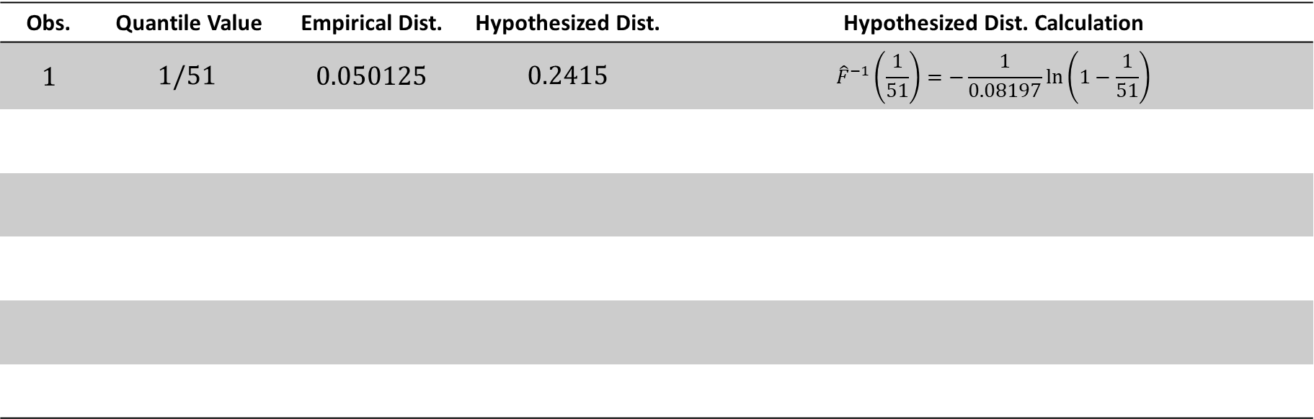

Example
Sort the observations first! (Ordered sample!)
Find the pairs (Hypothesized vs Empirical) per each quantile of empirical dist.
Obs. | Quantile Value | Empirical Dist. | Hypothesized Dist. | Hypothesized Dist. Calculation
1 | $$1/51$$ | 0.050125 | 0.2415 | $${\hat{F}}^{−1}\left(\frac{1}{51}\right)=−\frac{1}{0.08197}\ln\left(1−\frac{1}{51}\right)$$
$$i$$
$$\frac{i−a}{n+1−2a}$$

Slide 5
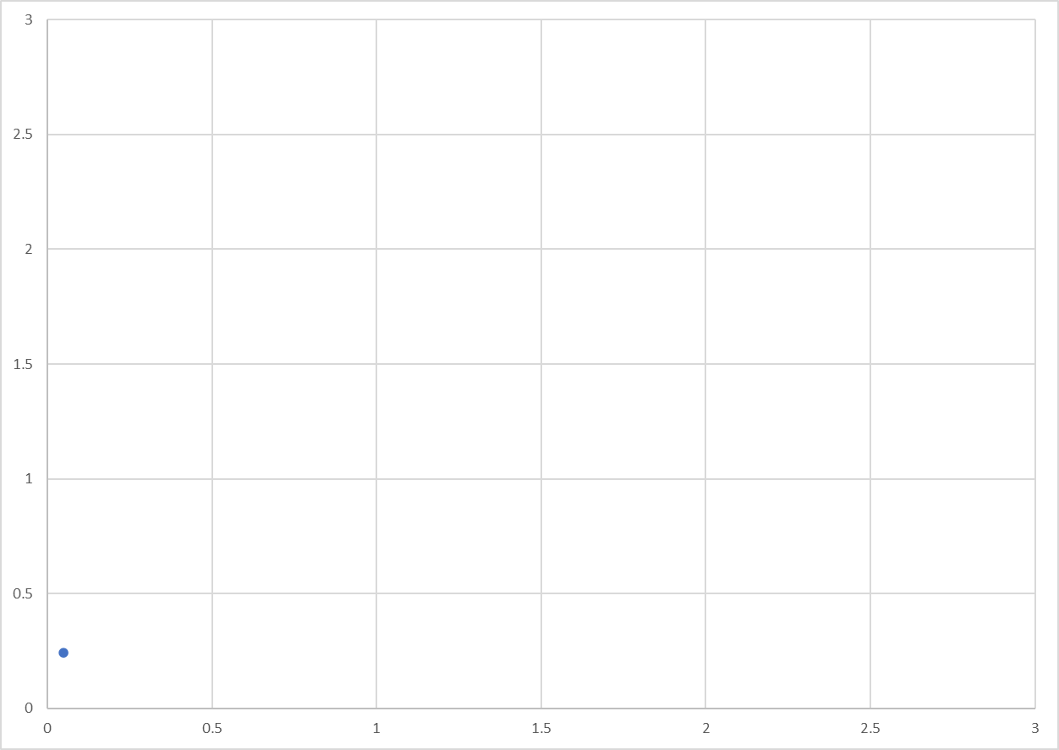


$${\hat{F}}^{−1}\left(y\right)$$
$$F_{n}^{−1}\left(y\right)$$

Slide 6
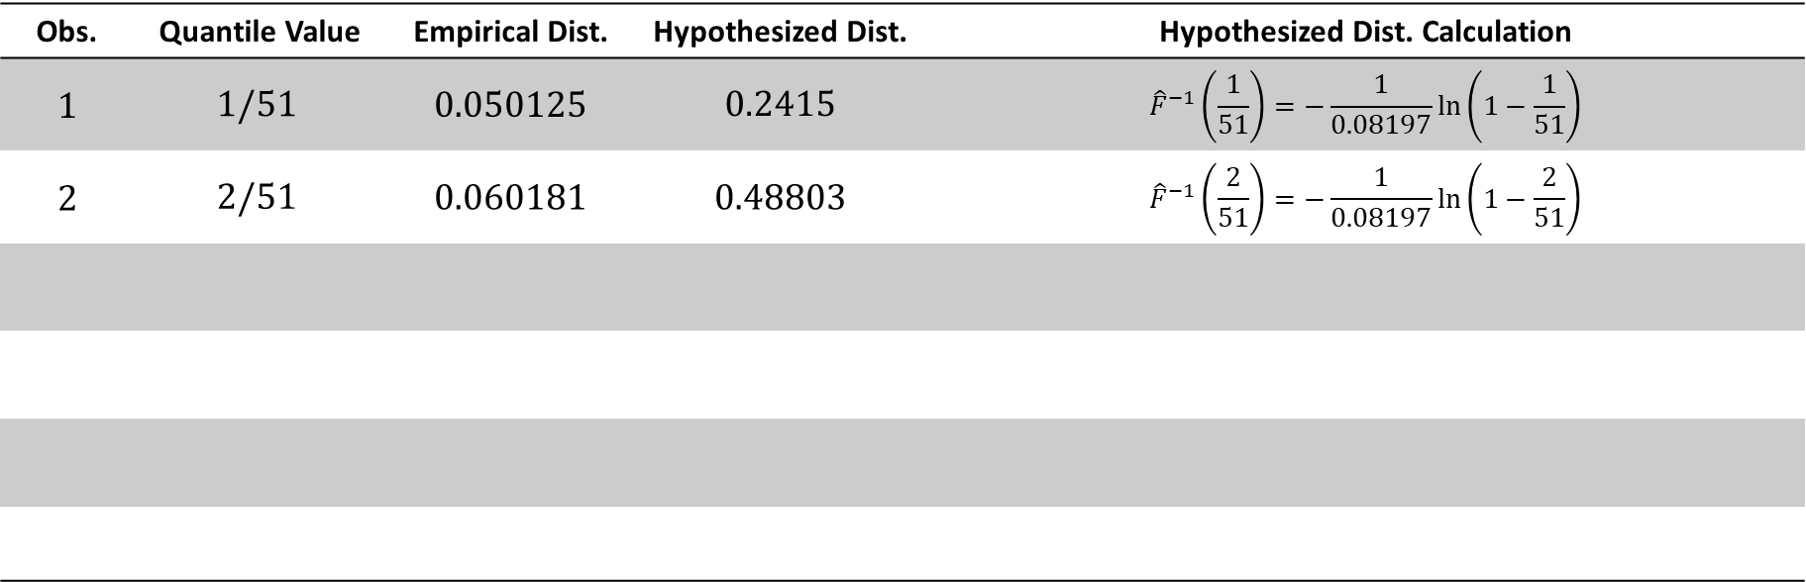
Example
Sort the observations first! (Ordered sample!)
Find the pairs (Hypothesized vs Empirical) per each quantile of empirical dist.
Obs. | Quantile Value | Empirical Dist. | Hypothesized Dist. | Hypothesized Dist. Calculation
1 | $$1/51$$ | 0.050125 | 0.2415 | $${\hat{F}}^{−1}\left(\frac{1}{51}\right)=−\frac{1}{0.08197}\ln\left(1−\frac{1}{51}\right)$$
2 | $$2/51$$ | 0.060181 | 0.48803 | $${\hat{F}}^{−1}\left(\frac{2}{51}\right)=−\frac{1}{0.08197}\ln\left(1−\frac{2}{51}\right)$$

Slide 7
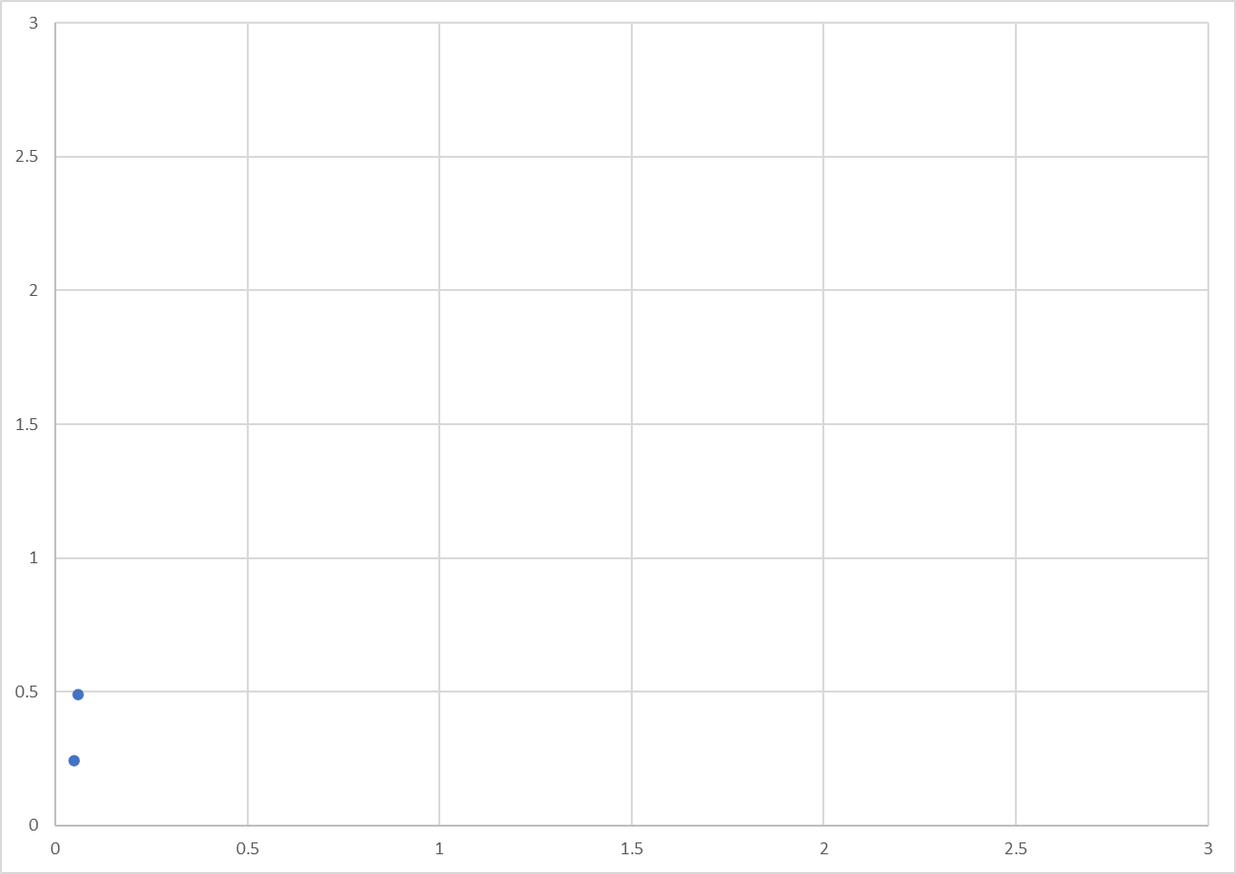
$${\hat{F}}^{−1}\left(y\right)$$
$$F_{n}^{−1}\left(y\right)$$

Slide 8
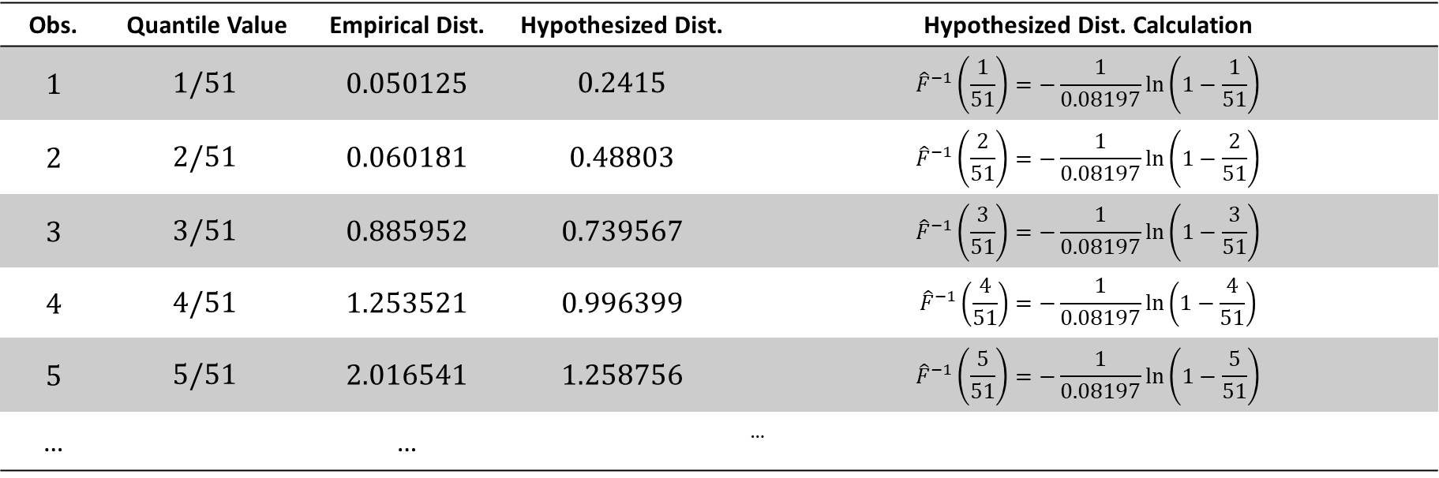
Example
Sort the observations first! (Ordered sample!)
Find the pairs (Hypothesized vs Empirical) per each quantile of empirical dist.
Obs. | Quantile Value | Empirical Dist. | Hypothesized Dist. | Hypothesized Dist. Calculation
1 | $$1/51$$ | 0.050125 | 0.2415 | $${\hat{F}}^{−1}\left(\frac{1}{51}\right)=−\frac{1}{0.08197}\ln\left(1−\frac{1}{51}\right)$$
2 | $$2/51$$ | 0.060181 | 0.48803 | $${\hat{F}}^{−1}\left(\frac{2}{51}\right)=−\frac{1}{0.08197}\ln\left(1−\frac{2}{51}\right)$$
3 | $$3/51$$ | 0.885952 | 0.739567 | $${\hat{F}}^{−1}\left(\frac{3}{51}\right)=−\frac{1}{0.08197}\ln\left(1−\frac{3}{51}\right)$$
4 | $$4/51$$ | 1.253521 | 0.996399 | $${\hat{F}}^{−1}\left(\frac{4}{51}\right)=−\frac{1}{0.08197}\ln\left(1−\frac{4}{51}\right)$$
5 | $$5/51$$ | 2.016541 | 1.258756 | $${\hat{F}}^{−1}\left(\frac{5}{51}\right)=−\frac{1}{0.08197}\ln\left(1−\frac{5}{51}\right)$$
… |  | … |  | …

Slide 9
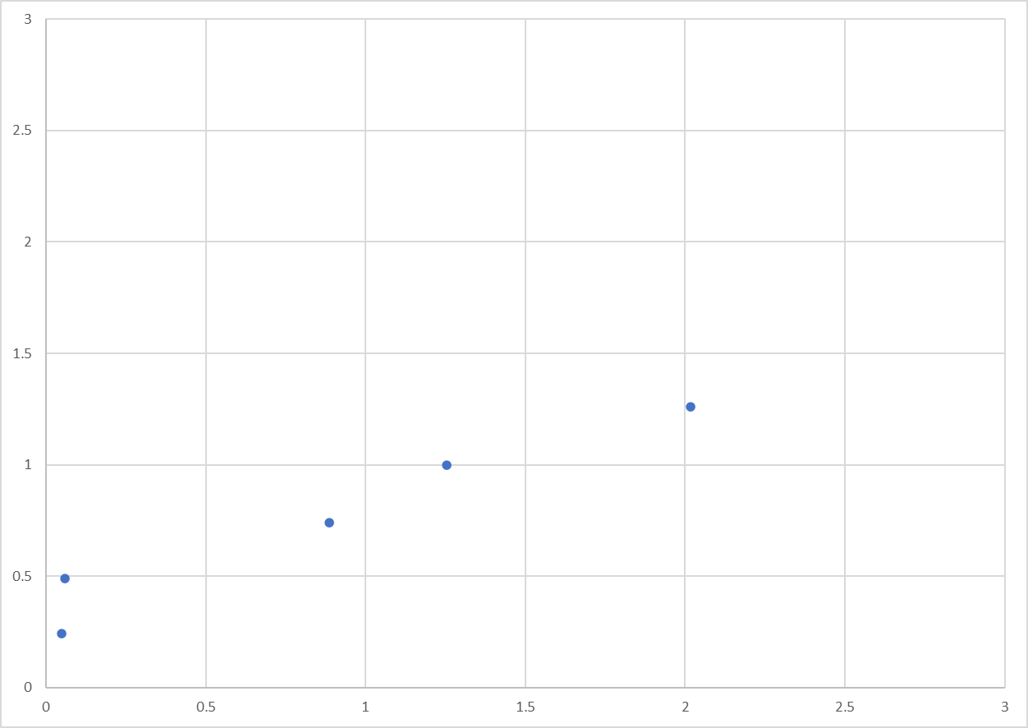
$${\hat{F}}^{−1}\left(y\right)$$
$$F_{n}^{−1}\left(y\right)$$

Slide 10
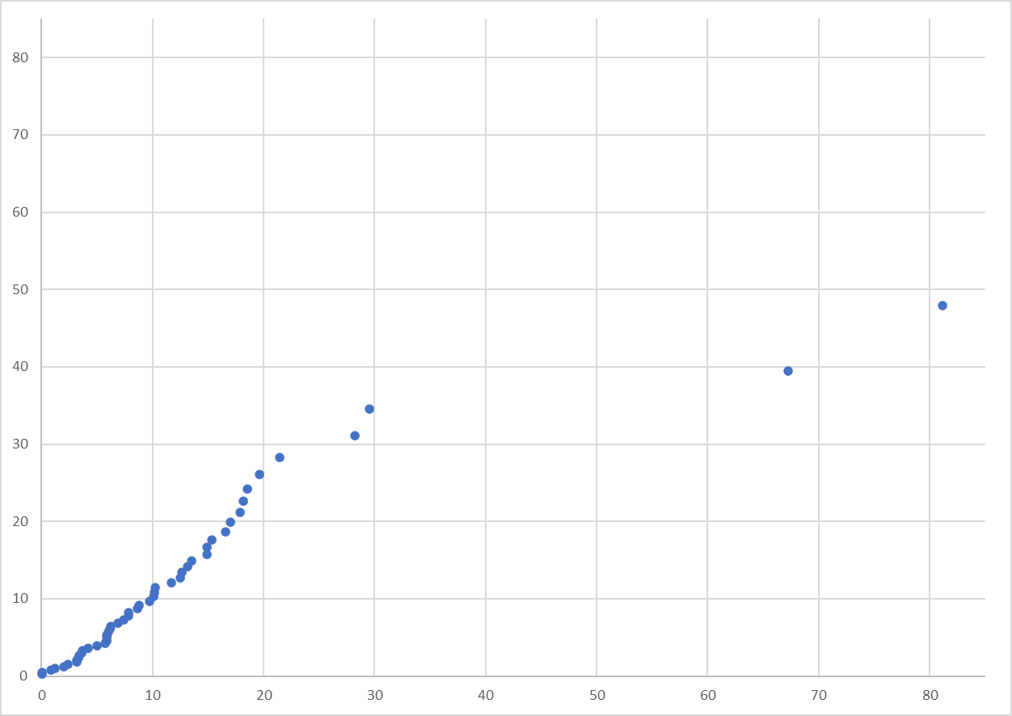
$${\hat{F}}^{−1}\left(y\right)$$
$$F_{n}^{−1}\left(y\right)$$

Slide 11
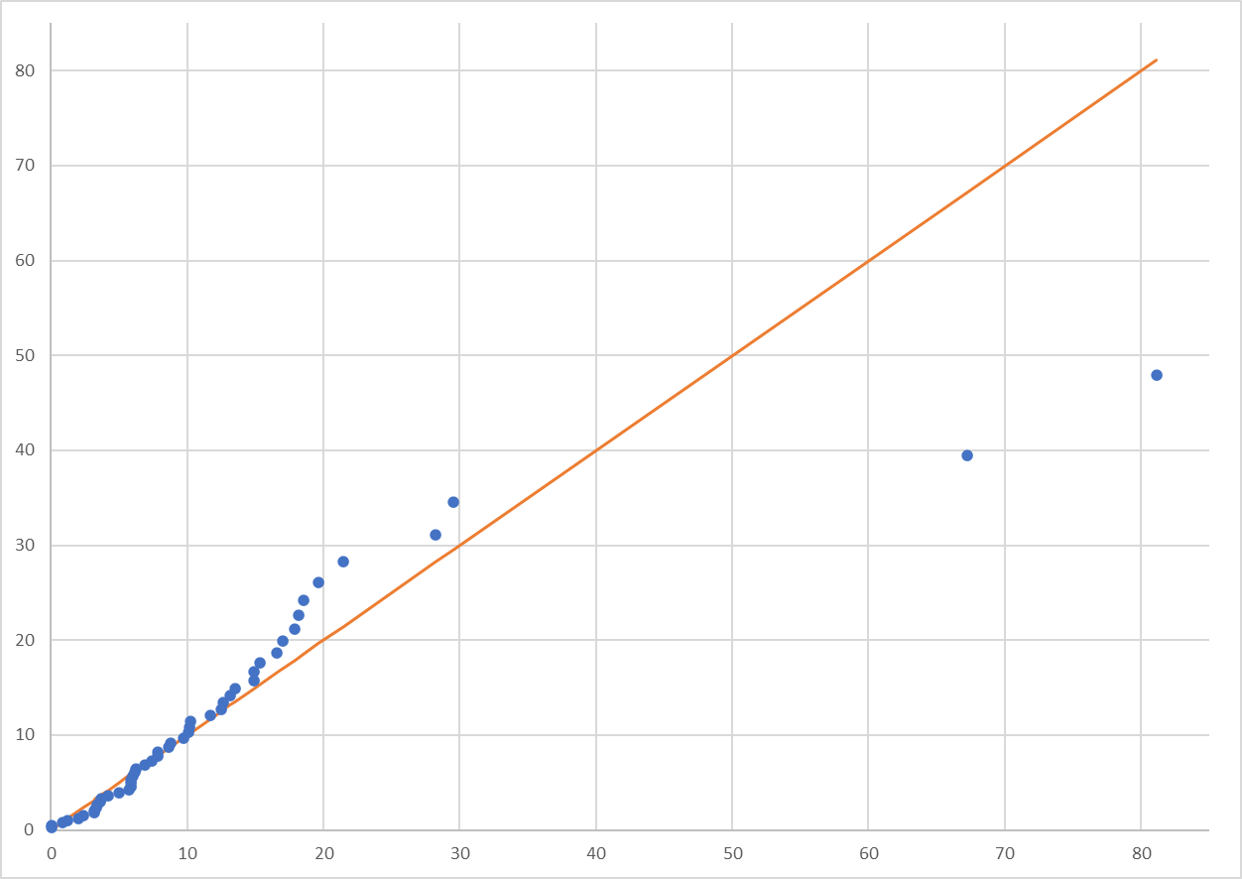
$${\hat{F}}^{−1}\left(y\right)$$
$$F_{n}^{−1}\left(y\right)$$

