Slide 1
IE 324 SIMULATION
ARENA
DETAILED MODELING

Slide 2
PART I
What if there were only 26 trunk lines available?

Slide 3
PART II
What if the new calls would be dropped if all 26 trunk lines were busy?
  We also need to record the number of attempted, dropped and completed calls.

Slide 4
PART III
What if we would like to differentiate between different calls in the reports?

Slide 5
PART IV
What if the order status calls requiring to speak with a Sales Representative gets a lower priority than the Sales Calls?

Slide 6
PART V
What if we would like to run this model for a workday (8 AM to 6 PM) where calls received before 6 PM are completed even if this happens after 6PM?
  No calls after 6 PM but the model should continue to run. (Assume that operating until 7 PM will clear out all held calls.
  The system runs until the last call is completed. (Disregard the assumption of operating exactly until 7 PM)

Slide 7
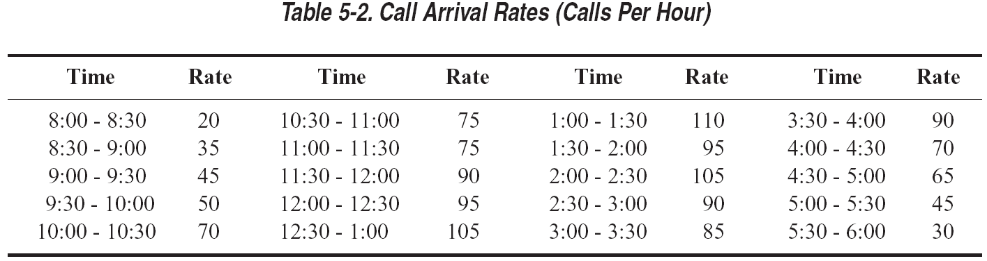
PART VI
What if we had varying arrival rates throughout the day?
  The calls happen with a Nonstationary Poisson Process.
  Rates are given in number of calls/hour, but valid for ½ hour.

Slide 8
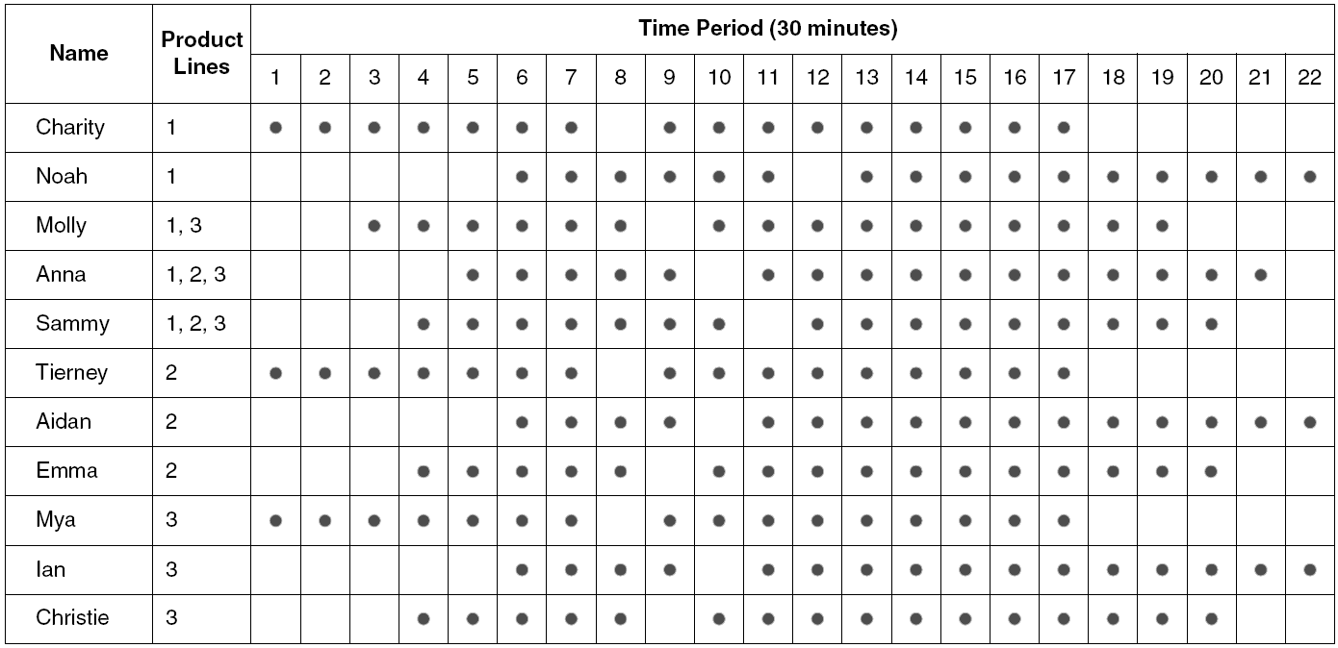
PART VII
What if we could differentiate between the capabilities of each Tech Support Representative?

Slide 9
PART VII
Set selection rules
  Cyclical: 1-2-3-1-2-3
  Random
  Preferred Order 1-2-3
  Specific Member
  Largest Remaining Capacity
  Smallest Number Busy

Slide 10
PART VIII
What if we had varying number of sales and tech support representatives throughout the day?

Slide 11
PART IX
What if 4% of the tech calls require further investigation after the customer hangs up?
  The investigation takes EXPO(60) minutes.
  The tech support representative that answered the original call calls the customer back and this call takes TRIA(2,4,9) minutes. (This call has a higher priority than the incoming calls)
  The return call also requires one trunk line (again with a higher priority)

Slide 12
PART X
What if we would like to obtain the number of rejected calls per each hour of operation?

Slide 13
PART XI
What if we plan to hire new sales employees who will work from 12 PM (noon) to 4 PM?
  We would like to make this amount flexible as later we may want to find the optimal number of these newly hired sales employees.

Slide 14
PART XII
What if we would like to learn the total amount of excess waiting time for sales calls?
  Any wait above 1 minute is considered as excess.

Slide 15
PART XIII
Consider the following cost structure:
  Sales Reps: $20/hour (New Hires: $17/hr)
  Tech Support Reps: $18/hour
  Excess Wait Cost: 81.8 cents/minute ($49.08/hour)
  Cost of Trunk Lines: $20/line day.
What is the cost of operating this call center per day?

