Slide 1
Meaning and Measure of Inflation
Lecture No. 35
Chapter 11
Contemporary Engineering Economics
Copyright © 2010

Slide 2
What is Inflation?
Definition: Inflation is the rate at which the general level of prices and goods and services is rising, and subsequently, purchasing power is falling.
  Earning Power
  Purchasing Power
Earning Power
  Investment Opportunity
Purchasing Power
  Decrease in purchasing power (inflation)
  Increase in purchasing power (deflation)
Time Value of Money

Slide 3
Inflation - Decrease in Purchasing Power
$100
$100
1990
1990 2010
You could buy 50 Big Macs in year 1990 with $100
You can only buy 28.5 Big Macs in year 2010.
75%
$2.00 / unit
$3.50 / unit
Price change due to inflation
The $100 in year 2010 has only $57
worth purchasing power of 1990

Slide 4
Deflation - Increase in Purchasing Power
$100
$100
2004 2005 2006 2010
2004 2005 2006 2010
You could purchase 63.69 gallons of purified drink water a year ago.
You can now purchase 80 gallons of purified
drink water.
20.38%
$1.57 / gallon
$1.25 / gallon
Price change due to deflation

Slide 5
Inflation Terminology - I
Producer Price Index: a statistical measure of industrial price change, compiled monthly by the Bureau of Labor Statistics, U.S. Department of Labor
Consumer Price Index: a statistical measure of change, over time, of the prices of goods and services in major expenditure groups—such as food, housing, apparel, transportation, and medical care—typically purchased by urban consumers
Average Inflation Rate (f): a single average rate that accounts for the effect of varying yearly inflation rates over a period of several years.
General Inflation Rate (f ): the average inflation rate calculated based on the CPI for all items in the market basket.

Slide 6
Consumer Price Index
Consumer Price Index (CPI): the CPI compares the cost of a sample “market basket” of
goods and services in a specific period relative to
the cost of the same “market basket” in an earlier reference period. This reference period is designated as the base period.
CPI (Old measure) – Base Period = 1967
  1967 100
  2010 649.10 (January)
CPI (New measure) – Base Period (1982-84)
  1982-84 100
  2010 216.68 (January)

Slide 7
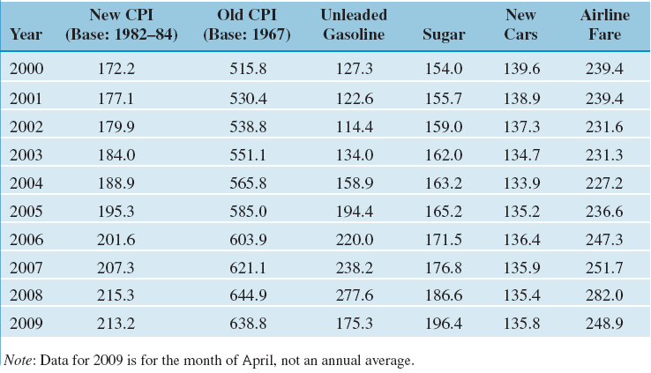
Selected Price Indexes (Index for Base Year = 100, Calendar Month = April)

Slide 8
Average Inflation Rate (f )
Fact:
  Base Price = $100 (year 0)
  Inflation rate (year 1) = 4%
  Inflation rate (year 2) = 8%
Find: Average inflation rate over 2 years?
Step 1: Find the actual inflated price at the end of year 2.
$100 ( 1 + 0.04) ( 1 + 0.08) = $112.32
Step 2: Find the average inflation rate by solving the following equivalence equation.
$100 ( 1+ f)² = $112.32
f = 5.98%
$112.32
0 1
2
$100

Slide 9
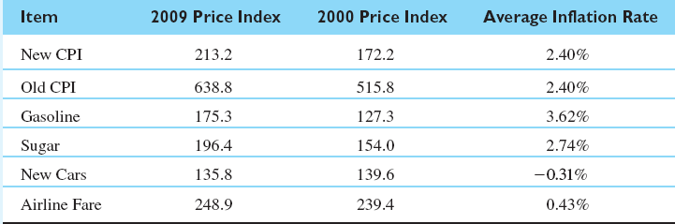
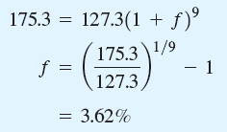
Example 11.1 Average Inflation Rate
Sample Calculation for Average Inflation rate for Gasoline:
Given: P = 127.3, F = 175.3, N = 2009-2000 = 9.
Find: f
Average Inflation Rate

Slide 10
General Inflation Rate (f)
Formula:
Calculation:
Given:
  CPI for 2009 = 213.2,
  CPI for 2000 = 172.2
Find: f

Slide 11
Example 11.2 Yearly and Average Inflation Rates
Year cost data:
Find: Yearly and Average inflation rates
Solution:
Year | Cost
0 | $504,000
1 | 538,000
2 | 577,000
3 | 629,500

Slide 12
Inflation Terminology – II
Actual Dollars (A_{n} ): Estimates of future cash flows for year n that take into account any anticipated future changes in amount caused by inflationary or deflationary effects.
Constant Dollars (A_{n}’ ): Estimates of future cash flows for year n in constant purchasing power, independent of the passage of time (or base period).

Slide 13
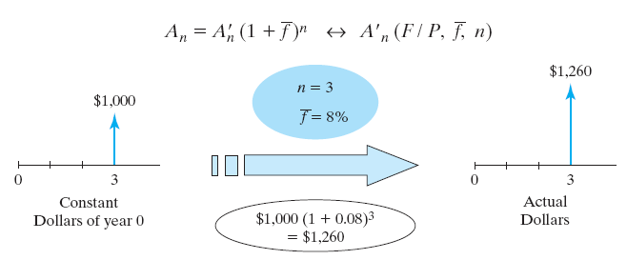
Finding Actual Dollars
Conversion from Constant to Actual Dollars
Example: General inflation rate = 5%

Slide 14
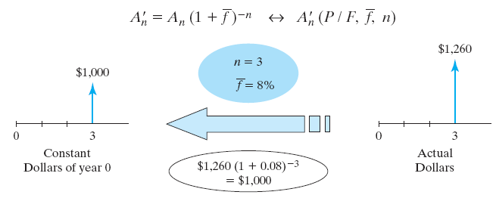
Finding Constant Dollars
Conversion from Actual to Constant dollars
Example 11.4 - General inflation rate of 5%

