Slide 1
Equivalence Calculation under Inflation
Lecture No. 36
Chapter 11
Contemporary Engineering Economics
Copyright © 2010

Slide 2
Equivalence Calculations under Inflation
Types of Interest Rate
Market Interest Rate (i)
Inflation-free Interest Rate (i’)
Types of Cash Flows
Estimated in Constant Dollars
Estimated in Actual Dollars
Types of Analysis Method
Constant-Dollar Analysis
Actual-Dollar Analysis

Slide 3
Inflation Terminology - III
Inflation-free interest rate (i’): an estimate of the true earning power of money when the inflation effects have been removed (also known as real interest rate).
Market interest rate (i): an interest rate which takes into account the combined effects of the earning value of capital and any anticipated changes in purchasing power (also known as inflation-adjusted interest rate).

Slide 4
Inflation and Cash Flow Analysis
Constant Dollar analysis
  Estimate all future cash flows in constant dollars.
  Use i’ as an interest rate to find the equivalent worth.
Actual Dollar Analysis
  Estimate all future cash flows in actual dollars.
  Use i as an interest rate to find the equivalent worth.

Slide 5
When do we Prefer Constant Dollar Analysis?
In the absence of inflation, all economic analyses up to this point is, in fact, the constant dollar analysis.
Constant dollar analysis is common in the evaluation of many long-term public projects, because governments do not pay income taxes.
For private sector, income taxes are levied based on the taxable income in actual dollars, so the actual dollar analysis is more common.

Slide 6
Two Alternate Ways in Conducting Actual Dollars Analysis
Method 1: Deflation Method
- Step 1: Bring all cash flows to have common purchasing power.
- Step 2: Consider the earning power.
Method 2: Adjusted-discount Method
- Combine Steps 1 and 2 into one step.

Slide 7
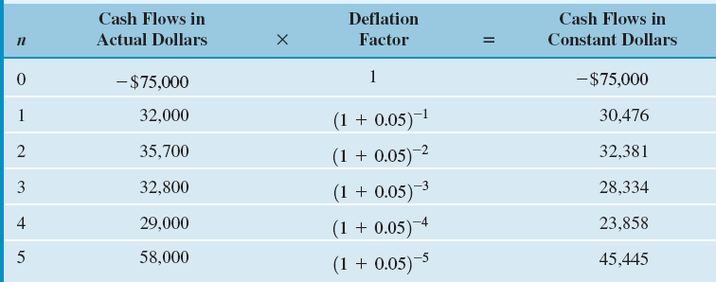
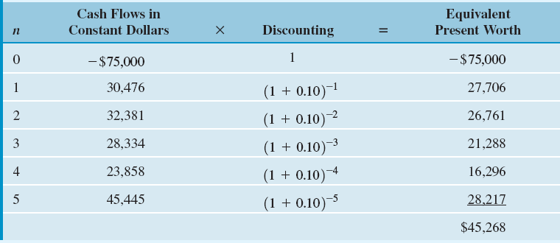
Example 11.6 – Deflation Method
Step 1: Converting Actual Dollars into Constant Dollars
Step 2: Calculating Equivalent Present Worth

Slide 8
Graphical Overview on Deflation Method (Example 11.6): Converting actual dollars to constant dollars and then to equivalent present worth
n = 0
n = 1
n = 2
n = 3
n = 4
n = 5
Actual
Dollars
-$75,000 $32,000 $35,700 $32,800 $29,000 $58,000
Constant
Dollars
-$75,000
$30,476
$32,381
$28,334
$23,858
$45,455
Present
Worth
$28,218
-$75,000
$26,761
$21,288
$16,295
$27,706
$45,268

Slide 9
Adjusted-Discount Method – Perform Deflation and Discounting in One Step
Discrete Compounding
Step 1
Step 2
Continuous Compounding

Slide 10
Example 11.7 Adjusted-Discounted Method
Given: inflation-free interest rate = 0.10, general inflation rate = 5%, and cash flows in actual dollars
Find: i and NPW

Slide 11
Graphical Overview on Adjusted Discount Method:
Converting actual dollars to present worth dollars by applying the market interest rate
n = 0
n = 1
n = 2
n = 3
n = 4
n = 5
Actual
Dollars
-$75,000 $32,000 $35,700 $32,800 $29,000 $58,000
Present
Worth
$28,218
-$75,000
$26,761
$21,288
$16,295
$27,706
$45,268

Slide 12
Mixed-Dollar Analysis – College Savings Plan - Equivalence Calculation with Composite Cash Flow Elements
Approach: Convert any cash flow elements in constant dollars into actual dollars. Then use the market interest rate to find the equivalent present value. Assume f = 6% and i = 8% compounded quarterly.
Age (Current Age = 5 Years Old) | Estimated College Expenses in Today’s Dollars | College Expenses Converted into Equivalent Actual Dollars
18 (Freshman) | $30,000 | $30,000(F/P,6%,13) = $63,988
19 (Sophomore) | 30,000 | 30,000(F/P,6%,14) = 67,827
20 (Junior) | 30,000 | 30,000(F/P,6%,15) = 71,897
21 (senior) | 30,000 | 30,000(F/P,6%,16) = 76,211

Slide 13
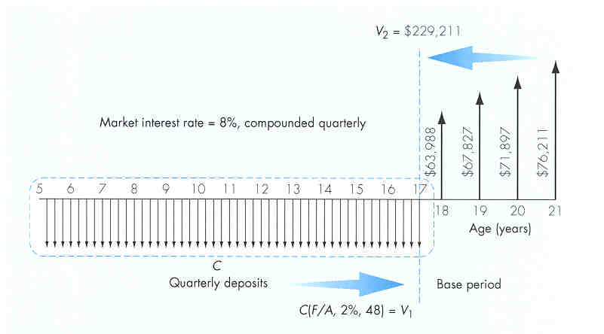
Solution: Required Quarterly Contributions to College Funds
V₁ = C(F/A, 2%, 48)
V₂ = $229,211
Let V₁ = V₂ and solve
for C:
C = $2,888.48

