Slide 1
Effects of Inflation on Project Cash Flows
Lecture No. 37
Chapter 11
Contemporary Engineering Economics
Copyright © 2010

Slide 2
Effects of Inflation on Projects with Depreciable Assets
Item | Effects of Inflation
Depreciation expense Salvage value | Depreciation expense is charged to taxable income in dollars of declining values; taxable income is overstated, resulting in higher taxes Inflated salvage value combined with book values based on historical costs results in higher taxable gains.
Note: Depreciation expenses are based on historical costs and
always expressed in actual dollars

Slide 3
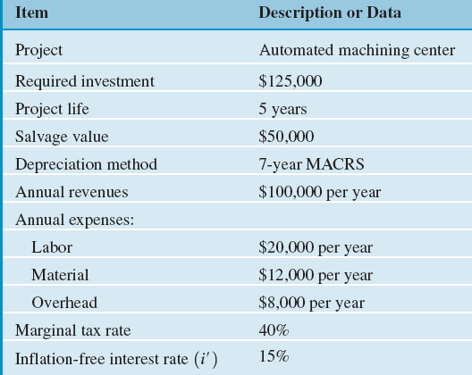
Example 11.8
Reconsider the Automated Machining Center project discussed earlier. What will happen to this investment project if
  the general inflation during the next five years is expected to increase by 5% annually,
  sales, operating costs, and working capital requirements are assumed to increase accordingly,
  depreciation will remain unchanged, but taxes, profits, and thus cash flow will be higher.
  the firm’s inflation-free interest rate is known to be 15%.
Determine the PW of the project.

Slide 4
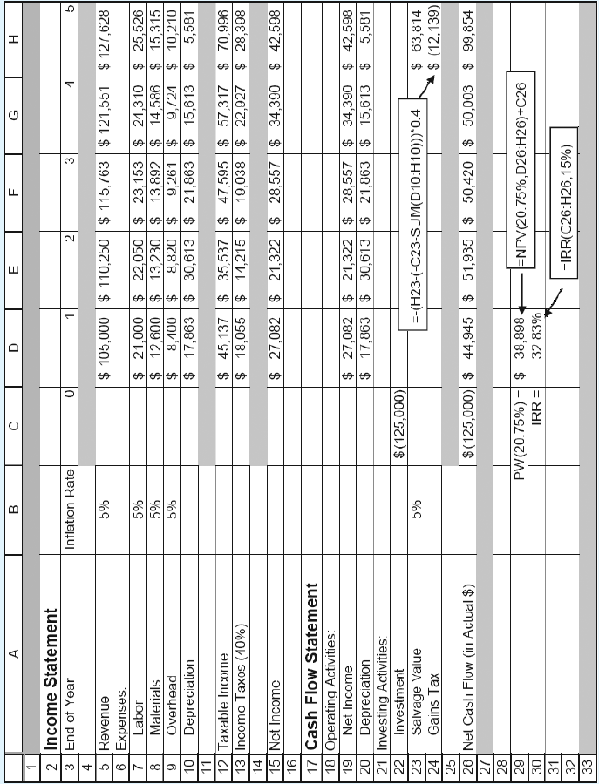
Solution: Excel Worksheet

Slide 5
Effects of Borrowed Funds under Inflation
Item | Effects of Inflation
Loan repayments | Borrowers repay historical loan amounts with dollars of decreased purchasing power, reducing the debt-financing cost.

Slide 6
Example 11.10 Effects of Inflation on Payments with Financing
Given: borrowing rate = 15.5%, general inflation rate = 5%, and inflation-free interest rate = 15%, amount of borrowing = $62,500 over 5 years
Find: NPW
  Market interest rate = 0.15 + 0.05 + 0.0075 = 20.75%
  NPW w/o borrowing = $38,898
  NPW w borrowing = $54,159
  The gain in NPW due to debt financing = $15,261

Slide 7
Effects of Inflation on Return on Investment
Item | Effects of Inflation
Rate of Return and NPW | Unless revenues are sufficiently increased to keep pace with inflation, tax effects and/or a working capital drain result in lower rate of return or lower NPW.

Slide 8
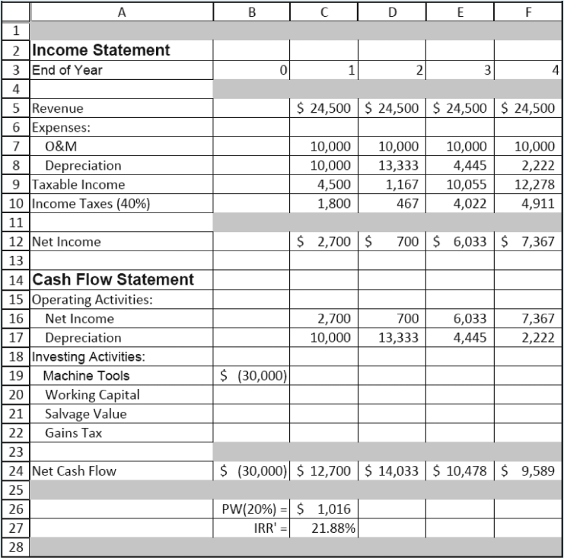
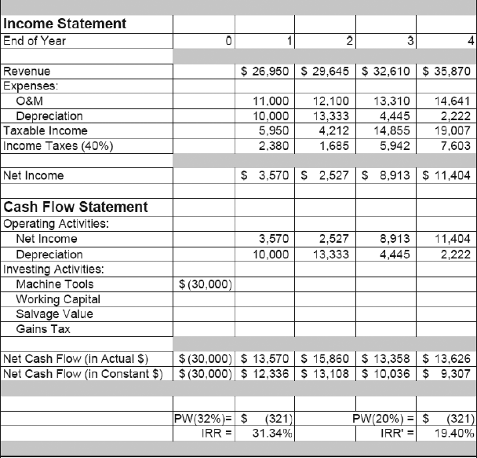
Example 11.11 IRR Analysis with Inflation
IRR in the absence of inflation
IRR Calculation under Inflation

Slide 9
Rate of Return Analysis under Inflation
Principle: True (real) rate of return should be based on constant dollars.
If the rate of return is computed based on cash flows in actual dollars, the real rate of return can be calculated as:
n | Net cash flows in actual dollars | Net cash flows in constant dollars
0 1 2 3 4 | -$30,000 13,570 15,860 13,358 13,626 | -$30,000 12,336 13,108 10,036 9,307
IRR 31.34% 19.40%

Slide 10
Decision Criterion
If you use 31.34% as your IRR, you should use a market interest rate (or inflation-adjusted MARR) to make an accept and reject decision.
If you use 19.40% as your IRR, you should use an inflation-free interest rate (inflation-free MARR) to make an accept and reject decision. In our example, MARR’ = 20%.

Slide 11
Effects of Inflation on Working Capital
Item | Effects of Inflation
Working capital requirement | Known as working capital drain, the cost of working capital increases in an inflationary environment.

Slide 12
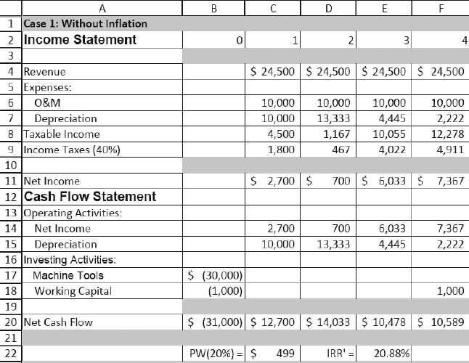
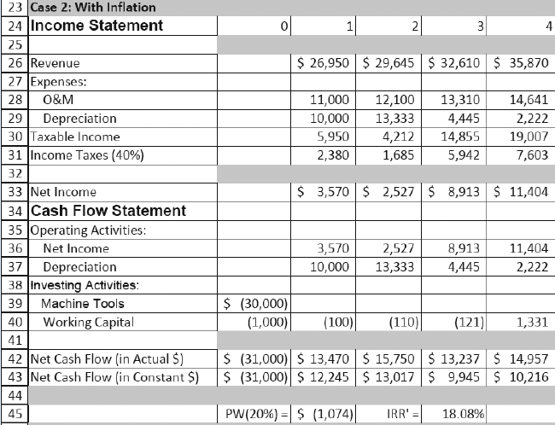
Example 11.12 Effects of Inflation on Working Capital

Slide 13
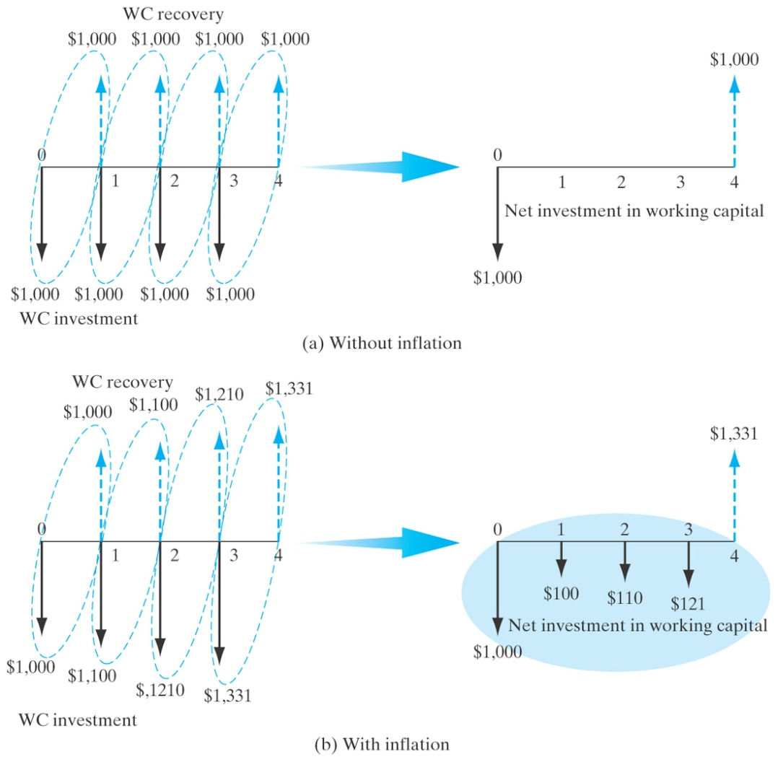
Working Capital Requirements under Inflation

Slide 14
Summary
The Consumer Price Index (CPI) is a statistical measure of change, over time, of the prices of goods and services in major expenditure groups—such as food, housing, apparel, transportation, and medical care—typically purchased by urban consumers.
Inflation is the term used to describe a decline in purchasing power evidenced in an economic environment of rising prices.
Deflation is the opposite: An increase in purchasing power evidenced by falling prices.

Slide 15
The general inflation rate (f) is an average inflation rate based on the CPI. An annual general inflation rate ( ) can be calculated using the following equation:
Specific, individual commodities do not always reflect the general inflation rate in their price changes. We can calculate an average inflation rate for a specific commodity (j) if we have an index (that is, a record of historical costs) for that commodity.

Slide 16
Project cash flows may be stated in one of two forms
  Actual dollars (A_{n}): Dollars that reflect the inflation or deflation in the economy.
  Constant dollars (A’_{n}): Dollars in Year 0 purchasing dollars.
Interest rates for project evaluation may be stated in one of two forms:
  Market interest rate (i): A rate which combines the effects of interest and inflation; used with actual dollar analysis.
  Inflation-free interest rate (i’): A rate from which the effects of inflation have been removed; this rate is used with constant dollar analysis.

Slide 17
To calculate the present worth of cash flows in actual dollars, we can use a two-step or a one-step process:
  Deflation method—two steps:
  1. Convert cash flows in actual dollars by deflating with the general inflation rate of
  2. Calculate the PW of cash flows in constant dollars by discounting at i’
  Adjusted-discount method—one step
  1. Compute the market interest rate.
  2. Use the market interest rate directly to find the present value of cash flows in actual dollars.

