Slide 1
Methods of Describing Project Risk
Lecture No. 38
Chapter 12
Contemporary Engineering Economics
Copyright © 2010

Slide 2
Methods of Describing Project Risk
Sensitivity Analysis: a procedure of identifying the project variables which, when varied, have the greatest effect on project acceptability.
Break-Even Analysis: a procedure of identifying the value of a particular project variable that causes the project to exactly break even.
Scenario Analysis: a procedure of comparing a “base case” to one or more additional scenarios, such as best and worst cases, to identify the extreme and most likely project outcomes.

Slide 3
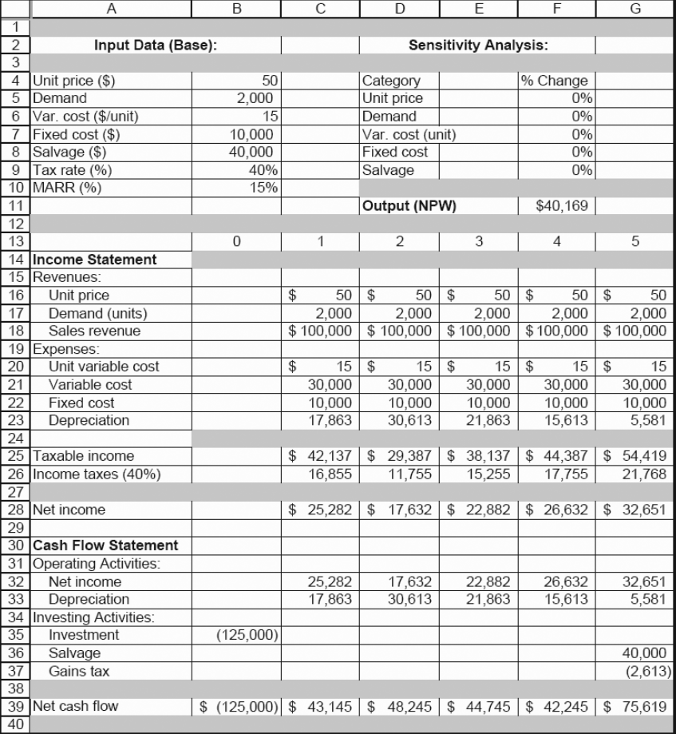
Example 12.1 Transmission-Housing Project by Boston Metal Company
Financial Facts:
  Known with Great Confidence
    Required investment = $125,000
    Project Life = 5 years
    Income tax rate = 40%
    MARR = 15%
  Unknown but Predictable (Most Likely Values)
    Unit variable cost = $15 per unit
    Number of units = 2,000 units
    Unit Price = $50 per unit
    Salvage value = $40,000
    Fixed cost = $10,000/Yr
Required: Determine the acceptability of the investment

Slide 4
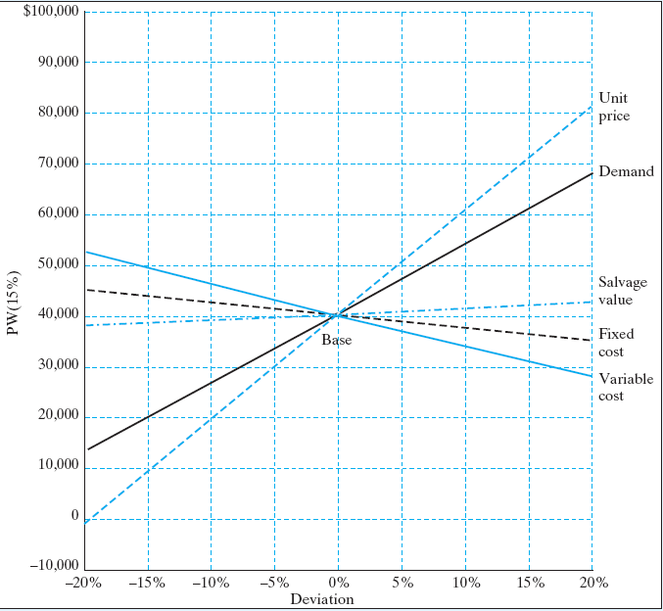
Sensitivity Analysis for Five Key Input Variables
Deviation | -20% | -15% | -10% | -5% | 0% | 5% | 10% | 15% | 20%
Unit price | $57 | $9,999 | $20,055 | $30,111 | $40,169 | $50,225 | $60,281 | $70,337 | $80,393
Demand | 12,010 | 19,049 | 26,088 | 33,130 | 40,169 | 47,208 | 54,247 | 61,286 | 68,325
Variable cost | 52,236 | 49,219 | 46,202 | 43,186 | 40,169 | 37,152 | 34,135 | 31,118 | 28,101
Fixed cost | 44,191 | 43,185 | 42,179 | 41,175 | 40,169 | 39,163 | 38,157 | 37,151 | 36,145
Salvage value | 37,782 | 38,378 | 38,974 | 39,573 | 40,169 | 40,765 | 41,361 | 41,957 | 42,553
Variable most sensitive to NPW – Unit price
Variable least sensitive to NPW – Salvage value

Slide 5
Break-Even Analysis
Breakeven analysis is a tool used to determine when a business will be able to cover all its expenses and begin to make a profit from a project.
Excel using a Goal Seek function
Analytical Approach

Slide 6
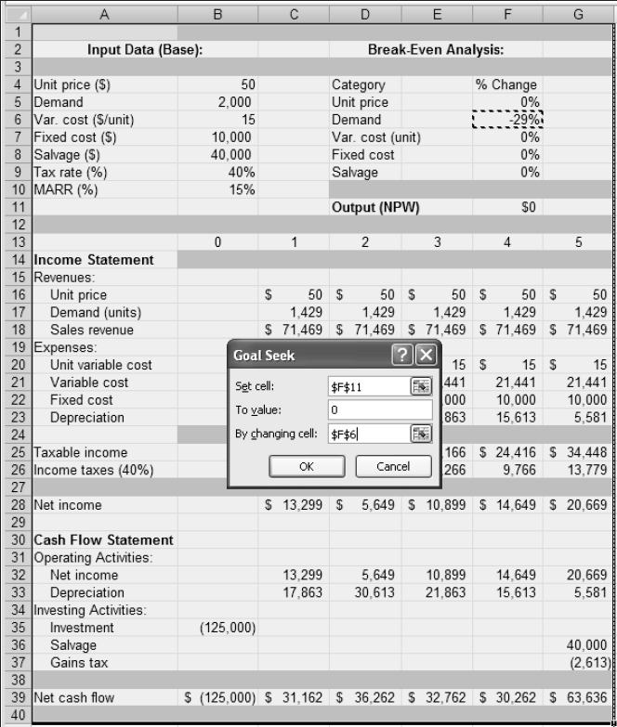
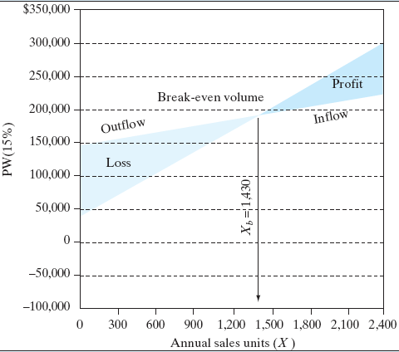
Using a Goal Seek Function in Excel
PW of Inflow: 100.5650X + $44,490
PW of Outflow: 30.1694X + $145,113
NPW = 70.3956X - $100,623

Slide 7
Analytical Approach
● The NPW:
PW (15%) = 100.5650X + $44,490 - (30.1694X + $145,113)
=70.3956X - $100,623.
● Breakeven volume:
PW (15%)= 70.3956X - $100,623 = 0
X_{b} =1,430 units.
● PW of cash inflows
PW(15%)_{Inflow}= (PW of after-tax net revenue)
+ (PW of net salvage value)
+ (PW of tax savings from depreciation
= 30X(P/A, 15%, 5) + $37,389(P/F, 15%, 5)
+ $7,145(P/F, 15%,1) + $12,245(P/F, 15%, 2)
+ $8,745(P/F, 15%, 3) + $6,245(P/F, 15%, 4)
+ $2,230(P/F, 15%,5)
= 30X(P/A, 15%, 5) + $44,490
= 100.5650X + $44,490
● PW of cash outflows:
PW(15%)_{Outflow} = (PW of capital expenditure
+ (PW) of after-tax expenses
= $125,000 + (9X+$6,000)(P/A, 15%, 5)
= 30.1694X + $145,113

Slide 8
Scenario Analysis
Scenario analysis is a process of analyzing possible future outcomes by considering alternative possible events (scenarios). The analysis is designed to allow improved decision-making by allowing more complete consideration of outcomes and their implications.
Source: Wikipedia

Slide 9
Example 12.3 Scenario Analysis

