Slide 1
Probabilistic Cash Flow Analysis
Lecture No. 39
Chapter 12
Contemporary Engineering Economics
Copyright, © 2010

Slide 2
Probability Concepts for Investment Decisions
Random variable: variable that can have more than one possible value
Discrete random variables: random variables that take on only isolated (countable) values
Continuous random variables: random variables that can have any value in a certain interval
Probability distribution: the assessment of probability for each random event

Slide 3
Types of Probability Distribution
Continuous Probability Distribution
  Triangular distribution
  Uniform distribution
  Normal distribution
Discrete Probability Distribution
Cumulative Probability Distribution
  Discrete
  Continuous
∫ f(x)dx

Slide 4
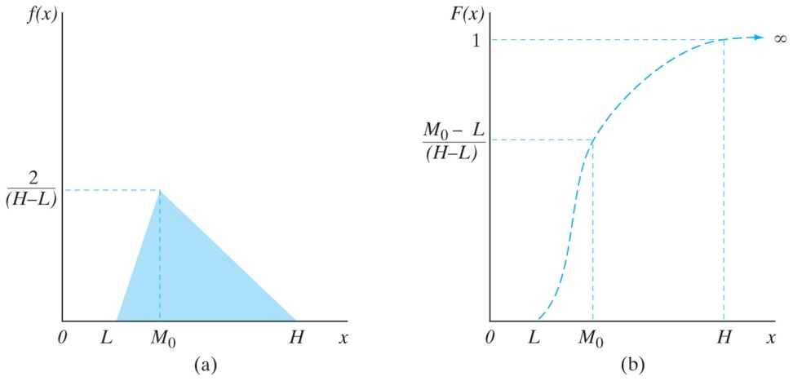
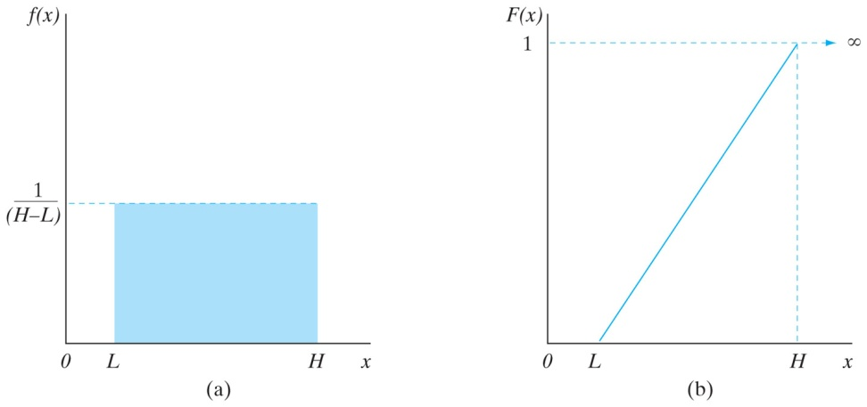
Useful Continuous Probability Distributions in Cash Flow Analysis
(a) Triangular Distribution
(b) Uniform Distribution
L: minimum value
M_{o}: mode (most-likely)
H: maximum value
Notes:
Figure: 12-03

Slide 5
Discrete Distribution -Probability Distributions for Unit Demand (X) and Unit Price (Y) for BMC’s Project
Product Demand (X) |  | Unit Sale Price (Y)
Units (x) | P(X = x) | Unit price (y) | P(Y = y)
1,600 | 0.20 | $48 | 0.30
2,000 | 0.60 | 50 | 0.50
2,400 | 0.20 | 53 | 0.20

Slide 6
Cumulative Probability Distribution for X
Unit Demand (x) | Probability P(X = x)
1,600 | 0.2
2,000 | 0.6
2,400 | 0.2

Slide 7
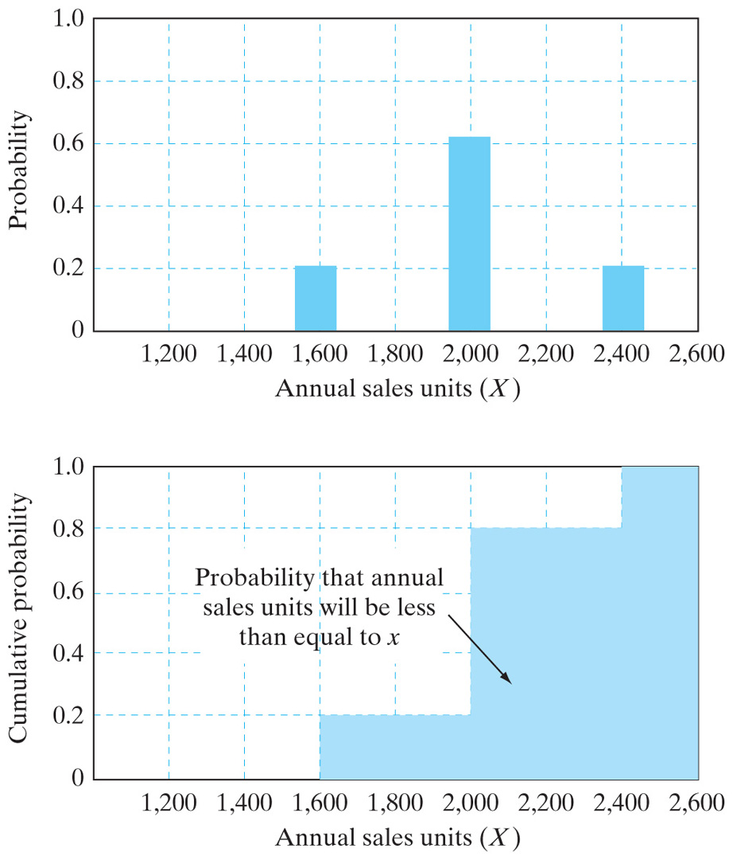
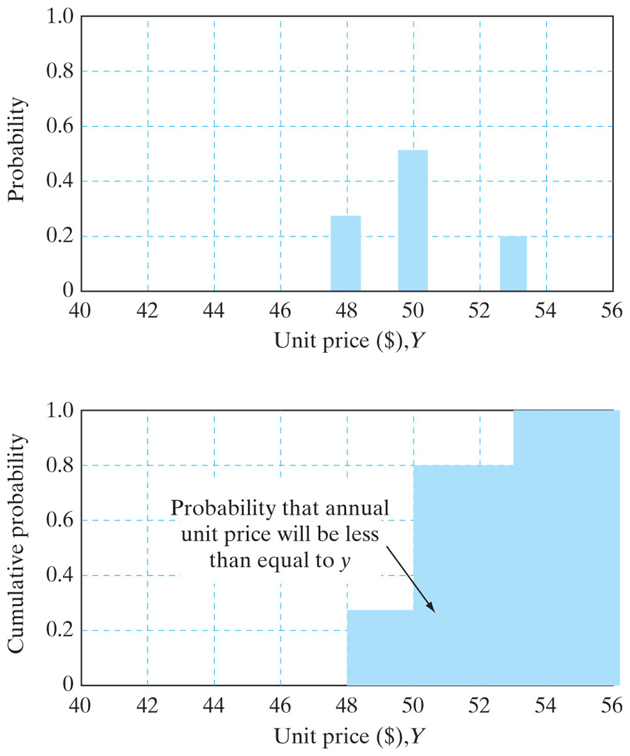
Probability and Cumulative Probability Distributions for Random Variable X and Y
Unit Demand (X)
Unit Price (Y)

Slide 8
Measure of Expectation
Discrete case
Continuous case
Event | Return (%) | Probability | Weighted
1 2 3 | 6% 9% 18% | 0.40 0.30 0.30 | 2.4% 2.7% 5.4%
Expected Return (μ) |  |  | 10.5%
E[X] = ∫ xf(x)dx

Slide 9
Measure of Variation
Formula:
Variance Calculation:
μ = 10.5%
Event | Probability | Deviation Squared | Weighted Deviation
1 | 0.40 | (6 – 10.5)² | 8.10
2 | 0.30 | (9 – 10.5)² | 0.68
3 | 0.30 | (18 – 10.5)² | 16.88
Variance (σ²) = |  |  | 25.66
σ = |  |  | 5.07%

Slide 10
Example 12.5 Calculation of Mean & Variance
X_{j} | P_{j} | X_{j}(P_{j}) | (X_{j}-E[X]) | (X_{j}-E[X])² (P_{j})
1,600 | 0.20 | 320 | (-400)² | 32,000
2,000 | 0.60 | 1,200 | 0 | 0
2,400 | 0.20 | 480 | (400)² | 32,000
 |  | E[X] = 2,000 |  | Var[X] = 64,000
 |  |  |  | σ = 252.98
Y_{j} | P_{j} | Y_{j}(P_{j}) | [Y_{j}-E[Y]]² | (Y_{j}-E[Y])² (P_{j})
$48 | 0.30 | $14.40 | (-2)² | 1.20
50 | 0.50 | 25.00 | (0) | 0
53 | 0.20 | 10.60 | (3)² | 1.80
 |  | E[Y] = 50.00 |  | Var[Y] = 3.00
 |  |  |  | σ = 1.73

Slide 11
Joint and Conditional Probabilities

Slide 12
Assessments of Conditional and Joint Probabilities
Unit Price Y | Marginal Probability | Conditional Unit Sales X | Conditional Probability | Joint Probability
$48 | 0.30 | 1,600 | 0.10 | 0.03
 |  | 2,000 | 0.40 | 0.12
 |  | 2,400 | 0.50 | 0.15
50 | 0.50 | 1,600 | 0.10 | 0.05
 |  | 2,000 | 0.64 | 0.32
 |  | 2,400 | 0.26 | 0.13
53 | 0.20 | 1,600 | 0.50 | 0.10
 |  | 2,000 | 0.40 | 0.08
 |  | 2,400 | 0.10 | 0.02

Slide 13
Marginal Distribution for X
X_{j}
1,600 | P(1,600, $48) + P(1,600, $50) + P(1,600, $53) = 0.18
2,000 | P(2,000, $48) + P(2,000, $50) + P(2,000, $53) = 0.52
2,400 | P(2,400, $48) + P(2,400, $50) + P(2,400, $53) = 0.30

Slide 14
Covariance and Coefficient of Correlation

Slide 15
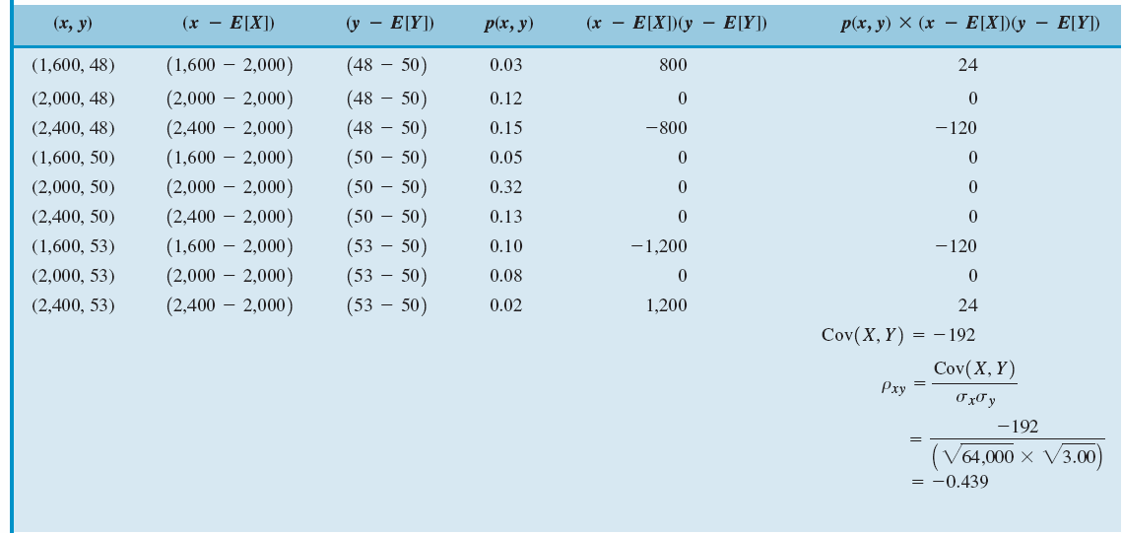
Calculating the Correlation Coefficient between X and Y

Slide 16
Meanings of Coefficient of Correlation
Case 1: 0 <ρ_{XY} < 1
  Positively correlated – When X increases in value, there is a tendency that Y also increases in value. When ρ_{XY} = 1, it is known as a perfect positive correlation.
Case 2: ρ_{XY} = 0
  No correlation between X and Y. If X and Y are statistically independent each other, ρ_{XY} = 0.
Case 3: -1 < ρ_{XY} < 0
  Negatively correlated – When X increases in value, there is a tendency that Y will decrease in value. When ρ_{XY} =-1, it is known as a perfect negative correlation.

Slide 17
Estimating the Amount of Risk involved in an Investment Project
How to develop a probability distribution of NPW
How to calculate the mean and variance of NPW
How to aggregate risks over time
How to compare mutually exclusive risky alternatives

Slide 18
Example 12.6 Probability Distribution of an NPW
Step 1:
Item | 0 | 1 | 2 | 3 | 4 | 5
Cash inflow:
Net salvage
X(1-0.4)Y |  | 0.6XY | 0.6XY | 0.6XY | 0.6XY | 0.6XY
0.4 (dep) |  | 7,145 | 12,245 | 8,745 | 6,245 | 2,230
Cash outflow:
Investment | -125,000
-X(1-0.4)($15) |  | -9X | -9X | -9X | -9X | -9X
-(1-0.4)($10,000) |  | -6,000 | -6,000 | -6,000 | -6,000 | -6,000
Net Cash Flow | -125,000 | 0.6X(Y-15) +1,145 | 0.6X(Y-15) +6,245 | 0.6X(Y-15) +2,745 | 0.6X(Y-15) +245 | 0.6X(Y-15) +33,617
Express After-Tax Cash Flow as a Function of Unknown Unit Demand (X) and Unit Price (Y).

Slide 19
Step 2:
Develop an NPW Function Based on After-Tax Project Cash Flows.

Slide 20
Step 3:
Calculate the NPW for Each Event with PW(15%) = 2.0113X(Y - $15) - $100,623
Sample Calculation:
  X = 1,600
  Y = $48
  PW(15%) = 2.0113(1,600)(48 – 15) - $100,623
  = $5,574

Slide 21
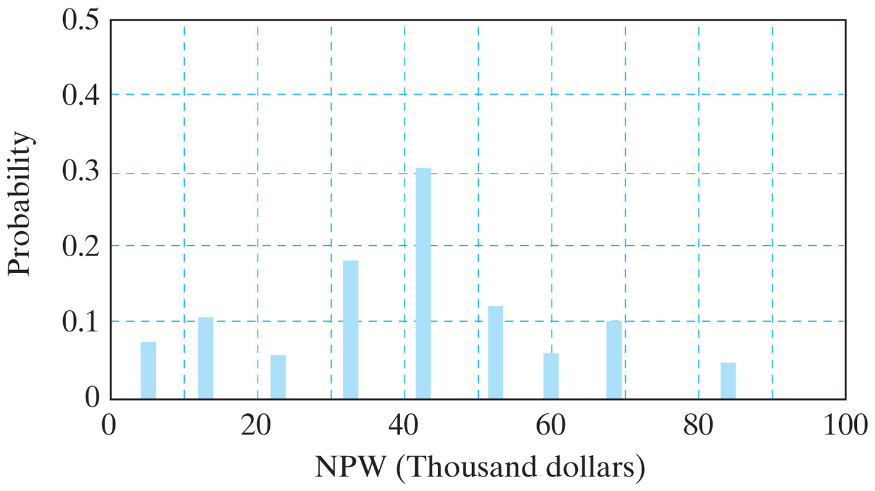
Step 4:
Plot the NPW Probability Distribution Assuming X and Y are Independent

Slide 22
Step 5:
Calculation of the Mean of the NPW Distribution.

Slide 23
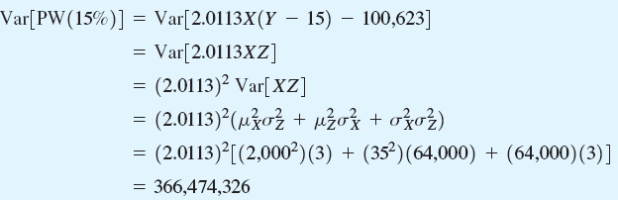
Step 6:
Calculation of the Variance of the NPW Distribution.

Slide 24
Aggregating Risk Over Time
Approach: Determine the mean and variance of cash flows in each period, and then aggregate the risk over the project life in terms of NPW.
0
1
2
3
4
5
E[NPW]
Var[NPW]
NPW

Slide 25
Case 1: Independent Random Cash Flows

Slide 26
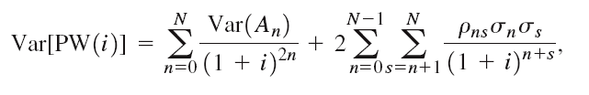
Case 2: Dependent Cash Flows
Notes:
Figure: 12-07-01UN

Slide 27
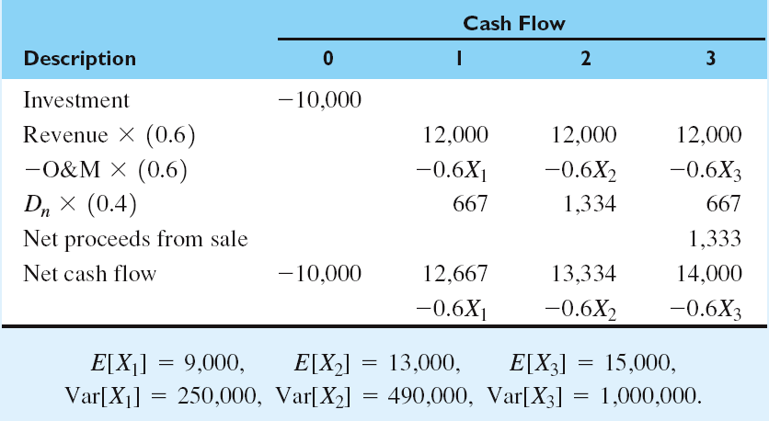
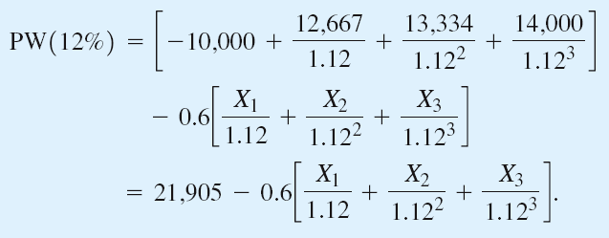
Example 12.7 Aggregation of Risk Over Time
Net Cash Flow Statement Using the Generalized Cash Flow Approach
0
1
2
3

Slide 28
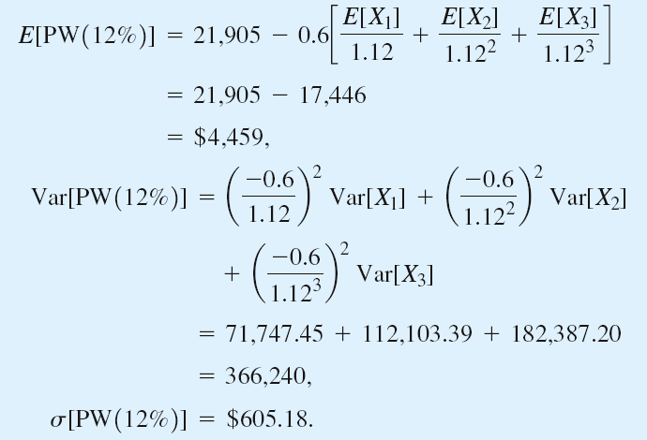
Case 1: Independent Cash Flows

Slide 29
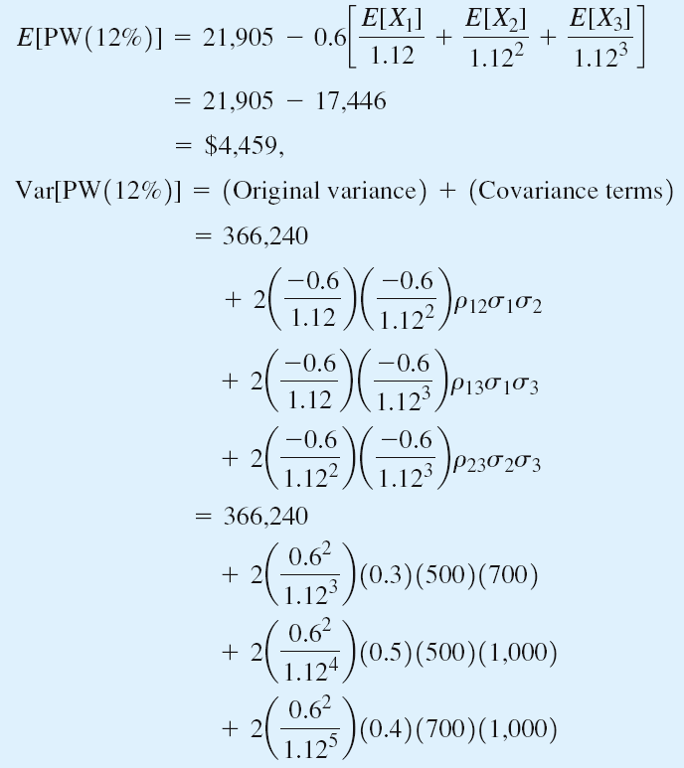
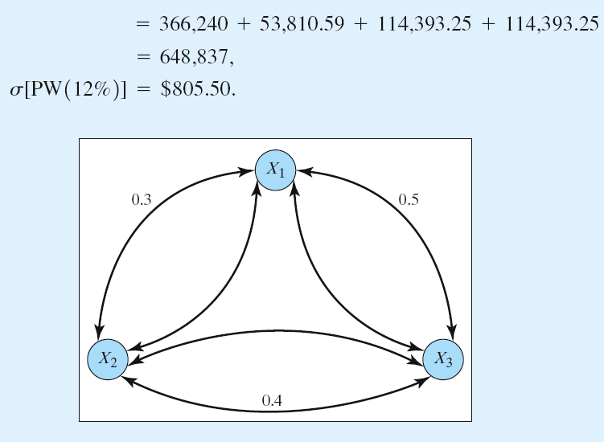
Case 2: Dependent Cash Flows

Slide 30
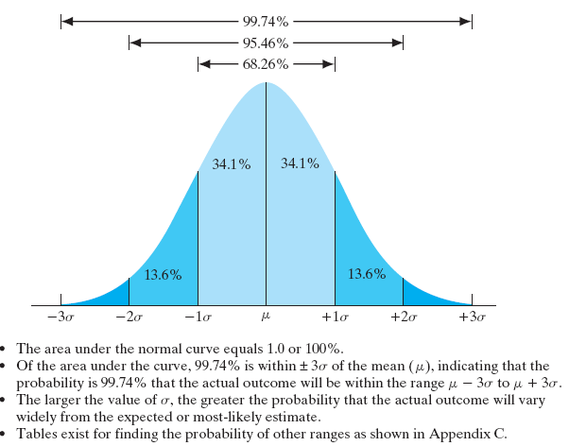
Normal Distribution Assumption
The distribution of a sum of a large number of independent variables is approximately normal – Central-Limit-Theorem.

Slide 31
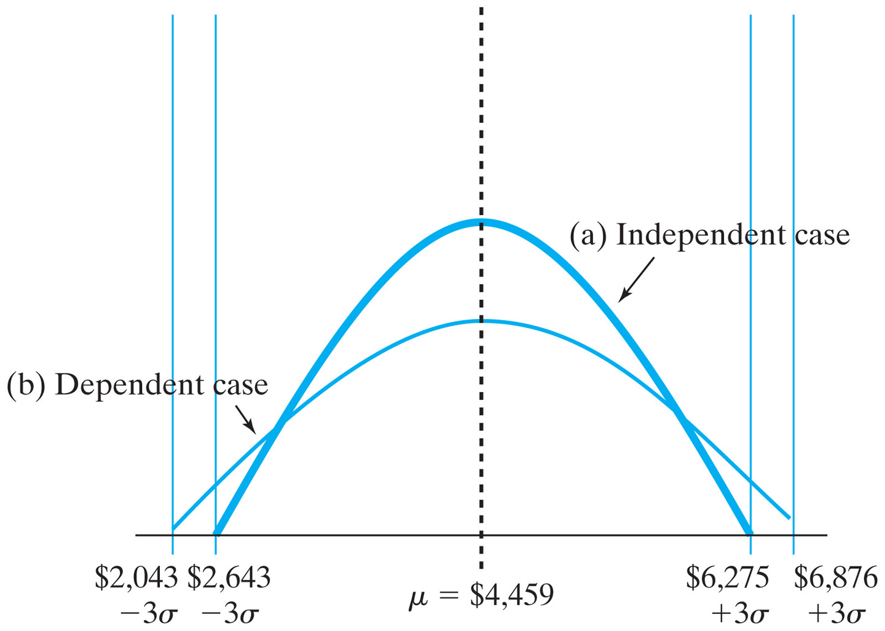
NPW Distribution with ±3σ
Notes:
Figure: 12-08EXM

Slide 32
Expected Return/Risk Trade-off

Slide 33
Example 12.8 Comparing Risky Mutually Exclusive Projects
Green Engineering has developed a prototype conversion unit that allows a motorist to switch from gasoline to compressed natural gas.
Four models with different NPW distributions at MARR = 10%.
Find the best model to market.

Slide 34
Comparison Rule
If E_{A} > E_{B} and V_{A} ≤ V_{B}, select A.
If E_{A} = E_{B} and V_{A} ≤ V_{B}, select A.
If E_{A} < E_{B} and V_{A} ≥ V_{B}, select B.
If E_{A} > E_{B} and V_{A} > V_{B}, Not clear.
Model Type | E (NPW) | Var (NPW)
Model 1 | $1,950 | 747,500
Model 2 | 2,100 | 915,000
Model 3 | 2,100 | 1,190,000
Model 4 | 2,000 | 1,000,000
Model 2 vs. Model 3 Model 2 >>> Model 3
Model 2 vs. Model 4 Model 2 >>> Model 4
Model 2 vs. Model 1 Can’t decide

Slide 35
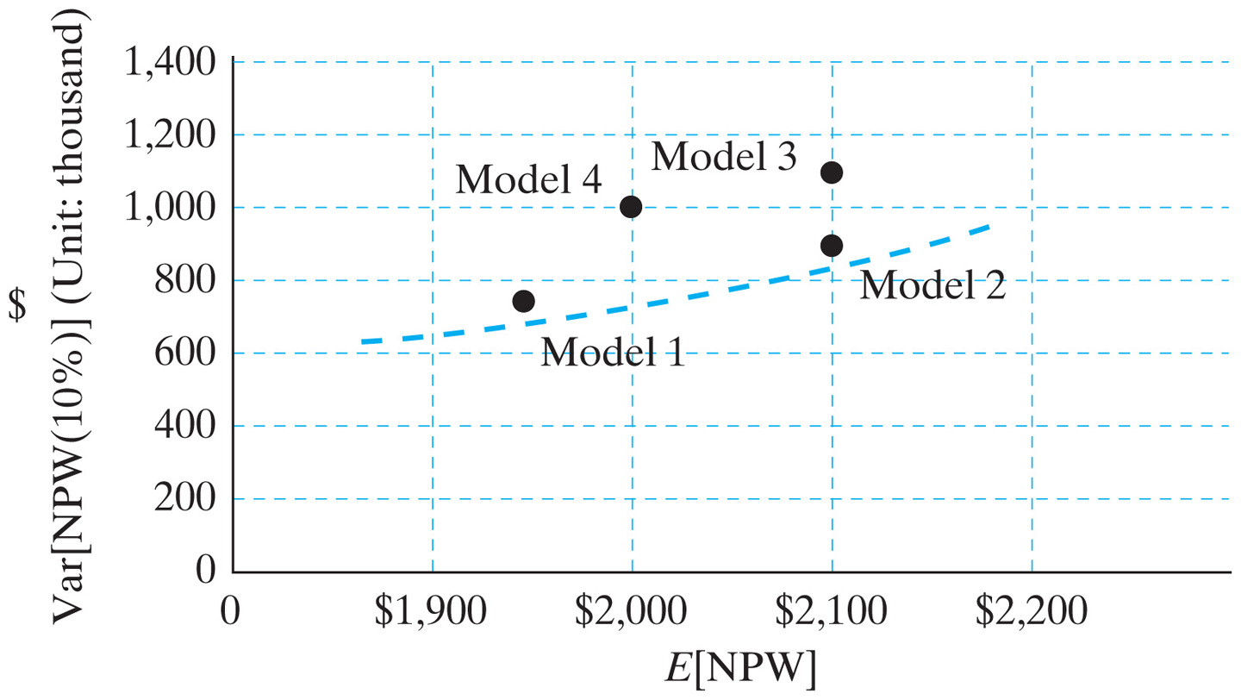
Mean-Variance Chart Showing Project Dominance
Notes:
Figure: 12-09EXM

Slide 36
Summary
Project risk—the possibility that an investment project will not meet our minimum return requirements for acceptability.
Our real task is not to try to find “risk-free” projects—they don’t exist in real life. The challenge is to decide what level of risk we are willing to assume and then, having decided on your risk tolerance, to understand the implications of that choice.
Three of the most basic tools for assessing project risk are (1) sensitivity analysis, (2) break-even analysis, and (3) scenario analysis.

Slide 37
Sensitivity, break-even, and scenario analyses are reasonably simple to apply, but also somewhat simplistic and imprecise in cases where we must deal with multifaceted project uncertainty.
Probability concepts allow us to further refine the analysis of project risk by assigning numerical values to the likelihood that project variables will have certain values.
The end goal of a probabilistic analysis of project variables is to produce an NPW distribution.

Slide 38
From the NPW distribution, we can extract such useful information as the expected NPW value, the extent to which other NPW values vary from , or are clustered around the expected value, (variance), and the best- and worst-case NPWs.
All other things being equal, if the expected returns are approximately the same, choose the portfolio with the lowest expected risk (variance).

