Slide 1
Replacement Analysis
Lecture No. 46
Chapter 14
Contemporary Engineering Economics
Copyright © 2010

Slide 2
Economic Service Life
Definition: Economic service life is the remaining useful life of an asset that results in the minimum annual equivalent cost.
Annual Equivalent Cost (AEC) = Capital Cost + Operating Cost

Slide 3

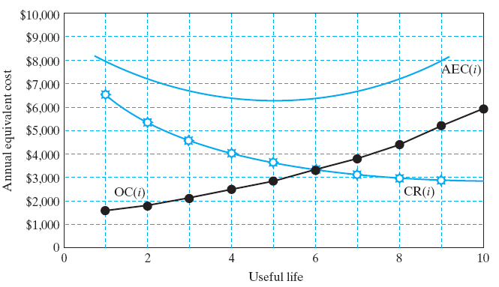


Mathematical Relationship
Capital Cost:
Operating Cost:
Total Cost:
Objective: Find n* that minimizes AEC(i)
n*

Slide 4
Example 14.3 Economic Service Life for a Lift Truck
Given: I = $18,000, i = 12%, Salvage value = -20% over the previous year, O&M = $3,000 during the first year, and 15% increase over the previous year thereafter
Find: Economic Service Life
n = 1:
n = 2:
$14,400
0
1
$3,000
$18,000
$11,520
0
1
2
$3,000
$3,450
$18,000

Slide 5
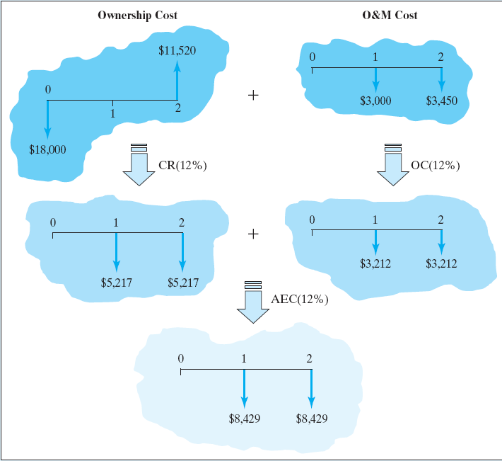
AEC Calculation If you Kept the Truck for 2 Years
Ownership Cost:
Operating Cost:
Annual Equivalent Cost:
$5,217
$5,217 + $3,212

Slide 6
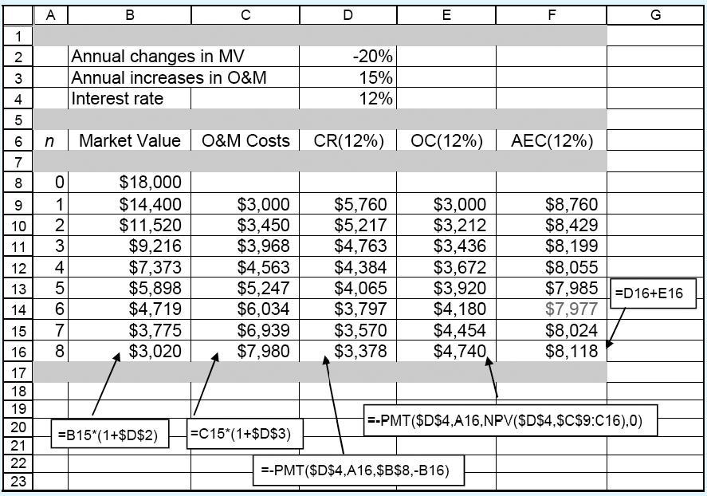
Economic Service Life Calculation Using Excel
Economic Service Life = 6 Years with AEC(12%) = $7,977
What It Really Means? You purchase a brand new lift truck for every 6 years, assuming that the future replacement cost as well as operating costs remain constant. Then the equivalent annual cost of owning and operating the truck is $7,977.

Slide 7
Sensitivity of Economic Service Life
For an asset with non-increasing operating cost, keep the asset as long as it lasts.
If everything remains the same, a higher interest rate will tend to extend the economic service life (or defer the replacement decision).

Slide 8
Replacement Decisions
Defender: an old machine
Challenger: a new machine
Current market value: selling price of the defender in the market place

Slide 9
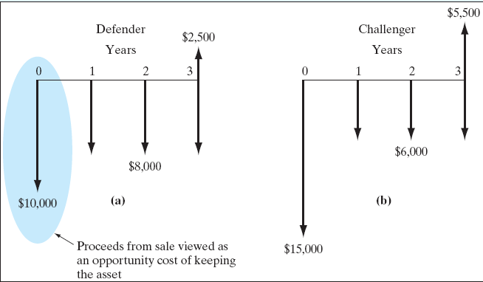
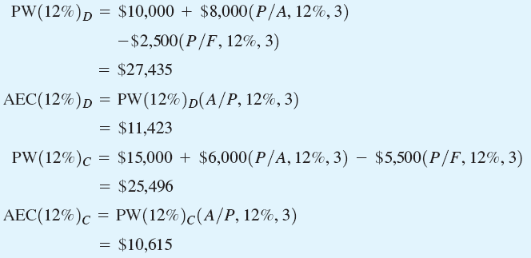
Example 14.2 -Opportunity Cost Approach
Basic Principle: Treat the proceeds from sale of the old machine as the investment required to keep the old machine.
Defender:
  Market price: $10,000
  Remaining useful life: 3 years
  Salvage value: $2,500
  O&M cost: $8,000
Challenger:
  Cost: $15,000
  Useful life: 3 years
  Salvage value: $5,500
  O&M cost: $6,000
Decision: Replace the defender now

Slide 10
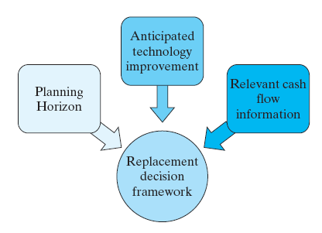
Required Assumptions and Decision Frameworks
Planning Horizon (Study Period)
  Infinite planning horizon
  Finite planning horizon
Technology
  No technology improvement is anticipated over the planning horizon
  Technology improvement cannot be ruled out
Relevant Cash Flow Information

Slide 11
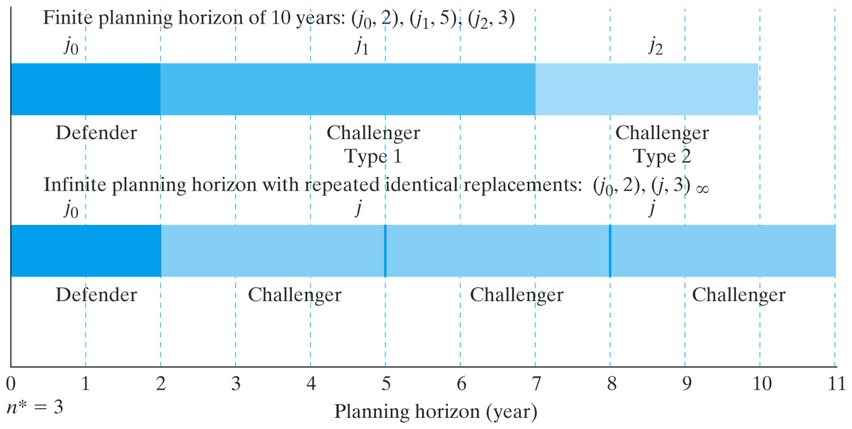
Types of Typical Replacement Decision Frameworks
Notes:
Figure: 14-06

Slide 12
Replacement Strategies under the Infinite Planning Horizon
Decision Rules:
Step 1: Compute the AECs for both the defender and challenger at its economic service life, respectively.
Step 2: Compare AEC_{D*} and AEC_{C*.}
  If AEC_{D*} > AEC_{C*} , replace the defender now.
  If AEC_{D*} < AEC_{C*} , keep the defender at least for the duration of its economic service life if there are no technological changes over that life.
Step 3: If the defender should not be replaced now, conduct marginal analysis to determine when to replace the defender.
Cash Flow Assumptions:
Replace the defender now: The cash flows of the challenger estimated today will be used. An identical challenger will be used thereafter if replacement becomes necessary again in the future. This stream of cash flows is equivalent to a cash flow of AEC_{C*} each year for an infinite number of years.
Replace the defender, say, x years later: The cash flows of the defender will be used in the first x years. Starting in year x+1,the cash flows of the challenger will be used indefinitely thereafter.

Slide 13
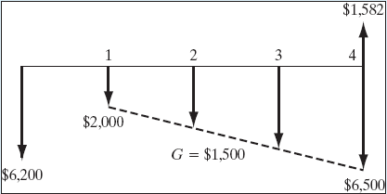
Example 14.4 Replacement Analysis under an Infinite Planning Horizon
Defender:
  Current salvage value = $5,000, decreasing at an annual rate of 25% over the previous year’s value
  Required overhaul = $1,200
  O&M = $2,000 in year 1, increasing at the rate of $1,500 each year
Challenger:
  I = $10,000
  Salvage value = $6,000 after one year, will decline 15% each year
  O&M = $2,200 in the first year, increasing by 20% per year thereafter
Find: (a) Economic service lives for both defender and challenger, (b) when to replace the defender
Cash flow diagram for defender when N = 4 years
Notes:
Figure: 14-07EXM

Slide 14
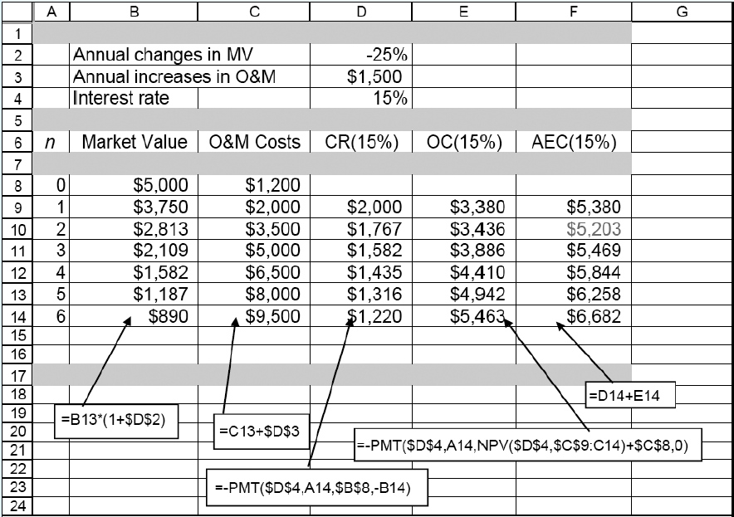
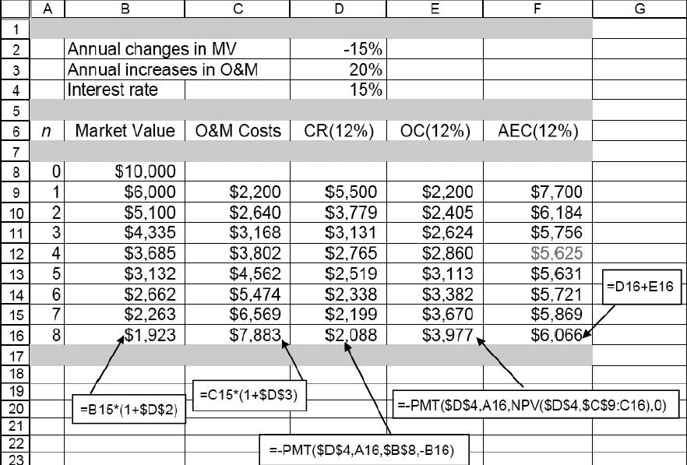
Economic Service Life
Defender
Challenger

Slide 15
Replacement Decisions (Example 14.4)
Should replace the defender now? No, because AEC_{D*} < AEC_{C*}
If not, when is the best time to replace the defender? Need to conduct the marginal analysis.
N_{C*}= 4 years
AEC_{C*}=$5,625

Slide 16
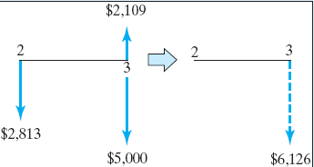
Marginal Analysis to Determine when the Defender should be Replaced
Question: What is the additional (incremental) cost for keeping the defender one more year from the end of its economic service life, from Year 2 to Year 3?
Financial Data:
Opportunity cost at the end of year 2: Equal to the market
value of $2,813
Operating cost for the 3rd year: $5,000
Salvage value of the defender at the end of year 3: $2,109
Step 1: Calculate the equivalent cost of retaining the defender one more from the end of its economic service life, say 2 to 3.
$2,813(F/P,15%,1) + $5,000
- $2,109 = $6,126
Step 2: Compare this cost with AEC_{C} = $5,625 of the challenger.
Conclusion: Since keeping the defender for the 3rd year is more expensive than replacing it with the challenger, DO NOT keep the defender beyond its economic service life.

Slide 17
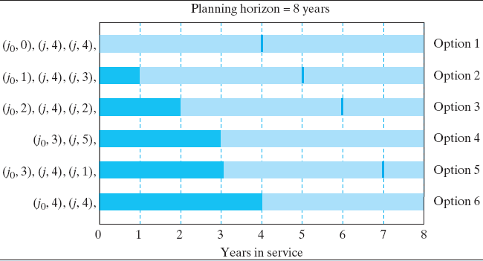
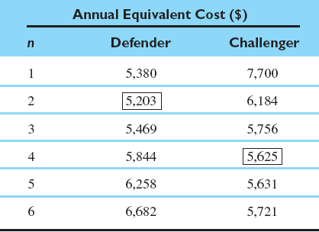
Example 14.5 Replacement Analysis under the Finite Planning Horizon
Given: Economic service lives for both defender and challenger , and i = 15%
Find: the most plausible/economical replacement strategy
Some Likely Replacement Patterns

Slide 18
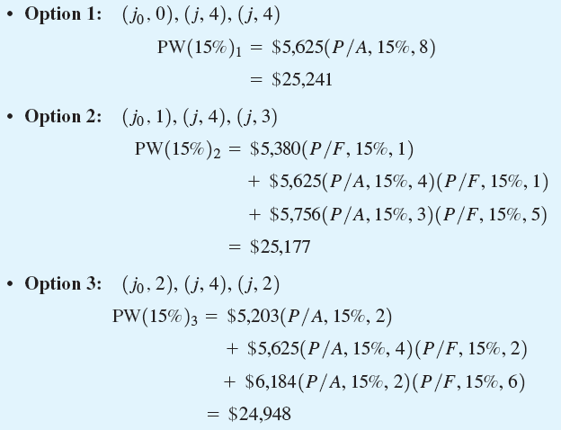
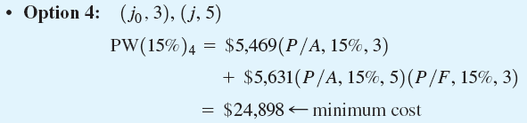
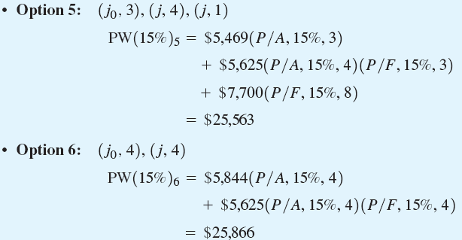
Present Equivalent Cost for Each Option

Slide 19
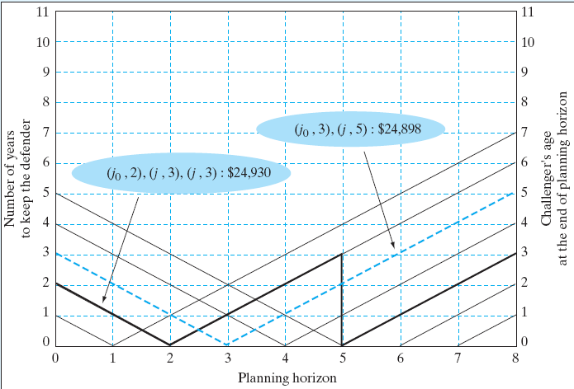
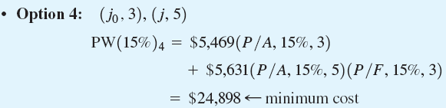
Graphical Representation of Replacement Strategies under a Finite Planning Horizon (Example 14.5)
Optimal Strategy:
Notes:
Figure: 14-10EXM

