Slide 1
Replacement Analysis Fundamentals
Lecture No. 46
Chapter 14
Contemporary Engineering Economics
Copyright © 2010

Slide 2
Replacement Terminology
Defender: an old machine
Challenger: a new machine
Current market value: selling price of the defender in the market place
Sunk cost: any past cost unaffected by any future decisions
Trade-in allowance: value offered by the vendor to reduce the price of a new equipment

Slide 3
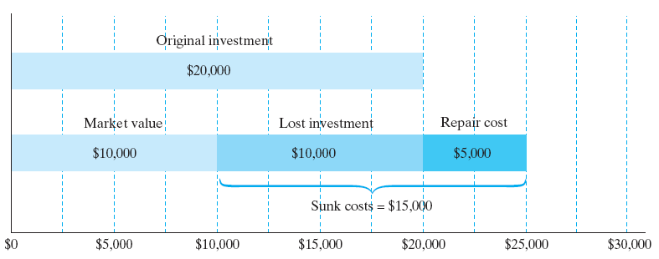
Sunk Cost associated with an Asset’s Disposal
Given: Original investment = $20,000, current market value = $10,000, repair cost made in the past = $5,000
Find: Relevant cost for replacement analysis
  Lost investment value, $10,000
  Repair cost made, $5,000
  Total sunk cost = $15,000
  Relevant cost for replacement analysis = current market value = $10,000

Slide 4
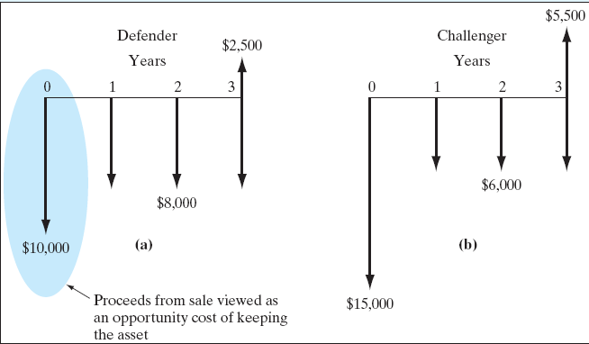
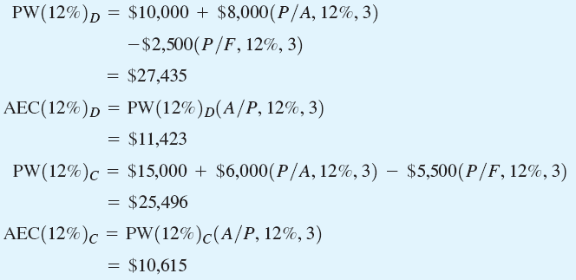
Example 14.2 -Opportunity Cost Approach
Basic Principle: Treat the proceeds from sale of the old machine as the investment required to keep the old machine.
Defender:
  Market price: $10,000
  Remaining useful life: 3 years
  Salvage value: $2,500
  O&M cost: $8,000
Challenger:
  Cost: $15,000
  Useful life: 3 years
  Salvage value: $5,500
  O&M cost: $6,000
Decision: Replace the defender now

Slide 5
Economic Service Life
Definition: Economic service life is the remaining useful life of an asset that results in the minimum annual equivalent cost.
Annual Equivalent Cost (AEC) = Capital Cost + Operating Cost

Slide 6

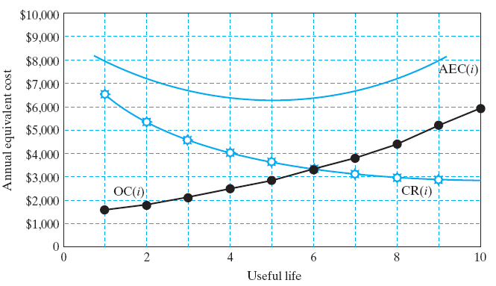


Mathematical Relationship
Capital Cost:
Operating Cost:
Total Cost:
Objective: Find n* that minimizes AEC(i)
n*

Slide 7
Example 14.3 Economic Service Life for a Lift Truck
Given: I = $18,000, i = 12%, Salvage value = -20% over the previous year, O&M = $3,000 during the first year, and 15% increase over the previous year thereafter
Find: Economic Service Life
n = 1:
n = 2:
$14,400
0
1
$3,000
$18,000
$11,520
0
1
2
$3,000
$3,450
$18,000

Slide 8
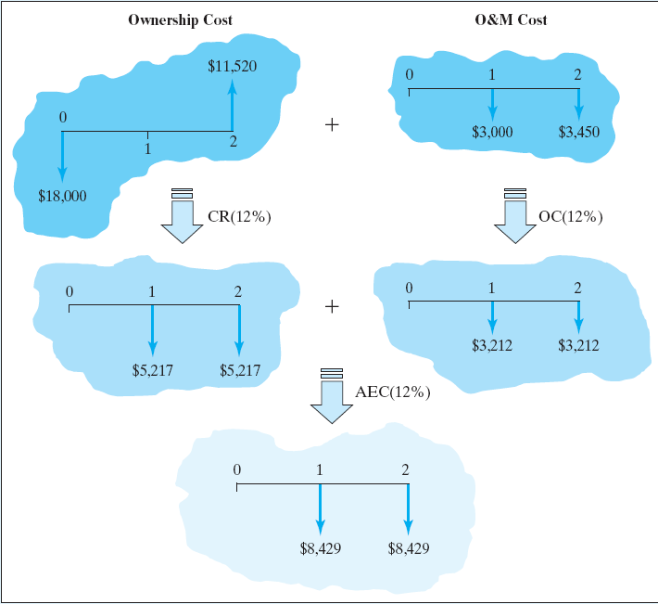
AEC Calculation If you Kept the Truck for 2 Years
Ownership Cost:
Operating Cost:
Annual Equivalent Cost:
$5,217
$5,217 + $3,212

Slide 9
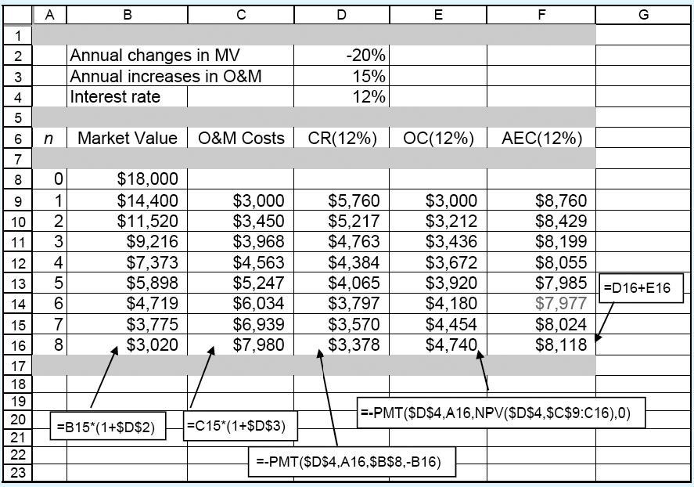
Economic Service Life Calculation Using Excel
Economic Service Life = 6 Years with AEC(12%) = $7,977
What It Really Means? You purchase a brand new lift truck for every 6 years, assuming that the future replacement cost as well as operating costs remain constant. Then the equivalent annual cost of owning and operating the truck is $7,977.

Slide 10
Sensitivity of Economic Service Life
For an asset with non-increasing operating cost, keep the asset as long as it lasts.
If everything remains the same, a higher interest rate will tend to extend the economic service life (or defer the replacement decision).

