Slide 1
Inflation and Its Effects on Project Cash Flows
Lecture No. 35
Chapter 11
Contemporary Engineering Economics
Copyright © 2010

Slide 2
What is Inflation?
Definition: Inflation is the rate at which the general level of prices of goods and services is rising, and subsequently, purchasing power is falling.
  Earning Power
  Purchasing Power
Earning Power
  Investment Opportunity
Purchasing Power
  Decrease in purchasing power (inflation)
  Increase in purchasing power (deflation)
Time Value of Money

Slide 3
Inflation - Decrease in Purchasing Power
$100
$100
1990
1990 2010
You could buy 50 Big Macs in year 1990 with $100
You can only buy 28.5 Big Macs in year 2010.
75%
$2.00 / unit
$3.50 / unit
Price change due to inflation
The $100 in year 2010 has only $57
worth purchasing power of 1990

Slide 4
Deflation - Increase in Purchasing Power
$100
$100
2004 2005 2006 2010
2004 2005 2006 2010
You could purchase 63.69 gallons of purified drink water a year ago.
You can now purchase 80 gallons of purified
drink water.
20.38%
$1.57 / gallon
$1.25 / gallon
Price change due to deflation

Slide 5
Inflation Terminology - I
Average Inflation Rate (f): a single average rate that accounts for the effect of varying yearly inflation rates over a period of several years.
Consumer Price Index: a statistical measure of change, over time, of the prices of goods and services in major expenditure groups—such as food, housing, apparel, transportation, and medical care—typically purchased by urban consumers
General Inflation Rate (f ): the average inflation rate calculated based on the CPI for all items in the market basket.

Slide 6
Average Inflation Rate (f )
Fact:
  Base Price = $100 (year 0)
  Inflation rate (year 1) = 4%
  Inflation rate (year 2) = 8%
Find: Average inflation rate over 2 years?
Step 1: Find the actual inflated price at the end of year 2.
$100 ( 1 + 0.04) ( 1 + 0.08) = $112.32
Step 2: Find the average inflation rate by solving the following equivalence equation.
$100 ( 1+ f)² = $112.32
f = 5.98%
$112.32
0 1
2
$100

Slide 7
Consumer Price Index
Consumer Price Index (CPI): the CPI compares the cost of a sample “market basket” of
goods and services in a specific period relative to
the cost of the same “market basket” in an earlier reference period. This reference period is designated as the base period.
CPI (Old measure) – Base Period = 1967
  1967 100
  2010 649.10 (January)
CPI (New measure) – Base Period (1982-84)
  1982-84 100
  2010 216.68 (January)

Slide 8
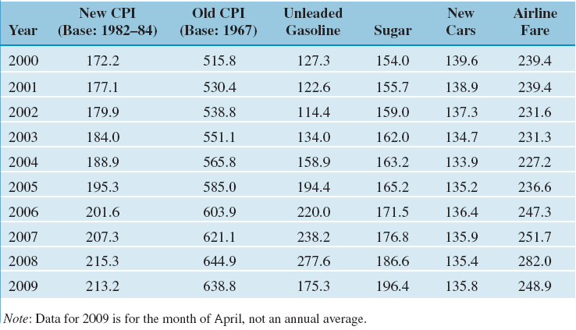
Selected Price Indexes (Index for Base Year = 100, Calendar Month = April)

Slide 9
General Inflation Rate (f)
Formula:
Calculation:
Given:
  CPI for 2009 = 213.2,
  CPI for 2000 = 172.2
Find: f

Slide 10
Example 11.2 Yearly and Average Inflation Rates
Year cost data:
Find: Yearly and Average inflation rates
Solution:
Year | Cost
0 | $504,000
1 | 538,000
2 | 577,000
3 | 629,500

Slide 11
Inflation Terminology – II
Actual Dollars (A_{n} ): Estimates of future cash flows for year n that take into account any anticipated future changes in amount caused by inflationary or deflationary effects.
Constant Dollars (A_{n}’ ): Estimates of future cash flows for year n in constant purchasing power, independent of the passage of time (or base period).

Slide 12
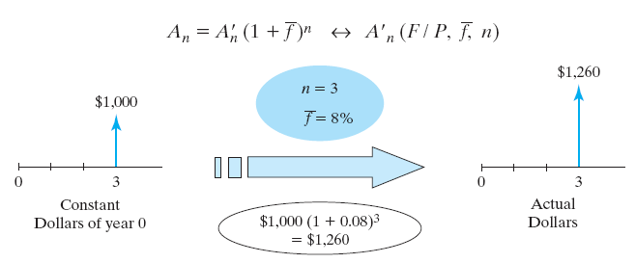
Finding Actual Dollars
Conversion from Constant to Actual Dollars
Example: General inflation rate = 5%

Slide 13
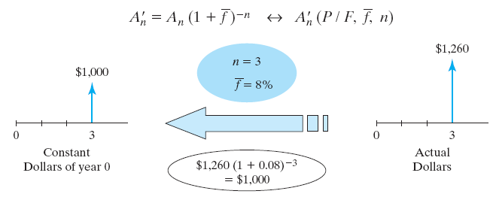
Finding Constant Dollars
Conversion from Actual to Constant dollars
Example 11.4 - General inflation rate of 5%

Slide 14
Inflation Terminology - III
Inflation-free interest rate (i’): an estimate of the true earning power of money when the inflation effects have been removed (also known as real interest rate).
Market interest rate (i): an interest rate which takes into account the combined effects of the earning value of capital and any anticipated changes in purchasing power (also known as inflation-adjusted interest rate).

Slide 15
Inflation and Cash Flow Analysis
Constant Dollar analysis
  Estimate all future cash flows in constant dollars.
  Use i’ as an interest rate to find the equivalent worth.
Actual Dollar Analysis
  Estimate all future cash flows in actual dollars.
  Use i as an interest rate to find the equivalent worth.

Slide 16
When do we Prefer Constant Dollar Analysis?
In the absence of inflation, all economic analyses up to this point is, in fact, the constant dollar analysis.
Constant dollar analysis is common in the evaluation of many long-term public projects, because governments do not pay income taxes.
For private sector, income taxes are levied based on the taxable income in actual dollars, so the actual dollar analysis is more common.

Slide 17
Two Alternate Ways in Conducting Present Worth Analysis Using Actual Dollars
Method 1: Deflation Method
- Step 1: Bring all cash flows to have common purchasing power.
- Step 2: Consider the earning power.
Method 2: Adjusted-discount Method
- Combine Steps 1 and 2 into one step.

Slide 18
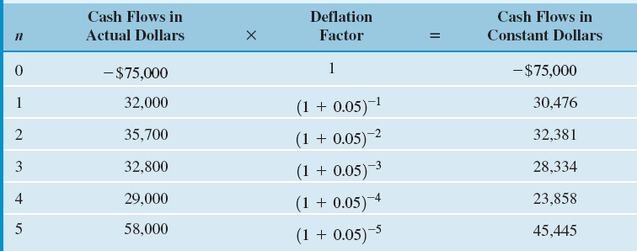
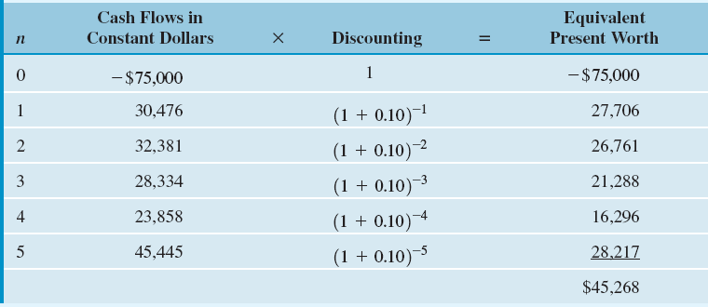
Example 11.6 – Deflation Method
Step 1: Converting Actual Dollars into Constant Dollars
Step 2: Calculating Equivalent Present Worth

Slide 19
Graphical Overview on Deflation Method (Example 11.6): Converting actual dollars to constant dollars and then to equivalent present worth
n = 0
n = 1
n = 2
n = 3
n = 4
n = 5
Actual
Dollars
-$75,000 $32,000 $35,700 $32,800 $29,000 $58,000
Constant
Dollars
-$75,000
$30,476
$32,381
$28,334
$23,858
$45,455
Present
Worth
$28,218
-$75,000
$26,761
$21,288
$16,295
$27,706
$45,268

Slide 20
Adjusted-Discount Method – Perform Deflation and Discounting in One Step
Discrete Compounding
Step 1
Step 2
Continuous Compounding

Slide 21
Example 11.7 Adjusted-Discounted Method
Given: inflation-free interest rate = 0.10, general inflation rate = 5%, and cash flows in actual dollars
Find: i and NPW

Slide 22
Graphical Overview on Adjusted Discount Method:
Converting actual dollars to present worth dollars by applying the market interest rate
n = 0
n = 1
n = 2
n = 3
n = 4
n = 5
Actual
Dollars
-$75,000 $32,000 $35,700 $32,800 $29,000 $58,000
Present
Worth
$28,218
-$75,000
$26,761
$21,288
$16,295
$27,706
$45,268

Slide 23
Mixed-Dollar Analysis – College Savings Plan - Equivalence Calculation with Composite Cash Flow Elements
Approach: Convert any cash flow elements in constant dollars into actual dollars. Then use the market interest rate to find the equivalent present value. Assume f = 6% and i = 8% compounded quarterly.
Age (Current Age = 5 Years Old) | Estimated College Expenses in Today’s Dollars | College Expenses Converted into Equivalent Actual Dollars
18 (Freshman) | $30,000 | $30,000(F/P,6%,13) = $63,988
19 (Sophomore) | 30,000 | 30,000(F/P,6%,14) = 67,827
20 (Junior) | 30,000 | 30,000(F/P,6%,15) = 71,897
21 (senior) | 30,000 | 30,000(F/P,6%,16) = 76,211

Slide 24
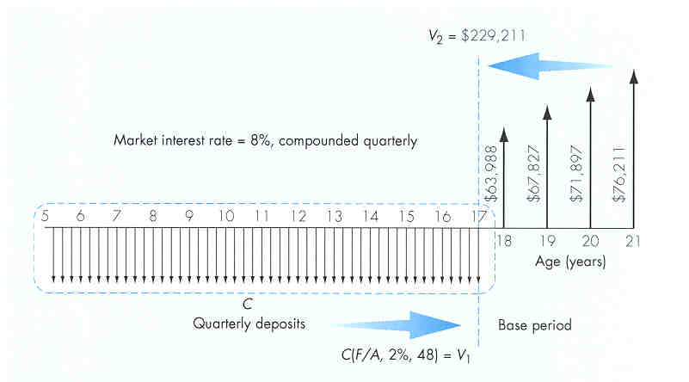
Solution: Required Quarterly Contributions to College Funds
V₁ = C(F/A, 2%, 48)
V₂ = $229,211
Let V₁ = V₂ and solve
for C:
C = $2,888.48

Slide 25
Effects of Inflation on Project Cash Flows

Slide 26
Effects of Inflation on Projects with Depreciable Assets
Item | Effects of Inflation
Depreciation expense Salvage value | Depreciation expense is charged to taxable income in dollars of declining values; taxable income is overstated, resulting in higher taxes Inflated salvage value combined with book values based on historical costs results in higher taxable gains.
Note: Depreciation expenses are based on historical costs and
always expressed in actual dollars

Slide 27
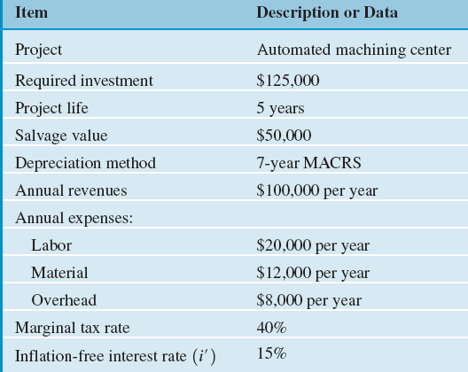
Example 11.8
Reconsider the Automated Machining Center project discussed earlier. What will happen to this investment project if
  the general inflation during the next five years is expected to increase by 5% annually,
  sales, operating costs, and working capital requirements are assumed to increase accordingly,
  depreciation will remain unchanged, but taxes, profits, and thus cash flow will be higher.
  the firm’s inflation-free interest rate is known to be 15%.
Determine the PW of the project.

Slide 28
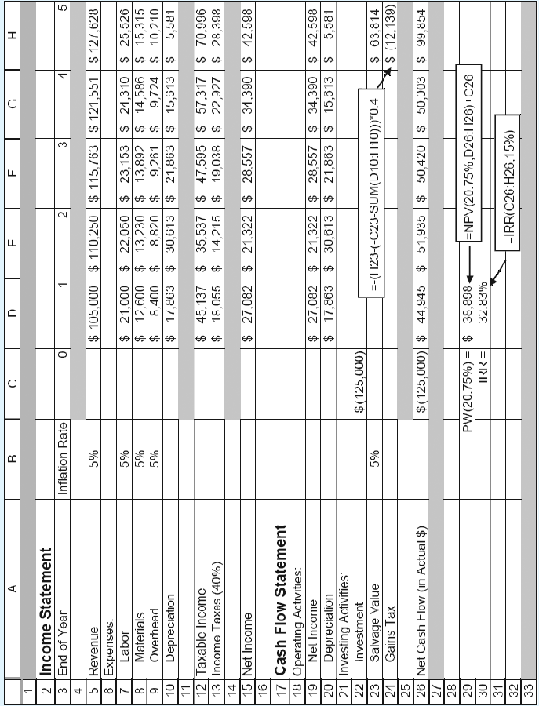

Slide 29
Effects of Inflation on Working Capital
Item | Effects of Inflation
Working capital requirement | Known as working capital drain, the cost of working capital increases in an inflationary environment.

Slide 30
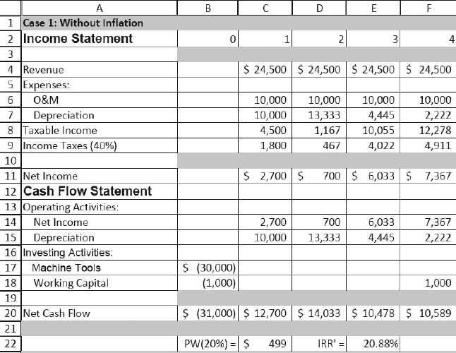
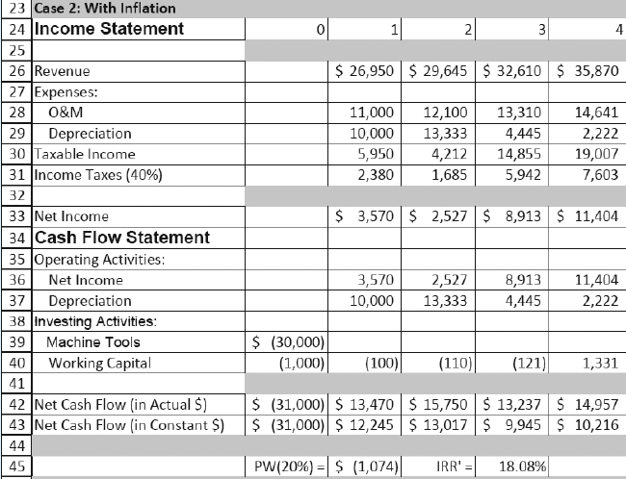
Example 11.12 Effects of Inflation on Working Capital

Slide 31
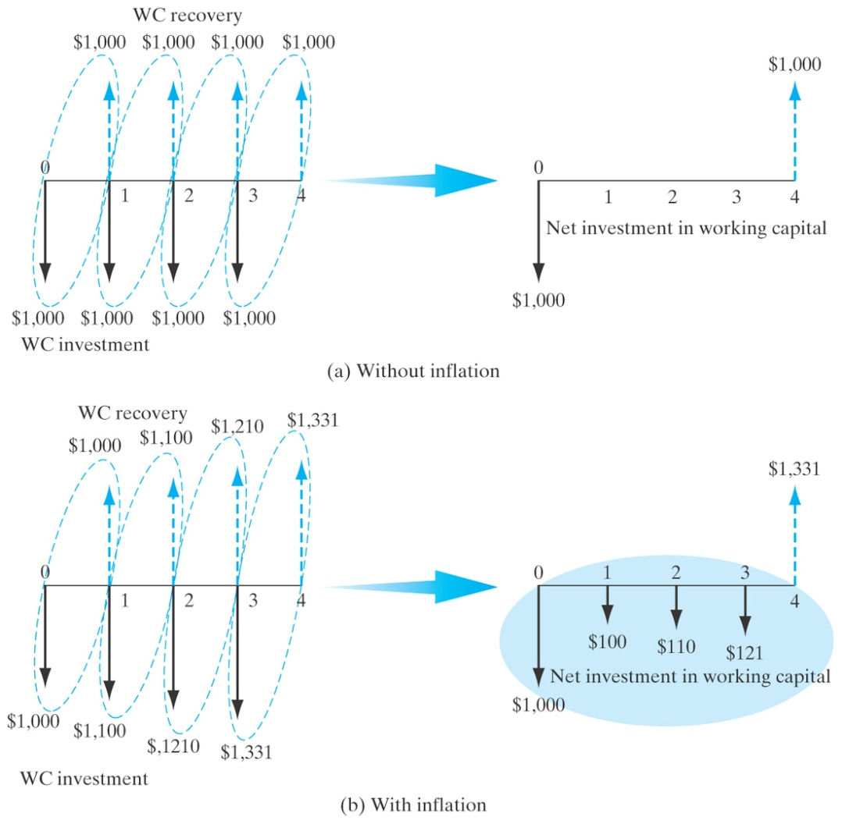
Working Capital Requirements under Inflation

Slide 32
Effects of Borrowed Funds under Inflation
Item | Effects of Inflation
Loan repayments | Borrowers repay historical loan amounts with dollars of decreased purchasing power, reducing the debt-financing cost.
Note: Loan expenses are always expressed in actual dollars!

Slide 33
Example 11.10 Effects of Inflation on Payments with Financing
Given: borrowing rate = 15.5%, general inflation rate = 5%, and inflation-free interest rate = 15%, amount of borrowing = $62,500 over 5 years
Find: NPW
  Market interest rate = 0.15 + 0.05 + 0.0075 = 20.75%
  NPW w/o borrowing = $38,898
  NPW w borrowing = $54,159
  The gain in NPW due to debt financing = $15,261

Slide 34
Effects of Inflation on Return on Investment
Item | Effects of Inflation
Rate of Return and NPW | Unless revenues are sufficiently increased to keep pace with inflation, tax effects and/or a working capital drain result in lower rate of return or lower NPW.

Slide 35
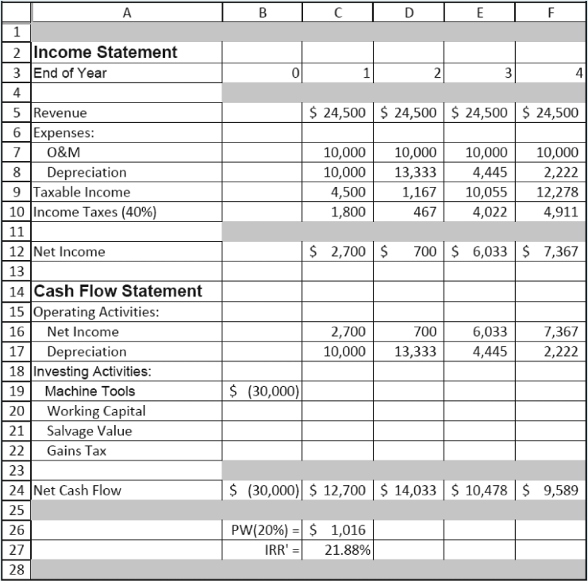
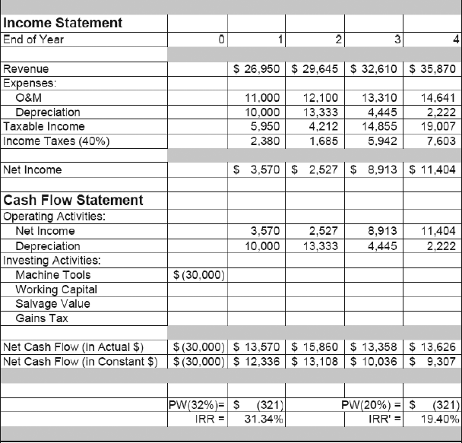
Example 11.11 IRR Analysis with Inflation
IRR in the absence of inflation
IRR Calculation under Inflation

Slide 36
Rate of Return Analysis under Inflation
Principle: True (real) rate of return should be based on constant dollars.
If the rate of return is computed based on cash flows in actual dollars, the real rate of return can be calculated as:
n | Net cash flows in actual dollars | Net cash flows in constant dollars
0 1 2 3 4 | -$30,000 13,570 15,860 13,358 13,626 | -$30,000 12,336 13,108 10,036 9,307
IRR 31.34% 19.40%

Slide 37
Decision Criterion
If you use 31.34% as your IRR, you should use a market interest rate (or inflation-adjusted MARR) to make an accept and reject decision.
If you use 19.40% as your IRR, you should use an inflation-free interest rate (inflation-free MARR) to make an accept and reject decision. In our example, MARR’ = 20%.

