Slide 1
Benefit-Cost Ratio
Lecture No. 53
Chapter 16
Contemporary Engineering Economics
Copyright © 2016

Slide 2
Benefit-Cost Analysis
The benefit-cost analysis is commonly used to evaluate public projects.
Benefits of a nonmonetary nature need to be quantified in dollar terms as much as possible and factored into the analysis.
A broad range of project users distinct from the sponsor can and should be considered—benefits and disbenefits to all these users can and should be taken into account.

Slide 3
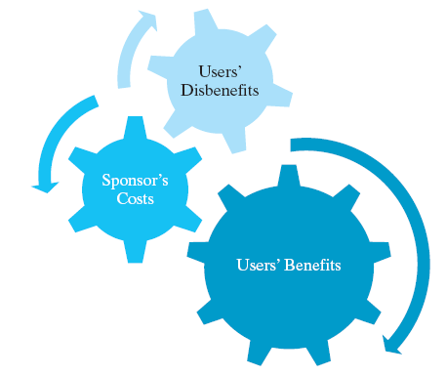
Framework of Benefit-Cost Analysis
  Step 1: Identifying all the users and sponsors of the project.
  Step 2: Identifying all the benefits and disbenefits of the project.
  Step 3: Quantifying all benefits and disbenefits in dollars or some other unit of measure.
  Step 4: Selecting an appropriate interest rate at which to discount benefits and costs in future to a present value.

Slide 4
Benefit-Cost Ratio Criterion
If this BC ratio exceeds 1, the project can be justified.

Slide 5
Definition of Benefit-Cost Ratio
b_{n}=Benefit at the end of period n, b_{n} ≥ 0
c_{n}= Expense at the end of period n, c_{n}≥ 0
A_{n}= b_{n} − c_{n}
N = Project life
i= Sponsor’s interest rate (discount rate)

Slide 6
Breakdown of the Sponsor’s Cost
Equivalent capital investment
at n = 0
Equivalent O&M costs
at n = 0

Slide 7

Example 16.1: Benefit-Cost Ratio
Indian River Lagoon South Project: To reverse the damaging effects of pollution and unnaturally large freshwater discharges into these ecologically vital water bodies.
  Price tag of $1.2B
  Annual benefits of $159M along with other environmental benefits
Is it worth undertaking?
Notes:
Figure: 16-00UN

Slide 8
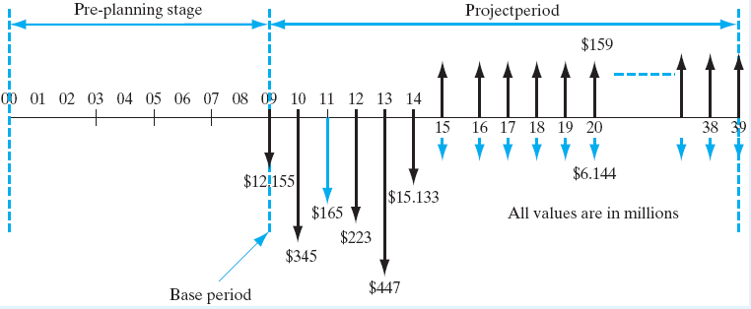
Description of Financial Data
Given: Financial data for IRL-South Project
  Estimated construction cost = $1,207,288,000
  Annual recurring O&M, repair costs = $6,144,700
  Estimated annual benefits = $159,000,000
  Discount rate = 5 5/8%
  Project period = 39 years
Find: B/C ratio

Slide 9
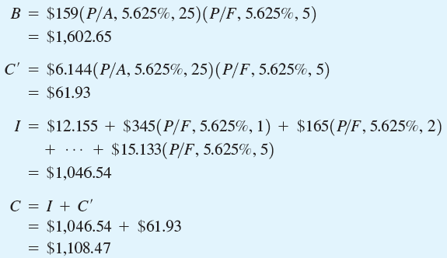

Benefit-Cost Ratio Calculation

Slide 10
Incremental Analysis Based on BC(i)
If BC(i)_{k-j}> 1, select alternative j which has the smaller cost.
IfΔI+ ΔC’ = 0, we cannot use the benefit-cost ratio. When this happens, just select the project with the largest B value.
In situations where public projects with unequal service lives are to be compared, compute all component values (B, I, and C’) on an annual basis.

Slide 11
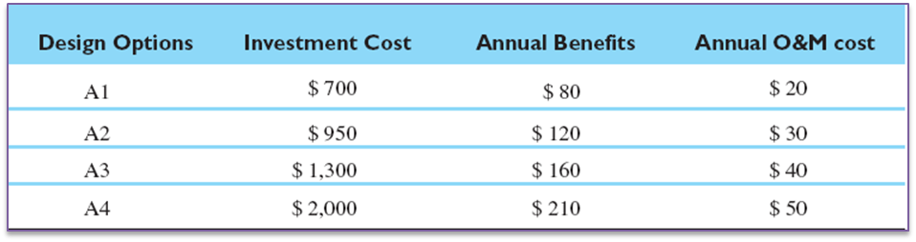
Example 16.2: Incremental Benefit-Cost Ratios: Four Alternatives
Given: I, B, C’, and i = 5%, N = 30 years
Find: Which design option?

Slide 12
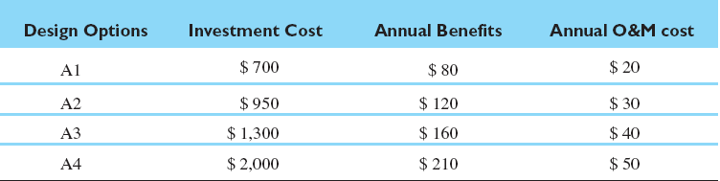
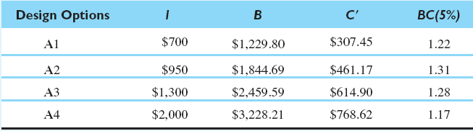
Step 1: Calculate BC (5%) for Each Alternative

Slide 13
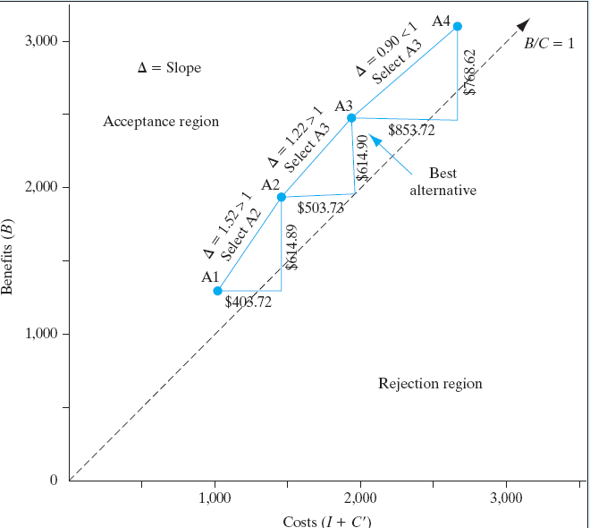



Step 2: Incremental Analyses
A1 versus A2
A3 versus A2
A4 versus A3

Slide 14
Profitability Index
Definition: Net benefits expressed per dollar invested.
Decision Rule

Slide 15
Relationship Between B/C Ratio, NPW, and PI
B> (I + C’)
B − (I+ C’) > 0
PW(i) = B − C> 0

Slide 16
Summary
A benefit-cost analysis is commonly used to evaluate public projects.
Difficulties involved in public project analysis include the following:
  Identifying all the users who can benefit from the project.
  Identifying all the benefits and disbenefits of the project.
  Quantifying all benefits and disbenefits in dollars or some other unit of measure.
  Selecting an appropriate interest rate at which to discount benefits and costs to a present value.

Slide 17
The B/C ratio is defined as:
The decision rule: if BC(i) > 1, the project is acceptable.
The profitability index (PI) is defined as
The PI expresses the net benefit expected per dollar invested. The same decision rule applies as for the B/C ratio.

