Slide 1
Meaning and Measure of Inflation
Lecture No. 35
Chapter 11
Contemporary Engineering Economics
Copyright © 2016

Slide 2
What is Inflation?
Definition: The rate at which the general level of prices of goods and services is rising, and subsequently, purchasing power is falling
Time Value of Money
Earning power
  Investment opportunity
Purchasing power
  Decrease in purchasing power (inflation)
  Increase in purchasing power (deflation)

Slide 3
Chapter Opening Story
Purchasing Power: The Big Mac Index
An indicator of a country’s individual purchasing power.
Big Mac prices are calculated by converting the average national Big Mac prices with the latest exchange rate to U.S. dollars.
Two dominant factors are Inflation and cost of labor.
Source: “The Big Mac Index,” The Economist, January 25, 2014

Slide 4
Inflation: Decrease in Purchasing Power
$110
$110
1990
1990 2015
You could buy 50 Big Macs in the year 1990 with $110.
You can only buy 23.81Big Macs in the year 2015.
+210%
$2.20 / unit
$4.62 / unit
Price change due to inflation
The $110 in year 2015 has only $52.38
worth the purchasing power of 1990.

Slide 5
Deflation: Increase in Purchasing Power
$100
$100
2012
2012 2015
With $100, you could purchase 27.17gallons of unleaded gasoline in 2012.
With $100, you can now purchase 42.55gallons of unleaded gasoline in 2015.
−36.14%
$3.68 / gallon
$2.35 / gallon
Price change due to deflation

Slide 6
Inflation Terminology I
Producer Price Index:A statistical measure of industrial price change, compiled monthly by the Bureau of Labor Statistics, U.S. Department of Labor
Consumer Price Index:A statistical measure of change, over time, of the prices of goods and services in major expenditure groups—such as food, housing, apparel, transportation, and medical care—typically purchased by urban consumers
Average Inflation Rate (f):A single average rate that accounts for the effect of varying yearly inflation rates over a period of several years
General Inflation Rate (f ): The average inflation rate calculated based on the CPI for all items in the market basket

Slide 7
Consumer Price Index (CPI)
Definition: A measure that examines the weighted average prices of a consumer goods and services.
How to calculate: Taking price changes for each item in the market basket of goods and services and averaging them.
CPI (Old measure) − Base Period = 1967
  1967: 100
  2015: 712.35 (May)
CPI (New measure) − Base Period (1982–84)
  1982–84: 100
  2015: 237.85 (May)

Slide 8
Selected Price Indexes

Slide 9
Average Inflation Rate (f )
Given:
Base Price = $100 (year 0)
Inflation rate (year 1) = 4%
Inflation rate (year 2) = 8%
Find:Average inflation rate over 2 years
Step 1: Find the actual inflated price at the end of year 2.
$100 ( 1 + 0.04) ( 1 + 0.08) = $112.32
Step 2: Find the average inflation rate by solving the following equivalence equation.
$100 ( 1+ f)²= $112.32
f= 5.98%
$112.32
0 1
2
$100

Slide 10
Example 11.1: Average Inflation Rate
Sample calculation for average inflation rate for gasoline
Given: P = 194.4, F = 304.2,
N = 2014–2005 = 9
Find: f

Slide 11
Solution
Average inflation rate for gasoline over 9 years

Slide 12
General Inflation Rate (f)
Formula
Calculation
Given:
  CPI for 2005 = 195.3,
  CPI for 2014 = 236.4
Find:

Slide 13
Example 11.2: Yearly and Average Inflation Rates
Given:Year cost data
Find: (1) Yearly and average inflation rates, (2) Average inflation rate (or price index)
Year | Cost
0 | $504,000
1 | 538,000
2 | 577,000
3 | 629,500

Slide 14
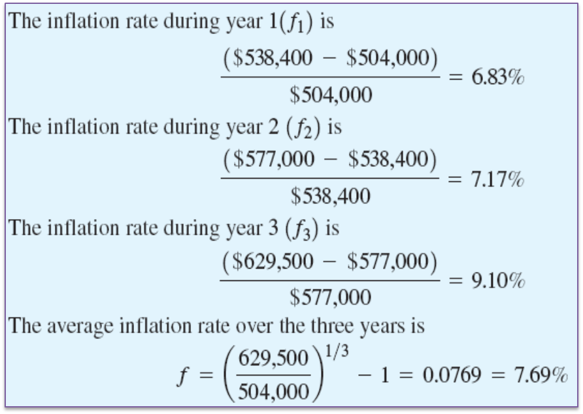
Solution

Slide 15
Inflation Terminology II
Actual dollars (A_{n}): Estimates of future cash flows for year n that take into account any anticipated future changes in amount caused by inflationary or deflationary effects
Constant dollars (A_{n}’): Estimates of future cash flows for year n in constant purchasing power, independent of the passage of time (or base period)

Slide 16
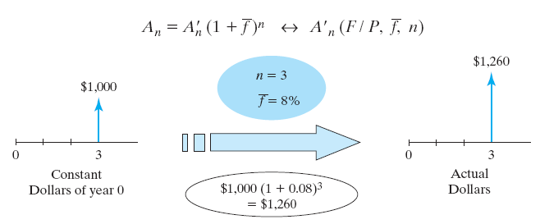
Finding Actual Dollars
Conversion from constant to actual dollars
General inflation rate = 5%

Slide 17
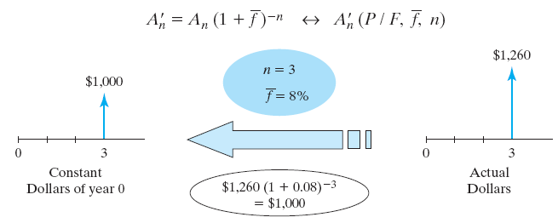
Finding Constant Dollars
Conversion from actual to constant dollars
General inflation rate of 5%

Slide 18
Inflation Terminology III
Inflation-free interest rate (i’): an estimate of the true earning power of money when the inflation effects have been removed (also known as real interest rate).
Market interest rate (i): an interest rate which takes into account the combined effects of the earning value of capital and any anticipated changes in purchasing power (also known as inflation-adjusted interest rate).

Slide 19
Inflation and Cash Flow Analysis
Constant dollar analysis
  Estimate all future cash flows in constant dollars.
  Use i’ as an interest rate to find the equivalent worth.
Actual dollar analysis
  Estimate all future cash flows in actual dollars.
  Use i as an interest rate to find the equivalent worth.

Slide 20
Equivalence Calculations Under Inflation
Types of Interest Rate
Market Interest Rate (i)
Inflation-free Interest Rate (i’)
Types of Cash Flows
Estimated in Constant Dollars
Estimated in Actual Dollars
Types of Analysis Method
Constant-Dollar Analysis
Actual-Dollar Analysis

Slide 21
When to Use Constant Dollar Analysis?
In the absence of inflation, all economic analysis up to this point is, in fact, the constant dollar analysis.
Constant dollar analysis is common in the evaluation of many long-term public projects, because governments do not pay income taxes.
For private sector, income taxes are levied based on the taxable income in actual dollars, so the actual dollar analysis is more common.

Slide 22
Actual Dollars Analysis
Method 1: Deflation Method
    Step 1: Bring all cash flows to have common purchasing power.
    Step 2: Consider the earning power.
Method 2: Adjusted-discount Method
    Combine Steps 1 and 2 into one step.

Slide 23
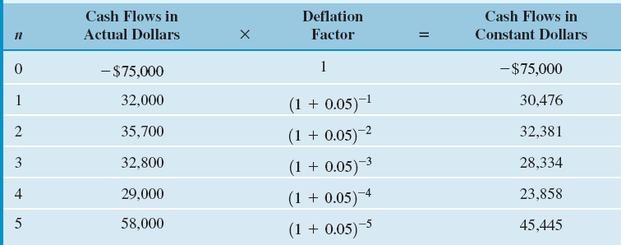
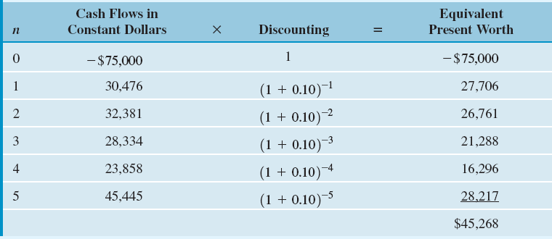
Example 11.6: Deflation Method
Step 1: Converting actual dollars into constant dollars
Step 2: Calculating equivalent present worth

Slide 24
Graphical Overview on Deflation Method
n = 0
n = 1
n = 2
n = 3
n = 4
n = 5
Actual
Dollars
-$75,000 $32,000 $35,700 $32,800 $29,000 $58,000
Constant
Dollars
-$75,000
$30,476
$32,381
$28,334
$23,858
$45,455
Present
Worth
$28,218
-$75,000
$26,761
$21,288
$16,295
$27,706
$45,268

Slide 25
Adjusted-Discount Method
Discrete compounding
Step 1
Step 2
Continuous compounding

Slide 26
Example 11.7: Adjusted-Discounted Method
Given: inflation-free interest rate = 0.10, general inflation rate = 5%, and cash flows in actual dollars
Find: i and NPW

Slide 27
Graphical Overview on Adjusted Discount Method
n = 0
n = 1
n = 2
n = 3
n = 4
n = 5
Actual
Dollars
-$75,000 $32,000 $35,700 $32,800 $29,000 $58,000
Present
Worth
$28,218
-$75,000
$26,761
$21,288
$16,295
$27,706
$45,268

Slide 28
Mixed-Dollar Analysis
College Savings Plan: Determine the required quarterly contribution
Approach: Convert any cash flow elements in constant dollars into actual dollars. Then use the market interest rate to find the equivalent present value. Assume f = 6% and i = 8% compounded quarterly.
Age (Current Age = 5 Years Old) | Estimated College Expenses in Today’s Dollars | College Expenses Converted into Equivalent Actual Dollars
18 (Freshman) | $30,000 | $30,000(F/P,6%,13) = $63,988
19 (Sophomore) | 30,000 | 30,000(F/P,6%,14) = 67,827
20 (Junior) | 30,000 | 30,000(F/P,6%,15) = 71,897
21 (senior) | 30,000 | 30,000(F/P,6%,16) = 76,211

Slide 29
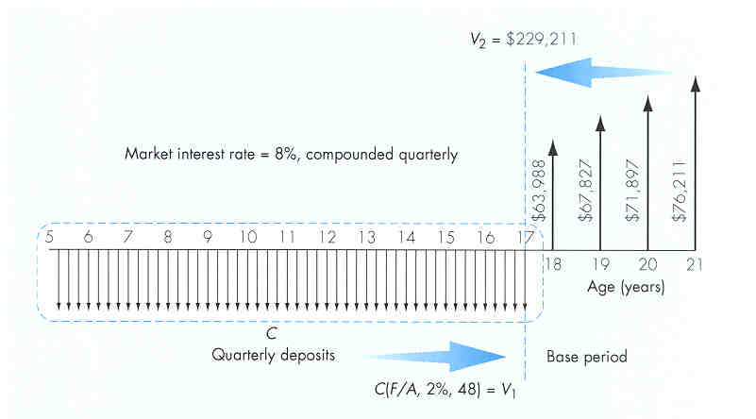
Required Quarterly Contributions to College Funds
V₁ = C(F/A, 2%, 48)
V₂ = $229,211
Let V₁ = V₂ and solve
for C:
C = $2,888.48

Slide 30
Effects of Inflation on Projects with Depreciable Assets
Item | Effects of Inflation
Depreciation expense Salvage value | Depreciation expense is charged to taxable income in dollars of declining values; taxable income is overstated, resulting in higher taxes. Inflated salvage value combined with book values based on historical costs results in higher taxable gains.
Note: Depreciation expenses are based on historical costs and
always expressed in actual dollars.

Slide 31
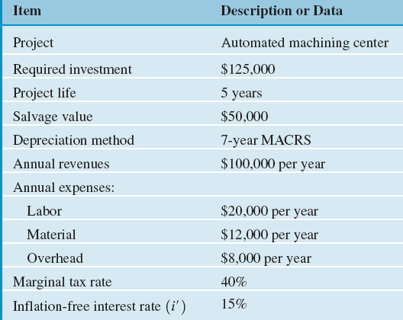
Example 11.8: Effects of Inflation on Depreciable Assets
Given: Reconsider Example 11.1 with:
  The general inflation = 5% during the next five years is expected to increase by 5% annually.
  Sales, operating costs, and working capital requirements are assumed to increase accordingly.
  Depreciation will remain unchanged, but taxes, profits, and thus cash flow will be higher.
  The firm’s inflation-free interest rate is known to be 15%.
Find: Determine the PW of the project.

Slide 32
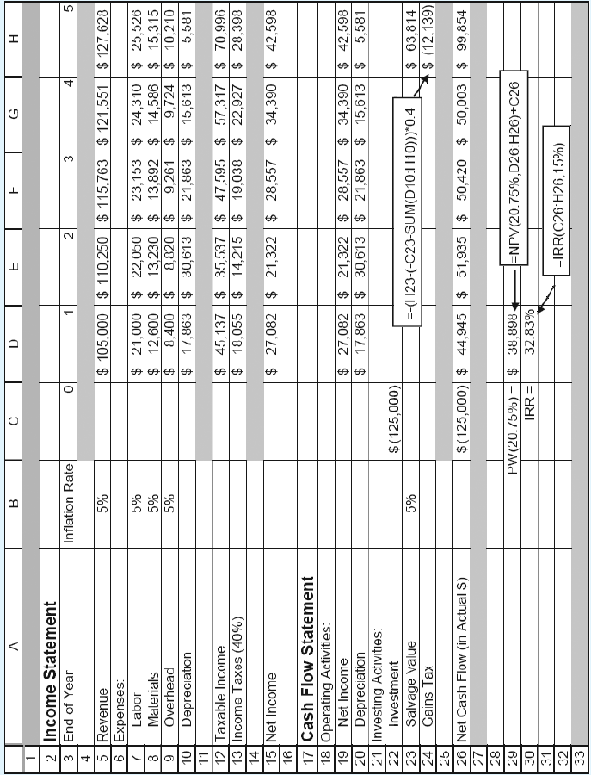
Solution: Excel Worksheet

Slide 33
Effects of Borrowed Funds Under Inflation
Item | Effects of Inflation
Loan repayments | Borrowers repay historical loan amounts with dollars of decreased purchasing power, reducing the debt-financing cost.

Slide 34
Example 11.10: Effects of Inflation on Payments with Financing
Given:
  Borrowing rate = 15.5%
  General inflation rate = 5%
  Inflation-free interest rate = 15%
  Amount of borrowing = $62,500 over 5 years
Find: NPW

Slide 35
  Market interest rate = 0.15 + 0.05 + 0.0075 = 20.75%
  NPW without borrowing: $38,898
  NPW with borrowing:
  $54,159
  The gain in NPW due to debt financing: $15,261

Slide 36
Effects of Inflation on Return on Investment
Item | Effects of Inflation
Rate of Return and NPW | Unless revenues are sufficiently increased to keep pace with inflation, tax effects and/or a working capital drain result in lower rate of return or lower NPW.

Slide 37
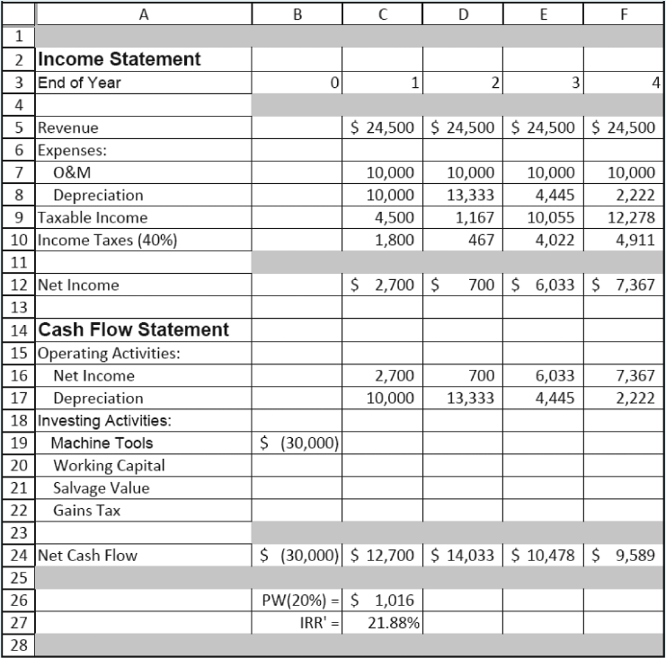
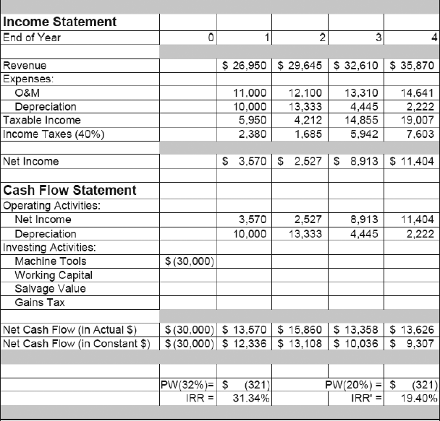
Example 11.11: IRR Analysis with Inflation
IRR in the absence of inflation
IRR calculation under inflation

Slide 38
Rate of Return Analysis Under Inflation
Principle: True (real) rate of return should be based on constant dollars.
If the rate of return is computed based on cash flows in actual dollars, the real rate of return can be calculated as:
n | Net cash flows in actual dollars | Net cash flows in constant dollars
0 1 2 3 4 | -$30,000 13,570 15,860 13,358 13,626 | -$30,000 12,336 13,108 10,036 9,307
IRR 31.34% 19.40%

Slide 39
MARR to Use
If you use 31.34% as your IRR, you should use a market interest rate (or inflation-adjusted MARR) to make an accept and reject decision.
If you use 19.40% as your IRR, you should use an inflation-free interest rate(inflation-free MARR) to make an accept and reject decision. In our example, MARR’ = 20%.

Slide 40
Effects of Inflation on Working Capital
Item | Effects of Inflation
Working capital requirement | Known as working capital drain, the cost of working capital increases in an inflationary environment.

Slide 41
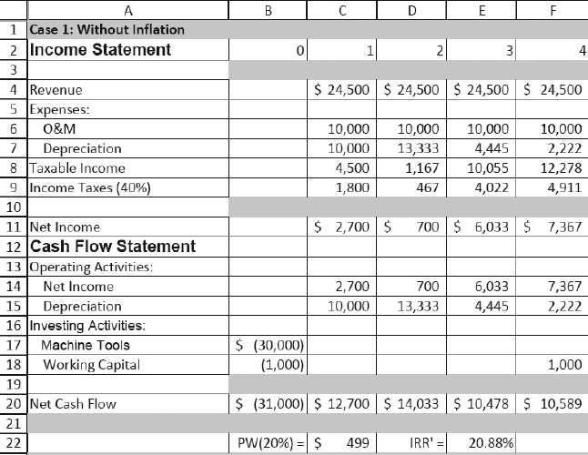
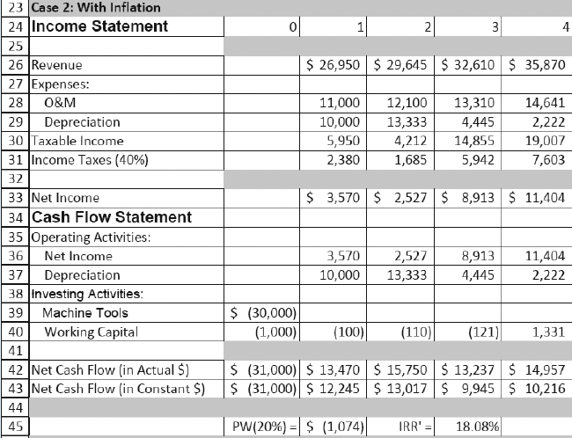
Example 11.12: Effects of Inflation on Working Capital

Slide 42
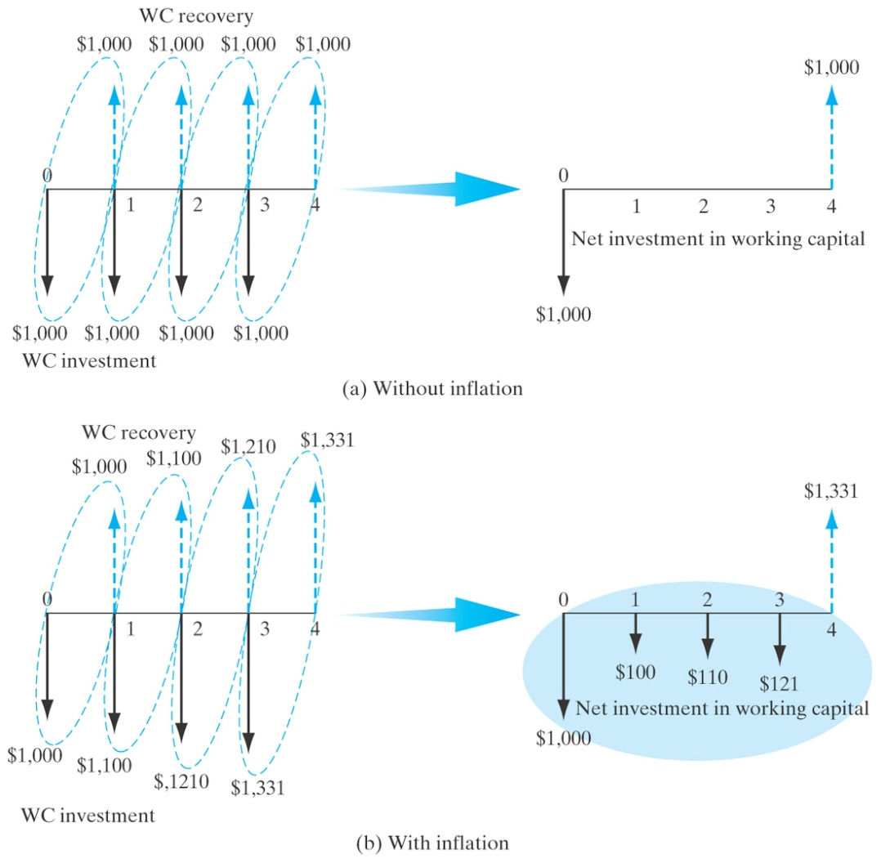
Working Capital Requirements Under Inflation

