Slide 1
Applying Annual Worth Analysis
Lecture No. 20
Chapter 6
Contemporary Engineering Economics
Copyright © 2016

Slide 2
Annual Worth Analysis
Principle: Measure an investment’s worth on an annual basis.
Benefits: By knowing the annual equivalent worth, we can:
  Seek consistency of report format.
  Determine the unit cost (or unit profit).
  Facilitate the unequal project life comparison.
Annual Equivalent Conversion

Slide 3
Fundamental Decision Rules
For Single Project:
For Mutually Exclusive Alternatives:
  If AE(i) > 0, accept the investment.
  If AE(i) = 0, remain indifferent to the investment.
  If AE(i) < 0, reject the investment.
  Service projects: Select the alternative with the minimum annual equivalent cost (AEC).
  Revenue projects: Select the alternative with the maximum AE(i).

Slide 4
Example 6.1: Economics of Installing a
Feed-water Heater
Install a 150MW unit
  Initial cost = $1,650,000
  Service life = 25 years
  Salvage value = 0
  Expected improvement in fuel efficiency = 1%
  Fuel cost = $0.05kWh
  Load factor = 85%
Determine the annual worth for installing the unit at
i = 12%.
If the fuel cost increases at the annual rate of 4%, what is AE(12%)?

Slide 5
Solution: Calculation of Annual Fuel Savings
Required input power before adding the second unit
Required input power after adding the second unit
Reduction in energy consumption
272,727kW − 267,857kW =
4,870 kW
Annual operating hours
Annual Fuel Savings
:
.

Slide 6
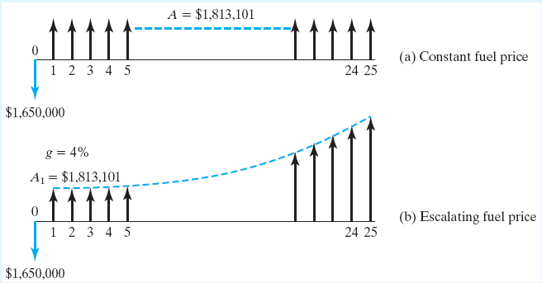
Solution: Annual Worth Calculations
(a) with constant fuel price
(b) with escalating fuel price
Cash Flow Diagrams

Slide 7
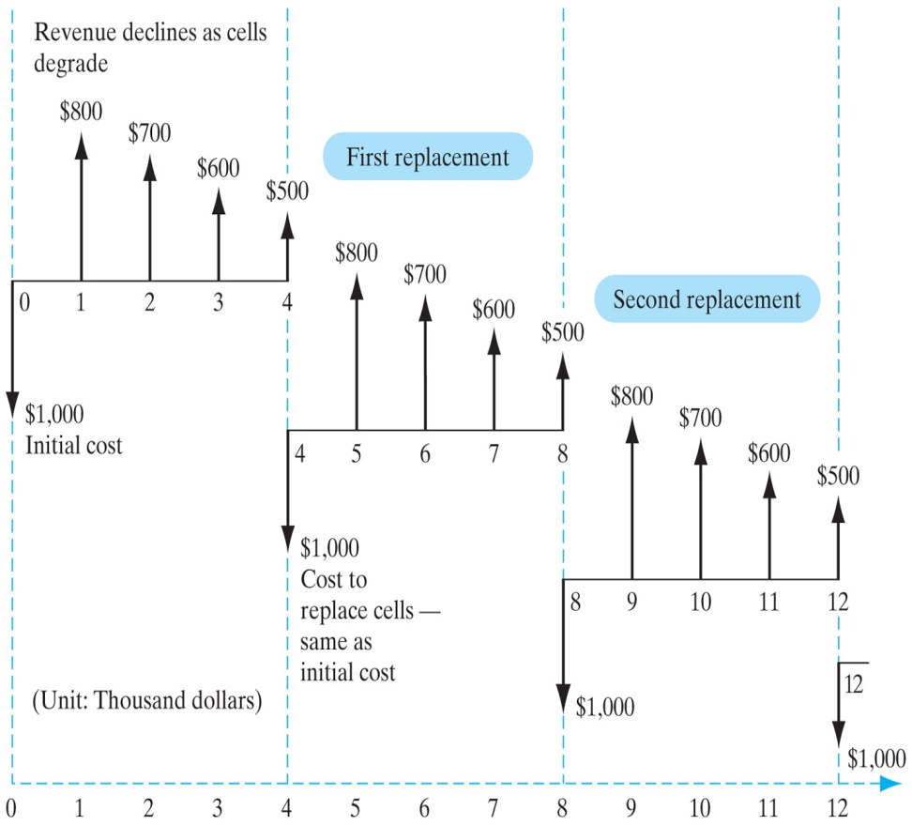
Repeating Cash Flow Cycles
First Cycle
Repeating Cycles
Notes:
Figure: 06-02EXM

Slide 8
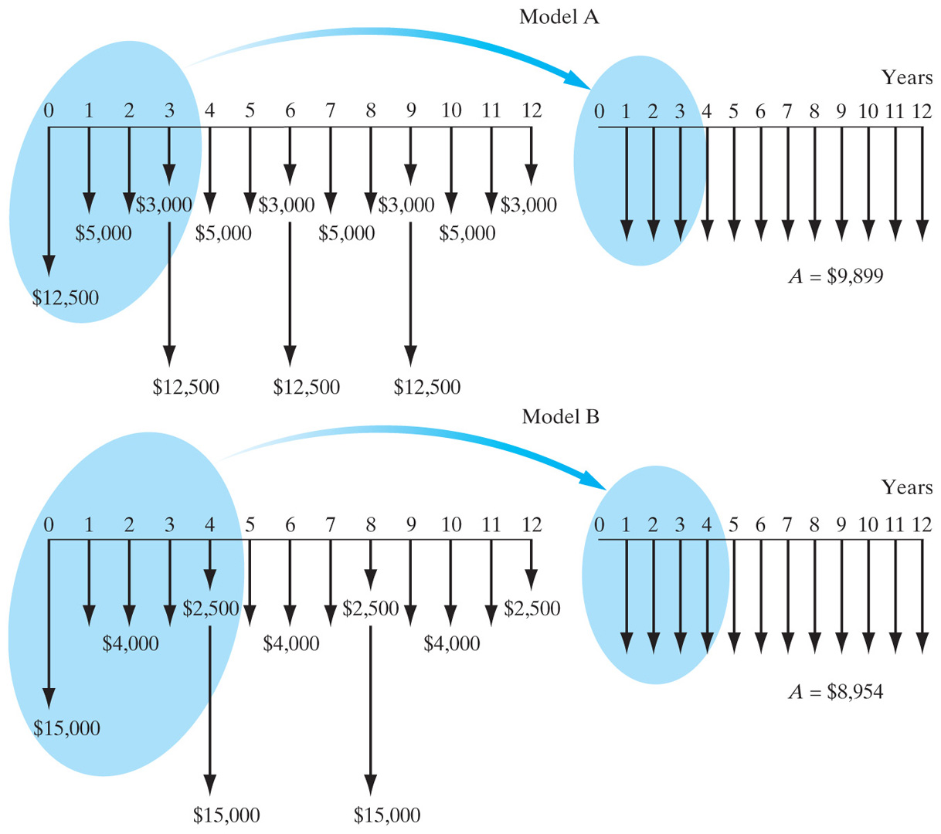
Example 6.3: Comparing Alternatives
Notes:
Figure: 06-03

Slide 9
Solution
Required assumptions
  The service life of the selected alternative is required on a continuous basis.
  Each alternative will be replaced by an identical asset that has the same costs and performance.
  Model A
  Model B

Slide 10
Annual Equivalent Cost (AEC)
When only costs are involved, the AE method is called the annual equivalent cost (AEC).
Revenues must cover two kinds of costs: operating costsand capital costs.
Capital
costs
+
Annual Equivalent Costs
Operating
costs
Annual equivalent cost = Capital cost + Operating costs

Slide 11
Capital (Ownership) Cost
Def: Owning equipment associated with two transactions—(1) its initial cost (I), and (2) its salvage value (S).
Capital costs: Taking these items into consideration, we calculate the capital costs as:

Slide 12
Cost of Owning a Vehicle
SEGMENT | BEST MODELS | ASKING PRICE | PRICE AFTER 3 YEARS
Compact car | Mini Cooper | $19,800 | $12,078
Midsize car | Volkswagen Passat | $28,872 | $15,013
Sports car | Porsche 911 | $87,500 | $48,125
Compact Luxury car | BMW 3 Series | $39,257 | $20,806
Luxury car | Mercedes CLK | $51,275 | $30,765
Minivan | Honda Odyssey | $26,876 | $15,051
Subcompact SUV | Honda CR-V | $20,540 | $10,681
Compact SUV | Acura MDX | $37,500 | $21,375
Full size SUV | Toyota Sequoia | $37,842 | $18,921
Compact truck | Toyota Tacoma | $21,200 | $10,812
Full size truck | Toyota Tundra | $25,653 | $13,083

Slide 13
Example: Capital Cost (Mini-Cooper)
Capital Recovery Cost
Given:
  I = $19,800
  N = 3 years
  S = $12,078
  i = 6%
Find: CR(6%)

Slide 14
Example 6.4: Required Annual Revenue
Cost of Owning and Operating
Given:
  I = $20,000
  S = $4,000
  N = 5 years
  i= 10%
Find: See if an annual revenue of $5,000 is large enough to cover both the capital and operating costs.

Slide 15
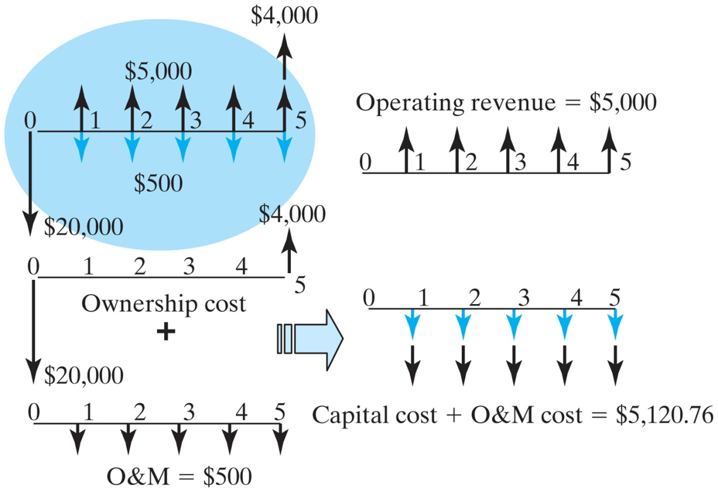
Solution
Need additional revenue in the amount of $120.76 to justify the investment
Notes:
Figure: 06-05

Slide 16
Where to Apply the AE Analysis
Unit cost (or profit) calculation
Outsourcing (make-buy) decision
Pricing the use of an asset

Slide 17
Unit Cost (Profit) Calculation
Step 1: Determine the number of units (annual volume) to be produced (or serviced) each year over the life of the asset.
Step 2: Determine the annual equivalent cost (or worth) of owning and operating the asset.
Step 3: Divide the equivalent cost (worth) by the annual volume.

Slide 18
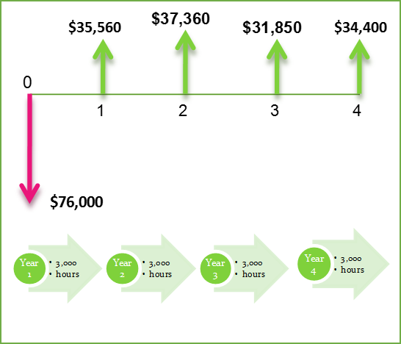
Example 6.5: Unit Profit per Machine Hour When Annual Operating Hours Remain Constant
Project Cash Flows and Operating Hours

Slide 19
Example 6.6: Unit Profit per Machine Hour When Annual Operating Hours Fluctuate

Slide 20
Make or Buy Decision
Step 1: Determine the time span(planning horizon) for which the part (or product) will be needed.
Step 2: Determine the annual volumeof the part (or product).
Step 3: Obtain the unit costof purchasing the part (or product) from an outside firm.
Step 4: Determine the equipment, manpower, and all other resources required to make the part (or product).

Slide 21
Step 5: Estimate the net cash flows associated with the “make” option over the planning horizon.
Step 6: Compute the annual equivalent cost of producing the part (or product).
Step 7: Compute the unit cost of making the part (or product) by dividing the annual equivalent cost by the required annual volume.
Step 8: Choose the option with the minimum unit cost.

Slide 22
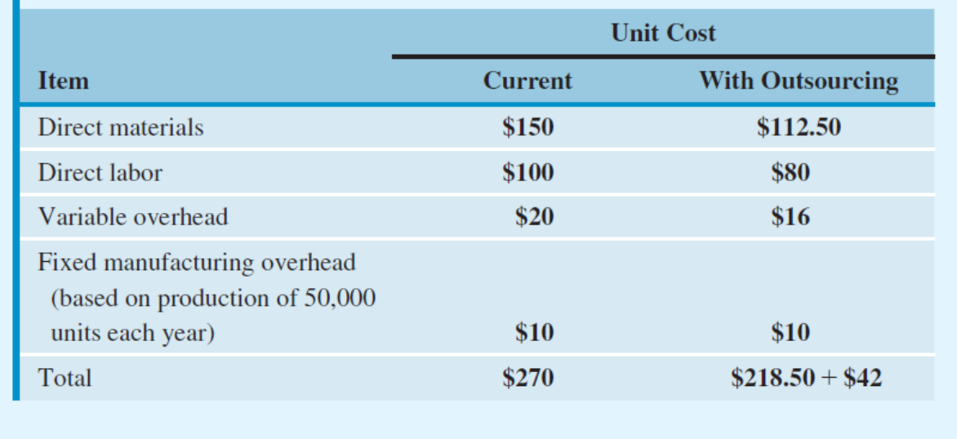
Example 6.7: Outsourcing Production of Electric Compressors
Investment and Other Financial Date Related to Outsourcing
  Electric compressor: $42 per unit
  Required investment: $325,000
  Salvage value: $60,000
  Service life: 7 years
  Annual maintenance cost: $120,000
  MARR: 18%

Slide 23
Pricing the Use of an Asset
The cost per square foot for owning and operating a real property (example, user fee)
The cost of using a private car for business (cost per mile)
The cost of flying a private jet (cost per seat)
The cost of using a parking deck (cost per hour)

Slide 24
Example 6.8: Pricing an Apartment Rental Fee
Investment Problem: Building a 50-unit apartment complex
Land investment cost = $1,000,000
Building investment cost = $2,500,000
Annual upkeep cost = $150,000
Property taxes and insurance = 5% of total investment
Occupancy rate = 85%
Study period = 25 years
Salvage value = Only land cost can be recovered in full
Interest rate = 15%
At Issue: How to price the monthly rental per unit?

