Slide 1
Incremental Analysis Examples

Slide 2
Example 7.11: IRR on Incremental Investment: Two Alternatives
Given: Project Cash Flows
Find: Which project is a better choice at MARR = 10%?

Slide 3
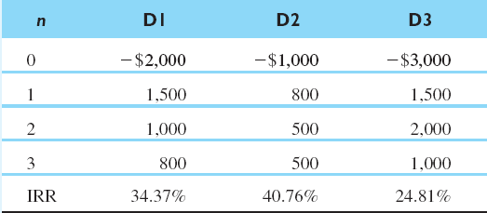
Example 7.12: IRR on Incremental Investment: Three Alternatives
Given: MARR = 15%
Find: Which project to choose?

Slide 4
Example 7.14: Incremental Analysis for Service Projects
At Issue: Can we compare mutually exclusive service projects based on IRR criterion?

Slide 5
Example 7.15: IRR Analysis for Projects with Different Lives
At Issue: Can we compare projects with different service lives based on the principle of IRR criterion?
Given: MARR = 15%, incremental cash flows on service projects (Model B − Model A)
Find: Which model to select?

Slide 6
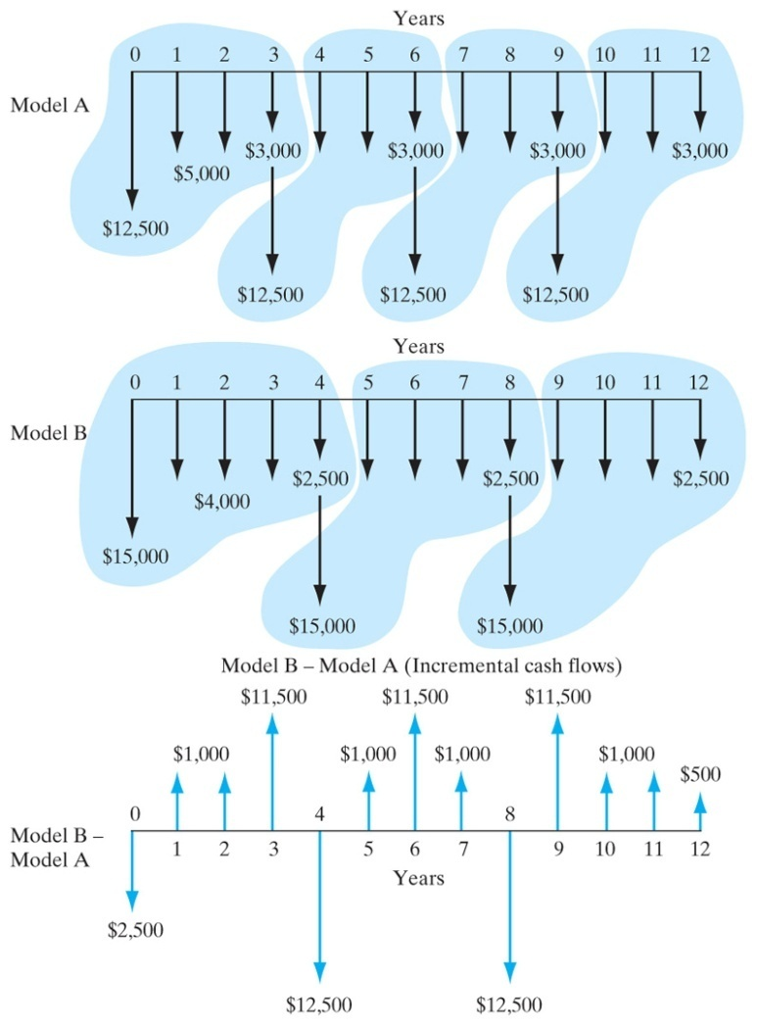
Solution
Assumptions: Project repeatability is likely. Use LCM of 12 years.
The incremental cash flows (Model B − Model A) result in a mixed investment. We need to calculate the RIC at 15%.
RIC_{B–A} = 50.68% > 15%
Select Model B.

