Slide 1
Replacement Decisions
Lecture No. 47
Chapter 14
Contemporary Engineering Economics
Copyright © 2016

Slide 2
Overall Replacement Strategies Under an Infinite Planning Horizon

Slide 3
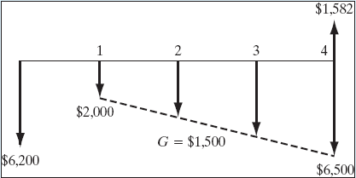
Example 14.4: Replacement Analysis Under an Infinite Planning Horizon
Given:
  Defender
  Current salvage value = $5,000, decreasing at an annual rate of 25% over the previous year’s value
  Required overhaul = $1,200
  O&M = $2,000 in year 1, increasing at the rate of $1,500 each year
  Challenger
  I = $10,000
  Salvage value = $6,000 after one year, will decline 15% each year
  O&M = $2,200 in the first year, increasing by 20% per year thereafter
Find: (a) Economic service lives for both defender and challenger, (b) when to replace the defender
Cash flow diagram for defender when N = 4 years
Notes:
Figure: 14-07EXM

Slide 4
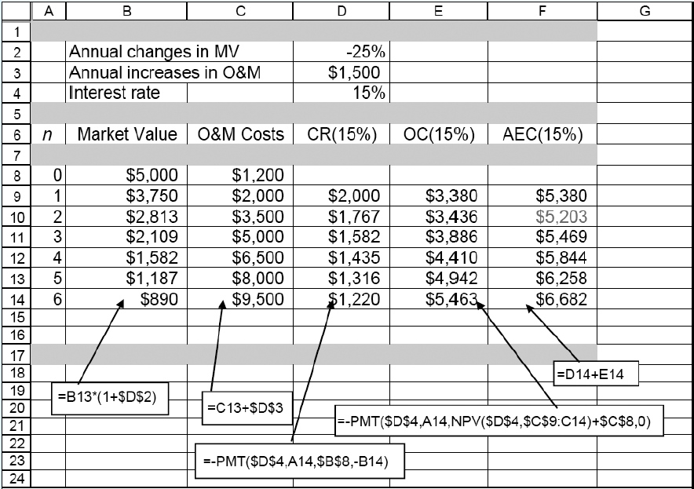
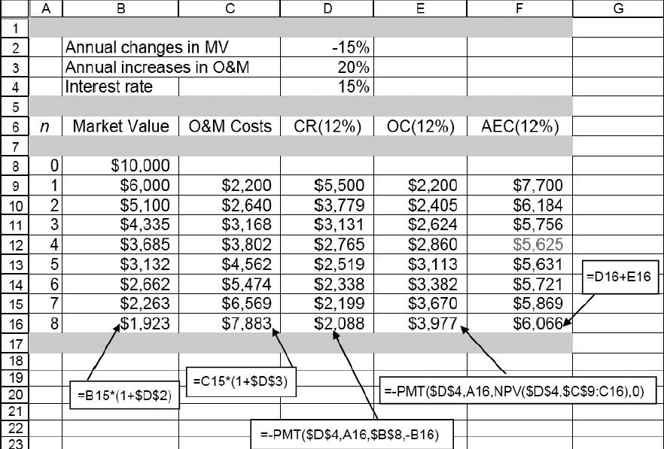
Economic Service Life
Defender
Challenger

Slide 5
Replacement Decisions
Should replace the defender now? No, because AEC_{D*}<AEC_{C*}
If not, when is the best time to replace the defender?Need to conduct the marginal analysis.
N_{C*}= 4 years
AEC_{C*}=$5,625

Slide 6
Marginal Analysis to Determine when the Defender Should Be Replaced
Question:What is the additional (incremental) cost for keeping the defender one more year from the end of its economic service life, from Year 2 to Year 3?
Financial Data
Opportunity cost at the end of year 2: Equal to the market value of $2,813
Operating cost for the 3rd year: $5,000
Salvage value of the defender at the end of year 3: $2,109

Slide 7
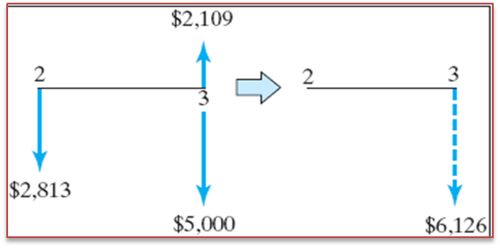
Marginal Analysis
Step 1: Calculate the equivalent cost of retaining the defender one more from the end of its economic service life, say 2 to 3.
$2,813(F/P,15%,1) + $5,000
− $2,109 = $6,126
Step 2: Compare this cost with AEC_{C} = $5,625 of the challenger.
Conclusion: Since keeping the defender for the 3rd year is more expensive than replacing it with the challenger, DO NOT keep the defender beyond its economic service life.

Slide 8
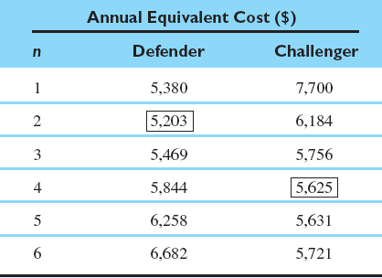
Example 14.5: Replacement Analysis Under the Finite Planning Horizon
Given: Economic service lives for both defender and challenger, planning horizon = 8 years, and i = 15%
Find: the most plausible/economical replacement strategy

Slide 9
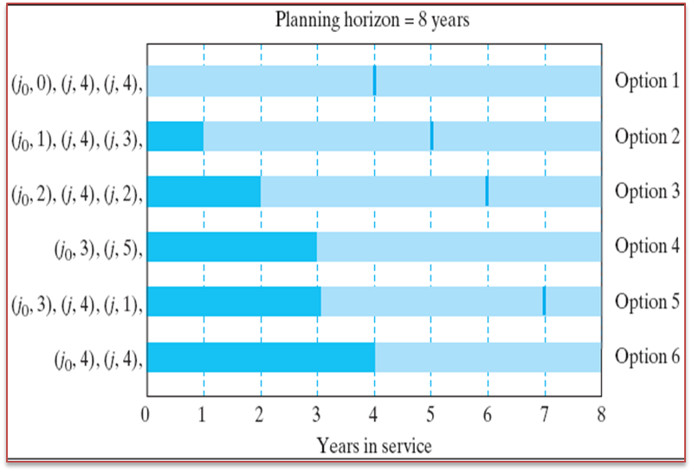
Some Likely Replacement Patterns

Slide 10
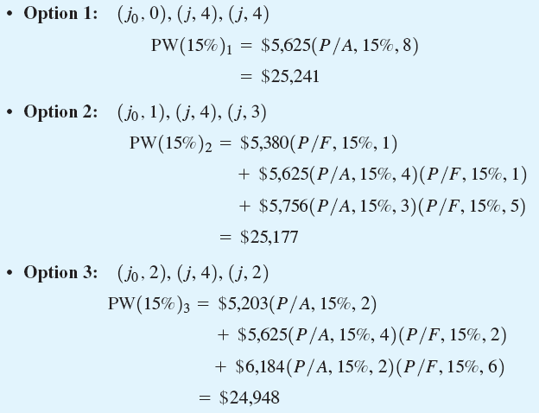
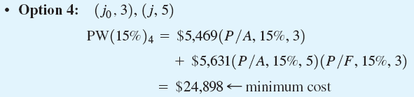
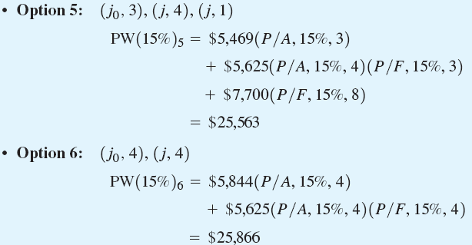
Present Equivalent Cost for Each Option

