Slide 1
Interest Formulas for Single Cash Flows
Lecture No. 6
Chapter 3
Contemporary Engineering Economics
Copyright © 2016

Slide 2
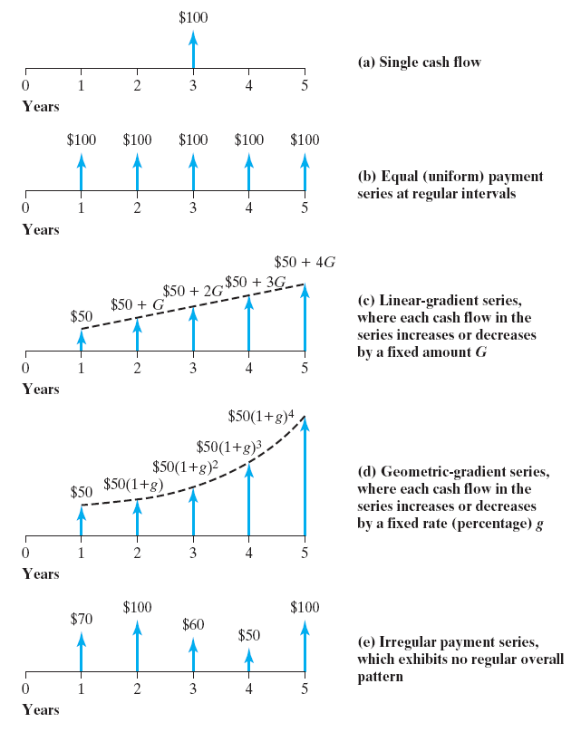
Types of Common Cash Flows in Engineering Economics
Single cash flow
Equal (uniform) payment series at regular intervals
Linear gradient series
Geometric gradient series
Irregular (random) payment series

Slide 3
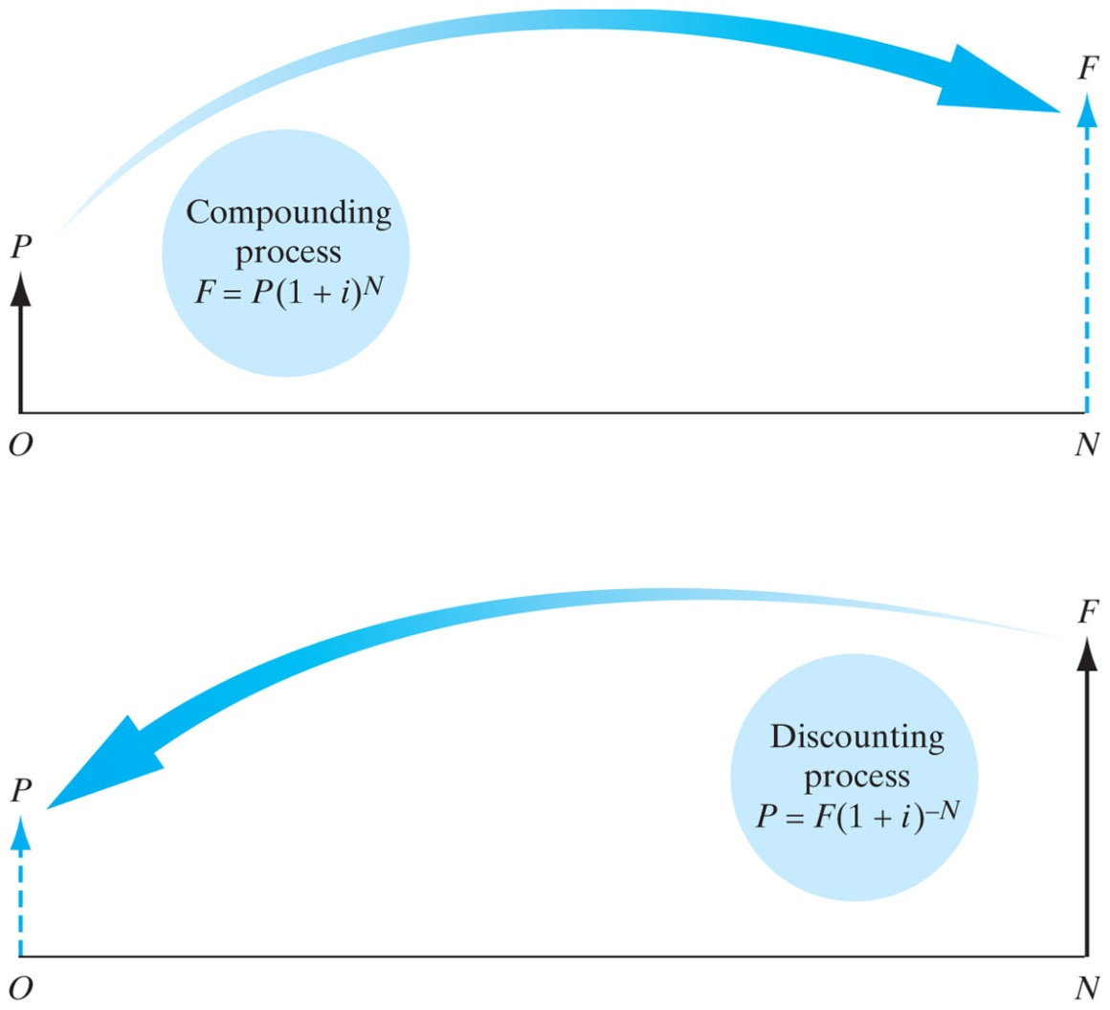
Equivalence Relationship Between P and F
Compounding Process
  Finding an equivalent future value of a current cash payment
Discounting Process
  Finding an equivalent present value of a future cash payment

Slide 4
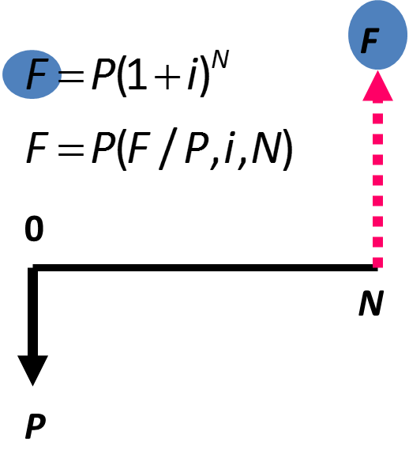
Singe Cash Flow Formula
Compound Amount Factor

Slide 5
Example 3.7: Find F, Given i, N, and P
Given: P = $2,000,
i = 10%, N = 8 years
Find: F

Slide 6

A Typical Compound Interest Table at 12%
To find the compound interest factor when the interest rate is 12% and the number of interest periods is 10, we could evaluate the following equation using the interest table.

Slide 7
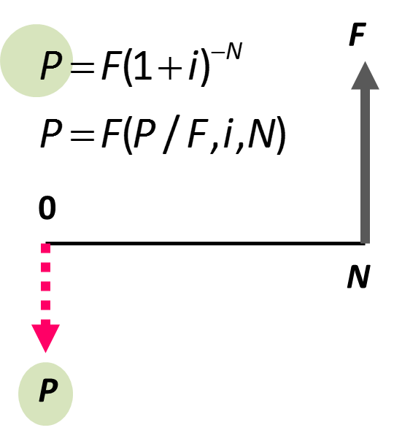
Single Cash Flow Formula
Present Worth Amount Factor

Slide 8
Example 3.8: Find P, Given i, N, and F
Given: F = $1,000,
i= 12%, N = 5 years
Find: P

Slide 9
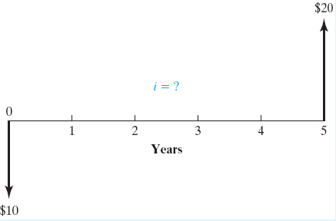
Example 3.9: Find i, Given P, F, and N
Given: F = $20, P = $10,
N = 5 years
Find: i
Cash Flow Diagram

Slide 10
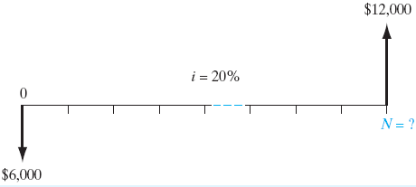
Example 3.10: Find N, Given P, F, and i
Given: P = $6,000, F = $12,000,i = 20%
Find: N
Solving for N

Slide 11
Rule of 72

