Slide 1
IE 342- Engineering Economic Analysis
2026 Summer Semester

Slide 2
IE 342 - Engineering Economic Analysis
Instructor | Dr. Emre Uzun E-mail: emreu@bilkent.edu.tr Offıce: EA 328 Tel: x3484 Office Hours: By appointment via email
Teaching Assistants | TBA

Slide 3
Course Description
Concepts of time value of money.
Analysis of engineering decisions.
Principles and methodology of comparing decision alternatives, such as various engineering designs, manufacturing equipment, or industrial projects.
Effects of depreciation, inflation and taxation on economic decisions, cost benefit analysis of public projects.
Dealing with uncertainty and risk; rational decision making when future outcomes are uncertain.
Replacement analysis.

Slide 4
Required Text Book:
Park, C. S., Contemporary Engineering Economics, 6th Ed., Prentice Hall, 2016

Slide 5
Grading
Midterm 1 - 30 %
Midterm 2 - 30%
Final Exam - 40 %
Study Sets (will not be graded)

Slide 6
Policies
FZ Grade Policy:
  No FZ this semester!

Slide 7
Policies
Web Site/Email:
A Moodle Web Page will be opened after the end of the add/drop period.
Students are responsible for all the announcements made in class, on the web page or via e-mail.
It is the students’ responsibility to be aware of what has been covered in lectures, and to check the web page and e-mail accounts regularly and not miss any activity or information

Slide 8
Policies
Makeup Policy:
  A make-up examination for the midterms will only be given under highly unusual circumstances (such as serious health or family problems). The student should contact the instructor as early as possible and provide the instructor with proper documentation (such as a medical note certified by Bilkent University’s Health Center).
  There is no make-up for quizzes.

Slide 9
Tentative Course Outline:
Ch.1: Engineering Economic Decisions
Ch.3: Time Value of Money
Ch.3: Economic Equivalence
Ch.3: Interest Formulas - Single Cash Flows
Ch.3: Interest Formulas – Equal Payment Series
Ch.3: Interest Formulas – Gradient Series
Ch.3: Unconventional Equivalence Calculations
Ch.4: Nominal and Effective Interest Rates
Ch.4: Equivalence Analysis using Effective Interest Rates
Ch.4: Debt Management
Ch.4: Investing in Financial Assets
Ch.5: Payback Period
Ch.5: Discounted Cash Flow Analysis

Slide 10
Tentative Course Outline:
Ch.5: Variations of Present Worth Analysis
Ch.5: Comparing Mutually Exclusive Alternatives
Ch.6: Annual Equivalent Worth Criterion
Ch.6: Applying Annual Worth Analysis
Ch.7: Rate of Return Analysis
Ch.7: Finding RoR
Ch.7: Internal Rate of Return Criterion
Ch.7: Incremental Analysis
Ch.9: Asset Depreciation
Ch.9: Depreciation Methods
Ch.9: Corporate Income Taxes
Ch.10: Developing Project Cash Flows
Ch.11: Meaning and Measure of Inflation
Ch.11: Equivalence Calculation under Inflation
Ch.11: Effects of Inflation of Project Cash Flows

Slide 11
Tentative Course Outline:
Ch.12: Decision Tree Analysis
Ch.14: Replacement Analysis Fundamentals
Ch.14: Replacement Decision Models
Ch.15: Methods of Financing
Ch.15: Cost of Capital
Ch.15: Choice of MARR
Ch.16: Benefit-Cost Ratio

Slide 12
Engineering Economic Decisions

Slide 13
You need a car!
You are a fresh graduate and you need a car to commute to work.
For this purpose you go to a car dealer.

Slide 14
Options
Pay the entire amount in CASH
Retail price of car
Taxes
Dealer fee
Title & registration fees
….
You own the car
You pay for maintenance and insurance as you drive the car
Pay in INSTALLMENTS
You agree with a Financial Institution (FI)
FI pays for the car
You pay the amount you owe to the FI in equal installments
You also pay for:
Taxes
Dealer Fee
Title & Registration Fees
….
You own the car
You pay for maintenance and insurance as you drive the car (higher insurance premiums)
after you payoff your
balance

Slide 15
Financial Institution
Why does a company let you buy a car with their money?
  For profit companies want to make money!
  APR – Annual percentage rate: is the rate that determines the amount FI earns from you
  So you will end up paying more at the end when you finance your car.

Slide 16
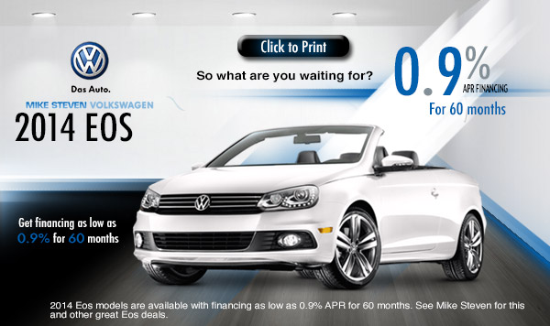
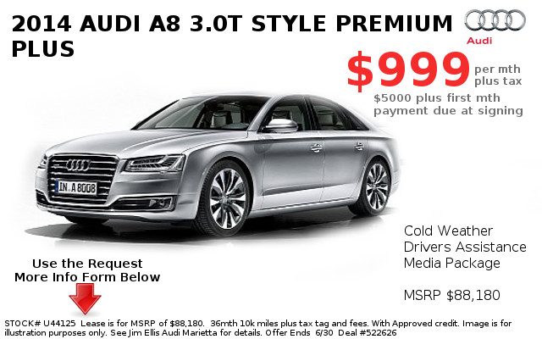


Getting a Car in the USA

Slide 17
Car Dealers
Dealers want to sell cars! No matter what!
  They can offer 0% APR!

Slide 18


Getting a Car in the USA

Slide 19
Financial Institution 2
Suppose you decided to go with FI and paid for the installments for one year
FI2 tells you if you switch to them you will have a lower APR!
  How can this be possible?

Slide 20
A Simple Illustrative Example: Car to Finance – Audi or BMW?
Recognize the decision problem
Collect all needed (relevant) information
Identify the set of feasible decision alternatives
Define the key objectives
and constraints
Select the best possible and implementable decision alternative
Need to get a car
Gather technical and
financial data
Select cars to consider
Wanted: small cash outlay, safety, good performance, aesthetics,…
Choice between Audi and BMW (or others)
Select the car

Slide 21
Engineering Economic Decisions
Planning
Investment
Manufacturing
Marketing
Profit
Plan for the acquisition of equipment (capital expenditure) that will enable the firm to design and produce products economically

Slide 22
What Makes Engineering Economic Decisions Difficult?
Estimating a required investment
Forecasting a product demand
Estimating a selling price
Estimating a manufacturing cost
Estimating a product life

Slide 23
Large-Scale Engineering Projects
These typically
require a large sum of investment
can be very risky
take a long time to see the financial outcomes
lead to revenue and cost streams that are difficult to predict
All the above aspects (and some others not listed here)
point towards the importance of EEA

Slide 24
Common Types of Strategic Engineering Economic Decisions
Equipment or process selection
Equipment replacement decisions
New products and product expansion
Improvement in service or quality
Cost reduction

Slide 25
Fundamental Principles of Engineering Economics
Principle 1: An instant dollar is worth more than a distant dollar.
Principle 2: The only thing that matters is the difference between alternatives.
Principle 3: Marginal revenue must exceed marginal cost.
Principle 4: Additional risk is not taken without the expected additional return.

Slide 26
Principle 1
An instant dollar is worth more than a distant dollar…
Today
6 months later

Slide 27
Principle 1
An instant dollar is worth more than a distant dollar…
$100
today
$110
one
year
later
$121
two
years
later
Interest rate = 10%

Slide 28
Principle 2
The only thing that matters is the difference between alternatives.
Option | Monthly fuel cost | Monthly maintenance | Cash outlay at signing | Monthly payment | Salvage value at end of year 3
Buy | $960 | $550 | $6,500 | $350 | $9,000
Lease | $960 | $550 | $2,400 | $550 | 0
Irrelevant items in decision-making

Slide 29
Principle 3
Marginal revenue must exceed marginal cost.
Marginal
cost
Manufacturing cost
1 unit
Marginal
revenue
Sales revenue
1 unit

Slide 30
Principle 4
Additional risk is not taken without the expected additional return.
Investment Class | Potential Risk | Expected Return
Savings account (cash) | Low/None | 1.5%
Bond (debt) | Moderate | 4.8%
Stock (equity) | High | 11.5%

