Slide 1
IE 469
Industrial Applications of Operations Research
Spring 2017

Slide 2
Teaching Staff
Instructors | Dr. Emre Uzun E-mail: emreu@bilkent.edu.tr Offıce: EA 328 Tel: x3484 Office Hours: By appointment via email
Teaching Assistants | Utku Karaca Zeynep Aygar (UG)

Slide 3
Industrial Applications of Operations Research
The course is named as ‘Industrial’ ‘Applications’ of ‘Operations Research’
We will do some applications related to industry where you will utilize your OR background (and more...)
As you progress in this course, think of it as a real life job experience!
Pretend that you work at a consulting company and some tasks are assigned to you.
Whether they are easy or challenging, you will have to do them.

Slide 4
Industrial Applications of Operations Research
What can be an example application of OR in industry?
  Production Planning
  Inventory Management
  Transportation
  Queuing Systems
  How do you solve these problems?
  What tools to use?
Availability?

Slide 5
Industrial Applications of Operations Research
Many commercial software you use to handle these problems will NOT be available to you!
There will be no CPLEX, no GAMS, no XPress, no Arena.
  These software will cost $10,000+ each to get a license for a single computer.
In some instances there will be no Internet connection except for email.
  Especially in military or government based companies.
  You will not be able to download any “trial” version of these software.

Slide 6
Industrial Applications of Operations Research
The most commonly installed software is MS Office Applications.
  Word, Excel, PowerPoint, Access, Visio, Project…
Can you guess which one you would use the most?

Slide 7
Spreadsheets
MS Excel is NOT for making simple tables like:
  Your weekly timetable
  Your bowling party participants list
  MS Word is more than enough for these simple tables.

Slide 8
Spreadsheets
MS Excel is actually for tables like:
  Annual budget items
  Distance matrices
  Production plans
  Inventory levels
  i.e. Tables that include big datasets, calculations, algorithms…etc.

Slide 9
Spreadsheets
A spreadsheet is an interactive computer application program for organization, analysis and storage of data in tabular form.
Spreadsheets are developed as computerized simulations of paper accounting worksheets.
The program operates on data represented as cells of an array, organized in rows and columns.
Besides performing basic arithmetic and mathematical functions, modern spreadsheets provide built-in functions for common financial and statistical operations.

Slide 10
Spreadsheets
MS Excel lets you do many different applications:
  Production Planning – Use excel functions to make EOQ calculations to make production planning.
  Capacity Planning – You can use Excel Solver to solve a mathematical model to make a decision on increasing the production capacity.
  Transportation – You can code network flow algorithms (like Dijkstra, Floyd Warshall) and make routing decisions.
  Queuing Systems – You can write codes to simulate a queuing system (like a bank, airport) and make a decision on number of tellers to hire.

Slide 11
Course Objectives
You will learn how to write complex formulae using MS Excel.
  Not limited to sum, average...etc
  Decision making, data analyzing (if, vlookup, pivot tables)
You will learn how to use MS Excel Solver (and possibly OpenSolver) to handle linear and integer programming problems.
You will learn how to code in VBA.
  You will write macros that will enable you to solve problems utilizing algorithms.
You will develop some small applications using VBA.

Slide 12
Course Objectives
This is a hands-on interactive course!
  (That’s why we are in a computer lab!)
In some classes, there will be demos which you should follow on your computers.
In some classes, you will be assigned some case studies.

Slide 13
Case Studies
You will be assinged some different case studies as much real as I possibly get for this course!
  There will be real datasets.
  There will be real-like situations.
You should prepare a presentable product for each case.
  Presentable means: Neat, clean, easy-to-follow and result oriented.
  Just like you present to your manager.

Slide 14
Project
This is going to be a challenging project!
  Again a real-like project with real dataset.
  You will ABSOLUTELY be free to choose the method to solve the problems.
  Groups will compete as they will present their findings at the end of the semester.
  You will have at least a month to submit it. Start as early as you could.
  You should again prepare a presentable product.
Failing to submit the project will result in an FZ grade!

Slide 15
Groups
Case studies and Project can be done with a group of maximum 3 students.
  Not any three students!
  No more than two students in the same group, who are also group members in IE477-IE478 courses.
Send your group info to the course TA by the end of this week!

Slide 16
Industrial Applications of Operations Research
Assessment:
  18% - 3 in-class ‘Short’ Midterms (Most likely going to be 1 hour long)
  28% - About 6-7 in-class Case Studies (Groups of max 3 students)
  24% - 1 Group Project (Groups of max 3 students)
  30% - 1 Final Exam

Slide 17
Prerequisites
Even though there are no formal prerequisites for this course, you should be comfortable with basic OR principles (IE 202, IE 303, IE 324...) and also basic computer programming logic (CS 114)
Don’t be so scared!

Slide 18
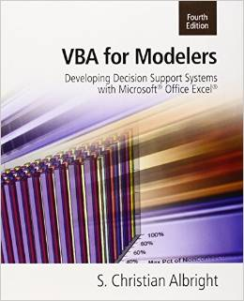
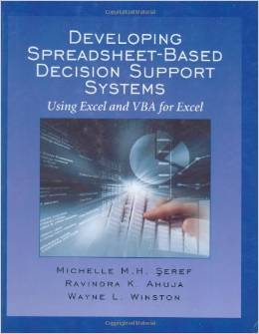
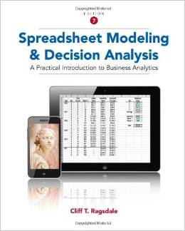
Available texts
VBA for Modelers: Developing Decision Support Systems
Author: S. Christian Albright (2007), Indiana University Kelley School of Business
Developing Spreadsheet-Based Decision Support Systems
Authors: M.H. Seref, Ravindra A. Ahuja, Wayne L. Winston (2007), University of Florida, Department of Industrial & Systems Engineering
Spreadsheet Modeling and Decision Analysis: A Practical Introduction to Business Analytics (2014)
Author : Cliff Ragsdale (College of Business at Virginia Tech)

Slide 19
Questions?

