Slide 1
Heuristic Algorithms via VBA
IE 469 Spring 2017

Slide 2
Why do we need Heuristic Algorithms after all?
We could use Excel Solver or Open Solver to solve optimization problems.
So, why is there a need to consider heuristic algorithms?

Slide 3
Why do we need Heuristic Algorithms after all?
Some problems are very hard to solve.
  Even though given a solution instance it is very easy to verify if it is feasible and if so, the value of the objective function; there is no efficient way to find the optimal solution.
  As the problem size grows bigger it gets even harder to solve them optimally.
  Example: TSP problem
It all comes down to computational complexity.
  Many of these hard probems are said to be NP-Complete.

Slide 4
Heuristic Algorithms
When you start working, you will have absolutely no excuse to your manager if you fail to solve a problem assigned to you or your team!
Don’t worry, in real life circumstances you do NOT usually need the OPTIMAL solution after all!
A satisfactory solution provided in a reasonable time would be sufficient in many circumstances.
  Usually, these satisfactory solutions are not too far away from the optimal.
  In some cases and if you are lucky enough, they may even be the optimal solution you were looking for. (But there is no guarantee!)

Slide 5
Heuristic Algorithms
This course is NOT a heuristic algorithm design course.
  You are NOT expected to come up with a heuristic algorithm.
  BUT, given a heuristic algorithm design – sometimes a pseudocode, you should be able to code them in VBA.
  These will not be complex algorithms – I promise ☺

Slide 6

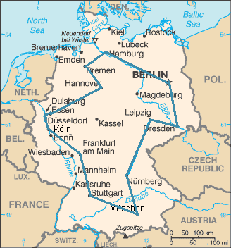
Traveling Salesman Problem
Given a graph, we should find the minimum distance tour that will
  Start and end at the same node.
  All nodes are visited once.

Slide 7
Traveling Salesman Problem
The algorithm we will use is called the Nearest Neighbor Algorithm. (Constructive Heuristic)
Assumption: The graph is fully connected!
Algorithm:
  Start from an arbitrary node a.
  From a, go to another node, b such that the node b has not been visited before and the distance (a,b) is the shortest among all other unvisited nodes.
  Stop when all nodes are visited.
Now, let’s code it!

